Slide 1
Physics 1611 Remember the Exam – Tonight!
First exam is Wednesday, February 17, at 6:30 pm in Macbride Auditorium.
We will provide an equation sheet (now available on ICON).
You should bring a pencil (or two) and a calculator of a type acceptable on the SAT (google calculator SAT to find a list).
Do not bring a cell phone.
Do not bring your own equation sheet.
If you have a conflict and have not arranged a make-up, see me after class!

Slide 2
Topics for Today
Work done by gravity (7-3)
“Proof” of relation between work and kinetic energy
Work done by a variable force (7-5)
Work done by a spring (7-4)
Power (7-6)

Slide 3
Work Done by Gravity
Gravitational force $\vec{F}=m\vec{g}$ always points downward.
Quiz- if an object is traveling downwards in a gravitational field, is the work done
Positive
Negative
Note that gravity is the only force acting on the object.

Slide 4
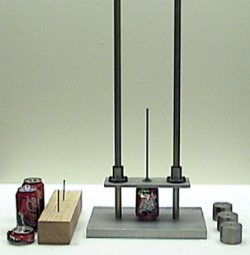
Do Pile Driver Demo
Do Demo 1M10.20 - Pile Driver
How much energy is required to crush a pop can to half of it’s original height?
0.5 J
5 J
50 J
500 J

Slide 5
Work Done by Gravity
How much kinetic energy is gained by a 0.929 kg weight as it drops through a distance of 0.5 meters?
Draw diagram with force and displacement
What is angle between force and displacement?
What is magnitude of force?
What is magnitude of displacement?
Find $W= \vec{F}∙\vec{D}=Fd\cos{θ}$
Answer $W=Fd\cos{θ}=mgd\cos{0=mgd}$
= 0.93 kg × 9.8 m/s² × 0.5 m = 4.6 kg∙m²/s² = 4.6 J

Slide 6
Work and Kinetic Energy
Object starts with velocity $v_{i}$
Is subjected to force $F$ acting over distance $d$.
Use $F=ma$, find acceleration is $a=\frac{F}{m}.$
So, change in velocity is $v_{f}=v_{i}+at$.
Can solve for time, $t=(v_{f}−v_{i})/a$.
Position is $x_{f}=x_{i}+v_{i}t+\frac{1}{2}at^{2}$.
Distance traveled is $d=x_{f} −x_{i}=v_{i}t+\frac{1}{2}at^{2}$
Substitute for t: $d=v_{i}(\frac{v_{f}−v_{i}}{a})+\frac{1}{2}a{(\frac{v_{f}−v_{i}}{a})}^{2}$

Slide 7
Work and Kinetic Energy
Have: $d=v_{i}(\frac{v_{f}−v_{i}}{a})+\frac{1}{2}a{(\frac{v_{f}−v_{i}}{a})}^{2}$
Multiply by 2a: $2ad={2v}_{i}(v_{f}−v_{i})+{(v_{f}−v_{i})}^{2}$
$2ad={2v}_{i}v_{f}−2v_{i}^{2}+v_{f}^{2}−{2v}_{i}v_{f}+v_{i}^{2}=v_{f}^{2}−v_{i}^{2}$
Have: $2ad=v_{f}^{2}−v_{i}^{2}$
Recall $a=\frac{F}{m}$, so $2\frac{F}{m}d=v_{f}^{2}−v_{i}^{2}$ or $Fd=\frac{1}{2}m(v_{f}^{2}−v_{i}^{2})$
Work is $W=Fd=\frac{1}{2}m(v_{f}^{2}−v_{i}^{2})$
Define kinetic energy: $K_{i}=\frac{1}{2}{mv}_{i}^{2}$
So $W=Fd=\frac{1}{2}m(v_{f}^{2}−v_{i}^{2})$ $=K_{f}−K_{i}=∆K$

Slide 8
Work with Multiple Forces
If multiple forces act on an object, then use the net force to calculate the work, just in the same way that you would use the net force to calculate the acceleration.

Slide 9
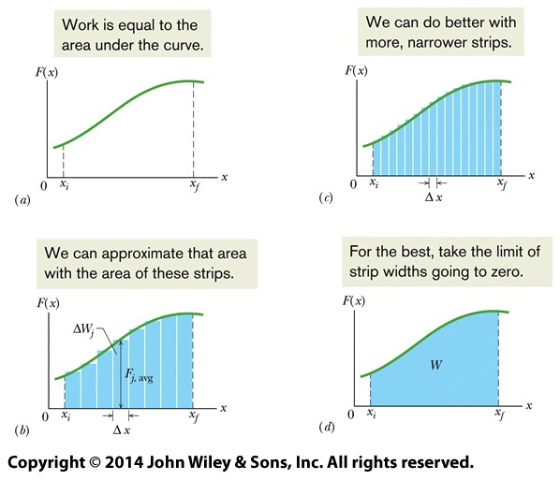
Work with a Variable Force
We have assumed that the force is constant. What about a force that varies as the object moves?
We can plot the force as a function of position.
Then we can divide up the graph into little pieces
Force is roughly constant in each piece.
Work = force × distance = area of piece.
In the limit of very little pieces, we get an integral – the work is the integral of force over position.

Slide 10
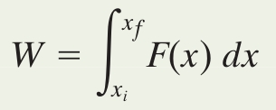
Work with a Variable Force
In symbols, our sum of rectangles is:
This becomes the integral:
In three dimensions, we integrate dimension each separately:

Slide 11
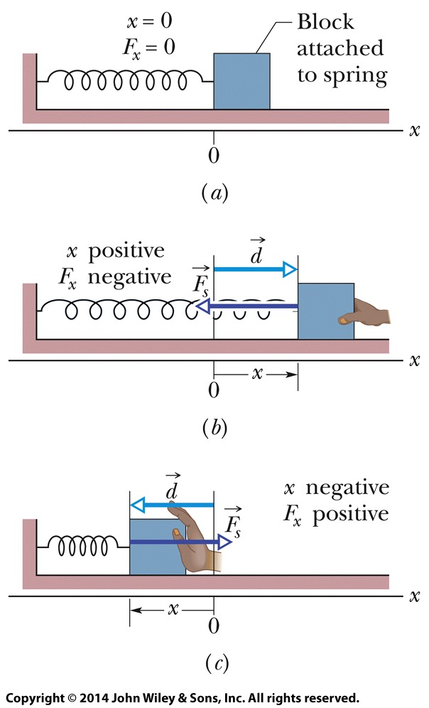
Spring Force
In its “relaxed” state, a spring produces no force.
If the spring is stretched, it tries to pull back to the relaxed state: force is opposite the displacement.
If the spring is compressed, it tries to push back to the relaxed state: force is opposite the displacement.
Force is given by Hooke’s law: $\vec{F}=−k\vec{d}$, where k is the spring that describes how stiff the spring is. Large k means a stiff spring.
In one-dimension, we have $F_{x}=−kx.$

Slide 12
Spring Force
We can find the work by integrating: $W=\int_{x_{i}}^{x_{f}}{F dx}$
Plug -kx in for F_{x}: $W=\int_{x_{i}}^{x_{f}}{(−kx) dx}=−k\int_{x_{i}}^{x_{f}}{x dx}$
Find: $W=\frac{1}{2}kx_{i}^{2} − \frac{1}{2}kx_{f}^{2}$
Note that i and f are swapped because of the minus sign in the force law.
Work is positive if block ends up closer to the relaxed position (x = 0) and negative if it ends up farther away.

Slide 13
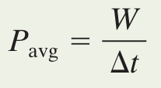
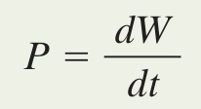
Power
Power is the time rate at which a force does work
A force does W work in a time Δt; the average power is:
The instantaneous power at a particular time is:
The SI unit for power is the watt (W): 1 W = 1 J/s
Therefore work-energy can be written as (power) x (time), for example Watt-seconds or, more commonly, kilowatt-hour.

Slide 14
Power
Find the instantaneous power using the definition of work: $P=\frac{dW}{dt}=\frac{Fdx\cos{θ}}{dt}=F\frac{dx}{dt}\cos{θ}=Fv cos{θ}$
Where we have used $v=\frac{dx}{dt}.$
Power is the dot product of force and velocity: $P=\vec{F}∙ \vec{v}$
Since $W=∆K$, we find $P=\frac{dW}{dt}=\frac{dK}{dt}$
Power is also the time derivative of (kinetic) energy.

Slide 15
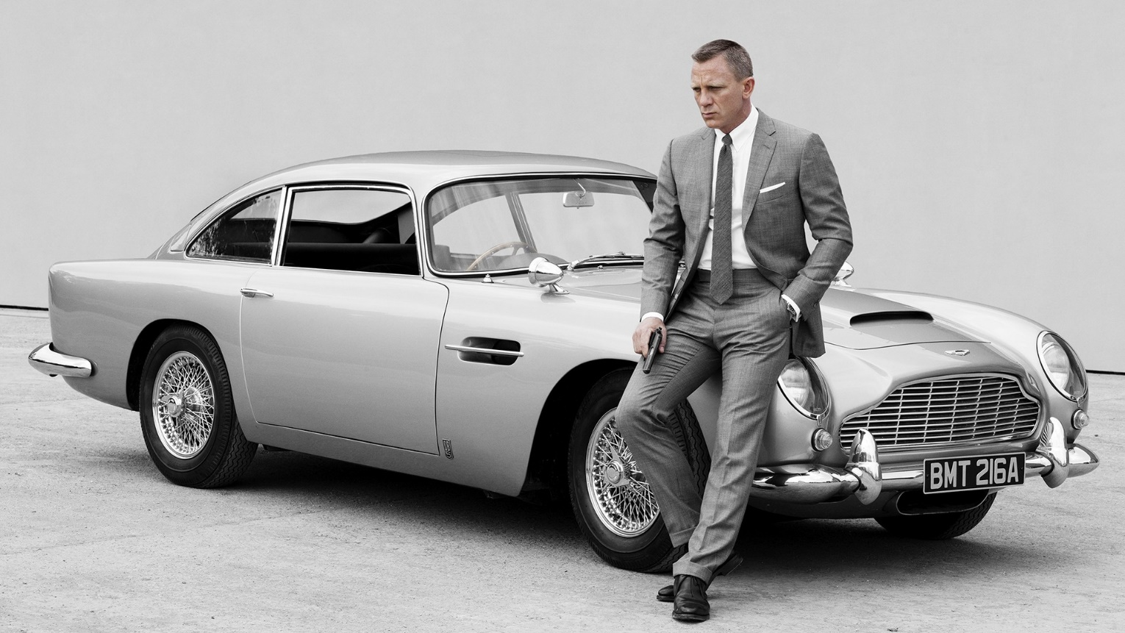
Driving Like James Bond
James Bond drives an Aston Martin DB5 that has a mass of 1500 kg and an engine that produces 210 horsepower = 157 kW.
How fast can the car accelerate from 0 to 60 mph (97 km/h)?
1 s
3.5 s
8 s
12 s

Slide 16
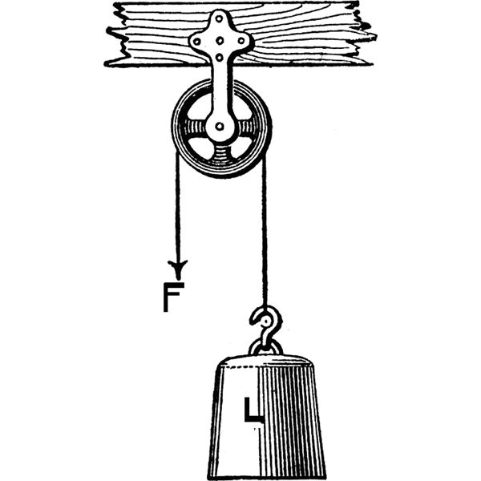
Pulleys
In a single pulley system, if you pull on the rope, the load moves by an equal distance.
Also, the force equals the load.
Therefore, the work that you do on the rope equals the work that the rope does on the load.

Slide 17
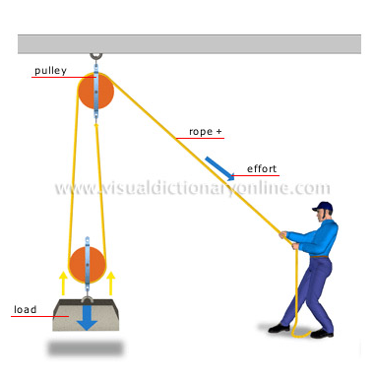
Pulleys
In a double pulley system, if you pull on the rope, the load moves only half the distance.
Quiz - what is the relationship between the applied force and the load?
Force = 0.5 × load
Force = load
Force = 2 × load

Slide 18
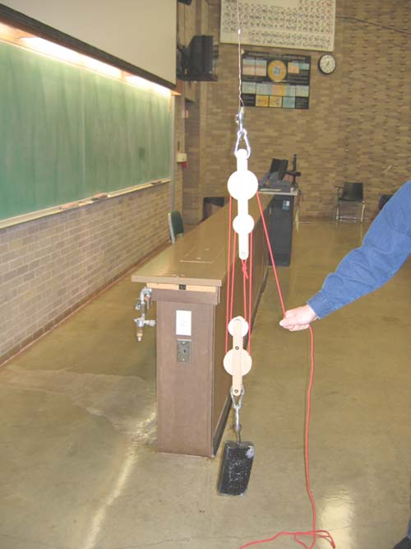
Pulleys
Do demo 1M20.11 Pulley systems.
Measure weight of load
Count number of pulleys
What is ratio of pull distance to distance that load moves?
What is ratio of load to applied force?
Measure applied force, find ratio.
Note that work done is the same.

Slide 19
Physics 1611 Remember the Exam – Tonight!
First exam is Wednesday, February 17, at 6:30 pm in Macbride Auditorium.
We will provide an equation sheet (now available on ICON).
You should bring a pencil (or two) and a calculator of a type acceptable on the SAT (google calculator SAT to find a list).
Do not bring a cell phone.
Do not bring your own equation sheet.
If you have a conflict and have not arranged a make-up, see me after class!

