Slide 1
Rotation
As you come in, please set clicker to channel 44 and then answer the following question (before the lecture starts).
Quiz – You are building a house and there is a door mounted on hinges. Where do you put the door knob?
On the edge of the door near the hinges
On the edge of the door away from the hinges
On the middle of the door.
↓

Slide 2
Topics for Today
Rotational variables (10-1)
Constant angular acceleration (10-2)
Relating linear and angular variables (10-3)
Kinetic energy of rotation (10-4)

Slide 3
Rotation
Not everything in the universe goes in straight lines. Some things spin or rotate. We looked at uniform circular motion, which was a particle moving in a circle at a fixed speed. Now we will look at solid objects rotating around an axis at variable speeds. The big concepts in this chapter are “moment of inertia” and “torque”. You already have some intuition about these.
↓

Slide 4
Rotation
Quiz – You are building a house and there is a door mounted on hinges. Where do you put the door knob?
On the edge of the door near the hinges
On the edge of the door away from the hinges
On the middle of the door.

Slide 5
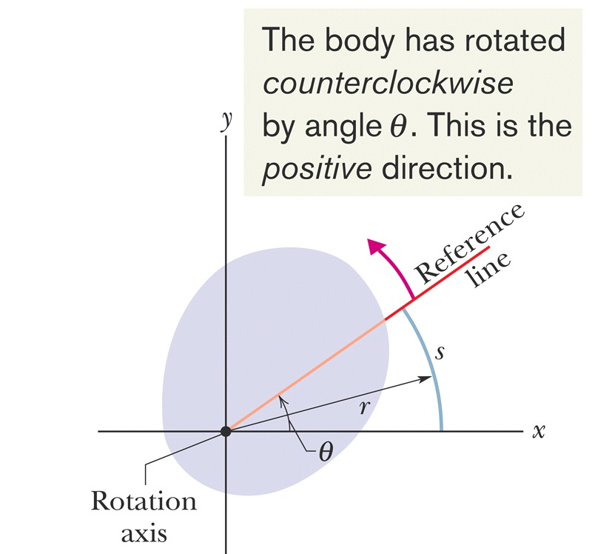
Rotational Variables
A “rigid body” is an object in which all the parts have fixed relative positions – like a door or a bicycle wheel (less the axle).
A “fixed axis” means that the rigid body rotates around an axis that doesn’t move – like the door rotating on its hinges or the bicycle wheel rotating around the axle.
To measure the rotation, we draw a reference line on the body that passes through the rotation axis. The reference line stays fixed on the body as it rotates.
The angular position, θ, is the angle between reference line and the x-axis. We measure angles in radians.
$θ=\frac{s}{r}$ where s is length along a circular arc with radius r.

Slide 6
Rotational Variables
It is important that you use radians to measure angles.
From the previous definition, if the arc s goes all the way around the circle, then its length will be 2πr, thus θ = 2π.
Full circle = 2π radians = 360°
π/2 = 90°
1 rad = 57.3°
We measure angles counterclockwise from the x-axis.
Thus, the motion of a clock is negative – corresponds to decreasing θ.

Slide 7
Rotational Variables
Angular displacement is a change in angular position Δθ = θ₂ - θ₁.
Now let’s spin our rigid body…
Average angular velocity $ω=\frac{θ_{2}−θ_{1}}{t_{2}−t_{1}}=\frac{Δθ}{Δt}$
Instantaneous angular velocity $ω=\frac{dθ}{dt}$
Angular acceleration $α=\frac{dω}{dt}$
All points in a rigid body have the same angular displacement, thus same angular velocity and same angular acceleration.
Greek to me: α=alpha, θ=theta, ω=omega

Slide 8
Rotational Variables
Quiz – what is the ratio of the angular velocities of the inner versus outer horses on this carousel? Assume the inner horses are 3 meters from the rotation axis and the outer horses are 4 meters from the rotation axis.
4:3
3:4
1:1
Too dizzy to answer.
https://youtu.be/8YieCo58C9o

Slide 9
Rotational Variables
Angular velocity $ω=\frac{dθ}{dt}$ has units of radians/second = rad/s. It’s unusual to talk about rotation rates in these terms (but useful for calculations).
More commonly, one talks about rotation speed in terms of revolutions per minutes (rpm) or revolutions per second, one full revolution = 2π radians, so 1 rpm = 2 π rad/60 s = 0.105 rad/s.
A common way to talk about slower rotation, is the time it takes to make one full revolution = T = period of rotation. One full revolution = 2π radians, so
$$ω=\frac{2π}{T}$$

Slide 10
Relating Linear and Angular Variables
Quiz – what is the angular speed of the hour hand on this clock?
0.105 rad/s
0.0017 rad/s
1.5×10⁻⁴ rad/s
7.3×10⁻⁵ rad/s

Slide 11
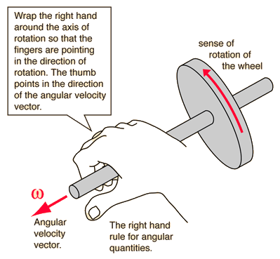
Angular Velocity as a Vector
We have been talking about angular velocity as a scalar, but the axis of rotation defines a direction. Rotate bicycle wheel with different orientations.
We use the right hand rule to define the direction of the vector.
Wrap your right hand around the axis with your fingers pointing in the direction of rotation. Your thumb then points in the direction of the angular velocity.
You can sum two angular velocities using the usual rules for vector addition. This also works for angular acceleration.

Slide 12
Constant Angular Acceleration
We can integrate the equations for angular motion just like we do for linear motion. For constant acceleration we have:

Slide 13
Relating Linear and Angular Variables
For a rigid body, all points in the body are described by the same angular displacements, angular velocity, and angular acceleration. However, the linear motion of the different points is quite different. For example, points on the outer edge of the bicycle wheel move much faster than points near the axle.
There are simple relations that describe the linear motion of a point on a rigid rotating body based on the angular variables and the distance of the point from the rotation axis = the radius r.
Position – any point on the body will move along a circular arc. As the body rotates through an angle θ, the point will move a distance along the arc
$$s= θr$$
Remember that θ must be in radians.

Slide 14
Relating Linear and Angular Variables
Speed – differentiating $s= θr$, we find $\frac{ds}{dt}=\frac{dθ}{dt}r$.
But $\frac{ds}{dt}=v$ is the linear speed of the point and $\frac{dθ}{dt}=ω$ = angular velocity, so we find $v=ωr$.

Slide 15
Relating Linear and Angular Variables
Acceleration – differentiating $v=ωr$, we find
$\frac{dv}{dt}=\frac{dω}{dt}r → a_{t}=αr$
This is the component of acceleration along the edge of the circle = tangential acceleration.
The component of acceleration towards the rotation axis = radial acceleration, we found already from circular motion
$$a_{r}=\frac{v^{2}}{r}=ω^{2}r$$

Slide 16
Relating Linear and Angular Variables
Quiz – what is the linear speed of the second hand on this clock? The second hand is 0.2 m from rotation axis to tip.
0.021 m/s
0.105 m/s
0.021 rad/s
0.105 rad/s

Slide 17
Kinetic Energy of Rotation
Rotating objects have kinetic energy.
We can estimate the kinetic energy by dividing the object into little pieces, then adding up all pieces
$$K=\frac{1}{2}m_{1}v_{1}^{2} + \frac{1}{2}m_{2}v_{2}^{2}+ \frac{1}{2}m_{3}v_{3}^{2} + …$$
Translate this to angular variables $v=ωr$.
$K=\frac{1}{2}m_{1}ω^{2}r_{1}^{2} + \frac{1}{2}m_{2}ω^{2}r_{2}^{2} + …$
$$K=\frac{1}{2}\left(m_{1}r_{1}^{2} + m_{2}r_{2}^{2} + …\right)ω^{2}=\frac{1}{2} Iω^{2}$$
I = “Rotational inertia” = “moment of inertia”
${I= m}_{1}r_{1}^{2} + m_{2}r_{2}^{2} + …$

