Slide 1
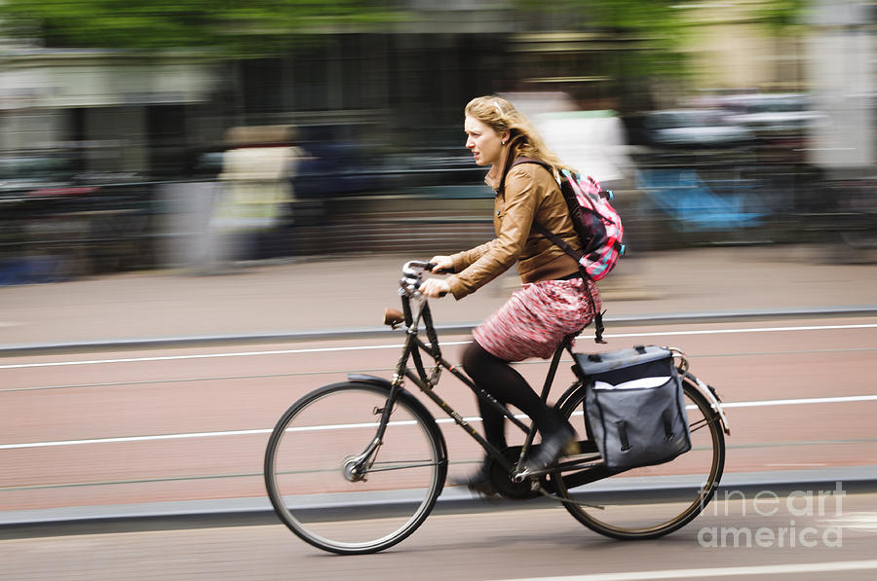
Rotation
As you come in, please set clicker to channel 44 and then answer the following question (before the lecture starts).
Quiz – a woman on a bicycle is headed due West. In which direction is the angular momentum of the front wheel (take the origin as the center of the wheel)?
A=North, B=South, C=East, D=West, E=Up, F=Down

Slide 2
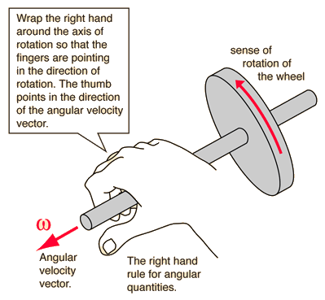
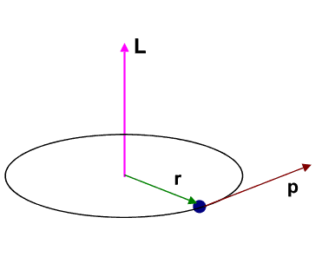
Rotational Quantities as Vectors
Angular momentum $\vec{L}=I\vec{ω}$.
Use right hand rule to find $\vec{ω}$.
Or use $\vec{l}=\vec{r}×\vec{p}=\vec{r}×m\vec{v}$

Slide 3
Topics for Today
Newton’s 2nd law for angular momentum (11-6)
Angular momentum of a rigid body (11-7)
Conservation of angular momentum (11-8)
Precession of a gyroscope (11-9)

Slide 4
2nd Law for Angular Momentum
Newton’s 2nd law for linear momentum is $\vec{F}=\frac{d\vec{p}}{dt}$ , where $\vec{F}$ is the sum of all forces acting on the system and $\vec{p}$ is the sum of the linear momenta of all the parts of the system.
The angular analog is $\vec{τ}=\frac{d\vec{L}}{dt}$, where $\vec{τ}$ is the sum of all torques acting on the system and $\vec{L}$ is the sum of the linear momenta of all the parts of the system.
Conservation of angular momentum – for a system with no external forces acting on it, the total torque is zero, so
$\frac{d\vec{L}}{dt}=0 ⇒ \vec{L}=$ constant
Total angular momentum of final state = angular momentum of initial state.

Slide 5
2nd Law for Angular Momentum
Each of the three objects shown in the figure are spun around a fixed central axis using a string wrapped around the outside and pulled with the same tangential force. The outer radii are all equal.
Quiz – which object has the highest final angular momentum?
A=Disk, B=Hoop, C=Sphere, D=All equal
Quiz – which object has the lowest angular velocity?
A=Disk, B=Hoop, C=Sphere, D=All equal

Slide 6
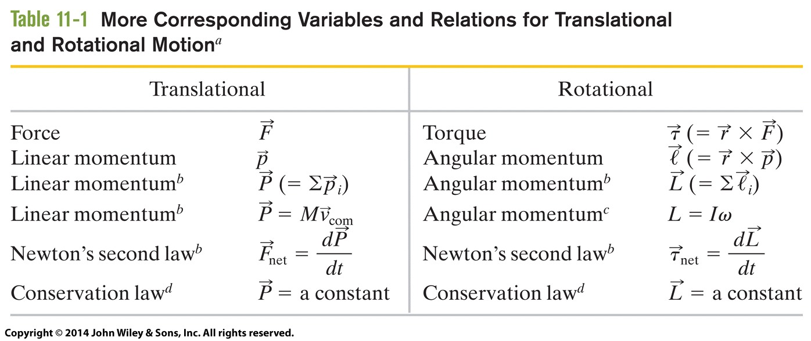
Angular Momentum

Slide 7
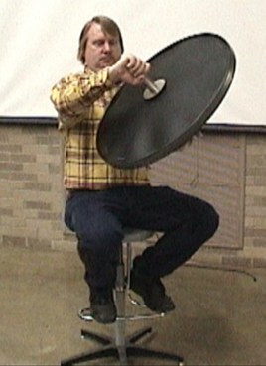
Conservation of Angular Momentum
Quiz – can someone sitting in a stool make him/herself spin in one direction and then the other without touching the floor?
Do demo 1Q40.30 - Cons. of Angular Momentum Demo - Bicycle Wheel

Slide 8
Conservation of Angular Momentum
Quiz – When this skater pulls her arms in, she starts to spin faster. Is her rotational kinetic energy the same when spinning fast versus slow?
The same
Higher kinetic energy when spinning faster
Higher kinetic energy when spinning slower

Slide 9
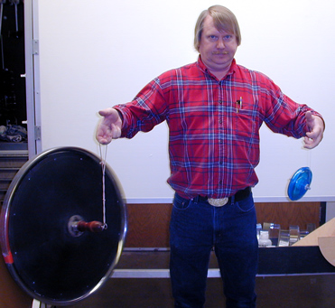
Gyroscope
Quiz – if I hang a spinning bicycle wheel from the end of a string, how will it move?
Fall down
Spin in place
Rotate around as it spins
Do demo 1Q50.21 - Bicycle Wheel - Suspended

Slide 10
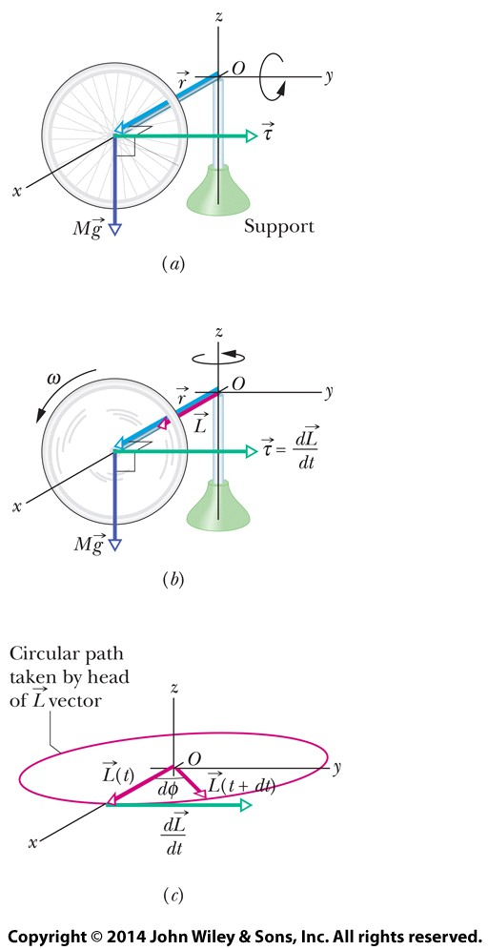
Gyroscope
Force of gravity, $m\vec{g}$, acts at center of mass of wheel.
Angular momentum, $\vec{L}$, points along same direction as displacement from rope to center of mass, $\vec{r}$.
Torque $\vec{τ}=\vec{r}×m\vec{g}$ is perpendicular to $\vec{r}$ and $\vec{L}$.
From 2nd law have $\frac{d\vec{L}}{dt}=\vec{τ}$
Torque is perpendicular to $\vec{L}$, so change in $\vec{L}$ is perpendicular to $\vec{L}$.
This is like acceleration and velocity for circular motion. Torque changes direction of $\vec{L}$, but not its magnitude. Thus, $\vec{L}$ rotates around.

Slide 11
Gyroscope
Use φ as angle of $\vec{L}$, then $dL=Ldφ$.
Note $L=Iω$, so $dL=Iωdφ$
Use 2nd law, to find $dL=τdt$.
Torque $τ=Mgr$, so $dL=Mgrdt=Iωdφ$
Find precession rate
$$Ω=\frac{dφ}{dt}=\frac{Mgr}{Iω}$$
Note that M cancels out in end, since $I∝M$.
This analysis is valid only if $ω≫Ω$, spin of wheel is much faster than precession.

