Slide 1
Topics for Today
Pendulum (15-4)
Torsion pendulum (15-3)

Slide 2
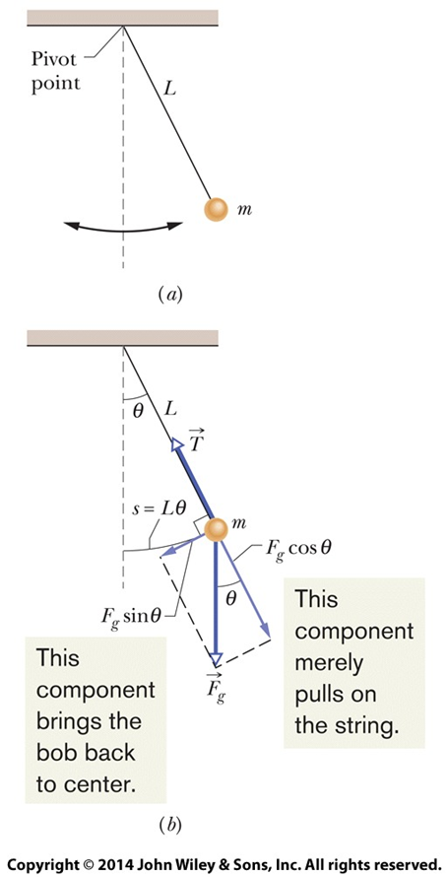
Pendulum
A pendulum is a mass on one end of a string with the other end fixed in place.
If you start the mass swinging, it will swing back and forth, much like a mass on a spring will oscillate back and forth.
This is another example of simple harmonic motion.

Slide 3

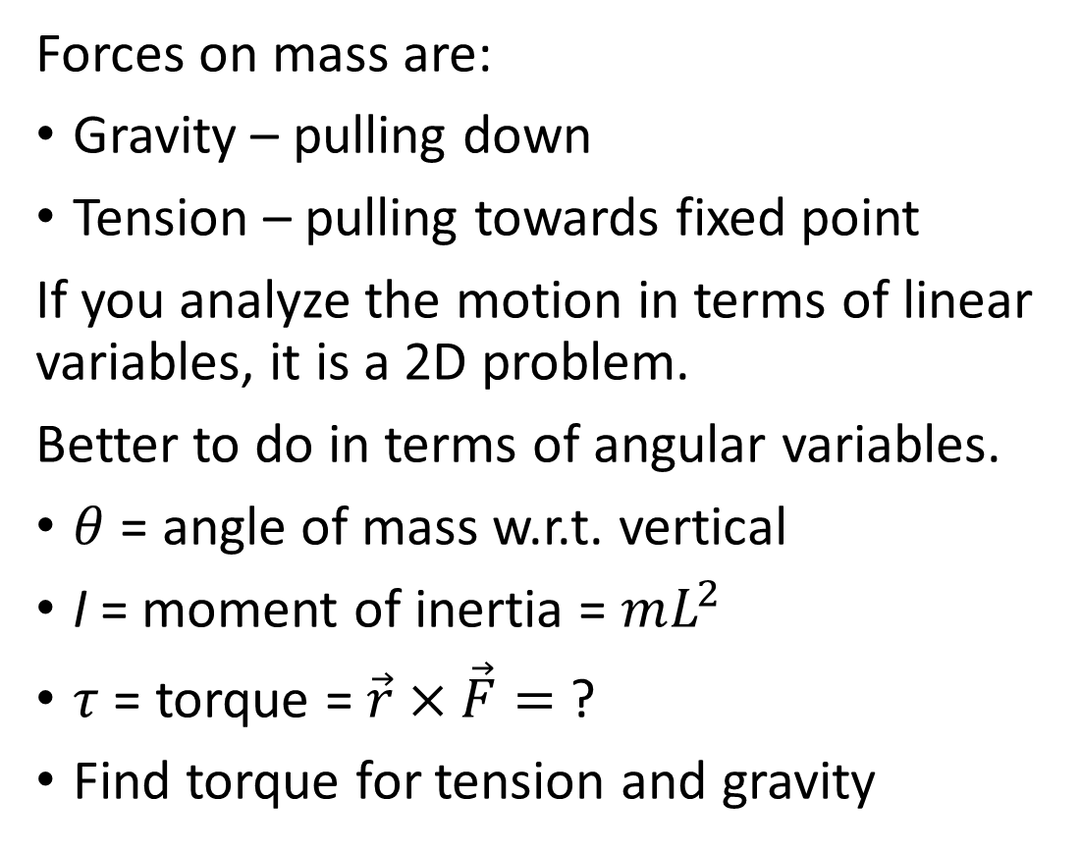
Force Diagram
Forces on mass are:
Gravity – pulling down
Tension – pulling towards fixed point
If you analyze the motion in terms of linear variables, it is a 2D problem.
Better to do in terms of angular variables.
$θ$ = angle of mass w.r.t. vertical
I = moment of inertia = $mL^{2}$
$τ$ = torque = $\vec{r}×\vec{F}=$ ?
Find torque for tension and gravity

Slide 4
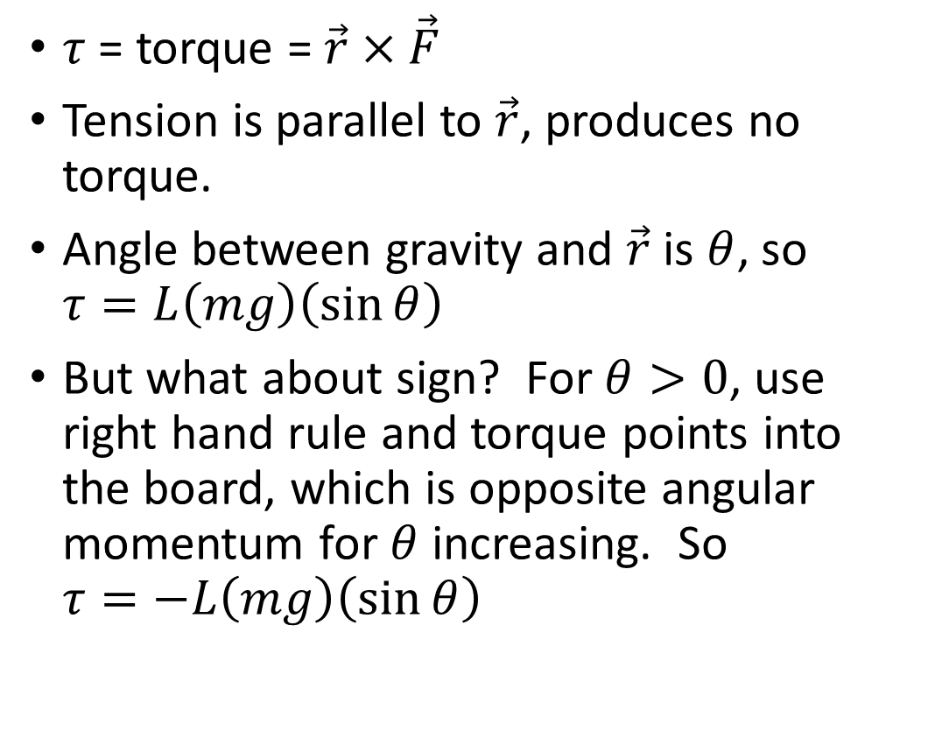
Force Diagram
$τ$ = torque = $\vec{r}×\vec{F}$
Tension is parallel to $\vec{r}$, produces no torque.
Angle between gravity and $\vec{r}$ is $θ$, so $τ=L\left(mg\right)\left(\sin{θ}\right)$
But what about sign? For $θ>0$, use right hand rule and torque points into the board, which is opposite angular momentum for $θ$ increasing. So $τ=−L\left(mg\right)\left(\sin{θ}\right)$

Slide 5
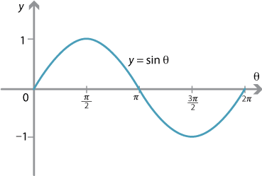

Sin(θ) for small angles
Approximate$\sin{θ}$ around 0 as a line.
Slope at zero is 1, so best approximation is $\sin{θ≈}$ $θ$

Slide 6
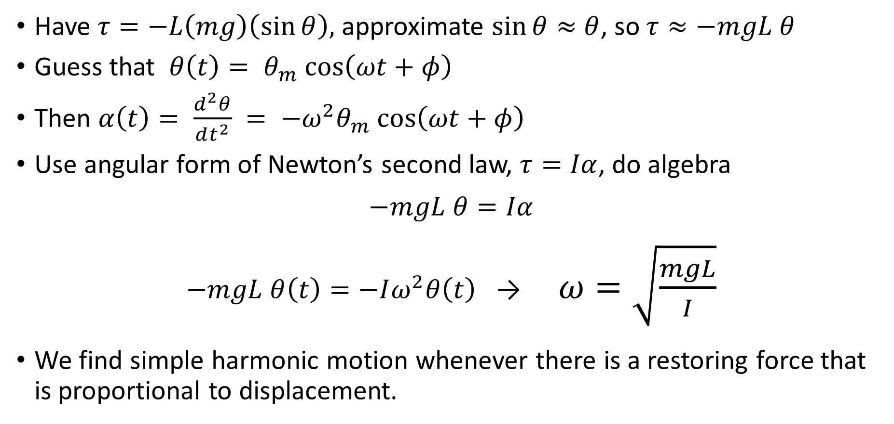
Motion of Pendulum
Have $τ=−L\left(mg\right)\left(\sin{θ}\right),$ approximate $\sin{θ≈}$ $θ$, so $τ≈−mgL θ$
Guess that $θ\left(t\right)= θ_{m} cos\left(ωt+φ\right)$
Then $α\left(t\right)= \frac{d^{2}θ}{dt^{2}} = −ω^{2}θ_{m} cos\left(ωt+φ\right)$
Use angular form of Newton’s second law, $τ=Iα$, do algebra
$$−mgL θ=Iα$$
$−mgL θ\left(t\right)=−Iω^{2}θ\left(t\right)$ → $ω=\sqrt{\frac{mgL}{I}}$
We find simple harmonic motion whenever there is a restoring force that is proportional to displacement.

Slide 7
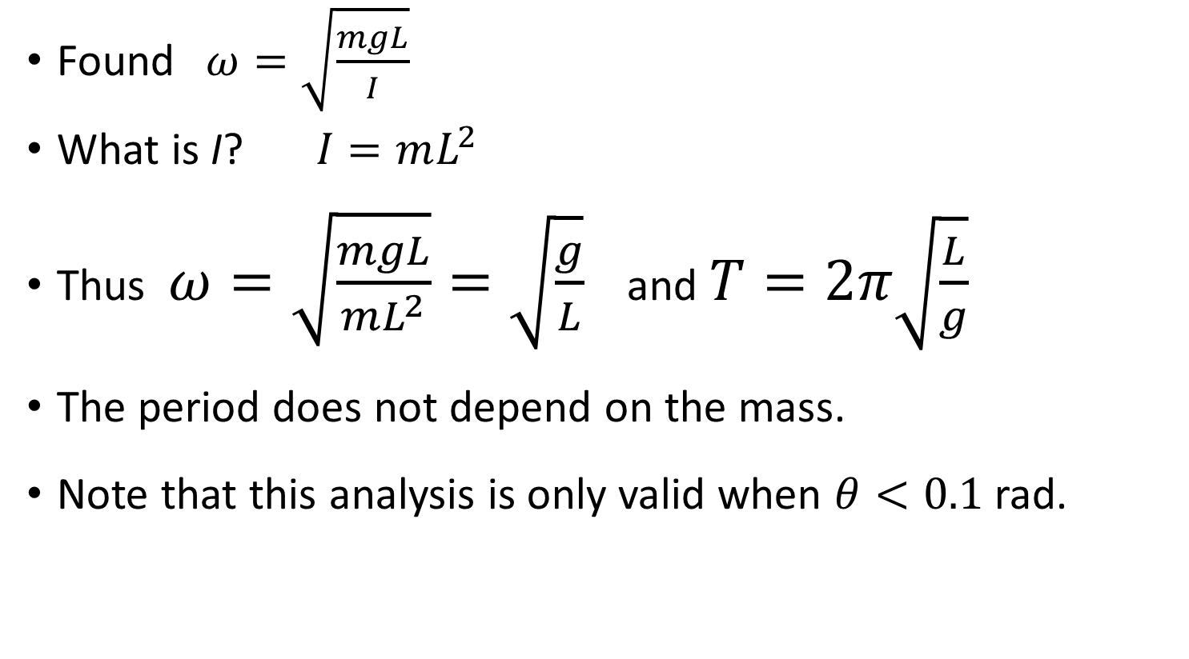
Motion of Pendulum
Found$ω=\sqrt{\frac{mgL}{I}}$
What is I? $I=mL^{2}$
Thus $ω=\sqrt{\frac{mgL}{mL^{2}}}=\sqrt{\frac{g}{L}}$ and $T=2π\sqrt{\frac{L}{g}}$
The period does not depend on the mass.
Note that this analysis is only valid when $θ<0.1$rad.

Slide 8
Simple Harmonic Motion
Quiz - A person swings on a swing at a playground. The person gets the swing into motion and then stops pumping. The swing moves back and forth at some period. If two people sit on the swing, how does the period change?
A – increases by a factor of 2
B – increases by a factor of 1.414
C – stays the same
D – decreases by a factor of 1.414
E – decreases by a factor of 2

Slide 9
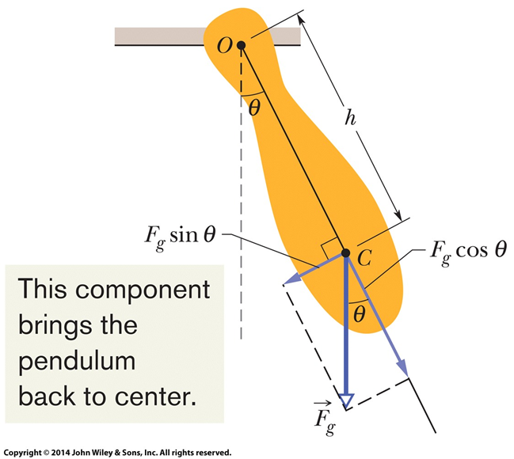
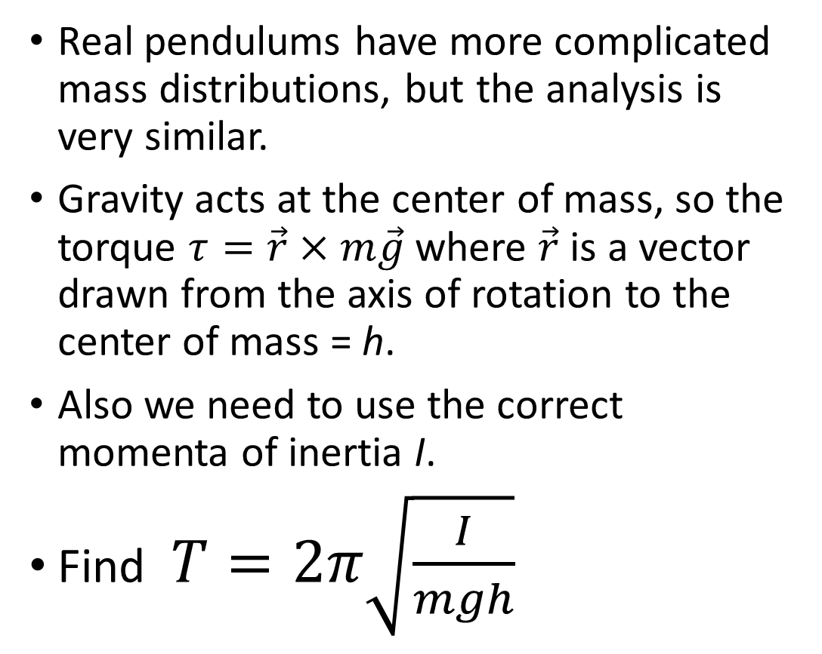
Physical Pendulum
Real pendulums have more complicated mass distributions, but the analysis is very similar.
Gravity acts at the center of mass, so the torque $τ=\vec{r}×m\vec{g}$where $\vec{r}$ is a vector drawn from the axis of rotation to the center of mass = h.
Also we need to use the correct momenta of inertia I.
Find $T=2π\sqrt{\frac{I}{mgh}}$

Slide 10
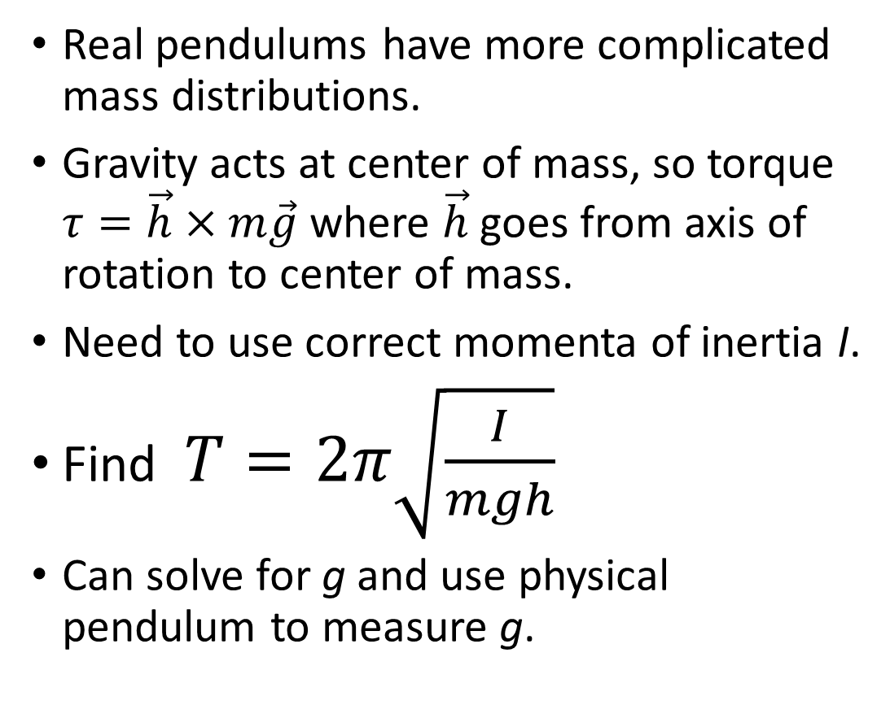
Physical Pendulum
Real pendulums have more complicated mass distributions.
Gravity acts at center of mass, so torque $τ=\vec{h}×m\vec{g}$where $\vec{h}$ goes from axis of rotation to center of mass.
Need to use correct momenta of inertia I.
Find $T=2π\sqrt{\frac{I}{mgh}}$
Can solve for g and use physical pendulum to measure g.

Slide 11
Simple Harmonic Motion
Quiz - A person swings on a swing at a playground. The person gets the swing into motion and then stops pumping. The swing moves back and forth at some period. Now the person stands up. How does the period change?
A – increases
B – stays the same
C – decreases

Slide 12
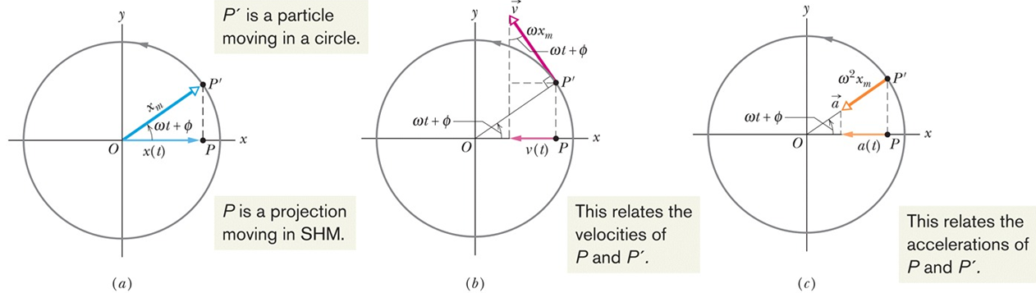



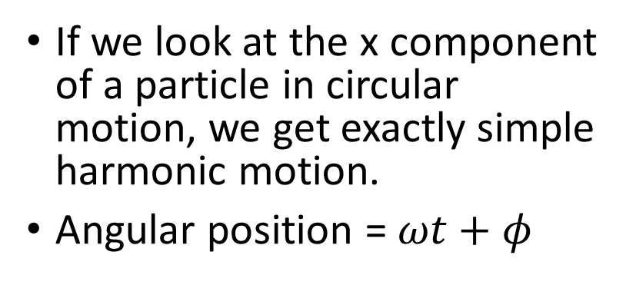
Simple Harmonic Motion = Projection of Circular Motion
If we look at the x component of a particle in circular motion, we get exactly simple harmonic motion.
Angular position = $ωt+φ$

Slide 13

Simple Harmonic Motion = Projection of Circular Motion
Simple harmonic motion of piston drives circular motion of wheel.

Slide 14
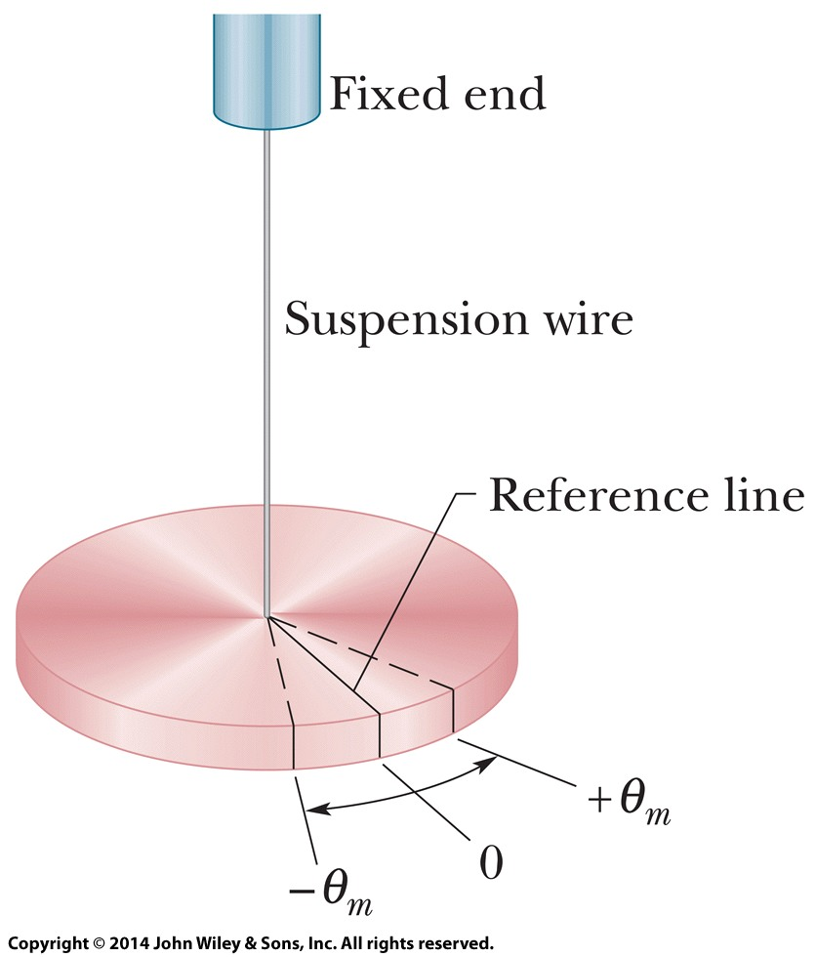
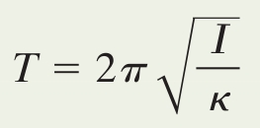
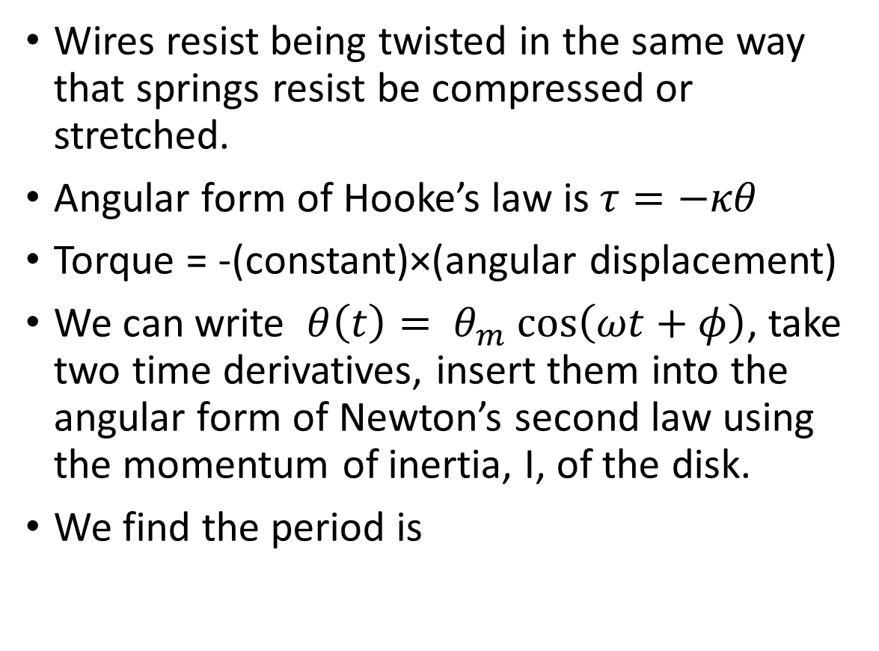
Torsion Pendulum
Wires resist being twisted in the same way that springs resist be compressed or stretched.
Angular form of Hooke’s law is $τ=−κθ$
Torque = -(constant)×(angular displacement)
We can write $θ\left(t\right)= θ_{m} cos\left(ωt+φ\right)$, take two time derivatives, insert them into the angular form of Newton’s second law using the momentum of inertia, I, of the disk.
We find the period is

