Slide 1
Topics for Today
Third exam is Wednesday, April 20
Third exam will cover chapters 11-15.
Waves (16-1)
Wave speed on a stretched string (16-2)
Power of a wave traveling on a string (16-3)

Slide 2

Mechanical Waves
Make waves on slinky.
Mechanical waves: sound, water, seismic, stadium, …
Bits of the material move back and forth, but not over long distances.
Transmit energy over long distances, but not material.
Can only exist within a material (medium) such as air, water, rock, people, …
Speed of waves depends on the medium.

Slide 3
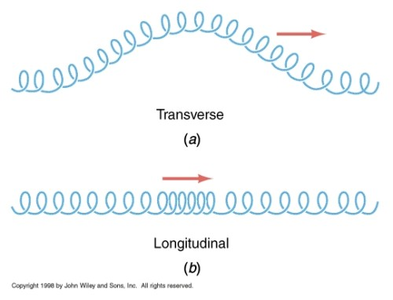
Transverse vs Longitudinal Waves
Transverse waves –
Medium moves perpendicular to wave
Visible as movement from side to side
Longitudinal waves –
Medium moves parallel to wave
Also called “compression waves”
Visible as regions of high/low density

Slide 4

Transverse vs Longitudinal Waves
Quiz – What type of waves are sound?
A – transverse
B – longitudinal
C – gnarly

Slide 5
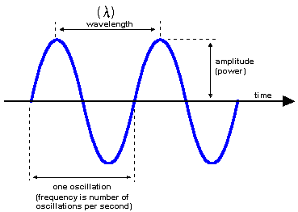
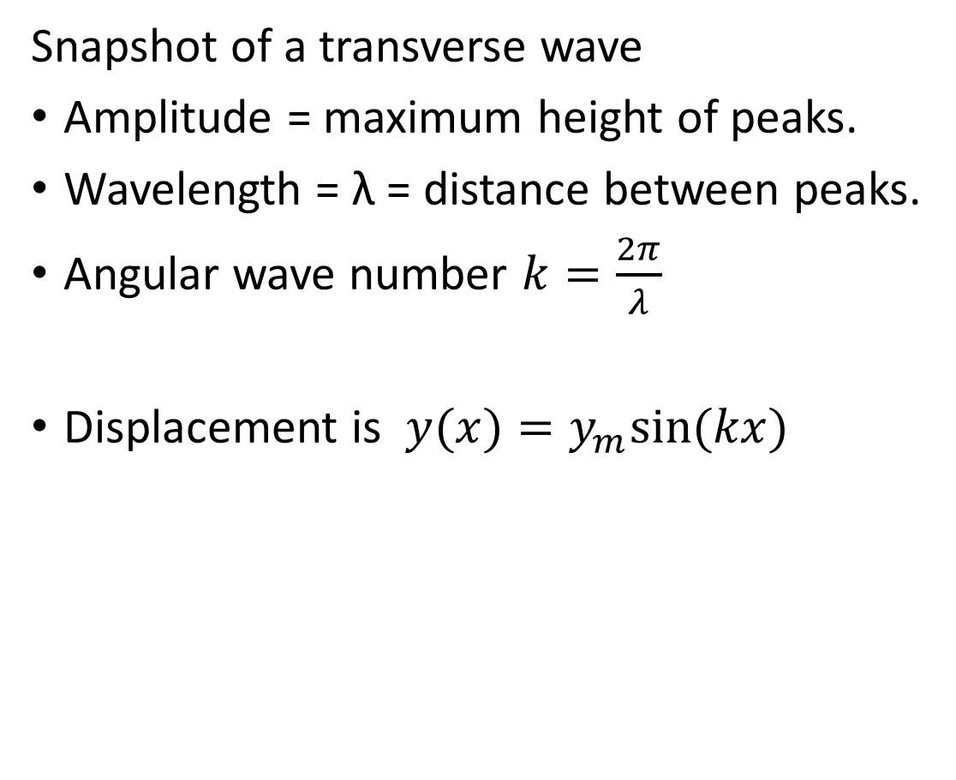
Spatial Variations
Snapshot of a transverse wave
Amplitude = maximum height of peaks.
Wavelength = λ = distance between peaks.
Angular wave number $k=\frac{2π}{λ}$
Displacement is $y(x)=y_{m}sin{(kx)}$

Slide 6
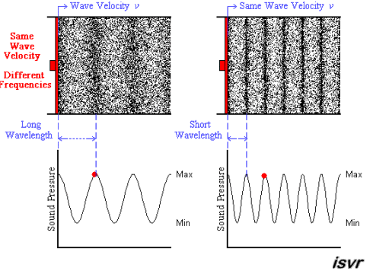
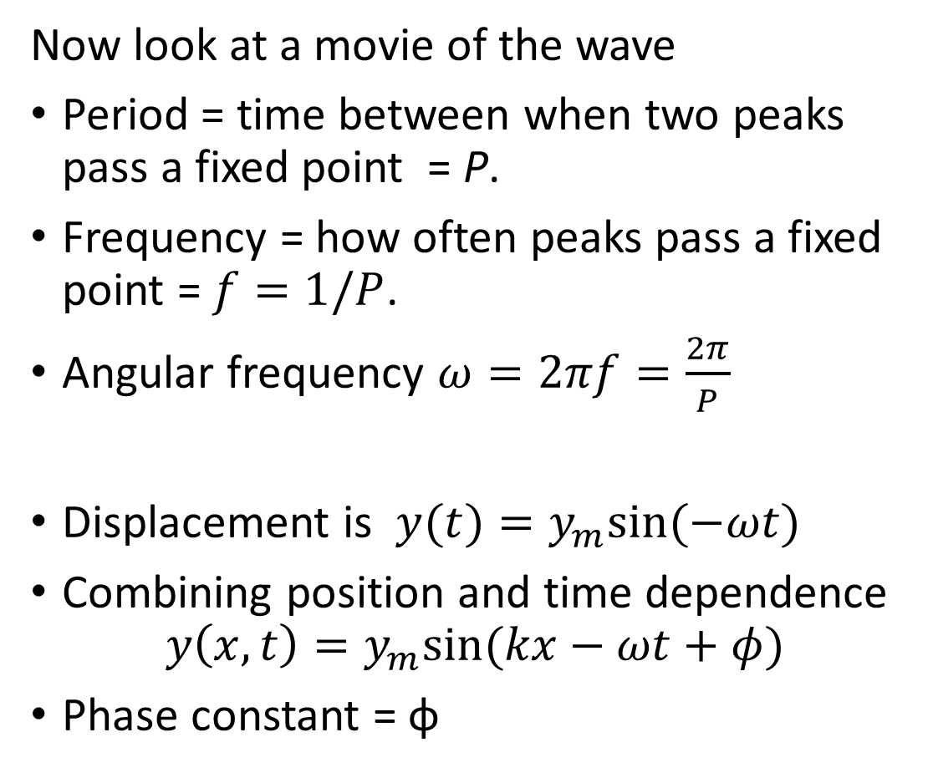
Time Variations
Now look at a movie of the wave
Period = time between when two peaks pass a fixed point = P.
Frequency = how often peaks pass a fixed point = $f=1/P$.
Angular frequency $ω=2πf=\frac{2π}{P}$
Displacement is $y(t)=y_{m}sin{(−ωt)}$
Combining position and time dependence
$$y\left(x,t\right)=y_{m}sin{(kx−ωt+φ)}$$
Phase constant = φ

Slide 7
Time Variations
A wave pulse is moving as shown with uniform speed (v) along a rope. Which of the graphs correctly shows the relation between displacement (s) at point P and time (t)?

Slide 8
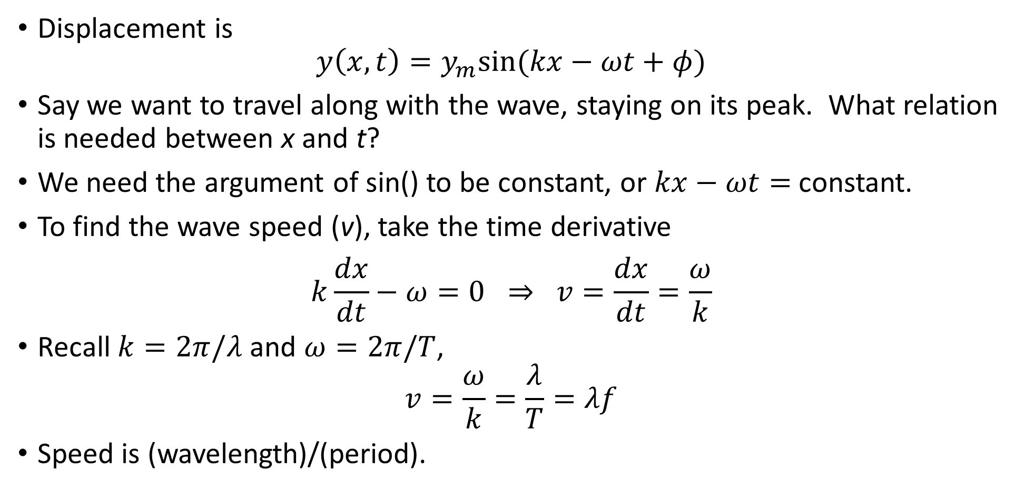
Wave Speed
Displacement is
$$y\left(x,t\right)=y_{m}sin{(kx−ωt+φ)}$$
Say we want to travel along with the wave, staying on its peak. What relation is needed between x and t?
We need the argument of sin() to be constant, or $kx−ωt=$ constant.
To find the wave speed (v), take the time derivative
$$k\frac{dx}{dt}−ω=0 ⇒ v=\frac{dx}{dt}=\frac{ω}{k}$$
Recall $k=2π/λ$ and $ω=2π/T$,
$$v=\frac{ω}{k}=\frac{λ}{T}=λf$$
Speed is (wavelength)/(period).

Slide 9
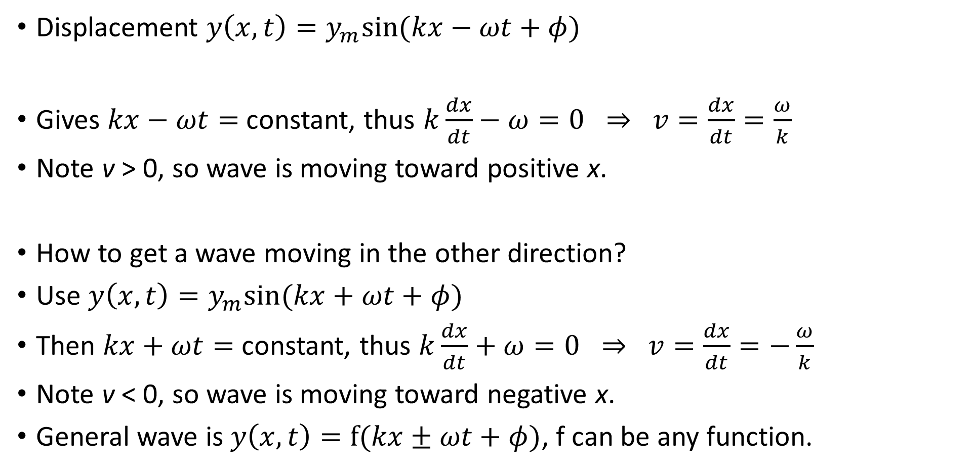
Wave Velocity
Displacement $y\left(x,t\right)=y_{m}sin{(kx−ωt+φ)}$
Gives $kx−ωt=$ constant, thus $k\frac{dx}{dt}−ω=0 ⇒ v=\frac{dx}{dt}=\frac{ω}{k}$
Note v > 0, so wave is moving toward positive x.
How to get a wave moving in the other direction?
Use $y\left(x,t\right)=y_{m}sin{(kx+ωt+φ)}$
Then $kx+ωt=$ constant, thus $k\frac{dx}{dt}+ω=0 ⇒ v=\frac{dx}{dt}=−\frac{ω}{k}$
Note v < 0, so wave is moving toward negative x.
General wave is $y\left(x,t\right)=f{(kx±ωt+φ)}$, f can be any function.

Slide 10
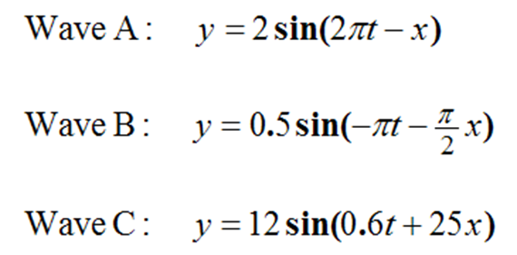
Wave Velocity
Consider the three waves described by the equations below. Which wave(s) is moving in the negative x direction?
A) A only
B) B only
C) A and B
D) B and C

Slide 11
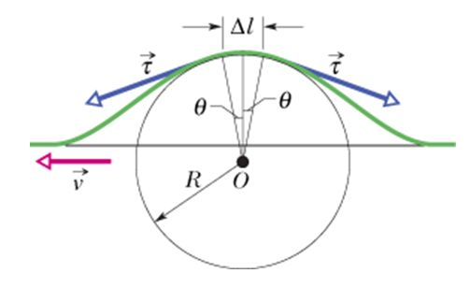
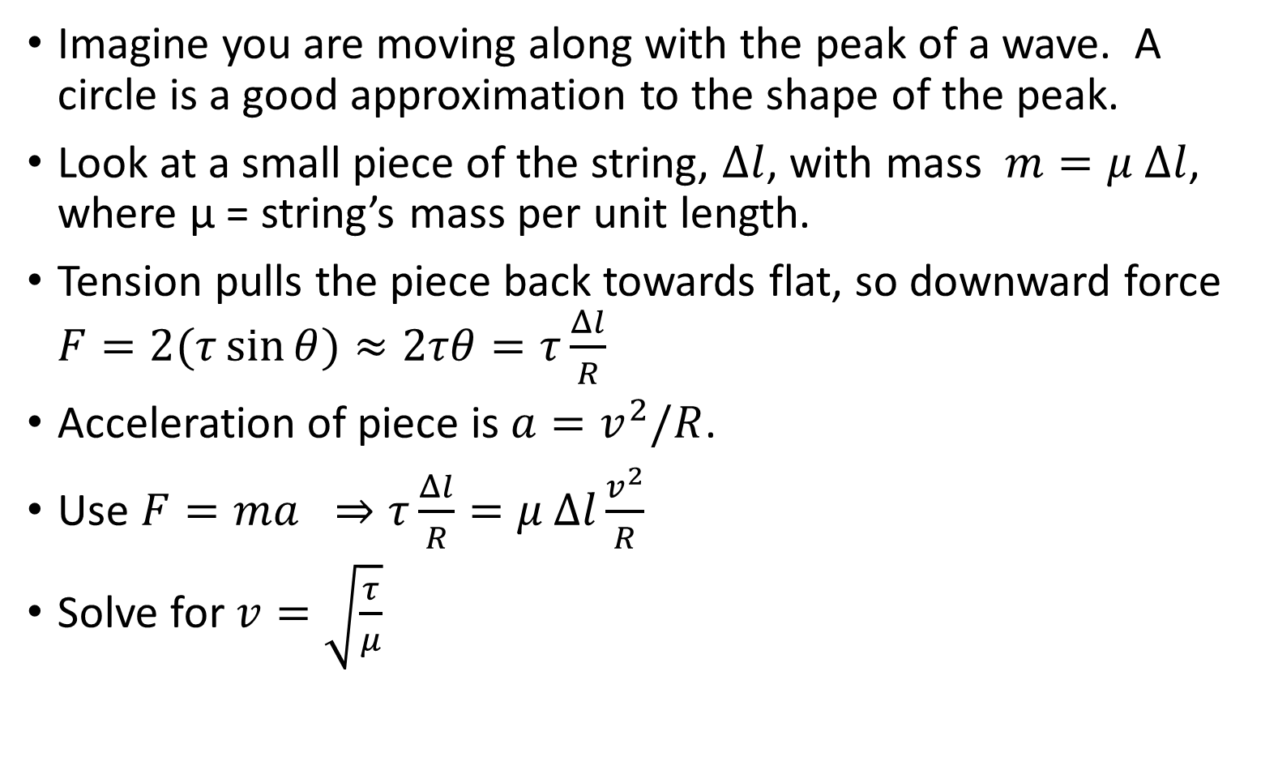
Wave Speed
Imagine you are moving along with the peak of a wave. A circle is a good approximation to the shape of the peak.
Look at a small piece of the string, $Δl$, with mass $m=μ$ $Δl$, where μ = string’s mass per unit length.
Tension pulls the piece back towards flat, so downward force $F=2(τ\sin{θ)≈2τθ=τ\frac{Δl}{R}}$
Acceleration of piece is $a=v^{2}/R$.
Use $F=ma ⇒τ\frac{Δl}{R}=μ Δl\frac{v^{2}}{R}$
Solve for $v=\sqrt{\frac{τ}{μ}}$

Slide 12
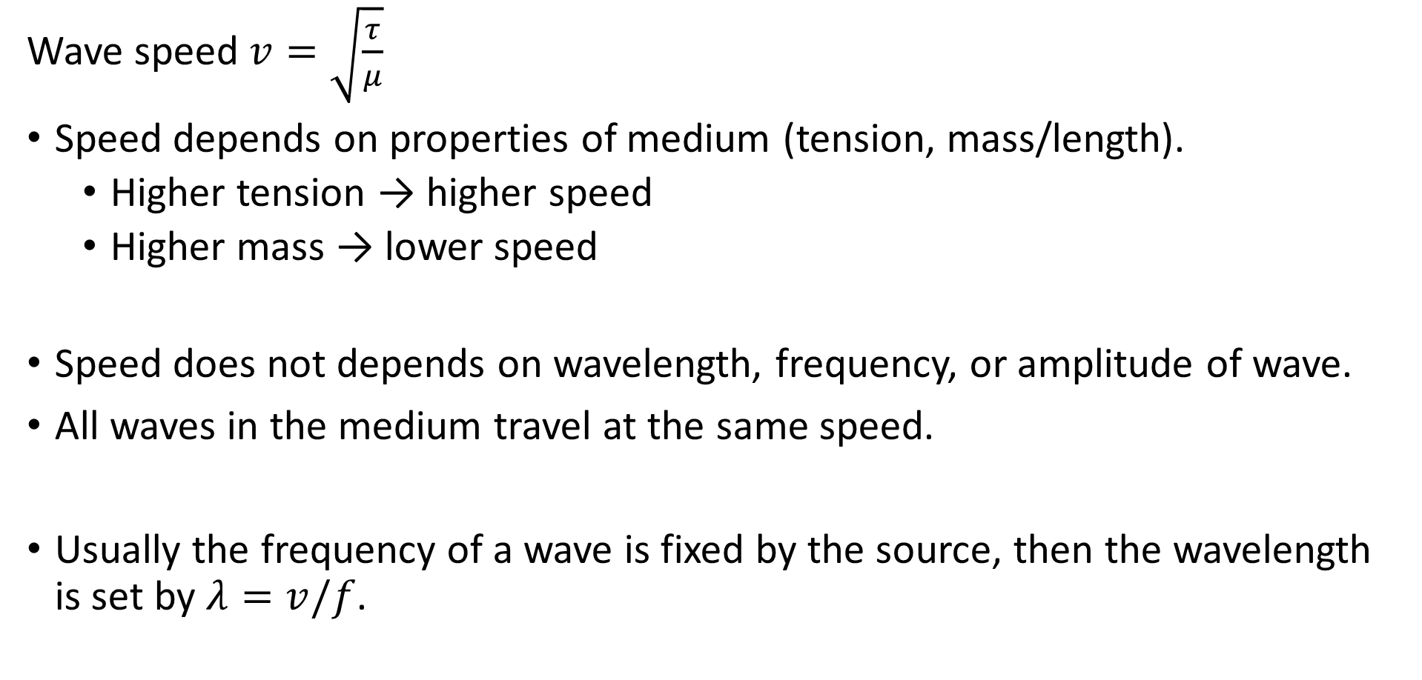
Wave Speed
Wave speed $v=\sqrt{\frac{τ}{μ}}$
Speed depends on properties of medium (tension, mass/length).
  Higher tension → higher speed
  Higher mass → lower speed
Speed does not depends on wavelength, frequency, or amplitude of wave.
All waves in the medium travel at the same speed.
Usually the frequency of a wave is fixed by the source, then the wavelength is set by $λ=v/f$.

Slide 13
Wave Speed
Which one of the following factors is important in determining the speed of waves on a string?
A) amplitude
B) frequency
C) length of the string
D) mass per unit length
E) speed of the particles that compose the string

Slide 14
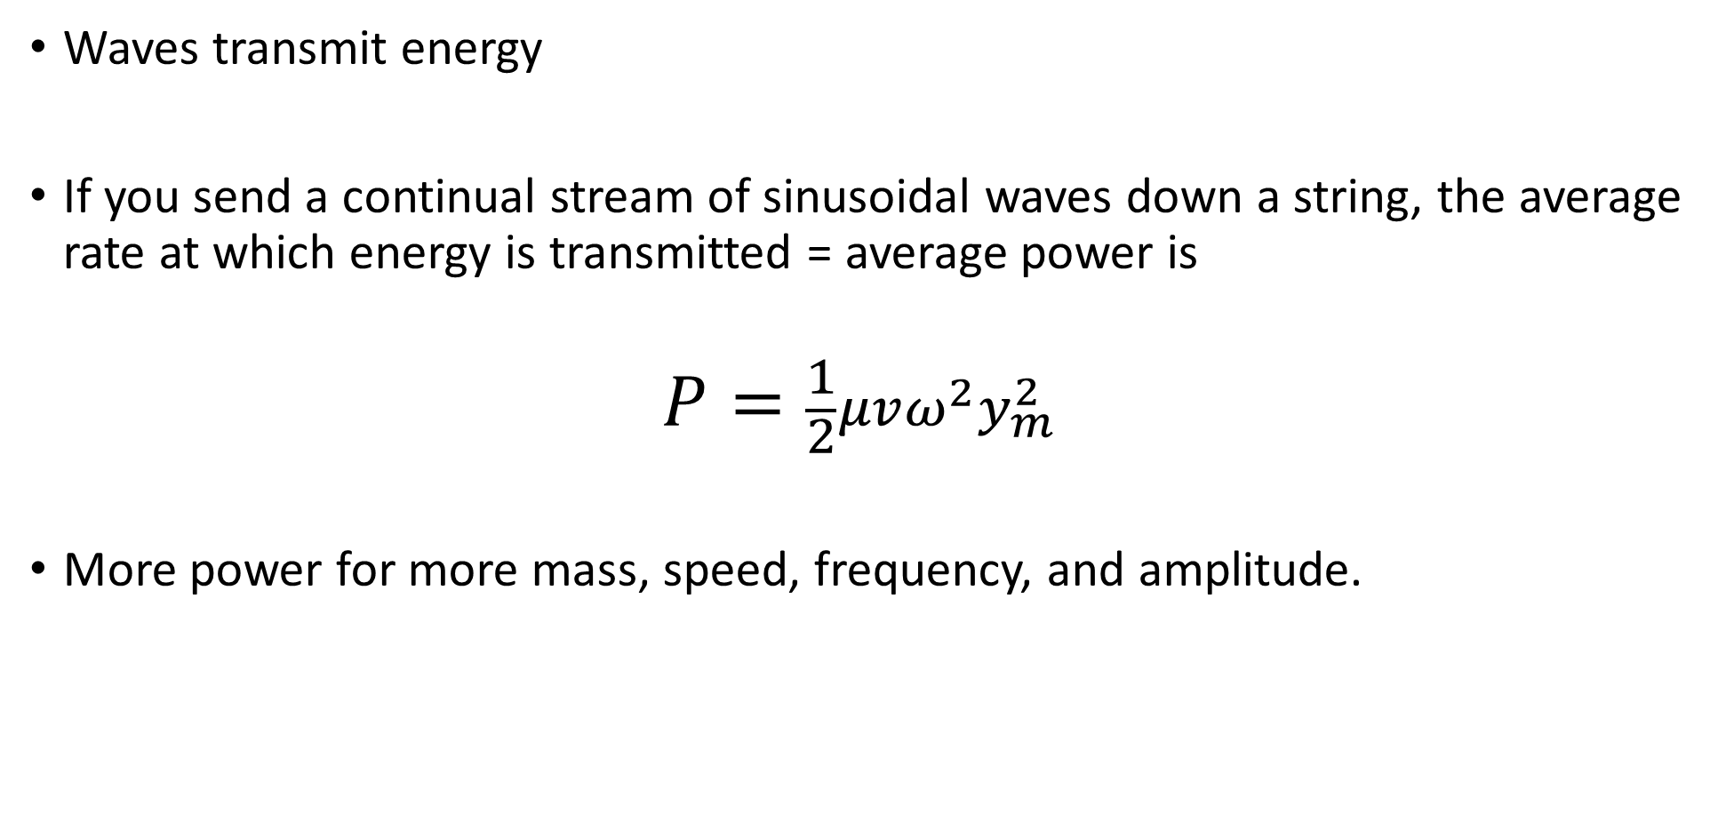
Power of a wave traveling on a string
Waves transmit energy
If you send a continual stream of sinusoidal waves down a string, the average rate at which energy is transmitted = average power is
$$P=\frac{1}{2}μvω^{2}y_{m}^{2}$$
More power for more mass, speed, frequency, and amplitude.

