Slide 1
Topics for Today
Third exam is Wednesday, April 20
Third exam will cover chapters 11-15.
Energy and power of a wave on a string (16-3)
Wave Interference (16-5)
Will not do wave equation (16-4) or phasors (16-6)
Millionaire game

Slide 2
Wave Speed
A wave is described by the equation y = 0.020 sin (3.0x - 6.0t), where the distances are in meters and time is measured in seconds. What is the speed of this wave?
A) 0.50 m/s
B) 1.0 m/s
C) 2.0 m/s
D) 0.020 m/s

Slide 3
Power of a wave traveling on a string
Waves transmit energy
If you send a continual stream of sinusoidal waves down a string, the average rate at which energy is transmitted = average power is
$$P=\frac{1}{2}μvω^{2}y_{m}^{2}$$
More power for more mass, speed, frequency, or amplitude.

Slide 4
Wave Interference
Demo of interference.
When two waves pass through the same region of space, we simply add their amplitudes:
$$y^{′}\left(x,t\right)= y_{1}\left(x,t\right)+y_{2}\left(x,t\right)$$
When the wave pulse move past each other, they come through unchanged.

Slide 5
Wave Interference
“Constructive” interference is when the final amplitude is greater than the individual amplitudes.
“Destructive” interference is when the final amplitude is less than the individual amplitudes.
Extreme case of destructive interference results in zero amplitude – note velocity is usually not zero.

Slide 6
Wave Interference
For sinusoidal waves, the displacement oscillates between positive and negative and whether or we have constructive or destructive interference depends on the relative phase.
Let’s look at two sinusoidal waves with the same frequency, and thus the same wavelength (why?), and the same amplitude.
$y_{1}=y_{m}\sin{(kx−ωt)}$ $y_{2}=y_{m}\sin{(kx−ωt+φ)}$
The sum of sines is $\sin{α+\sin{β}=2\sin{\frac{1}{2}(α+β)}}\cos{\frac{1}{2}(α−β)}$
Use $α=kx−ωt$ and $β=kx−ωt+φ$
Then $α+β=2(kx−ωt)+φ$ and $α−β=−φ$
Find $y^{′}={2y}_{m}\cos{(\frac{1}{2}φ)}\sin{(kx−ωt+\frac{1}{2}φ)}$
We get another sinusoidal wave with the same frequency and wavelength, but with a different amplitude and phase.

Slide 7
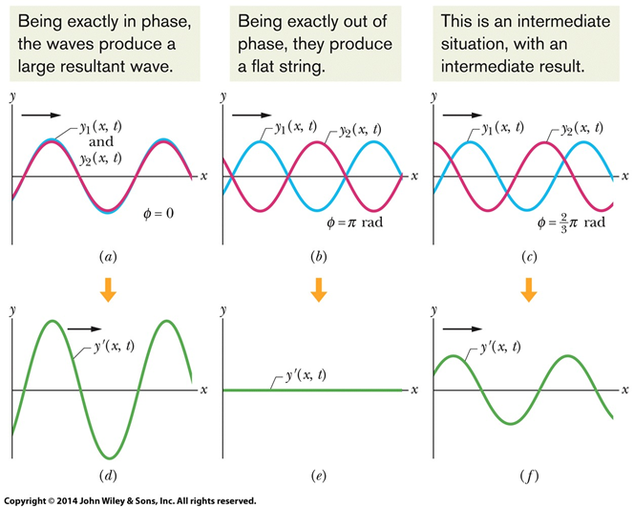
Wave Interference
Amplitude of sum of two sinusoidal waves is
$${2y}_{m}\cos{(\frac{1}{2}φ)}$$
“In phase” is $φ=0$, amplitude is 2× original.
“Out of phase” is $φ=π$ rad = 180°, amplitude is zero.
Adding $2π$ rad = 360° to a phase has no effect.

Slide 8
Wave Interference
Quiz – You put pulses into the two ends of a rope. The pulses have opposite amplitudes, but are otherwise identical and symmetric. The pulses travel (in opposite directions) along the rope interfere. Which of the following is true?
A – There is an instant when the string is completely straight.
B – When the two pulses interfere, the energy is momentarily zero.
C – There is a point on the string that does not move up or down.

