Slide 1
Topics for Today
Go over exam
Traveling sound waves (17-2)
Interference (17-3)

Slide 2
Exam #3
EXAM 3
A 12-15
B 9-11
C 5-8
D 3-4
F 0-2

Slide 3
Rolling
A solid sphere and a hollow sphere each of mass M and radius R are released at the same time from the top of an inclined plane. Which one of the following statements is necessarily true?
A) The hollow sphere will reach the bottom first.
B) The solid sphere will reach the bottom first.
C) Both spheres will reach the bottom at the same time.
D) The hollow sphere will reach the bottom with the greater kinetic energy.
E) The solid sphere will reach the bottom with the greater kinetic energy.

Slide 4
Fluids
A large water tank, open at the top, has a small hole in the bottom. When the water level is 30 m above the bottom of the tank, the speed of the water leaking from the hole:
A) is 2.5 m/s
B) is 24 m/s
C) is 44 m/s
D) cannot be calculated unless the area of the hole is given
E) cannot be calculated unless the areas of the hole and tank are given

Slide 5
Rotational Motion
A spinning skater draws in her outstretched arms thereby reducing her moment of inertia by a factor of 2. Determine the ratio of her final kinetic energy to her initial kinetic energy.
A) 16
B) 4
C) 2
D) 1
E) 0.5

Slide 6
Simple Harmonic Motion
A block attached to a spring undergoes simple harmonic motion on a horizontal frictionless surface. Its total energy is 50 J. When the displacement is half the amplitude, the kinetic energy is:
A) 0 J
B) 37.5 J
C) 25 J
D) 50 J
E) 12.5 J

Slide 7
Equilibrium
A ladder leans against a wall. If the ladder is not to slip, which one of the following must be true?
A) The coefficient of friction between the ladder and the wall must not be zero
B) The coefficient of friction between the ladder and the floor must not be zero
C) Both A and B
D) Either A or B
E) Neither A nor B

Slide 8
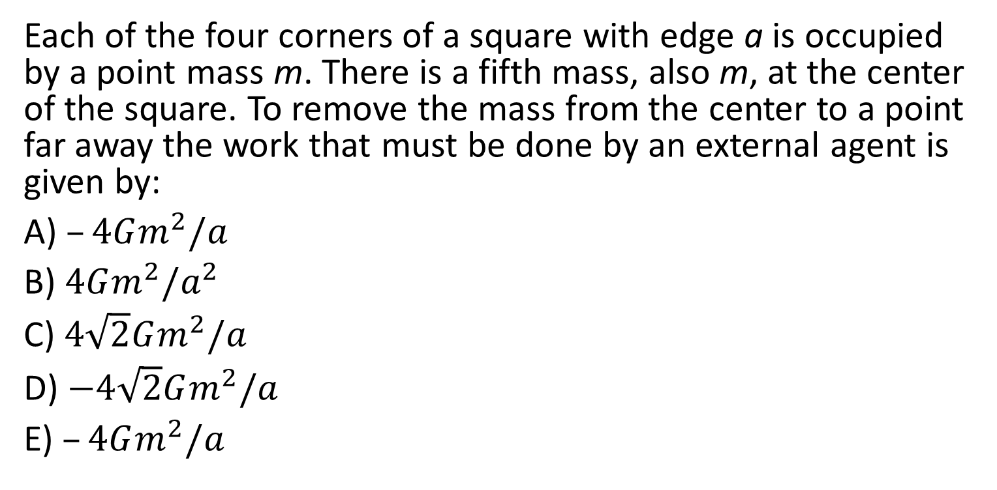
Simple Harmonic Motion
Each of the four corners of a square with edge a is occupied by a point mass m. There is a fifth mass, also m, at the center of the square. To remove the mass from the center to a point far away the work that must be done by an external agent is given by:
A) $–4Gm^{2}/a$
B) $4Gm^{2}/a^{2}$
C) $4\sqrt{2}Gm^{2}/a$
D) $−4\sqrt{2}Gm^{2}/a$
E) $–4Gm^{2}/a$

Slide 9
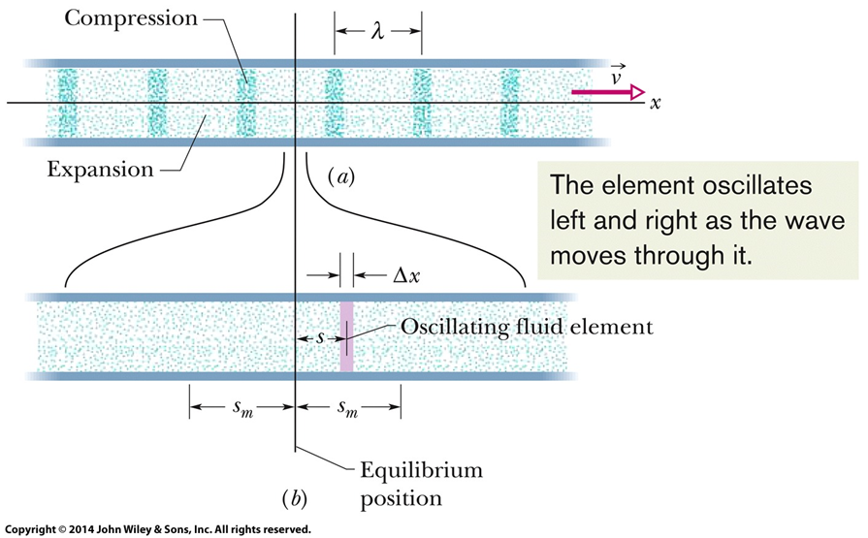
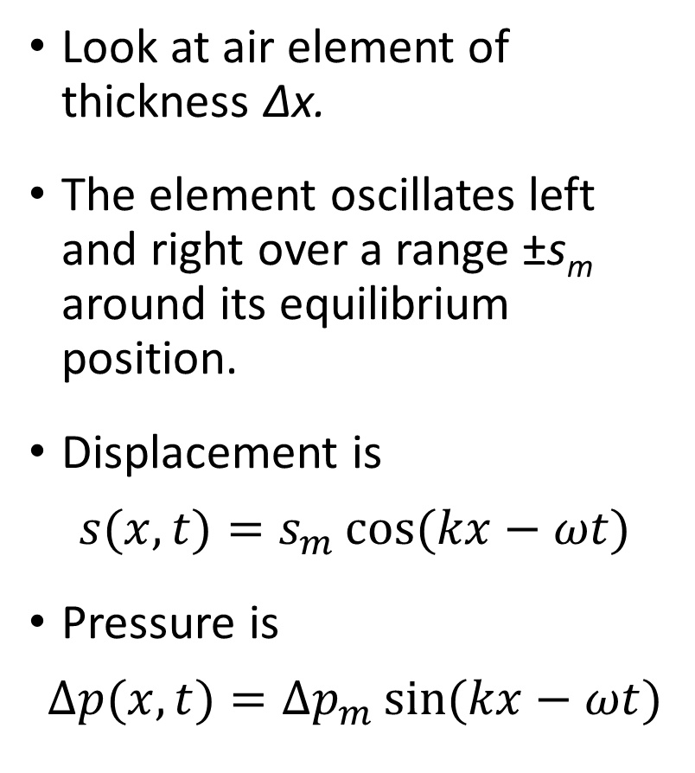
Traveling Sound Waves
Look at air element of thickness Δx.
The element oscillates left and right over a range ±s_{m} around its equilibrium position.
Displacement is
$$s(x,t)=s_{m}\cos{(kx−ωt)}$$
Pressure is
$$Δp(x,t)={Δp}_{m}\sin{(kx−ωt)}$$

Slide 10
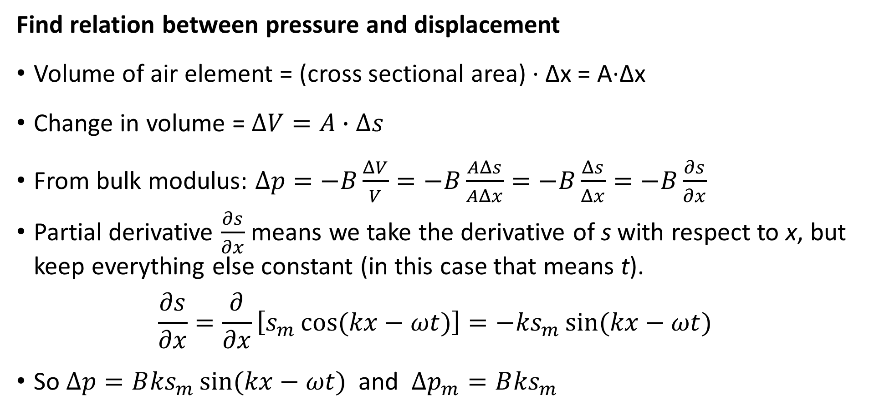
Traveling Sound Waves
Find relation between pressure and displacement
Volume of air element = (cross sectional area) ∙ Δx = A∙Δx
Change in volume = $ΔV=A∙Δs$
From bulk modulus: $Δp=−B\frac{ΔV}{V}=−B\frac{AΔs}{AΔx}=−B\frac{Δs}{Δx}=−B\frac{∂s}{∂x}$
Partial derivative $\frac{∂s}{∂x}$ means we take the derivative of s with respect to x, but keep everything else constant (in this case that means t).
$$\frac{∂s}{∂x}=\frac{∂}{∂x}\left[s_{m}\cos{(kx−ωt)}\right]=−{ks}_{m}\sin{(kx−ωt)}$$
So $∆p=B{ks}_{m}\sin{(kx−ωt)}$ and ${Δp}_{m}=B{ks}_{m}$

Slide 11
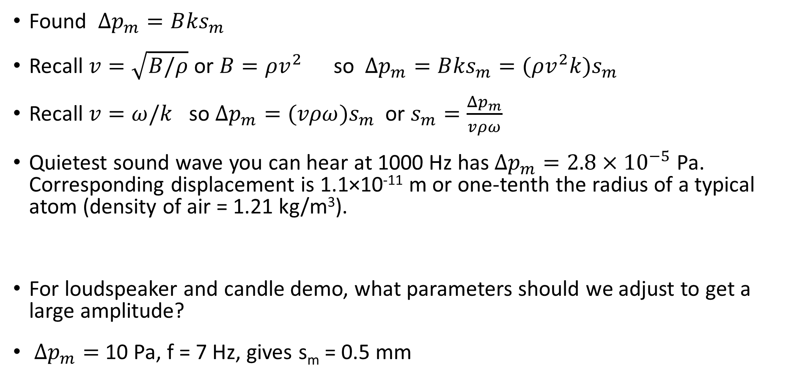
Traveling Sound Waves
Found ${Δp}_{m}=B{ks}_{m}$
Recall $v=\sqrt{B/ρ}$ or $B=ρv^{2}$ so ${Δp}_{m}=B{ks}_{m}=(ρv^{2}{k)s}_{m}$
Recall $v=ω/k$ so ${Δp}_{m}=(vρω{)s}_{m}$ or $s_{m}=\frac{{Δp}_{m}}{vρω}$
Quietest sound wave you can hear at 1000 Hz has ${Δp}_{m}=2.8×{10}^{−5}$ Pa. Corresponding displacement is 1.1×10⁻¹¹ m or one-tenth the radius of a typical atom (density of air = 1.21 kg/m³).
For loudspeaker and candle demo, what parameters should we adjust to get a large amplitude?
${Δp}_{m}=$ 10 Pa, f = 7 Hz, gives s_{m} = 0.5 mm

Slide 12
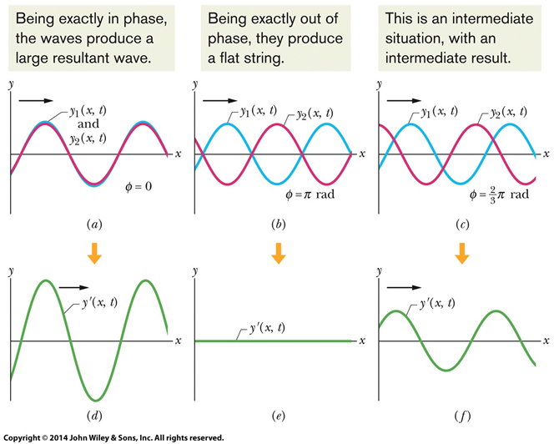
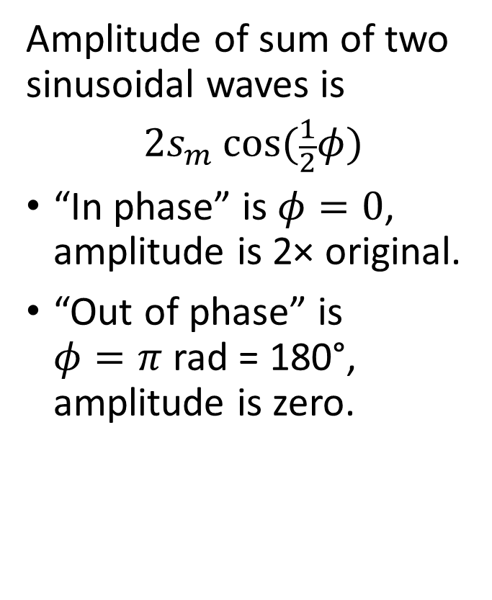
Interference
Amplitude of sum of two sinusoidal waves is
$${2s}_{m}\cos{(\frac{1}{2}φ)}$$
“In phase” is $φ=0$, amplitude is 2× original.
“Out of phase” is $φ=π$ rad = 180°, amplitude is zero.

Slide 13
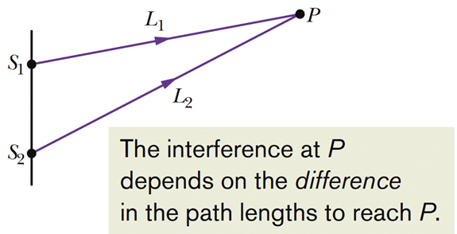
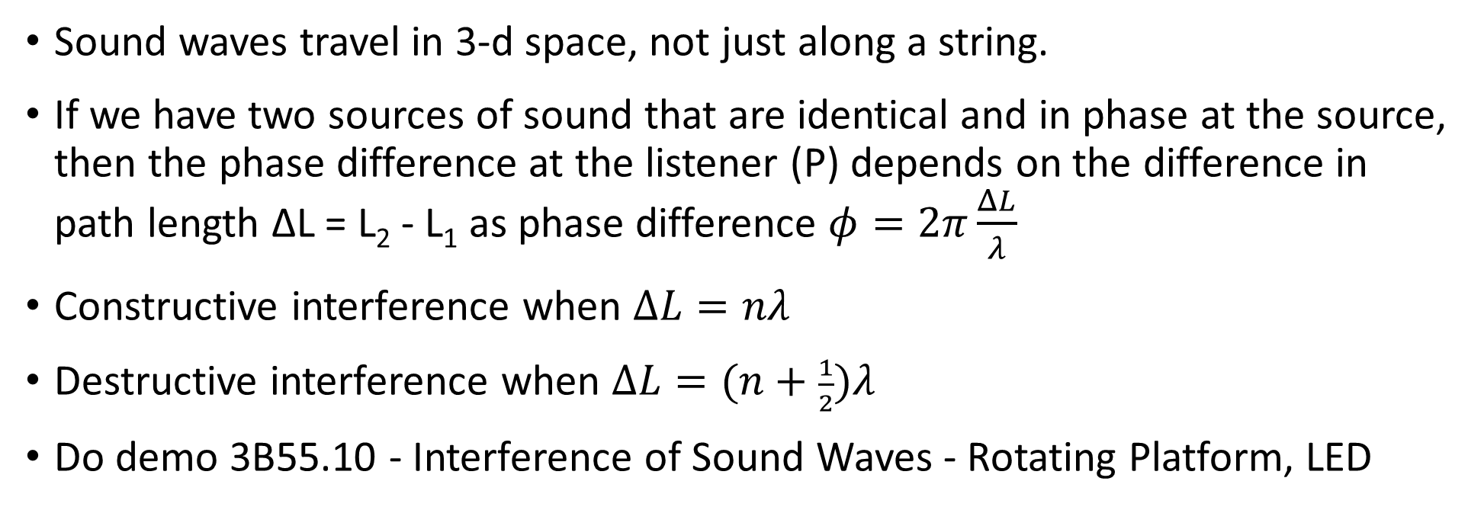
Interference
Sound waves travel in 3-d space, not just along a string.
If we have two sources of sound that are identical and in phase at the source, then the phase difference at the listener (P) depends on the difference in path length ΔL = L₂ - L₁ as phase difference $φ=2π\frac{ΔL}{λ}$
Constructive interference when $ΔL=nλ$
Destructive interference when $ΔL=(n+\frac{1}{2})λ$
Do demo 3B55.10 - Interference of Sound Waves - Rotating Platform, LED

