Slide 1
Topics for Today
Intensity and sound level (17-4)
Sources of musical sound (17-5)
Beats (17-6)

Slide 2
A particle of dust is floating in the air approximately one half meter in front of a speaker. The speaker is then turned on produces a constant pure tone of 226 Hz, as shown. The sound waves produced by the speaker travel horizontally. Which one of the following statements correctly describes the subsequent motion of the dust particle, if any?
a) The particle of dust will oscillate left and right with a frequency of 226 Hz.
b) The particle of dust will oscillate up and down with a frequency of 226 Hz.
c) The particle of dust will be accelerated toward the right and continue moving in that direction.
d) The particle of dust will move toward the right at constant velocity.
e) The dust particle will remain motionless as it cannot be affected by sound waves.

Slide 3
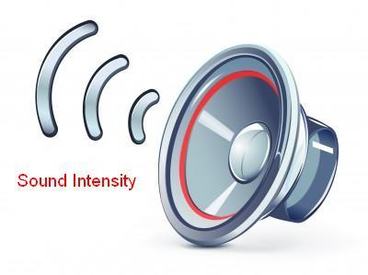
Intensity and Sound Level
The loudness of a sound is set by how much energy the sound waves transmit (per unit area).
The intensity I of a sound wave at a surface is the average rate per unit area at which energy is transferred by the wave through or onto the surface $I=P/A$ where P is the time rate of energy transfer (power) of the sound wave and A is the area of the surface intercepting the sound.
The intensity can also be calculated from the displacement amplitude s_{m} as $I=\frac{1}{2}ρvω^{2}s_{m}^{2}$
Do demo 3B30.50 - Sound in Helium and CO2

Slide 4
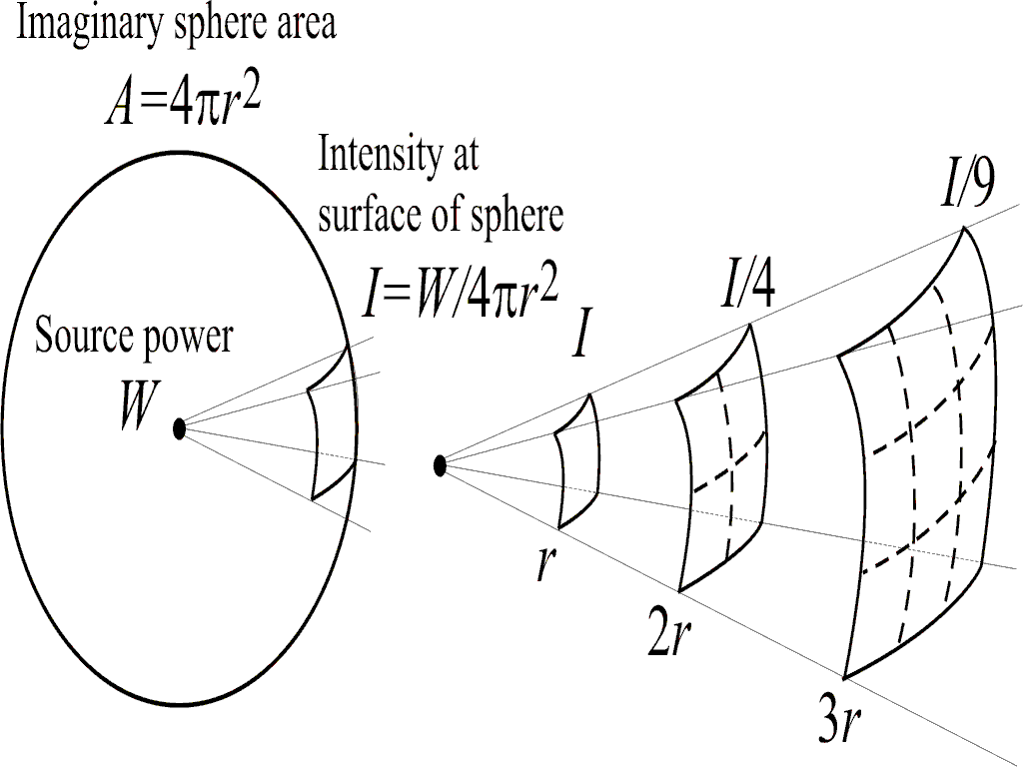
Intensity and Sound Level
Intensity decreases as distance squared as you move away from the source
$$I=\frac{P}{4πr^{2}}$$

Slide 5
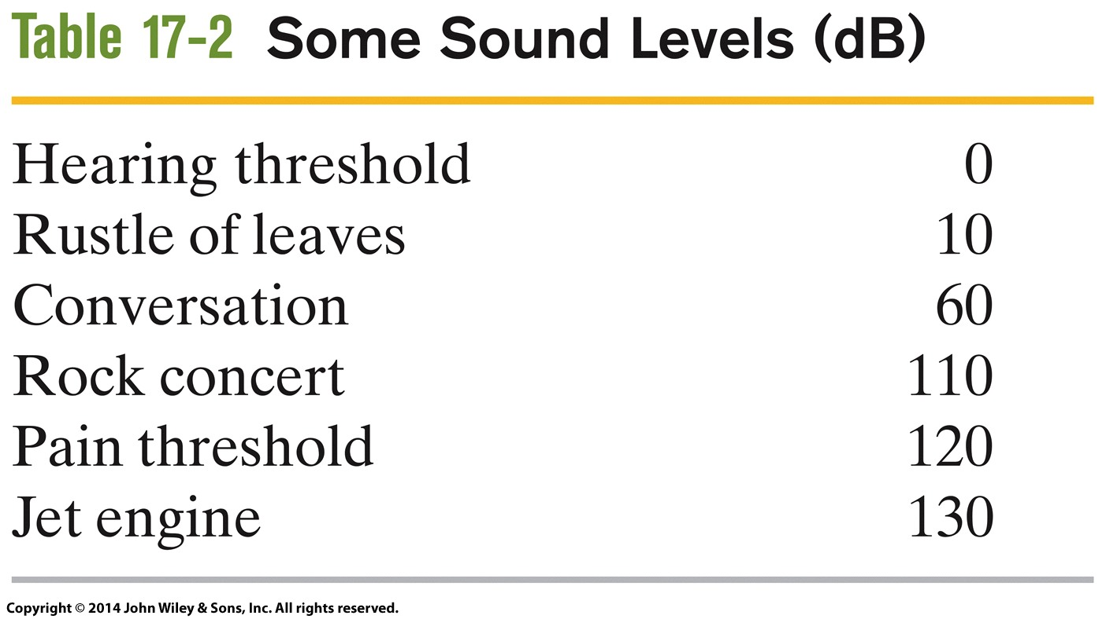
Intensity and Sound Level
We use the Decibel scale to describe sound levels.
Sound level β in decibels (dB) is
$β=\left(10 dB\right) \log{\frac{I}{I_{0}}}$
where I₀ = 10⁻¹² W/m² is (roughly) the human hearing threshold.
A factor of 10 increase in intensity adds 10 to the decibel level.

Slide 6
Intensity and Sound Level
Natalie is a distance d in front of a speaker emitting sound waves. She then moves to a position that is a distance 2d in front of the speaker. By what percentage does the sound intensity decrease for Natalie between the two positions?
a) 10 %
b) 25 %
c) 50 %
d) 75%

Slide 7
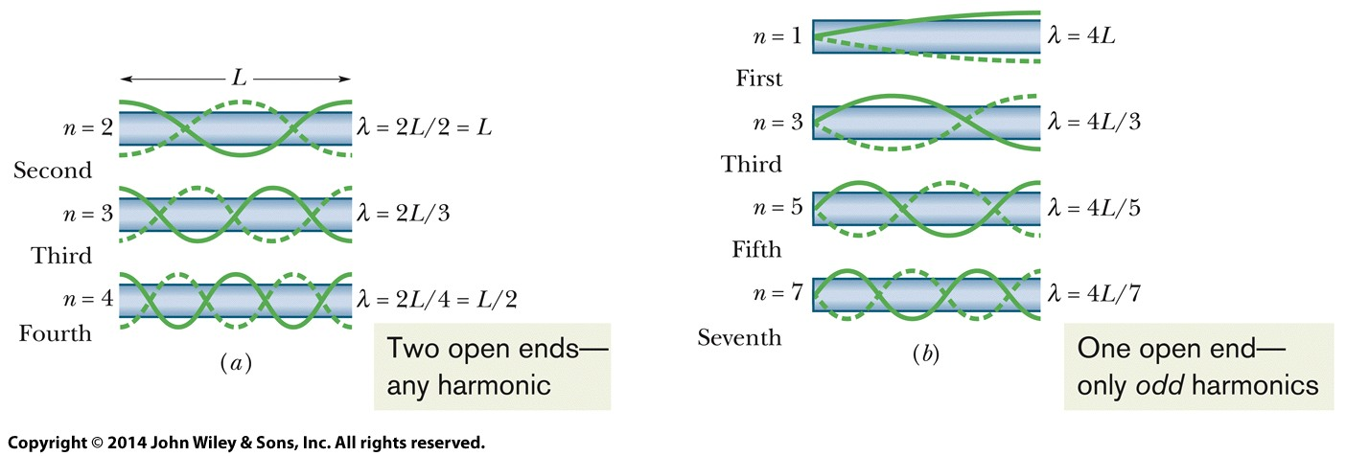
Sources of Musical Sound
Sound can produce standing waves, very much like standing waves on strings. Consider air in a tube. Wavelength of resonances are set by length of the tube.
Standing wave will have a node if the end is closed, will have antinode if the end is open.
A pipe open at both ends will resonate at frequencies $f=\frac{v}{λ}=\frac{nv}{2L}$
A pipe closed at one end and open at the other will resonate at frequencies $f=\frac{v}{λ}=\frac{nv}{4L}$

Slide 8
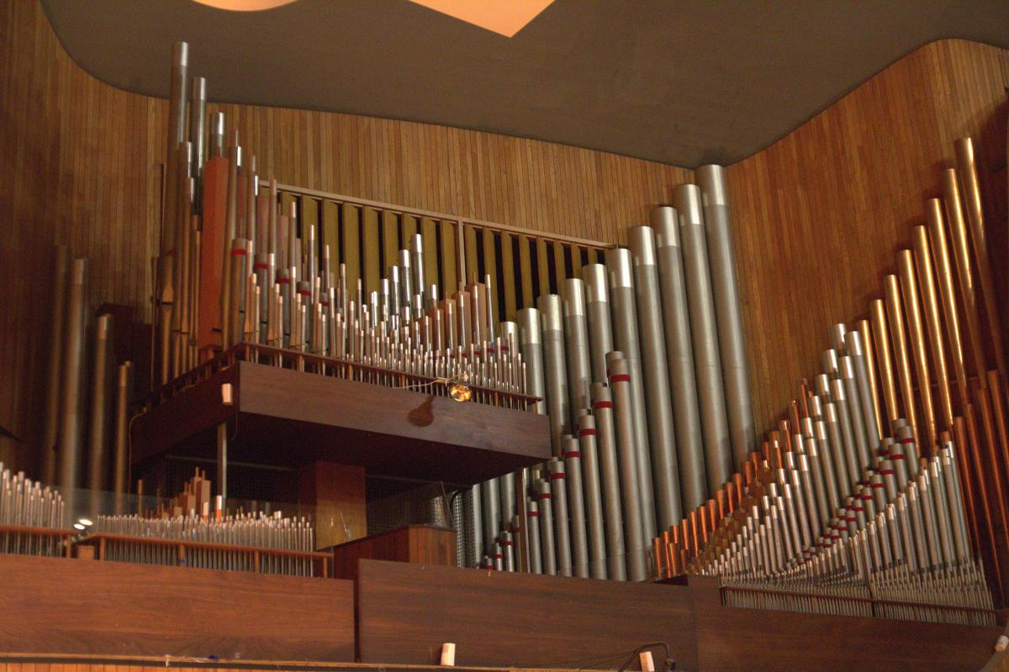
Sources of Musical Sound
For musical instruments, which “note” the instrument plays is set (mostly) by the length of the tube, e.g. an organ has many tubes of different lengths for the different notes, a trombone slides to change which note is played.
In addition to the note, different instruments sound different. This is called “timbre”. This comes from having different amounts of harmonics.
A pipe closed at one end and open at the other will resonate at frequencies $f=\frac{v}{λ}=\frac{nv}{4L}$
Medium | Speed (m/s)
Air (20 C) | 343
Helium | 965
Do demo 3B30.50 - Sound in Helium and CO2

Slide 9
Sources of Musical Sound
A soft drink bottle is 15 cm tall. Sam blows across that top of the bottle just after drinking the last of his drink. What is the approximate fundamental frequency of the tone that Sam generates?
a) 230 Hz
b) 570 Hz
c) 680 Hz
d) 810 Hz
e) 1100 Hz

Slide 10
Sources of Musical Sound
Should all future lectures be done with helium?
Yes
No

Slide 11
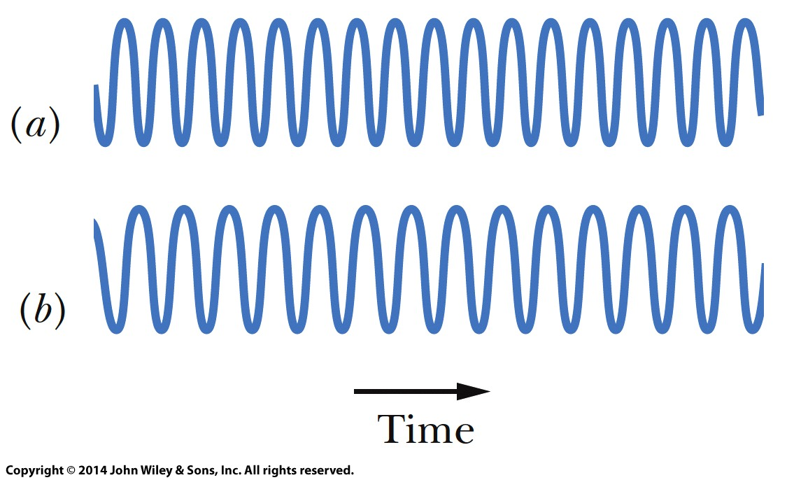
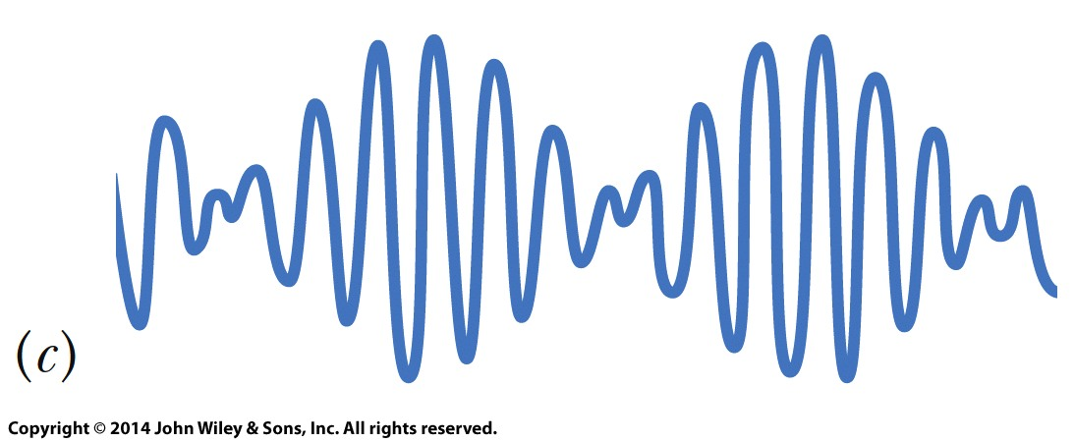
Beats
Beats arise when two waves having slightly different frequencies, ƒ₁ and ƒ₂, interfere. The beat frequency is
$$f_{beat}=f_{1}−f_{1}$$
One can think of this as the waves moving slowly in and out of phase because their frequencies are close.
Do demo 3B60.13 - Beats - Organ Pipes

Slide 12
Beats
A guitar string produces 4 beats/s when sounded with a 250 Hz tuning fork and 9 beats per second when sounded with a 255 Hz tuning fork. What is the vibrational frequency of the string?
a) 246 Hz
b) 240 Hz
c) 259 Hz
d) 254 Hz
e) 263 Hz

Slide 13
Interference
Two identical speakers are emitting a constant tone that has a wavelength of 0.50 m. Speaker A is located to the left of speaker B. Where should you put your ear to hear silence (complete destructive interference occur)?
A) 2.00 m from speaker A and 3.00 m from speaker B
B) 2.50 m from speaker A and 1.00 m from speaker B
C) 2.15 m from speaker A and 3.00 m from speaker B
D) 3.75 m from speaker A and 2.50 m from speaker B

Slide 14
Speed of Sound
Earthquakes generate sound waves inside Earth. Unlike a gas, Earth can experience both transverse (S) and longitudinal (P) sound waves. Typically, the speed of S waves is about 4.36 km/s, and that of P waves 8.06 km/s. A seismograph records P and S waves from an earthquake. The first P waves arrive 263 seconds before the first S waves. If the waves travel in a straight line, how far away does the earthquake occur?
973 km
1147 km
2120 km
2498 km

