Slide 1
Announcements
We will do class evaluations on Wednesday, please bring a laptop.
Final is Wednesday, May 11, at 5:30-7:30 pm in the Macbride Hall Auditorium.
This is the usual place for exams, but is an hour earlier.
Prof. Kletzing is in Iowa and holding office hours.
Please contact Kletzing and Kaaret if you are taking the class under the second grade option.
Someone left an article of clothing at the last exam, please see me if it is yours.

Slide 2
Topics for Today
First Law of Thermodynamics (18-5)
Avogadro’s number (19-1)
Ideal gases (19-2)

Slide 3
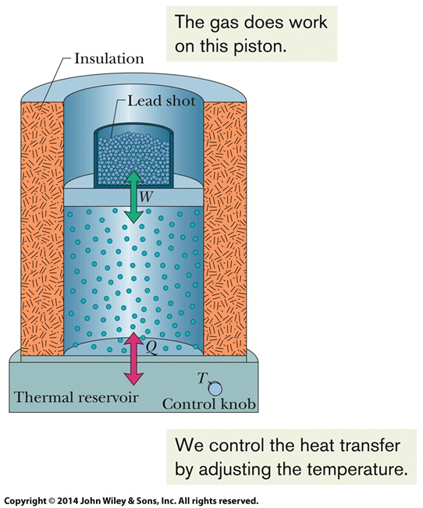
First Law of Thermodynamics
Every system has some internal energy = E.
You can change the internal energy either by adding/removing heat to/from the system (Q) or by having the system do mechanical work (W).
The first law of thermodynamics is
ΔE = Q – W
Heat added to the system (Q) increases its internal energy.
Heat removed from the system (Q) decreases its internal energy.
Work done by the system (W) decreases its internal energy.
Work done on the system (W) increases its internal energy.
In differential form: dE = dQ – dW
Do demo 4B60.10 - Work Into Heat - Lead Shot

Slide 4
First Law of Thermodynamics
Work is $dW=\vec{F}∙d\vec{s}$
Thermodynamicists are very fond of gases in pistons. For piston containing gas, the force on the piston is F = pA, where A is the area of the piston.
Work is $dW=\vec{F}∙d\vec{s}=\left(pA\right)\left(ds\right)=p\left(A ds\right)=p dV$
Change in volume = dV.
If we go from an initial volume to a final volume, the work done by the gas is $W=\int{dW=\int_{V_{i}}^{V_{f}}{p dV}}$.
Note that the pressure may vary as the volume varies.
A “process” is a particular choice of pressure versus volume.

Slide 5
First Law of Thermodynamics
We show the process as a curve on a plot of pressure versus volume.
Work $W=\int{p dV}$ is then the integral under the curve – as long as V_{i} < V_{f}
Different processes can produce different amounts of work, even if the end points are the same.

Slide 6
First Law of Thermodynamics
Work $W=\int{p dV}$ is negative if V_{i} > V_{f}
We can have a cyclic process, one that returns to the starting point, that does net work (of either sign).

Slide 7
First Law of Thermodynamics
A gas is enclosed in a cylinder by a piston. The volume of the gas is then reduced to one half its original value by applying a force to the piston. Which one of the following statements concerning the internal energy of the gas is true?
The internal energy of the gas will decrease.
The internal energy of the gas will increase.
The internal energy of the gas will neither increase nor decrease.
The internal energy of the gas will equal the work done in moving the piston.
The internal energy of the gas may increase, decrease, or remain the same depending on the amount of heat that is gained or lost by the gas.

Slide 8
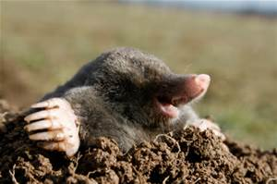
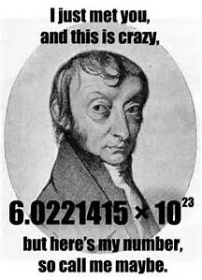
Moles
To understand the behavior of objects in terms of atoms, we need to know the number of atoms in the objects.
That number tends to be really big, rather than counting individual atoms, we count them in “moles”.
One mole is defined as the number of atoms in 12 grams of carbon 12, a particular isotope of carbon.
You then need to do experiments on grams of carbon, or some other atom, to determine what the number is.
The number is “Avogadro’s number” and has a value of $N_{A}=6.02×{10}^{23}/$mol.

Slide 9
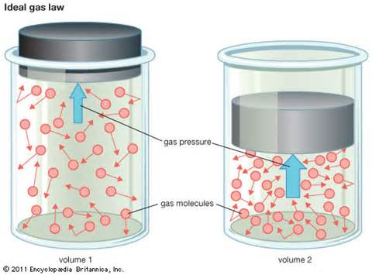
Ideal Gases
It would be nice to know the relationship between pressure (p) and volume (V).
In “ideal gas”, the molecules are like little balls – they bounce off each other but do not have any long range interactions.
The “ideal gas law” is $pV=nRT$
where n = number of moles of gas,
T = temperature (in Kelvin),
R = “gas constant” = 8.31 J/mol∙K.
Also have $pV=NkT$
where N = number of atoms of gas,
k = “Boltzmann constant” = $R/N_{A}$.

Slide 10
Ideal Gas
An ideal gas is enclosed within a container by a moveable piston. If the final temperature is two times the initial temperature and the volume is reduced to one-fourth of its initial value, what will the final pressure of the gas be relative to its initial pressure, P?
A) 8P₁
B) 4P₁
C) 2P₁
D) P₁/2
E) P₁/4

Slide 11
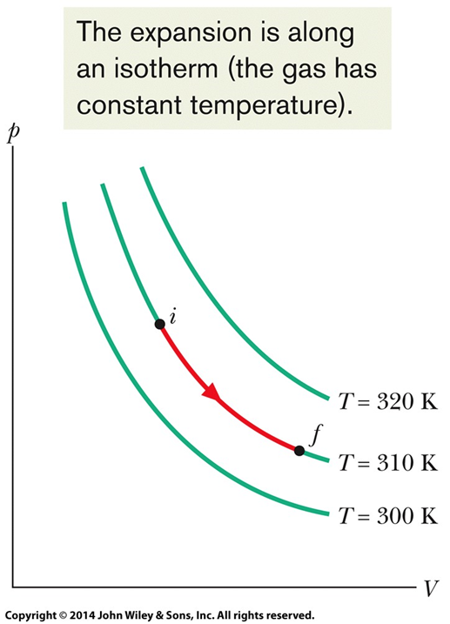
Isothermal process
“Isothermal” process = gas temperature is constant.
From the ideal gas law, $pV=nRT$= constant.
Work is
$$W=\int{p dV=\int{\frac{nRT}{V}dV=nRT}}\int{\frac{dV}{V}}$$
$$=nRT\left(\ln{V_{f}−}\ln{V_{i}}\right)=nRT \ln{\frac{V_{f}}{V_{i}}}$$
For expansion, the final volume is larger than the initial, so the ratio > 1 and work done by the gas is positive.
For compression, work done by the gas is negative.

Slide 12
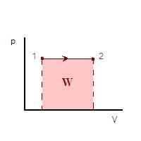
Constant pressure process
From the ideal gas law, $pV=nRT$, the temperature would need to change as the volume changes in order to keep the pressure constant.
Work is
$W=\int{p dV= p\int{dV}}$ $=p\left(V_{f}−{V_{i}}\right)$
For expansion, the final volume is larger than the initial, so the work done by the gas is positive.
For compression, the work done by the gas is negative.

Slide 13
Constant volume process
Work is
$$W=\int{p dV}$$
Constant volume means that the initial and final volumes are the same (and every intermediate volume is the same), so the integral is over an interval of zero and W = 0.

Slide 14
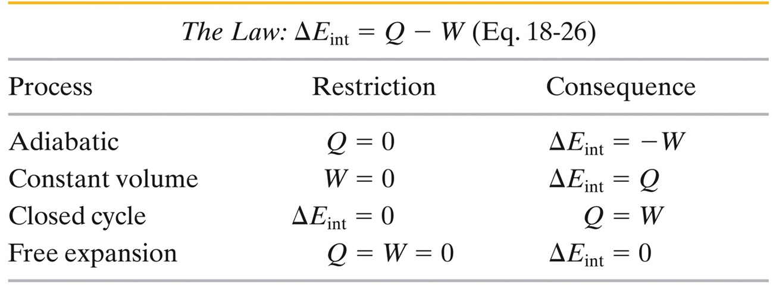
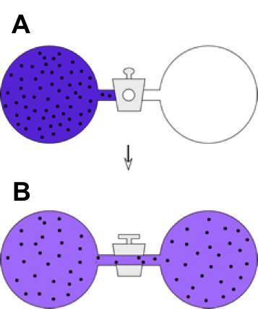
First Law of Thermodynamics
Some processes have special names.
Adiabatic = no heat transfer, either well insulated or very fast.
Closed cycle means final state = initial state, including internal energy.
Free expansion cannot be shown on a pressure-volume diagram because the pressure is not well defined during the process.

