Slide 1
029:006 — Lecture 2 Mechanics (M1) Why do things move?
Historical Perspective

Slide 2
Aristotle
350 BC
Was the final word on any scientific question
Influenced scientific thought until the end of the 17th century
Believed that the natural state of an object was to be at rest—He was WRONG!

Slide 3
Galileo 1564-1642
To understand nature, you must first observe it
He is considered the “Father of Modern Science”
Imprisoned by Pope Urban VIII in 1633 for advocating that the earth was a planet revolving around the sun (heliocentric hypothesis)
Pope John Paul II in 1992 declared that the Church was in error regarding Galileo.

Slide 4
Galileo, continued
Previous thinking, accepted for 15 centuries, held that the earth was the center of the universe (geocentric hypothesis)
Invented the first useful telescope in 1609
Discovered the rings of Saturn
He performed the first experimental studies of motion

Slide 5
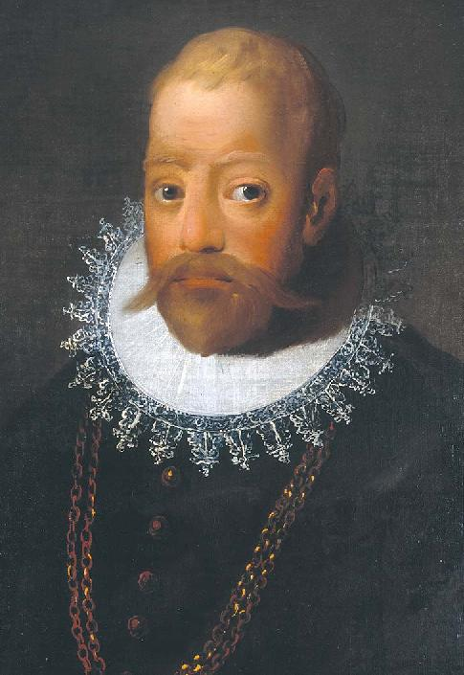
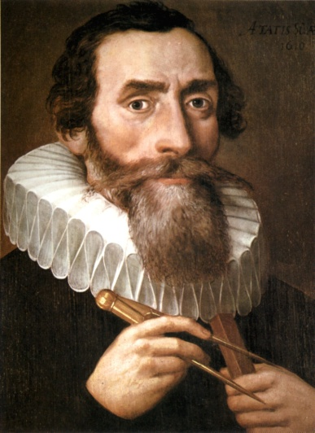
Tycho Brahe (1546-1601) and Johannes Kepler (1571-1630)
Tycho Brahe compiled the first detailed observational data on planetary motion (Mars), without a telescope! No one had previously attempted to make so many planetary observations.
T. Brahe
Johannes Kepler derived the laws of planetary
motion using the data obtained by Brahe.
J. Kepler

Slide 6
Isaac Newton
Born Jan 4, 1642
Published The Principia in 1687, considered the greatest scientific book ever written
Discovered the 3 laws of mechanics, known as Newton’s Laws
Based on the work of Kepler, he discovered the Law of Gravity

Slide 7
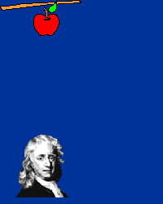
Newton, continued
Showed that the same laws that govern the fall of objects on earth also govern the motion of the planets.
Newton’s work followed directly from the experimental work of Galileo and Kepler’s analysis of the observations of Brahe
Scientific progress: Brahe→ Galileo & Kepler→ Newton

Slide 8
Why does something move?
Because nothing stops it!

Slide 9
Newton’s laws of motion
Newton’s 1st law (Galileo’s principle of inertia) “A body at rest tends to remain at rest; a body in motion tends to remain in motion.”
Newton’s 2nd law (law of dynamics) “The rate of change of the velocity of an object (i.e., its acceleration), is the net force exerted on it divided by its mass.”
Newton’s 3rd law “For every action (force) there is an equal and opposite reaction.”

Slide 10
Law of Inertia - examples
Pull the tablecloth out from under the dishes
Knock the card out from under the marble
Hoop and Pen
Knock the plate out under the egg
Hammer head
Shake the water off of your hands
The car on the air track keeps going
Homer not wearing his seatbelt
If you are at rest, you tend to stay at rest; if you are moving,
you tend to keep moving, unless something stops you.

Slide 11
Dogs use the principle of inertia!
When a dog is wet, he twists his body back and forth to shake off the water.
When the dog rotates his body in one direction, the water is set into motion.
When the dog twists the other way, the water drops keep moving in the original direction and fly off of him.
We do the same thing when we shake our hands after washing them.

Slide 12
Galileo’s principle of Inertia
A body at rest tends to remain at rest
A body in motion tends to remain in motion
Or stated in another way:
You do not have to keep pushing on an object to keep it moving
If you give an object a push, and if nothing tries to stop it, (like friction) it will keep going
The “natural state” of an object is not rest

Slide 13
Ice Hockey

Slide 14
Physics and Ice Hockey
No force is needed to keep the puck moving
forward after it leaves the player’s stick.

Slide 15
What is inertia?
All objects have it
It is the tendency to resist changes in velocity
if an object is at rest, it stays at rest
if an object is moving, it keeps moving
Mass is a measure of the inertia of a body, in units of kilograms (kg)= 1000 grams
Mass is NOT the same as weight !

Slide 16
Bart is on the moving train and then jumps straight up on the moving train
will he land:
1) on the ground, or
2) on the train?
Bart maintains his forward motion even as he jumps up. He lands on the train.

Slide 17
Other examples
Having a catch on a plane, bus or train
Throwing a ball up and down while walking
Dribbling a basketball while running

Slide 18
Refined Law of Inertia
No force (push or pull) is needed to keep an object moving with constant velocity
Constant velocity- moving in a straight line with constant speed
No stopping or turning
Note that a body at rest has
a constant velocity of zero

Slide 19
Concepts: speed and velocity
Speed: How fast am I going?
measured in miles per hour (mph),
kilometers per hour (km/h), feet per second (ft/s), meters per second (m/s), . . .

Slide 20
Velocity includes speed and direction
Velocity includes information both about the speed (magnitude) and direction, not only how fast, but also in what direction
It is what we call a vector quantity – one having both magnitude and direction
Formula to calculate the magnitude

Slide 21
Example
The average human can walk at 5 km/hr [1 kilometer (km) = 1000 m]. If a person walks at this rate for half a day, how far would he or she travel?
Answer Since v = d / t, then d = v  t d = v  t = 5 km/hr  12 hr = 60 km

Slide 22
Position vs. time plots
v = d / t
Case A: speed is
20 m/10 s = 2.0 m/s
Case B: speed is
10 m/10 s = 1.0 m/s
Case C: speed is
5 m/10 s = 0.5 m/s

Slide 23
EXAMPLE
distance (meters)
6 m
3 m
0
0 1 2 3 4 5 6
time (seconds)
t = 0 to t = 1 s → velocity = 3 m / 1s = 3 m/s
t = 1 s to t = 3 s → velocity = 0 m/s (at rest)
t = 3 s to t = 6 s → velocity = 3 m / 3 s = 1 m/s

