Slide 1
L-3 Gravity and Free Fall
Review – Principle of inertia (Galileo)
Inertia: the tendency of objects to resist changes in motion.
  If an object is at rest, is stays at rest.
  If an object is moving with constant velocity, it continues moving with constant velocity unless something stops it.
The inertia of an object is measured by its mass in kilograms (kg) – the quantity of matter in it.

Slide 2
Forces can change velocity
No force is required to keep an object moving with constant velocity.
acceleration is a change in velocity
A net force must be applied to an object to produce an acceleration
For example:
  If an object is at rest, you must push it to get it to move
  If it is moving, a force must be applied to stop it, e.g., friction, air resistance

Slide 3
The force of gravity
We will first consider a common force that can accelerate an object: gravity
As an object falls its velocity constantly increases; the velocity of an object thrown upward constantly decreases as it rises
The force of gravity depends on the mass of the object
Gravity keeps us on Earth, the Moon in its orbit, and the Earth in orbit around the Sun; gravity holds the Universe together.

Slide 4
Weight and gravity
All objects exert an attractive force on each other – Newton’s Universal Law of Gravity
Your weight is the attractive force that the earth exerts on you → it is what makes things fall!
All objects are pulled toward the center of the earth by gravity.
The Sun’s gravity holds the solar system together.
It is a non-contact force→ no touching required!

Slide 5
Newton’s Law of Gravity
Sun
Earth
the force of gravity depends on how large the masses are ➔ big M’s ➔ big force,
and, how far apart they are, the closer the masses are ➔ the bigger the force
Since we are closer to the Earth than to the Sun, our gravitational force is mainly due to the Earth

Slide 6
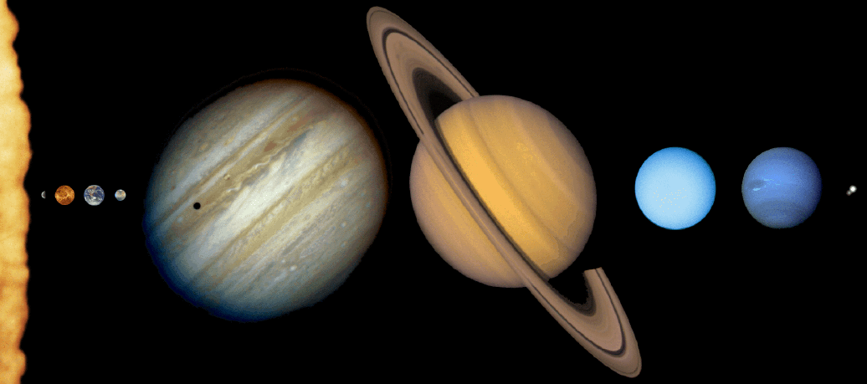
The Sun is the most massive object in the solar system, about 3 million times the Earth’s mass, and 1000 times more massive than the most massive planet - Jupiter.
THE SOLAR SYSTEM
SUN
Uranus
Pluto
Mars
Mercury Venus Earth Jupiter Saturn Neptune

Slide 7
A little astronomy
The planets revolve around the sun in approximately circular paths (Kepler)
The further the planet is from the sun the longer it takes to go around (Kepler)
  the time for a planet to go completely around the sun is a year
  the earth spins on its axis once every day
  the moon revolves around the earth about once every month

Slide 8

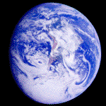



What does your weight depend on?
The weight w of an object depends on its mass and the local strength of gravity- we call this g
g is the acceleration due to gravity
Wherever you are on the earth, it pulls you with a force that points to the center of the earth

Slide 9
What is this thing called g?
g is something you often hear about, for example you might hear that a fighter pilot experiences
2 g’s when turning his jet.
g is the acceleration due to gravity
When an object falls its speed increases as it descends; the speed of a rising object decreases as it ascends
g is the amount by which the speed of a falling object increases each second – about 10 meters per second each second or 10 m/s²
A more precise value for g is 9.80665 m/s², but we will use g ≈ 10 m/s² in this course

Slide 10
Example – a falling object
time | velocity
0 s | 0 m/s
1 s | 10 m/s
2 s | 20 m/s
3 s | 30 m/s
4 s | 40 m/s
5 s | 50 m/s
+ 10 m/s
Change in velocity, or
acceleration
≈10 m/s/s
or, 10 m/s²
+ 10 m/s
+ 10 m/s
+ 10 m/s
+ 10 m/s

Slide 11
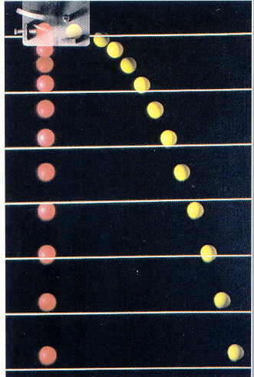
Snapshots of a falling ball taken at equal time intervals
Ball starts falling here from rest
the ball falls through larger distances for each
second that it descends
red arrows are velocity
green arrows are
displacement

Slide 12
How to calculate weight
Weight (w)
= mass (m) x acceleration due to gravity (g)
w = m  g = mg
Units to be used in this formula:
  m is in kilograms (kg)
  g ≈ 10 m/s²
  w is in force units called Newtons (N)
≈ means approximately equal to

Slide 13
example
Question: What is the weight of a 100 kg object?
Answer: w = m x g = 100 kg x 10 m/s² = 1000 N
One Newton is equal to 0.225 pounds (lb), so in these common units 1000 N = 225 lb
Often weights are given by the equivalent mass in kilograms. We would say that a 225 lb man “weighs” 100 kg; this is commonly done but, it is technically incorrect.

Slide 14
Compared to Earth, you weigh more on Jupiter and less on the Moon
Your mass is the same everywhere, but your weight depends on where you are, since g depends on the mass of the planet.
On the moon g ≈ 1.6 m/s² ≈ (1/6) g on earth, so your weight on the moon is only (1/6) your weight on earth
On Jupiter, g ≈ 23 m/s² ≈ 2.3 g on earth, so on Jupiter you weigh 2.3 times what you weigh on earth

Slide 15
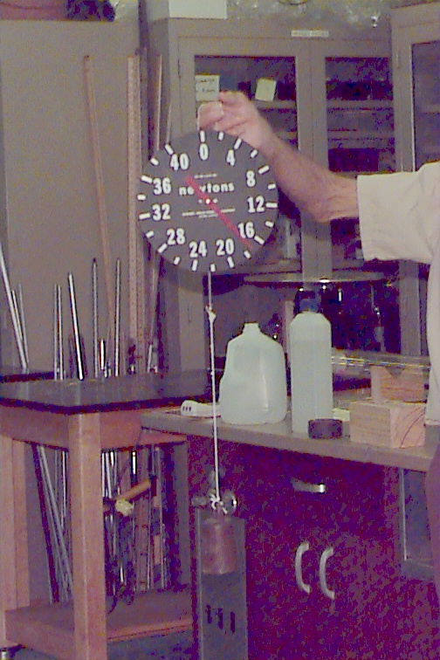
Get on the scale:
How to weigh yourself
spring
force
m
weight
mass

Slide 16
Free Fall
Galileo showed that all objects (regardless of mass) fall to earth with the same acceleration → g = 10 m/s²
This is only true if we remove the effects of air resistance. [feather and quarter]
We can show this by dropping two objects inside a tube that has the air removed,
The moon has no atmosphere, because its gravity is too weak to hold onto one [video]

Slide 17
Galileo’s experiments
m₁ m₂
Galileo showed this by dropping 2 objects of different mass, from the same height, H, and measuring how long they took to reach the ground
If H isn’t too big,
then air resistance is not a big effect
H
m₁ does not equal m₂

Slide 18
On the other hand . . .
If you drop an object from a small height it falls so quickly that it is difficult to make an accurate measurement of the time
We can show experimentally that it takes less than half a second for a mass to fall 1 meter. (demo)
Galileo did not have an accurate clock, so he reduced the effect of gravity by using inclined planes

Slide 19
Galileo used inclined planes to reduce the effect of gravity
inclined plane
h
D
h
D

Slide 20
What did Galileo learn from the inclined plane experiments?
He measured the time it took for different masses to fall down the inclined plane.
He found that different masses take the same time to fall down the inclined plane.
Since they all fall the same distance, he concluded that their accelerations must also be the same.
By using different distances he was able to discover the relation between time and distance.
To reduce the effects of friction, Galileo made the balls roll down the inclined plane

Slide 21
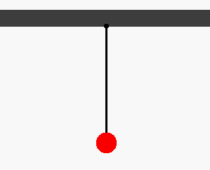
How did Galileo measure time?
Galileo used his own pulse, or a pendulum to measure time.

