Slide 1
L-6 – Newton's Second Law
Objects have a property called inertia which causes them to resist changes in their motion (Newton’s1st Law or Galileo’s law of inertia)
→ if it is at rest, it stays at rest
→ if it is moving, it keeps moving with constant velocity
forces can overcome inertia to produce acceleration (2nd Law)
Change in velocity

Slide 2
Force is a vector quantity
The effect of a force depends on both its
magnitude (strength), and its direction.
object

Slide 3
The NET Force
What really matters is the Net Force
The Net Force is what you get when all the forces are properly combined
The Net Force takes into account both how strong the forces are and in what direction they act
The Net Force determines the acceleration of the object
net force

Slide 4
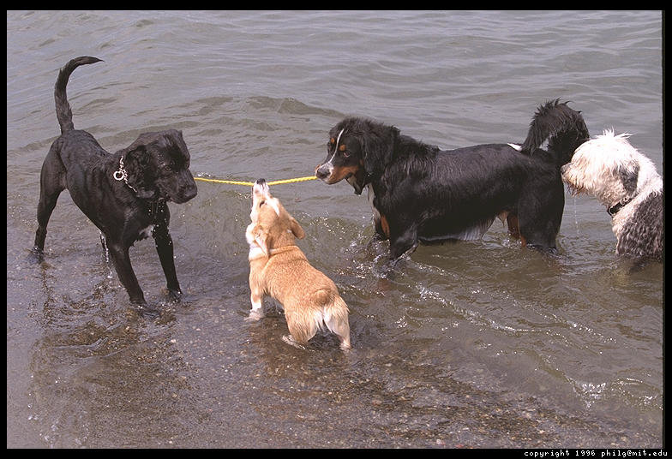
Example: Net force = 0

Slide 5

Net force = 0
An object may have many forces acting on it at the same time.
If all the forces oppose each other exactly then the net force = 0 and the object will either be at rest or move with constant velocity.
If the net force is zero and the object is at rest, this is called static equilibrium.
tension
weight

Slide 6
Skydiving: motion with constant velocity
Two forces act on a sky-diver:
  gravity (weight) and
  air resistance (drag)
The force of air resistance increases with velocity
When the air resistance equals the weight, the forces cancel, and the skydiver then falls with constant velocity called the “terminal velocity.”
air
resistance
gravity
(weight)
Without a parachute, a skydiver’s terminal speed would be greater than about 100 mph (not good for landing!)
The parachute increases the air resistance and reduces the terminal speed to about 10 mph (landing is more pleasant!)
Zero net force does not necessarily imply zero velocity

Slide 7
Newton’s 2nd Law
To change the velocity of an object a net force must be applied to it.
A push
Or a pull

Slide 8
Contact and non-contact forces
Pushes, pulls, friction, and tension are contact forces- whatever exerts the force actually touches the object
Non-contact forces: → Forces that act without contact between objects
a) electric forces
b) magnetic forces
c) gravity

Slide 9

The moon is always falling
The force of gravity acting on the moon pulls it away from the straight line path it would follow if the
Earth was not pulling on it.
MOON

Slide 10
Acceleration
Any change in velocity is acceleration
If you speed up (velocity increases), there is acceleration
If you slow down (velocity decreases) there is acceleration – we call this deceleration – putting on the brakes!
If you turn (change direction) there
is acceleration

Slide 11
You are NOT accelerating if
You are riding your bike up a hill at constant speed ( v = a constant)
You are in a parked car (v = 0)
You are in an elevator that is going up with constant speed. ( v = a constant)
You are in an elevator that is going down with constant speed. ( v = a constant)

Slide 12
You are accelerating if
You are going down a steep hill on rollerblades (your velocity increases)
In an elevator when it starts to go up (you are at rest then start moving)
In a car going around a curve at constant speed (the direction of your velocity changes)
You are on a bus that is slowing down (your velocity decreases)
you are in an elevator and the cable breaks (you will accelerate downward (good luck)

Slide 13
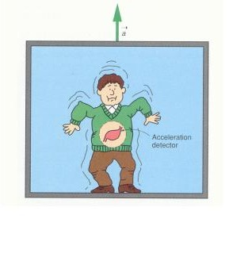
Your stomach is an acceleration detector!
The funny feeling you have when the elevator starts to go up (or down) is your stomach’s inertia resisting motion.
Your body starts going up but your stomach lags behind a bit, before it catches up!

Slide 14
Hanging mass accelerometer
Measures
acceleration
Constant velocity
Acceleration = 0
Increasing velocity
Non-zero Acceleration

Slide 15
What does it take to get it going?
m
BIG FORCE
little force
m

Slide 16
Newton’s 2nd Law
Force = mass times acceleration
F = m × a
NET Force in Newtons
(N)
Mass in
Kilograms (kg)
Acceleration in m/s²

Slide 17
Newton’s 2nd Law: F = m a
It is the law which explains how things move - dynamics
If a net force is applied to an object it will accelerate – change its velocity
It includes the law of inertia → if there is no force, F = 0, then the acceleration = 0
→ the velocity doesn’t change
→ no force is needed to keep an object moving with constant velocity.

Slide 18


The “F” in F = m a
If there is more than one force acting on an object, then F is the net force.
If two people pull on an object with equal forces in opposite directions, then the net force is zero and the acceleration is zero.
m

Slide 19
Acceleration due to gravity
w = m × g
F = m × g = m × a
weight, w
➔ a = g for all masses (Galileo)

Slide 20
Breaking the string
F₁ is applied gently to lift the weight (F₁  W, so a  0), the string does not break
A much larger F₂ is applied and the string breaks
F₂ – W = ma, so
F₂ = ma + W >> F₁
If the string is not strong enough to provide the tension, it breaks
F₁
F₂
W
W

Slide 21
Example Problem -1
Two forces act on a 4 kg object. A 14 N force acts to the right and a 2 N force acts to the left. What is the acceleration of the object?
Net force = 14 N − 2 N = 12 N (to the right)
F = m a → 12 N = 4 kg x a
→ a = 3 m/s² ➔ the object accelerates to the right at 3 m / s², in the direction of the NET force

Slide 22
Example Problem 2
Push = 10 N
2 kg
Friction force = 2 N
A 2 kg box is pushed by a 10 N force while a 2 N friction force acts on the box. What is the acceleration of the box?
Net force = 10 N – 2 N = 8 N to the right
acceleration = Force / mass = 8N / 2 kg = 4 m/s²
to the right.
➔ acceleration is in the direction of the NET Force

