Slide 1
L-9 (M-8) I. Conservation of Energy
II. Friction III. Circular Motion
Kinetic energy, potential energy and conservation of energy
What is friction and what determines how big it is?
Friction is what keeps our cars moving
What keeps us moving in a circular path?
centripetal vs. centrifugal force

Slide 2
Kinetic energy (KE)
If something moves, it has kinetic energy KE
kinetic energy is energy of motion:
  KE = ½ m v²
  units: kg m²/s² = Joules (J)
If I drive my car into a tree, the car’s KE is used to perform work on the tree to knock it over
m v

Slide 3
Work and Gravitational Potential Energy (GPE)
To lift an object, I must do work and this creates gravitational potential energy (GPE)
The work done when I lift a mass m up a distance h is, W = F s = (mg) h = mgh
  units of work: F in N, h in m, W in Joules (J)
By lifting an object a distance h, the object gains
  GPE = m g h
  m in kg, g = 10 m/s², h in m, GPE in Joules (J)
the higher I lift the object the more GPE it has
Gravitational potential energy is the energy an object has due to its position above the Earth
If the raised object is released, the GPE is converted to KE which can be used to do work
h
F
mg

Slide 4
Conservation of energy
if something has energy it doesn’t loose it
It may change from one form to another (potential to kinetic and back)
KE + PE = constant
example – roller coaster
when we do work in lifting the object, the work is stored as potential energy.
W stored as
GPE = mgh
F
h
mg
mg
W=mgh
PE regained
as KE

Slide 5
Amusement park physics
the roller coaster is an
excellent example of the
conversion of energy from
one form into another
work must first be done in
lifting the cars to the top
of the first hill.
the work is stored as gravitational potential energy
as the cars fall down the hill, GPE is converted to KE, which then propels the car up the next hill, creating PE.

Slide 6
Up and down the track
PE
PE
Total energy
Kinetic Energy
If friction is not too big the ball will get
up to the same height on the right side.
PE KE

Slide 7
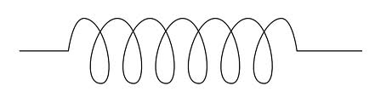
Springs have potential energy
Uncompressed spring
Work is done to compress the spring → Spring has potential energy
When released,
spring PE is given
to block as KE

Slide 8
FRICTION
Friction is a force that acts between two surfaces that are in contact
It always acts to oppose motion
It is different depending on whether or there is motion or not.
It is actually a force that occurs at the microscopic level.

Slide 9
A closer look at friction
Magnified view
of a “smooth”
surface
At the microscopic level even two smooth surfaces look bumpy → this is what produces friction

Slide 10
Static friction
If we push on a block and it doesn’t move then
the force we exert is less than the friction force.
push, P
friction, f
This is the static friction force at work
If I push a little harder, the block may still not
move → the friction force can have any value up
to some maximum value.

Slide 11
Kinetic friction
If I keep increasing the pushing force, at some point the block moves → this occurs when the push P exceeds the maximum static friction force.
When the block is moving it experiences a smaller friction force called the kinetic friction force
It is a common experience that it takes more force to get something moving than to keep it moving.

Slide 12

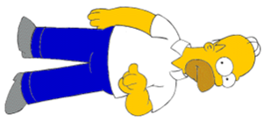
Homer discovers the hard way that kinetic friction is less than static friction!
Big heavy
box

Slide 13
Friction forces
Gravity pulls the block down the incline
Friction acts to keep the block from sliding down
At some point as the angle if the plane is increased the block will start slipping
At this point, the friction force and gravity are equal
The block then slides down with constant velocity
For larger angles, the block accelerates

Slide 14

Going in circles: centripetal force
Bart swings the tennis ball around his head in a
circle. The ball is accelerating. What force makes
it accelerate? → The tension in the string!

Slide 15
Uniform circular motion
Velocity means both the speed and direction
Uniform here means that the speed is constant as the objects goes around
The direction of v is changing constantly, so there is an acceleration a
For this type of motion we call the acceleration centripetal acceleration
R
v

Slide 16
Centripetal acceleration, a_{C}
a_{C}
R
The acceleration
points toward the
center of the circle
v

Slide 17
Centripetal acceleration and force
centripetal acceleration
  magnitude: a_{c} = v² / R
  direction: toward the
  center of the circle
since F = ma , a force is
necessary to produce this
centripetal acceleration
The force that produces the centripetal acceleration is called a Centripetal Force
In any particular situation, the source of the centripetal force must be identified.
v
a_{c}
R

Slide 18
Ball on a string
The tension in the string
provides the necessary
centripetal force to keep
the ball going in a circle.
path of ball if the string
breaks

Slide 19
Example
What is the tension in a string used to twirl a 0.3 kg ball at a speed of 2 m/s in a circle of 1 meter radius?
Force = mass x acceleration [ m × a_{C} ]
acceleration a_{C} = v² / R = (2 m/s)²/ 1 m
= 4 m/s²
force = m a_{C} = 0.3 × 4 = 1.2 N
If the string is not strong enough to handle this tension it will break and the ball goes off in a straight line.

Slide 20
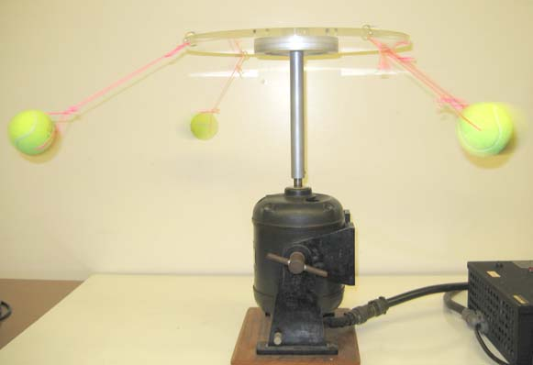
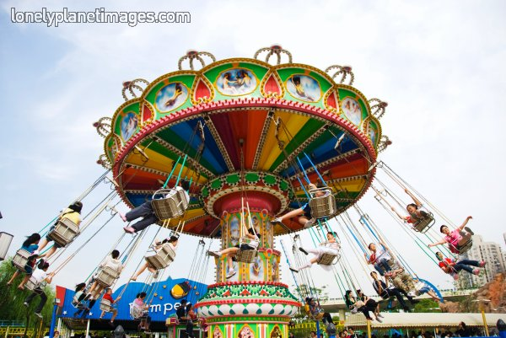
Carnival Ride
T
T_{V}
R
T_{H}
mg
There are 2 forces on the tennis ball- weight, mg and the tension, T
The vertical part of the tension force T_{V} supports the weight
The centripetal force is provided by the horizontal part, T_{H} = mv²/R

Slide 21
Going around a curve
When you drive around a curve,
you are travelling in part of a
circular path
When going around the curve
you experience centripetal
acceleration, and thus a centripetal
force is necessary to make the turn
The centripetal force is provided by the inward friction force between your tires and the road.
If the road is slippery, the friction force may be insufficient, as a result you go off the road.

Slide 22
Wide turns and tight turns
Wide turn →
Large radius
R
“tight turn” →
small radius
R
Since the centripetal acceleration is v²/R, a larger centripetal force is needed for a tight turn or a turn taken at high speed
“Safe” speeds are sometimes posted on turns

Slide 23
What is centrifugal force ?
The red object will make the turn only if there is enough friction between it and the dash, otherwise it moves in a straight line
The car actually slides out from under the object
the apparent outward force (as seen by someone in the car) is called the centrifugal force
it is NOT A REAL force! It is a fictitious force
an object will not move in a circle until something makes it!
object on
the dashboard
straight line
object naturally
follows

