Slide 1
L 13 Fluids - 2
Fluid Statics: fluids at rest
More on fluids at rest
How is atmospheric pressure measured?
Buoyancy: How can a steel boat float?

Slide 2
Review: Pressure = force per unit area
Example: A large rectangular box of mass 4.8 kg has dimensions of 2 m x 3 m x 4 m. What pressure would the box exert on the floor depending on which side it is set on?
3 m
P = F/A → The force exerted by the box on the floor is equal to its weight w = m g = 4.8 kg x 10 m/s² = 48 N. There are 3 possible values of the area A depending on which side rests on the floor:
A₁ = 2 m x 3 m = 6 m²
A₂ = 2 m x 4 m = 8 m²
A₃ = 3 m x 4 m = 12 m².
4 m
2 m
w = mg
P₁ = w/A₁ = 48 N / 6 m² = 8 N/m² = 8 Pa
P₂ = w/A₂ = 48 N / 8 m2 = 6 N/m² = 6 Pa
P₃ = w/A₃ = 48 N / 12 m² = 4 N/m² = 4 Pa

Slide 3
Pressure in a fluid increases with depth h
The pressure at the surface is
atmospheric pressure (1 atm)
= 1.01310⁵ N/m² = 1.01310⁵ Pa
≈ 10⁵ Pa
P_{o} = P_{atm}
Pressure at depth h
P(h) = P_{o} + ρ g h
ρ = density (kg/m³)
≈ 1000 kg/m³ for water
ρ g h ≈ 1000 x 10 x h = 10⁴ h
h
P(h)
Density = Mass/Vol. = ρ

Slide 4

DEMONSTRATION
Since the pressure increases with depth, the speed of the water leaking from the bottom hole is larger than that from the higher ones.
P₁
P₂ > P₁
P₃ > P₂

Slide 5
Pressure depends only on depth
P = P_{o} = 1 atm ≈ 10⁵ Pa
10 m
P = P_{o} + P_{o}= 2 atm ≈ 2 x10⁵ Pa
20 m
10 m
P = P_{o} + 2P_{o}= 3 atm ≈ 3 x10⁵ Pa
All 3 objects experience same pressure

Slide 6
Pressure is always perpendicular to the surface of an object
Pressure has the same value in all directions

Slide 7
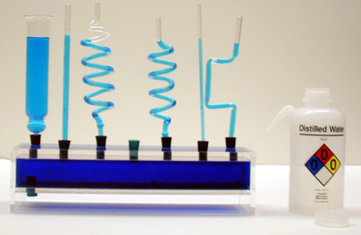
Pascal’s Vases
The fluid levels are the same in all each tube irrespective of their shape

Slide 8
Barometer measures atmospheric pressure
Inverted closed
tube filled with
liquid
The column of liquid is
held up by the pressure
of the liquid in the tank.
P_{liquid} ≈ P_{ATM} at surface,
➔ the atmosphere holds the liquid up.
P_{ATM}
P_{ATM}
P_{liquid}

Slide 9
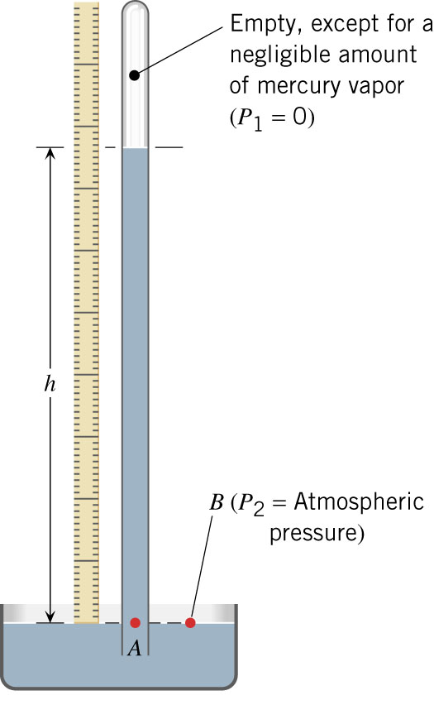
Barometric pressure
Atmospheric pressure can support a column of water 10.3 m high, or a column of mercury (which is 13.6 times as dense as water) 30 inches high → the mercury barometer
Today’s Weather

Slide 10
Pascal’s Principle
If you apply pressure to an enclosed fluid, that pressure is transmitted equally to all parts of the fluid
If I exert extra pressure on the fluid with a piston, the pressure in the fluid increases everywhere by that amount
Cartesian diver
W

Slide 11
Pascal’s Principle
A change in pressure in an enclosed
Fluid at rest is transmitted undiminished
to all points in the fluid
5 kg
W = 10 N
W = 50 N
1kg
area 1 m²
area 5 m²
h
h

Slide 12
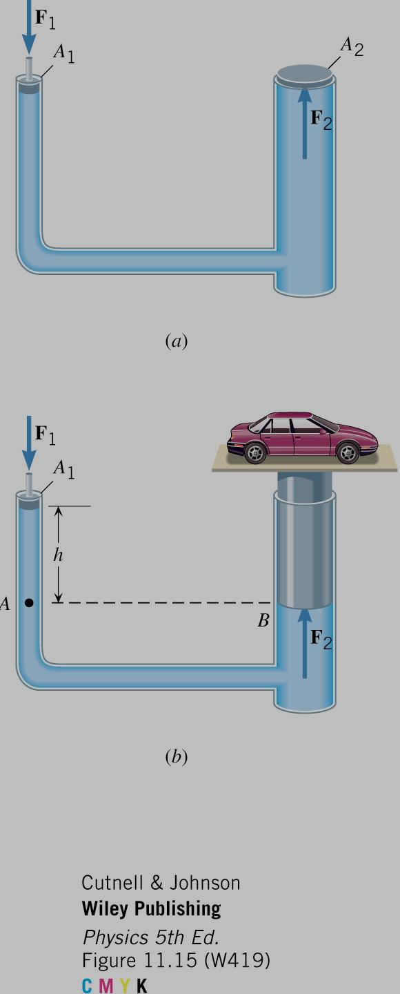
A hydraulic car lift
Pressure is F / A
At the same depth the pressures are the same
so F₁ /A₁ = F₂ /A₂, or
with a little force you can lift a heavy object!
the jack

Slide 13
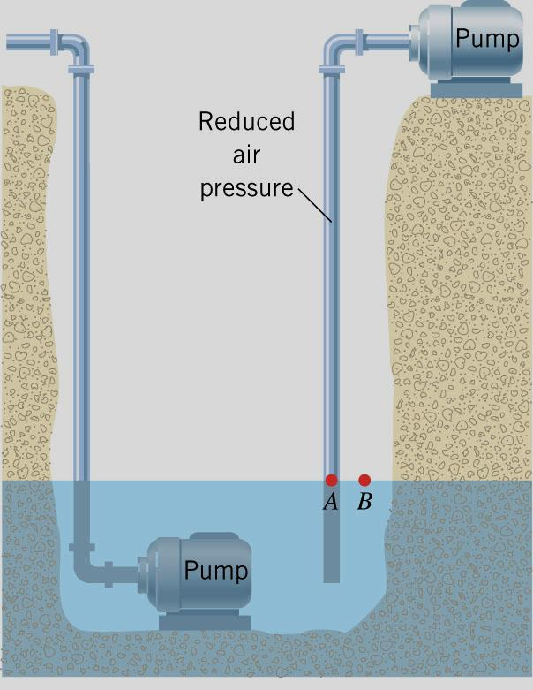
Water pumps and drinking straws
A ground level pump can only be used to cause water to rise to a certain maximum height since it uses atmospheric pressure to lift the water
for deeper wells the pump must be located at the bottom
When you use a straw, you create a vacuum in your mouth and atmospheric pressure pushes the liquid up

Slide 14
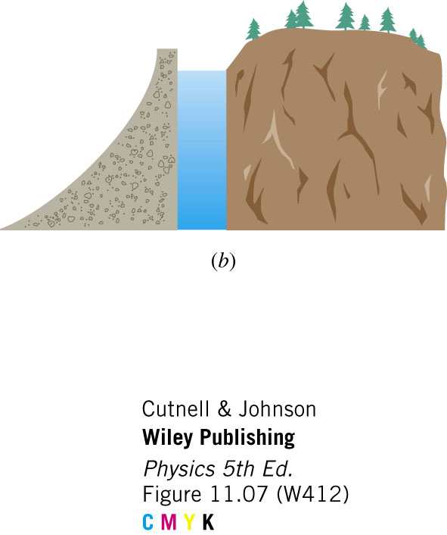
Pressure depends only on depth
Dam
The pressure at the bottom of the lake is higher than at the top
The dam must be thicker at its base
The pressure does not depend on how far back the lake extends

Slide 15
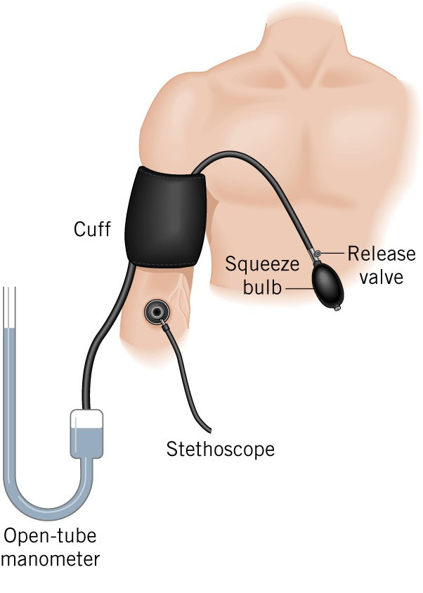
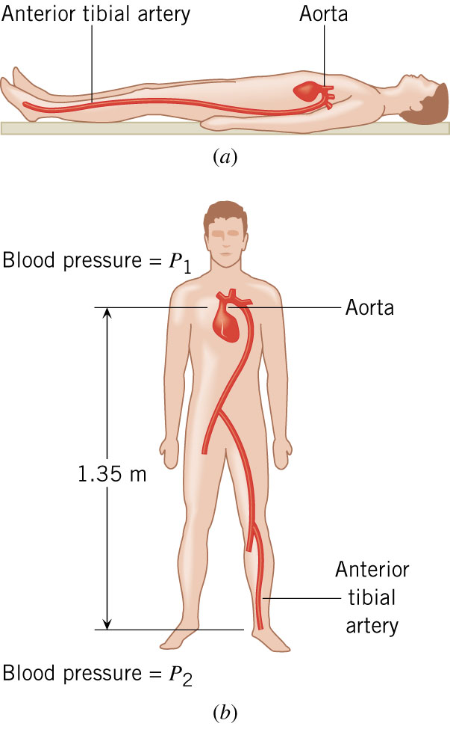
Blood Pressure
Sphygmomanometer
The blood pressure in your feet can be greater than the blood pressure in your head depending on whether a person is standing or reclining

Slide 16
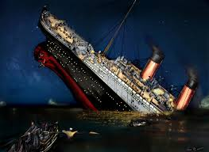
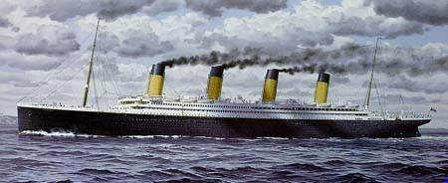
Buoyancy – why things float
TITANIC
The trick is to keep the water on the outside, and
avoid hitting icebergs (which also float), which
are not easily seen, since 90% of it is submerged
The hole in the Titanic hull was only about 1 m²

Slide 17
Buoyant Force
submerged object
that has a mass
density ρ_{O}
The density of the
water is ρ
P_{Top}A
F = P ⋅ A
h
P_{Bottom}A
W

Slide 18
Buoyant force
The water pushes down on the top of the object, and pushes up on the bottom of the object
The difference between the upward force and the downward force is the buoyant force F_{B}
since the pressure is larger on the bottom the buoyant force is UP
There is a buoyant force even if the object does not float

Slide 19

Archimedes principle
♦ The buoyant force on an object in a fluid equals
the weight of the fluid which it displaces.
♦ Anything less dense than water will float in water
♦ water weighs 10 N/liter➔ each liter of displaced water
provides 10 N of buoyant force
  this works for objects in water
  helium balloons (density of He = 0.18 kg/m³)
  hot air balloons → the density of hot air
  is lower than the density of cool air so
  the weight of the cool air that is displaced
  is larger than the weight of the balloon

Slide 20
Will it float?
The object will float if the buoyant force is enough to support the object’s weight
The object will displace just enough water so that the buoyant force = its weight
If it displaces as much water as possible and this does not match its weight, it will sink.
Objects that have a density less than water will always float in water, e.g., oil
A steel bolt will float in mercury (ρ = 13.6 g/cm³)

Slide 21
Floating objects
lighter object
heavier object

Slide 22
Oil Tankers
empty
tanker
full
tanker

Slide 23
example problem
An object having a volume of 6 liters and weighing W = 30 N is placed in a tank of water. What will happen? Will it sink? Will it float? What fraction of its volume will be submerged if it floats?
If the object were completely submerged, the buoyant force would be
F_{B, max} = 10N/liter x 6 liters = 60 N
thus, the object will float with half of its volume submerged, so that F_{B} = W = 30 N
W
F_{B}

Slide 24
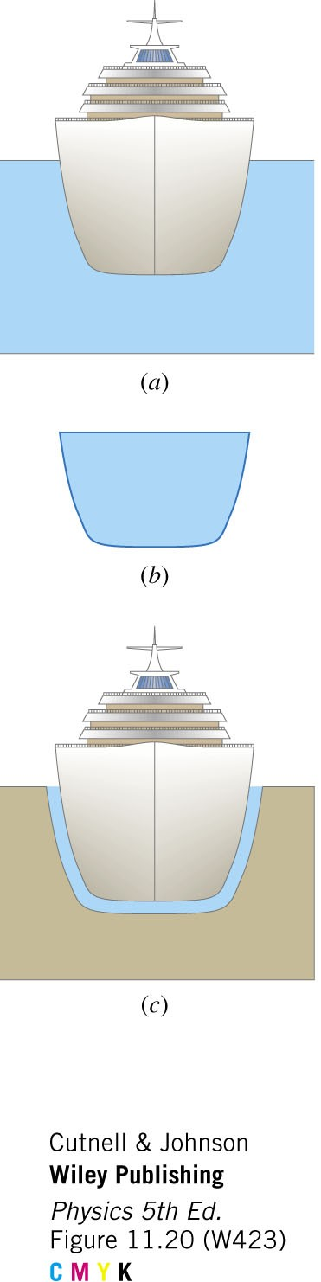
Floating in a cup of water
Only a thin layer of
water around the hull
is needed for the ship
to float!

