Slide 1

L-14 Fluids - 3
Fluids at rest → Fluid Statics
  Why things float ➔ Archimedes’ Principle
Fluids in Motion → Fluid Dynamics
  Hydrodynamics
  Aerodynamics

Slide 2
Example: What does 1 liter (about a quart) of water weigh?
1 liter = 1000 cm³
Density of water = 1 g/cm³ = 1000 kg/m³
Mass of 1 liter of water
= 1 g/cm³ x 1000 cm³ = 1000 g = 1 kg
W = mg = 1 kg x 9.8 m/s² = 9.8 N (≈ 10 N)
= 2.2 pounds (1 gallon → 8 pounds)
Water weighs about 10 N/liter

Slide 3
Archimedes principle
A
h
F_{B}
W_{O}
♦ The buoyant force on an object in a fluid equals
the weight of the fluid (e.g., water) which it displaces.
♦ Anything less dense than water will float in water
♦ water weighs 10N/liter➔ each liter of displaced water
provides 10 N of buoyant force

Slide 4
Will it float?
The buoyant force is always there whether the object floats or not
The object will float if the buoyant force is big enough to support the object’s weight
The object will displace just enough water so that the buoyant force = its weight
If the object is completely submerged, and the weight of the displaced water is less than the weight of the object, the object will sink
Objects that have a density less than water will float- when fully submerged, they weigh less than the water, so the water supports them
An object will float in a liquid that is denser than it;
➔ a steel bolt will float in mercury

Slide 5
Floating or sinking objects
lighter object
heavier object
too heavy
The weight of displaced
water is less than the
weight of the object

Slide 6
Oil Tankers
empty
tanker
full
tanker

Slide 7
example problem
An object having a volume of 6 liters and weighing W = 30 N is placed in a tank of water. What will happen? Will it sink? Will it float? What fraction of its volume will be submerged if it floats?
If the object were completely submerged, the buoyant force would be
F_{B, max} = 10 N/liter x 6 liters = 60 N
thus, the object will float with half of its volume submerged, so that F_{B} = W = 30 N
W
F_{B}
7

Slide 8
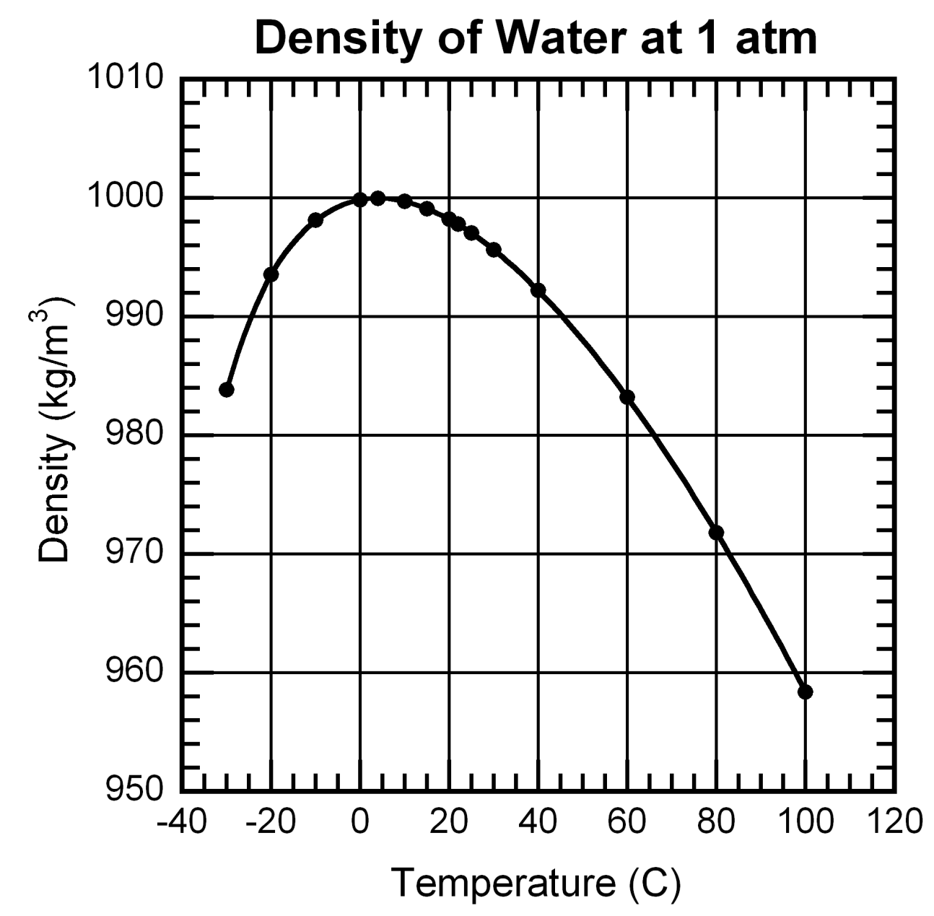
Water is weird stuff!
The pressure of
expanding ice can
break steel pipes.
VIDEO
Maximum density at T = 4 C

Slide 9
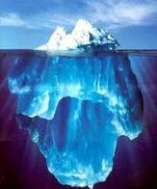
Why does ice float?
Water, the most plentiful
substance on earth is also
one of the most unusual in
its behavior in that it
expands when it freezes.
Since it expands, the density of ice is slightly less than the density of water (958 kg/ m³ as compared to 1000 kg/ m³ for water). So the part of the iceberg above the surface contains less than 10 % of the total volume.

Slide 10
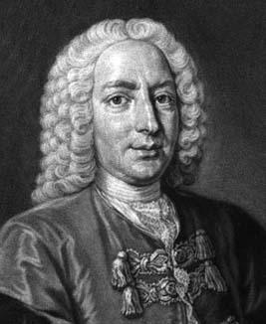
Fluid Flow → fluid dynamics
A Swiss mathematician,
born in 1700.
He applied the laws of mechanics to the problem of fluid flow
He developed the basic principle that explains, for example, how airplanes work
Daniel Bernoulli

Slide 11

How do we measure fluid flow?
We can time how long it takes to fill a bucket, say 30 seconds
the flow rate is then 1 bucket say per 30 seconds
in other words, the flow rate is volume of fluid per unit time
gallons per min (gpm), liters/s, cubic feet per min (cfm),
or m³/s
➔ Q_{V} = volume flow rate

Slide 12
Volume flow rate → Q_{V}
If the water comes out of a tube of cross sectional area A with a flow speed u the volume flow rate = Q_{V} = u × A (m/s ×m²)
To measure u just see how long it takes to fill a gallon jug from a hose and measure the diameter of the hose.
u
m³/s

Slide 13
Mass flow rate → Q_{m}
We could also measure how much mass comes out per unit time – kg/s for example
if you are using a fluid of density ρ coming out of a hose of cross sectional area A with speed v the mass flow rate is
mass flow rate = Q_{m} = ρ × u × A = ρ Q_{V}

Slide 14
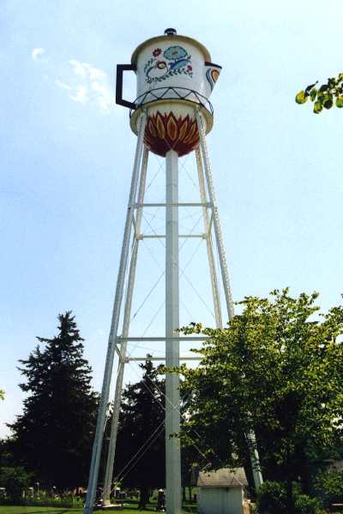
What makes water flow?
gravity
by placing the water up high, the pressure at the bottom is high enough to supply water to all parts of town that are lower than the tower
Stanton, IA
Montgomery Co. Pop. 680

Slide 15
Pressure differences
P₂
P₁
Water experiences a resistance to flow
a pressure difference must be maintained across the ends of the pipe to push the water along → P₂ must be greater than P₁
this pressure difference can maintained by a water pump

Slide 16
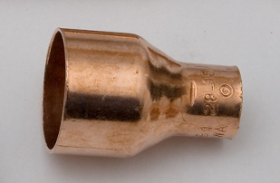
Water does not disappear!
If water goes in one end of a pipe it must come out the other end (if there are no leaks). Sounds obvious, but it has a number of interesting consequences!
This applies to pipes that have constrictions
v₁, A₁
v₂, A₂

Slide 17
Principle of the continuity of flow
since whatever goes in must come out, we have that the incoming flow rate – outgoing flow rate or, Q_{V1} = Q_{V2}
➔ v₁ A₁ = v₂ A₂ (continuity principle)
thus the fluid in the narrow part of the tube must flow FASTER that the fluid on the left.
Cardiologists use this to determine if arteries might be clogged.

Slide 18
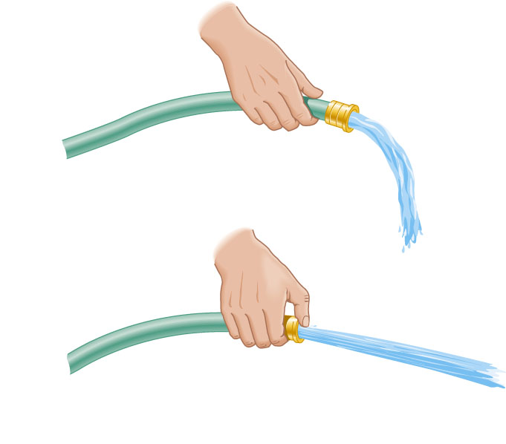
Other examples - the nozzle effect
you use this principle whenever you hold your finger over the end of the hose to make the water spray farther.

Slide 19
An amazing thing about moving fluids
The pressure in a moving fluid is less than the pressure in a fluid at rest → this is Bernoulli's Principle
Where a fluid moves faster its pressure is lower, where it moves slower, its pressure is higher
As we will see, this is the principle that allows airplanes to fly

Slide 20
You can demonstrate Bernoulli’s principle with a sheet of paper!
low pressure
High pressure
Sheet of
paper

Slide 21
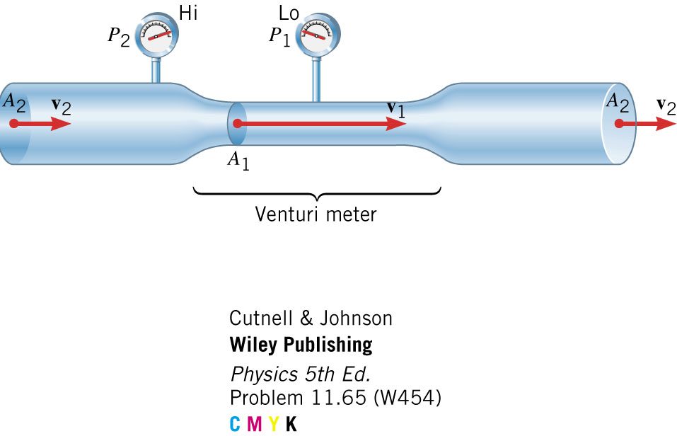
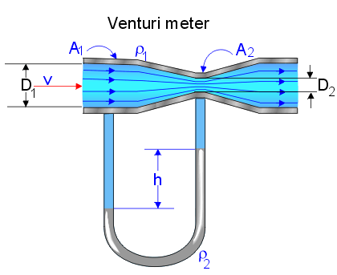
The Venturi Meter
Pressure is lower in the right lube because
the air moves faster there, so the liquid rises

Slide 22
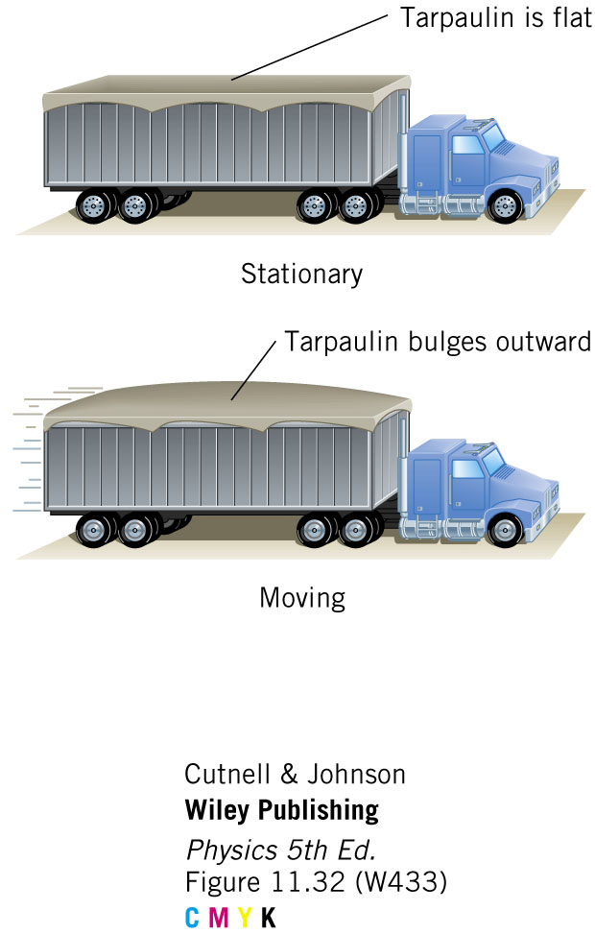

Slide 23

Atomizers (perfume spritzers)
Using the Bernoulli effect,
fine droplets of liquid are
formed with this device

