Slide 1
L 16 Thermodynamics-1
This unit deals with one of the most practical aspects of everyday life – how we use energy
We do not create energy, but transform it from one form into another
These transformations should be done as efficiently as possible, since natural resources are limited
These issues include science, but political and economic considerations as well

Slide 2
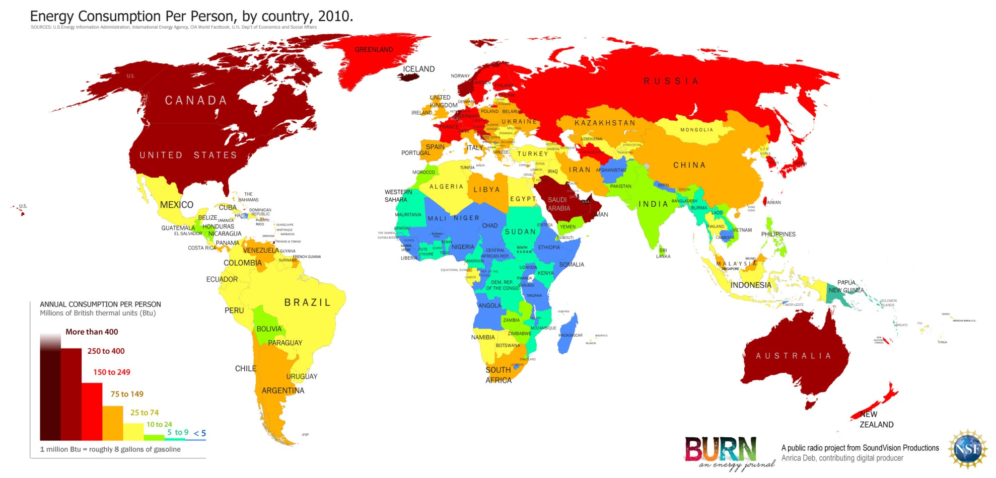
World Energy Consumption 2010

Slide 3
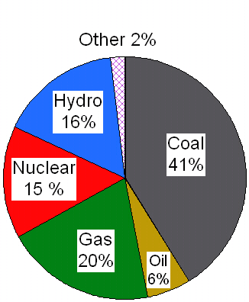
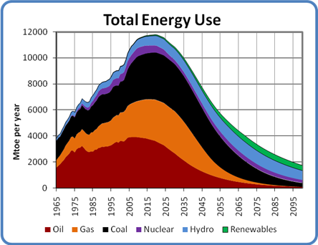
Energy use by source
Existing energy sources must be used more efficiently
New energy sources must be developed

Slide 4
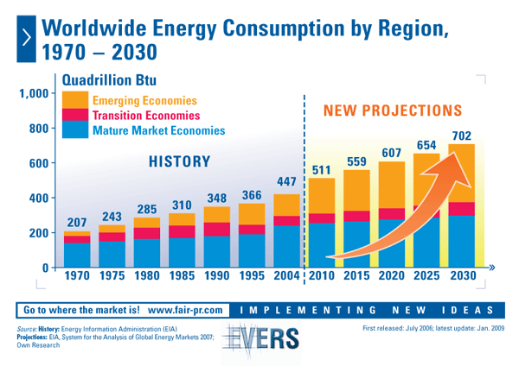

Slide 5
THERMODYNAMICS
The science dealing with heat, work and energy
The study of heat energy and its transformation into mechanical energy.
Is a set of a few basic empirical
(based on observations) rules that place limits of how these transformations can occur, and how efficiently they can be carried out.

Slide 6
Some of the topics we will cover
What is temperature?
How is it measured?
What is heat?
What is internal energy?
What is the difference between internal energy, temperature, and heat?
Applications: engines, refrigerators, air conditioners, human body, electric power production systems, the atmosphere

Slide 7
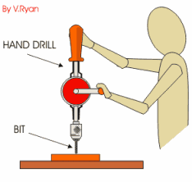
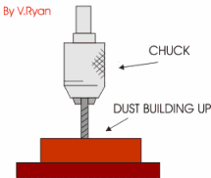

Work and Heat produce same effect
A drill bit gets very hot when drilling a hole
metal in contact with a grinding wheel gets hot
You can also get the bit or the metal hot by placing it in a torch
Is there a difference in the outcome?
the difference between work and heat must be made clear
Grinding wheel

Slide 8
“Engines”
Any device which uses heat to do work
Steam engine, internal combustion engine
Burn fuel → boil water (steam) → push piston (work)
Hero’s
engine
steam
steam
HEAT

Slide 9
Human engine
The human body is an engine.
Food in → metabolism → work out
Energy in → → Energy out
We are all subject to the laws of thermodynamics
BODY
ENGINE

Slide 10
Engine efficiency
Energy
in ($$$)
Work
out
Engine
Work out
Efficiency =
Energy in
If we convert all of the energy taken in to work the efficiency would be 100%
Are there limits on the efficiency?

Slide 11
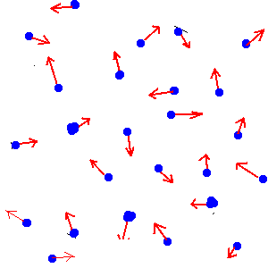
Internal energy
All systems have internal energy-- U
The internal energy U is the sum of the energy of all the molecules in the system
For example - in a gas the molecules are in random motion, each molecule has kinetic energy = ½ m v²
If we add up all the kinetic energies of all the molecules we get the internal energy of the system:
U cannot be measured directly
Is there a parameter that can be measured that represents U ?
Box containing N molecules
all moving around randomly

Slide 12
Internal energy and temperature
in a gas the molecules
have energy because
they are moving.
the sum of all the energies of all the molecules is the system’s internal energy
the temperature of the system is a measure of the average kinetic energy of the atoms,
Temperature ➔ Average Kinetic Energy

Slide 13
Temperature and Internal Energy
Temperature, T, measures the average kinetic energy (KE) of the molecules
The internal energy, U, is the total energy of all of the molecules
T₁ = T₂ = T₃
U₃ > U₂ > U₁
50° C
50° C
50° C
1
2
3

Slide 14
What is heat?
System A
at temp T_{A}
System B
at temp T_{B}
Heat is the energy that flows from one system to another because of their temperature difference.
Heat stops flowing when the two systems come to the same temperature.
Heat was first thought to be an actual fluid (caloric), but it is not a fluid- it is energy!

Slide 15
Work can change internal energy
When one object is rubbed against another, work is done and heat is produced
When a gas is compressed its internal energy is increased; when it expands, its internal energy decreases
The internal energy of a system can change if work is done on the system or heat is transferred to it. (1st Law of Thermo.)

Slide 16
How is temperature measured?
We use the fact that the properties of materials change with temperature
For example:
    Metals expand with increasing temp
    Length of liquid column expands (DEMO)
    Electrical resistance changes
    Pressure of a gas increases with temperature
    Infrared emission from objects changes color
These devices will be discussed in the next lecture.

Slide 17
Length of a mercury column
The length of the Hg column increases with temperature
How is the thermometer calibrated?
→ temperature scales
  Fahrenheit
  Celsius (centigrade)
  Kelvin
Mercury
column
Mercury
reservoir

Slide 18
Temperature scales: based on freezing and boiling points of water
Celsius
scale
Fahrenheit
scale
boiling
point
100°
212°
100°
180°
freezing
point
0°
32°

Slide 19
Centigrade & Fahrenheit scales
Scales are offset ( 0 °F is not 0°C)
Celsius scale is compressed compared
to the Fahrenheit scale, 1°C ≠ 1°F
1°C = 180/100 = 9/5 °F
Conversion formulas:

Slide 20
Examples
1) What is the temperature in C if the temperature is 68°F?
T_{C} = (5/9) ×(T_{F} – 32 ) = (5/9)×(68 – 32)
= (5/9) × (36) = 20°C
2) What is the temperature in F if the temperature is – 10 °C?
T_{F} = (9/5 × T_{C}) + 32 = (9/5 × – 10) + 32
= – 18 + 32 = 14°F

Slide 21
Absolute zero – as cold as it gets!
There is nothing particularly significant about
0°C or 0°F.
Is there a temperature scale where 0 really is ZERO – the lowest possible temperature?
YES – It is called the KELVIN scale.
It doesn’t get any colder than 0 K!
At zero Kelvin, all molecular motion stops.
We can see this from the behavior of gases,
where pressure decreases with temperature.

Slide 22
Approaching absolute zero
GAS A
Gas Pressure
GAS B
GAS C
°C
273.15 °C
As a gas is cooled, its pressure decreases
The P vs. T plot extrapolates to a temperature of
- 273.15 C for all gases, this is absolute zero
T_{K} = T_{C} + 273.15° ≈ T_{C} + 273°
One degree K = one degree C
There are no negative Kelvin temperatures

