Slide 1
L 18 Thermodynamics [3]
Heat transfer processes
  convection
  conduction
  ➔ radiation
Physics of the atmosphere
  the ozone layer
  Greenhouse effect
  climate change

Slide 2
Thermodynamics- review
Thermodynamics is the science dealing with heat, work, and energy and the trans-formation of one into the other
  Heat is disordered energy – random motion of molecules
  Work is ordered or organized energy
The laws of thermodynamics are a set of empirical (based on observations) rules that place limits on the transformations

Slide 3
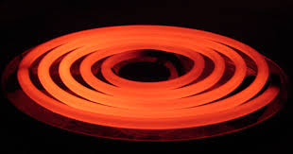
→ radiation
Heat as moving light
Radiation emitted
by a heating element
heat can be transferred by the emission of electromagnetic waves – thermal “light waves”, invisible to our eyes
thermal radiation is a small part of the electromagnetic spectrum – called infrared radiation
waves are characterized by their frequency or wavelength
different colors in the visible correspond to different wavelengths from red to blue

Slide 4
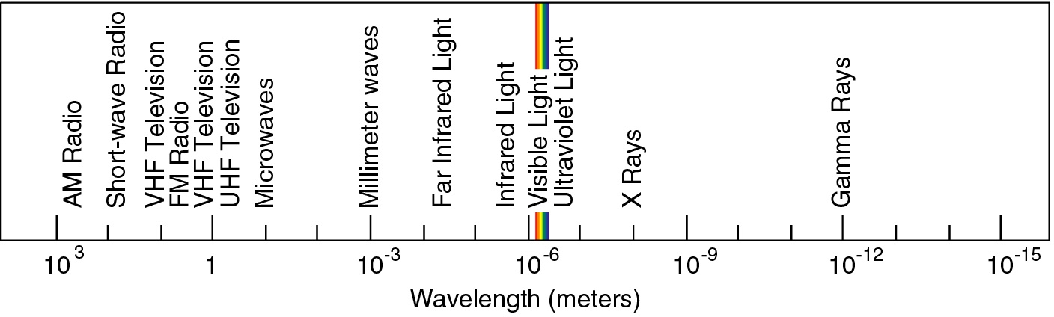
electromagnetic spectrum
microwaves,
cell phones
thermal
radiation
TV
visible
radio
waves
x-rays

Slide 5
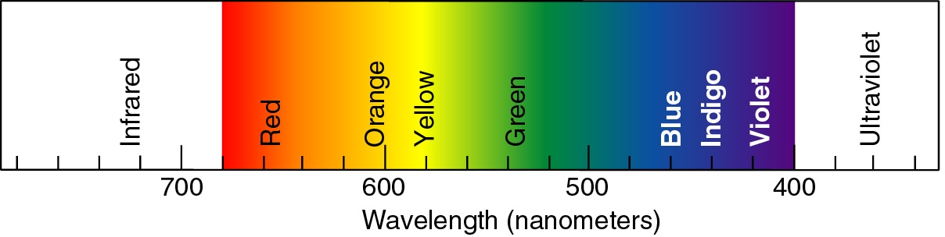
visible electromagnetic waves: LIGHT
shorter wavelength ➔ more energy
visible light
thermal
radiation
UV radiation
produces sunburn

Slide 6
What produces thermal radiation?
All objects whose temperature is above absolute zero emit thermal radiation
We continuously emit thermal radiation and absorb it from objects and people around us
If we just emitted radiation we would eventually cool to absolute zero!
The rate (J/s or Watts) at which thermal energy is radiated is given by P_{radiation} = σ e A T⁴, where σ is a constant, A is the area of the object, T is its temperature in K, and e is a number between 0 and 1 called the emissivity (poor emitters have a small value of e and good emitters have e  1.

Slide 7

Emission and Absorption are balanced

Slide 8
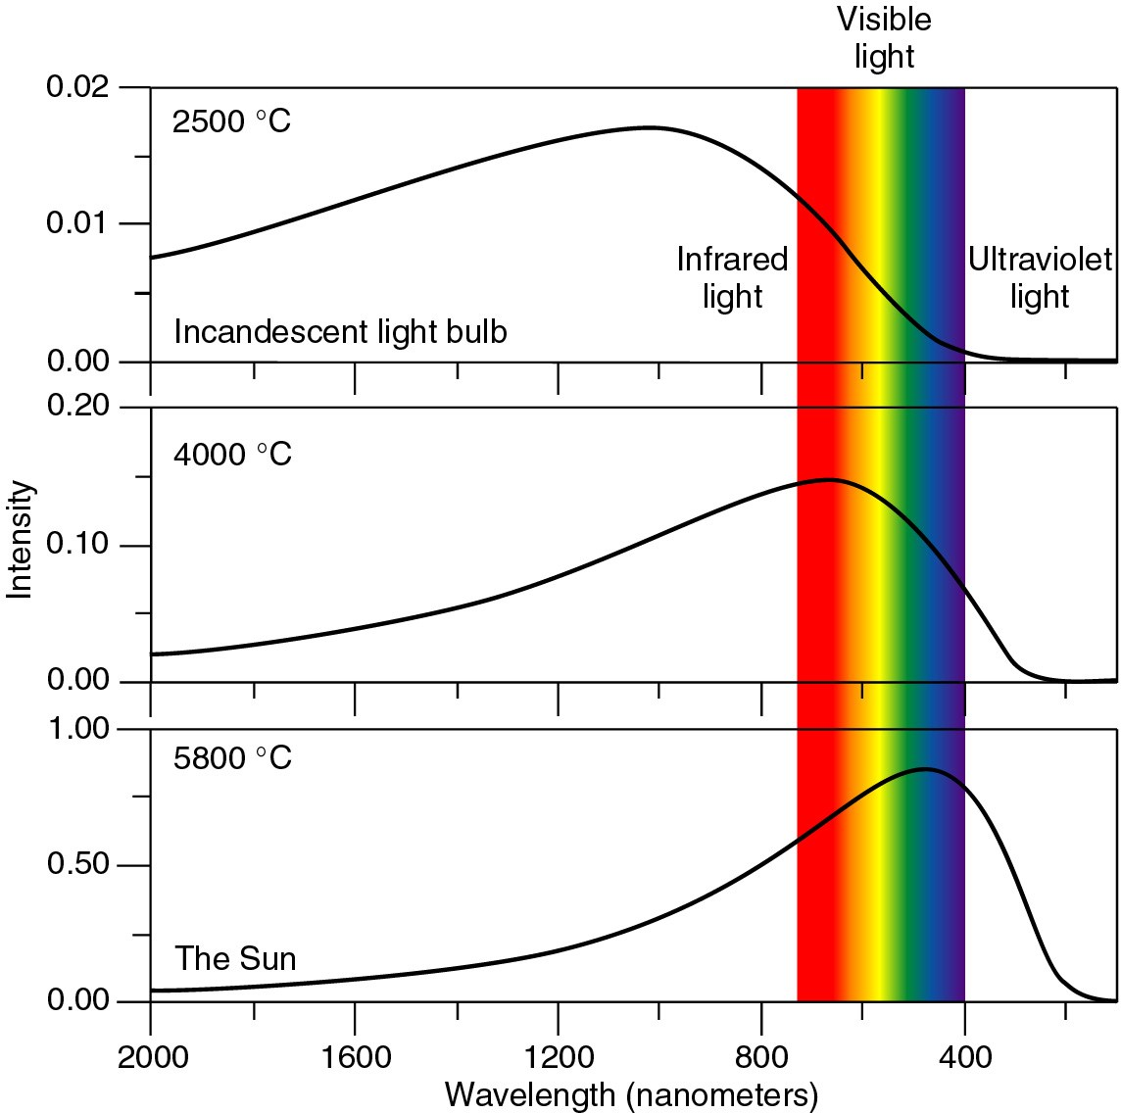
Thermal radiation spectrum
The intensity of radiation increases with temperature
the color shifts toward the blue at higher temperatures
The UV radiation from the sun is just beyond the violet (11,000 F)

Slide 9
sources of thermal radiation
the incandescent light bulb ( the ones that have a filament) are sources of both visible light and heat.
when electricity flows through a wire it gets hot.
it emits radiation even though you can’t see it
as it gets hotter it glows red then orange then white
tungsten filament,
has a very high melting point, 3400 C
evacuated glass bulb

Slide 10
good emitters are good absorbers
an object that is a good emitter is also a good absorber of thermal radiation
a poor emitter is also a poor absorber
generally dark, dull objects are the best emitters/absorbers
shinny objects are poor emitters/absorbers, they are good reflectors of radiation
If you do not want the edges of your pie to burn, you wrap it in aluminum foil. The aluminum foil reflects the heat rather than absorbing it.

Slide 11
good/bad emitters-Leslie’s cube
infrared
radiation sensor
copper cube
filled with hot
water
this side is
painted black
Even though all sides are at the
same temperature, the black
sides emit more radiation.

Slide 12

Practical considerations
wear light clothing in summer → light clothing absorbs less sunlight
cover all body parts in winter → warm body parts (like your head) emit radiation→ wear a hat

Slide 13
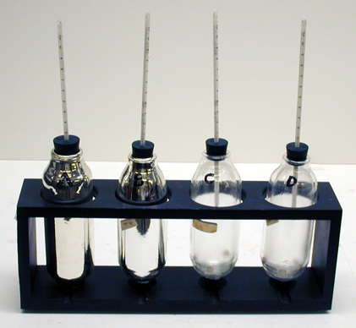
Which thermos bottle is best?
Evacuated
hollow glass
bottle: reduces
heat loss by
conduction
Silver coating:
reduces heat
loss by radiation
A B C D
silvered and evacuated
silvered and un-evacuated
evacuated
un-silvered and un-evacuated
Plug to evacuate

Slide 14
Physics of the atmosphere
How the sun warms the earth
The ozone layer issue
Greenhouse effect
Climate change: we share one planet with one atmosphere - the issues are global, and involve science, international politics, and economics

Slide 15

Why is it colder at the poles than at the equator?
SUN
More of the Sun’s energy per unit area falls on the equatorial regions compared to the polar regions
the earth reflects about 30% of incident solar energy
without the atmosphere the earth would be 30° C cooler!
Seasons are due to change in tilt of the earth

Slide 16
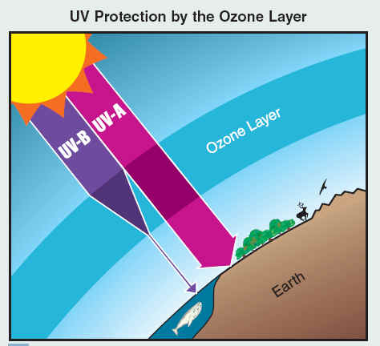
The ozone layer: blocks UV-B rays
ozone, O₃ is a naturally occurring trace element in the atmosphere
It absorbs solar ultraviolet radiation, especially the harmful UV-B rays
Ozone is destroyed by CFC’s (chlorofluorocarbons)
loss affects us and environment
Long-term observations reveal that Earth’s ozone has been strengthening following international agreements to protect this vital layer of the atmosphere.

Slide 17
The Greenhouse effect
infrared radiation is trapped
Sun’s visible light
30%
H₂O, CO₂
E A R T H
Without the greenhouse effect, the average
temperature of the Earth would be −20 F

Slide 18
Effect of greenhouse gases:
H₂O, CO₂, CH₄, . . .
the sun’s visible light can penetrate through the atmosphere to the earth’s surface and heat it
the visible light energy is converted to thermal light energy
the thermal radiation is reflected from the greenhouse gases in the atmosphere
CO₂ concentrations are about 0.04% and increasing
CO₂ produced by burning fossil fuels
Water vapor accounts for up to 66%

Slide 19
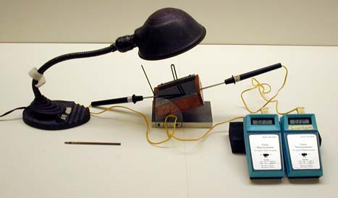
Greenhouse effect Demo
Heat source
Wooden box
with glass window
glass lets visible light through, but blocks infrared heat rays from
getting out
T_{out}
T_{in}

Slide 20
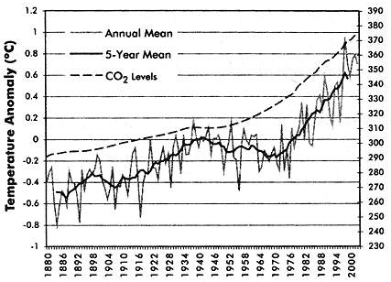
Temperature change 1880-2003 the temperature anomaly is the difference between the current temperature and a long-term average value
CO₂ levels

Slide 21
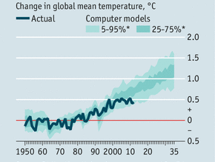
No temperature rise over the last 15 years

Slide 22
What are climate forcings?
Many factors affect the Earth’s climate
These factors are called forcings because they can drive or force the climate system to change
Most important forcings during the last 1000 yrs.
  changes in the output of energy from the sun
  volcanic eruptions (injects dust into the atm.)
  changes in the concentration of greenhouse
  gases in the atmosphere
The big issues – are the changes:
  natural or man-made (anthropogenic)
  Self-reversible or require intervention

Slide 23
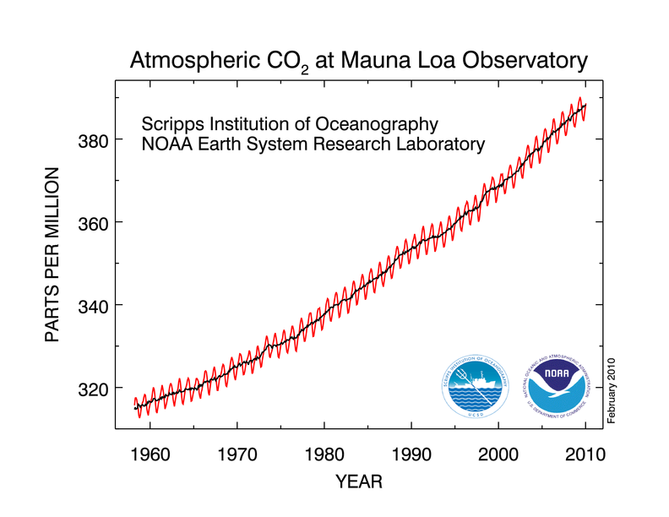
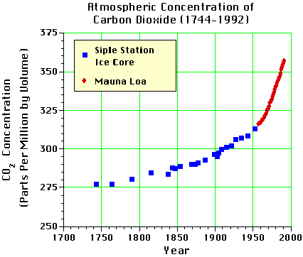
Greenhouse effect and climate change
concentrations of CO₂ have been increasing
→ rise in earth’s temperature
similar effect occurs in your car during the day.

Slide 24
Climate change
Are climate changes part of a natural cycle or
driven by human activity (anthropogenic)?
A recent statement signed by 256 members of US National Academy of Science (Science, 5/7/10)
  There is always uncertainty associated with science, science never absolutely proves anything
  Taking no action on climate change poses a dangerous risk for our planet
Conclusions
  The planet is warming due to increased concentrations of heat-trapping gases in our atmosphere
  Most of the increase in the concentration over the last century is due to human activities, especially the burning of fossil fuels and deforestation (controversial)

Slide 25
Climate change, continued
  Natural causes also play a role but are now being overwhelmed by human-induced changes
  Warming the planet will cause climatic patterns to change at unprecedented speeds
  Policy makers should move forward to address the causes of climate change and reduce the threat of global climate change
  Effective actions are possible, but delay is not an option
What are the social, political, and economic repercussions of taking or not taking action?

