Slide 1
L 26 Electricity and Magnetism [4]
simple electrical circuits – direct current DC
Alternating current (AC) vs direct current (DC)
electric power distribution
household electricity
    household wiring
      Protection circuits - GFIC’s
      Electrocution hazards
    the kilowatt-hour (what you pay for)
Your carbon footprint

Slide 2
A direct current (DC) circuit
DC: current always flows in the same direction
Batteries provide direct currents.
Current flows in direction that + charges would move
resistor
R
I
I
Duracell
V
+
OHM’S LAW
I(Amps)= V(volts)/R(Ohms)

Slide 3
Direct Current DC
a circuit containing a battery is a DC circuit
in a DC circuit the current always flows in the same direction
Duracell
Duracell
+
+

Slide 4
Alternating Current (AC)
In an AC circuit the current reverses direction periodically
AC is what you get from the power company
Tesla and Edison fought over the use of AC vs. DC for NYC. Tesla won,
and AC was in!

Slide 5
How does the line voltage change in time?
peak
rms

Slide 6
AC power
The line voltage reverses polarity 60 times a second or 60 Hertz (in Europe 50 Hz)
the current through the bulb reverses direction 60 times a second also
for heaters, hair dryers, irons, toasters, waffle makers, the fact that the current reverses makes no difference
battery chargers (e.g., for cell phones) convert the AC to DC

Slide 7
Why do we use AC ?
(DC seems simpler )
AC power is easier to generate
late 1800’s → the war of the currents
Edison (DC) vs Tesla (Westinghouse) (AC)
Edison opened the first commercial power plane for producing DC in NY in 1892
Tesla who was hired by George Westinghouse believed that AC was superior
Tesla was right, but Edison never gave up!

Slide 8
Advantages of AC over DC
DC power is provided at one voltage only
AC power can be stepped up or down to provide any voltage required
DC is very expensive to transmit over large distances compared to AC, so many plants are required
DC power plants must be close to users
AC plants can be far outside cities
by 1895 DC was out and AC was in

Slide 9
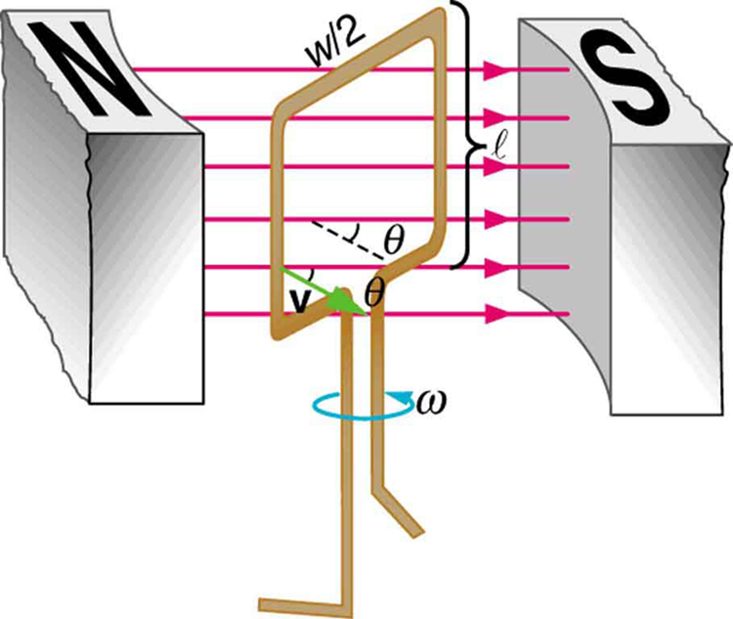
The electric generator
when a coil of wire is rotated
inside a magnet, AC electricity
is produced
the voltage depends on
how much wire the coil has
and how fast it is rotated.
devices called transformers can
make the voltage higher or lower
transformers only work with AC
Energy is required to rotate the coil

Slide 10
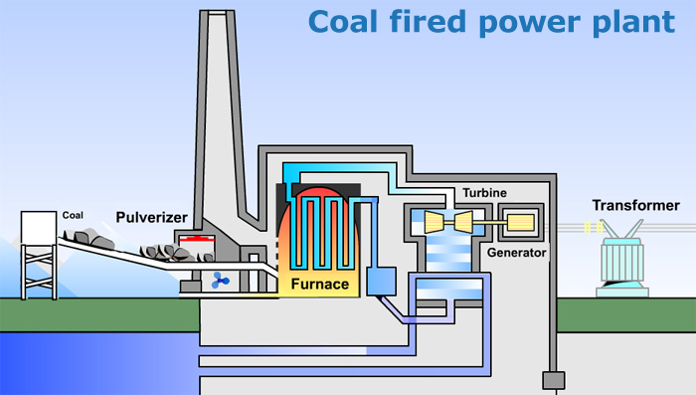
Coal fired power plant

Slide 11
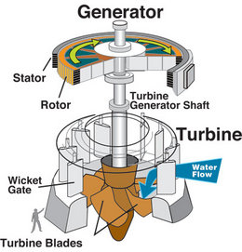
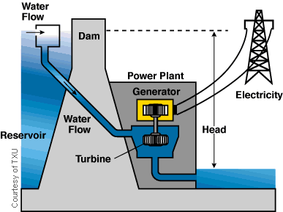
Hydroelectric power

Slide 12
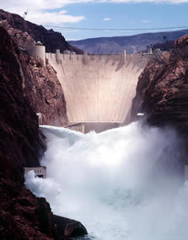
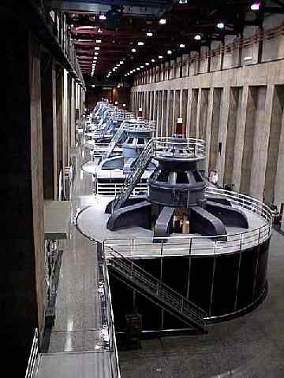
Hydroelectric power: Hoover Dam

Slide 13
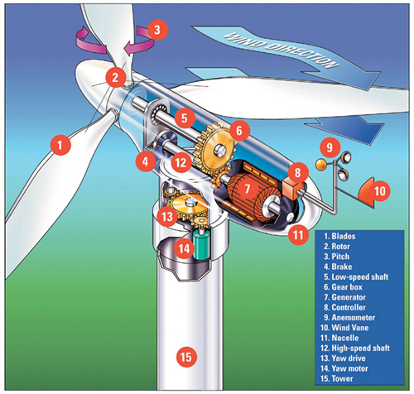
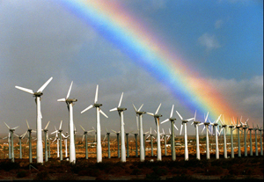
Wind Power
Large wind turbine has diameter of about 100 m
Generates several megawatts of power (UI has 25 MW)
Investment 1M$/MW, but the wind is free!
Disadvantages:
  Require frequent and costly maintenance
  between 100,000 and 200,000 birds killed each year in collisions with wind turbines

Slide 14
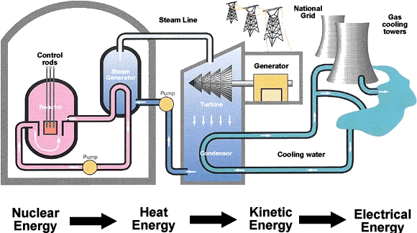
Nuclear power plant

Slide 15
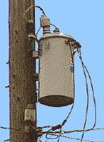
Transformers
This is a typical step-down
transformers used to bring
the line voltage down from
5000 V to 240 V before it
gets to your home
In your home two voltages
are available: 240 V &120 V.
The 240 is used for the high
power appliances like the
clothes dryer, oven, etc. The
120 V is for everything else.
Transformers only work with AC.

Slide 16
Bodily Effects of Electrical Currents
60 Hz AC, 1 mA = 0.001 A
MEN | WOMEN | EFFECT
0.4 mA | 0.3 mA | Slight sensation experienced
1.1 mA | 0.7 mA | Threshold of perception
9 mA | 6 mA | Painful, but voluntary muscle control maintained
16 mA | 10.5 mA | Painful, unable to let go
23 mA | 15 mA | Severe pain, difficulty breathing
100 mA | 100 mA | Possible heart fibrillation after 3 seconds → death

Slide 17
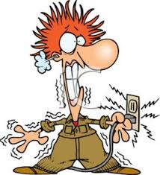
ELECTROCUTION
Human lethality is most common with alternating current at
100–250 volts.

Slide 18
Electric outlets
The current is supposed to flow from the hot side (black wire) to the neutral (white wire), if too much current flows the fuse blows or the circuit breaker trips.
the ground (green wire) is there for protection; to provide a safe path for current in the event of a short circuit
on some circuits (kitchens and bathrooms) there is additional protection →GFCI → ground fault circuit interrupter. If current accidentally flows through anything other than the hot or neutral it interrupts the circuit very quickly (in about 25 milliseconds, before fibrillation can occur)

Slide 19
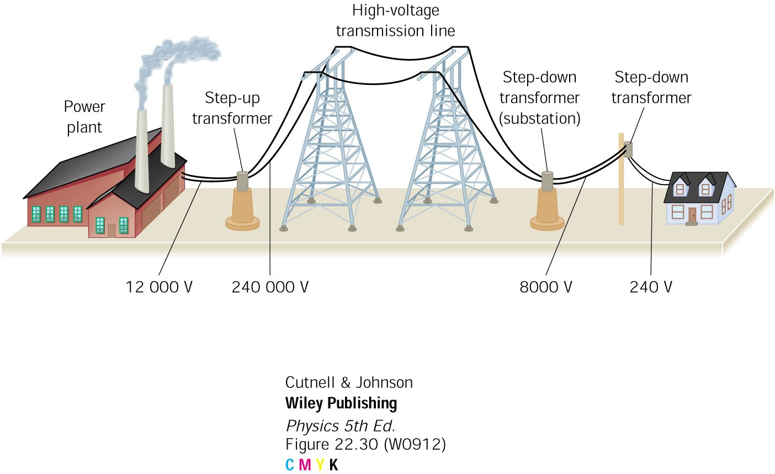
Electric power generation and distribution
electrical power P = I V, energy per unit time
Joules/s = WATTS (watts = amps x volts)
It is more efficient to transmit electrical
power at high voltage and low current.
The losses along the transmission lines are
reduced compared to transmission at low V.

Slide 20
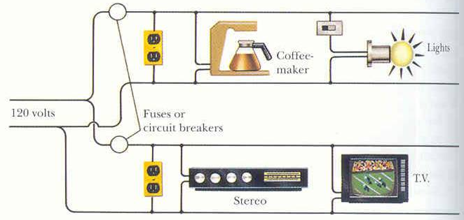
House wiring
all circuits are
connected in parallel

Slide 21
electrical power
the power is how much electrical energy is used per second = 1 Watt.
1 Watt = 1 Joule / 1 second
Power (Watts) = current (A)  voltage (V)
some appliances require high power, like your electric range or clothes dryer, they operate at the higher voltage (240 V), so less current is used.
we pay for the total energy (not power) used each month - KW-hours (KWH)

Slide 22
Paying for electricity (KWH)
You pay for the total amount of electrical energy that is used
the energy is measured in kilowatt-hours
the kilowatt (kW) = 1000 W, is the energy used per unit time
When kW are multiplied by a time unit (hours) we get total energy in KWH
The cost per KWH varies from about 6¢ in SD to 17¢ in HI, the average is about 10¢

Slide 23
example
At a rate of 10 cents per kWh, how much does it cost to keep a 100 W light bulb on for one day (24 hours)
Solution
  100 W = 0.1 kW
  # KWH = 0.1 kW x 24 hr = 2.4 kWh
  cost = 2.4 kWh x $0.10/kWh
= $0.24 = 24¢
for one month the cost is $7.20

Slide 24
Your carbon footprint
1 ton (2000 lbs) of coal produces about 6000 KWH of electric power
a 100 W light on 200 hours uses 1 lb of coal
an average US household uses about 10,000 KWH of electricity per year
Each household consumes about 1.7 tons of coal each year for its electricity usage
US coal reserves estimate: 300 billion tons!
US is now #1 natural gas producer in world.
Energy density (energy/volume) is an important issue in choosing energy sources, e.g., 1 kg of nuclear fuel has the same energy content of 1 million kg of coal.
Many US power plants switching to natural gas, which produces far less pollution and less than half of the CO₂ compared to coal.

Slide 25
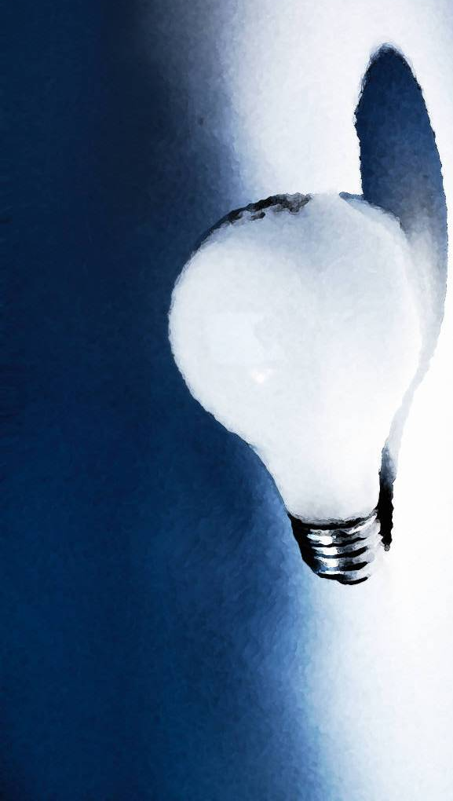
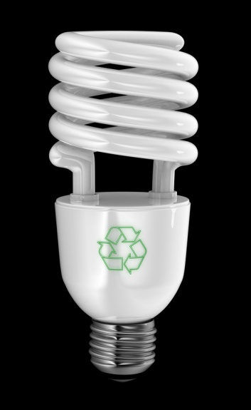
Incandescent vs. Fluorescent ?
Incandescent lights must produce heat to make light: they are inefficient
Fluorescent lights (gas discharges) produce the same amount of light using less electricity
Fluorescent lights can take several seconds to come to full brightness because they contain a small amount of mercury (environmental issue) which must first heat up for the light to work well
Fluorescent lights do not work well as outdoor lights in the coldest climates

