Slide 1
L 29 Light and Optics - 1
Measurements of the speed of light:
c = 3 × 10⁸ m/s = 186,000 miles/s
light propagating through matter – transparent vs. opaque materials
colors
The bending of light – refraction
    dispersion - what makes the pretty colors?
    total internal reflection- why do diamonds sparkle?
    how are rainbows formed
Atmospheric scattering
    blue sky
    red sunsets

Slide 2
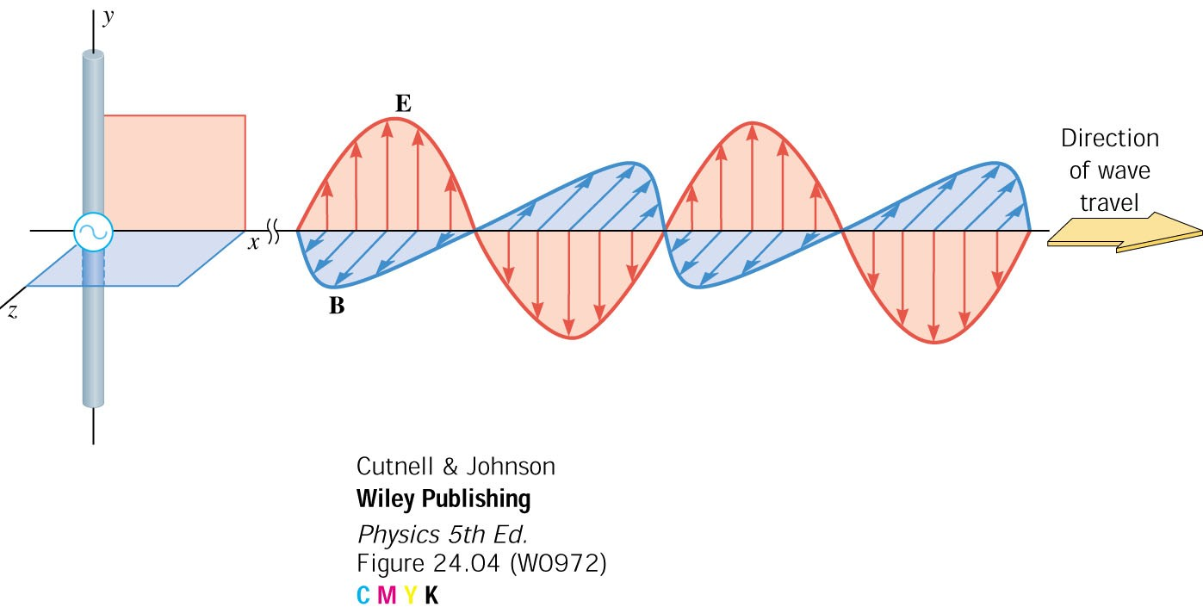
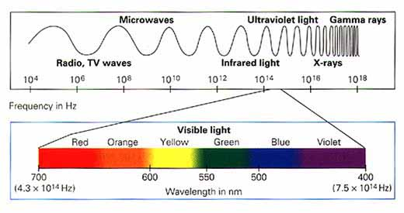
Electromagnetic Waves
Synchronized electric and magnetic fields moving through space at the speed of light c = 310⁸ m/s; it is a transverse wave
LIGHT is an electromagnetic wave with a wavelength that our eyes are sensitive to (400 nm to 700 nm) [nm (nanometer) = 10^{—9} m]
Frequency in Hz
Wavelength in nm

Slide 3
Measurement of the speed of light
speed of light in vacuum = c
  c = 300,000,000 m/s = 186,000 miles/s
  ≈7 times around the earth every second
the moon is 239,000 miles from the earth, so it takes 239,000 mi/186,000 mi/s =1.3 s for light from the moon to get to the earth
  8 minutes from the Sun to Earth
  24 minutes across the solar system
Galileo was the first person to consider whether the speed of light was finite or infinite
Galileo attempted to measure the speed of light by stationing himself on one mountain and an assistant on a nearby mountain and sending light signals

Slide 4

Galileo attempts to measure the speed of light
Massimo
Galileo
Speed of light
= 2D/t
D
Galileo turns his flashlight on and starts his clock
His assistant Massimo holds a mirror which reflects the light back to Galileo
When Galileo sees the light reflected from the mirror, he stops his clock and notes the time

Slide 5
Galileo’s result
“If not instantaneous, it is extraordinarily rapid; at least 10 times faster than sound.”
Suppose D = 2 miles, then the time delay would be t = D/c = 5 millionths of a sec. (The time delay for sound would be about 10 sec.)
It is not surprising that Galileo was not able to measure this!
We will measure the speed of light by timing how long it takes for a pulse of light to travel through a long plastic fiber

Slide 6
The speed of light inside matter
The speed of light c = 310⁸ m/s in vacuum
In any other medium such as water or glass, light travels at a lower speed.
The speed of light in a medium can be found by using the formula
where c is the speed in vacuum (310⁸ m/s) and
n is a number called the index of refraction.
Since n is greater than 1, v_{medium} is less then c.

Slide 7
V_{medium} = c / n
MEDIUM | INDEX OF REFRACTION (n) | SPEED OF LIGHT (m/s) (v_{medium})
Vacuum air | Exactly 1 1.000293 | 300,000,000
water | 1.33 | 225,564,000
glass | 1.52 | 197,368,000
diamond | 2.42 | 123,967,000

Slide 8
Transparent and opaque materials
In transparent materials, when a light
wave enters it the electrons in the
material vibrate. The vibrating electrons
re-emit the wave but at a slightly
shorter wavelength. This is a resonance
effect similar to 2 identical tuning forks
In opaque materials, the electrons also vibrate, but immediately pass their energy to the nearby atoms, so the wave is not re-emitted.
There is a slight delay between the vibration of the electrons
and the re-emission of the wave. This delay is what causes a
slowing down of light in the material, so that
vmedium < c

Slide 9
glass blocks both ultraviolet and infrared light, but is transparent to visible light
Glass
ultraviolet
visible
infrared

Slide 10
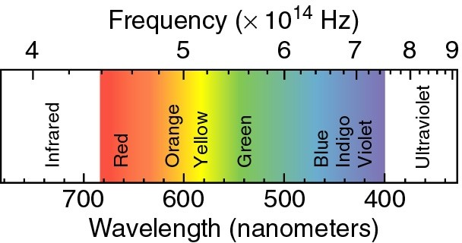
VISIBLE LIGHT
Color ➔ WAVELENGTH OR FREQUENCY
Wavelength × Frequency = c
e.g., 600x10⁻⁹ m x 5x10¹⁴ Hz = 3x10⁸ m/s

Slide 11
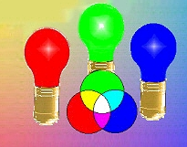
COLOR
Any color can be made by
combining primary colors
→ Red, Green and Blue
A color TV uses mixtures
of the primary colors to
produce “full color” images
Perceived color is a
physiological effect

Slide 12
Refraction→ the bending of light
One consequence of the fact that light travels more slowly in say water compared to air is that a light ray must bend when it enters water→ this is called refraction
the amount of refraction (bending) that occurs depends on how large the index of refraction (n) is, the bigger n is, the more bending that takes place

Slide 13

What does it mean to “see” something?
To “see” something, light rays from an object must get into your eyes and be focused on the retina.
unless the object is a light bulb or some other luminous object, the light rays from some light source (like the sun) must reflect off the object and enter our eyes.

Slide 14
Reflection and refraction at a surface
Incident
Light ray
Normal line
reflected
Light ray
θ1
θ1
AIR
WATER
θ2
refracted
Light ray
θ2 < θ1

Slide 15
Refraction of light
Incident
rays
refracted
rays
Water n= 1.33
Glass n=1.5
The refracted ray is bent more in the glass

Slide 16
Normal incidence
If the ray hits the interface at a right angle (we call this normal incidence) there is no refraction even though the speed is lower
The wavelength is shorter, however
λout
λin

Slide 17
Refraction from air into water
The “normal” is the line that passes through
the surface at 90°
Incident
ray
n = 1.0
When a light ray
goes from air
into water, the
refracted ray is
bent toward the
normal.
n = 1.33
refracted
ray
water

Slide 18
Refraction from water into air
normal
When a light ray
goes from water
into air, the refracted
ray is bent away
from the normal.
n = 1.0
n = 1.33
water

Slide 19
Effects caused by refraction
An underwater object appears to be closer
to the surface than it actually is
Total internal reflection➔ fiber optics
Seeing through a window
Dispersion ➔ rainbows

Slide 20
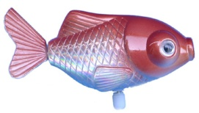
Looking at objects that are underwater
Apparent location
Of the fish
fish
Underwater objects appear to be closer
to the surface than then actually are

Slide 21
Total internal reflection, n₁ > n₂
n2
n1 > n2
θcrit
When, n1 > n2 and the incident angle is greater than a certain value (θcrit), the refracted ray disappears, and the incident ray is totally reflected back into the medium.

Slide 22
Fiber optics (light pipes)
A fiber optic cable is a bunch (thousandths) of very fine (less than the diameter of a hair) glass fibers clad together.
The light is guided through the cable by successive internal reflections.

Slide 23
fiber optic communications
can carry more info with less distortion over long distances
not affected by atmospheric conditions or lightning and does not corrode
copper can carry 32 telephone calls, fiber optics can carry 32,000 calls
takes 300 lbs of copper to carry same info as 1 lb of fiber optics
downside ➔ expensive

Slide 24
Where is the pencil?
top
view
Bottom half
of pencil
Top half of pencil
Total internal reflection on side
side view

