Slide 1
L 31 Light and Optics-3
Images formed by mirrors
  plane mirrors
  curved mirrors
    Concave (converging)
    Convex (diverging)
Images formed by lenses
the human eye
  correcting vision problems
    nearsightedness
    farsightedness
    astigmatism
  depth perception
PLANE
CONCAVE
F
CONVEX
F

Slide 2
Review-Law of reflection angle of incidence = angle of reflection
R
PLANE
angle of
reflection
normal
line
angle of
incidence
90°
I
R
I
I
R
CONCAVE
CONVEX

Slide 3
Review
VIRTUAL image: light rays appear to come from a point where there is no light
REAL image: light rays actually converge at the image location
PLANE MIRROR
Image is VIRTUAL
Same size as object
Upright
Same distance behind
mirror
OBJECT
IMAGE
CONCAVE MIRROR
Image is REAL
Inverted
smaller than object
OBJECT
IMAGE

Slide 4
Image formation with lenses
converging lens (positive lens)
diverging lens (negative lens)
the human eye
  correcting for nearsightedness
  correcting for farsightedness
optical instruments
lenses are relatively simple optical devices
the principle behind the operation of a lens is refraction→ the bending of light as it passes from air into glass (or plastic)

Slide 5
Refraction (bending) depends upon the index of refraction, n
The refracted ray is bent away from the direction of the incident ray, toward the normal line.
The larger the value of n, the more the ray is bent.
Refracted
ray
Normal line
Incident
ray
Material of Index of refraction, n

Slide 6
A flat (sides are parallel) piece of glass does not make a lens
Refraction occurs at surfaces 1 and 2
At surface 1, the ray is bent toward the normal
At surface 2, the rays are bent away from the normal
The rays emerging from surface 2 are parallel to the incident rays but displaced
The rays are neither converging or diverging, so this does not form a lens
1
2

Slide 7
converging lens: thicker in middle
focal
point F
A converging lens focuses parallel rays
to a point called the focal point.
A thicker lens has a shorter focal length.

Slide 8
Diverging lens: thicker at edge
F
A diverging lens causes
parallel rays to diverge
as if they came from a
focal point F

Slide 9
Refraction at a curved surface
Converging
lens
Diverging
lens

Slide 10
Image formation by a converging lens
image
object
2F
F
➔If the object is located at a distance of at least 2F from the
lens, the image is inverted and smaller than the object.
➔The image is called a REAL image since light rays
actually converge at the image location

Slide 11
A converging lens is used to focus rays from the sun to a point
since the sun is very
far from the lens, the
rays are nearly
parallel

Slide 12
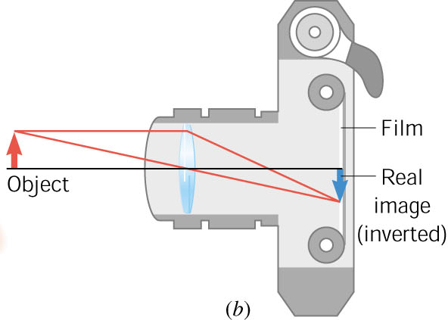
a converging lens is used in a camera to focus light onto the film
when you focus a camera, you adjust the distance between the lens and the film depending on the object location.

Slide 13
Image formation by a diverging lens
Object
image
➔The diverging lens produces an image that is upright
and diminished in size.
It is a VIRTUAL image, since light rays do not
actually pass through the image point

Slide 14
a magnifying lens
F
F
object
virtual image
By placing the lens close to the object (image is within the focal length) a magnified virtual image is formed.

Slide 15
Vision – the human eye
Physics of the human eye
Abnormal vision
    Nearsightedness
    Farsightedness
    astigmatism
Depth perception

Slide 16
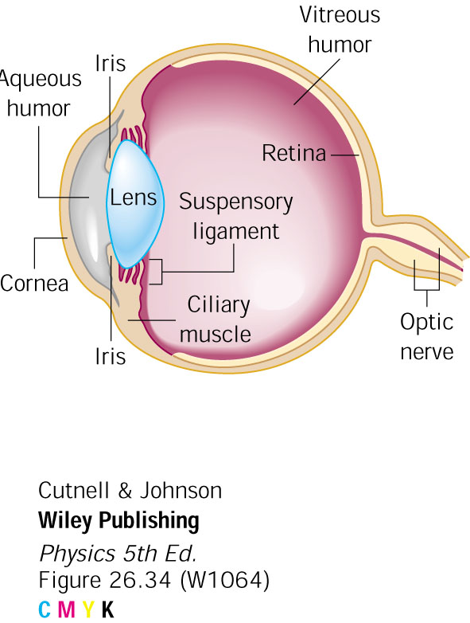
The Eye
light enters through the cornea
the iris controls the amount of light that gets in, a muscle can close it or open it; the iris determines your eye color
the lens is filled with a jelly-like substance; the ciliary muscle can change the shape of the lens and thus change its focal length
→ by changing the focal
length, (accommodation) the
lens is able to focus light onto
the retina for objects located
at various distances

Slide 17
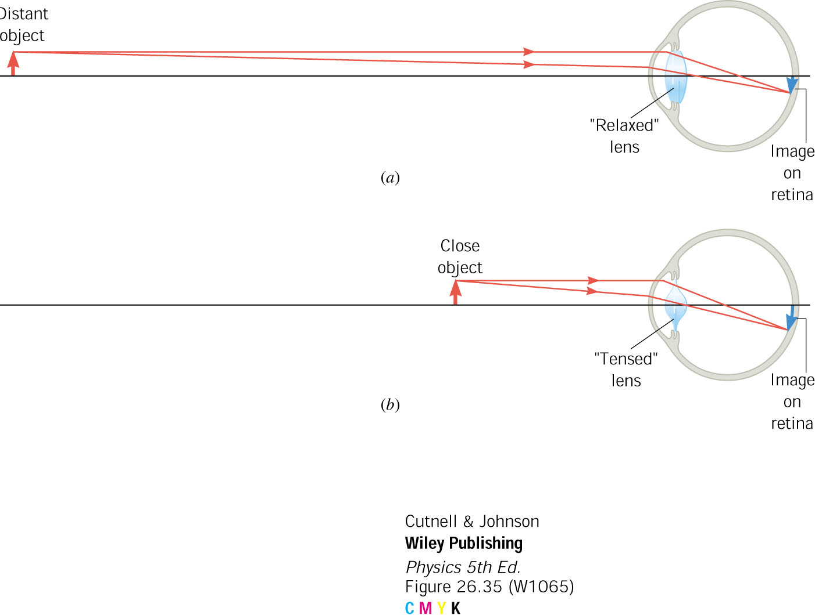
the physics of the human eye
Normal vision
The relaxed eye can easily focus on distant objects.
To focus on close objects, the lens is squeezed to shorten
it’s focal length, allowing the rays to converge on the retina.
The near point is the distance at which the closest
object can be seen clearly. The near point recedes with age.

Slide 18
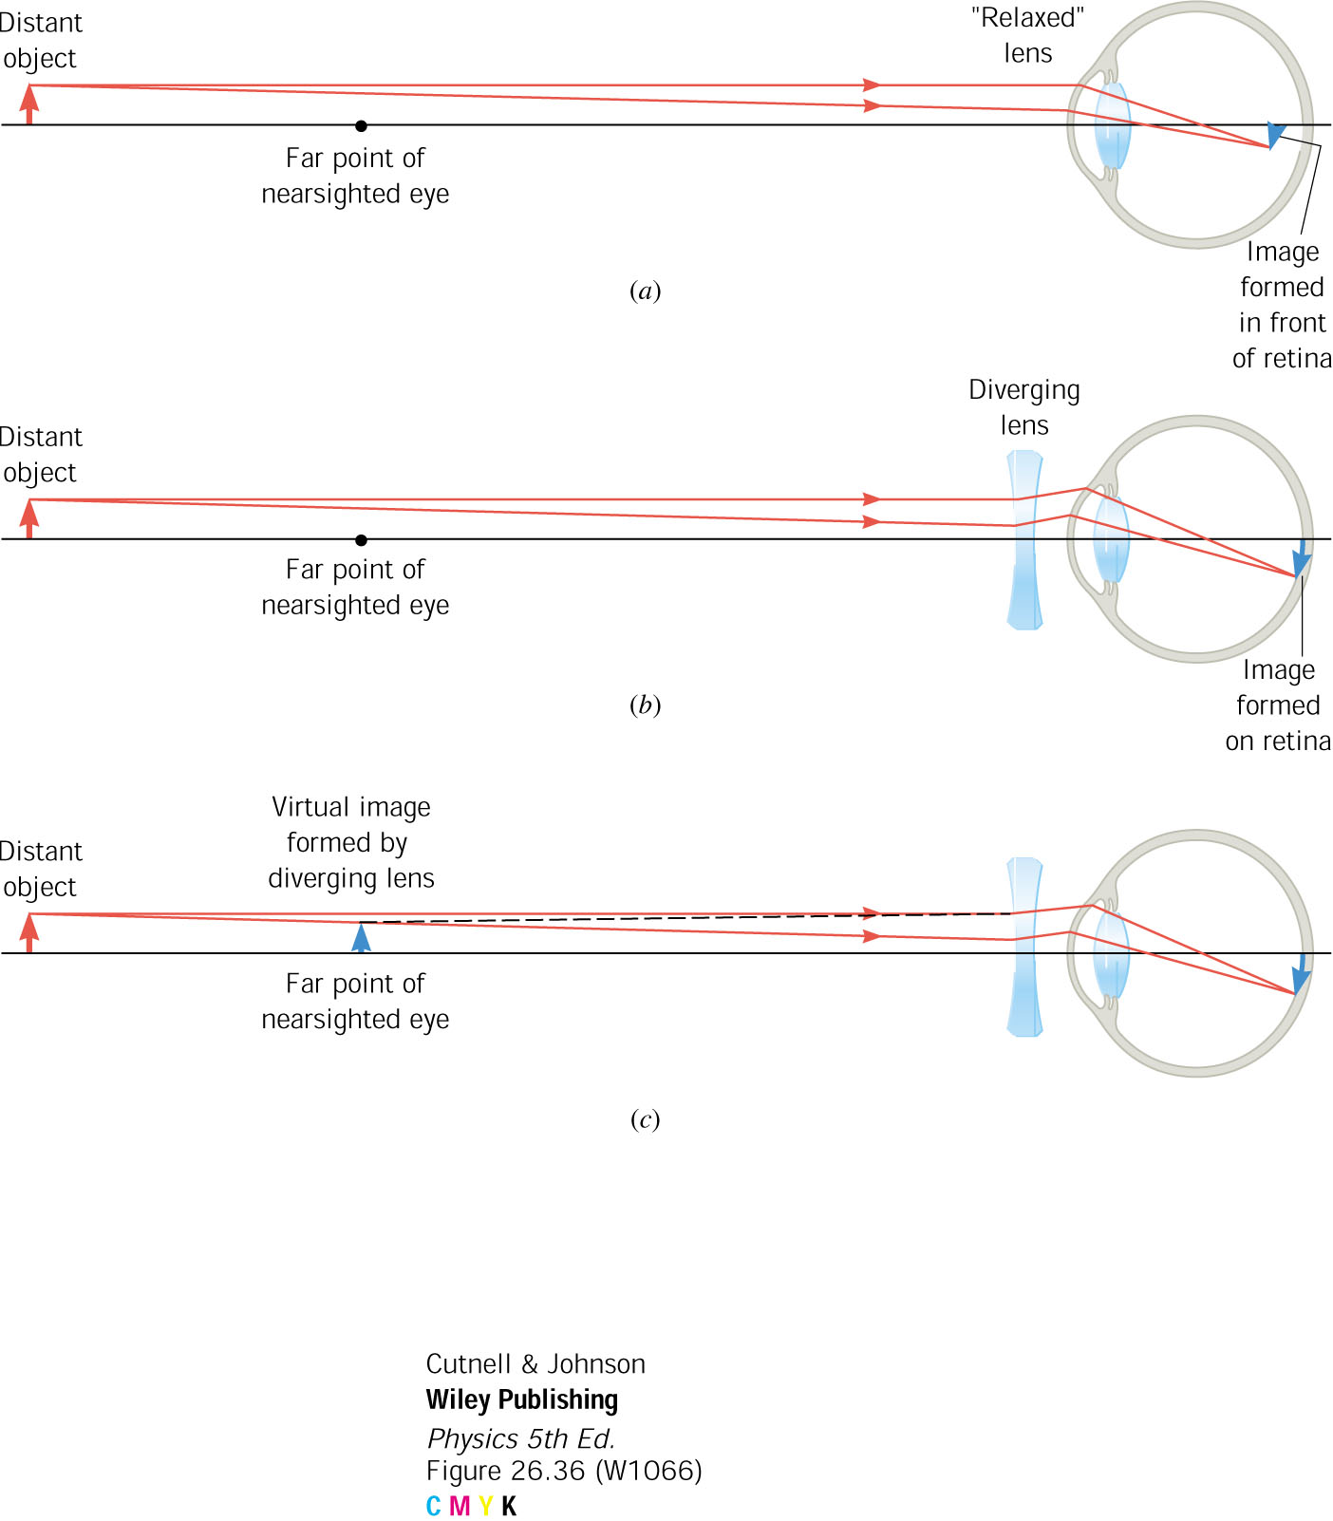
Corrective lens for a nearsighted person
When a nearsighted person views a distant object, the lens
cannot relax enough to focus at the retina. The rays converge
too quickly. The remedy is to place a diverging lens in front
of the eye to first diverge the rays before they enter the eye.

Slide 19
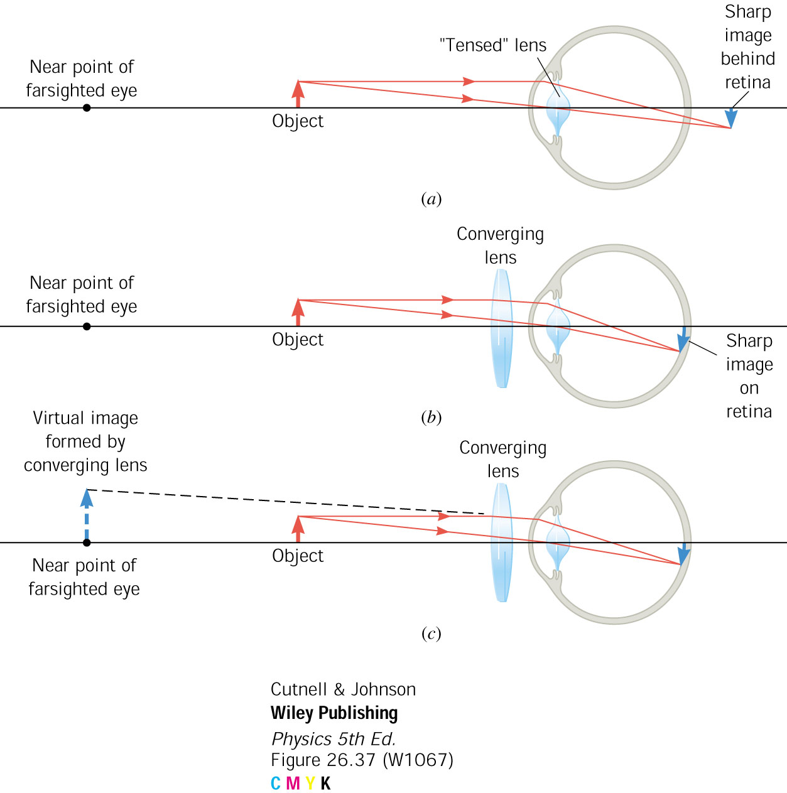
Corrective lens for a farsighted person
When a farsighted person tries to focus on a close object
the lens cannot be squeezed enough to focus on the retina.
The focus point is behind the retina. The remedy is to place
a converging lens in front of the eye to converge the rays
before they enter the eye.

Slide 20
How does the eye judge distance?
Right eye
D
B
Left eye
Our brain interprets the images formed on the retinas of both eyes as a single image → this is called binocular vision
Our eyes roll inward slightly to focus on the distant point D. Our brain interprets the distance BD by the muscular effort required to roll the eyes inward.

Slide 21
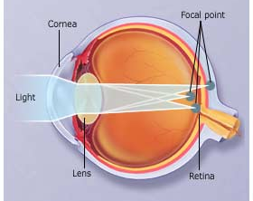
Astigmatism
With astigmatism the cornea is oval like a football instead of spherical like a basketball.
This causes light to focus on more than one point in the eye, resulting in blurred vision.
It can be corrected with specially shaped lenses or, in extreme cases, with surgery

