Slide 1
PHYS:1200 FINAL EXAM
FINAL EXAM: Wednesday December 17, 12:30 P - 2:30 P in LR-1 VAN
FE covers Lectures 23 – 36
The study guide, formulas, and practice final exam questions are posted on the Exam Information Link below.
We will review the practice final exam questions on Wed. Dec. 10, and Friday Dec. 12.

Slide 2
L 33 Modern Physics [1]
Introduction- quantum physics
Particles of light → PHOTONS
The photoelectric effect
  Photocells & intrusion detection devices
The Bohr atom
  emission & absorption of radiation
  LASERS
Sometimes light behaves like a particle and
sometimes particles behave like waves!

Slide 3
Modern Physics- Introduction
“Modern” – 20th Century
By the end of the 19th century it seemed that all the laws of physics were known
  planetary motion was understood
  the laws of electricity and magnetism were known
  the conservation principles were established
However, there were a few problems where classical physics didn’t seem to work
It became obvious that Newton’s laws could not explain phenomena at the level of atoms

Slide 4
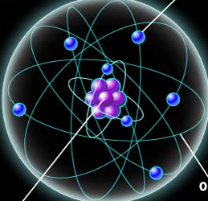
ATOMS and classical physics
In the classical picture, the electrons in atoms orbit around the nucleus just as the planets orbit around the Sun.
However, the laws of mechanics and electromagnetism predict that an orbiting electron should continually radiate electromagnetic waves, and very quickly the electron would loose all of its energy and collapse into the nucleus.
Classically, there could be no atoms!

Slide 5
Problems with Newton’s Laws
Newton’s laws, which were so successful in allowing us to understand the behavior of big objects such as the motions of the planets, could not explain phenomena at the atomic level
This is not too surprising since Newton’s laws were discovered by considering the behavior of macroscopic objects, like planets
Physical “laws” have a limited range of applicability, and must be continually tested
to find their limitations, and then modified

Slide 6
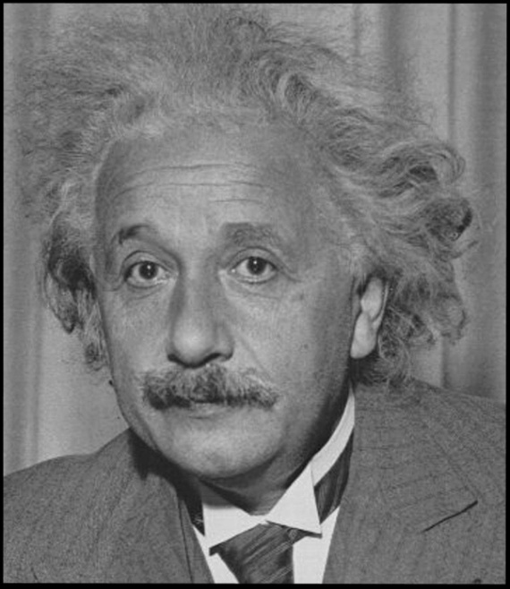
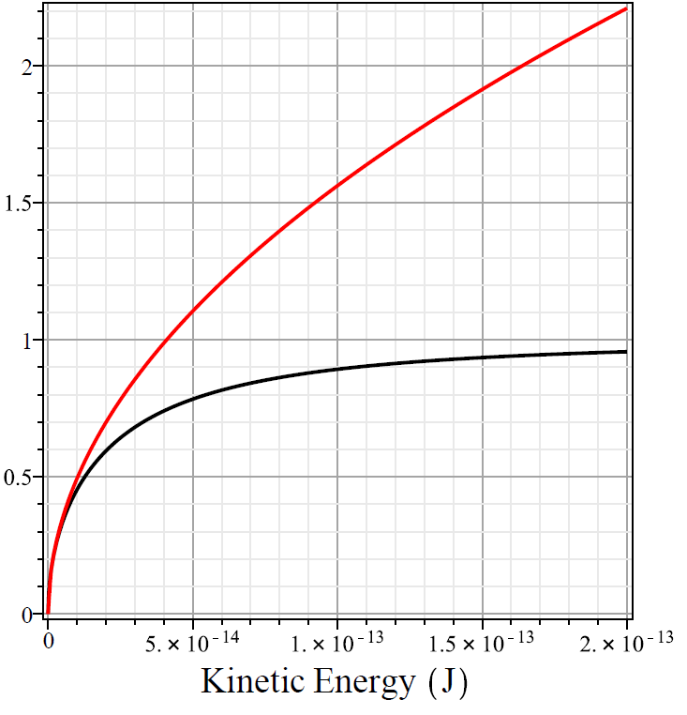
Newton’s laws fail at high velocities
accelerate to K measure v
Classical
prediction
Relativistic
prediction
Einstein showed
that mass is not a constant, but depends on speed
As speed increases,
so does mass
Speed can never
exceed the speed
of light, c
Electron velocity / c
DATA
Kinetic Energy (J)

Slide 7
The failure of the “old” physics
We will now discuss an example of an effect that could not be explained by the pre- 20th century laws of physics.
The discovery of the correct explanation led to a revolution in the way we think about light and matter, particles and waves
The new concepts also led to a revolution in technology that has changed our lives, e.g., the semiconductor led to the introduction of the personal computes, cell phones, etc.

Slide 8
The photoelectric effect- photons
photoelectrons
LIGHT
Metal plate
When light shines on a metal surface, electrons may pop out
Photoelectrons are only emitted if the wavelength of the light is shorter than some maximum value, no matter how intense the light is, so the color (wavelength) is critical
blue light makes electrons pop out, red light does not

Slide 9
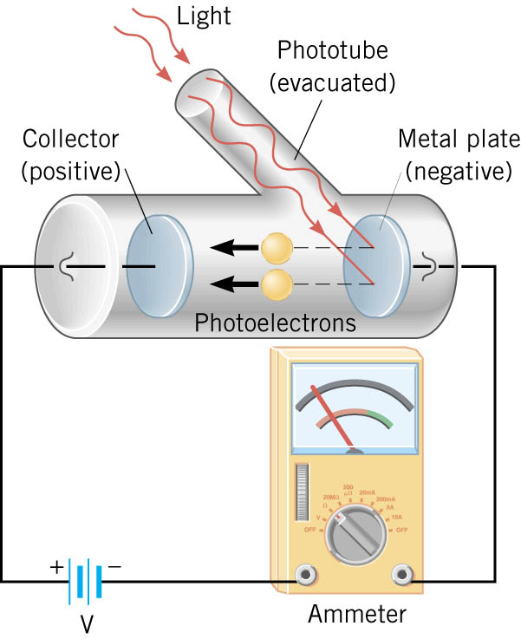
Details of a photocell

Slide 10
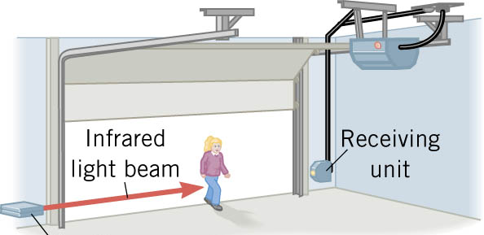
Photocells used as a safety device
Sending
unit
The child interrupts the beam, stopping the current, which causes the motor to stop.

Slide 11
No classical explanation for the photoelectric effect
According to electromagnetic wave theory, if the intensity of the light is sufficiently high, the electron should be able to absorb enough energy to escape
The wavelength of the light should not make a difference.
But the wavelength does matter!

Slide 12
Einstein received the 1921 Nobel Prize for explaining the photoelectric effect
A radical idea was needed to explain the photoelectric effect.
Light is an electromagnetic wave, but when it interacts with matter (the metal surface) it behaves like a particle
Light is a particle called a photon → packets of energy moving at the speed of light!
A beam of light is thought of as a beam of photons.

Slide 13
Photoelectric effect – PHOTONS
The energy of a photon depends on the wavelength or frequency of the light
Recall that speed of light
= wavelength (λ) x frequency (f)
Photon energy: E = h f
E = Planck’s constant (h) x frequency = h f
h = 6.626 x 10⁻³⁴ J s
f = c /λ → E = h (c/λ) = (hc) / λ
Shorter wavelength (or higher f ) photons have a higher energy

Slide 14
The photon concept explains the photoelectric effect
A certain amount of energy is required to remove an electron from a metal
A photoelectron is emitted if it absorbs a photon from the light beam that has enough energy (high enough frequency)
No matter how many photons hit the electron, if they don’t have the right energy the electron doesn’t come out of the metal

Slide 15
Blue and red photons - example
How much energy does a photon of wavelength = 350 nm (nanometers) have compared to a photon of wavelength = 700 nm?
Solution: The shorter wavelength photon has the higher frequency. The 350 nm photon has twice the frequency as the 700 nm photon. Therefore, the 350 nm photon has twice the energy as the 700 nm photon.

Slide 16
The quantum concept
The photon concept is a radical departure from classical thinking.
In classical physics, energy can come in any amounts
In modern physics, energy is QUANTIZED → comes in definite packets → photons of energy h f.
In the PE effect, energy is absorbed by the electrons only in discreet amounts

Slide 17

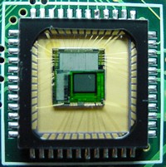
Video recorders and digital cameras
pixel
Electronic cameras convert light into an electric charge using the photoelectric effect
A two-dimensional megapixel array of sensors captures the charge and records its intensity on computer memory

Slide 18
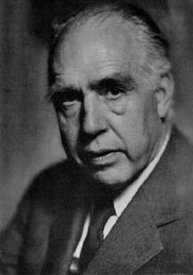
Niels Bohr explains atoms in 1913
Niels Bohr, a Danish physicist, used the quantum concept to explain the nature of the atom
Recall that the electron in a hydrogen atom should quickly radiate away all of its energy
If this occurred, atoms would emit radiation over a continuous range
of wavelengths
But, atoms emit light in discreet lines

Slide 19
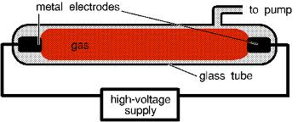
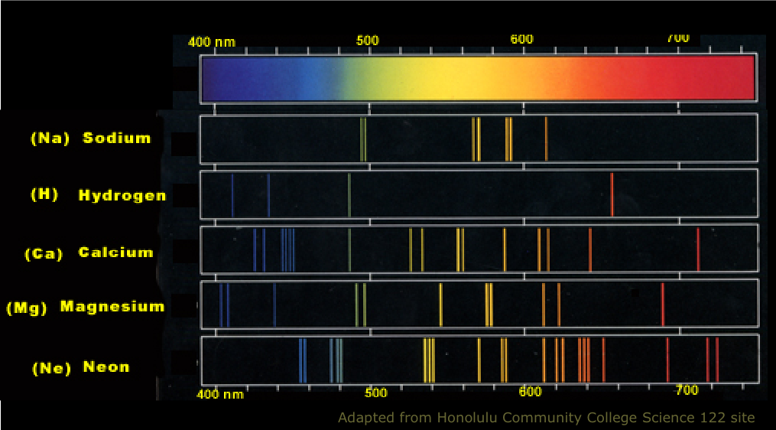
Line spectra of atoms
Line spectra are like fingerprints which
uniquely identify the atom

Slide 20
The Bohr Atom
The electrons move in certain allowed, “stationary” orbits or states in which then do not radiate.
The electron in a high energy state can make a transition to a lower energy state by emitting a photon whose energy was the difference in energies of the two states, hf = E_{i} - E_{f}
Nucleus
+
E_{f}
E_{i}
The orbits farther from
the nucleus are higher
energy states than
the closer ones

Slide 21
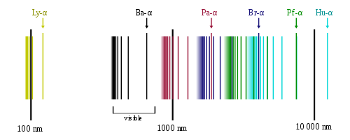
Line spectra of atomic hydrogen
The Bohr model was successful in predicting
where all the spectral lines of H should be.

Slide 22
Emission and Absorption
When an electron jumps from a high energy state to a low energy state it emits a photon → emission spectrum
An electron in a low energy state can absorb a photon and move up to a high energy state → absorption spectrum

Slide 23
Emission and Absorption
+
+
Electron spontaneously
jumps to a lower energy
state and emits a photon
Electron absorbs a
photon and jumps to
a higher energy state

