Slide 1
PHYS:1200 FINAL EXAM
FINAL EXAM: Wednesday December 17, 12:30 P - 2:30 P in LR-1 VAN
The Final Exam is not cumulative and only covers Lectures 23 – 36
The study guide, formulas, and practice final exam questions are posted on the Exam Information Link below.
We will review the practice final exam questions on Wed. Dec. 10, and Friday Dec. 12.

Slide 2
L 34 — Modern Physics [2]
Modern physics concepts
  Photons
  Uncertainty principle
X-rays and gamma rays
Lasers
  Medical applications of lasers
  Applications of high power lasers
Medical imaging techniques
  CAT scans
  MRI’s

Slide 3
Modern physics concepts
In classical physics (pre-20th Century) we studied particles and waves as two distinct entities.
In modern physics (20th Century) the distinction between particle and wave behavior is not as clear.
Electromagnetic waves sometimes behave like particles- photons –discreet (quantized) packets of energy, as in e.g., the photoelectric effect
Particles, e.g., electrons, sometimes behave as waves
→ matter waves that can only exist in allowed orbits (Bohr’s stationary states)
Electrons actually have a wavelength and can experience diffraction! The electron “waves” are not localized like particles

Slide 4
The Photon Concept
a beam of light waves also behaves like a beam of light particles called PHOTONS
Photons are little packets of electromagnetic energy; they are never at rest but always move at the speed of light
The energy is proportional to the frequency or inversely proportional to the wavelength
E_{photon} = h f, but c = f λ ⎝ E_{photon} = h c/λ,
where h is a constant called Planck’s constant, and c is the speed of light
blue photons have more energy than red photons
Light energy is absorbed or emitted in discreet amounts as spectral lines

Slide 5
The Heisenberg uncertainty principle
In classical physics we can measure the position and velocity of a particle simultaneously
At the atomic level, measurements can disturb what we are trying to measure
To locate an electron and measure its velocity, we have to scatter (collide) a photon from it, but this will change its velocity.
Uncertainty principle: It is impossible to precisely measure the position and velocity of an electron simultaneously.

Slide 6
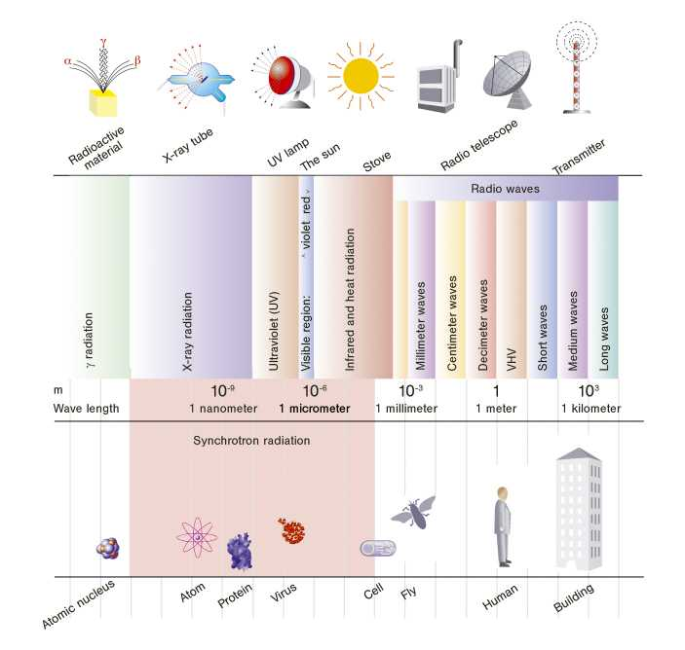
X-ray and gamma ray photons
X rays
x-rays are very short wavelength photons
gamma rays have even shorter wavelengths
E = h f = hc/λ ◊ gamma rays have more energy than x-rays

Slide 7
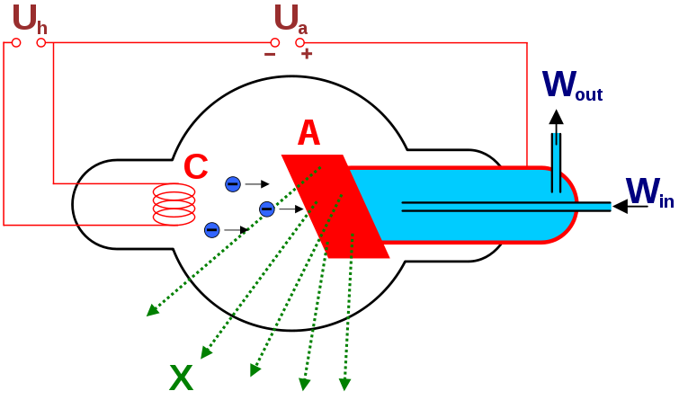
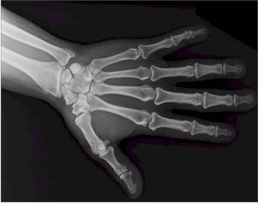
X-RAYS (Roentgen,1895)
very short wavelength (0.01 – 0.1 nm) EM waves
able to penetrate soft tissue, but not bone
produces a two dimensional shadow image
Electrons are emitted by a hot filament (C), are accelerated and slam into a target (A)
The electron’s KE is converted to x-ray energy

Slide 8
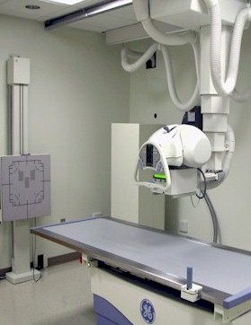
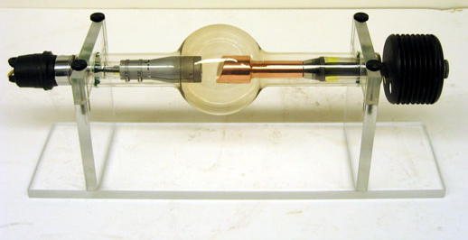
X-ray machines
X-ray tube
20 years ago, the x-ray
images were recorded
on photographic plates
Now, the images are
recorded on digital
electronic detectors.

Slide 9
Gamma rays γ
Gammas are extremely energetic photons
  x ray photons are a 1000 times more energetic than visible light photons
  gamma ray photons are 1,000,000 more energetic than visible light photons
sources of gamma rays
  produced by cosmic rays that constantly bombard the earth
  emitted by radioactive materials (next lecture)

Slide 10
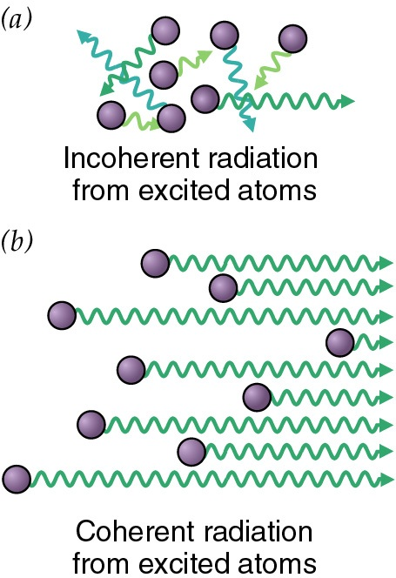
LASERS → a device that controls the way that energized atoms release photons.
Light Amplification by Stimulated Emission of Radiation
A laser is an electro-optical device which produces a tightly collimated beam of light at a single wavelength
First we must understand the difference between incoherent and coherent radiation
Ordinary light sources (light bulbs, fluorescent lights) produce incoherent light
lasers produce coherent, single wavelength (one color) light→ all atoms radiate in the same manner

Slide 11
Spontaneous vs. Stimulated Emission
Coherent radiation is produced when an atom undergoes stimulated emission.
Spontaneous emission occurs when an electron makes an unprovoked transition to a lower energy level
Stimulated emission occurs when an incoming photon induces the electron to change energy levels → amplification
E_{i} (higher energy)
photon
E_{f} (lower energy)
Spontaneous emission
Incoming
photon
Stimulated emission

Slide 12
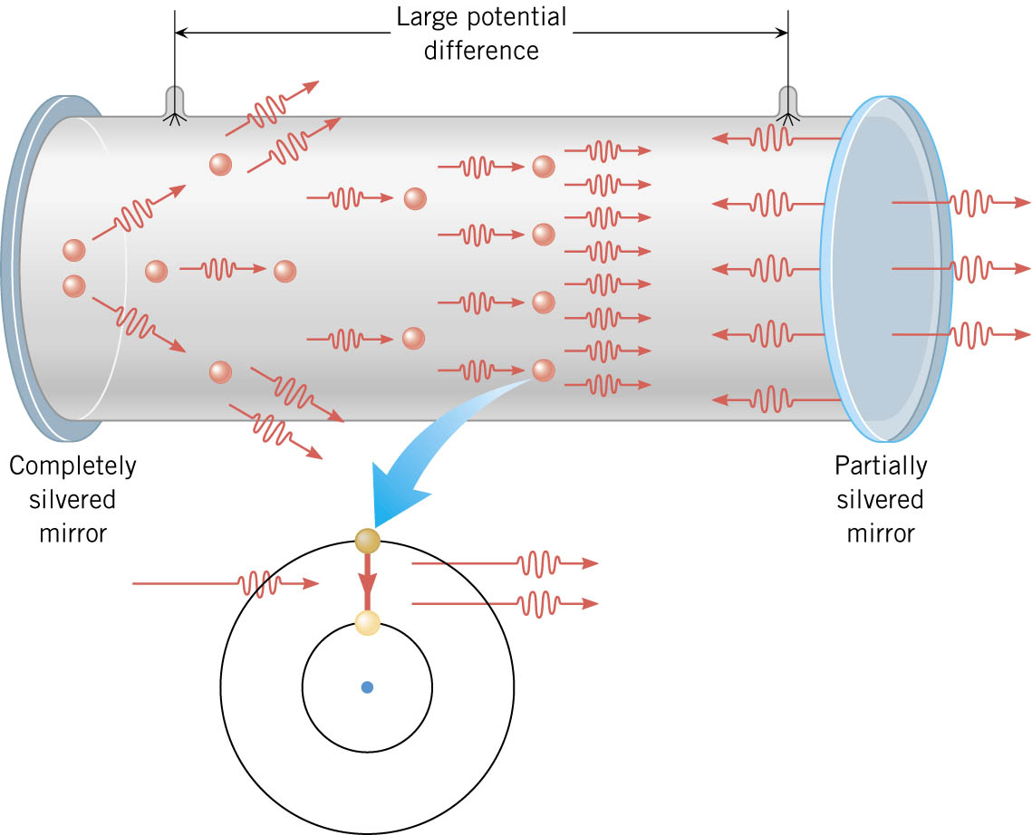
A Helium-Neon (HeNe) Gas Laser
The wavelength of the
HeNe laser is 633 nm

Slide 13
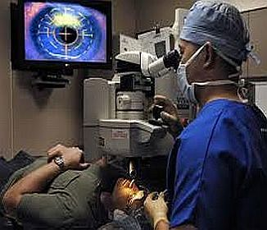
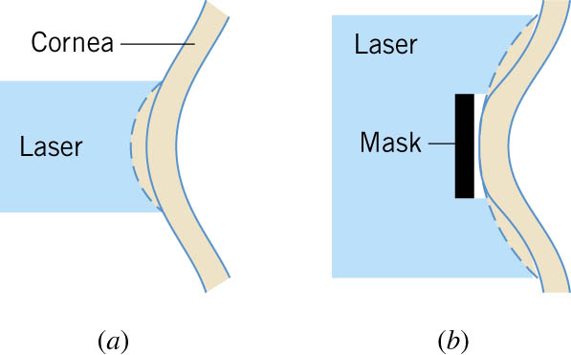
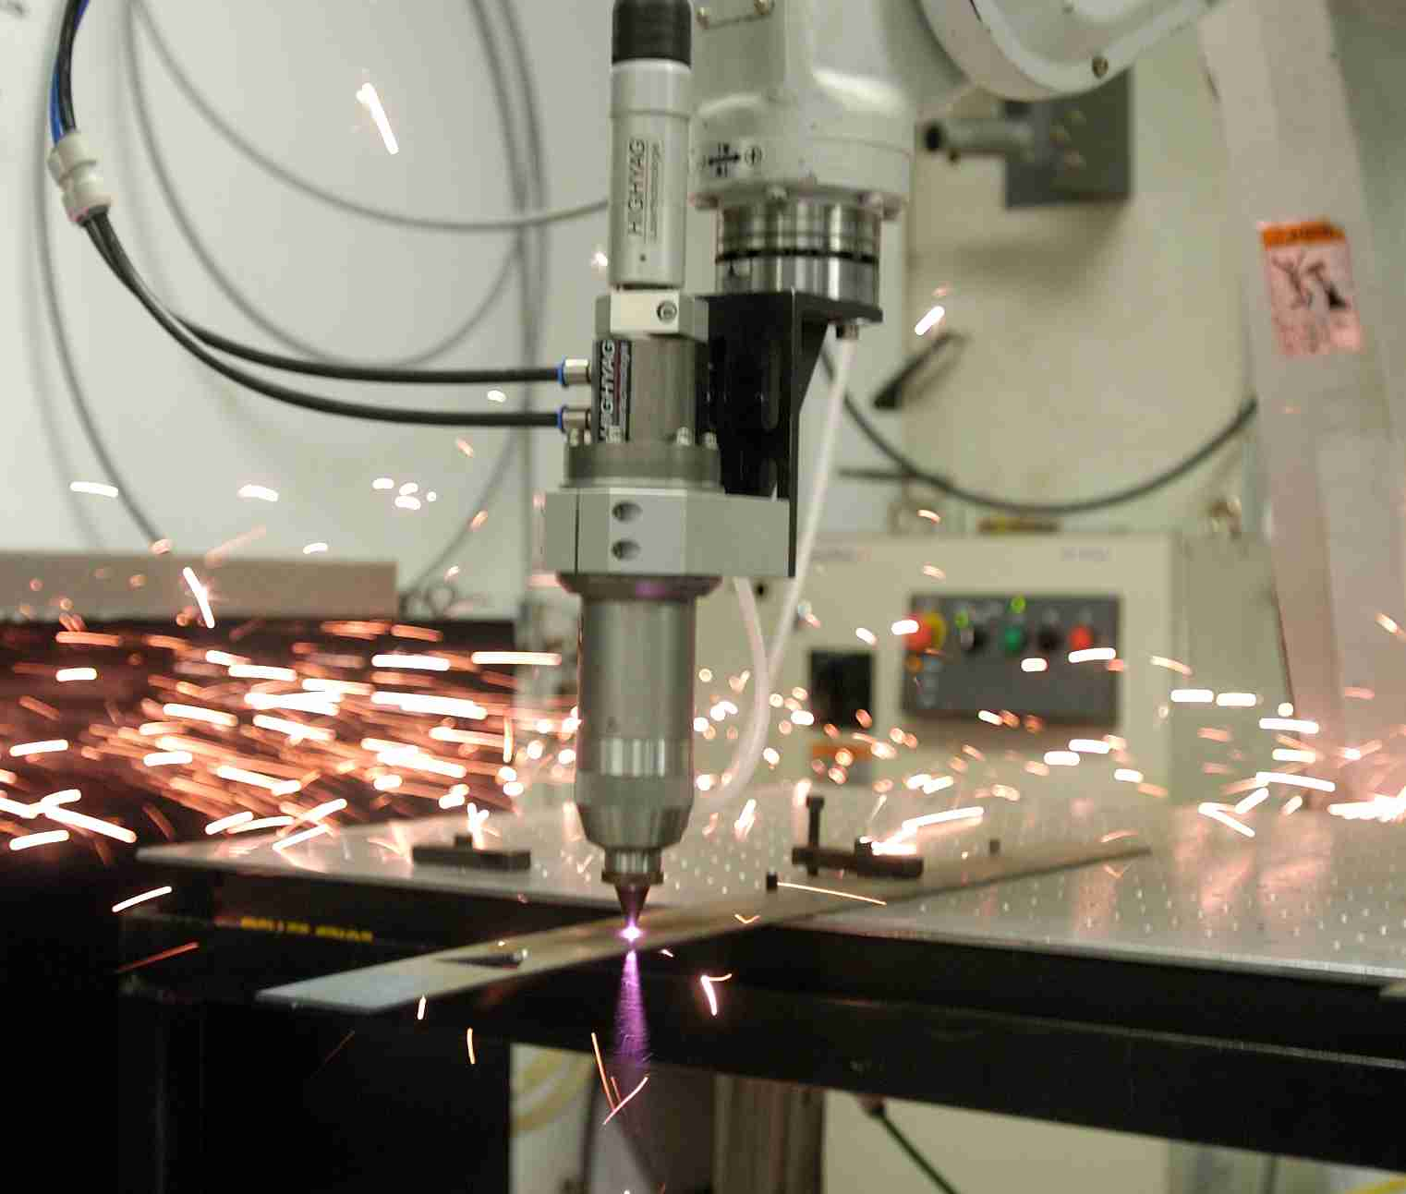
Applications of lasers
Laser surgery to correct for
nearsightedness, and
farsightedness
Laser cutting tools

Slide 14
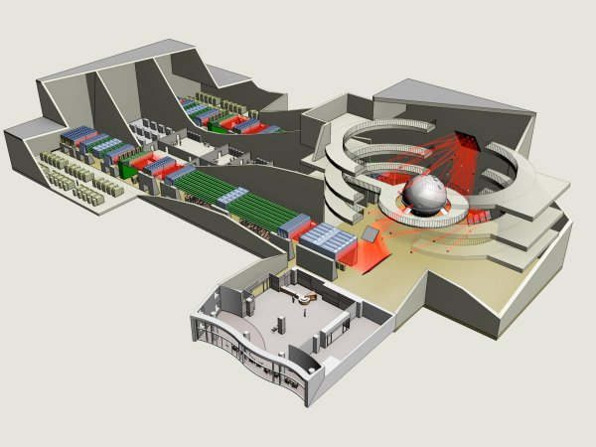
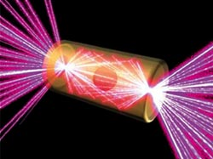
World’s most powerful laser -- NIF
Size → Kinnick Stadium
For 1 picosec
(10⁻¹² s) NIF produces 5 x 10¹⁴ W of laser power– more than all of US, a total of 1.85 MJ
Its 192 beams are focused on a tiny pellet, which gets compressed and heated to conditions similar to the interior of a star, 10 MK.
National
Ignition
Facility
Livermore, CA
5 mm

Slide 15
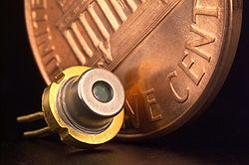
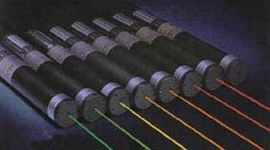
Solid State Laser Diodes
Diode lasers use semiconductor materials (tiny chips of silicon) as the lasing media
Power levels < 1 W
When current flows through the silicon chip it emits an intense beam of coherent light.
Diode lasers are used to read the information embedded in the pits in CD’s and DVD’s, and also to read UPC’s in bar code scanners and in laser pointers!
Come in a variety of
wavelengths (colors)

Slide 16
Applications of modern technology
Laser speed gun: sends out a laser beam that bounces off your car and back; from the time delay it calculated your car’s speed
CD burner: CD coated with a photosensitive dye that darkens when hit with laser light
Medical imaging methods
  x-rays
  CT and CAT scans
  MRI’s (Magnetic Resonance Imaging)

Slide 17
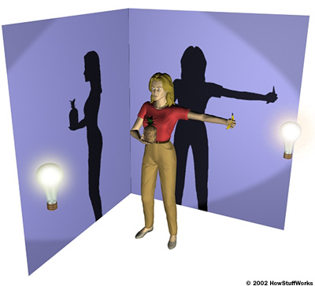
Tomography- constructing a 3D image from many 2D images
A shadow image can be misleading
two shadows taken from different angles provides a better picture
shadows taken at multiple angles gives a more complete picture
this is what a CT or CAT scan does

Slide 18
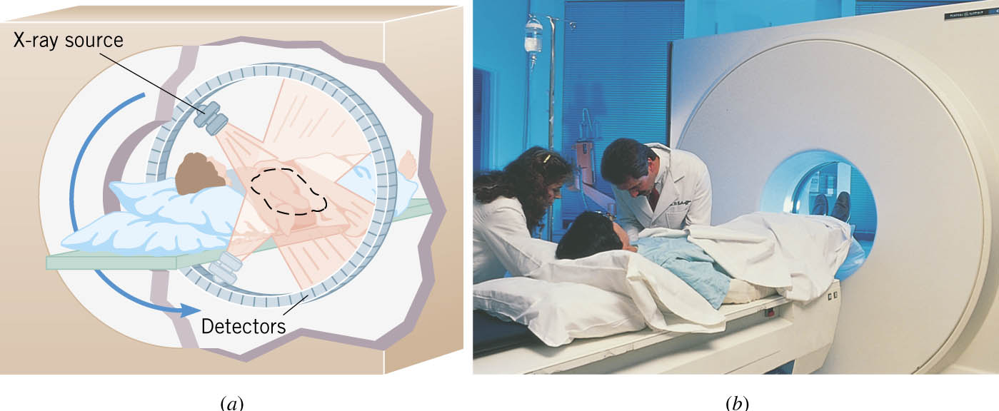
CAT (Computer Aided Tomography) Scans
X ray images are taken at many different angles
passing through the patient. Some of the slices
overlap. A full three dimensional image can be reconstructed using computers.

Slide 19
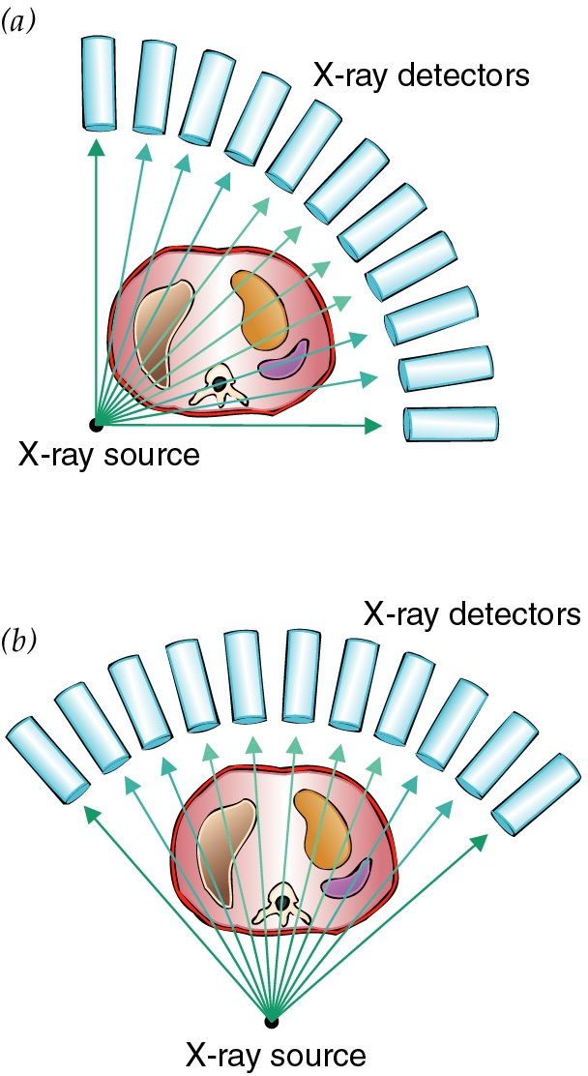
Computerized Tomography (CAT scan)
A computerized tomography or CT scan image is formed by analyzing x-ray shadow images taken at many different angles and positions
an x-ray source and an array of electronic detectors rotates around the patient as the patient slowly moves through the ring.

Slide 20
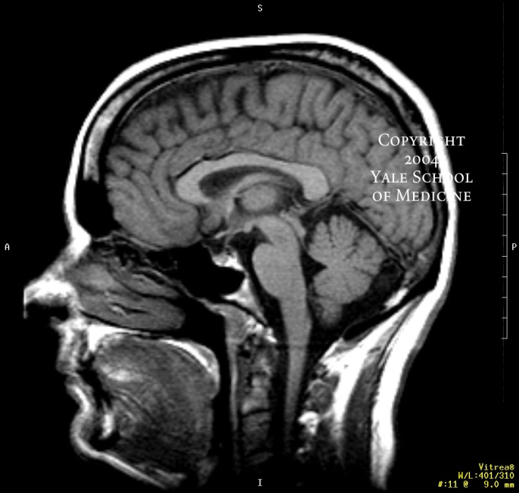
Magnetic Resonance Imaging
A CAT scan does a good job of imaging bones, but it does not provide a very good image of soft tissue
CAT scans expose the patient to a large dose of x-rays, which can have long term side effects → it is an invasive diagnostic
Magnetic Resonance Imaging (MRI) can provide high resolution images of soft tissue inside a body, and does not use any ionizing radiation. ➔ An MRI is safer than a CAT scan.

Slide 21
MRI images the protons of the H atoms in the body of the patient
If a magnetic field is turned on near a magnet, the magnet
flips until it is aligned with the magnetic field
The magnetic field is produced by passing a large current
through a solenoid
The protons in our body behave like tiny bar magnets
N
S
N
S

Slide 22
MRI – How it works
I. I. Rabi discovered that a magnetic field combined with
radio waves caused the nuclei of atoms to "flip,“ a
property now known as magnetic resonance.
Hydrogen (H) atoms in the body are used to create a signal that is processed to form an image of the body
Energy from radio waves excite the H atoms which then emit a signal that is detected by a receiving antenna
The radio signal can be made to encode position information by varying the main magnetic field using auxiliary coils that are rapidly switched on and off (this is what produces the banging noise that you hear)
The contrast between different tissues is determined by the rate at which the excited H atoms return to their equilibrium state

Slide 23
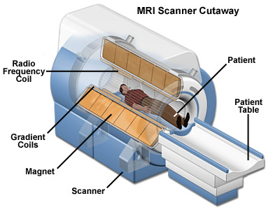
MRI Device
The largest and most expensive part of an MRI device is the superconducting magnet which must be cooled to below 4 K
The magnetic field in the device is about 60,000 times higher than the Earth’s field
It is critically important that NO iron is near the magnet. Iron would be pulled into the magnet.
http://abcnews.go.com/US/story?id=92745

