Slide 1
PHYS:1200 FINAL EXAM
FINAL EXAM: Wednesday December 17, 12:30 P - 2:30 P in LR-1 VAN
FE covers Lectures 23 – 36
The study guide, formulas, and practice final exam questions are posted on the Exam Information Link below.
We will review the practice final exam questions on Wed. Dec. 10, and Friday Dec. 12.

Slide 2
L-35 Modern Physics-3
Nuclear Physics
L-35 Nuclear structure
  what’s inside the nucleus
  what holds it together
  isotopes
  radioactivity
  half-life
L-36 Nuclear energy
  nuclear fission
  nuclear fusion
  nuclear reactors
  nuclear weapons

Slide 3
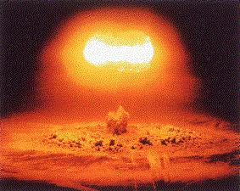

Slide 4
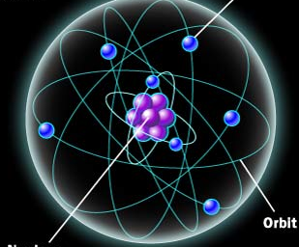
Structure of the nucleus
nucleus
Electron(-)
proton (+)
10⁻¹⁵ m
10⁻¹⁰ m
neutron (0)
The diameter of the nucleus is about 10⁻⁵ times smaller than the diameter of the atom.

Slide 5
The atom and the nucleus
the electron and proton have the same charge value, but the electron is − and the proton is +
  Q_{e} = − Q_{p} (charge value is 1.6 × 10⁻¹⁹ C)
  the neutron has no charge, Q_{n} = 0
the attractive force between the + protons and
the − electrons holds the atom together
the neutron and proton have about the same mass, and are about 2000 times more massive than the electron
  m_{p} ≈ m_{n} , m_{p} ≈ 2000 • m_{e} = 1.67 × 10⁻²⁷ kg
  the nuclear mass is about 99.9% of the atoms mass
What role do the neutrons play?

Slide 6
Nuclear Terminology
Atomic number Z = the number of protons in the nucleus, which is equal to the number of electrons in the atom, since atoms are electrically neutral. The atomic number is what distinguishes one chemical element from another
Neutron number N = the number of neutrons in the nucleus, atoms with the same Z but different N’s are called isotopes
Atomic mass number A = Z + N = the number of protons + neutrons, A determines the mass of the nucleus

Slide 7
Symbol for the nucleus of element X
Number of protons
and neutrons
N = A – Z
Number of
protons

Slide 8
Nuclei having the same number of protons, but different numbers of neutrons are called isotopes
Hydrogen 1 proton, 0 neutrons Deuterium 1 proton, 1 neutron Tritium 1 proton, 2 neutrons
Helium-3 2 protons, 1 neutrons He-4 (a particle) 2 protons, 2 neutrons
Carbon 6 protons, 6, 7, 8 neutrons
Uranium-235 92 protons, 235 – 92 = 143 neutrons

Slide 9
What holds the nucleus together?
The nuclear glue!
The nucleus contains positively charged protons, all stuck in a very small volume, repelling each other
so what keeps the nucleus together?
the nuclear force (glue)
this is where the neutrons play a role

Slide 10
the nuclear (strong) force
protons and neutrons exert an attractive nuclear force on each other when they are very close to each other.
However the nuclear force of the protons alone isn’t enough to hold the nucleus together, but the neutrons add more “nuclear glue” without adding the repulsive electric force.
stable light (Z < 50) nuclei have as many neutrons as protons
stable heavy nuclei (Z > 50) have more neutrons than protons, often many more
Z,
Since the proton and neutron have
roughly the same mass, the Nuclear
mass is about the mass of the protons
plus the mass of the neutrons. Nuclei
with the same number of protons and
neutrons lie on the straight line. As Z
Increases, N increases more rapidly.

Slide 11
What is radioactivity?
in some nuclei, there is a very delicate balance between electric repulsion and nuclear attraction forces.
some nuclei are just on the verge of falling apart and need to release some excess energy → an unstable nucleus
an unstable nucleus can disintegrate spontaneously by emitting certain kinds of particles or very high energy photons called gamma rays (γ’s) → radioactivity

Slide 12
Natural radioactivity
some nuclei are naturally radioactive and give off either alpha rays (He nucleus), bets rays (electrons) or gamma rays (high energy photons) randomly
the particles are classified in terms their ability to penetrate matter, gammas are the most penetrating and alphas the least penetrating. Gammas can go right through several inches of lead!
how do we detect these particles – using a Geiger counter

Slide 13
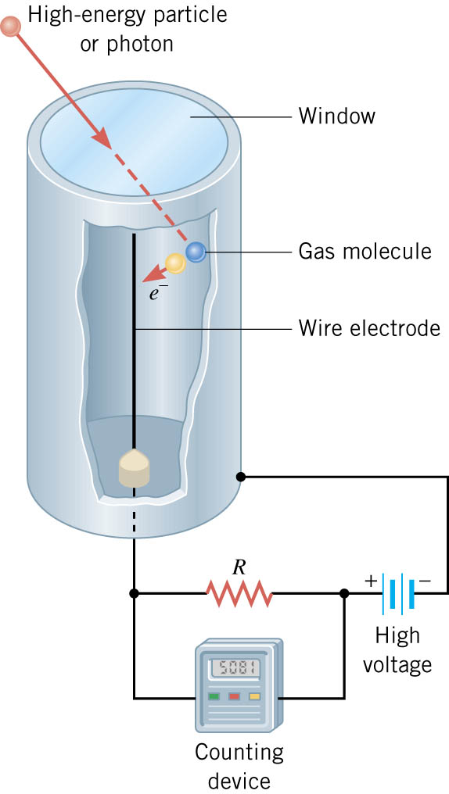
Geiger Counters
a gas filled metal cylinder with a positively charged wire down the center
the γ, β, or α ray ionizes the gas, and the resulting
electrons are collected
by the positive wire
the result is a pulse (blip) of current which is converted to a sound pulse

Slide 14
Geiger tube
+ High
Voltage
Electronic
counter
Demos

Slide 15
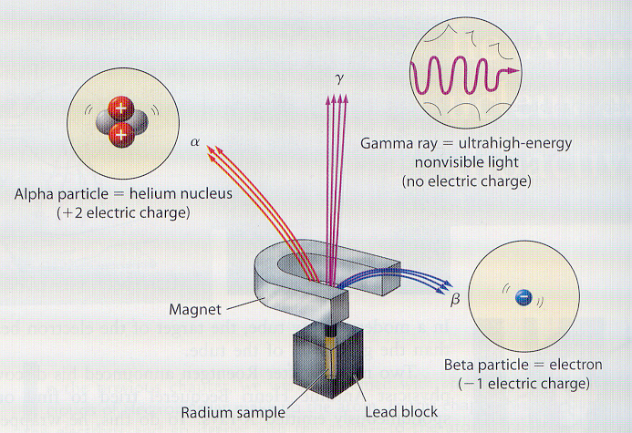
Alpha, beta and gammas in a magnetic field
Alpha and beta particles are charged, so they are deflected by
a magnetic field. Gammas are photons which are not deflected.
γ
α
β

Slide 16
Half-Life of radioactive nuclei
the decay of radioactive nuclei is a random process. If you have a sample of many unstable nuclei, you cannot predict when any one nuclei will disintegrate
if you start with N_{o} radioactive nuclei now, the HALF LIFE T_{1/2} is defined as the time for half of the nuclei present to disintegrate.

Slide 17
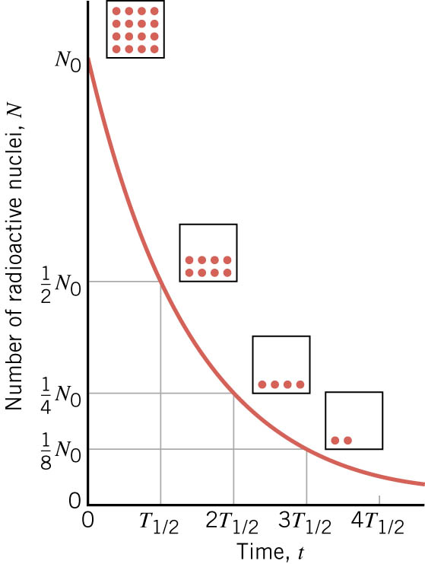
Half Life, T_{1/2}
Start, N₀
After one Half-life, ½ N₀
After two Half-lives, ½ (½ N₀)
After three Half-lives, ½ ( ½ (½ N₀))

Slide 19
T_{1/2} ≈ 2.5 min

Slide 20
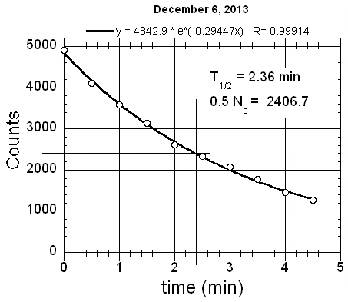

Slide 21
Nuclear reactions
decays to by emitting an alpha particle with a half life of 3.8 days
If we started with 20,000 atoms of Rn-222, then in 3.8 days we would have 10,000 atoms of Rn-222 and 10,000 atoms of Po-218
In 7.6 days we would have 5000 atoms of Rn-222, in 11.4 days, 2500 Rn-222’s, etc
Cobalt-60, T_{1/2} 5.27 years; decays by emitting betas and gammas

Slide 22
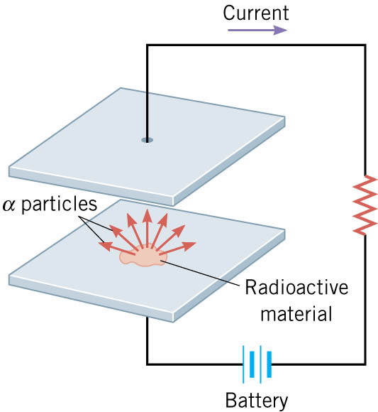
Smoke detectors use radioactivity
Smoke detectors have
a radioactive alpha
emitting source. The alpha particles ionize the air in the detector creating a current.
If smoke particles enter the detector they can interfere with the current causing it to drop, which sets off the alarm.
Americium 241

Slide 23
Carbon Dating
As soon as a living organism dies, it stops taking in new carbon. The ratio of carbon-12 to carbon-14 at the moment of death is the same as every other living thing, but the carbon-14 decays and is not replaced
The carbon-14 decays with its half-life of 5,700 years, while the amount of carbon-12 remains constant in the sample
By measuring the ratio of carbon-12 to carbon-14 in the sample and comparing it to the ratio in a living organism, it is possible to determine the age of a formerly living thing fairly precisely.

Slide 24
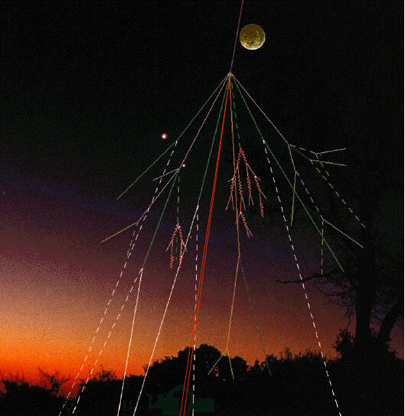
Natural Radioactivity
Radon gas
occurs in soil and can leak into basements. It can attach to dust particles and be inhaled.
cosmic rays – energetic particles from the cosmos enter the atmosphere and decay

Slide 25
Nuclear activation
Some nuclei that are stable can be
activated (made unstable) by
bombarding them with neutrons.
stable nucleus
neutron

Slide 26
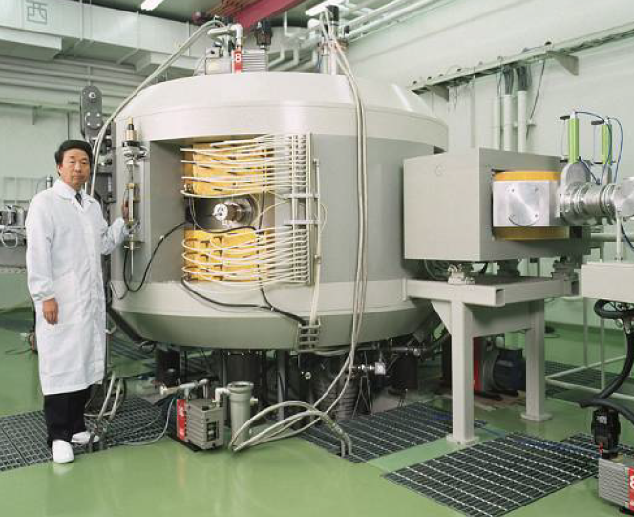
Cyclotron facility at UIHC
Nuclear medicine
A cyclotron is a device which accelerates charged particles producing beams of energetic protons
These protons are used to bombard materials to produce radioisotopes: unstable nuclei with a short half-life
The radioisotopes are implanted in patients for either diagnostic purposes or for cancer treatment

