Slide 1
L-11 (M-10) Rotational Inertia and
Conservation of rotational momentum
Why does a wheel keep spinning?
  Spinning ice skater Video
Why is a bicycle stable when it is moving, but falls over when it stops?
Why is it difficult to change the orientation of the axis of a spinning wheel?

Slide 2
Rotational inertia → symbol I
Rotational inertia is a parameter that is used to quantify how much torque it takes to get a particular object rotating
it depends not only on the mass of the object, but where the mass is relative to the axis of rotation
the rotational inertia is bigger, if more mass is located farther from the axis.

Slide 3
Rotational inertia and torque
To start an object spinning, a torque must be applied to it
The amount of torque required depends on the rotational inertia (I) of the object
The rotational inertia (I) depends on the mass of the object, its shape, and on how the mass is distributed. I is larger if more mass is further from the center.
The larger the rotation inertia, the more torque that is required to make an object spin
R
T
M
W= mg
Torque = T ⋅ R

Slide 4
rotational inertia examples
small rotational inertia ➔ large rotational inertia
m
m
m
m
M
M
M

Slide 5
How fast does it spin?
For spinning or rotational motion, the rotational inertia of an object plays the same role as ordinary mass for simple motion
For a given amount of torque applied to an object, its rotational inertia determines its rotational acceleration → the smaller the rotational inertia, the bigger the rotational acceleration

Slide 6
Same torque, different rotational inertia
Big rotational
inertia
Small rotational
inertia
spins
slow
spins
fast

Slide 7
Rolling down the incline
Which one reaches the bottom first, the solid disk or the hoop? They have the same mass and diameter.
The solid disk gets to the bottom faster because
it has a smaller rotational inertia

Slide 8
Speed of rotation
For motion in a straight line velocity is simply how far you travel in a certain time (meters per second)
How do we quantify how fast an object rotates?
We use a parameter called rotational velocity, simply the number of revolutions per minute for example -- the number of times something spins say in a second or minute (rpm’s- revs per min)
for example, the rotational speed of the earth spinning on it axis is 1 revolution per day or 1 revolution per 24 hours; the rotational speed of the earth around the sun is 1 revolution per year.
Another way to quantify rotational velocity is by the angular displacement of the object in degrees per second

Slide 9
Ordinary (linear) speed vs. rotational speed
the rod is rotating around the circle in the counterclockwise direction
ALL points on the rod have the SAME rotational speed – every point moves through the same angle in the same time
However, the red point in the middle has only half the linear speed as the blue point on the end.
every point on the green dashed line
moves through the same angle

Slide 10
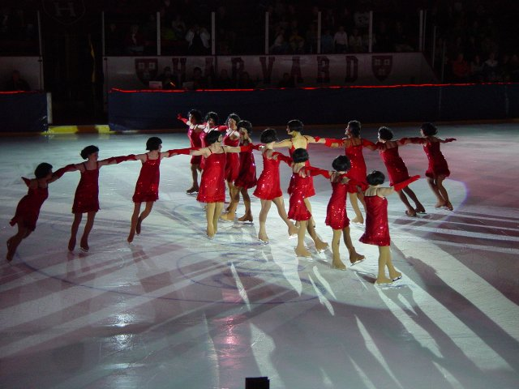
Ice Capades
Skaters farther from center must skate faster

Slide 11

Hurricanes
The winds are higher as you get farther from
the eye of a hurricane.

Slide 12
Rotational (angular) momentum
Rotational, or angular momentum is a measure of the amount of rotation an object has, taking into account its mass, shape and speed.
It is a law of nature that the total rotational (angular) momentum of an isolated system (no external torques) is constant.

Slide 13
Rotational (angular) momentum
A spinning object has rotational momentum
Rotational momentum depends on
  the mass of the spinning object
  where the mass is located
  how fast it is spinning
If the rotational inertia is larger, the rotational momentum is larger
If the rotational velocity is larger, the rotational momentum is larger

Slide 14
Conservation of rotational momentum
If no outside torques disturb a spinning object, it rotational momentum is conserved
The rotating masses on the rod form a system and keep spinning until the friction in the bearing slows brings it to rest.
Without friction in the axle, the system would keep spinning indefinitely.
Note that the total linear
momentum is zero.

Slide 15
Rotational momentum
The rotational momentum of a spinning object depends on both its rotational inertia and its rotational velocity (how fast it is spinning)
If either the rotational inertia or rotational velocity changes, the other parameter must also change to keep the rotational momentum constant
if the rotational inertia changes, the rotational velocity must also change
If the rotational inertia increases, then the rotational velocity must decrease
if the rotational inertia decreases, then the rotational velocity must increases

Slide 16
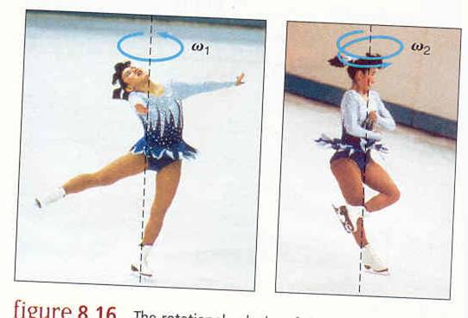
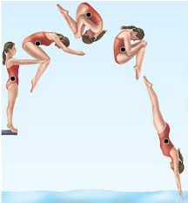
Conservation of Rotational momentum demonstrations
spinning ice skater
divers
Hobermann sphere
bicycle wheel
top
gyroscope
Slow spin Fast spin

Slide 17
You can change your rotational inertia
Big rotational
inertia
Small rotational
inertia

Slide 18
Spinning faster or slower
When your arms are extended you have a big rotational inertia
When you pull your arms in you make your rotational inertia smaller
If you were spinning with your arms out, when you pull your arms in you will spin faster to keep your rotational momentum constant
This works in figure skating and diving

Slide 19
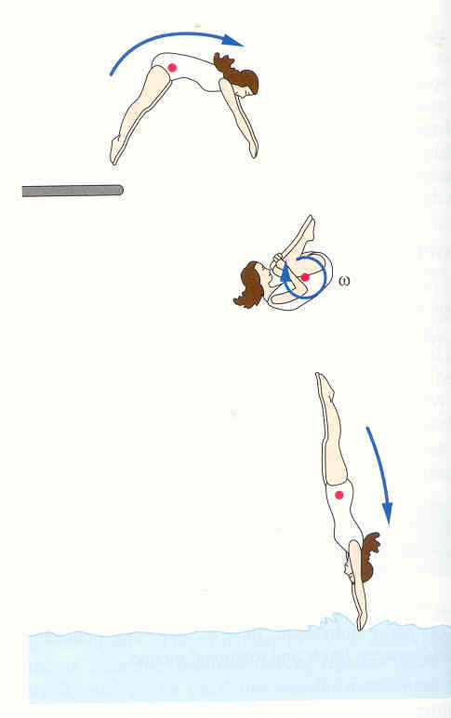
Divers use rotational momentum conservation to spin faster
the diver starts spinning when she jumps off the board
Her CG follows the path of a projectile
when she pulls her arms and legs in she makes her rotational inertia smaller
this makes her spin faster!

Slide 20
Example
Question: A figure skater with her arms outstretched spins at the rate of 1 revolution per sec. By pulling her arms and legs in, she reduces her rotational inertia to one-half its value when her arms and legs were outstretched.
→ What is her final rotational velocity?
Solution: Her angular momentum is conserved. If her rotational inertia is reduced by a factor of 2, her rotational velocity must increase by a factor of 2.
➔ Her final rotational velocity is 2 rev/sec.

Slide 21
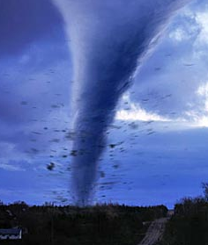
Tornadoes (Cyclones)
Technical term is mesocyclone
Intense updrafts stretch the mesocyclone vertically
As it is stretched upward it gets increasingly narrower
As it gets narrower, its rotation speed increases
This is similar to the ice skater who pulls hers arms in

Slide 22
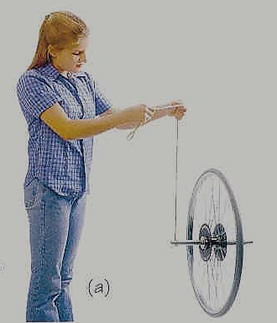
Spinning wheel defies gravity!
An object that can rotate about any axis is called a gyroscope
Once it starts spinning
its axle wants to keep
spinning in the same
direction.
It resists forces that try to change the direction of its spin axis
spinning
wheel

Slide 23
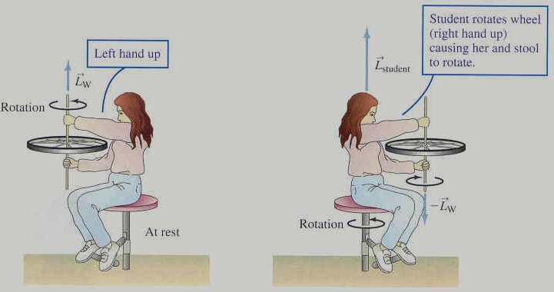
Falling off the stool!
The girl is holding a spinning wheel
while sitting on a
stool that can
rotate. As she
rotates the wheel,
She also rotates!
L
R
L
R
http://www.youtube.com/watch?v=V3UsrfHa4MQ

