Slide 1
L-8 (M-7)
I. Collisions II. Work and Energy
Momentum: an object of mass m, moving with velocity v has a momentum p = m v.
Momentum is an important and useful concept that is used to analyze collisions
  The colliding objects exert strong forces on each other over relatively short time intervals
  Details of the forces are usually not known, but the forces acting on the objects are equal in magnitude and opposite in direction (3rd law)
  The law of conservation of momentum which follows from Newton’s 2nd and 3rd laws, allows us to predict what happens in collisions

Slide 2
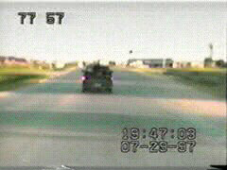

Slide 3
I. Physics of collisions: conservation of momentum
The concept of momentum is very useful when discussing how 2 objects interact.
Suppose two objects are on a collision course. A➔ ⬅B
We know their masses and speeds before they collide
The momentum concept helps us to predict what will happen after they collide.

Slide 4
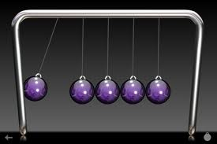
Law of Conservation of Momentum
A consequence of Newton’s 3rd law is that if we add the momentum of both objects before a collision, it is the same as the momentum of the two objects immediately after the collision. The collision redistributes the momentum among the objects.
The law of conservation of momentum and the law of conservation of energy are two of the fundamental laws of nature.
Newton’s Cradle
During the short time of the collision, the effect of gravity is not important.

Slide 5
Momentum conservation in a two-body collision,
How it works.
v_{B, before}
v_{A, before}
before
collision
B
A
v_{B, after}
after
collision
v_{A, after}
B
A

Slide 6
Example: big fish eats little fish
A big fish, M = 5 kg swimming at 1 m/s eats a little fish, m = 1 kg that is at rest. What is the speed of the big fish just after eating the little fish?
The two fishes form a system and their momentum before the “interaction” is the same as their momentum after the “interaction”.
Momentum before = M V_{before} + m (0) = 5 kg x 1 m/s
Momentum after = (M + m) V_{after} = (5 + 1) V_{after}
➔ 5 kg m/s = 6 V_{after} ➔ V_{after} = 5/6 m/s

Slide 7
Energy considerations in collisions
Objects that are in motion have kinetic energy:
KE = ½ m v² (Note that KE does not depend on
the direction of the object’s motion) more on this . . .
In the collision of two moving objects, both have KE
As a result of the collision, the KE of the objects may decrease because the objects get damaged, some heat is produced as well as sound.
Only if the objects bounce off of each other perfectly, with no permanent damage (perfectly elastic) is the KE conserved. “Real” collisions are never perfectly elastic.

Slide 8
Types of collisions
Elastic collision: the two objects bounce off each other with no loss of energy.
Inelastic collision: the two objects bounce off each other but with some loss of energy. Most realistic (everyday) collisions are of this type.
Completely inelastic collision: The two objects stick together after the collision. This type of collision involves the largest possible loss of energy.

Slide 9
“Super balls” make almost perfectly elastic collisions
A perfectly elastic “super ball” rebounds to the same height after bouncing off the floor; it leaves the floor with the same KE it had before it hit the floor
A “real” ball (not perfectly elastic) does not return to the same height; some of its KE is lost

Slide 10
Perfectly elastic collision
v = 0
v
before
m
m
v
after
m
m
momentum before = m v, KE_{before} = ½ mv²
momentum after = m v, KE_{after} = ½ mv²
Both momentum and KE are conserved

Slide 11
Completely inelastic collision: objects stick together → momentum is conserved but
KE is not conserved
BEFORE
v = 0
AFTER
2m
m
v
m
m
m
½ v
momentum before = m v + m 0 = m v
momentum after = (2 m) v/2 = m v
KE before = ½ mv²
KE after = ½ (2m)(v/2)² =1/4 mv²
= ½ KE before (half of the original KE is lost)

Slide 12
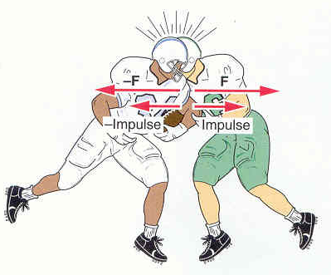
Football: a game of collisions
Football players exert
equal forces on each other in opposite directions

Slide 13
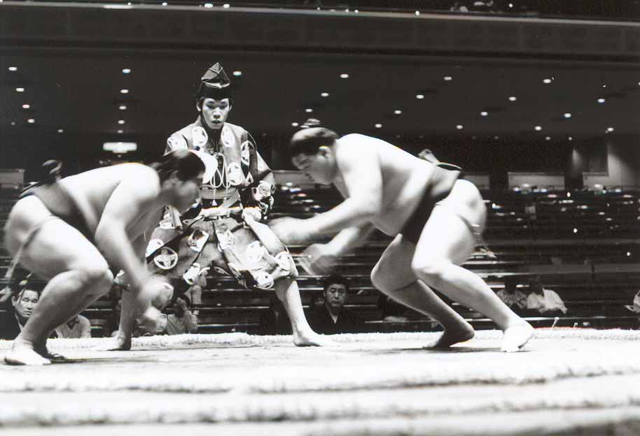
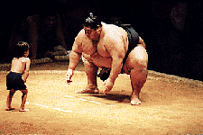
Sumo wrestling

Slide 14
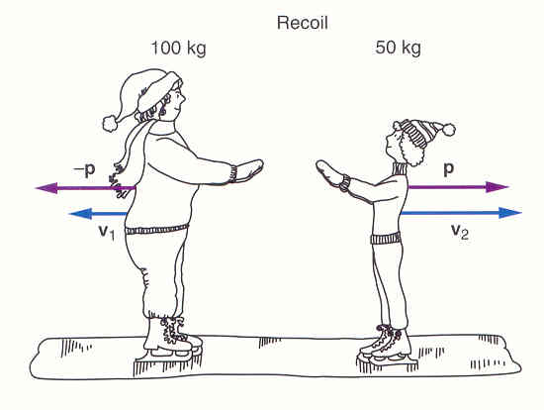
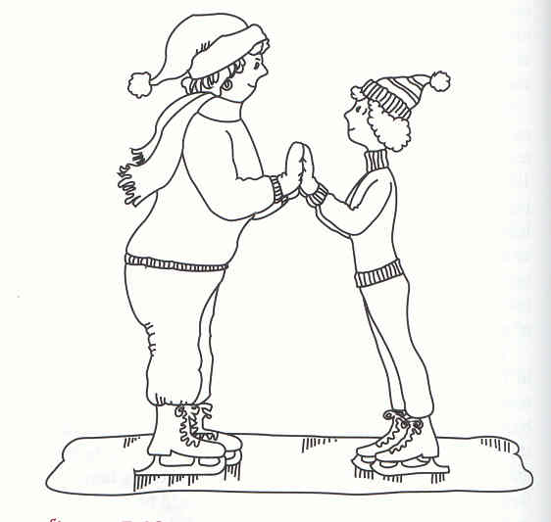
non-violent “collisions”
Two stationary ice skaters push off
both skaters exert equal forces on each other
however, the smaller skater acquires a larger speed than the larger skater.
momentum is conserved!

Slide 15
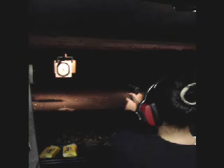
RECOIL
See You Tube for more videos of Rifle Shooting

Slide 16
Recoil
That “kick” you experience when you fire a gun is due to conservation of momentum
Before firing the cannon its momentum = 0
Conservation of momentum requires that after the cannon is fired the total (cannon plus ball) momentum must still be zero

Slide 17
Recoil of a cannon
Cannon mass M, velocity V; ball mass m, velocity v
The system (cannon and ball) are initially at rest so the initial momentum = 0
The momentum remains 0 after the ball is fired, so the final momentum = MV + mv = 0
The recoil velocity of the cannon in then: V = -mv/M
V is in the opposite direction to the ball and much less then the speed of the ball, v

Slide 18
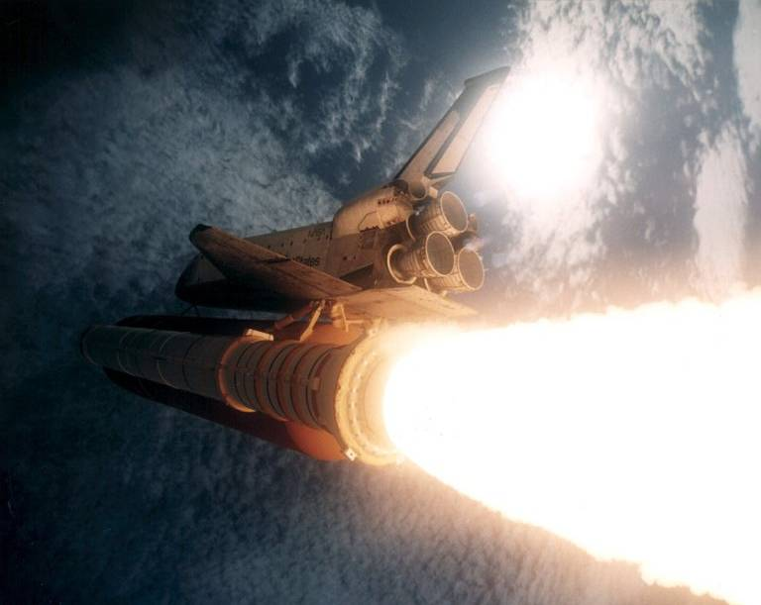
Recoil propels rockets
hot gas ejected at
very high speed

Slide 19
II. Work and Energy
These terms have a common meaning in everyday usage which may not be the same as the physics definitions
If we have “energy” we can do things: perform work (useful)
Energy is the ability to do work
We must give precise definitions to work and energy
We have already seen that objects in motion have KE = ½ mv²

Slide 20
Work and energy
According to the physics
definition, you are NOT
doing work if you are just
holding the weight above
your head
you are doing work only
while you are lifting the
weight above your head
In physics, WORK requires
both force and motion in the
direction of the force

Slide 21
Work requires:
(a) force and (b) motion (displacement) in the direction that the force acts
displacement, s
Force, F
mg
Work W = force (F) x displacement (s):
W_{F} = F s
Unit of work:
  force (N) x distance (m) = N m
  1 N m = 1 J (Joule)
Gravity, mg also acts on the box but does NO work because there is no vertical motion

Slide 22
Physics definition of WORK
to do work on an object you have to push the object a certain distance in the direction that you are pushing
Work = force x displacement = F s
If I carry a box across the room I do not do work on it because the force is not in the direction of the motion

Slide 23
Who’s doin the work around here?
NO WORK
WORK

Slide 24
A ramp is actually a machine
A machine is any device that allows us to accomplish a task more easily
it does not need to have any moving parts.
WORK DONE
= big force × little distance or little force × big distance

Slide 25
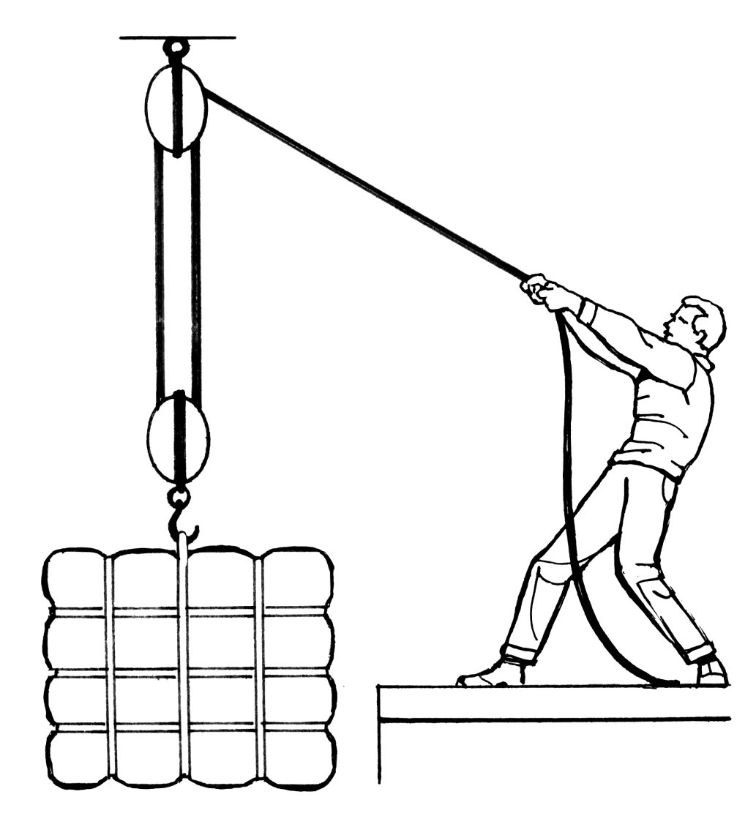
A lifting machine: Block and tackle

