Slide 1

L-14 Fluids - 3
Fluids at rest → Fluid Statics
  Why things float ➔ Archimedes’ Principle
Fluids in Motion → Fluid Dynamics
  Hydrodynamics
  Aerodynamics

Slide 2
Review: Archimedes principle
A
h
F_{B}
W_{O}
♦ The buoyant force on an object in a fluid equals
the weight of the fluid (e.g., water) which it displaces.
♦ Anything less dense than water will float in water
♦ water weighs 10N/liter➔ each liter of displaced water
provides 10 N of buoyant force

Slide 3
Will it float?
The buoyant force is always there whether the object floats or not
The object will float if the buoyant force is big enough to support the object’s weight
The object will displace just enough water so that the buoyant force = its weight
If the object is completely submerged, and the weight of the displaced water is less than the weight of the object, the object will sink
Objects that have a density less than water will float- when fully submerged, they weigh less than the water, so the water supports them
An object will float in a liquid that is denser than it;
➔ a steel bolt will float in mercury

Slide 4
Floating or sinking objects
lighter object
heavier object
too heavy
The weight of displaced
water is less than the
weight of the object

Slide 5
Will it float?
A container having a mass of 500 kg and a volume of 450 liters falls off of the deck of a cargo ship. Will it sink or float?
Answer: W = mg = 500 kg x 10 m/s² = 5000 N
Buoyant force required for floating = 5000 N
= 10 N/liter x volume of container submerged
So, volume of container must be at least 500 liters ➔ Since container volume is only 450 liters, it will sink!

Slide 6
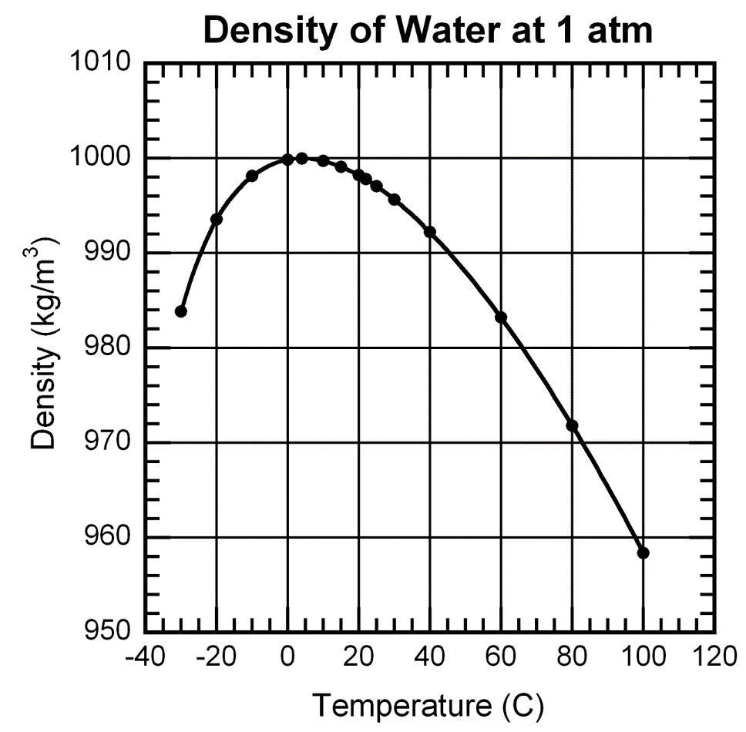
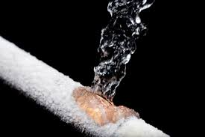
Water is weird stuff!
density = mass/volume → volume = mass/density
since the mass is constant → volume ~ 1/density
Maximum density at T = 4 C
The pressure of expanding
ice can break steel pipes.

Slide 7
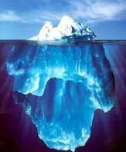
Why does ice float?
Water, the most plentiful
substance on earth is also
one of the most unusual in
its behavior in that it
expands when it freezes.
Since it expands, the density of ice is slightly less than the density of water (958 kg/ m³ as compared to 1000 kg/ m³ for water). So the part of the iceberg above the surface contains less than 10 % of the total volume.

Slide 8
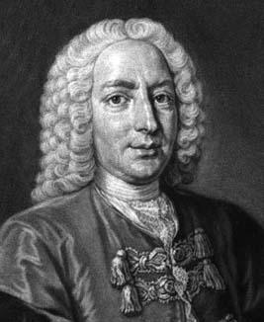
Fluid Flow → fluid dynamics
A Swiss mathematician,
born in 1700.
He applied the laws of mechanics to the problem of fluid flow
He developed the basic principle that explains, for example, how airplanes stay up in the air.
Daniel Bernoulli

Slide 9

How do we measure fluid flow?
We can time how long it takes to fill a bucket, say 30 seconds
the flow rate is then 1 bucket say per 30 seconds
in other words, the flow rate is volume of fluid per unit time
gallons per min (gpm), liters/s, cubic feet per min (cfm),
or m³/s
➔ Q_{V} = volume flow rate

Slide 10
Volume flow rate → Q_{V}
If the water comes out of a tube of cross sectional area A with a flow speed u the volume flow rate = Q_{V} = u × A (m/s ×m²)
To measure u just see how long it takes to fill a gallon jug from a hose and measure the diameter of the hose.
A
u
m³/s

Slide 11
Mass flow rate → Q_{m}
We could also measure how much mass comes out per unit time – kg/s for example
if you are using a fluid of density ρ coming out of a hose of cross sectional area A with speed v the mass flow rate is
mass flow rate = Q_{m} = ρ × u × A = ρ Q_{V}

Slide 12
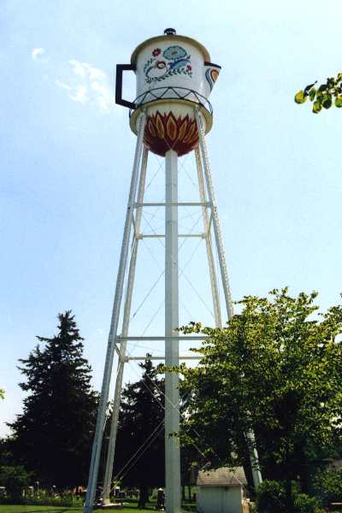
What makes water flow?
gravity
by placing the water up high, the pressure at the bottom is high enough to supply water to all parts of town that are lower than the tower
Stanton, IA
Montgomery Co. Pop. 664

Slide 13
Pressure differences
P₂
P₁
Water experiences a resistance to flow
a pressure difference must be maintained across the ends of the pipe to push the water along → P₂ must be greater than P₁
this pressure difference can maintained by a water pump

Slide 14
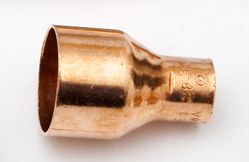
Water does not disappear!
If water goes in one end of a pipe it must come out the other end (if there are no leaks). Sounds obvious, but it has a number of interesting consequences!
This applies to pipes that have constrictions
v₁, A₁
v₂, A₂
swage
nipple

Slide 15
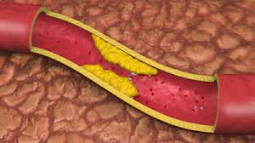
Principle of the continuity of flow
since whatever goes in must come out, we have that the incoming flow rate – outgoing flow rate or, Q_{V1} = Q_{V2}
➔ v₁ A₁ = v₂ A₂ (continuity principle)
thus the fluid in the narrow part of the tube must flow FASTER that the fluid on the left.
Cardiologists use this to
determine if arteries might
be clogged.

Slide 16
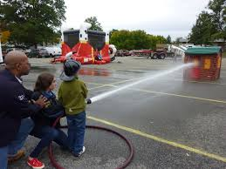
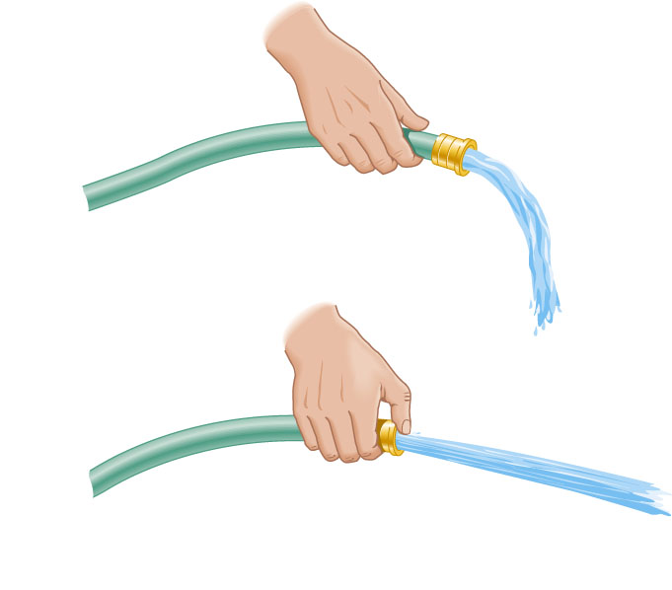
Other examples - the nozzle effect
You use this principle whenever you hold your finger over the end of the hose to make the water spray farther.

Slide 17
An amazing thing about moving fluids
The pressure in a moving fluid is less than the pressure in a fluid at rest → this is Bernoulli's Principle
Where a fluid moves faster its pressure is lower, where it moves slower, its pressure is higher
As we will see, this is the principle that allows airplanes to fly

Slide 18
You can demonstrate Bernoulli’s principle with a sheet of paper!
low pressure
High pressure
Sheet of
paper

Slide 19
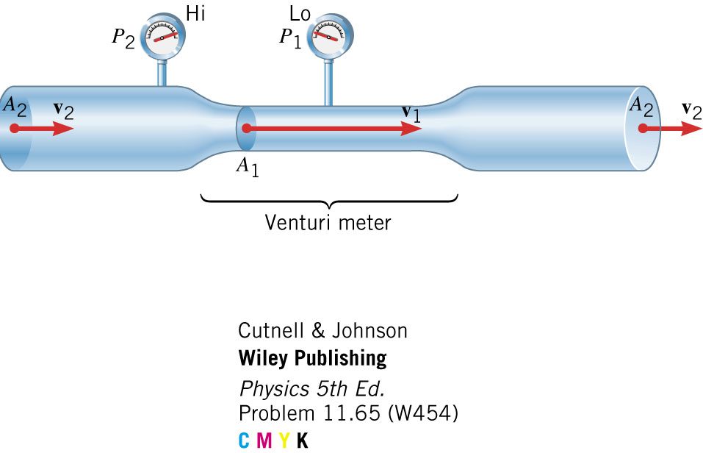
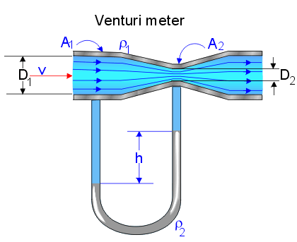
The Venturi Meter
Pressure is lower in the right lube because
the air moves faster there, so the liquid rises

Slide 20
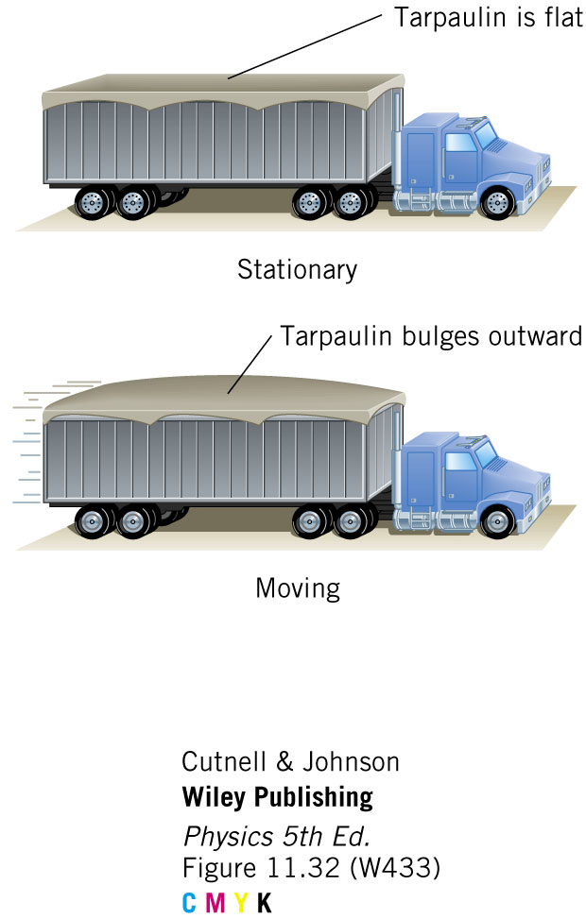

Slide 21

Atomizers (perfume spritzers)
Using the Bernoulli effect,
fine droplets of liquid are
formed with this device

Slide 22


