Slide 1
L 17 - Thermodynamics [2]
Science dealing with the relationship
between thermal energy (random molecular motion) and work (organized motion), and the conversion of one into the other
Today’s topics
  Practical thermal effects
  Devices for temperature measurement
  Mechanisms of heat transfer

Slide 2
Thermal Energy and
Work Energy
The random motion of the atoms is thermal energy
The upward motion of the piston is work energy

Slide 3
Thermocouples
180 F
two different metals
AMPS

Slide 4
Thermocouples- measure Temp.
Is composed of 2 wires of different metals welded together
when the tip gets hot an electrical current is produced
The current is proportional to the temperature
It can be used over a wide range of temperatures
500 °F

Slide 5
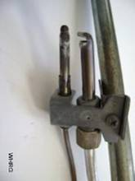
Thermocouples used as safety devices
a thermocouple is used in gas heaters, dryers, and fireplaces to protect against explosions
a thermocouple is placed in the pilot light
as long as the pilot light is on, the thermocouple is hot and current flows
a circuit detects the current and allows the main gas valve to open
if the pilot light is out, the circuit prevents the main gas valve from opening
Thermocouple
Pilot light
current gas

Slide 6
Thermal Expansion
L₁
Metal bar at T₁
Metal bar at T₂ > T₁
L₂
The length of a bar of metal increases when it is heated
Actually, all dimensions expand by the same percentage
Expansion must be taken into account when designing roads and bridges in climates that vary significantly from winter to summer – all materials expand, steel, concrete, asphalt . . .

Slide 7
Thermal Expansion
Most substances expand when heated
We use a parameter, α called the coefficient of thermal expansion to quantify this effect
The length of a metal bar increases from L₀ to L
(ΔL = L – L₀), when it is heated from T₁ to T₂
(ΔT = T₂ –T₁)
Change in length = ΔL = α L₀ ΔT
For copper, α = 17×10⁻⁶ per deg. C
Change ΔL = (17×10⁻⁶ per C)(1 m)(100 C-22 C)
= 0.0013 m = 1.3 mm

Slide 8
Coefficients of linear expansion
SUBSTANCE | α (per deg C)
aluminum | 23 × 10⁻⁶
brass | 19 × 10⁻⁶
glass | 9 × 10⁻⁶
rubber | 80 × 10⁻⁶
Ice | 51 × 10⁻⁶
lead | 29 × 10⁻⁶
steel | 11 × 10⁻⁶
concrete | 10 × 10⁻⁶

Slide 9
winter/summer expansion gaps

Slide 10
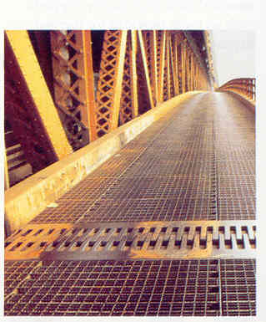
expansion gaps on bridges

Slide 11
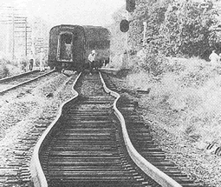
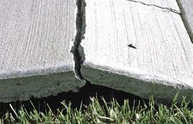
Thermal expansion problems
No room for thermal expansion
result ➔ buckling

Slide 12
Areas and volumes expand too!
cold
hot
cold
hot

Slide 13
Does the whole get bigger or smaller when heated?
cold
hot
Both the inner and outer diameters
increase when the ring is heated

Slide 14
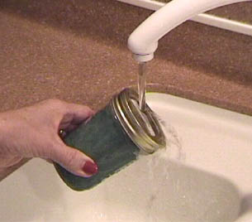
Hot water causes the lid to expand, making it easier to unscrew it.

Slide 15
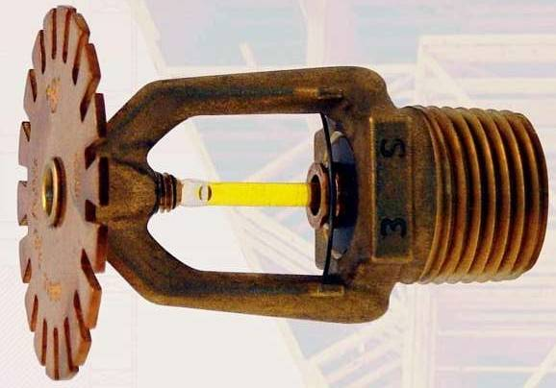

Fire sprinklers are triggered by thermal expansion of a liquid

Slide 16
Bi-Metal strips
thermal expansion of metals is put to good use in a bi-metallic strip.
it is two strips of different metals bonded together
metal A
metal B

Slide 17
Heating a Bi-metal strip
when heat is applied to the bi-metallic strip, both metals expand, but by different amounts!
result:
The metal with the
higher thermal
expansion coefficient is on top
The red side expanded more
than the blue side, so the strip bends toward the blue side.

Slide 18
Bi-Metal strip thermal switch used to turn power off when a preset temperature is reached
ON
OFF
Used in coffee makers and hair dryers

Slide 19
Heat Flow
HEAT
HOT
COLD
Heat is the energy that flows from one body to another because of their temperature difference
There are 3 ways that heat can be transferred:
  convection
  conduction
  radiation

Slide 20
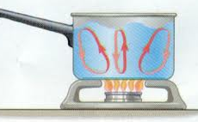
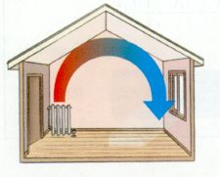
Heat transfer by Convection
heat is transferred from one location to another by the bulk movement and subsequent mixing of liquids or gases (fluids), but NOT in solids.
when water is boiled, hot water at the bottom rises and mixes with cooler water at the top
Hot air rises:
  in winter, want hot air in at lower level
  in summer, cold air in at upper level
convection
currents
Notes:
20

Slide 21

Heat transfer by conduction
heat is transferred directly through a material, with no bulk movement of material
only energy moves (molecules in a solid
are not free to move, but can vibrate)
iron is a poor
conductor
of heat
Notes:
21

Slide 22
heat conduction
Cross sectional
area A
L
HOT
COLD
Heat Flow
Heat Flow rate depends on A / L and a property
unique to the material, called thermal conductivity
Notes:
22

Slide 23
Thermal Conductivity: a parameter that quantifies the ability of a material to conducting heat.
Material | Thermal conductivity
metals | 14 - 400
wood | 0.15
glass | 0.8
wool | 0.04
Goose down | 0.025
Styrofoam | 0.01
Metal | Thermal Conductivity
Silver | 406
Copper | 385
Aluminum | 205
Brass | 109
Iron | 80
Steel /SS | 50/14
Notes:
23

Slide 24
Heat transfer by Radiation
The warmth you feel from the sun is the sun’s thermal radiation
It travels through the vacuum of space to reach earth, no material is necessary (takes 8 minutes)
you can feel its effects even though you cannot see the radiation.
you can feel the thermal radiation from a fireplace
Objects not in contact with liquids gases or other solids loose heat by radiation
Notes:
24

Slide 25
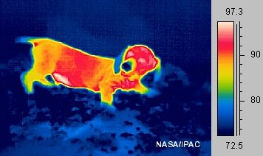
Thermal Radiation
The amount of thermal radiation emitted by an object is proportional to its temperature raised to the fourth power ~ T⁴
Doubling the temperature will increase the amount of thermal radiation by
2⁴ = 2 x 2 x 2 x 2 = 16

