Slide 1
L 24 Electricity & Magnetism [2]
static electricity
  the charging process
  the van de Graff generator
  electrostatic shielding
liquid and gaseous conductors
lightning
frogs legs and batteries
voltage, current, and resistance

Slide 2
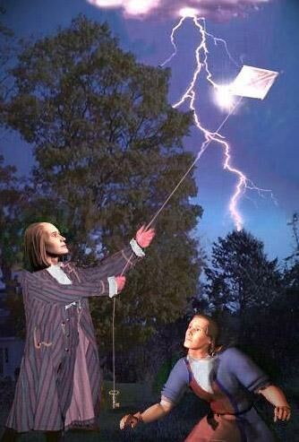
review – electric charge
Matter has two basic properties
    mass → gravitational force
    charge → electric and magnetic forces
      positive charge
      negative charge
electric forces
    like charges repel +/+ or - / -
    unlike charges attract + / -
charge is measured in Coulombs [C]
all charge is a multiple of the basic unit of charge ➔ e = 1.60217646 × 10⁻¹⁹ C
charges cannot be divided into smaller units

Slide 3
Where is the charge?
the charge is bound in atoms
  positive → protons
  negative → electrons
matter is electrically neutral → it has the same amount of positive and negative charge
only the electrons can be transferred from one object to another by rubbing (friction)
  to make an object (−) put electrons on it
  to make an object (+) remove electrons from it

Slide 4
Charging by friction
If you rub plastic with fur, electrons are rubbed onto the plastic making it negative
if you rub glass or plastic with silk, electrons are rubbed off the glass making it positive
charge can be transferred to other objects
  charge can be transferred to or from conductors or non-conductors
  charge (electrons) can only move through conductors.
  only the electrons can be transferred and move through conductors

Slide 5
Charge is Conserved: Example-1
10 Coulombs of negative charge are transferred from object A to object B. What, then is the net charge on each object?
Answer:
  → object A has a net charge of +10 C
  → object B has a net charge of 10 C.
A
-10 C
B
+10 C
-10 C

Slide 6
Charge is Conserved: Example-2
Initially, object A has a charge of –5 C and object B has a charge of +5 C. If –10 Coulombs of negative charge are transferred from object A to object B. What is the final charge on each object?
ANSWER: Removing –5 C from A leaves it with no net charge. Removing 5 more leaves it with a net +5C. So, object A has a net charge of +5 C and object B has a net charge of –5 C.
Note that the net charge (= 0) is the same before and after.
5 C
-10 C
+5 C
A
B
+5 C
–5 C
A
B

Slide 7
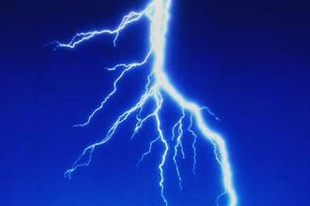
Lightning-atmospheric electrostatics
National Weather Service: about 25 million lightning strikes each year in the US
400 people struck, 51 killed; odds 1/10,000 in lifetime
causes 100 million dollars in damage each year in the US
lasts only a thousandth of a second, with up to 200,000 A
(typical hairdryer uses 10 A)
produces the thunder!

Slide 8
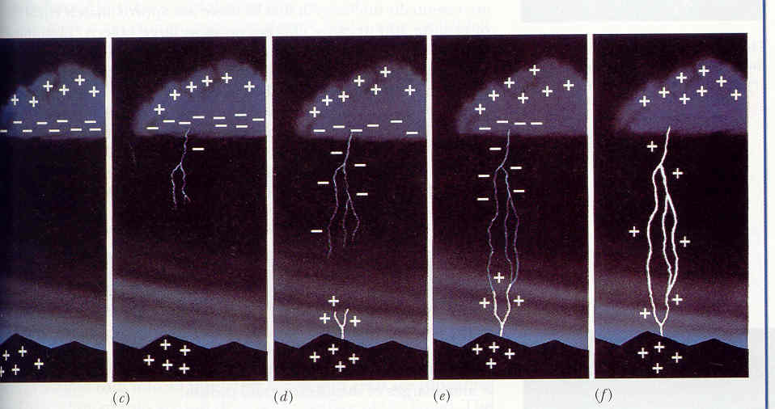
development of a lightning bolt
charge
separation
stepped
leader
leader &
streamer
leader meets
streamer
lightning
bolt

Slide 9
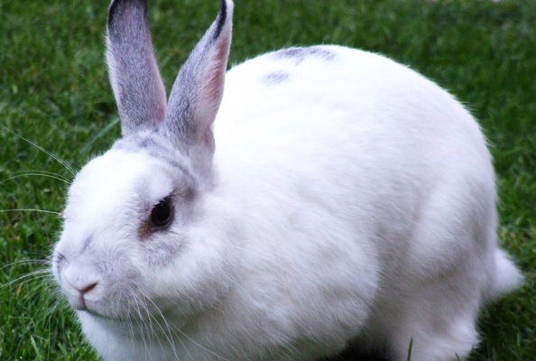
Electrostatic shielding
The metal cage protects
the rabbit

Slide 10
Electrostatic shielding
The effect of the high voltage on the van de Graff generator stops on the outside of the metal cage ➔ The rabbit is unharmed!
Being inside your car during a lightning storm offers you some protection
radio signals cannot penetrate through a metal enclosure
the metal bars (rebar) that reinforce the concrete walls affects radio transmissions

Slide 11
Liquid and gaseous conductors
Except for mercury, which is a conducting liquid at room temperatures, the metallic conductors are solids
Non-conducting liquids can be made conducting by adding ionic substances such as salt or acids
Gases are non-conducting unless they are ionized (electrons removed from the atoms), then they become good conductors

Slide 12
Pure water is non-conducting
clean water will not conduct electricity
if salt or acid is added, however, it will conduct electricity
SALT
H₂O
carbon electrodes

Slide 13
A salt water solution is a conductor
When salt NaCl (sodium chloride) is added to water H₂O, the NaCl molecule dissociates into a positive ion Na⁺, and a negative ion Cl⁻ .
Thus the solutions contains both positive and negative ions, both of which can conduct electricity.
Electric current can pass through dirty bath water and through you also!
we are conductors – water + Na⁺ + Cl–

Slide 14
Gas discharges
When a high voltage is applied to a gas-filled tube,
the gas becomes ionized → one or more electrons
are removed from each atom.
The ionized gas is a conductor → current can flow.
The excited gas atoms emit light of a characteristic color
PLASMA
Gas in
tube
not blood!
High Voltage
Source

Slide 15

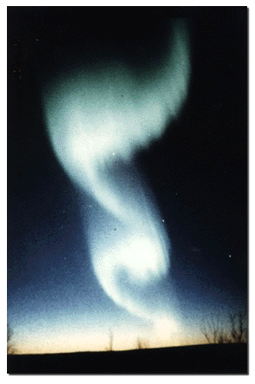
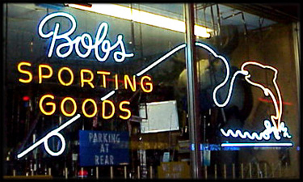
examples of electrical discharges
the Aurora
fluorescent lamp
neon lights

Slide 16
applications of electrostatics
electrostatic attraction to put ink droplets on paper
  Xerox machines
  Inkjet printers
  Paint sprayers
Sorting particles by charge and weight
electrostatic precipitators use the attraction of charged dust to remove dust particles from smoke.

Slide 17
Removing pollutants
Positive
cylinder
Smoke
stack
Charging units
spray electrons
on the soot
particles
soot

Slide 18
Current– flow of electric charge
Ordinarily, the free electrons in a piece of copper roam about randomly within the conductor – no current!
However, if I connect a battery to the copper bar the electrons are attracted to the positive side of the battery and will flow through the bar and connecting wires ➔ this is called current – the flow of charge
copper
An electric circuit!
+
Duracell
But, how does a battery work?

Slide 19
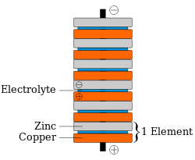
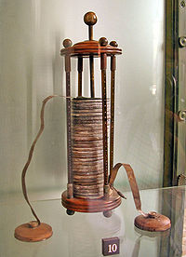
Batteries and frog’s legs
Galvani found that a frog leg hung on a copper hook twitched when touched by an iron scalpel.
Volta realized that the frog’s leg was just acting as a conductor, and the two metals produced the current --- the first battery
Volta replaced the frog’s leg with brine soaked paper placed between strips of Cu and Zn

Slide 20
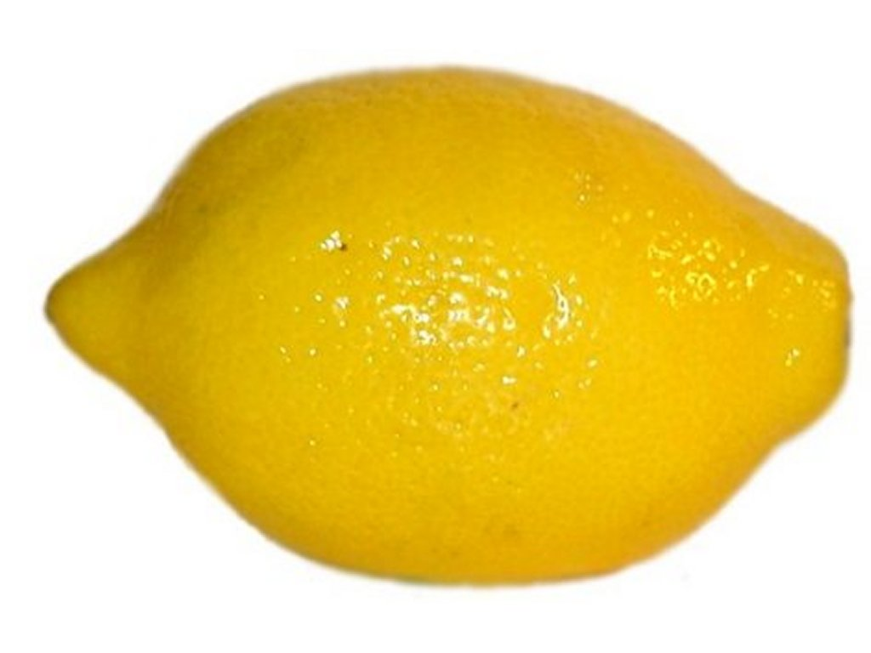
Batteries
use chemical energy to produce electricity
two dissimilar metals immersed in a conducting fluid (like an acid for example) cause a chemical reaction which produces electric current.
Cu Zn
Citric acid
acid
Cu
Zn

Slide 21
Potential difference or Voltage (V)
Voltage is what causes charges to move in a conductor → it produces an electrical force on the electrons which causes them to move
Voltage plays a role similar to pressure in a pipe → to get water to flow there must be a pressure difference between the ends, this pressure difference is produced by a pump
A battery is like a pump for charge → it provides the energy for pushing the charges around a circuit
water
Pump
charge
Battery

Slide 22
Inside a Duracell 1.5 Volt battery
Metal Cap
plastic case
+
Carbon center
electrode
Zinc outer
electrode
DURACELL
- Bottom
electrode
Electrolytic
paste

Slide 23
Electric current (symbol I)
Electric current is the flow of electric charge q (Coulombs)
It is the amount of charge q that passes a given point in a wire in a time t,
Current is measured in amperes
1 ampere (A) = 1 C / 1 s
q

