Slide 1
L 32 Light and Optics-4
Up to now we have been studying geometric optics
Today we will look at effects related to the wave nature of light – physical optics
  polarization
  interference
    thin film interference
    diffraction
    resolving close objects

Slide 2
Light “rays” travel in straight lines
Unless:
reflection
refraction

Slide 3
Effects due to the wave nature of light
Thus far we have been dealing only with geometrical optics
In geometrical optics we deal only with the behavior of light rays → it either travels in a straight line or is reflected by a mirror, or bent (refracted) when it travels from one medium into another.
However, light is a WAVE, and there are certain properties that can only be understood by taking into account the wave nature of light.

Slide 4
Diffraction: bending of light passing through an aperture (hole)
A simple shadow of the slit is not
observed, because the light spreads
out when passing through it.

Slide 5
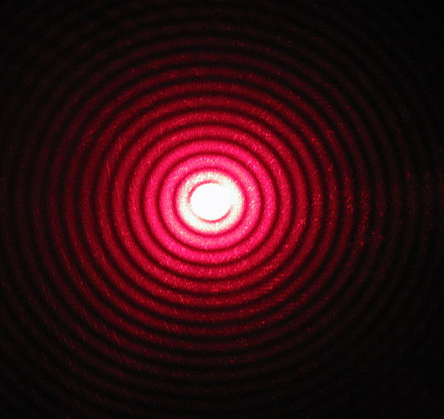
Wave or physical optics
We will consider two effects that are related to the wave properties of light
    polarization
    interference
everyday examples:
    Polaroid lenses
    the colors of an oil film
Laser passing
through a
pinhole

Slide 6
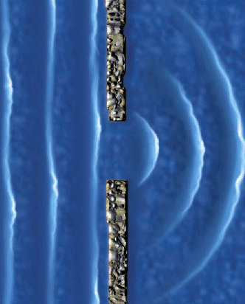
Diffraction of water waves

Slide 7
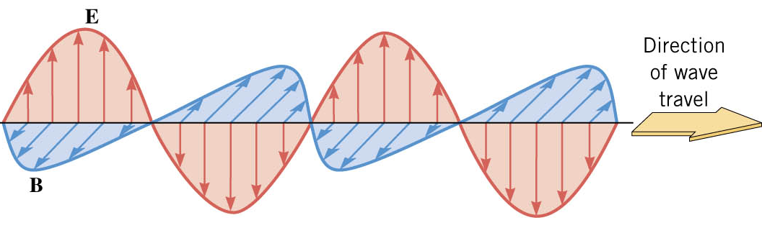
Polarization
x
z
y
Light is an electromagnetic wave with the
electric and magnetic field having very
specific orientations
A light wave in which the electric field always vibrates along one direction is called a
linearly polarized wave
The direction of polarization is the axis along which the electric field vibrates
In the diagram above, the wave polarization is x

Slide 8
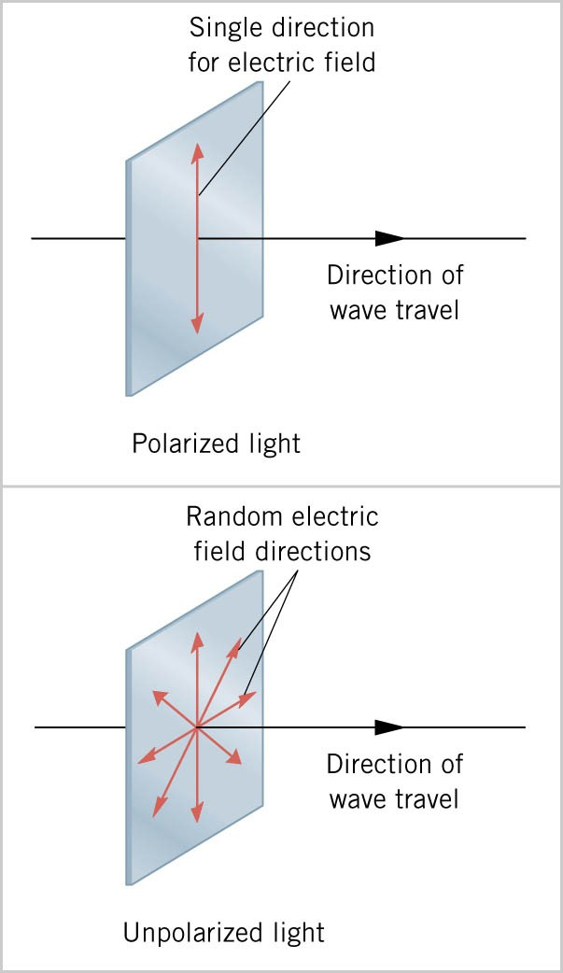
Polarization-a
the direction in which the electric field vibrates is the direction of polarization
with polarized light the electric field always vibrates in one direction
ordinary light is unpolarized so that the electric field is randomly oriented about the direction of travel
Polarized light
Un-polarized light

Slide 9
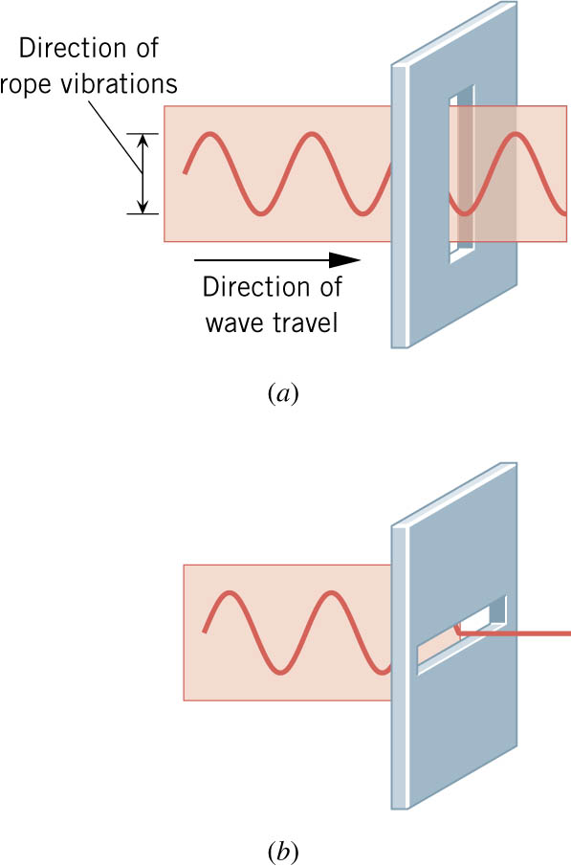
Polarization-b
a transverse wave is linearly polarized with its vibrations always along one direction
a linearly polarized wave can pass through a slit that is parallel to the vibration direction
the wave cannot pass through a slit that is perpendicular to the vibration direction

Slide 10
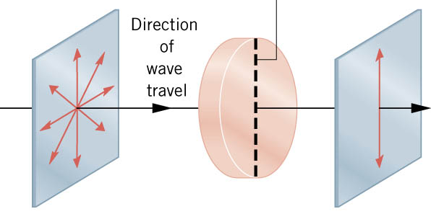
Polaroid Sheets
a polarizing material (polarizer) will only allow the polarization parallel to its axis to pass through thus, it reduces the light intensity
2 polarizers can be used to control the light intensity
Sunglasses made from polarizing material are used to remove “glare,” light reflected from a surface and tend to be polarized
A polarizer with
its transmission
axis vertical
Electric
field
Un-polarized
light
Vertically
polarized
light

Slide 11
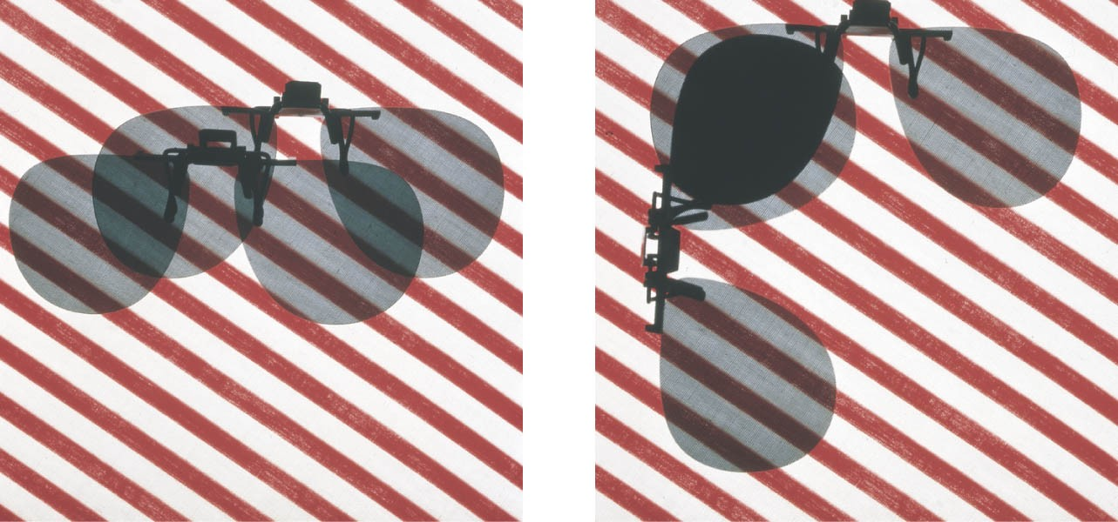
Polaroid sunglasses
When unpolarized light passes successively through 2
polarizers whose axes are oriented 90 degrees to each other,
no light will emerge. The first one polarizes the light, and the
second one then blocks it.

Slide 12
interference of light
when two light waves are combined, interference can occur → more light intensity or less light intensity
constructive
interference
reinforcement
destructive
interference
cancellation
partial cancellation
in-between
case

Slide 13
Spatial Interference
A
A
P
B
B
P
Waves leave A and B in phase,
travel the same distance to P,
and arrive in phase. P is a bright
spot → Constructive interference
Waves leave A and B in phase, but
travel different distances to P, and
arrive out of phase. P is a dark
spot → Destructive interference

Slide 14
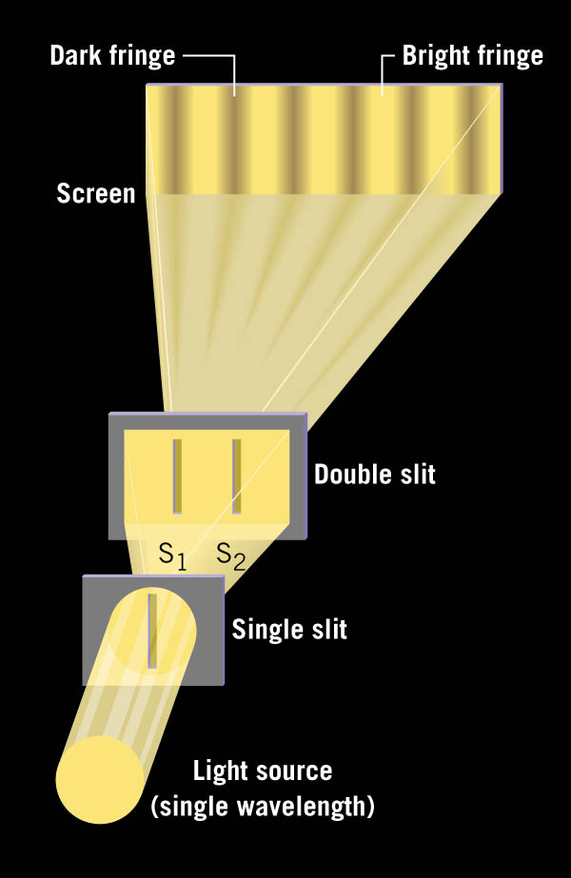
two-slit interference
Each slit of the double slit
acts as a new source of
light. Light waves from
the two sources then
interfere constructively in
places producing the bright
fringes, while in other places
they interfere destructively
producing dark fringes.

Slide 15
thin film interference
Ray 1 is reflected from the
oil surface. Ray 2 is
the ray resulting from
refraction at the gasoline/
water surface. Since the
rays travel different paths,
they interfere when combined.
Different wavelengths
interfere at different places
→ the produces COLORS
1
2
oil
water

Slide 16
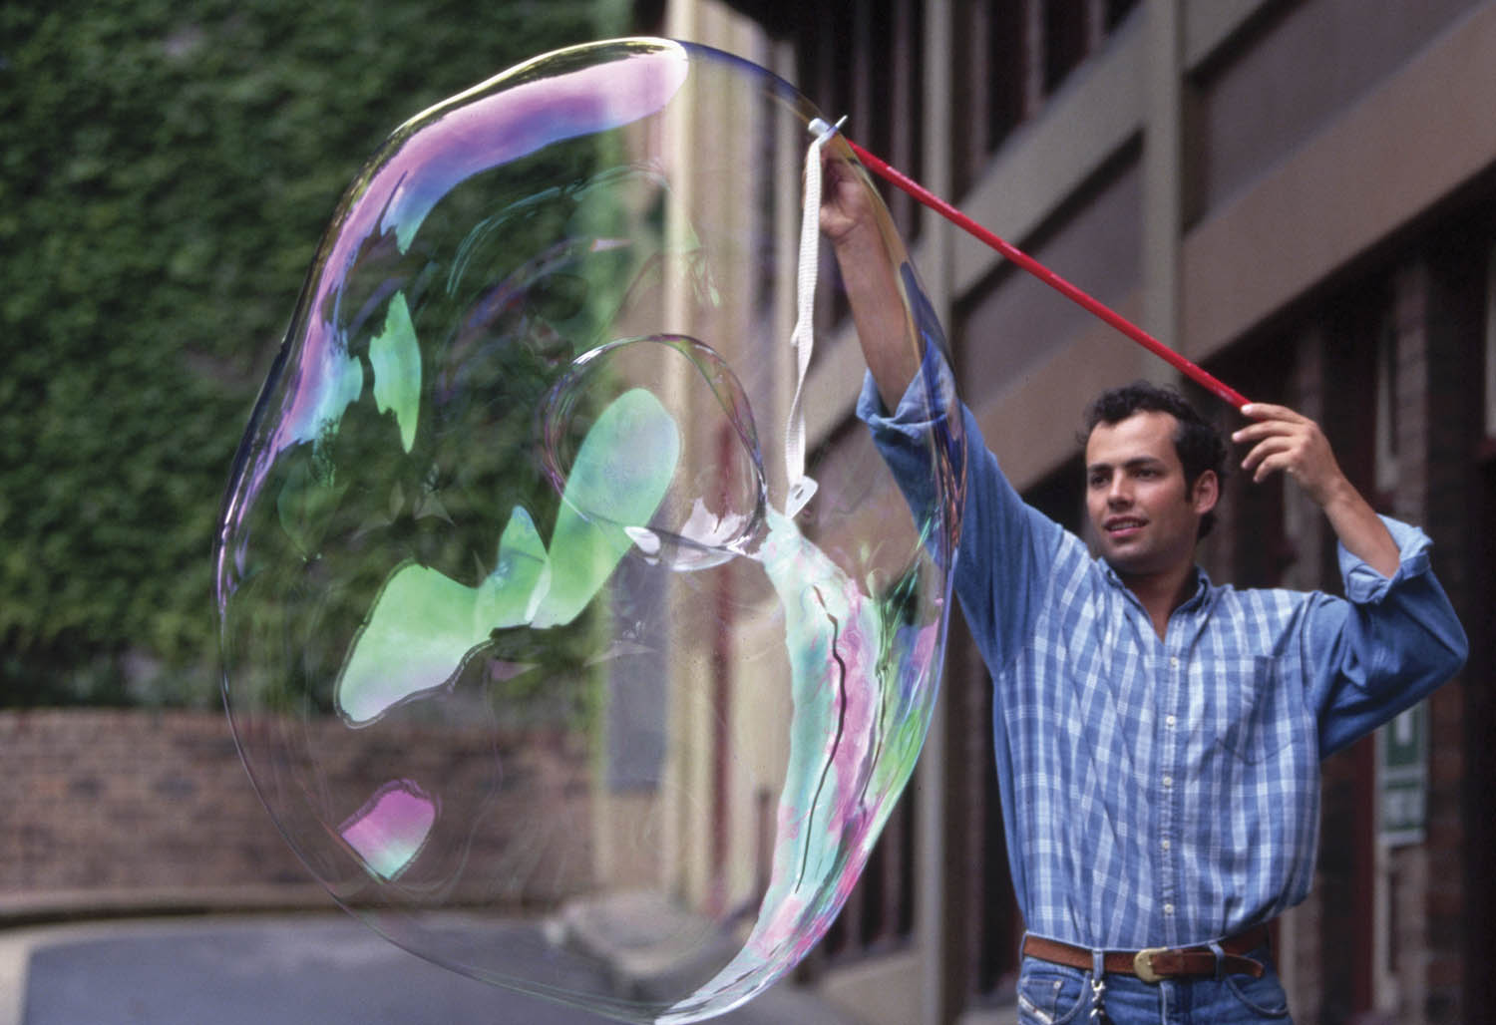
Soap bubbles are thin films

Slide 17
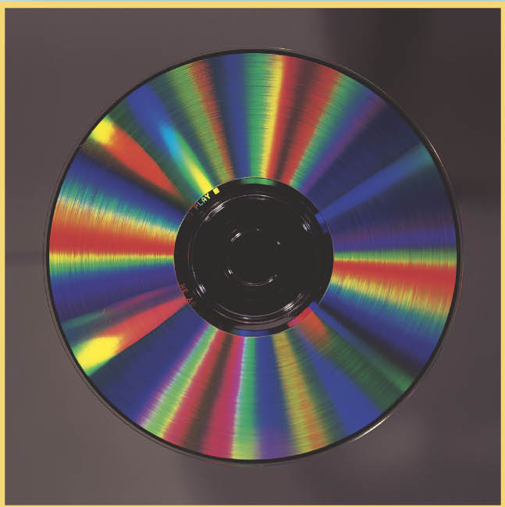
Interference from a CD
Whenever light bounces
off a surface having a
regular array of grooves
(like a CD) interference
occurs.
An optical device that
uses this effect is called
a diffraction grating.

Slide 18
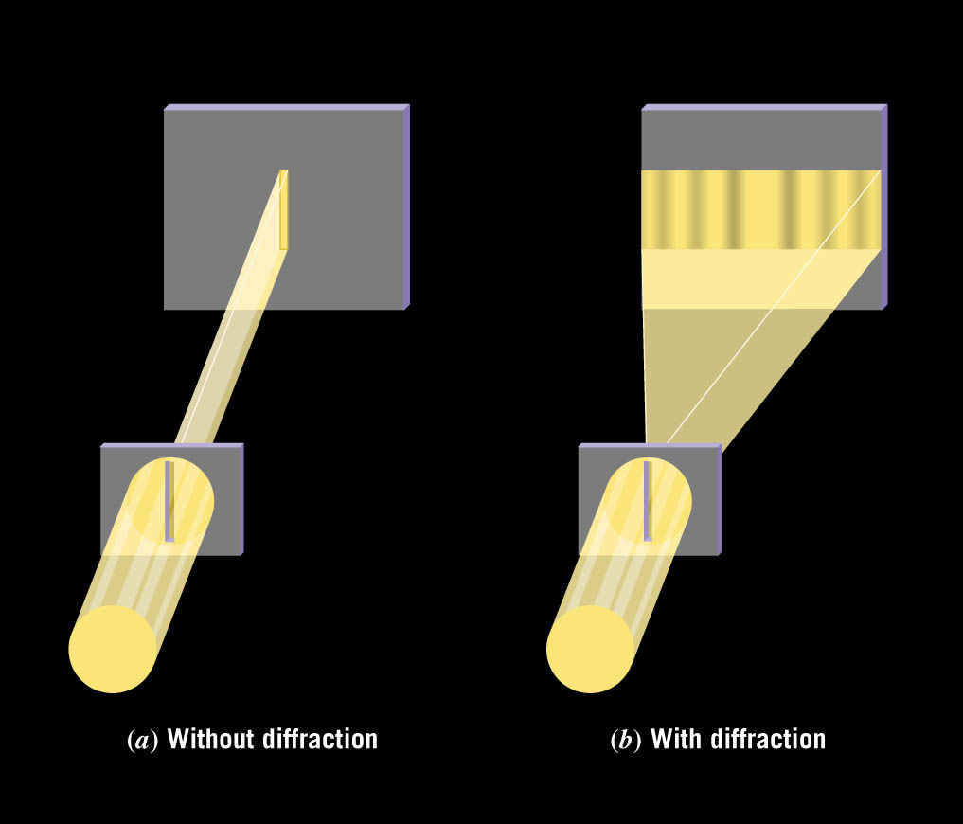
Diffraction
An important interference effect is the spreading of light as it passes through
a narrow opening.
without diffraction, light passing through a narrow slit would just produce a shadow effect.
The effect of diffraction is to cause the light to spread out around the edges of the slit

Slide 19
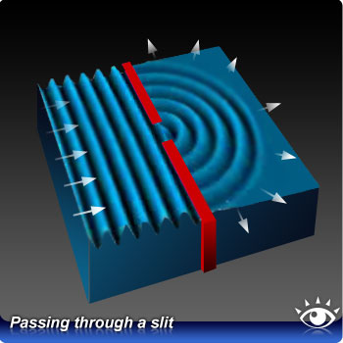
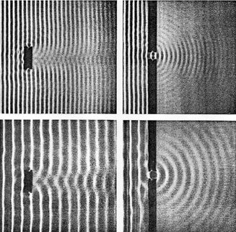
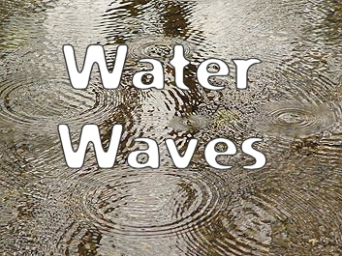
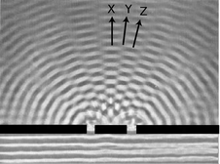
D
I
F
F
R
A
C
T
I
O
N

Slide 20
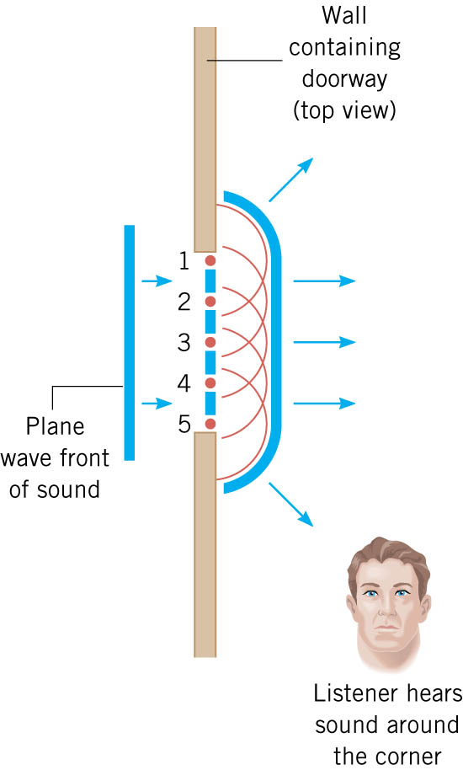
diffraction of sound
the diffraction of sound waves explains why we can hear sound around corners
diffraction of sound around the head makes hearers misjudge the location of sound sources

Slide 21
A diffraction grating
Incident
light
Bright
spots
grating

Slide 22
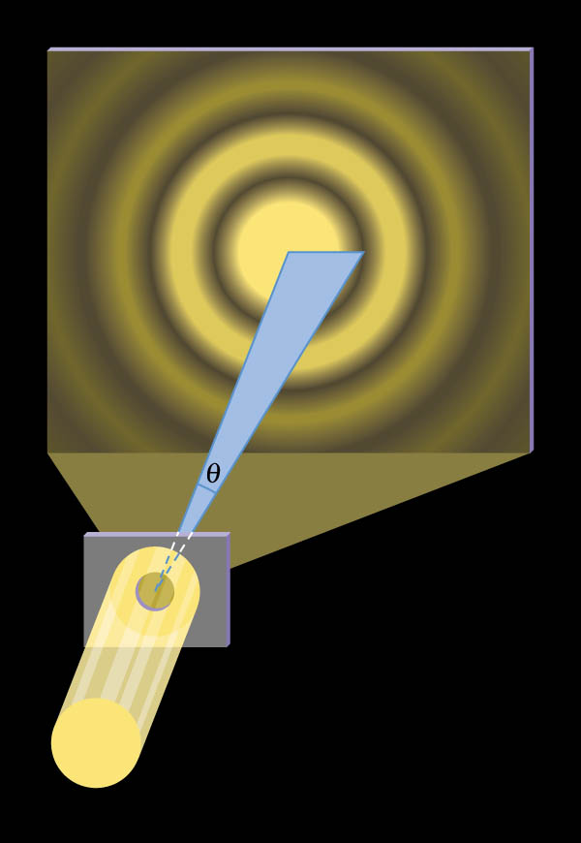
A pattern of concentric bright rings and dark rings is formed called interference fringes.
Light passing through a pinhole

Slide 23
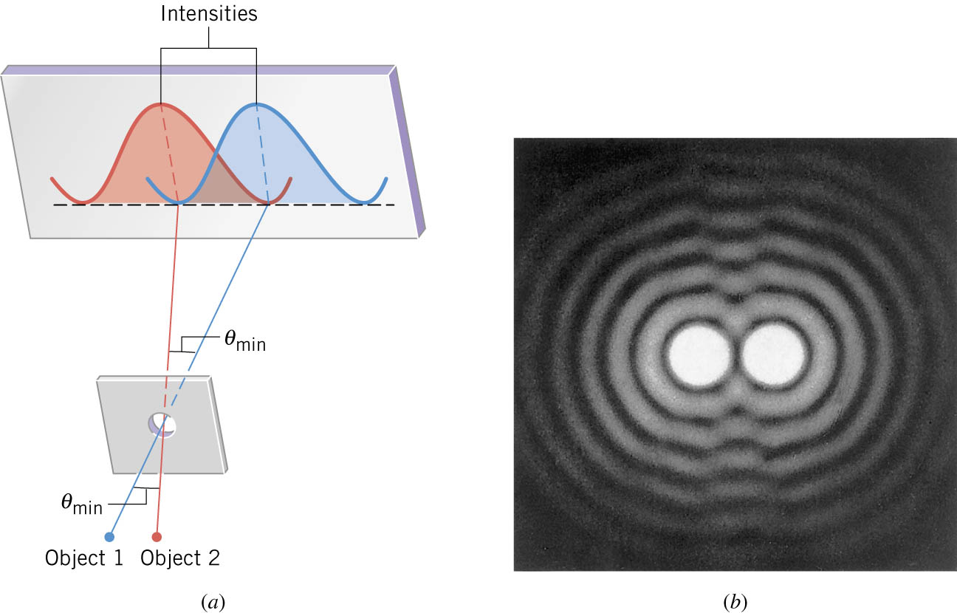
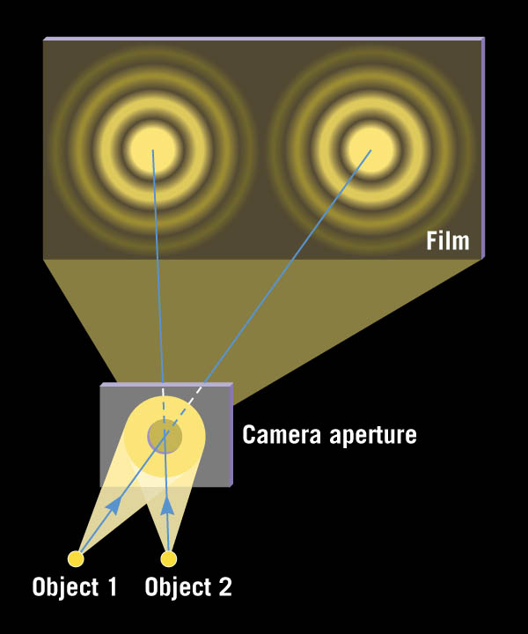
Diffraction effects
Barely resolved
Diffraction limits our ability to distinguish closely spaced objects because it causes the images to overlap
Diffraction limits the size of an object on the ground that can be photographed from a satellite

Slide 24
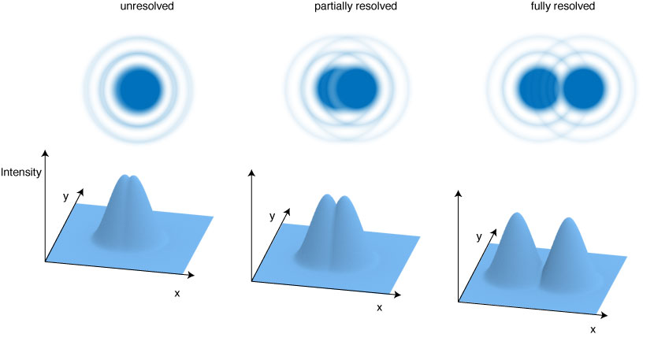
Lord Rayleigh established a criterion for objects to be barely resolved

Slide 25
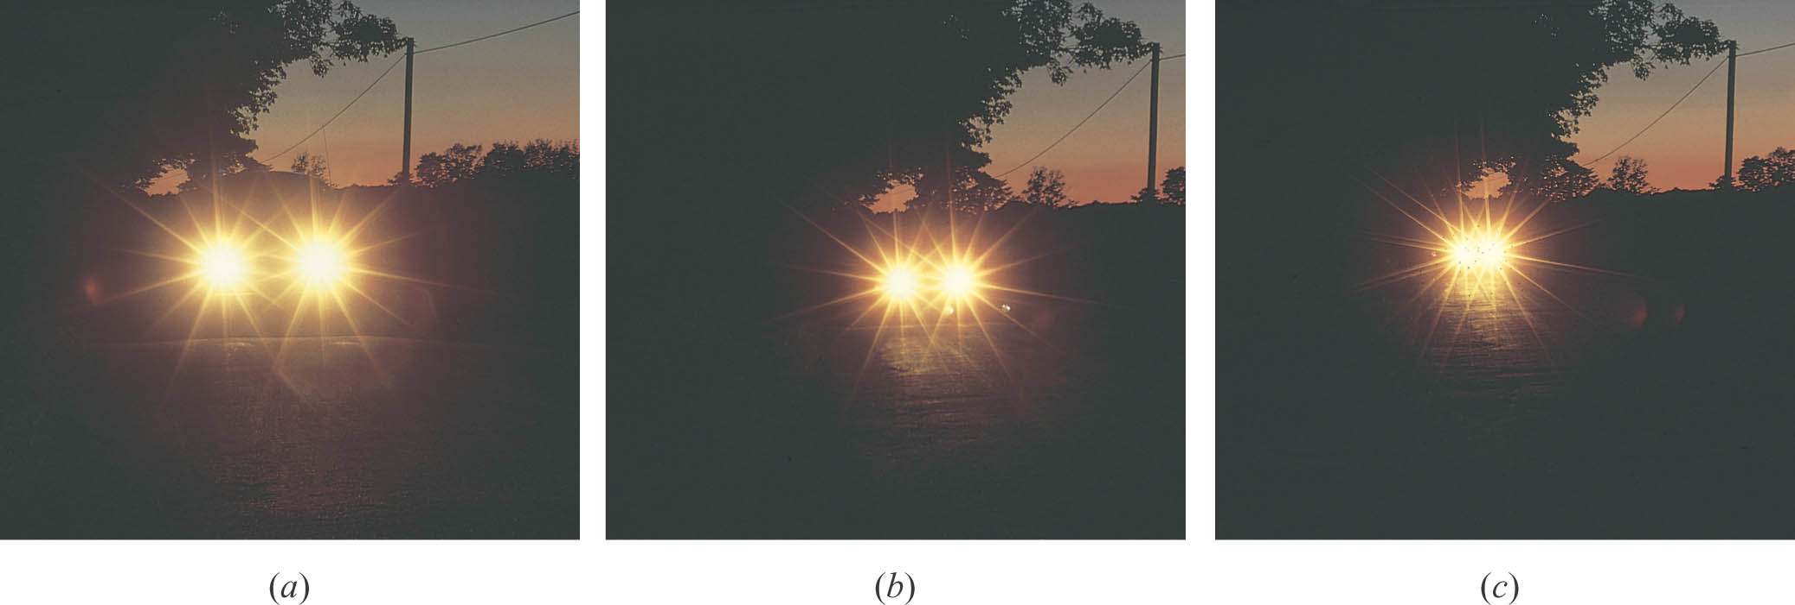
Diffraction affects the resolution of close objects
The automobile headlights were photographed
from various distances from the camera.
camera
close to car
camera
far from car

