Slide 1
PHYS:1200
No class: Friday May 1
We will review the practice final exam questions on Monday May 4 and Wednesday May 6.
No class: Friday May 8
Final Exam: Wednesday May 13
3 – 5 PM in LR1 VAN ( right here! )

Slide 2
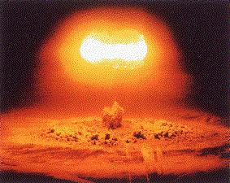
L 36 Modern Physics - 4
Nuclear physics ⬅
  what’s inside the nucleus and what
  holds it together ←
  what is radioactivity, half-life ←
  carbon dating ←
Nuclear energy
  nuclear fission
  nuclear fusion
  nuclear reactors
  nuclear weapons

Slide 3
Radioactivity
Some nuclei are unstable and spontaneously emit particles at random times
  Alpha particles (helium nucleus)
  Beta particles – energetic electrons
  Gammas - energetic photons (higher than x-rays)
The beta particles (electrons) come from a process called beta decay, in which a neutron decays into a proton, an electron and an antineutrino (note that charge is conserved!)

Slide 4
Nuclear reactions: E = mc²
Energy is released in the fission (breakup) of a
heavy nucleus by fast neutron bombardment
mass = 240.06 units
mass = 239.86 units
The extra mass is converted into kinetic energy, which is mostly in the neutrons.

Slide 5
Biological effects of nuclear radiation
Nuclear reactions can produce alphas, betas, neutrons and gamma radiation (particles or photons)
Nuclear radiation is ionizing radiation, i.e., energetic enough to knock electrons out of atoms or molecules
Ionizing radiation is potentially harmful to humans because the ionization it produces can alter significantly the structure of molecules within a living cell which can lead to alterations of the cell (make them cancerous) or to the death of the cell

Slide 6
Hazards of radiation
The hazards of radiation can be minimized by limiting overall exposure
The effects of absorbed doses or ionizing radiation is measured in a unit called the rem.
The effects of radiation exposure are
  Short term or acute effects appearing within a matter of minutes of exposure
  Long-term effects that may appear in years, decades or even in future generations

Slide 7
Average radiation doses received by a US resident
Source of radiation dose in mrem/yr*
Natural Background radiation
Cosmic rays…...............................28
Earth and air……………………….28
Internal radioactive nuclei………..39
Inhaled radon…………………….200
Man-made radiation
Medical / dental x-rays……………39
Nuclear medicine………………….14
*Current federal standards limit exposure to 500 mrem/yr

Slide 8
Radiation sickness
This is the general term applied to the acute effects of radiation
A dose less than 50 rem causes no short term ill effects
A dose of 50 – 300 rem at one time brings on radiation sickness
A whole body dose of 400 – 500 rem is lethal for about 50% of people exposed
Whole body doses greater than 600 rem results in death for almost all individuals

Slide 9
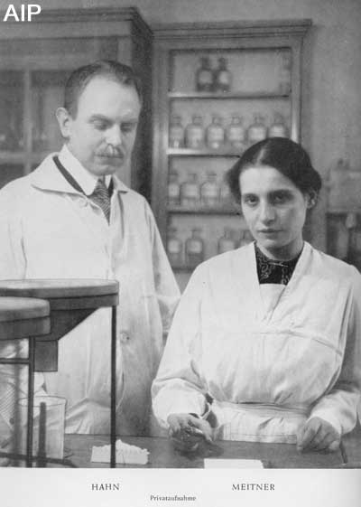
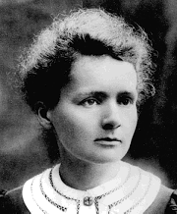
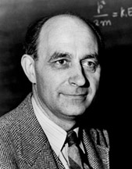
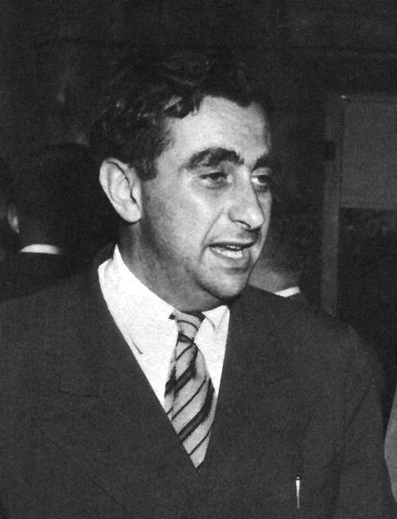
Nuclear Physicists
Otto Hahn and
Lise Meitner
discovered fission.
Only Hahn won
the Nobel Prize.
Meitner should
also have won.
Marie Curie discovered radioactivity. First woman to win a Nobel Prize. Won 2 Nobel prizes in Physics and Chemistry.
Enrico Fermi
“Father of the
Atomic bomb”
Won Nobel prize for discovering new radioactive elements.
Edward Teller
“Father of the
Hydrogen bomb”
Convinced Pres. Reagan to pursue the “Star Wars” project.

Slide 10
Energy from the nucleus
Huge amounts of energy are given off in two nuclear processes
  Nuclear fission: splitting a
  heavy nucleus in two
  Nuclear fusion: fusing two
  light nuclei into one

Slide 11
A lot of energy from a little mass
The energies released when a large nucleus undergoes fission or small nuclei undergo fusion are enormous compared to chemical energies (e.g. burning fossil fuel)
When Uranium splits apart about 0.1% of its mass is converted into energy
Pound for pound, nuclear reactions release about 10 million times more energy than chemical reactions
1 pound Uranium ➔ 1 million gallons of gasoline

Slide 12
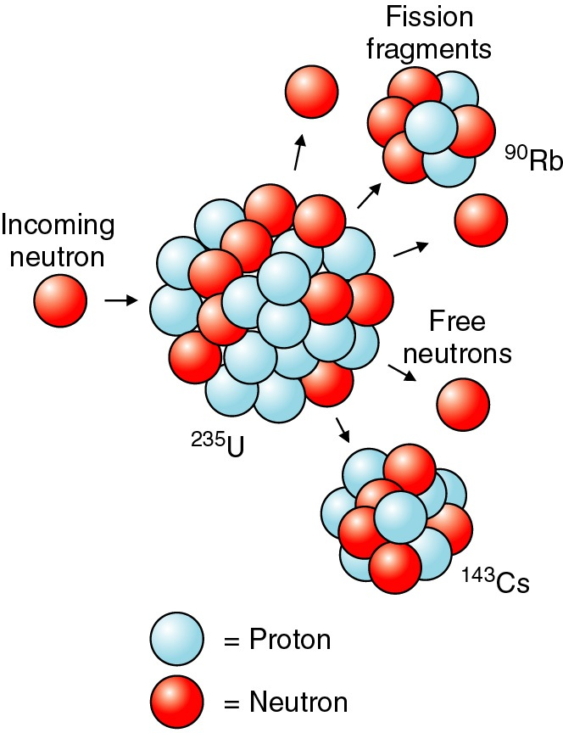
Splitting the atom→ Nuclear Fission
To split a uranium nucleus apart takes energy
A neutron hitting a uranium nucleus can cause it to split
A neutron can split U-235 into Cs-143 and Rd-90 plus a few extra neutrons

Slide 13
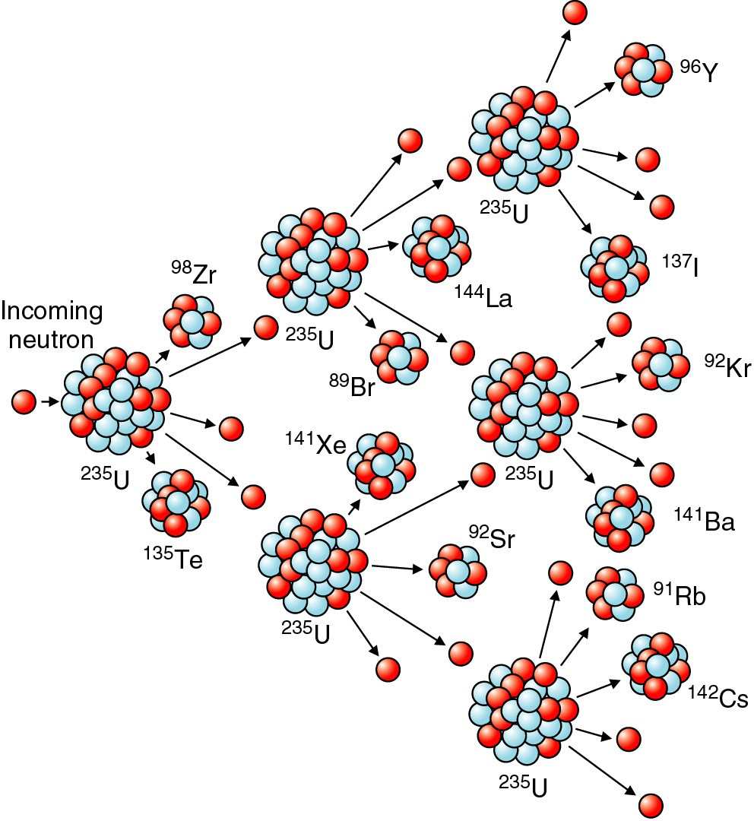
The nuclear chain reaction
When U-235 splits, on average 2.5 neutrons are released
These neutrons can then go on to cause other U-235’s to split, this resulting in a chain reaction
This can result in a catastrophic process
with enormous energy released.

Slide 14
Reactor or Bomb
If the energy released in a nuclear chain reaction is allowed to proceed in a controlled way, then this can be used as an energy source → nuclear reactor
If the chain reaction occurs in an uncontrolled manner then you have
→ atomic bomb
Enrico Fermi produced the first nuclear reactor under the west stands of Stagg Field at the University of Chicago in 1942

Slide 15
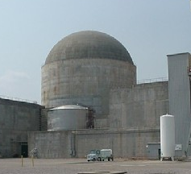
Electricity generation by nuclear power
Percentage of electricity
produced by nuclear power
France: 73%
Belgium: 52%
Slovakia: 54%
Switzerland: 36%
Sweden: 43%
USA: 19%
Germany: 18%
Japan: 18%
Russia: 18%
UK: 18%
Canada: 15%
Argentina: 7%
China: 2%
Nuclear Power Plant
Steel and Concrete
Containment vessel

Slide 16
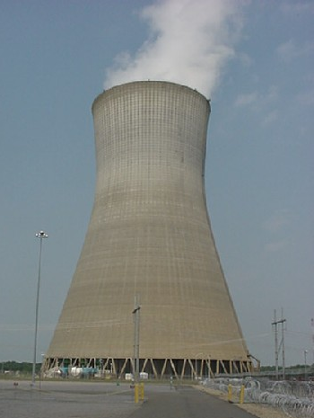
Nuclear reactors
The fuel elements contain the
fissile fuel in the form of rods of
1 cm diameter. There may be
thousands of such rods stacked together in the reactor core
The most common fuel is enriched U-235
Some type of moderator material is also used to slow down the neutrons to make their capture more efficient

Slide 17
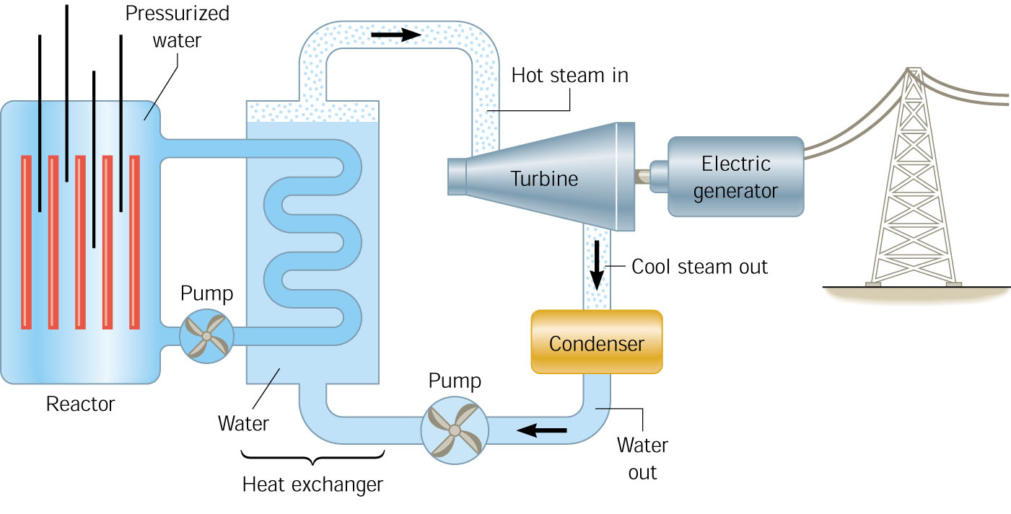
A nuclear power plant
Nuclear
reactor
Electric
generator
Electric
transmission

Slide 18
Reactor operation
The reactor is usually operated in the so-called critical state in which each fission leads to only one additional fission.
In the critical state the reactor produces a steady output of electrical energy
The reactor is designed not to go into the supercritical state – in this state the reactor produces an uncontrolled and increasing amount of energy which can cause it overheat and lead to meltdown.

Slide 19
Controlling the nuclear reactor
To keep the reactor in the critical state the operators adjust the control rods
The control rods can be moved into or out of the reactor core. They contain an element, such as cadmium or boron which absorbs neutrons.
If the reactor is getting too hot, the control rods are pushed into the core to slow down the chain reaction
The heat generated within the fuel rods is carried away by water surrounding the rods

Slide 20
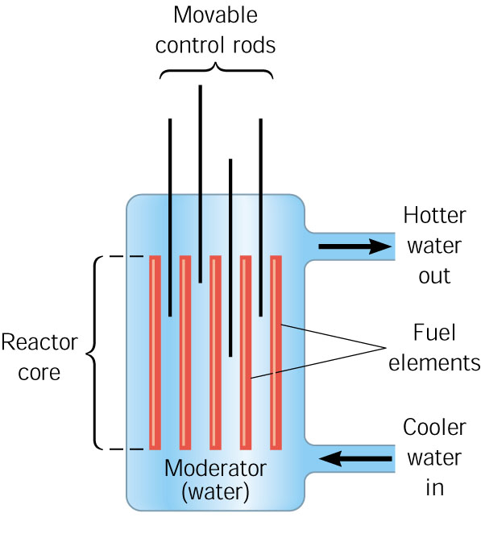
Reactor core
To start the reactor, the control rods are pulled out of the core
To stop the reactor, the control rods are pushed into the core
Inside a concrete containment vessel

Slide 21
Pros and Cons of Nuclear energy
ADVANTAGES
Plentiful fuel
no greenhouse gases
no poisonous emissions
non-polluting
efficient power production
DISADVANTAGES
must deal with nuclear waste
possibility of catastrophic accident
with long term effects*
expensive to build
can be used to enrich uranium for bombs
* -- US – 1979, Three mile Island, Pennsylvania
-- World- 1986, Chernobyl, Ukraine (80 killed within one week of accident)
-- Japan -2011 caused by Tsunami
negative spin – big disaster – no more nuclear power plants
positive spin – even with Tsunami, no one killed, build more plants

Slide 23
The atomic (fission) bomb
a critical mass of fissionable material is needed
Natural uranium contains ²³⁸U and 0.7% ²³⁵U, but only ²³⁵U is fissionable. In the enrichment process, the ²³⁵U and ²³⁸U are separated. Weapons-grade uranium requires enrichment to > 20%.
if a critical mass can be achieved than an self-sustained uncontrolled reaction occurs
To achieve critical mass (60 kg), 2 lumps (7 inch diameter ball ) of a non-critical mass of U-235 are brought together quickly using a cannon
When the U-235 becomes supercritical, a catastrophic fission will quickly turn into a fireball

Slide 24
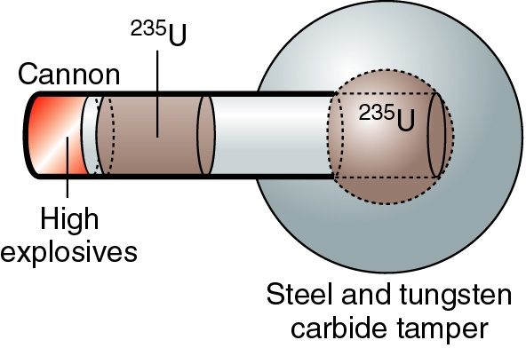
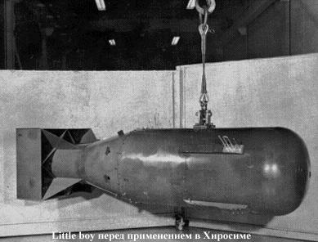
Little Boy (Uranium bomb)

Slide 25
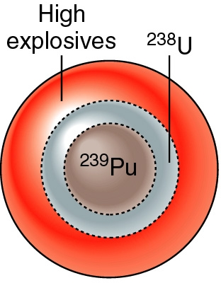
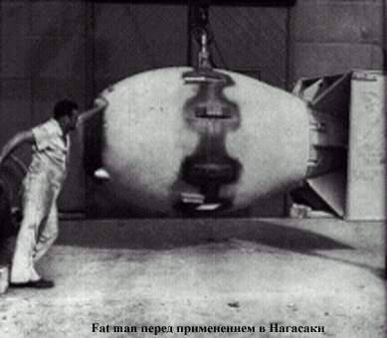
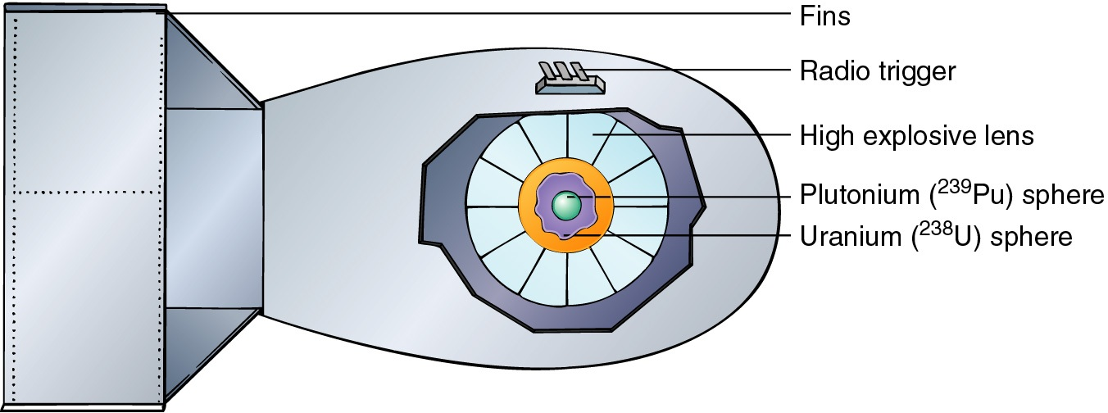
FAT MAN (Plutonium bomb)

Slide 26
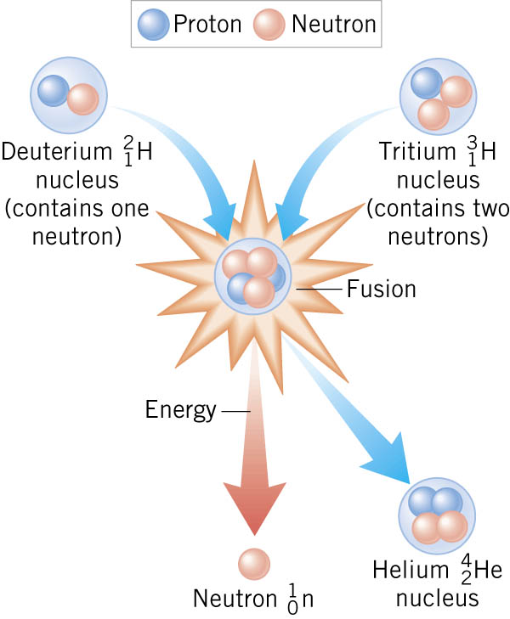
Nuclear Fusion
→ Two light nuclei (D & T) are combined into one (He) with a large release of energy
→ If this is done with a
a large number of nuclei,
the energy is released
catastrophically as
a Hydrogen Bomb

Slide 27
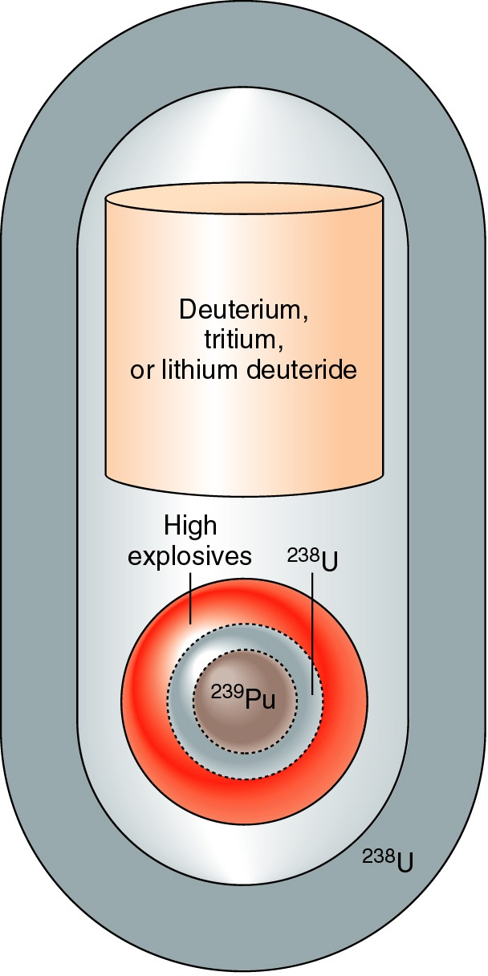
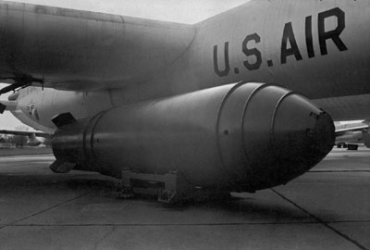
The Hydrogen (thermonuclear fusion) Bomb
A fusion bomb releases energy by fusing deuterium with tritium nuclei to form helium and neutrons
To achieve this, the hydrogen must be heated to 100 million C using a fission bomb → thermonuclear
Thermonuclear fusion is the energy source in a star
H bomb

Slide 28
Effects of a nuclear explosion
The released neutrons produce the fireball by heating everything around them
The ultra hot fireball produces an intense flash of light, x-rays and gamma rays
The explosion creates a huge pressure surge → blast wave that flattens everything within miles of ground zero
Long after the blast there is the fallout → the creation and release of radioactive nuclei that are carried away in the air

Slide 29
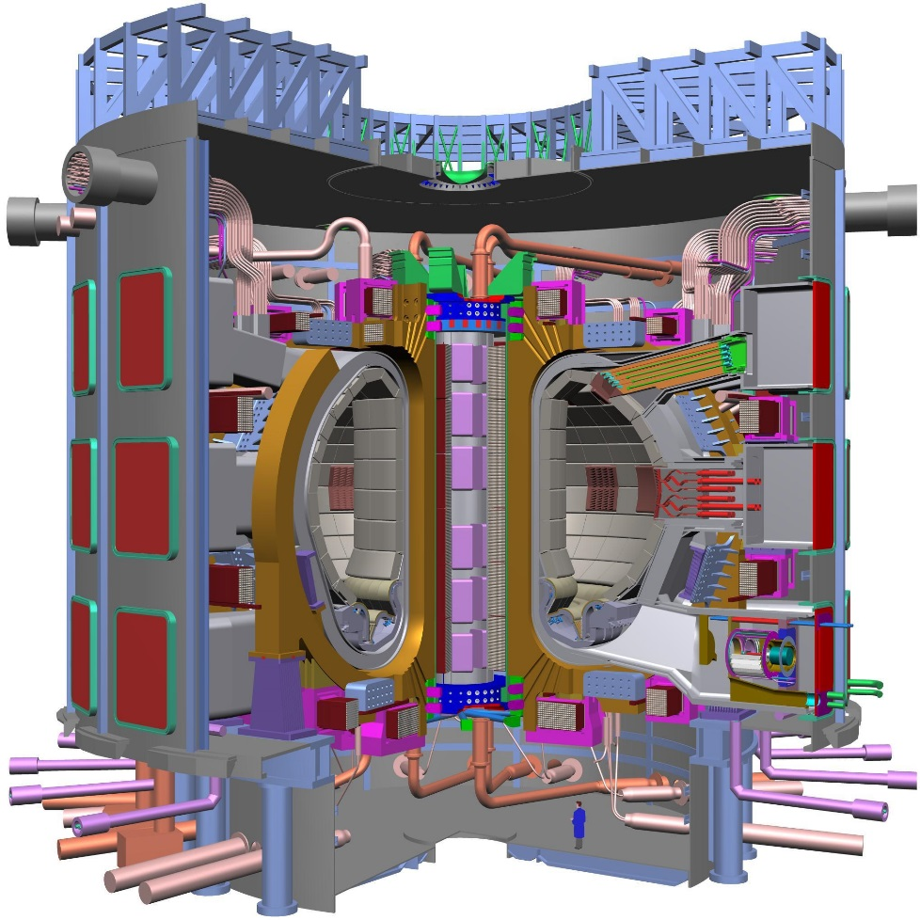
Controlled thermonuclear fusion
Nuclear reactor using nuclear fusion energy
Safer than fission reactor
Fuel (D, T) can be obtained from seawater
Will heat Tritium gas to 100,000,000 K
Test reactor being built in France; collaboration of seven countries: EU, IN, JP, CH, RU, SK, US.
International Thermonuclear
Experimental Reactor (ITER)

Slide 30

We will review the practice final exam questions on Monday May 4 and Wednesday May 6.
No class: Friday May 1 and Friday May 8
Final Exam: Wednesday May 13
3 – 5 PM in LR1 VAN ( right here! )

