Slide 1
L-10(M-9) torque and rotational inertia
We consider the rotation of rigid bodies. A rigid body is an extended object (as opposed to a point object) in which the mass is distributed spatially.
Where should a force be applied to make it rotate?
The same force applied at different locations produces different results.
AXLE

Slide 2
TORQUE – Greek letter tau τ
To make an object rotate, a force must be applied in the right place.
the combination of force and point of application is called TORQUE
The lever arm L is the distance from the axis of rotation to the point where the force is applied
If the line of action of F passes through the axis of rotation, it produces no torque.
lever arm: L
Axis
Force, F

Slide 3
Torque: τ (Greek tau)
Torque = force (F) x lever arm (L)
τ = F L
force F in Newtons, N
lever arm L in meters, m
Torque τ in units of N m

Slide 4
Torque example
What is the torque on a bolt
applied with a wrench that
has a lever arm: L= 20 cm
with a force: F = 30 N?
F
Solution:
τ = F L
= 30 N × 0.2 m
= 6 N m
L
For the same force, you get more torque
with a bigger wrench → the job is easier!

Slide 5
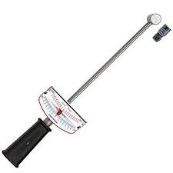
Torque wrench
A torque wrench is a wrench that applies
a calibrated torque to a bolt.
It prevents a bolt from being over-tightened
and possibly breaking.

Slide 6
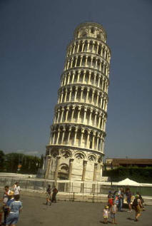

Homer attempts to straighten out the leaning tower of Pisa
lever
fulcrum

Slide 7
Net Force = 0 , Net Torque ≠ 0
10 N
10 N
> The net force = 0, since the forces are applied in
opposite directions so it will not accelerate.
> However, together these forces will make the rod
rotate in the clockwise direction.

Slide 8
Net torque = 0, net force ≠ 0
The rod will accelerate upward under these
two forces, but will not rotate.

Slide 9
Balancing torques
20 N
10 N
1 m
0.5 m
Left torque = 10 N x 1 m = 10 n m counterclockwise
Right torque = 20 N x 0.5 m = 10 N m clockwise

Slide 10
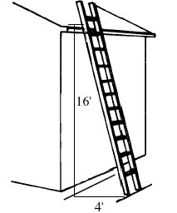
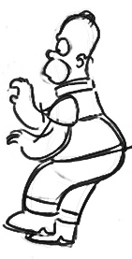
Equilibrium
To ensure that an object does not accelerate or rotate two conditions must be met:
  net force = 0
  net torque = 0
this results in the practical 4-1 “ladder rule”

Slide 11
When is an object stable?
If you can tip it over a bit and it doesn’t fall
The object may wobble a bit but it eventually stops and settles down to its upright position.
A thinner object is
easier to topple
An object that is thicker
at its base is more stable

Slide 12
Why do tall objects tend to fall over
Every object has a special point called the center of gravity (CG). The CG is usually in the center of the object.
if the center of gravity is supported, the object will not fall over.
The lower the CG the more stable an object is. stable → not easy to knock over!

Slide 13
Condition for stability
If the CG is above
the edge of the table, the object
will not fall off.
CG

Slide 14
Why makes an object tip over?
CG
STABLE
CG
UNSTABLE
D
D
For the wide object, the dashed line extending from the CG down is to the left of the point of contact; the torque due to the weight tends to rotate the object counterclockwise
For the narrow object, the dashed line extending from the CG down is to the right of the point of contact, the torque due to the weight tends to rotate the object clockwise.

Slide 15
Stable structures
Structures are
wider at their
base to lower their
center of gravity

Slide 16
Playing with blocks
CG
If the center of gravity
is supported, the blocks
do not fall over

Slide 17
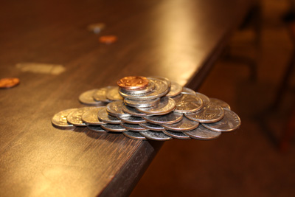
Coin Stack

Slide 18
High Profile Vehicles
wind
As more stuff is loaded into a semi, its center of gravity moves upward, making it susceptible to tipping over in high winds.

Slide 19
Rotational Inertia
(moment of inertia) symbol I
A rigid body is characterized by a parameter called its rotational inertia
The rotational inertia of a RB depends on how its mass is distributed relative to the axis of rotation
The rotational inertia of a RB is a parameter that is analogous to inertia (mass) for a non-extended object
For a RB, the rotational inertia determines how much torque is needed to produce a certain amount of rotational acceleration (spin).

Slide 20
rotational inertia examples
Rods of equal mass m and length L
axis through center
axis through end
The rod with the axis through the end requires more torque to get it rotating.

Slide 21
How fast does it spin?
For spinning or rotational motion, the rotational inertia of an object plays the same role as ordinary mass for simple motion
For a given amount of torque applied to an object, its rotational inertia determines its rotational acceleration → the smaller the rotational inertia, the bigger the rotational acceleration

Slide 22
Same torque, different rotational inertia
τ = F L = (mg) R
L = R
Small rotational
inertia
Big rotational
inertia
spins
slow
spins
fast
F = mg

