Slide 1
Review: motion with constant acceleration
Acceleration: change in velocity / time interval
a = 0 case
  no acceleration → velocity is constant → v = v_{i}
  position vs. time → x_{f} = x _{i} + v t, x_{i} is the starting position, x_{f} is the ending position
acceleration = a = constant
  velocity→ v_{f} = v_{i} + a t, v_{i} is the velocity at time t = 0
  position→ if motion starts at x_{i} = 0, with v_{i} = 0 (at rest)
→ x = ½ a t²
for problems in free-fall with v_{i} = 0, then a = g (= 10 m/s² )
→ v_{f} = g t and y_{f} = ½ g t²

Slide 2
Review: Free fall- object projected vertically up
time to reach the maximum height
total time in the air
H
Position, y
0
t_{up}
2t_{up}
Time, t
v_{i}
UP
DOWN
Velocity, v
Time, t
−v_{i}
Free fall is an example of motion with constant acceleration in one direction only (up and down), today we will take up motion in both the horizontal and vertical directions simultaneously → projectile motion.

Slide 3
example
Problem: An object is dropped from rest from a height of 20 m above the ground.
(a) How long will it take to reach the ground? (b) What is its velocity as it hits the ground?
Solution: initial velocity, v_{i} = 0
y_{f} = ½ g t² , v = g t

Slide 4
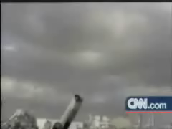
L-5 Projectile motion
A projectile is an object that is thrown, hit, kicked, shot, etc., and then travels under the influence of gravity.
It is an example of two-dimensional motion.

Slide 5
Projectile Examples
Tennis ball
Golf ball
Football
Softball
Soccer ball
bullet
Hockey puck or ball
Basketball
Volleyball
Arrow
Shot put
Javelin
These are all examples of things that are
launched, then move under the
influence of gravity (and air resistance)

Slide 6
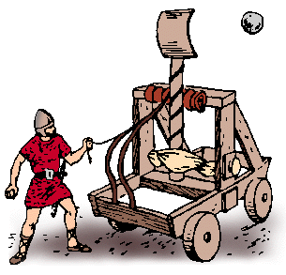
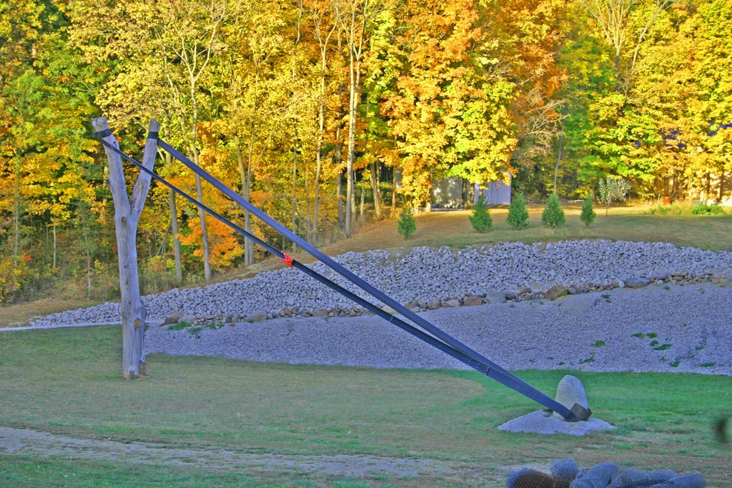
Not projectiles
Jet plane
Rocket
Car (unless it looses contact with ground)
catapult (before rock leaves)
slingshot (before rock leaves sling)

Slide 7
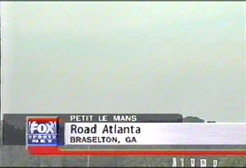
Unintended projectile

Slide 8
Projectile motion
force of
gravity
the key to understanding projectile motion is to realize that gravity acts in the vertical (downward) direction
gravity affects only the vertical motion, not the horizontal motion
we will ignore air resistance
8

Slide 9
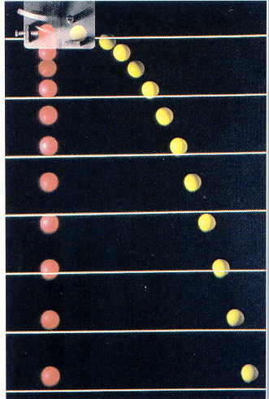
Demonstration
We can show that the horizontal and vertical motions are independent
The red ball was released and falls vertically down
The yellow ball was given a kick to the right.
They track each other vertically step for step and hit the ground at the same time

Slide 10
Galileo’s inclined plane experiments
NO!
YES!

Slide 11
Target practice
In the absence of gravity a bullet
would follow a straight line forever.
With gravity it FALLS AWAY from
that straight line!

Slide 12
Hitting the target – aim high, not directly at the target

Slide 13

Sports without gravity

Slide 14
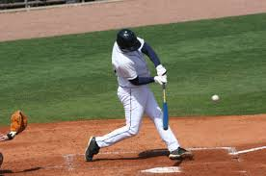

Baseball
Every hit ball
is a line drive,
If hit upward,
a homerun
Pop-ups never
come down.

Slide 15


Basketball – no jump shots!
Without
gravity
With
gravity

Slide 16
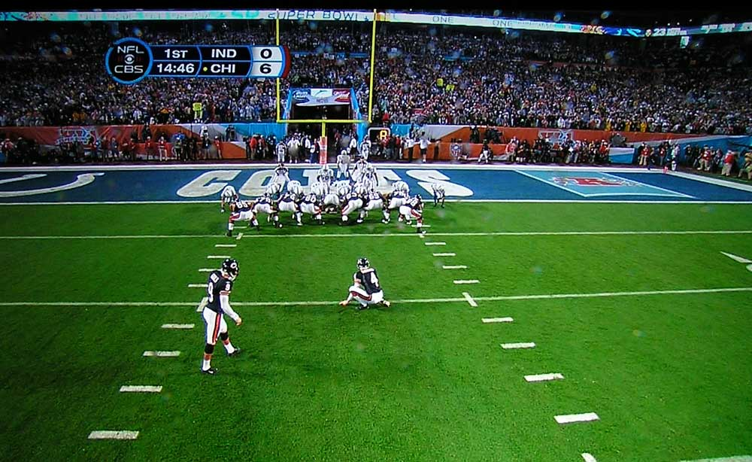
Kicking field goals would be easier!
100 yard field goals
would be possible.

Slide 17
Path of the Projectile: parabola
g
Height
rising
falling
v
Distance down range
angle of
elevation
v
projectile
Vertical
velocity
Horizontal velocity

Slide 18
Projectile motion – key points
The projectile has both a vertical and horizontal component of velocity
The only force acting on the projectile once it is released is gravity (neglecting air resistance)
At all times the acceleration of the projectile is g = 10 m/s² downward
The horizontal velocity of the projectile does not change throughout the path
On the rising portion of the path gravity causes the vertical component of velocity to decease

Slide 19
key points-continued
At the very top of the path the vertical component of velocity is ZERO
On the falling portion of the path the vertical velocity increases
When the projectile lands it will have the same vertical speed as it began with
The time it takes to get to the top of its path is the same as the time to get from the top back to the ground
The range of the projectile (horizontal distance travelled) depends on its initial speed and angle of elevation

Slide 20
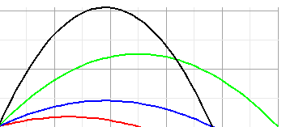
Maximum Range
When an artillery shell is fired the initial speed of the projectile depends on the explosive charge which cannot be easily changed
The only control is setting the angle of elevation.
You can control the range (where it lands) by changing the angle of elevation
To get maximum range set the angle to 45°
65°
45°
25°
15°

Slide 21

The ultimate projectile:
putting an object into orbit
NEWTON
Imagine trying to
throw a rock around
the world.
If you give it a large horizontal velocity, it will go into orbit around the earth!

Slide 22
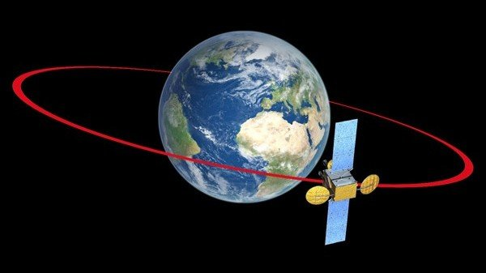
Geosynchronous Satellites
Satellite that always remains above the same
point on the earth. Must have an orbital period
of 24 hours. Altitude is 22,000 miles.

Slide 23
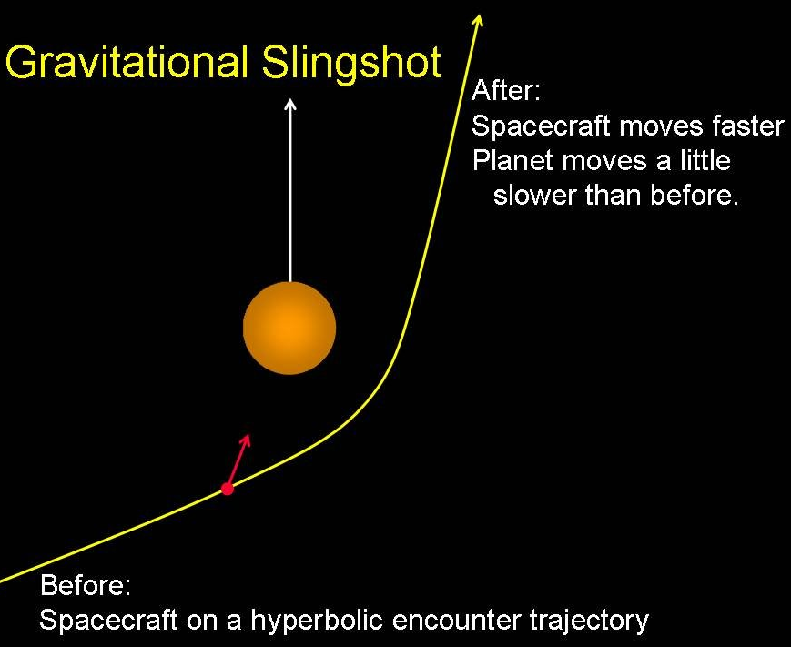
Escape from planet earth
To escape from the gravitational pull of the earth an object must be given a velocity larger than the so called escape velocity
For earth the escape velocity is 7 mi/sec or 11,000 m/s, 11 km/sec or about 25,000 mph.
The spacecraft gets a boost by using the gravitational slingshot effect

