Slide 1
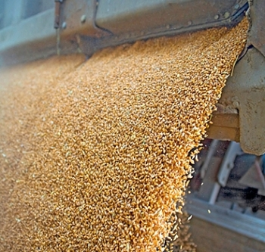
L12- FLUIDS-1
FLUIDS ➔ Stuff that FLOWS
FLUIDS
  liquids
  gases
sand, snow, or grain (granular materials)
While kernels of corn are solid, they behave more like a liquid when flowing through a silo
https://www.youtube.com/watch?v=Rqwg8JMR5vE

Slide 2
States of Matter
Comes in three states – solid, liquid, gas
So far we have only dealt with solid objects → blocks, sticks, balls, etc.
The study of fluids is more complicated because fluids are complicated since they do not have any particular shape
Fluids are not rigid bodies
But, Newton’s laws can be applied to fluids

Slide 3
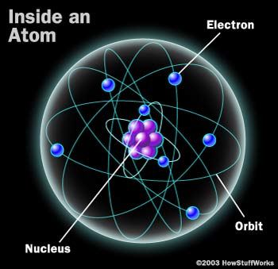
Atoms – the basic pieces of stuff
All matter is composed of atoms (atomic hypothesis)
If we imagine cutting an object into smaller and smaller pieces, we eventually get down to atoms
Diameter about 10⁻¹⁰ m
Acceptance of the atomic hypothesis evolved over about a century 1800-1900

Slide 4
Differences between solids, liquids and gases
The main difference is the distance between the atoms
  The atoms of a solid are closer to each other than the atoms in a liquid
  the atoms in a liquid are closer to each other than the atoms in a gas, and
The strength of the forces between the atoms.
  The forces between atoms in a solid are stronger than the forces between atoms in a liquid
  The forces between atoms in a liquid are stronger than the forces between atoms in a gas
SOLID LIQUID GAS

Slide 5
Mass Density (ρ, Greek rho)
Density is one way to characterize matter → it depends on how close the atoms are to each other
The mass density is the amount of mass in a unit volume of the substance
It is measured in kilograms per cubic meter (kg/m³) or g/cm³ (g/cc) = 1000 kg/m³
1 m
One cubic meter
1 m
1 kg
1 m

Slide 6
A few mass densities
Substance | Density (kg / m³)
lead | 11,000
water | 1,000
air | 1.25
aluminum | 2,700
iron | 2,300
mercury | 13,600

Slide 7
Gases: air pressure
The air molecules (oxygen and nitrogen) in the box bounce around in all directions
When they hit the wall they give it an impulse
The average effect of many, many molecules hitting the walls produces a force on the wall
The size of this force depends on the surface area of the wall – which depends on the container
It makes more sense to give the force on a unit surface --- PRESSURE

Slide 8
Definition of pressure
Pressure = force per unit area
P = force / area = F / A
The unit of pressure is Newtons per m²
One N/m² is called one Pascal (Pa)
Another commonly used unit is pounds per square inch (psi). These are the units on a typical tire pressure gauge

Slide 9
The pressure in a gas
The more molecules in the box (the number per unit volume) the larger the pressure
The pressure of a gas is also larger if the molecules have larger speeds (faster)
At a higher temperature the molecules have more energy and thus higher speeds
Thus the pressure depends on 2 factors:
pressure ∝ number density x temperature
proportional to
Ideal gas law

Slide 10

The Earth’s atmosphere
atmosphere
The atmosphere is a thin layer of air surrounding the earth
It extends upward to about 6 miles
It is held in place by gravity.
The moon has no atmosphere because its gravity is not strong enough to hold on to one
If the earth were a
basketball, the
atmosphere would be
the thickness of a
sheet of paper.

Slide 11
Atmospheric pressure
At the earth’s surface the pressure due to the atmosphere is about 100,000 N/m² (10⁵ N/m²) or just 1 atmosphere (atm)
units: 1 N/m² = 1 Pa (Pascal)
This means that over a 1 square meter of surface area the atmosphere exerts a force of 100,000 N/m² x 1 m² = 100,000 N
This amounts to about 22,500 lbs or 11 tons!
This corresponds to a mass of 10,000 kg
Why don’t we seem to notice this force?

Slide 12
The power of atmospheric pressure
We typically do not ‘feel’ atmospheric pressure because it is the same on all sides (inside and outside) of objects.
For example, the pressure is the
same on both sides of a window.
The pressure inside our bodies is the same as the pressure outside.
You feel atmospheric pressure on your eardrums when you go up a mountain or an elevator to the top of a tall building.

Slide 13
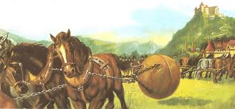
Magdeburg hemispheres
In 1654 two teams of horses try to separate the halves of a sphere with the air pumped out.
When under vacuum there is about 1 ton of
force holding the hemisphere’s together

Slide 14
Atmospheric pressure in action
When the air is removed
from inside the gas can,
atmospheric pressure on
the outside is unbalanced
and crushes the can.
Suction cups also
use atmospheric
pressure to hold
things together.
Vacuum
pump
1 US
Gallon

Slide 15
LIQUIDS
Liquids cannot support themselves
one layer of a fluid cannot exert a shear force (sidewise)to prevent slipping
Liquids must have a container

Slide 16
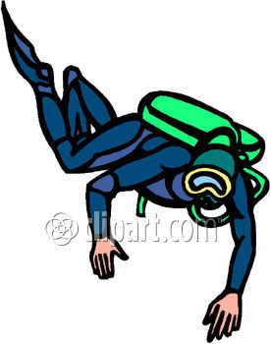
Variation of pressure with depth in a liquid
Anybody the does scuba diving knows that the pressure increases as you dive to greater depths
The increasing water pressure with depth limits how deep a submarine can go → crush depth
about 2400 ft for the US Seawolf class subs, 4000 ft for titanium soviet subs.

Slide 17
The deeper you go, the higher the pressure
The hypothetical volume of liquid of volume A x h is at rest
Thus, the net force on this volume must = 0
→ F_{bottom} = F_{top} + W
Therefore: F_{bottom} must be greater than F_{top}
The pressure on the bottom is higher than pressure on top
Pressure increases with depth
P_{atm}
P_{top}A
A
h
P_{bottom}A
W
Force = Pressure x Area
F = P A

Slide 18
How much does P increase with depth?
P(h) = P_{atm} + ρ g h
where ρ is the density of the liquid (kg/m³)
At the surface of a body of water
the pressure is 1 atm = 100,000 Pa
Example: As we go down into the water,
at what depth does the pressure
double, from 1 atm (100,000 Pa)
to 2 atm (200,000 Pa)?
P(h) = 200,000 Pa = 100,000 Pa + ρ g h
→ ρ g h = 100,000 Pa = 1000 (kg/m³)x 10 (m/s²) x h (m)
→ h = 10 m, or roughly 32 feet.
100,000 Pa
h
P(h)

Slide 19
Why does pressure increase with depth?
the block on the bottom
supports all the blocks
above it
this layer of fluid must
support all the fluid above it
Put simply, the deeper you go, the more water
you have pushing down on you from above.

Slide 20
Measuring atmospheric pressure - Barometers
Inverted closed
tube filled with
liquid
The column of liquid is
held up by the pressure of
the liquid in the tank. Near
the surface this pressure
is atmospheric pressure, so
the atmosphere holds the
liquid up.
P_{ATM}
P_{ATM}
P_{liquid}

Slide 21
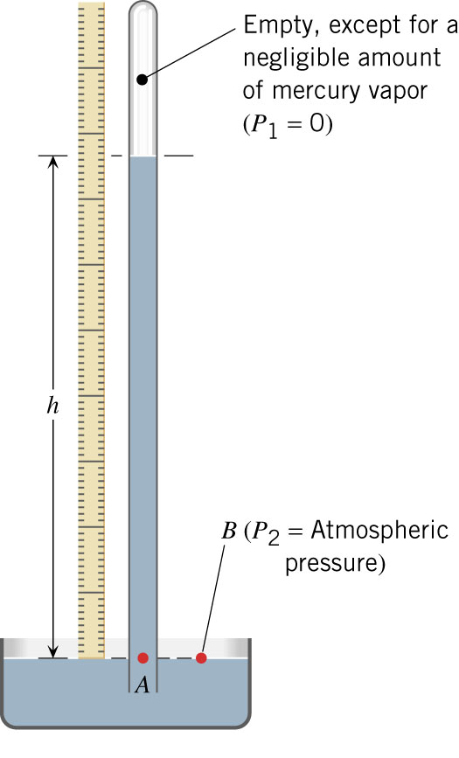
Barometric pressure
Atmospheric pressure can support a column of water 10.3 m high, or a column of mercury (which is 13.6 times as dense as water) 30 inches
high → the mercury barometer
Today’s weather

Slide 22
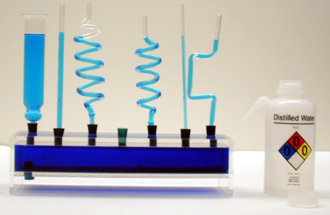
Pascal’s Vases
The fluid levels are the same in all each tube, regardless of their shape

