Slide 1
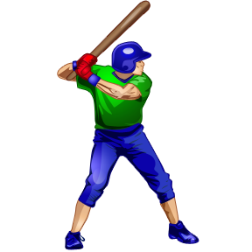
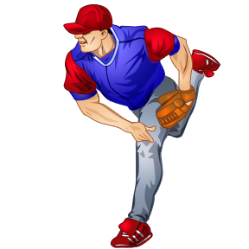
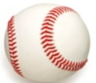
L 15 Fluids - 4
Fluid flow and Bernoulli’s principle
Airplanes and curveballs
Properties of “real fluids”
    viscosity
    surface tension

Slide 2
Basic principles of fluid dynamics
Volume flow rate = Q_{V} = v A (m³/s)
A
v
Continuity principle: Q_{V} = constant
v × A = constant → v₁A₁ = v₂A₂
v₁, A₁
v₂, A₂
II. Bernoulli’s principle: as the speed of a fluid increases, its pressure decreases

Slide 3
P_{ATM}
P_{ATM}
P_{ATM}
P < P_{ATM}
Blowing air over the top of the tube lowers the
air pressure on that side allowing the fluid to rise

Slide 4
Bernoulli’s principle
fast flow → low pressure
slow flow → high pressure
Low
pressure
High pressure
No flow
Flow on top

Slide 5
Loosing your roof in a tornado
WIND
Low Pressure
The wind does not
blow the roof off.
The wind lowers the
pressure above the
roof and the normal
pressure inside the
house blows the
roof off.
Normal
Pressure

Slide 6
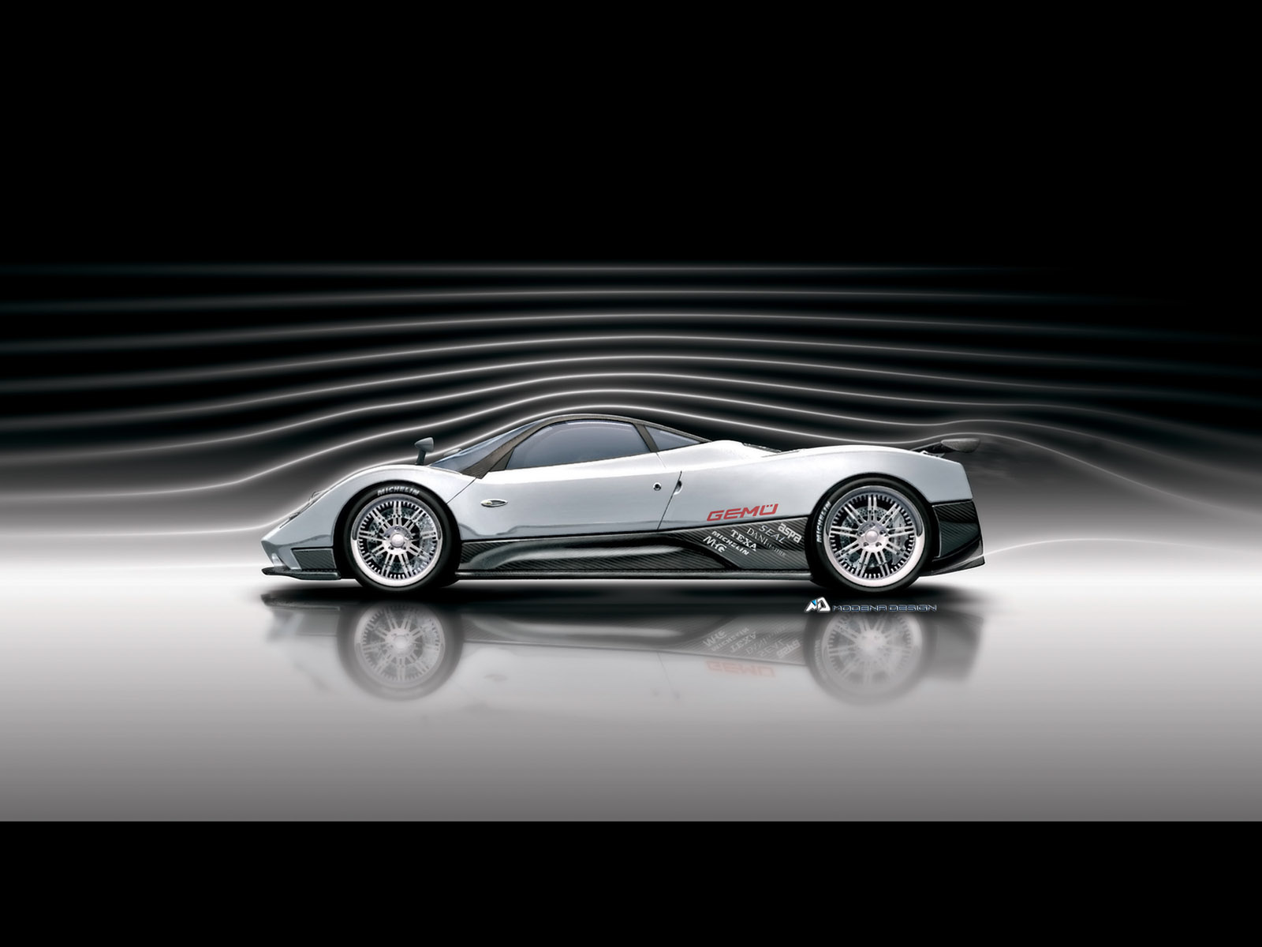
visualization of air flow in a wind tunnel
AIR
FLOW
streamlines
The spacing between the streamlines provides
information about the flow.

Slide 7
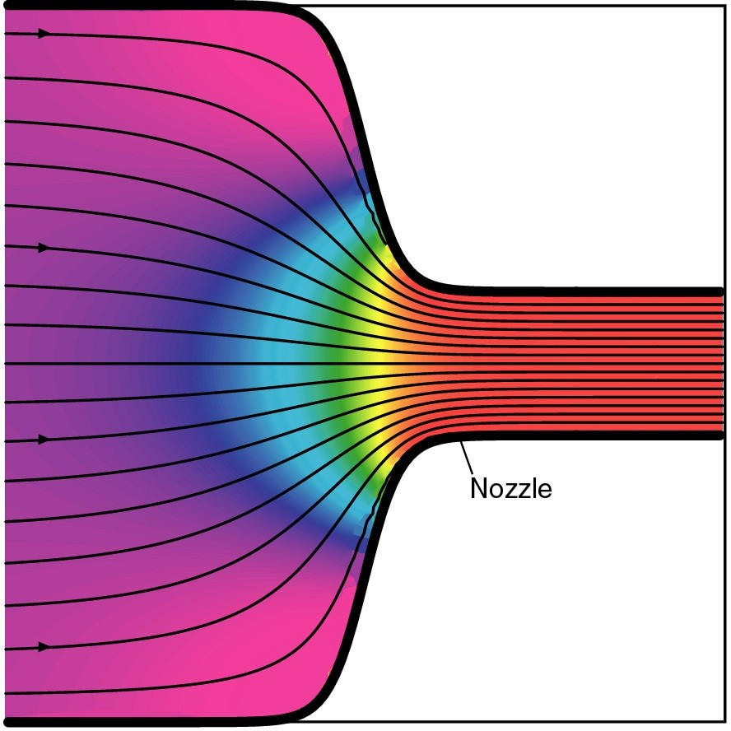
Streamlines and fluid flow
The black lines are the paths (streamlines) that the fluid takes as it flows.
Wider spacing indicates low speed flow, closer spacing indicates high speed flow
Color indicates pressure
High Low
pressure pressure

Slide 8
Bernoulli’s Principle
Fluid flow velocity = v
Fluid pressure = P
→ where v is high, P is low
→ where v is low, P is high

Slide 9
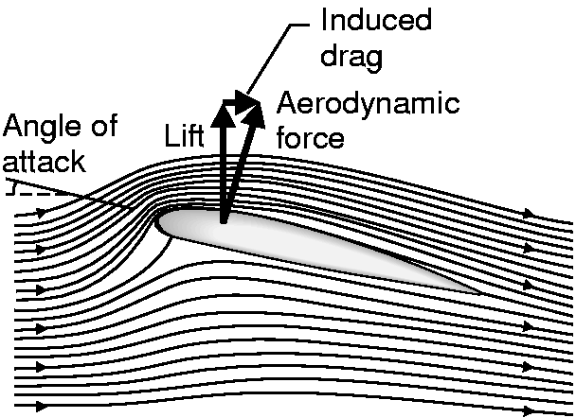
Streamlines around a wing
From the perspective of the jet, the air is moving past it
High speed → low pressure
wing
Low speed → high pressure

Slide 10
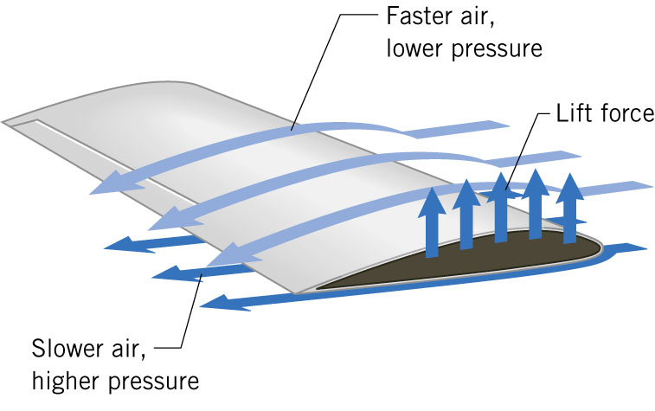
Flow over an airplane wing

Slide 11
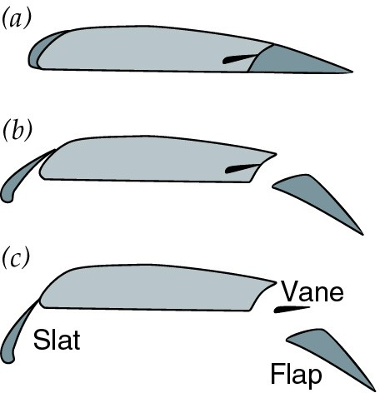
Control surfaces on a plane
By extending the slats and flaps, the wing area can be increased to generate more lift at low speeds for takeoff and landing

Slide 12
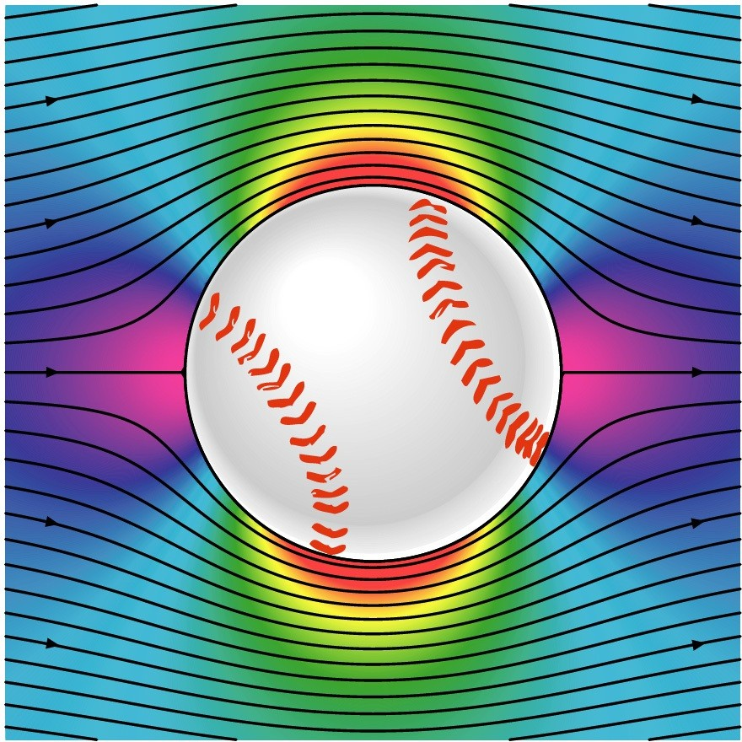
A baseball that is not spinning
The ball is moving but from the ball’s perspective the air moves relative to the ball
The streamlines are bunched at the top and bottom indicating higher flow speed
The pressure forces are balanced

Slide 13
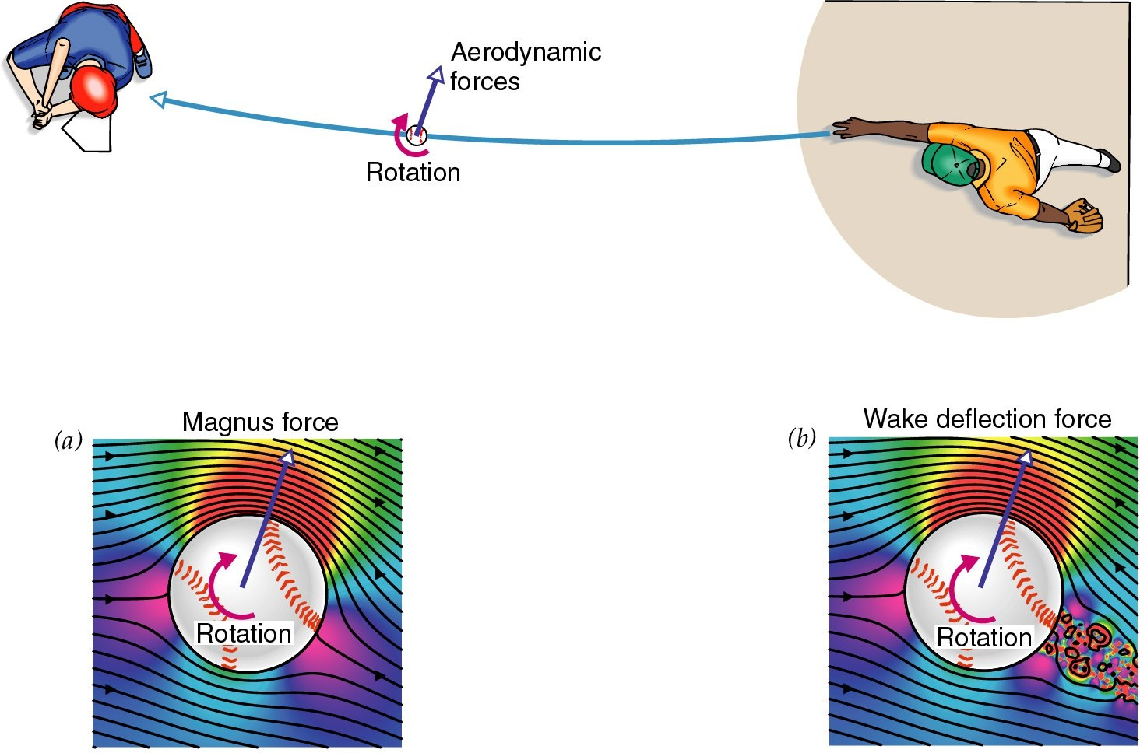
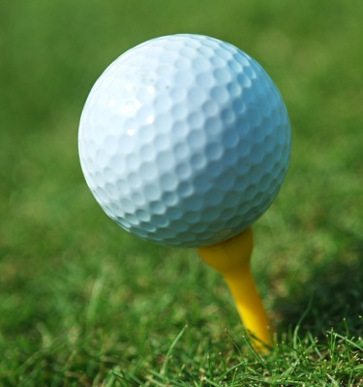
A Spinning baseball
The clockwise rotation of the ball cause the air to flow faster over the top
The streamlines are closer together on the top → high speed flow
The air pressure is then lower on the top than on the bottom (Bernoulli)
The ball experiences a sidewise force
TOP VIEW
Dimples on a golf
ball allow it to
go farther

Slide 14
Properties of “real liquids”
1. Viscosity
so far we have considered only “ideal” liquids → liquids that can flow without any resistance to the flow
“real” liquids (like ketchup) have a property called viscosity which is a tendency for the liquid to resist flowing

Slide 15
Viscosity
for example – pancake syrup flows more slowly than water – we say that pancake syrup is more “viscous” than water.
Ketchup and molasses are also good examples
viscosity is sometimes referred to as the “thickness” of a liquid
viscosity is an important property of engine oil – it should maintain its viscosity when hot, and not get too viscous when cold

Slide 16
Seeing the effects of viscosity
Pancake
syrup
Substances with higher
viscosity take longer to
flow down the ramp.
Viscosity is a measure of the resistance that one
layer of liquid experiences when flowing over another layer.

Slide 17
Viscosities of various substances
water has a viscosity of about 1 unit
pancake syrup has a viscosity of 2500
ketchup has a viscosity of 98,000
Lava- 100,000
peanut butter has a viscosity of 250,000
glass is a liquid with a very high viscosity of 10¹⁷ ➔ it does flow, but very slowly!
viscosity depends on temperature ➔ warm syrup flows faster than cold syrup

Slide 18
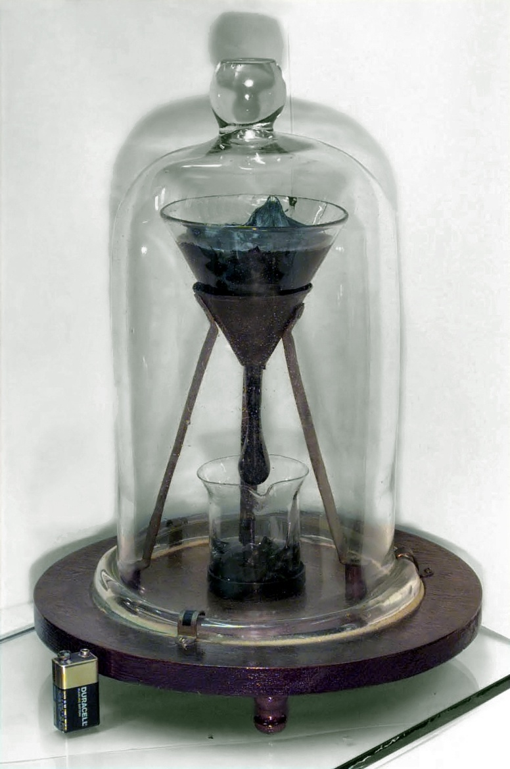
Pitch drop experiment at the University of Queensland in Brisbane, Australia
Pitch- used as a roofing material to prevent leaks
Must be heated to be applied
viscosity ~ 10¹¹ x water
Experiment began in 1927
8 drops have since fallen, one every decade or so

Slide 19
Measuring viscosity
ball
bearings
low viscosity
Liquid (e. g. water)
high viscosity
Liquid (e.g. syrup)

Slide 20
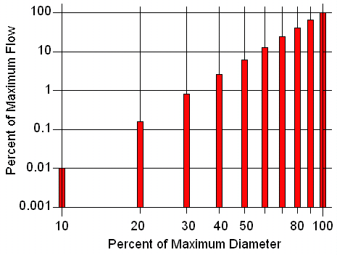
Flow through a pipe
P₂
P₁
D
L
D is the diameter
L is the length
P₂ – P₁ = pressure difference
η (eta) is the viscosity

Slide 21
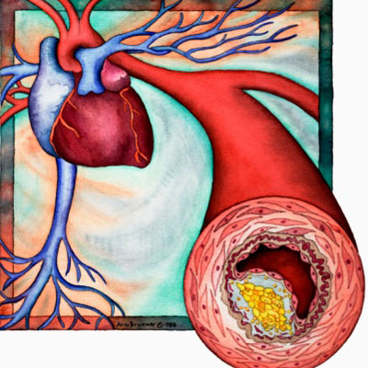
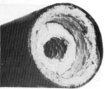
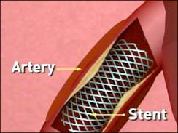
A pipe clogged
With calcium
deposits
clogged arteries

Slide 22
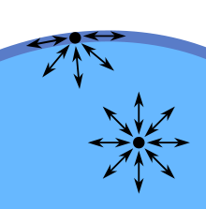
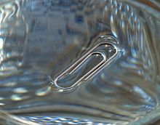
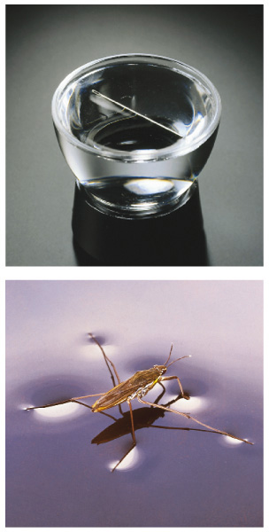
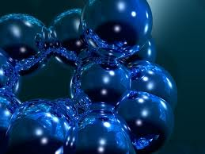
2. Surface tension
An attractive force between molecules at the surface of a liquid.
The surface tension force allows light objects and insects
to sit on a water surface, and causes bubbles to merge.
This effect is NOT due to a buoyant force

Slide 23
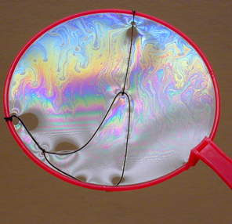
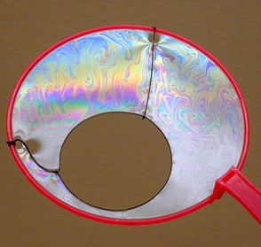
If a segment of the soap film is punctured, surface tension pulls the strings apart

