Slide 1
L 19 - Thermodynamics [4]
Change of phase
ice → water → steam
The Laws of Thermodynamics
  The 1st Law
  The 2nd Law
  Applications
    Heat engines
    Refrigerators
    Order to disorder

Slide 2
Change of Phase
Take ice from a freezer at -20C and continually add heat while monitoring its temperature.
Temperature in C
100 C
0 C
Heat
added
-20 C
heat
ice
melt
ice
heat
water
boil
water
heat
steam
Start: Ice
at -20 C
The temperature does not
change during a phase change.

Slide 3
Both temperature and pressure affect the phase changes
some recipes have high altitude instructions
The temperature at which water boils is 212 F at sea level
At higher altitudes, where the pressure is lower, water boils at a lower temperature
    at 5000 ft it boils at 203 F (95 C)
    at 7200 ft it boils at 199 F (93 C)
if we increase the pressure above atmospheric pressure, water is harder to boil

Slide 4
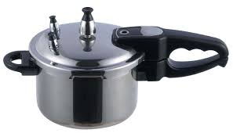
Boiling water
Liquid to gas phase change.
Energy is required to remove
Molecules from a liquid
The buildup of pressure inhibits molecules from
leaving the liquid.
heat source
A pressure cooker has a seal
that allows the pressure to
build up, so the liquid can
reach a temperature above its usual boiling point.

Slide 5
Boiling water with ice!
steam
as the water boils, the pressure (steam) builds up
when removed from the heat source the boiling stops due to the pressure of the water vapor
by cooling the water vapor, the pressure is lowered and the water will start boiling again
ice

Slide 6
Making ice in a vacuum:
Freeze drying
BELL
JAR
PUMP

Slide 7
REVIEW
Internal energy, Temperature, and Heat
The Internal Energy (U) of a system is the sum of the kinetic energies of all of its constituents
Temperature (T) of a system is a measure of the average kinetic energy of its constituents
Heat (Q) is the energy that is transferred from one system to another because they are initially at different temperatures; when the systems reach a common temperature, the flow of heat stops

Slide 8
Heat, work, and internal energy
a gas has internal energy (U) due to the kinetic energy of its molecules
if heat (Q) is added, its internal energy increases
if the gas expands, it does work on the atmosphere, and its internal energy decreases
the 1st law of thermodynamics is a statement of how the internal energy of the gas changes if heat is added or removed, and/or is work is done by the gas (expansion) or on the gas (compression)
gas
Heat (Q)

Slide 9
The First Law of Thermodynamics
the change in internal energy of the gas
= the heat absorbed by the gas
minus the work done by the gas
The change in internal energy is
Δ U = U_{final} − U_{initial}
Then, the 1st Law requires: Δ U = Q − W,
where Q is the heat absorbed by the gas, and W is the work done by the gas.
The 1st Law of Thermodynamics is a statement of conservation of energy – it is an energy
accounting principle.

Slide 10
EXAMPLE
What is the change in the internal energy of a gas if it takes in 3000 J of heat while it does 1000 J of work?
change in internal energy
= ΔU = Q − W
= 3000 J − 1000 J
= 2000 J (increase if ΔU is +)

Slide 11
Heat engines
A heat engine is a device that uses heat (input, which you must pay for in some form) to do work (output, which is useful).
The central issue is how much of the heat taken in can be converted into work
The outcome is first of all limited by the 1st law (you can’t get more out than goes in)
HEAT IN
Engine
WORK
HEAT
OUT

Slide 12
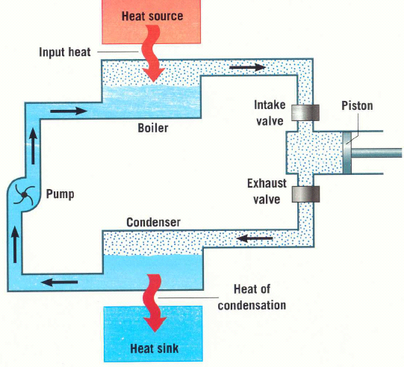
heat engine → operated in a cycle
work can be used
to rotate a turbine
and make electricity

Slide 13
A cyclic heat engine
Heat engines are operated in a cycle, which means that the working substance is returned to its original state at the end of the cycle.
Therefore, the change in internal energy of the engine is ZERO, i.e., ΔU = 0 for the cycle
The net heat into the engine is Q_{NET} = Q_{IN} – Q_{OUT}
Then, the energy balance given by the 1st law is:
So that:

Slide 14
Engine efficiency
The engine efficiency is defined as the ratio of the work done by the engine to the heat that goes into the engine
Since,
If Q_{OUT} = 0,the efficiency would be 100%, but this is prohibited by the second law

Slide 15
Heat engine example
A heat engine, operating in a cycle, absorbs 10,000 J
of energy from a heat source, performs work, and discards 6,000 J of heat to a cold reservoir.
(a) how much work is performed?
(b) what is this engine’s efficiency?
(c) what is the change in internal energy of this engine?
solution
W_{out} = Q_{in}- Q_{out} = 10,000 J – 6,000 J = 4,000 J
efficiency = W_{out}/Q_{in} = 4,000/10,000 = 0.4 or 40%
ΔU = 0, the change in internal energy for an engine operating in a cycle is zero

Slide 16
Second law of thermodynamics
There are 2 statements of the 2nd law which can be shown to be equivalent:
(Kelvin) It is impossible to have a heat
engine that is 100 % efficient.
➔ Not all of the heat taken in by the engine can be converted to work
(Clausius) In a spontaneous process, heat flows from a hot to a cold substance
➔ Work must by done to move heat from
a cold to a hot substance.

Slide 17
heat energy and work
heat cannot be completely converted into work.
the following example illustrates the difference between work energy and heat energy
give the block a push– it will stop due to friction
  the kinetic energy is converted to HEAT
  but, the block will not move by heating it!

Slide 18
Heat – disordered energy
When an object is heated, the energy of all of its molecules is increased.
however, the molecules do not all move in the same direction → they move about in all directions → this is what we mean by disordered (or thermal) energy
on the other hand, if we want the system to do work, we want it to move in some particular direction (work is directed energy)

Slide 19
refrigerators and air conditioners
Heat pump (heat engine in reverse)
You can make heat flow backward (cold to hot) only if there is an input of energy
in an air conditioner or refrigerator, this energy must be supplied by electricity
The electrical energy is used to run a motor (work) in the compressor
COLD
HEAT
WARM
Energy Input
(electricity)

Slide 20
order to disorder
All naturally occurring processes go in the direction from order to disorder
ice melts when placed in water; it never gets colder and the water gets warmer
ice, the solid state of H₂O is more ordered than water, the liquid state
in a solid all the molecules are lined up in a regular (ordered) array; there is less order in the liquid state, and even less in the gaseous state
when salt is put in water it dissociates; crystals of salt never spontaneously form in a salt water solution

Slide 21
Ice always melts in water
When ice is placed in a cup of water, it always melts → the water gets colder
The first law of thermodynamics does not prohibit the ice from getting colder and the water getting warmer
The first law only requires that energy is conserved → heat lost by ice = heat gained by water
The second law specifies the direction in which spontaneous processes proceed (hot → cold)

Slide 22
Order to disorder
Gas molecules expand to fill a volume
This always happens
spontaneously
This never happens
Under normal conditions there are several times 10²³ molecules in a box.
The chance that all of these are moving to the left at the same time is zero.
Orange and white ping-pong ball demo
What are the chances that after shaking
the balls will all be lined up again?

Slide 23
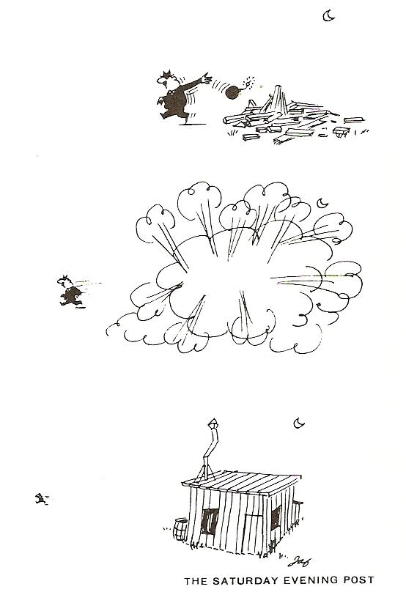
Just because it can happen doesn’t mean it will happen
Some processes are possible, but not probable
The second law of thermodynamics is a statement of the overwhelming likelihood of what occurs in systems that contain very large numbers of particles

