Slide 1
L 22 – Vibrations and Waves-3
resonance
clocks – pendulum
springs
harmonic motion
mechanical waves
sound waves
The periodic wave relation
Wave interference
  standing waves
  beats
musical instruments

Slide 2
Review
A mechanical wave is a disturbance that travels through a medium – solids, liquids or gases – it is a vibration that propagates
The disturbance moves because of the elastic nature of the material
As the disturbance moves, the parts of the material (segment of string, air molecules) execute harmonic motion (move up and down or back and forth)
  transverse wave--- waves on strings
  longitudinal wave --- sound

Slide 3
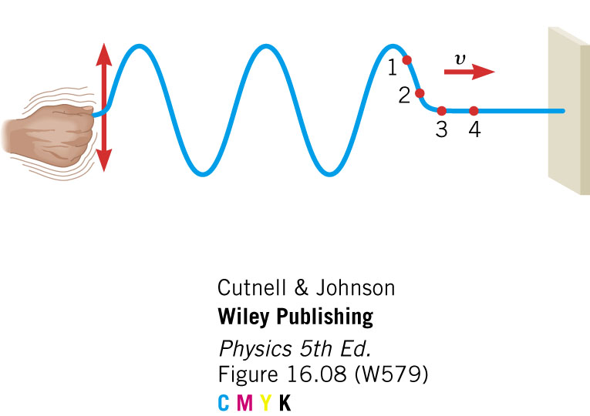
Wavelength: λ (lambda)
Snapshot of the string at some time – freezes the motion
Wave crests
λ
λ
Wave troughs
each segment of the string undergoes simple
harmonic motion as the wave passes by
distance between successive peaks (wave crests) is called the WAVELENGTH λ (lambda), it is measured in meters or centimeters

Slide 4
Period (T) or Frequency ( f )
An observer at a fixed position observes the wave moving by
The time between successive crests passing by (or troughs) is the PERIOD T
The number of crests passing by per unit time is the FREQUENCY f
Displacement (m)
Time
(s)
T
T
Period and frequency
are inversely related

Slide 5
The periodic wave relation
The wavelength, period (or frequency) and wave speed are related
In one period the wave moves one wavelength, so the wave speed v = λ/T
Since f = 1/T, this can be written as
λ f = v
which is the periodic wave relation.

Slide 6
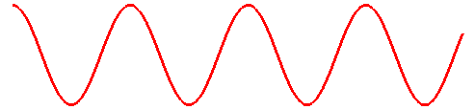
Example: wave on a string
2 cm
2 cm
2 cm
A wave moves on a string at a speed of 4 cm/s
A snapshot of the motion shows that the wavelength, λ = 2 cm, what is the frequency, ƒ ?
v = λ × ƒ, so ƒ = v / λ = (4 cm/s ) / (2 cm) = 2 Hz
T = 1 / f = 1 / (2 Hz) = 0.5 s

Slide 7

Making sound waves
→ longitudinal pressure disturbances
When the diaphragm in the speaker moves out it compresses the layer of air in front of it.
This compressed air layer then expands and pushes on another layer of air adjacent to it
A propagating sound wave is produced

Slide 8
Tuning forks make sound waves
The vibration of the fork causes the air near it to vibrate
The length of the fork determines the frequency
  longer fork → lower f
  shorter fork → higher f
It produces a pure pitch→ single frequency

Slide 9
Stringed instruments
Three types
  Plucked: guitar, bass, harp, harpsichord
  Bowed: violin, viola, cello, bass
  Struck: piano
All use strings that are fixed at both ends
The speed of the wave on the string depends on:
  The tension in the string which is adjustable (tuning)
  The thickness of the string (instruments have some thin and some thicker strings)
The periodic wave relation applies: λ f = v

Slide 10
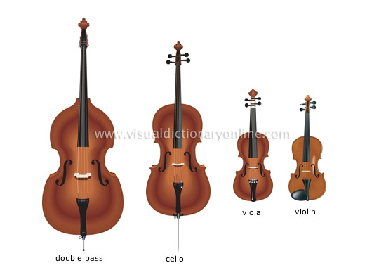
Bowed instruments
In violins, violas, cellos and basses, a bow made of horse hair is used to excite the strings into vibration
Each of these instruments are successively bigger (longer and heavier strings).
The shorter strings make the high frequencies and the long strings make the low frequencies
Bowing excites many vibration modes simultaneously
→ includes a mixture of tones (richness)

Slide 11
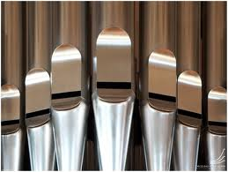
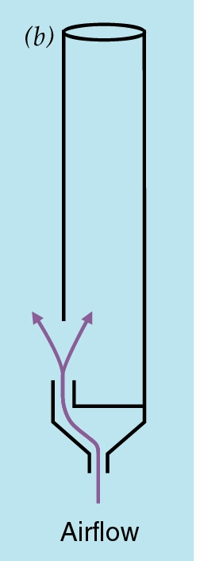
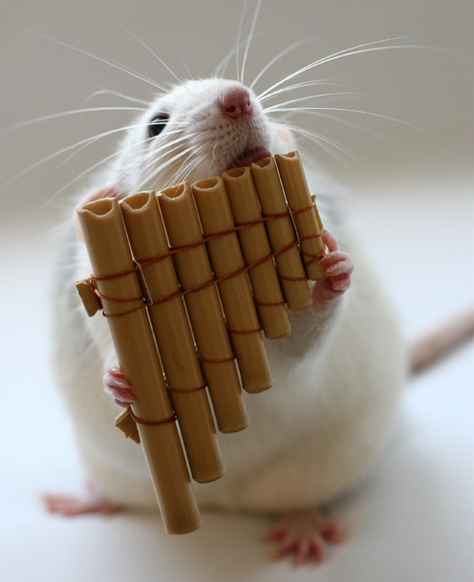
Wind instruments: organs, flutes…
The air pressure inside the pipe can vibrate, in some places it is high and in other places low
Depending on the length of the pipe, various resonant modes are excited, just like blowing across a pop bottle
The long pipes make the low notes, the short pipes make the high notes

Slide 12
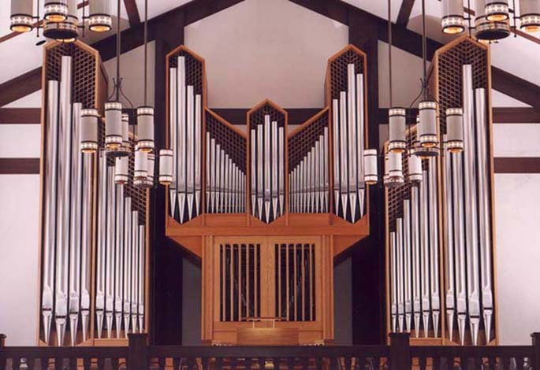
St. Vincent’s Episcopal Church in Bedford, Texas
Gravissima 8.2 Hz
4400 Hz

Slide 13
Wave interference
If there are 2 waves on a string, they can combine together to make another type of wave called a standing wave
Standing waves are produced by an effect called wave interference, and there are two types of interference:
  Constructive interference – the combination wave is bigger than the 2 waves
  Destructive interference- the combination wave is smaller than the 2 waves

Slide 14
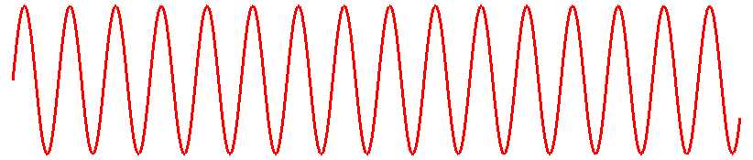
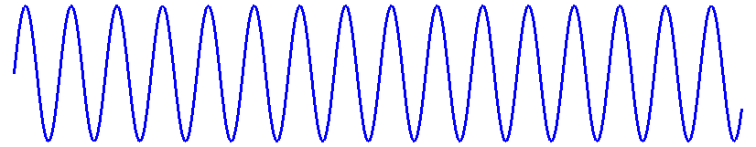
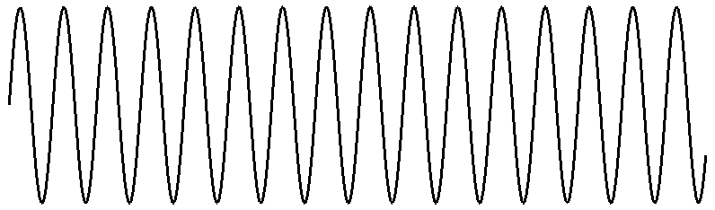
Constructive
Interference
Destructive
Interference
A
A
B
B
A+B
A+B

Slide 15
Wave interference effects
Waves can interfere with each other in space or in time
Wave interference in space gives rise to standing waves
Wave interference in time gives rise to beats

Slide 16
Standing waves
standing waves are produced by wave interference
when a transverse wave is launched on a string, a reflected wave is produced at the other end
the primary and reflected waves interfere with each other to produce a standing wave
In some places along the string, the waves interfere constructively and at other places destructively

Slide 17
Modes of vibration
Nodes N → the string does not move
Antinodes A→ string has maximum amplitude
N
N
Fundamental mode
Wavelength = 2 L
Frequency = f_{o}
A
L
N
N
First harmonic mode
Wavelength = L
Frequency = 2 f_{o}
A
N
A
N
N
Second harmonic mode
Wavelength = 2/3 L
Frequency = 3 f_{o}
A
A
N
N
A

Slide 18
Standing waves
At the NODES, the string does not move
At the ANTINODES the string moves up and down harmonically
Since the ends are fixed, only an integer number of half wavelengths can fit
e. g., 2 L, L, 2/3 L, ½ L, etc.
The frequency is determined by the velocity and mode number (wavelength)

Slide 19
Mode vibration frequencies
In general, f = v / λ, where v is the propagation speed of the string
The propagation speed depends on the diameter and tension of the string
Modes
  Fundamental: f_{o} = v / 2L
  First harmonic: f₁ = v / L = 2 f_{o}
  Second harmonic: f₂ = v / (2/3)L = 3 f_{o}
The effective length can be changed by the musician “fingering” the strings

Slide 20
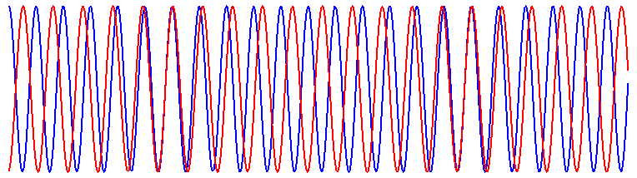
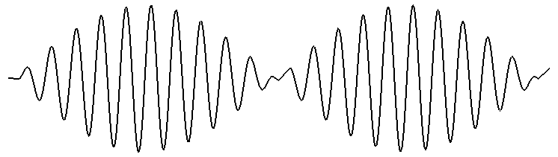
Beats – sound wave interference
Beats occur when 2 waves of slightly different frequencies are combined.

Slide 21
Room acoustics
Destructive interference accounts for bad room acoustics
Sound that bounces off a wall can interfere destructively (cancel out) sound from the speakers resulting in dead spots

Slide 22

Wave interference can be used to eliminate noise – anti-noise technology
Noise elimination headphones
The noise wave is inverted and added to the original wave, so the noise is effectively cancelled out.
+

