Slide 1
L 25 Electricity and Magnetism [3]
Electric circuits
    what conducts electricity
    what does and doesn’t conduct electricity
Current, voltage and resistance
  Ohm’s Law
  Power loss due to heat produced in a resistor
Simple circuit connections

Slide 2
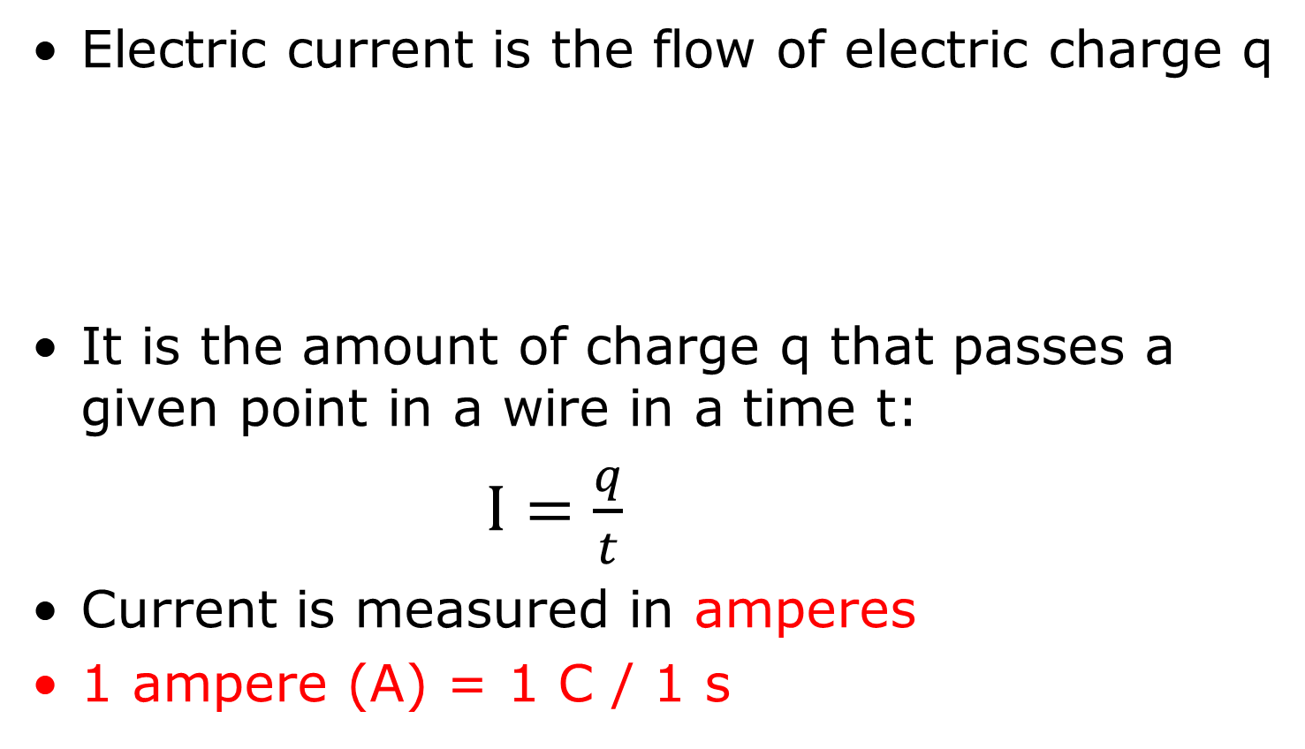
Electric current (symbol I)
Electric current is the flow of electric charge q
It is the amount of charge q that passes a given point in a wire in a time t:
$I=\frac{q}{t}$
Current is measured in amperes
1 ampere (A) = 1 C / 1 s
q

Slide 3
Examples
A charge of 1 microcoulomb (10⁻⁶ C) passes through a wire every millisecond (10⁻³ s). What is the current in the wire?
➔I = q/t = 10⁻⁶ C/10⁻³ s = 10⁻⁶⁺³ s = 10⁻³ A = 1 milliamp = 1 mA
A current of 3 A flows in a wire. Over a period of 1 minute, how much charge passes a given point in the wire?
➔ q = I  t = 3 A  60 s = 180 C

Slide 4
Potential difference or
Voltage (symbol V)
To make water flow in a pipe, a pressure difference must be applied between the ends of the pipe
A potential difference or voltage must be applied between the ends of a conductor to make the electrons flow
Voltage is supplied by a battery (DC) or a an electrical outlet (AC)

Slide 5
Electrical resistance (symbol R)
Conductors have “free electrons” that roam around randomly → no current
To push these free electrons through a conductor, i,e., to make a current, some external force must be applied to the conductor
This external force must be continually applied because the electrons experience a resistance to motion, because they keep bumping into the atoms and slowing down
The slowing down of the electrons is called “resistance” (R) and is measured in Ohms (Ω)
The battery provides the external force (voltage) that keeps the electrons moving

Slide 6
Electrons pass through an obstacle course in a conductor
atoms
electron
path
The resistance (R) is a measure of the degree to
which the conductor impedes the flow of current
We use the symbol to represent
the electrical resistance in a circuit

Slide 7
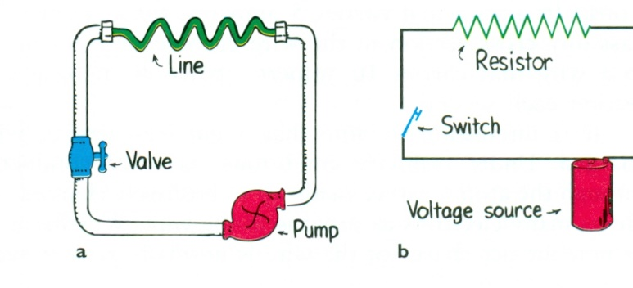
A battery is a charge pump

Slide 8
Direction of current flow
I
I
R
resistor
I
I
Duracell
I
+
I
By convention, the current direction is taken as the direction that positive charges would flow, so it is opposite to the electron flow

Slide 9
Current, Voltage and Resistance: OHM’S LAW
Resistance R
R could represent, the resistance of a light bulb,
hair dryer, coffee pot, vacuum cleaner, etc.
Current I
+
−
Battery voltage V
Ohm’s law is a relation between current (I), voltage (V) and resistance (R)
I = Voltage / Resistance = V / R
  V in volts (V), R in ohms (Ω), I in amps (A)
  equivalent forms: V = I R, I = V / R, R = V / I

Slide 10
Examples
If a 3 volt flashlight bulb has a resistance of 9 ohms,
how much current will it draw?
➔ I = V / R = 3 V / 9 Ω = 1/3 A (Ampere)
(2) If a light bulb draws 2 A of current when connected to a 120 volt circuit, what is the resistance of the light bulb?
    ➔ R = V / I = 120 V / 2 A = 60 Ω (Ohms)

Slide 11
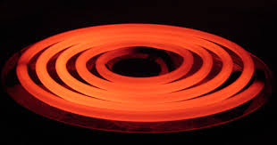
Heat produced in a resistor
As we have seen before, friction causes heat
The collisions between the electrons and the atoms in a conductor produce heat → wires get warm when they carry currents: in an electric stove
this heat is used for cooking
The amount of energy converted to heat each second is called the power loss in a resistor
If the resistor has a voltage V across it and carries a current I, the electrical power converted to heat is given by
Power: P = I × V = I ×(I × R) = I² × R
From Ohm’s law

Slide 12
Heat produced in a resistor
Power ➔ P = I ×V or I² × R
Power is measured in Watts = amps × volts
One Watt is one Joule per second
Wires are rated for the maximum current that can be handled based on how hot it can get
To carry more current you need wire of a larger diameter → this is called the wire gauge, the lower the gauge the more current it can carry
Using extension cords can be dangerous!

Slide 13
examples
How much current is drawn by a 60 Watt light bulb connected to a 120 V power line?
Solution: P = 60 W = I V = I  120
so I = 0.5 Amps (A)
What is the resistance of the bulb?
Solution: V = I R→ 120 V = ½ A  R
so R = 240 Ω, or R = V/I
How much current is used by a 2000 W hair dryer
plugged into a 120 V power source?
➔ P = I V → I = P / V = 2000W / 120 V ≈ 17 A

Slide 14
extension cords and power strips
extension cords are rated for maximum current → you must check that whatever is plugged into it will not draw more current than the cord can handle safely.
power strips are also rated for maximum current → since they have multiple inputs you must check that the total current drawn by everything on it does not exceed the posted current rating

Slide 15
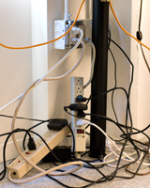
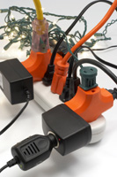
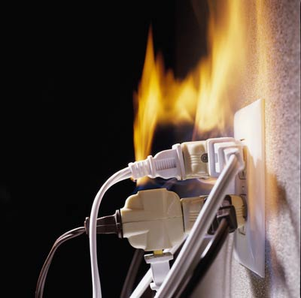
Unsafe practices
Must have capacity to carry all current

Slide 16
Parallel and Series Connections
Parallel connection
All bulbs have the same voltage = 12 V.
The current provided by the battery is divided equally among the 3 light bulbs.
+
−
12 V
Series connection
The same current passes through each light bulb.
Each bulb has a voltage of 4 V across it.
+
−
12 V

Slide 17
Simple direct current (DC) electric circuits
Exercise: given a battery, some wire and a
light bulb, connect them so that the bulb is on.
The battery polarity
+/- does not matter,
Either way the bulb
Will be on.
1.5 V

Slide 18
Electric circuits - key points
Electrons carry the current in a conductor
a circuit provides a closed path for the electrons to circulate around
Conductors have a property called resistance which impedes the flow of current
the battery is like a pump that re-energizes the electrons each time they pass through it
Ohm’s law is the relation between current, voltage and resistance: V = I R
When current passes through a wire, the wire heats up, the amount of heat energy produced each second (Power) is P = I V = I² R

Slide 19
What is DC (direct current) ?
With DC or direct current the current always flows in the same direction
this is the type of current you get when you use a battery as the voltage source.
the direction of the current depends on how you connect the battery
the electricity that you get from the power company is not DC it is AC (alternating).
We will discuss AC in the next lecture

Slide 20
connecting batteries
→ do’s and don’ts
don’t connect a wire from the + side to the – side,
this shorts out the battery and will make it get hot
and will shorten its lifetime.
Do not
do this
Duracell
+

Slide 21
dueling batteries
Do not
do this
Duracell
Duracell
+
+
The batteries are trying to push currents in
opposite directions → they are working against
each other. This does not work.

Slide 22
Proper battery connections
Connecting two 1.5 volt batteries
gives like this gives 3.0 volts.
Duracell
Duracell
+
+
A Flashlight!

Slide 23
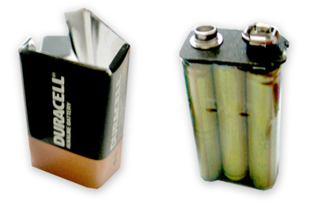
Batteries in parallel
This connection still
gives 1.5 volts but
since there are 2
batteries it will provide
electrical current
for a longer time
Duracell
+
Duracell
+
1.5 V D Cell

Slide 24
Longer lasting power series and parallel combination
1.5 V
+
1.5 V
+
Series connection [ – + – + ] gives 3.0 V
1.5 V
+
1.5 V
+
Parallel connection [ – + ]
[ – + ]
provides 3.0 V
This connection provides 3.0 volts and will
provide power for a longer amount of time

Slide 25
Disposable vs. Rechargeable Batteries
Disposable batteries are electrochemical cells that convert chemical energy into electrical energy. Because the electrode materials are irreversible changed during discharge, they must be replaced
Rechargeable batteries are also electro-chemical cells, but use materials in which the chemical reactions can be reversed in the recharging process

