Slide 1
L 27 Electricity & Magnetism [5]
Magnetism
Magnets
  permanent magnets
  electromagnets
  the Earth’s magnetic field
magnetic forces
applications

Slide 2
Magnetism
two sources of magnetism
    permanent magnets
    Electromagnets (currents in wires)
the earth’s magnetic field
    how does a compass work
    the north pole is really a south pole!
    Van Allen radiation belts

Slide 3
Permanent magnetism
certain minerals (magnetite, Fe₃O₄) are naturally magnetic
These minerals will attract bits of iron
a magnet produces a magnetic field in the space around it, just like the Sun has a gravitational field that holds the planets in their orbits
the magnetic field can be visualized with iron filings

Slide 4
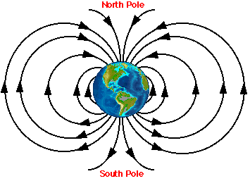
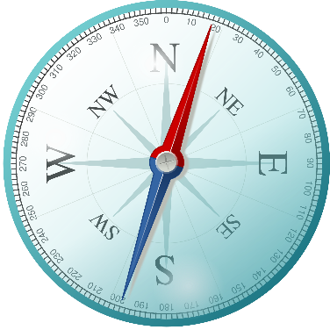
Earth’s magnetic and gravitational force fields
Gravitational
field
Magnetic
field

Slide 5
Permanent magnets
Are made from alloys of some of the rare earth elements like neodymium, samarium, and cobalt.
Always have a north and a south pole
like poles repel and unlike poles attract
if you break a magnet in half you get 2 magnets → cannot have just a north or just a south pole
S
N
S
N
S
N

Slide 6
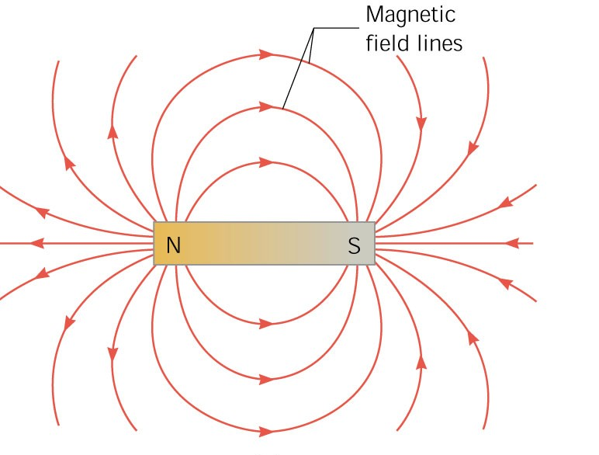
Magnetic field of a bar magnet
Oersted

Slide 7
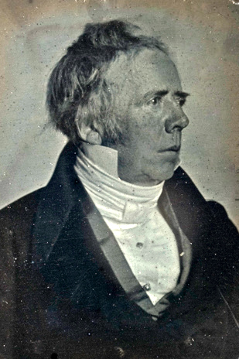
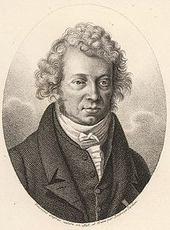
ELECTROMAGNETISM
I
N
S
Hans Christian Oersted in 1820 observed that current flowing in a wire near a compass caused the compass needle to move.
André-Marie Ampère in 1820, discovered the law relating the magnetic field and the current.

Slide 8
Magnetic field of a wire
Long straight wire
with current I
The magnetic field lines form a set of concentric circles surrounding the wire
The magnetic field is stronger close to the wire, and gets weaker away from the wire
Magnetic
field lines

Slide 9
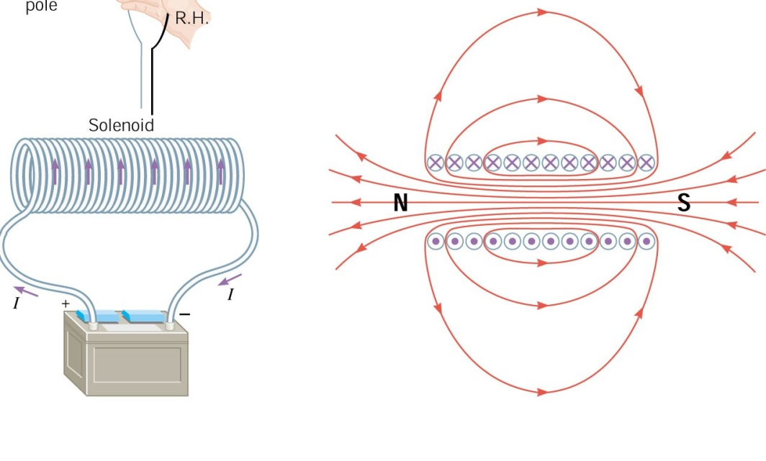
Magnetic field of a solenoid
A solenoid is a set of circular coils would on
a cylindrical form. The field is similar to the
field of a bar magnet.

Slide 10
Homemade magnets
Iron nail
COIL
Duracell
+
You can think of the nail as a collection of little
magnets that are randomly aligned. The magnetic
field of the coil aligns these little magnets giving a
larger field than that of the coil alone. We say that
the nail becomes “magnetized”, but the effect is
not permanent.

Slide 11
Inside a piece of iron
N S
N S
N S
N S
UNMAGNETIZED
atomic
magnets
N S
N S
N S
N S
PARTIALLY
MAGNETIZED
N S
N S
N S
N S
N S
N S
N S
N S
NORTH
N S
N S
N S
N S
SOUTH
Spinning
electrons
MAGNETIZED
N S
N S
N S
N S

Slide 12
Magnetic materials
some materials are naturally magnetic or can be magnetized and retain their magnetism → ferromagnetic materials
other materials (iron) can be magnetized temporarily by placing them near magnets
some materials have essentially no magnetic properties → copper, aluminum, plastics...
heat can destroy magnetism (Curie effect)
Permanent magnetism is due to the electron’s spin

Slide 13
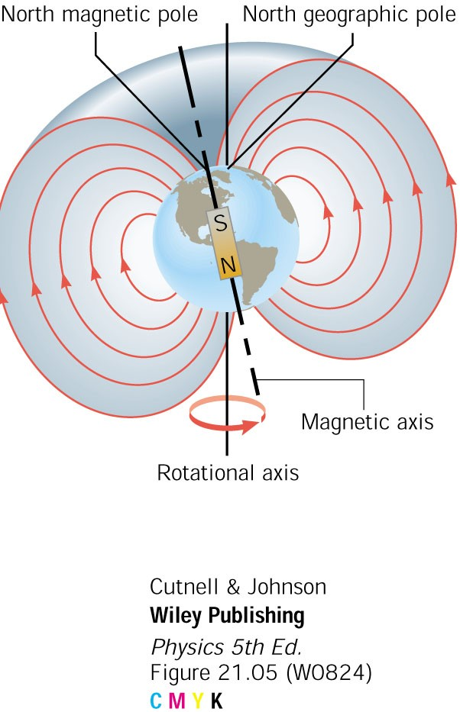
The earth is a big magnet
The earth’s north geographic pole is the south pole of a big magnet.
A compass needle is attracted to the earth’s north geographic pole
The earth’s magnetism is due to currents flowing in its molten core (not entirely understood!)
The magnetic north pole is
inclined about 14° from the
geographic north pole, or
by about 600 miles.

Slide 14
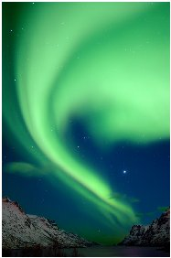
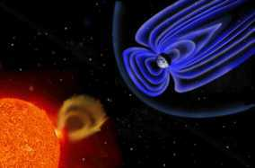
Sun – Earth Connection: space weather
earth
SUN
solar eruption
Space weather can have a large effect on
communications, and it can cause damage
to orbiting satellites and the power grid.
Northern Lights
(aurora)

Slide 15
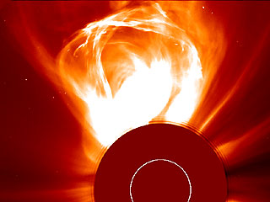
Solar eruptions – CMEs
(solar coronal mass ejections)
CMEs put out roughly 10¹² kg of mass

Slide 16
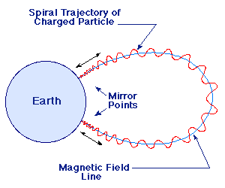
Charges stay on magnetic field lines
Electrons spiral around magnetic field lines – they are trapped
Electrons and protons that originate at the sun flow to earth as the solar wind
The particles get trapped by the earth’s magnetic field
Very energetic particles can damage satellites
Magnetic
field line

Slide 17
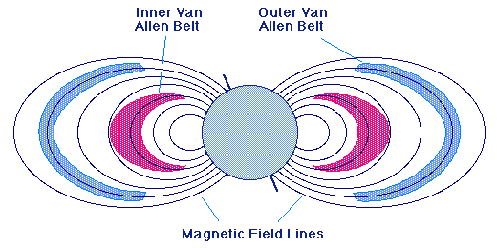
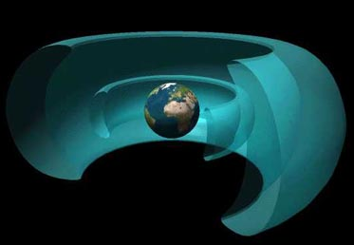
Van Allen Radiation Belts
2 regions around the earth where charged
particles are trapped in the earth’s Magnetic field

Slide 18
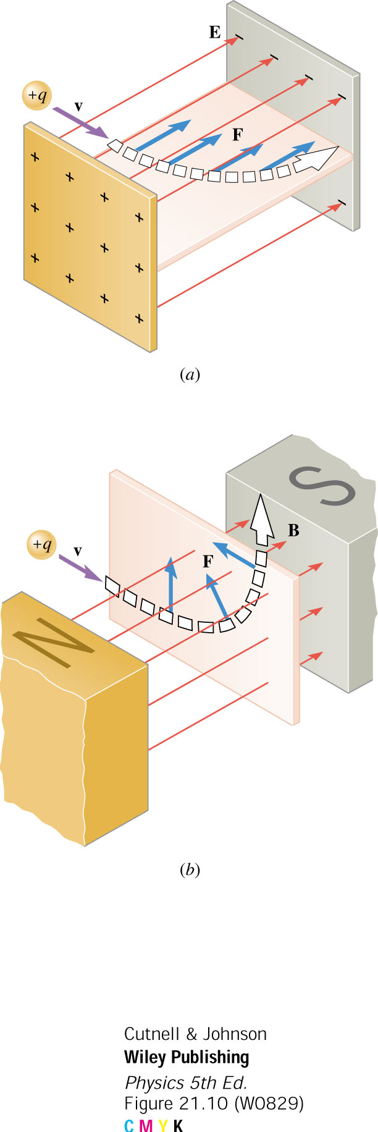
Magnetic forces
Magnetic fields exert sidewise forces on charges
A charge is turned around by the magnetic force
There is NO magnetic force if the charge is
not moving
+q

Slide 19
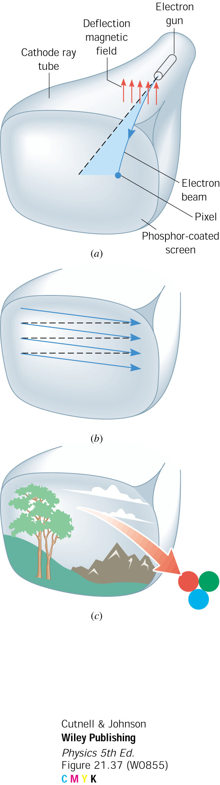
Application:
Magnetic deflection of electrons in a TV tube.

Slide 20
Magnetic forces on wires
Magnetic fields exert forces on the electrons
moving in a wire (current)
N
S
N
S
Wire pushed OUT
Wire pulled IN

Slide 21
Forces on current carrying wires
The current in one wire makes a magnetic field that
exerts a magnetic force on the current in the other wire
Opposites repel
Likes attract

Slide 22
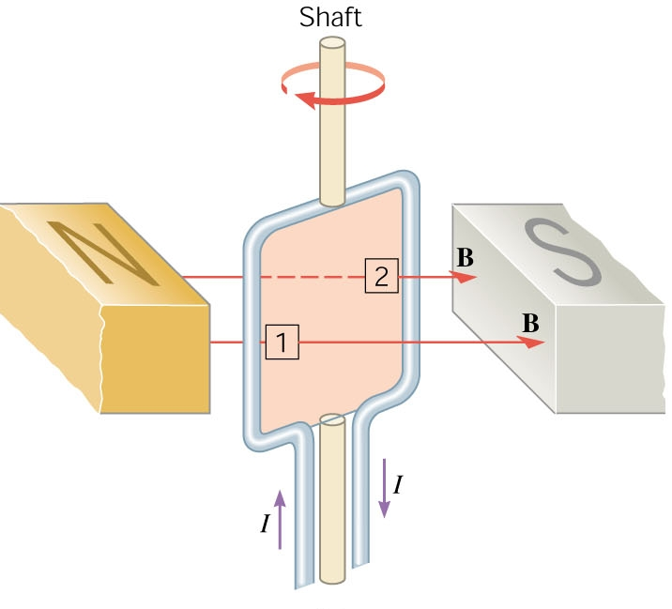
Torque on a current loop in a magnetic field
A loop of wire (coil)
carrying current experiences a torque
when placed in a
magnetic field.
The torque makes
the loop rotate.

Slide 23
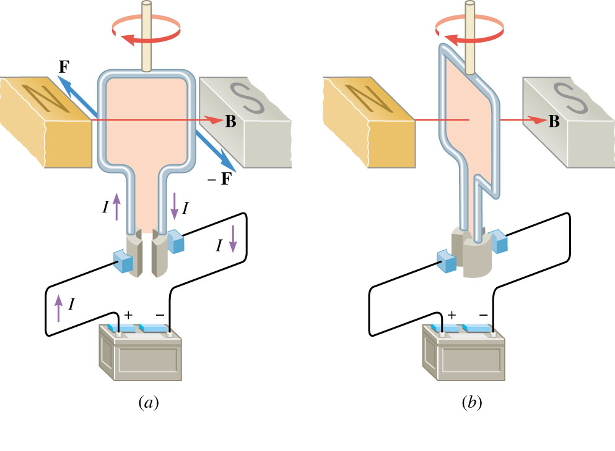
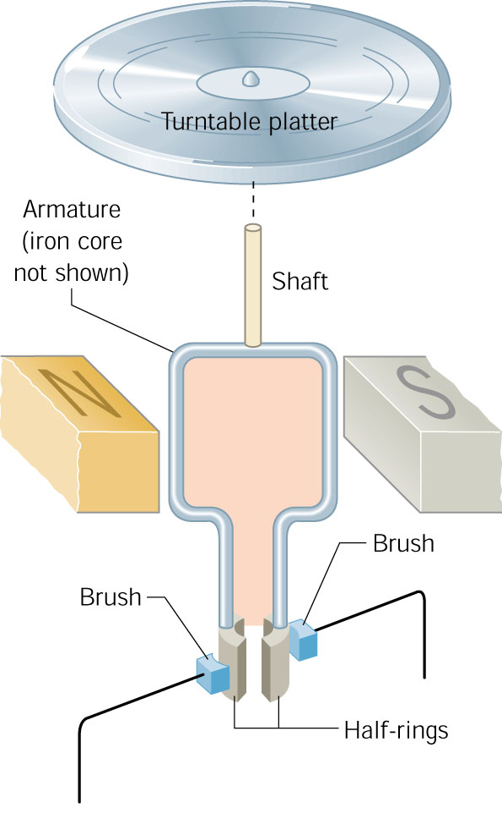
Application: The electric motor
When a current is present in a coil, it
experiences a torque and rotates.

Slide 24
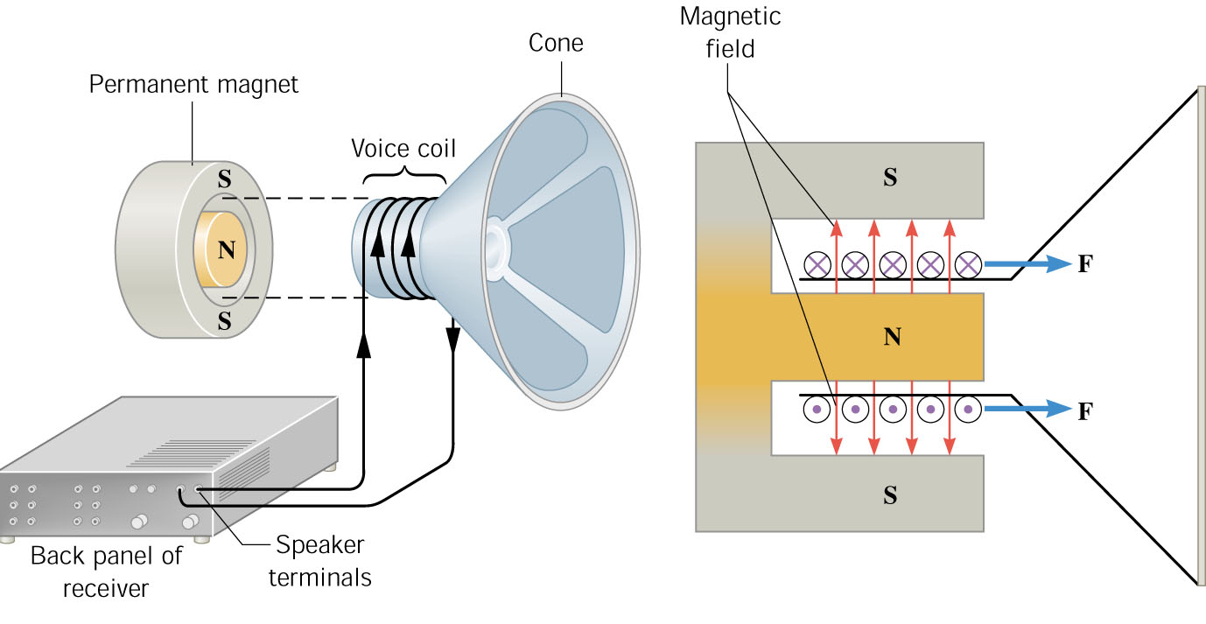
Application: Magnetic force in a speaker
The force between the permanent magnet
and the voice coil moves the speaker cone

Slide 25
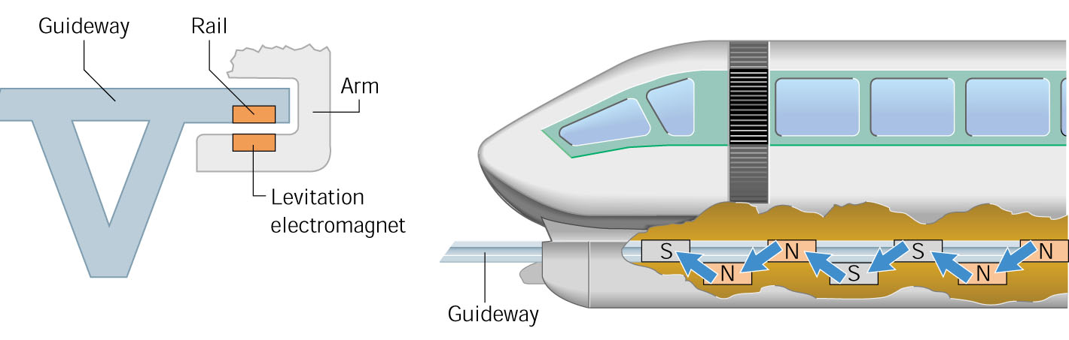
Application: MAGLEV Trains
Magnetic levitation can be used to keep
the cars on the track, and to propel
them without touching

