Slide 1
L 28 Electricity and Magnetism [6]
magnetism
Faraday’s Law of Electromagnetic Induction
  induced currents
  electric generator
  eddy currents
Electromagnetic Waves (Maxwell & Hertz)

Slide 2
Basic facts of Magnetism
Oersted discovered that a compass needle responded to the a current in a loop of wire
Ampere deduced the law describing how a magnetic field is produced by the current in a wire
magnetic field lines are always closed loops – no isolated magnetic poles; magnets always have a north and south pole
permanent magnets: the currents are atomic currents – due to electrons spinning in atoms - these currents are always there
electromagnets: currents in wires produce magnetic fields

Slide 3
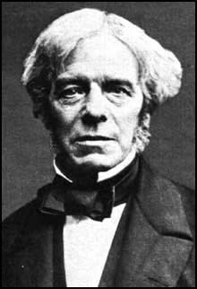
Faraday’s Law of Electromagnetic Induction
Faraday wondered if the magnetic field due to the current in one coil could regulate the current in an adjacent coil.
He was correct, with one important qualification:
the magnetic field must be changing in some way to
produce a current
the phenomenon that a changing magnetic field can produce a current is called electromagnetic induction
Michael Faraday
(1791-1867)

Slide 4
Induced currents (a)
A
B
magnetic
field lines
battery
current
indicator
switch
When a current is turned on or off in coil A, a magnetic field is produced which also passes through coil B.
A current then briefly appears in coil B
The current in coil B is called an induced current.
The current in B is only present when the current in A is turned on or off, that is, when the current in A is changing

Slide 5
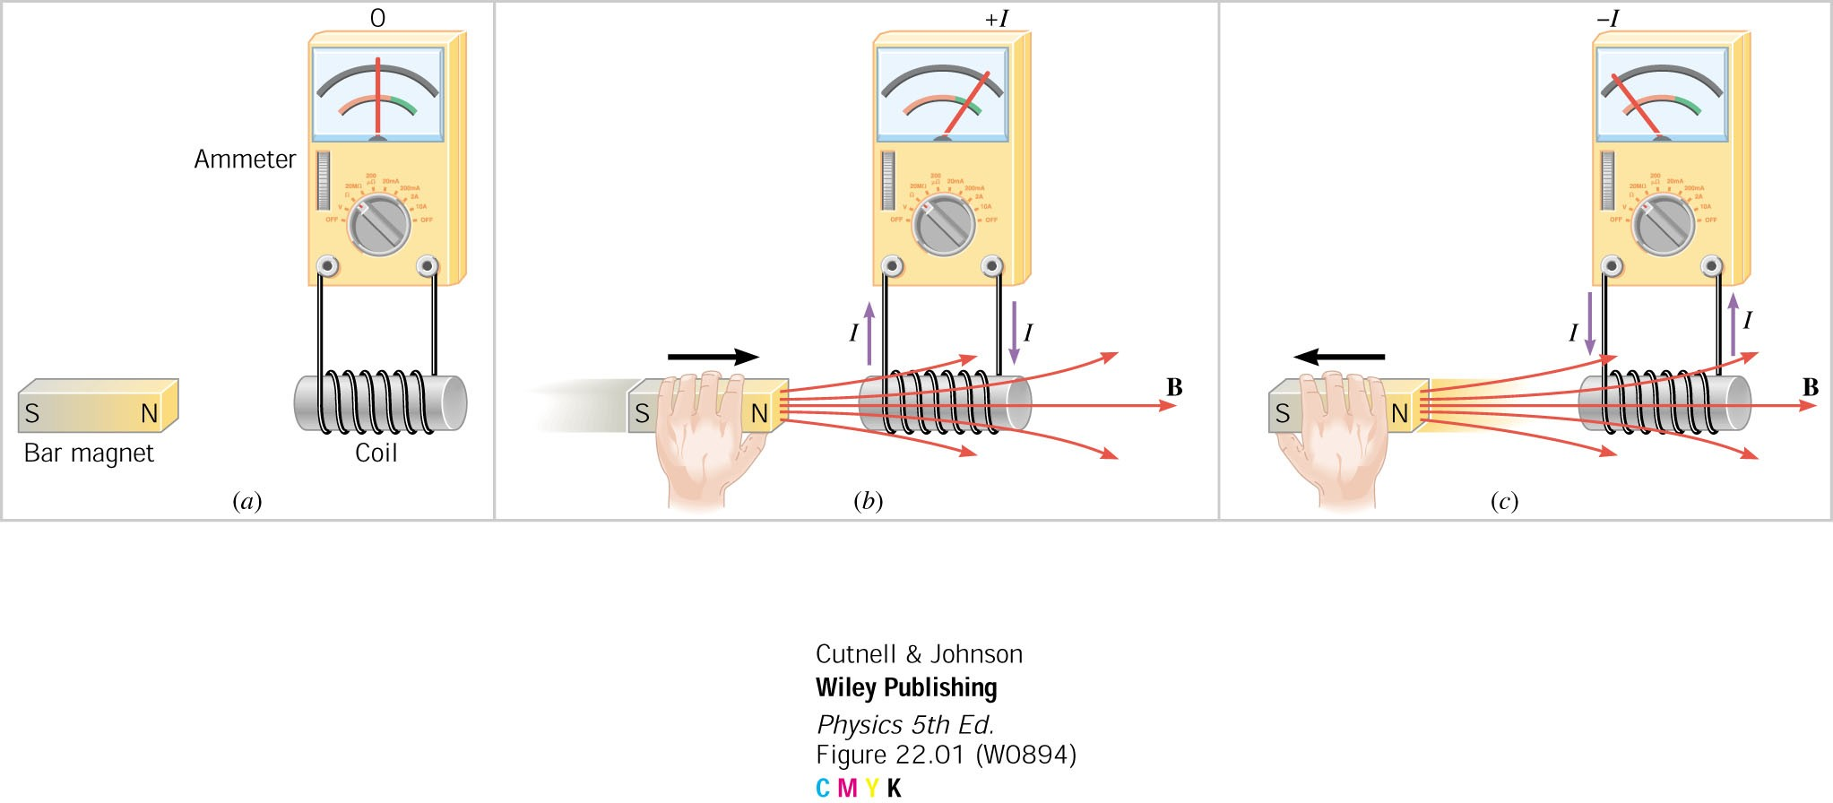
Induced currents (b)
(a)
(b)
(c)
No current is induced if the magnet is stationary.
When the magnet is pushed toward the coil or pulled away from it, an induced current appears in the coil.
The induced current only appears when the magnet is being moved

Slide 6
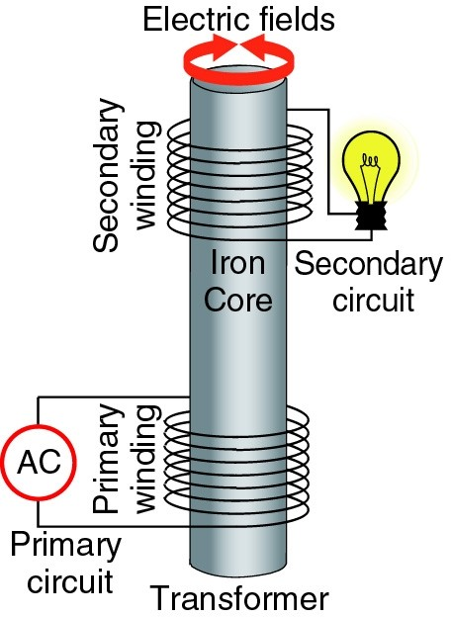
Induced currents (c)
If an AC (time varying) current is used in the primary circuit, a current is induced in the secondary windings.
If the current in the primary windings were DC, there would be NO induced current in the secondary circuit.
Levitated coil demo

Slide 7
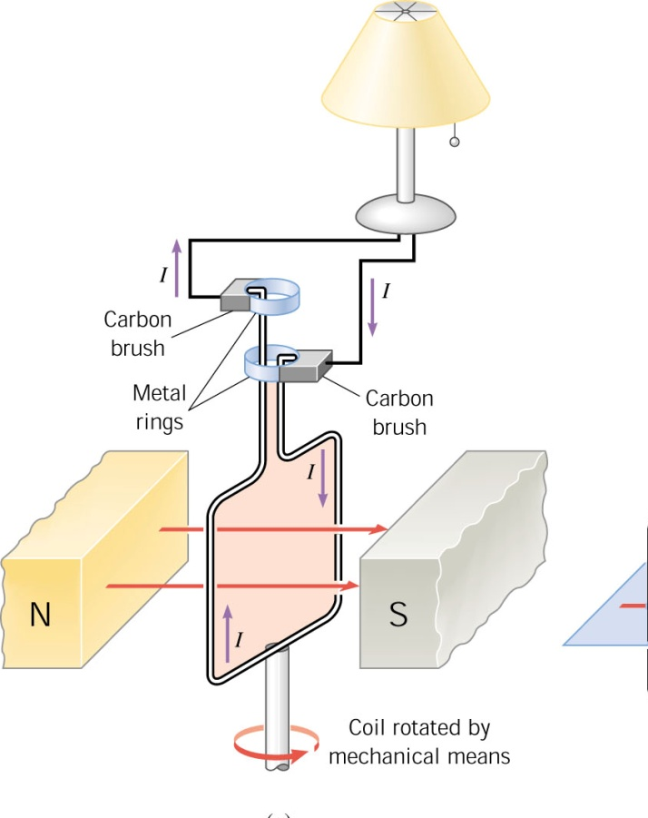
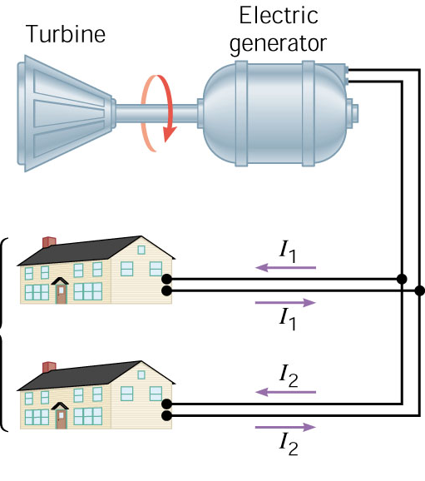
electric generators
When a coil is rotated in a magnetic field, an
induced current appears in it. This is how electricity
is generated. Some external source of energy is
needed to rotate the turbine which turns the coil.

Slide 8
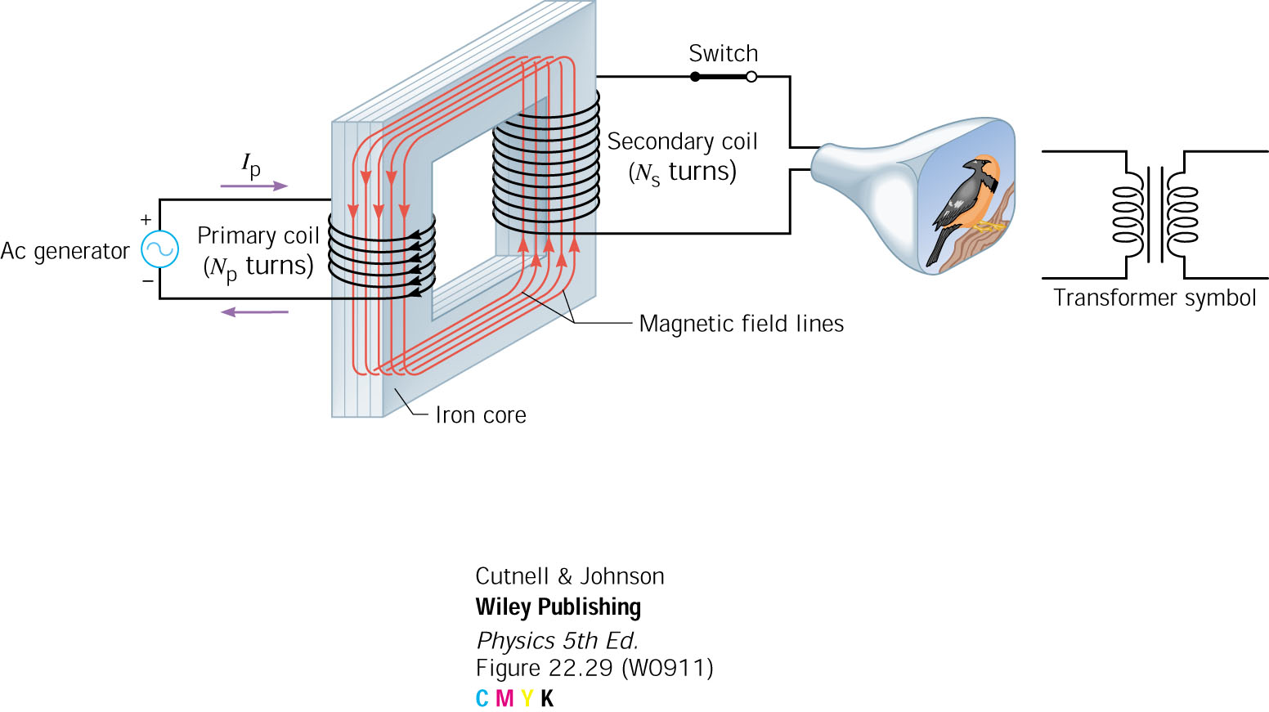
The transformer
The voltage on the secondary depends on the number
of turns on the primary and secondary.
Step-up → the secondary has more turns than the primary
Step-down → the secondary has less turns than the primary

Slide 9
Eddy currents
Eddy currents are induced in conductors if time-varying magnetic fields are present
As the magnet falls the magnetic field strength at the plate increases
Falling
magnet
Copper
plate
Eddy
currents
Induced magnetic field

Slide 10
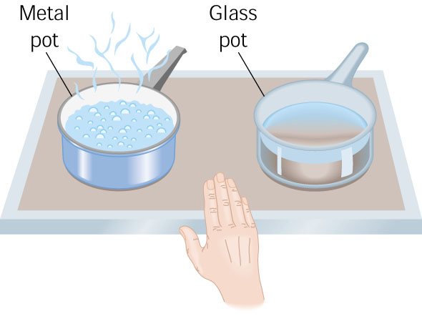

Eddy currents → application
An induction stove uses
eddy currents to cook food
Only the metal pot gets hot, not the
glass pot or the stove.

Slide 11
Floating magnet – induced currents
As the magnet falls, it induces currents in the copper pipe known as eddy currents.
These eddy currents produce a magnetic field that opposes the field of the falling magnet, so the magnet does not accelerate but descends slowly.
bar
magnet
slotted copper pipe

Slide 12
The Laws of Electricity and Magnetism
Laws of electricity
  electric charges produce electric fields (Coulomb)
  electric fields begin and end on charges
Laws of magnetism
  currents produce magnetic fields (Ampere)
  magnetic field lines are closed loops
  a changing magnetic field can produce a current (induced currents) (Faraday)
  A changing electric field can produce a magnetic field (Maxwell)

Slide 13
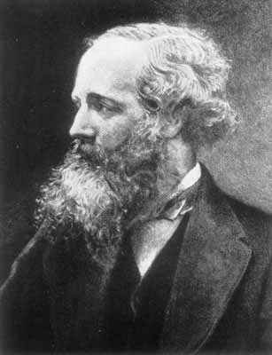
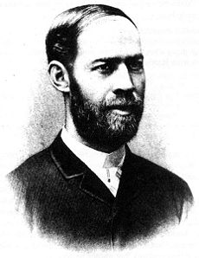
ELECTROMAGNETIC (EM) WAVES
Faraday laid the groundwork with the discovery of electromagnetic induction, Maxwell added the last piece.
EM
WAVES
LIGHT
James Clerk Maxwell in 1865 predicted theoretically that EM
waves should exist.
Heinrich Hertz showed
experimentally in 1886
that EM waves do exist.

Slide 14
Electromagnetic (EM) waves
Mechanical wave: a disturbance that propagates in a medium (eg, water, strings, air)
An electromagnetic wave is a combination
of electric and magnetic fields that oscillate together in space (no medium) and time in a synchronous manner, and propagate at the speed of light 3 ×10⁸ m/s or 186,000 miles/s.
EM waves include radio, microwaves, x-rays, light waves, thermal waves, gamma rays

Slide 15
the generation of an electromagnetic wave
electric field
wave emitter
e.g. antenna
magnetic field
The time varying electric field generated the time
varying magnetic field which generates the time
varying electric field and so on and so on . . . .

Slide 16
EM waves: transverse
the electromagnetic wave is a transverse wave, the electric and magnetic fields oscillate in the direction perpendicular to the direction of propagation
E field
direction of
propagation
B field

Slide 17
Electromagnetic waves
the EM wave propagates because the electric field recreates the magnetic field (Maxwell) and the magnetic field recreates the electric field (Faraday)
The EM wave is self-sustaining
an electromagnetic wave has an electric field and a magnetic field component, which are perpendicular to each other and to the direction of propagation.

Slide 18
How radio waves are produced
An oscillating voltage applied to the antenna
makes the charges in the antenna vibrate
up and down sending out a synchronized
pattern of electric and magnetic fields.
transmission
line
High Frequency
Oscillator
Dipole
Antenna

Slide 19
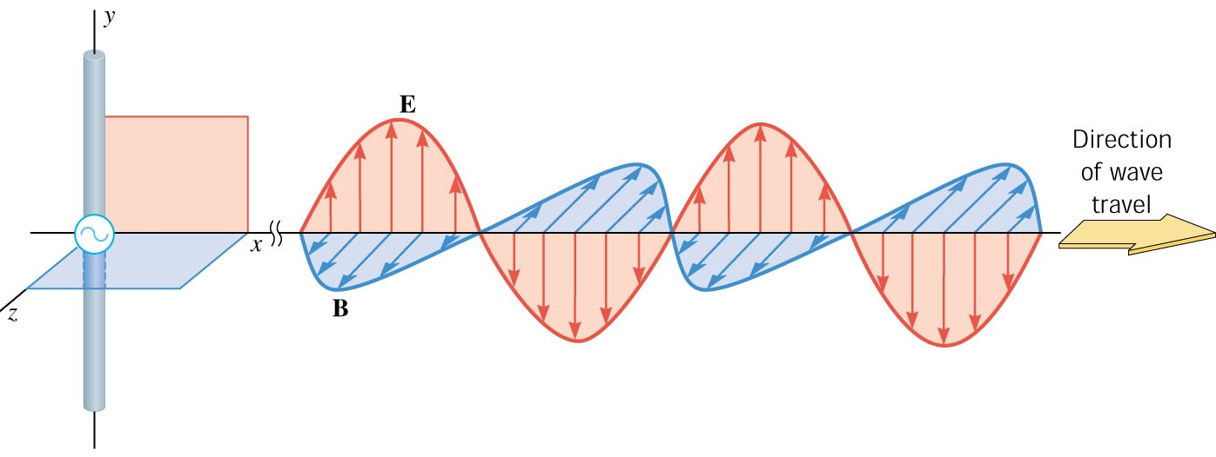
Electromagnetic Waves
EM WAVE: time and space
varying electric and magnetic
fields moving through space
at the speed of light, c =
3 x 10⁸ m/s = 186,000 miles/sec
Antenna:
emits waves

Slide 20

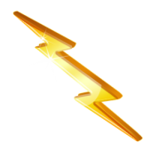
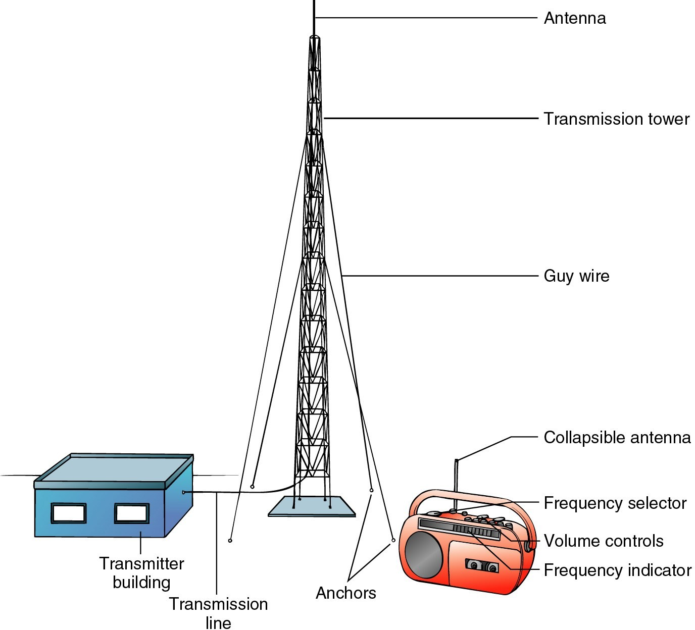

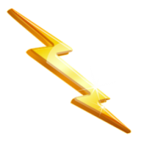
Radio antenna
the EM wave causes the electrons in the receiving antenna to oscillate at the same frequency
Sound waves are transformed to an electrical signal which is amplified and sent to the transmitter
the amplifier converts the electrical signal
to sound waves

Slide 21
The periodic wave relation applies to electromagnetic waves
The periodic wave relation: c = λ f
c = 3 ×10⁸ m/s is the speed of light
Example:
  What is the wavelength of an electromagnetic wave having a frequency f = 1 MHz (10⁶ Hz)?
  Solution:

Slide 22
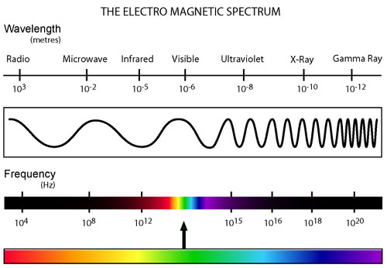
Electromagnetic spectrum
λƒ = c
Visible light

Slide 23
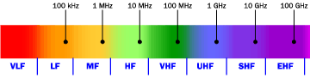
Common frequency bands
1 vibration per second = 1 Hertz (Hz)
1 KHz (kilohertz) = 10³ Hz
1 MHz (megahertz) = 10⁶ Hz
1 GHz (gigahertz) = 10⁹ Hz
AM radio: 535 KHz – 1.7 MHz
FM radio: 88 – 108 MHz
GPS: 1227 and 1575 MHz
Cell phones: 824 MHz – 2 GHz

Slide 24
Microwaves
are in the frequency range of a few billion Hz or wavelengths of about several cm (about the same range as radar → the “Radarange”
How do microwaves heat water?
Remember that the water molecule has a positive end and a negative end.
The electric field of the microwave grabs onto these charges and shakes them violently a few billion times each second
all this shaking energizes the molecules making the water hotter and hotter.

