Slide 1
L 30 Light and Optics - 2
Measurements of the speed of light (c)
Index of refraction v_{medium} = c/n
  the bending of light – refraction
  total internal reflection
Color (wavelength and frequency, c = λf
Dispersion
    rainbows
Atmospheric scattering
    blue sky and red sunsets
Law of reflection
  mirrors
  Image formation

Slide 2
Reflection and refraction at a surface
Index of refraction n = c/v > 1
Incident
Light ray
Normal line
reflected
Light ray
AIR
GLASS
refracted
Light ray

Slide 3
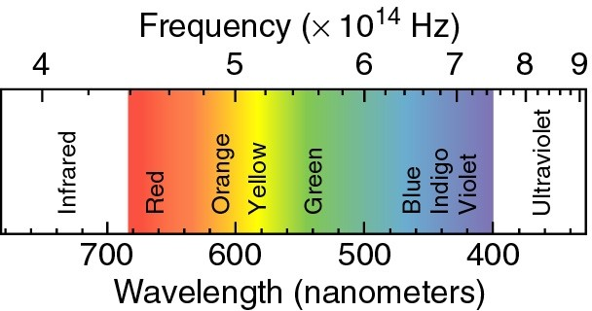
VISIBLE LIGHT
COLOR ➔ WAVELENGTH or FREQUENCY
Wavelength × Frequency = c = speed of light
e.g., 6x10¹⁴ Hz x 500x10⁻⁹ m = 3x10⁸ m/s

Slide 4
The index of refraction (n) depends of the color (wavelength) of the light
color | Wavelength (nm) | n
red | 660 | 1.520
orange | 610 | 1.522
yellow | 580 | 1.523
green | 550 | 1.526
blue | 470 | 1.531
violet | 410 | 1.538
1 nanometer (nm) = 1 × 10^{–9} m

Slide 5
Different colors are refracted (bent) by different amounts, this phenomenon is called dispersion
Blue light is bent more
than red light, because n
is larger for blue light
contains all
wavelengths
(colors)
white
light
red
glass prism
blue

Slide 6
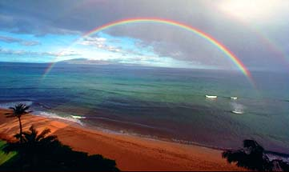
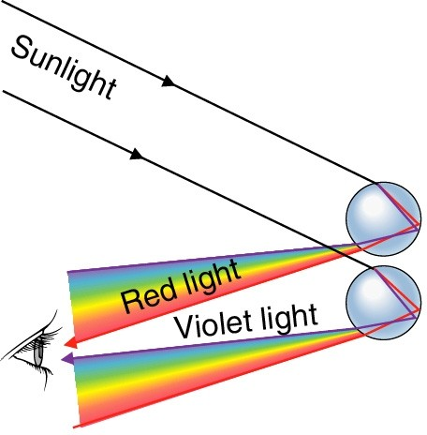
The rainbow
Rainbows are caused by dispersion of sunlight from water droplets which act as tiny prisms

Slide 7


Why is it a rain BOW ?
42°
The rain drops must be at just the
correct angle (42°) between your eyes and the sun to see the rainbow. This angle is maintained along the arc of a circle.

Slide 8
Atmospheric scattering
Why is the sky blue and sunsets red?
It is due to the way that sunlight is scattered by the atmosphere (N₂ and O₂)
Scattering→ atoms absorb light energy and re-emit it, but not at the same wavelength
Sunlight contains a full range of wavelengths in the visible region

Slide 9
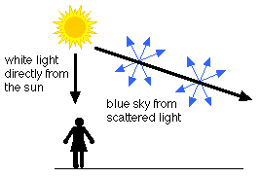
Atmospheric scattering: blue sky
Short wavelengths are scattered more than long wavelengths
Blue light (short) is scattered 10 times more than red light
The light that we see in the sky when not looking directly at the sun is scattered blue light

Slide 10
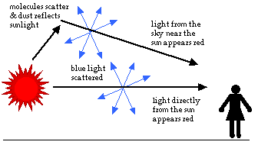
Atmospheric scattering: red sunset
At sunset, the sun is low on the horizon
When looking at the sun it appears red because much of the blue light is scattered out leaving only the red

Slide 11
Why are clouds white?
Clouds consist of water droplets and very small ice crystals
The water droplets and ice scatter the sunlight
Scattering by water and ice (particles) is very different from scattering by molecules
The atoms are smaller than the wavelength of light, but the ice and water particles are larger
Scattering by particles does not favor any particular wavelength so the white light from the sun is scattered equally → clouds are white!

Slide 12
Mirrors ➔ reflection
Light does not pass through metal (e.g. Aluminum)
Light is reflected at the surface
Two types of reflection: diffuse and specular
Rough surface
Polished surface
Diffuse reflection:
Fuzzy or no image
Specular reflection:
Sharp image

Slide 13
The law of reflection
normal
incident
ray
reflected
ray
i
r
mirror
The incident ray, reflected ray and normal all lie in the same plane, and
The angle of reflection = angle of incidence
r
=
i

Slide 14
image formation by plane mirrors
object
image
The reflected rays are diverging when they leave the object so they will not come to a focus point; our eyes perceive the reflected rays as coming from a point behind the mirror→ this is called a virtual image
A virtual image can be seen with our eyes but cannot be projected onto a screen (our eyes focus the diverging rays onto the retina)
The image is the same distance behind the mirror as the object is in front of the mirror, and the image is the same height as the object

Slide 15


You only need a mirror half as tall as you are to see your whole self
Homer’s image
Homer

Slide 16
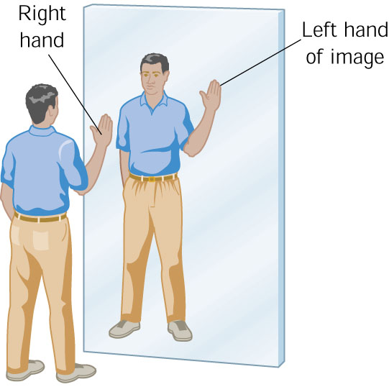
The image of your right hand is your left hand
AMBULANCE is printed
backward so that you can read it
correctly in your real-view mirror

Slide 17
Spherical or curved mirrors
parallel light rays are focused to one point in front of
the mirror
Concave
mirror
focus
parallel rays
diverge from
a focus point
behind the
mirror
Convex
mirror
focus

Slide 18
Reflection from a curved surface
CONCAVE
Reflection at a curved
surface is governed by
the law of reflection –
angle of reflection equals
angle of incidence.
The direction of the normal
changes from one point
to another on a curved
surface.
CONVEX

Slide 19
Real image formed by a concave mirror
OBJECT
F
IMAGE
When the object is at a distance greater than
the focal point, the reflected light rays meet
at a point in front of the mirror, so the image
is REAL; it is INVERTED and DIMINISHED in size.

Slide 20
Where is the light bulb?
image of light bulb
light bulb
F
f
f
A concave mirror will form a real image of an object placed at twice its
focal length at a distance of twice the focal length. It will be inverted
and the same size as the object.

Slide 21
Dish antennas
signal from
satellite
detector at
the focal
point of the dish

Slide 22
Magnifying mirrors
Homer’s
image
Homer
when something placed within the focus of a concave
mirror, an enlarged, upright image is formed.
this principle is used in a shaving or makeup mirror

Slide 23
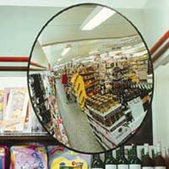
Convex mirrors: wide angle view
Object
Image
A convex lens provides a wide
angle view. Since it sees more,
the images are reduced in size.
Passenger side mirrors are often of this type with the warning: “Objects appear farther than they actually are.” Because they appear smaller, they appear to be farther away.

