Slide 1
Laboratory Study of Spiky Potential Structures Associated with Multi-Harmonic EIC Waves
APS DPP Mini-Conference on Nonlinear Effects in Geospace Plasmas November 9, 2015
Robert L. Merlino and Su-Hyun Kim
University of Iowa
Guru Ganguli
U. S. Naval Research Laboratory

Slide 2
Introduction
Parallel electric fields now considered to be responsible for energizing auroral particles
Spiky, repetitive electric field structures have been observed in the auroral region by the S3-3, Polar, Viking, Freja, and FAST satellites.
These appear as either unipolar or bipolar pulses in high time resolution waveforms of the potential difference between pairs of spheres deployed from the spacecraft.
The repetition frequency of these pulses are just above the proton gyrofrequency.
The spiky electric field structures may play a key role in supporting the parallel electric fields.
What is the origin of these spiky electric field structures?

Slide 3
Background
Electrostatic Ion Cyclotron (EIC) waves have been observed in the Earth’s auroral region
The theoretical work of Kindel and Kennel (1971) strongly influenced the interpretation of space plasma wave observations
EIC waves driven by field-aligned currents (FAC) (electron drift)
  Critical drift for EIC instability:
  Critical drift for ion acoustic instability:
Upward currents typically subcritical in auroral region
Ganguli et al showed in 1994 that EIC waves could grow, even in the absence of FAC, provided that inhomogeneous ion flows, i.e., ion flows parallel to B with transverse flow gradient, are taken into account

Slide 4
Inhomogeneous ion flow driven EIC waves
The presence of parallel ion flow with transverse shear can change the effect of cyclotron damping in the expression for the instability growth rate to growth, and thus provide an additional mechanism for EIC wave growth even in the absence of electron drifts.
Furthermore, the critical shear for EIC wave excitation is approximately independent of the harmonic number, so that multiple harmonic modes can be excited simultaneously.
The superposition of multiple cyclotron harmonics naturally results in the formation of spiky electric field structures.
In the non-linear phase, these structures can produce cross field transport and ion energization.

Slide 5
FAST observations
Particle measurements show the presence of localized, intense ion fluxes (a) with strong perpendicular shear (b) associated with parallel plasma flows.
The wave spectrum (d) of the perpendicular electric field (c) shows a mixture of broadband and discreet features at harmonics of Ω_{H+} (f)
High time resolution waveforms reveal the characteristic spiky electric field signatures (e).

Slide 6
Laboratory experiments investigating space physics phenomena
Configuration simulation
Attempt to reproduced the actual or scaled conditions of the space system. Attempt to have critical parameter ratios close to the actual system – difficult, if not impossible
Process simulation
The plasma physics process in question is studied. The idea is to use the laboratory to test theories which, if confirmed, can then be applied with some confidence to the actual space physics problem.

Slide 7
Schematic diagram of the Q Machine Plasma Device
K or Cs Atoms
Magnet Solenoid
(K⁺ or Cs⁺)/e⁻ plasma produced by surface ionization of K or Cs atoms on a hot (2400 K) Ta plate
Diameter: 6 cm, Length 1.5 m
B_{max} = 0.4 T → r_{e} =2.7x10⁻⁴ cm;
r_{i} = 0.7 mm (K), 1.3 mm (Cs)
Plasma density: 10¹⁵ -10¹⁶ m⁻³
Background pressure: 10⁻⁶ Torr
Temperatures: T_{e} = T_{i} = 0.2 eV
Ion-ion mfp: 10 – 100 cm
Oven
HV
Plasma Column
Filament
Hot Tantalum
Plate
Langmuir Probe
The Q Machine produces a nearly
fully-ionized, magnetized, collisionless plasma

Slide 8
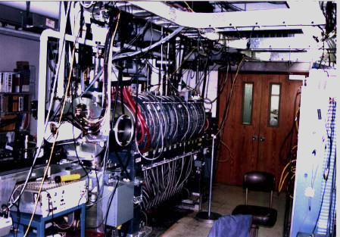
Schematic of the experimental setup
B-Field
Two identical plasma sources (HP1 and HP2) are used to produce plasmas with ions drifting in opposite directions.
A plasma with controllable parallel ion flow is produced using two electrodes (Ring and Disk) that are biased to collect ions.
An annular region of sheared ion flow occurs at the boundary between the ring and disk (green-white regions)
The plasma carries no current and there are negligible radial electric fields in the region of the parallel ion flow shear.
A strip antenna is used to launch electrostatic waves in the ion cyclotron frequency range perpendicular to the magnetic field.
HP1
Antenna
HP2
Ring
Disk
Ion flow
Langmuir Probe
Ion flow

Slide 9
Experiments
Study how EIC waves that are amplified in a plasma with magnetic field aligned ion flow with transverse shear and no field aligned electron current.
Study the excitation of multiple harmonic EIC waves and formation of spiky potential waveforms.

Slide 10
Effect of ion flow shear on EIC waves
No ion
flow shear
When the ion flow with shear is present, EIC waves (fundamental mode shown) are amplified in the regions of strong shear.
POP 11 4501 2004 FIG 2ab

Slide 11
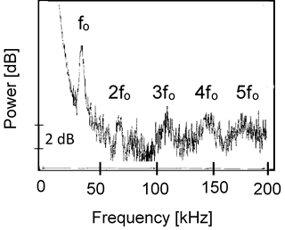
Results for higher cyclotron harmonics
The spectrum of amplified EIC waves when the input frequency to the antenna was swept up to 200 kHz.
The higher harmonic modes are amplified by the same value of the ion shear parameter
POP 11 4501 2004 FIG 3

Slide 12
Amplification of cyclotron harmonics for a broadband input signal
A broadband signal was applied to an RF amplifier in the frequency range of a few kHz up to 1 MHz. This signal was then fed to the antenna in the plasma.
When the ion flow with shear was ON, selective amplification of the cyclotron harmonics was observed.
POP 13, 012901 (2006) FIG 3

Slide 13
Spiky potential waveforms for multiharmonic EIC waves
0 0.1 0.2
time (ms)
0 0.1 0.2
time (ms)
0 0.1 0.2
time (ms)
The time separation between the pulses
scales inversely with the gyro-period.

Slide 14
Experimental and model time series
Model time series:
with
and measured A_{n} values
The model time series (linear superposition) reproduces the general features of the observed time series
Phase locking of the ϕ_{n} are required to reproduce the experimental time series
POP 13, 012901 (2006) FIG 4

Slide 15
Summary and Conclusions
The results of the experiments presented here show the critical role that parallel ion flow with transverse shear plays in the generation of multiple-harmonic EIC waves, and spiky electric potential structures:
  Ion cyclotron waves can grow in a plasma with magnetic field-aligned ion flow and transverse shear and no electron drift (FAC)
  Ion flow with transverse shear can excite multiple cyclotron harmonics
  Multiple cyclotron harmonic waves of comparable amplitude can combine linearly to form spiky potential structures.

