Slide 1
Coulomb fission of a charged dust cloud in an afterglow plasma*
T07.00001 APS DPP 2015 November 16-20 Savannah, GA
R. L. Merlino and J. K. Meyer
Department of Physics and Astronomy
The University of Iowa, Iowa City, IA 52242
*Supported by DOE and NSF

Slide 2
Coulomb explosion
PLASMA
A cloud of negatively charged dust particles suspended in a plasma which provides charge, confinement, and shielding
Turn the plasma off
The plasma decays on a time scale faster that the charging time of the dust
Now have cloud of negative particles with
  No confinement
  No shielding
Result → Coulomb explosion !
DUST

Slide 3
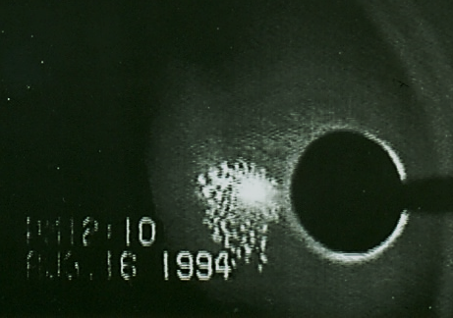
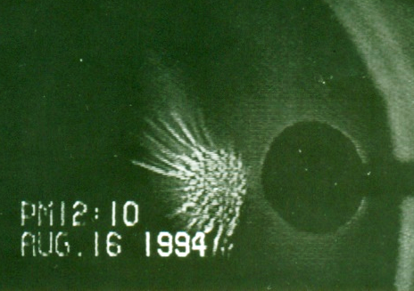
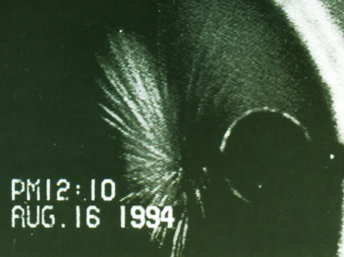
Coulomb explosion of dust particles confined in an anode glow discharge
t = 0
t = 1/30 s
t = 2/30 s
16 mm
Estimated acceleration ∼ few g
In agreement with MD simulations of Saxena, Avinash, and Sen, Phys. Plasmas 19, 093706, 2012.

Slide 4
Motivation
Study how a finite system responds to a large excess charge
Study behavior of a dusty plasma in a plasma afterglow
  What is the residual charge on the dust
  Depending on conditions interaction can be Coulomb or Yukawa
What are the possible topologies of a disintegrating charge cluster: large fragments, small fragments, or individual particles?
Analysis of cluster disintegration may reveal collective effects
Connections to Coulomb explosion and fission of atomic clusters under high intensity laser irradiation
Connections to disintegration of charged liquid droplets and the Rayleigh criterion for breakup: Q > 8p(e_{o}g a³)^{1/2}, g = surface tension.

Slide 5
Experimental set-up
DC glow discharge in argon at p ∼ 0.1 – 0.2 Torr
1 micron diameter spherical silica particles
Conical mesh used to trap a secondary dust cloud

Slide 6
Three fragmentation channels were observed
Blow-off: the outer layer of the cloud is suddenly shed
Expansion: the entire cloud expands in 3D under Coulomb repulsion
Fission: the cloud splits into 2 pieces
Relevant issues:
  Each cloud fragmentation event results in the destruction of the cloud
  The plasma and dust cloud must be reformed for each new experiment
  Each dust cloud is different in size, shape, and density
The observed fragmentation channel may be strongly affected by initial conditions.

Slide 7
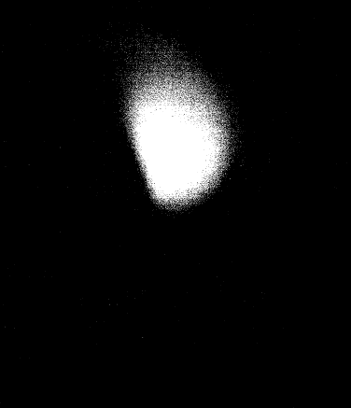
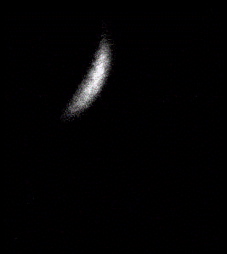
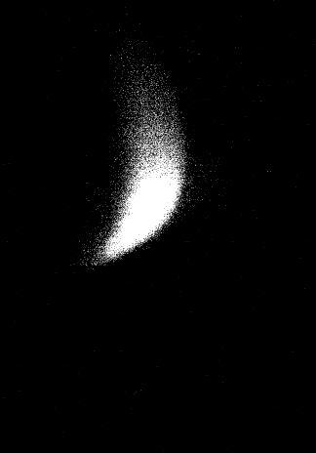
Blow-off
20 x 24 mm
Expansion
15 x 17 mm
Fission
18 x 26 mm

Slide 8
Single-frame images of dust cloud fission

Slide 9
Dust density profiles of a fissioning cloud

Slide 10
Position vs. time of maximum density in lower cloud
The position of the lower cloud ~ t² over the first 2 ms, with an estimated acceleration ∼ 10³ m/s²
From t > 6 ms, the lower cloud speed is reduced to a value consistent with free-fall with neutral drag
This reduction in the speed of the cloud is likely due to the reduction in the dust charge

Slide 11
SUMMARY
We have studied how clouds of charged dust particles respond when the plasma that they are immersed in is suddenly turned off.
Three types of cloud evolutions have been observed
  Blow-off --- the outer layer of the cloud is rapidly shed
  Expansion --- the cloud expands uniformly
  Fission --- the cloud fragments into two pieces
MD simulations are being performed to identify the conditions that control how a charged dust cloud evolves under repulsive electrostatic forces

