Slide 1
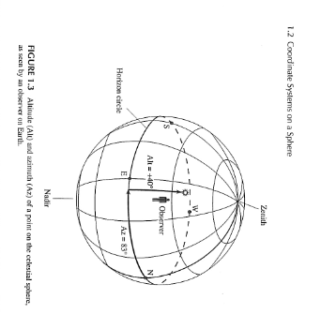
Lecture 2, Coordinate systems in astronomy
The horizon coordinate system

Slide 2
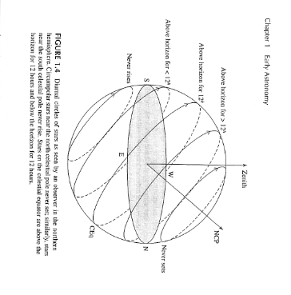
Diurnal motion of celestial objects in horizon system
Objects move on diurnal circles centered on the celestial pole

Slide 3
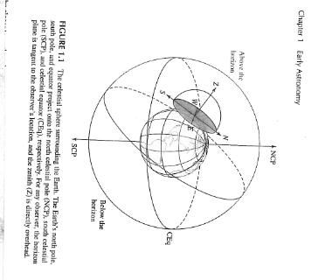
Why sky changes appearance in different places on the Earth
As the Earth rotates, the zenith points in different directions

Slide 4
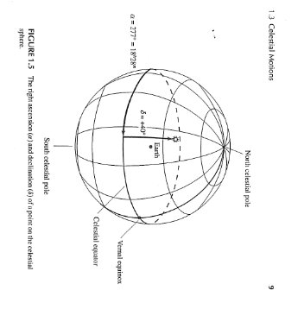
The equatorial coordinate system
a system like latitude and longitude for the celestial sphere

Slide 5
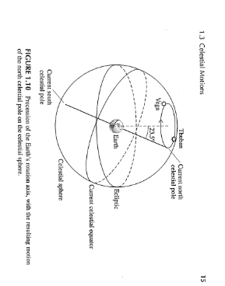
Two lines on the sky: the celestial equator and the ecliptic

Slide 6
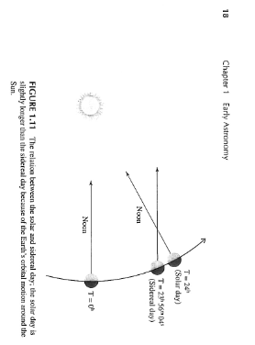
Revolution of the Earth about the Sun: an explanation for many astronomical phenomena
The seasonal changes in the night sky…
The difference between sidereal and solar time

Slide 7
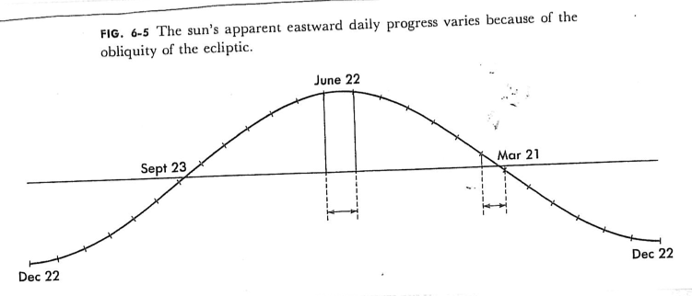
Why the solar day varies, Part 1…variable angle between celestial equator and ecliptic

Slide 8
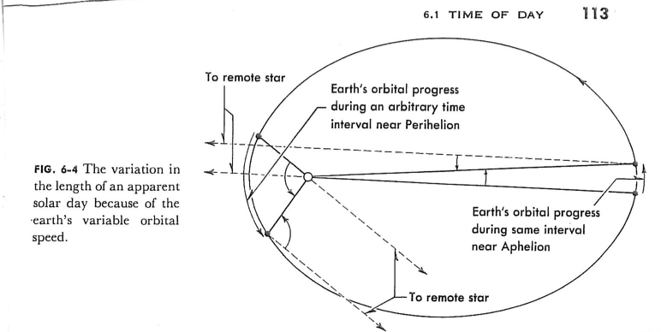
Why the solar day varies, part 2…the ellipticity of the Earth’s orbit + Kepler’s 2nd Law

Slide 9
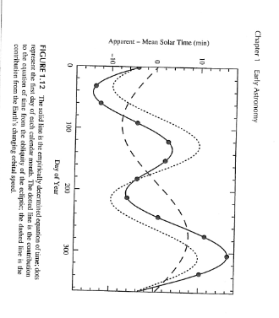
The Equation of Time

Slide 10
The “parade of the constellations”
Demo
Also look at online animation with the book web site

