Slide 1
Other Worlds in Space: modern astronomy from the perspective of Exoplanets
Steven R. Spangler
Department of Physics and Astronomy
University of Iowa

Slide 2
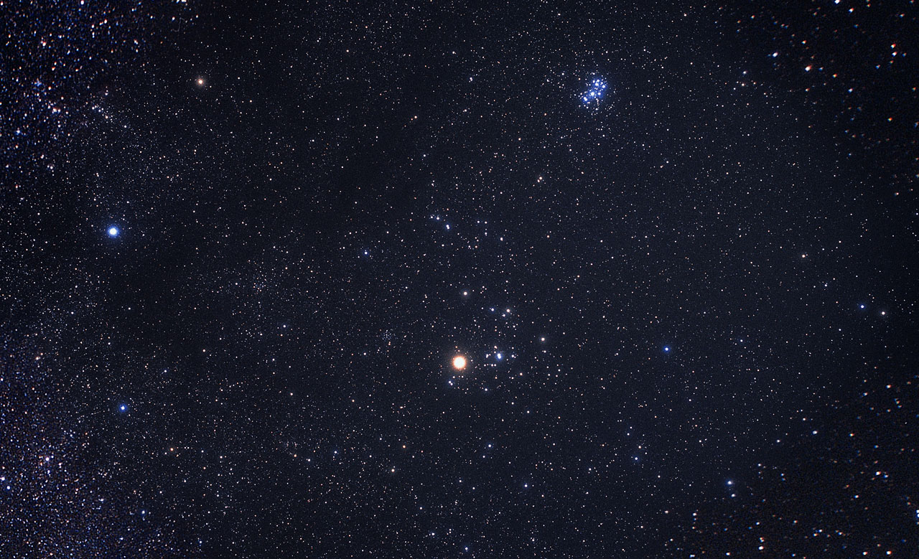
What we are doing in this class: a survey of (much of ) contemporary astronomy, but with emphasis on an exciting, recent wrinkle: exoplanets

Slide 3
A meditation on the study of astronomy:
“We want to feel, not just observe, what the heavens offer…”
John Goss, Astronomical League

Slide 4
The motivating idea for this class
We live on a planet (Earth) in the solar system
All the planets orbit (and are controlled by) the Sun
The Sun is a star
The night sky is filled with stars
Are there planets around some (or all) of those stars?
Are some of those planets like the Earth?
In 1995, we suspected the answer to (last 2 points) was yes, but we had no definite examples

Slide 5
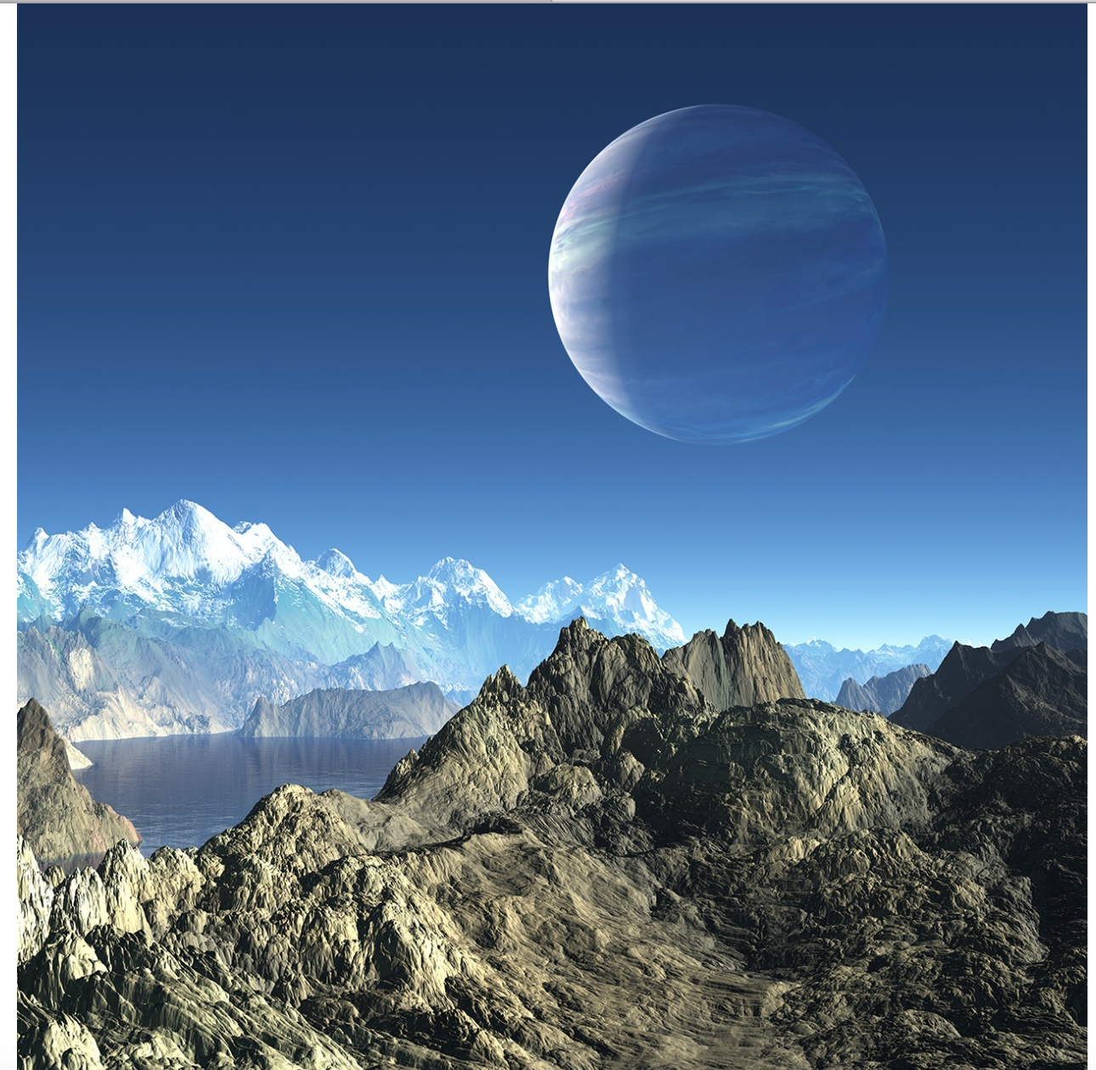
A mental goal of the class: an Earthlike planet around another star

Slide 6
A sneak preview of where we are headed: the situation with exoplanets as of Dec. 2017

Slide 7
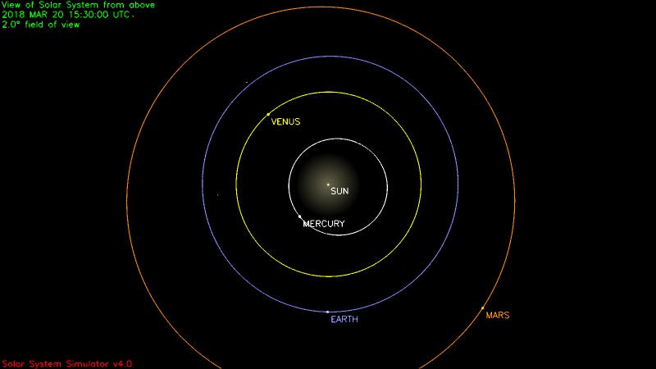
Let’s get back to basics: if we are going to understand exoplanets, we need to start with our own solar system
Technical term:
Astronomical unit: 93 million miles

Slide 8
“I seem to remember from junior high that there were others…”

Slide 9
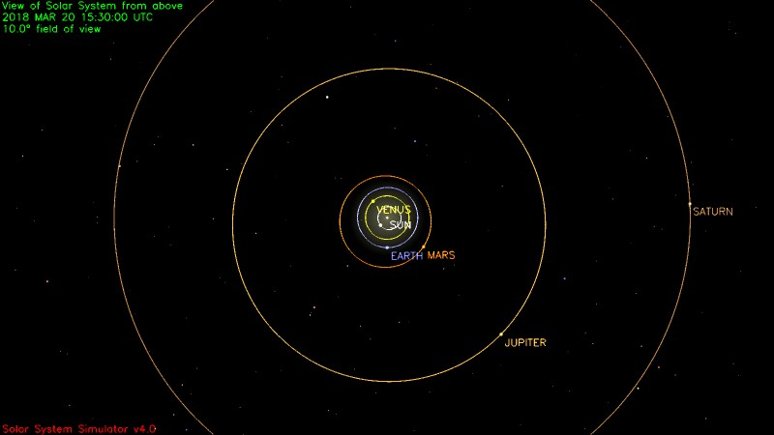
Jupiter, Saturn, Uranus, and Neptune are all further out

Slide 10
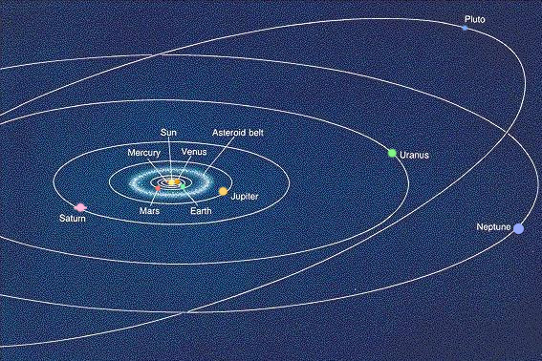
The Solar System: in school we learn about the 8 (or 9) planets that orbit the Sun
In solar system, the planets are where life is (at least in one case)

Slide 11
The Solar System is our best chance to study planets in detail (and learn some interesting astronomy, too)

Slide 12
The Earth as a Planet

Slide 13
Main aspects of the Earth
Surface temperature: about what is outside
The atmosphere
Liquid water

Slide 14
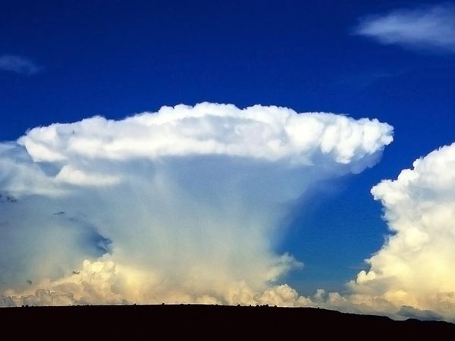
Chemical composition of the Earth’s atmosphere
Nitrogen (N2): 78%
Oxygen (O2): 21%
Argon: 1%
Water vapor: 0 - 4% !
Carbon dioxide (CO2): 0.040 %
By solar system standards, the Earth’s atmospheric composition is unusual; the oxygen content is extremely unusual

Slide 15
A measure of how “thick” an atmosphere is: atmospheric pressure
Atmospheric pressure is weight of overlying layers of air
In physics has units of Force/(unit area)= Newtons/(square meter) = Pascals
Atmospheric pressure at sea level = 1.013E+05 Pa
Also called “one atmosphere”

Slide 16
Liquid water on the surface of the Earth
The temperature and pressure at the surface of the Earth are close to the “Triple Point” of water (H2O), conditions where water simultaneously is in equilibrium in the solid, liquid and gaseous states. This permits the hydrological cycle on Earth
The hydrological cycle and the triple point of water are almost certainly crucial for the existence of life on Earth
Amazingly, the Earth is not unique among solar system objects in having a “hydrological” cycle. Stay tuned.

Slide 17
Overall Physical Structure of the Earth (the Earth as a ball)
Mass = 5.98E+024 kilograms
Diameter = 12756 kilometers (7920 miles)
Average density = 5.52 g/cc
Denser than almost all rocks: heavy stuff in Earth’s interior

Slide 18
How do the other planets “stack up” next to the Earth?

Slide 19
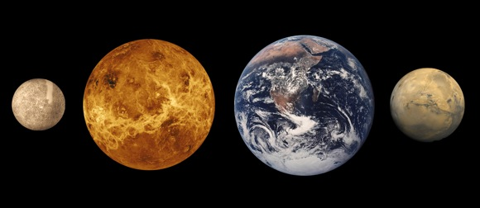
Rough sizes of the terrestrial planets
In our Solar System, the planets are so different, we have to put them in two groups
This picture was known 50 years ago

Slide 20
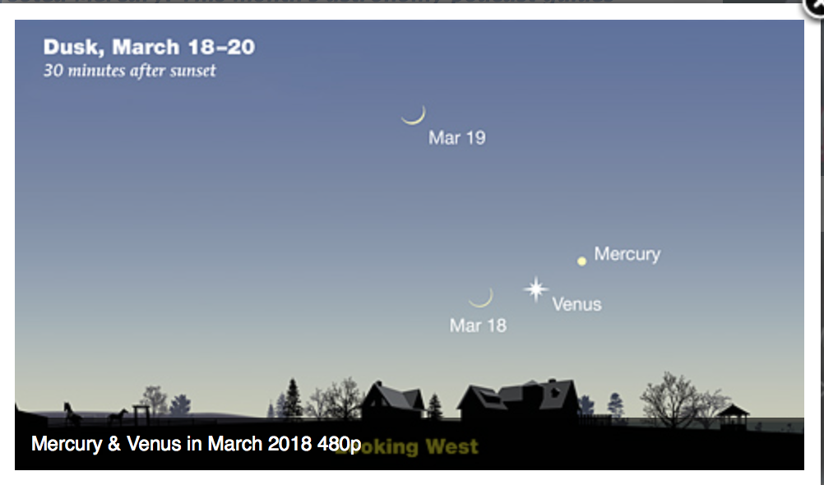
Where are Mercury and Venus in the night sky?
Very easy to find!

Slide 21
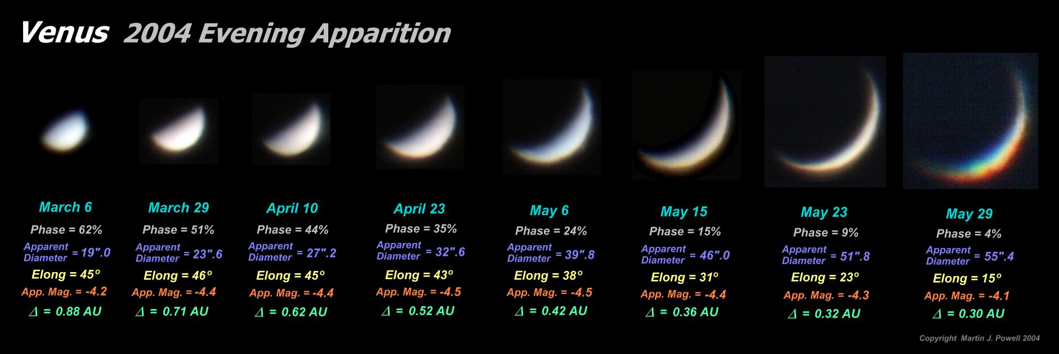
Venus…closer and bigger. Expect more to see
Current distance 1.61 AU, angular diameter 10.3 arcseconds. Why can’t we see anything on the surface?

Slide 22
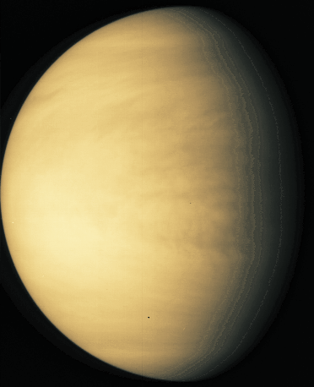
Venus…Earth’s twin
Venus is perpetually overcast. You cannot see the surface from Earth. Only the top of a cloud layer

Slide 23
Similarities between Earth and Venus?
Fact that Earth and Venus are so similar in physical properties (size and mass), and that one cannot see the surface was conducive to imagination

Slide 24
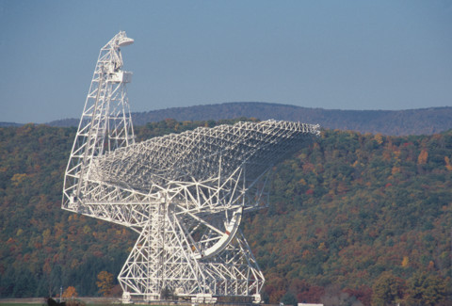
Seeing through the clouds of Venus with Radio Astronomy!

Slide 25
Radio astronomy and application of laws of physics allow us to measure the surface temperature of Venus (done first in the late 1950s)
Surface temperature is 730K
That corresponds to 855 degrees Fahrenheit
No longer “Earth’s twin”
What is responsible for this sort of temperature?
Physics tells us!

Slide 26
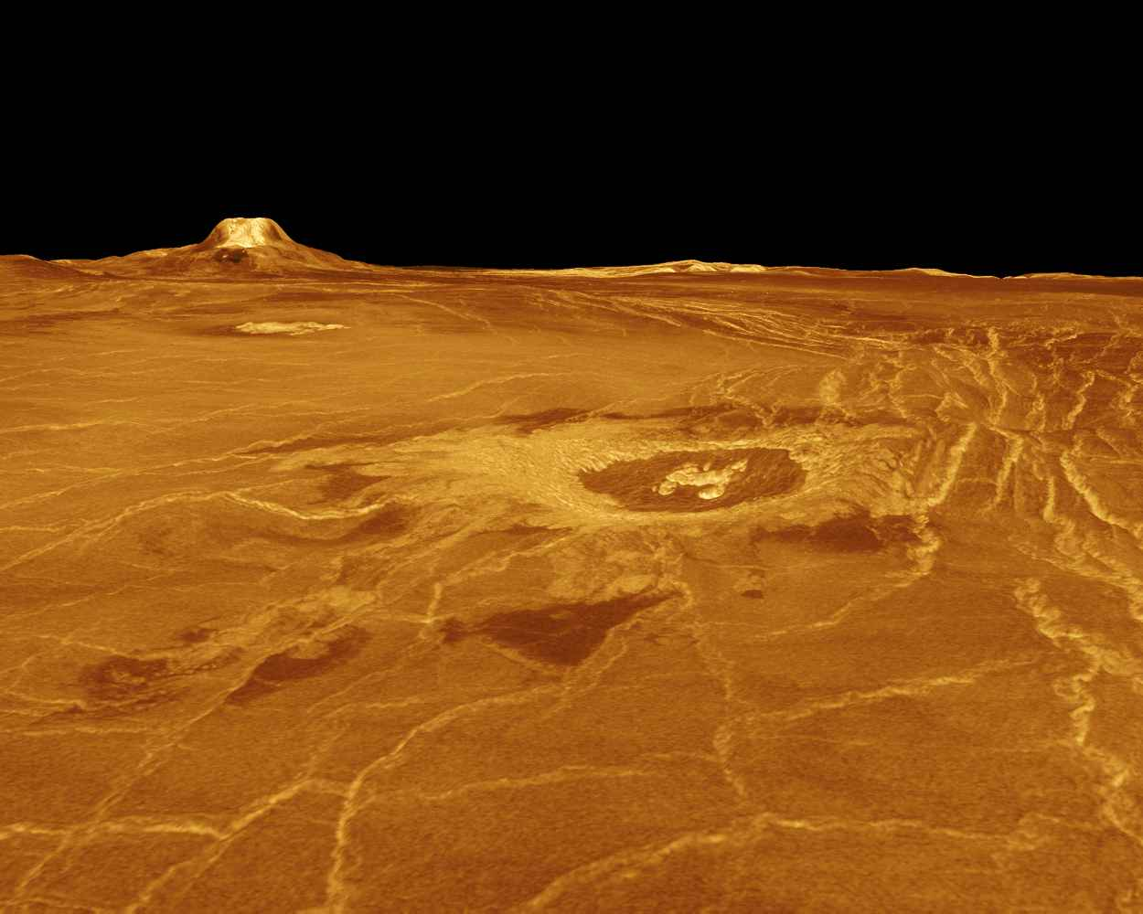
What the surface of Venus looks like

Slide 27
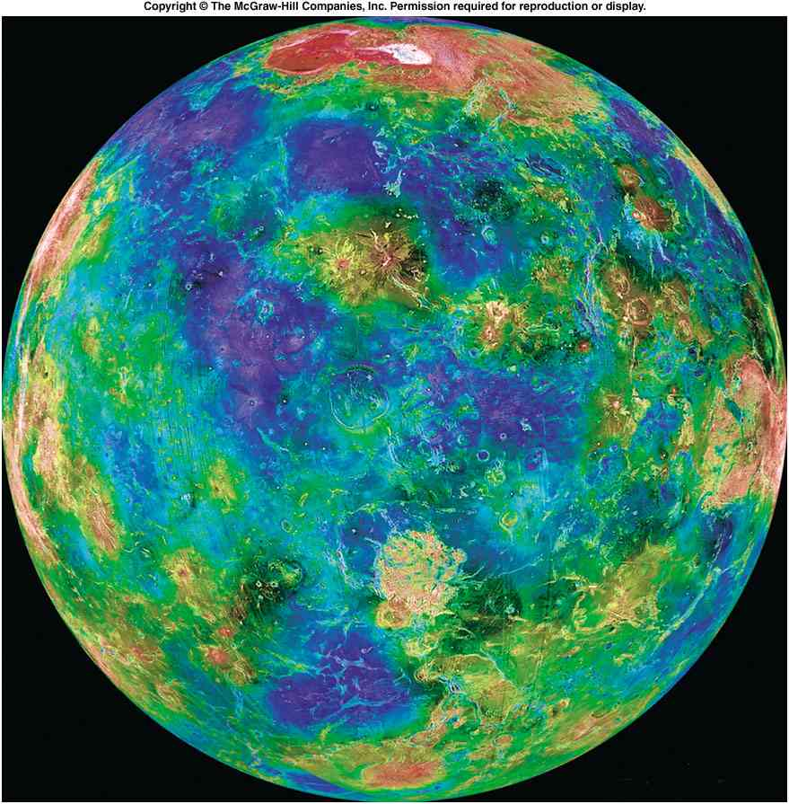
And now, a similar view of Venus, thanks to the Magellan orbiter

Slide 28
Remaining questions about Venus
Why is the surface temperature so high?
Hint: it has a dense, carbon dioxide atmosphere
Did Venus ever have oceans like the Earth?
If it did have them, where did they go? (See article from Sky and Telescope, April 2008)

Slide 29
Lessons of Venus for exoplanet studies
A planet can be the “right size”, and nearly in the “right place”, but still be completely unsuitable for life

Slide 30
Moving out in the solar system…Mars

Slide 31
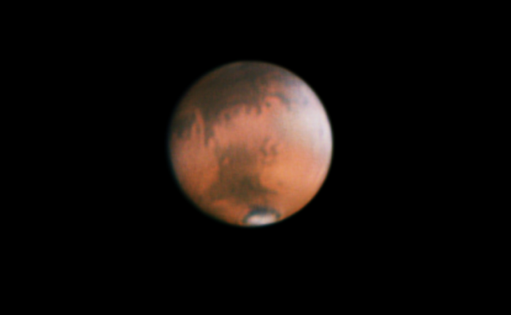
Mars…start with the orbital parameters
Semimajor axis: 1.524 AU
Orbital Period: 1.88 years
Eccentricity: 0.093
Best opposition since 2003 this summer (late July); take advantage of the chance to see Mars through a telescope

Slide 32
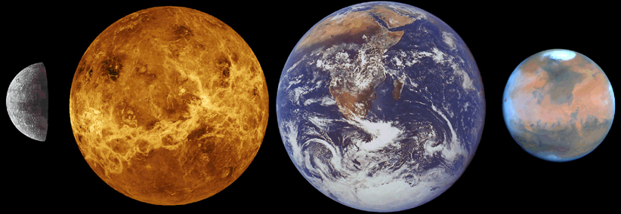
Average physical characteristics of Mars

Slide 33
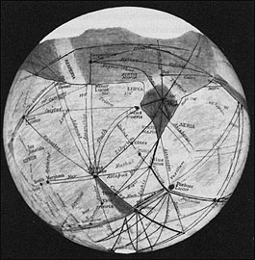
What could we tell before the age of spacecraft and large telescopes?
Observations showed features on surface (“canals of Mars”)

Slide 34
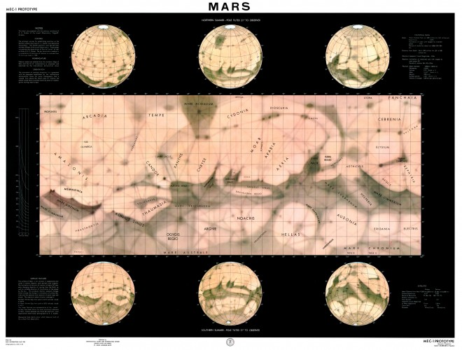
1962 Mars Map

Slide 35
Pre-space age telescopic observations yielded a number of intriguing features
Seasonal variations in features
Obliquity similar to Earth (25.0 degrees versus 23.5 degrees)
Polar caps that change with the season
Rotation period 24h 37m
Clouds in an atmosphere
Led to speculation that Mars might be an Earthlike planet with primitive life (lichens)

Slide 36
By the 1960s it was known that the circa-1900 view of an Earth-like Mars with higher life forms could not be right; the atmosphere on the surface of Mars is about 0.7 % the sea-level pressure on Earth. Water cannot exist in liquid form under those conditions.
The average surface temperature on Mars is also about 100 degrees Fahrenheit below.

Slide 37
The atmosphere of Mars: 95% CO2
Most of the rest is nitrogen (diatomic molecular)
The chemical composition of Martian atmosphere is like Venus, not the current Earth
(But like the early Earth)

Slide 38
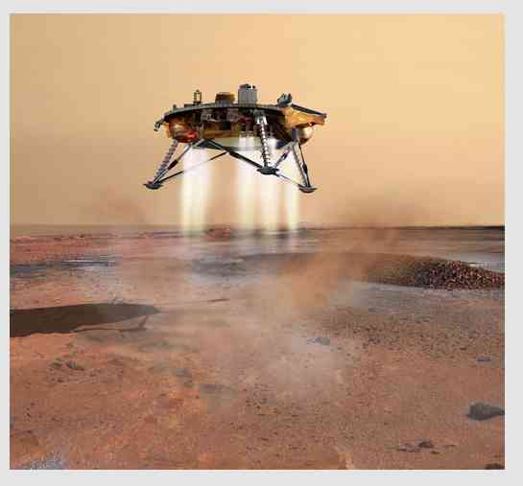
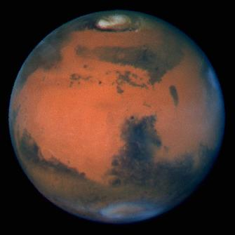
Robotic Exploration of Mars
We have learned an incredible amount about Mars in the past few decades

Slide 39
An illustration of the fascinating results brought to us by robot spacecraft

Slide 40
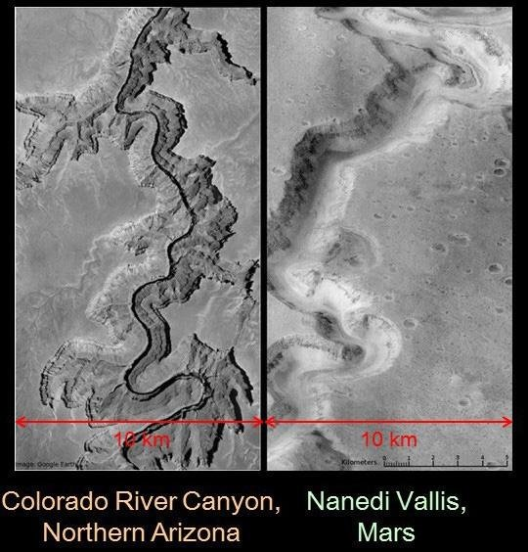
A major result: apparent ancient water channels

Slide 41
Determining the Ancient History of Mars
What its present surface tells us

Slide 42
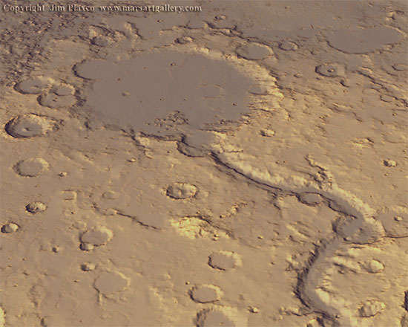
The central mystery of Mars since the 1970s
The present climate of Mars is such that liquid water cannot last long
Orbiting spacecraft show apparent evidence of flowing water channels (rivers and larger) in landscapes that formed 3 – 4 billion years ago
How are these two (apparently) contradictory results to be reconciled?

Slide 43
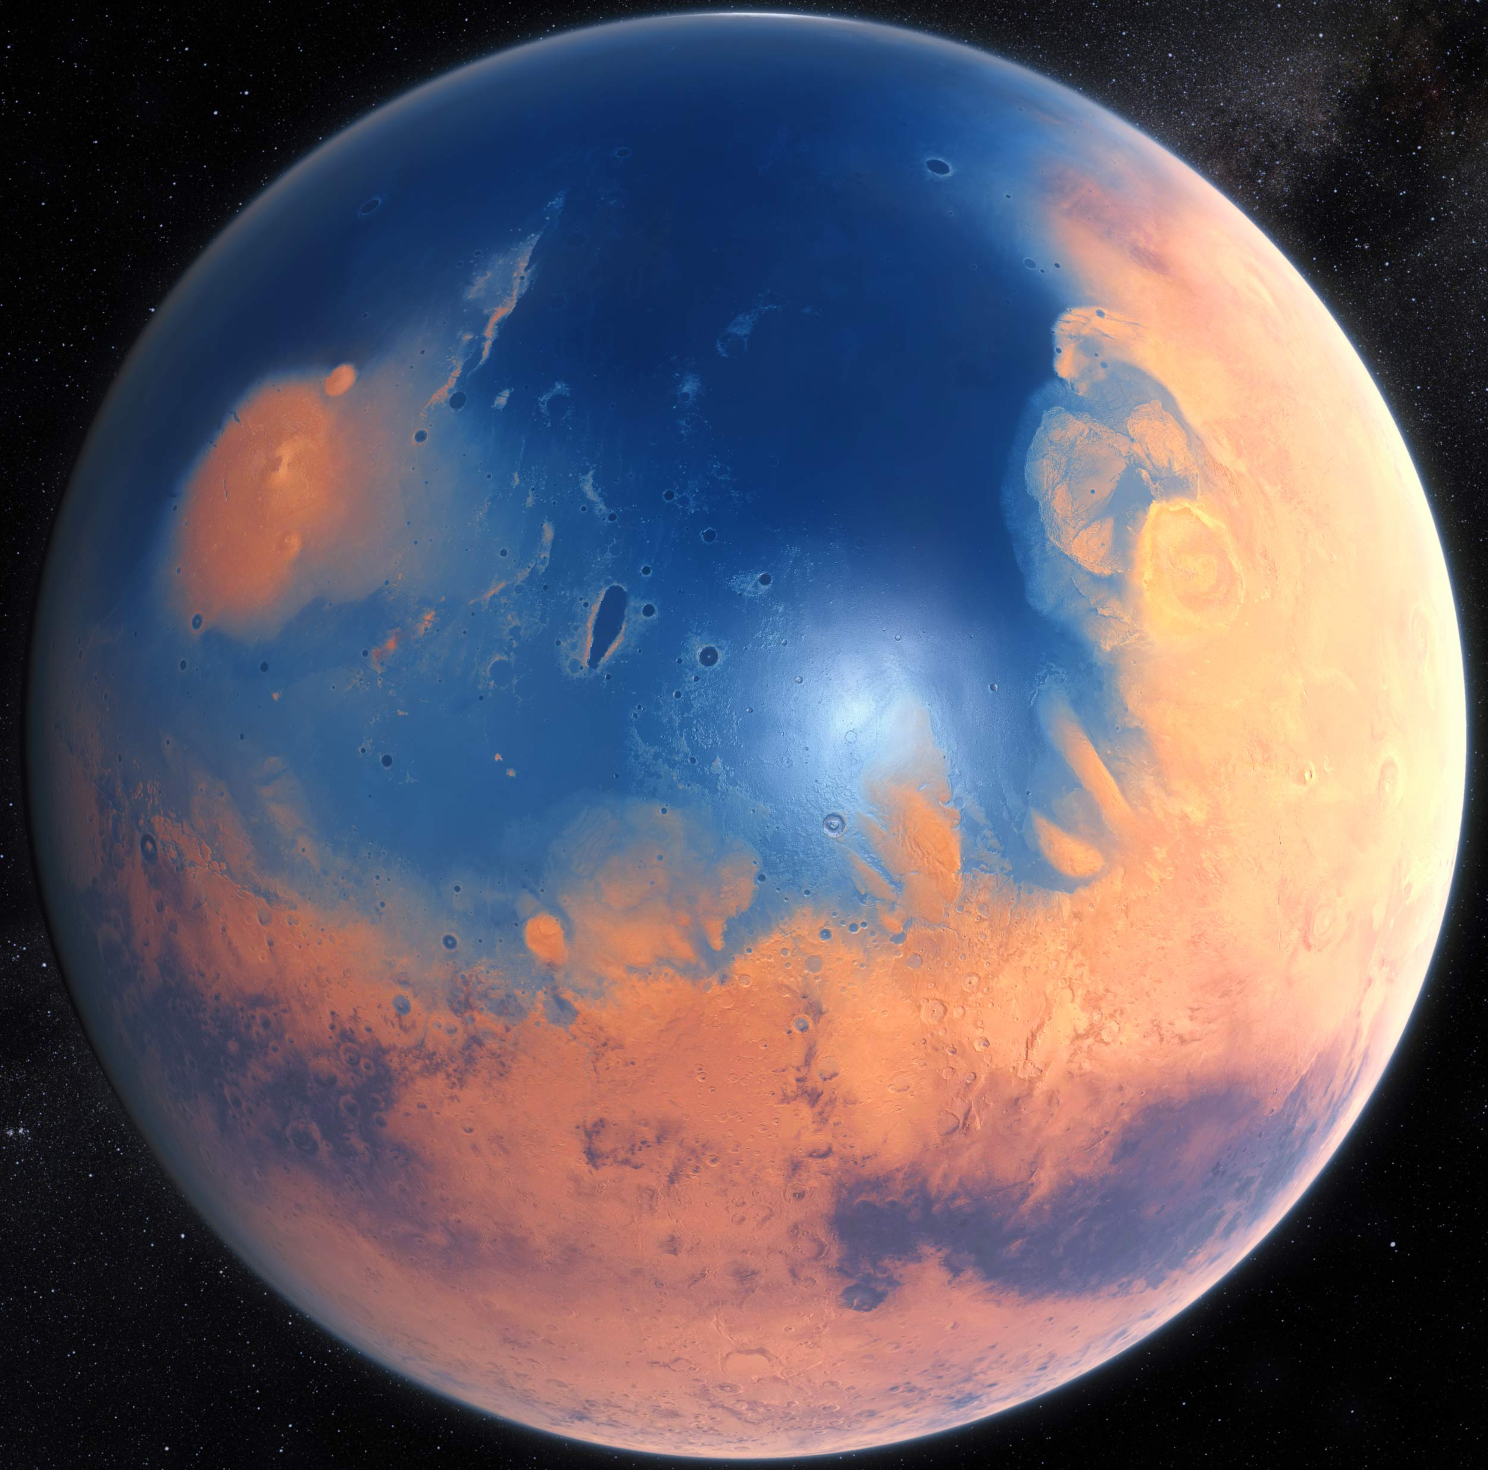
These observations led to the idea of the “Warm, Wet Mars”
Mars 3.8 billion years ago?
Since 1990s, clear that the key is to land on the surface, do geology

Slide 44
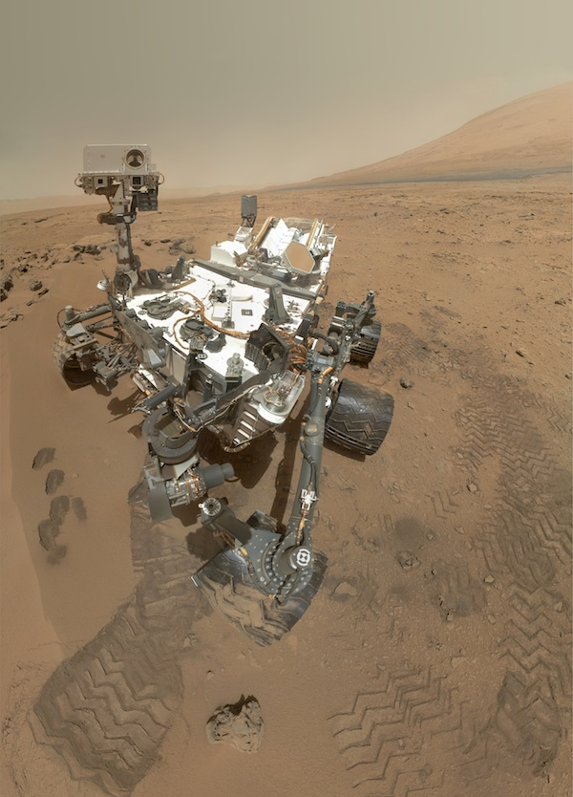
The key to determining the ancient climate of Mars (and implications for life); robot geological laboratories
Curiosity

Slide 45
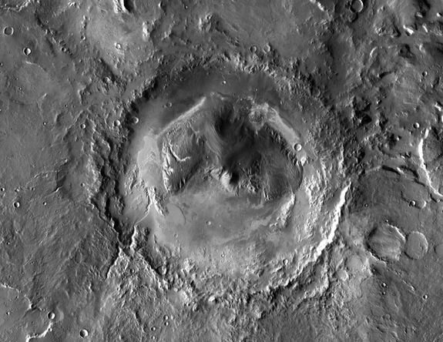
The Mars Science Laboratory and Gale Crater
Clay deposits at bottom of central mountain

Slide 46
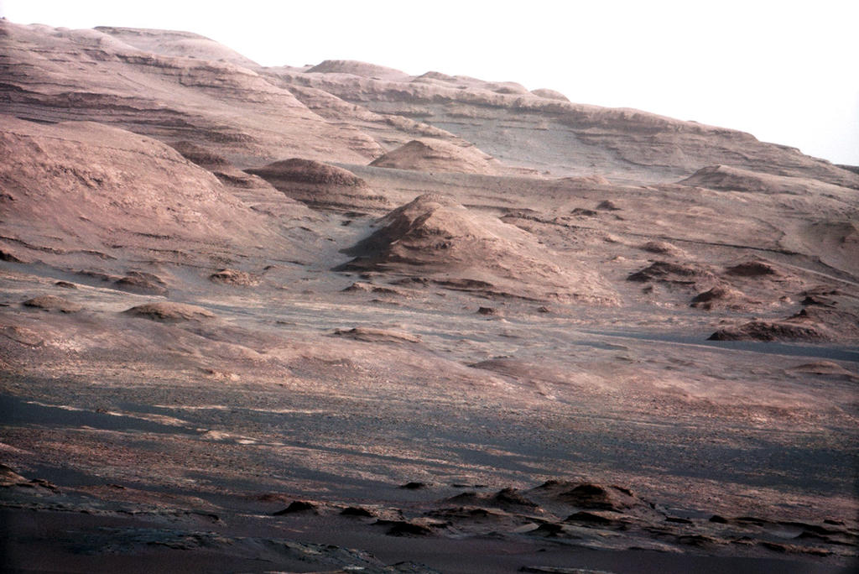
The destination for “Curiosity”

Slide 47
What have we learned from the MERs, “Mars Phoenix”, and Mars Science Laboratory
It now seems clear that there were standing bodies of water for long periods of time early in Martian history
Evidence is presence of hematite, jarosite, and other minerals that form in lakes or oceans
Relative absence of carbonate rocks is due to alternative chemistry in acidic water
But, apparently oldest rock strata do contain carbonate rocks and clay (montmorillonite)
Mars Science Laboratory has found abundant mineralogical evidence for water in Gale Crater
Apparently there were liquid water bodies on Mars in at least some locations (Gale Crater) long enough for life to have developed.

Slide 48
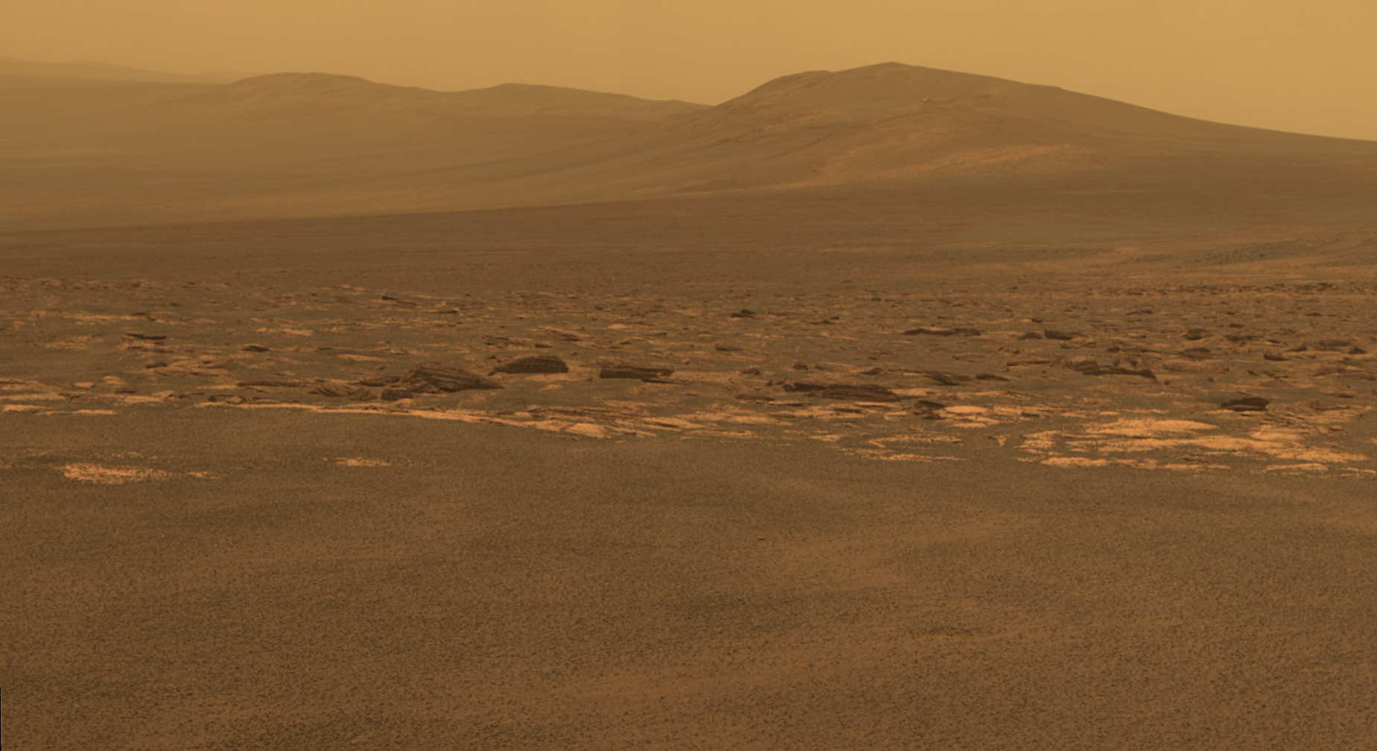
What happened to the atmosphere?
The rocks found on the Martian surface required higher atmospheric pressures than presently exist
Mars must have lost its atmosphere
Can we find independent evidence for this? Yes! Finding of the Maven spacecraft
How long did it take to lose its atmosphere?---We’ll have to wait for the answer

Slide 49
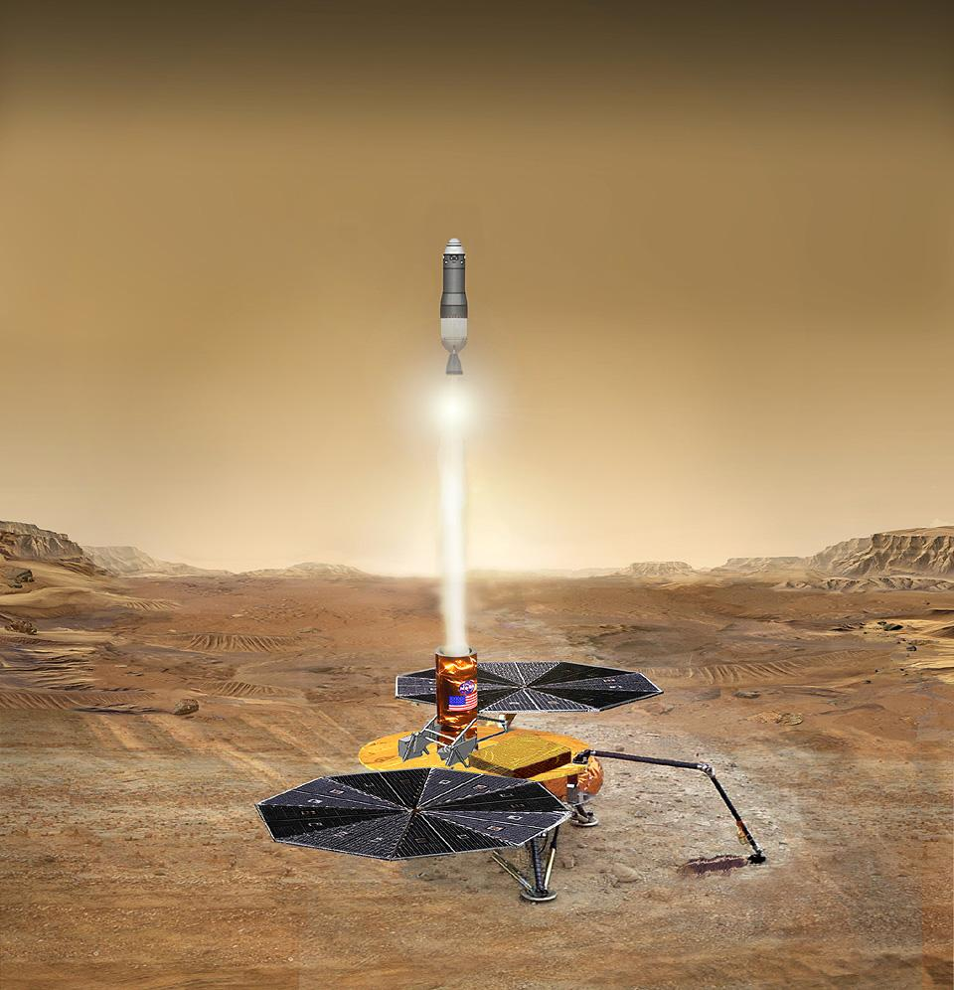
The El Dorado of future missions: Mars Sample Return
Stay tuned
rom
Earth) in 2014.

Slide 50
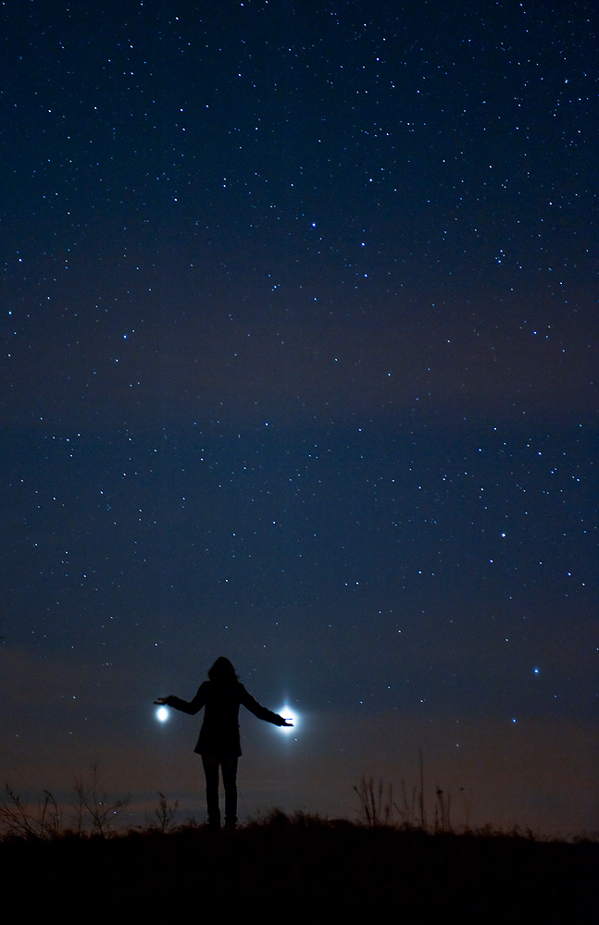
What about the more distant planets in the Solar System?
What can they tell us about how planets formed, the nature of other solar systems?

Slide 51
Exploring further out in the Solar System
Jupiter, Saturn, and friends

Slide 52
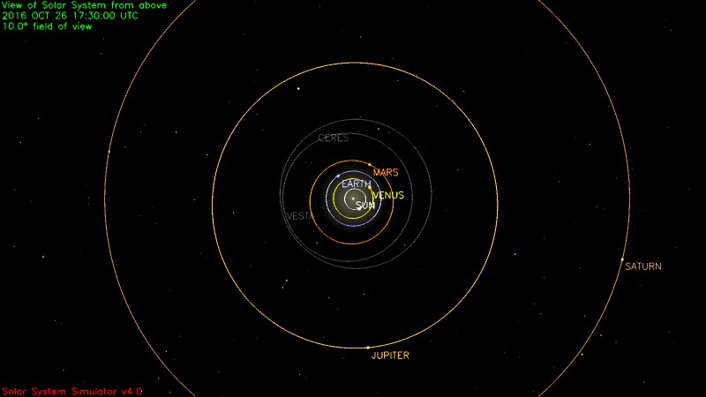
Jupiter and Saturn: orbital characteristics
Planet | a (AU) | P (yrs) | ecc | Incl (deg)
Jupiter | 5.20 | 11.9 | 0.049 | 1.3
Saturn | 9.58 | 29.4 | 0.057 | 2.5
What do they look like? Let’s start with Jupiter

Slide 53
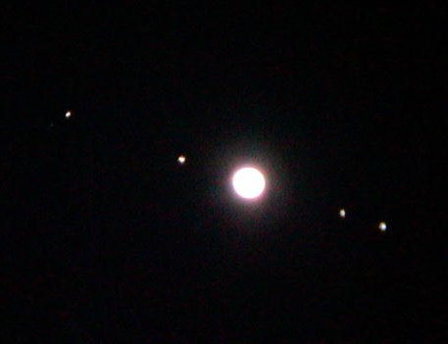
Jupiter…largest planet in the solar system

Slide 54
Basic properties of Jupiter and Saturn
Jupiter: 11.2 X diameter of Earth and 318 X mass
Saturn: 9.5 X diameter of Earth and 95 X the mass
Jupiter and Saturn: the “giant planets”
Jupiter and Saturn are “all atmosphere”, and mainly hydrogen and helium

Slide 55
Jupiter and the Earth

Slide 56
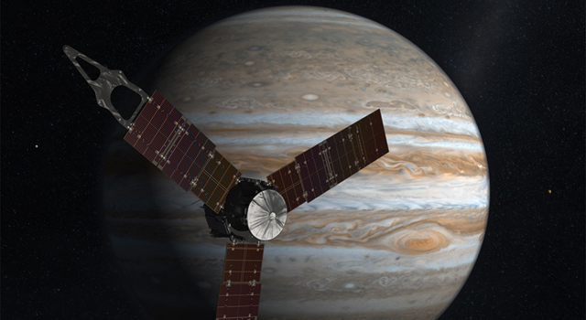
The future exploration of Jupiter… Juno (arrived last summer)
Launch: August 5, 2011… Arrival at Jupiter: July 4, 2016

Slide 57
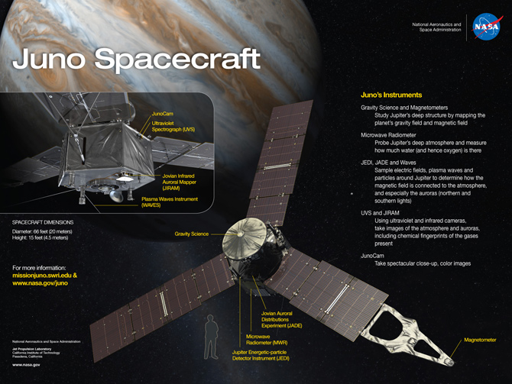

Slide 58
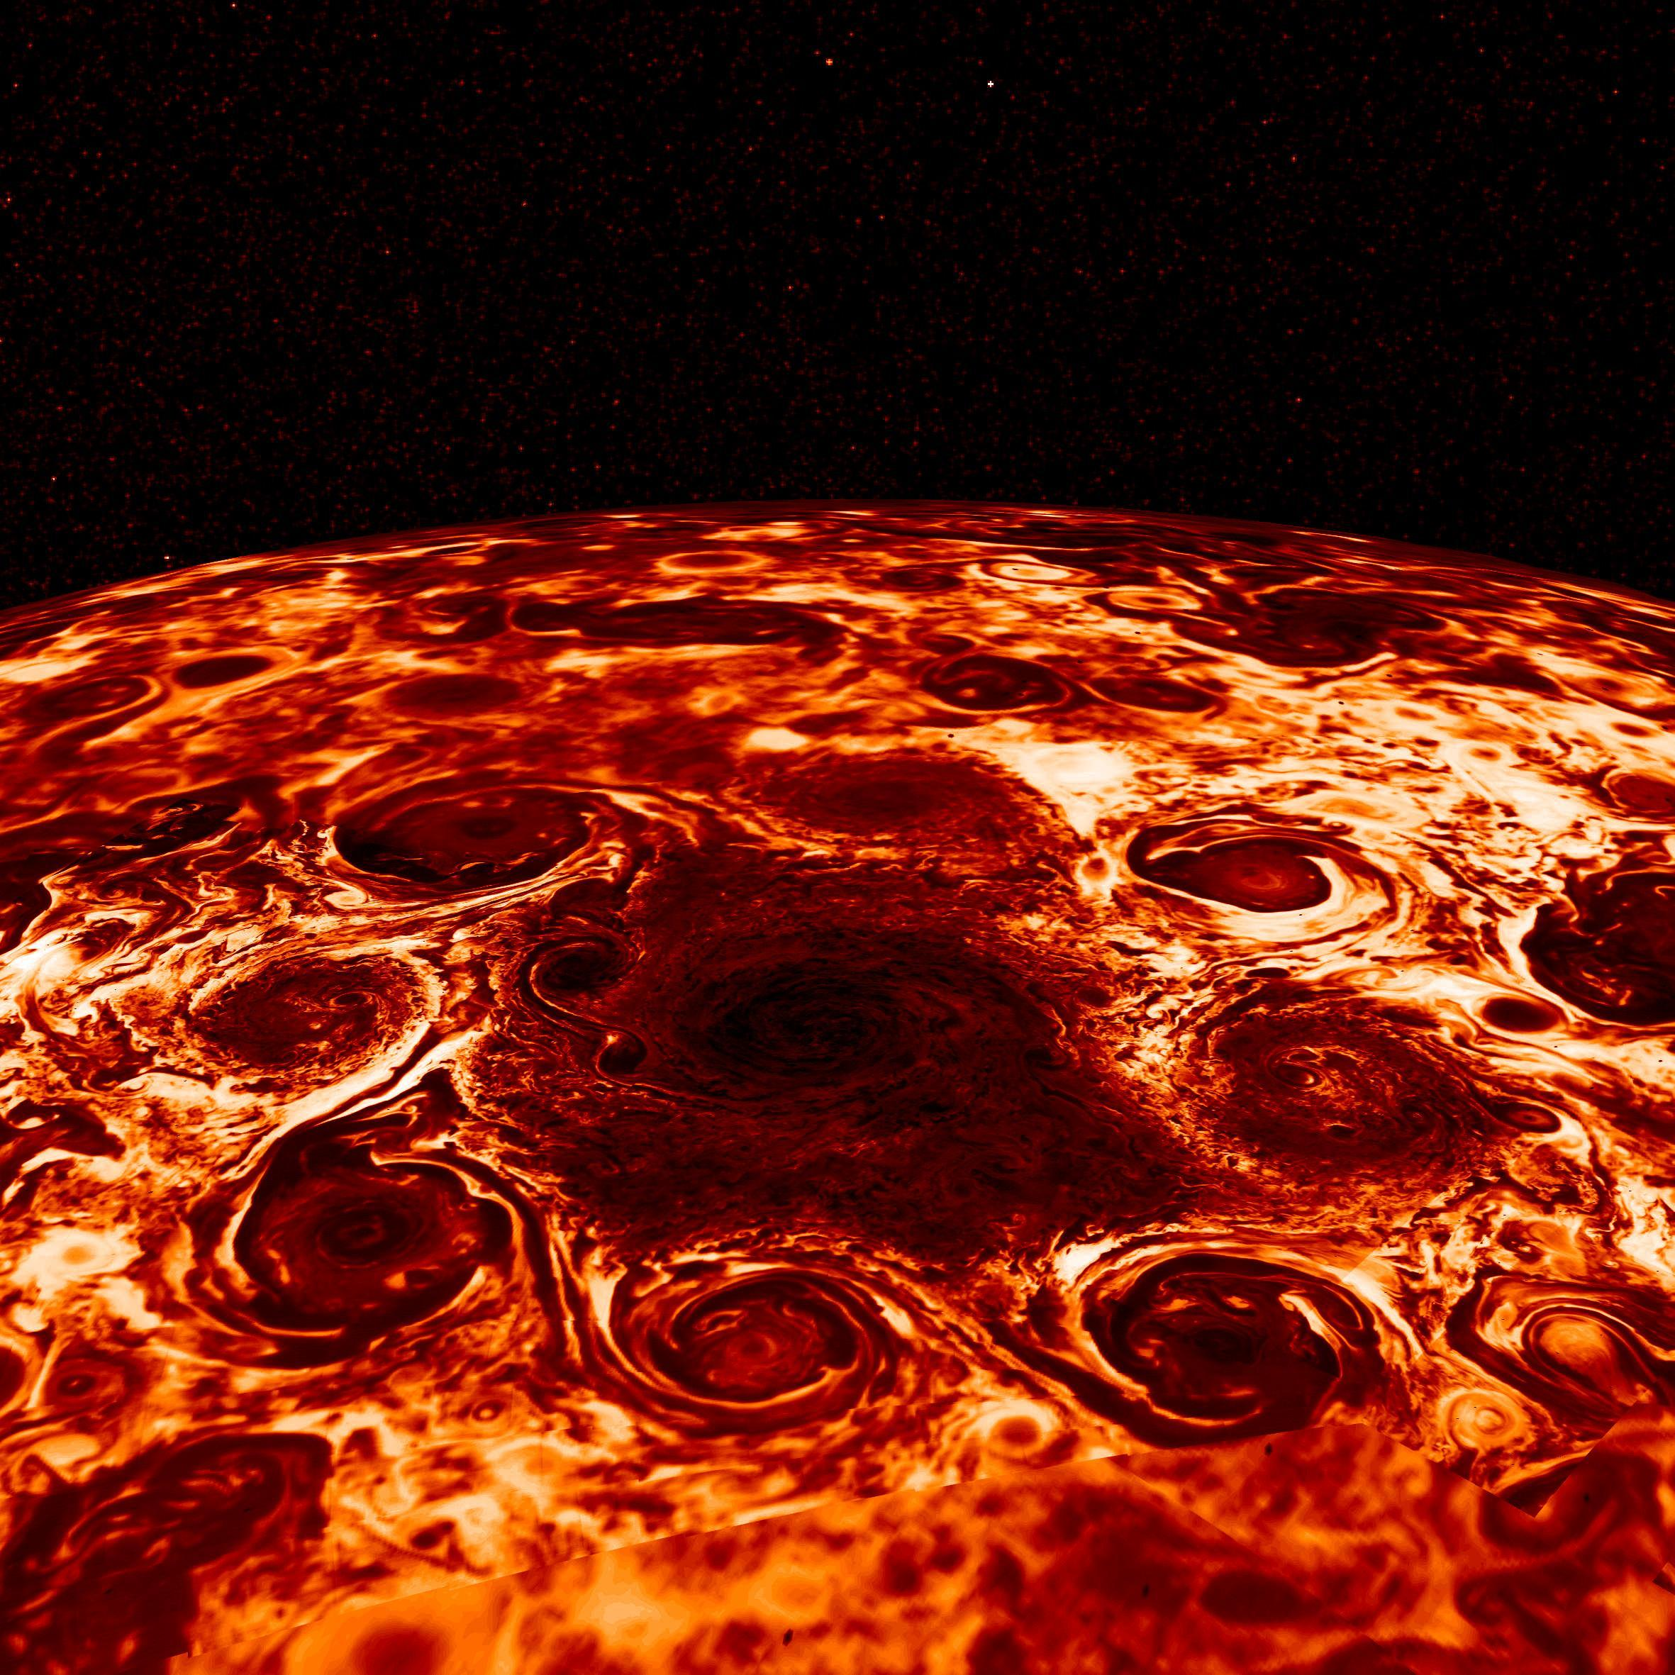
The Juno spacecraft is giving us new insights into Jupiter
There is really no surface on Jupiter; the gas density and pressure get larger and larger, matter weirder and weirder

Slide 59
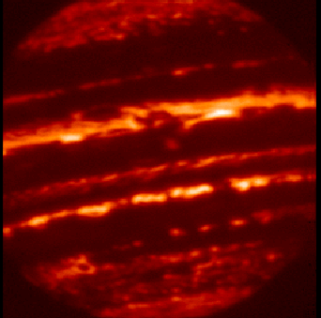
Are Jupiter and Saturn planets or stars?
Jupiter as seen at infrared wavelengths
Jupiter emits 70% more radiation to space than it receives from the Sun. It has an “engine” inside

Slide 60
The Moons of Jupiter

Slide 61
Jupiter has many moons
12 when I started studying astronomy
A standard textbook lists 38
Most important are the 4 Galilean satellites, Io, Europa, Ganymede, Callisto

Slide 62
From Earth, it is difficult to learn too much about the Galilean satellites
At opposition of Jupiter, the angular diameter of Ganymede is 1.7 arcseconds
Pre space-age telescope observations revealed a little bit about size, reflectivity (albedo), and surface features

Slide 63
Basic data on the Galilean satellites
moon | a (km) | P (days) | D (km)
Io | 422,000 | 1.769 | 3630
Europa | 671,000 | 3.551 | 3130
Ganymede | 1,071,000 | 7.155 | 5280
Callisto | 1,884,000 | 16.689 | 4840
MOON | 384,000 | 27.32 | 3476
The largest Moon, Ganymede, has a diameter about 50 percent larger than our Moon

Slide 64
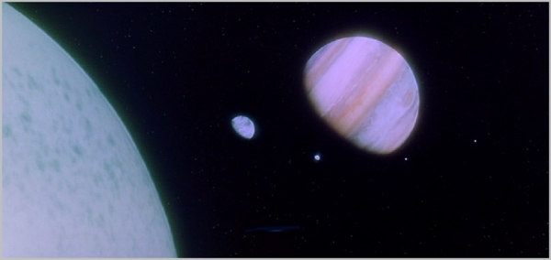
What are the moons of Jupiter like? Would do they look like “up close”?
The 1968 movie “2001 A Space Odyssey” has them similar and looking like our Moon

Slide 65
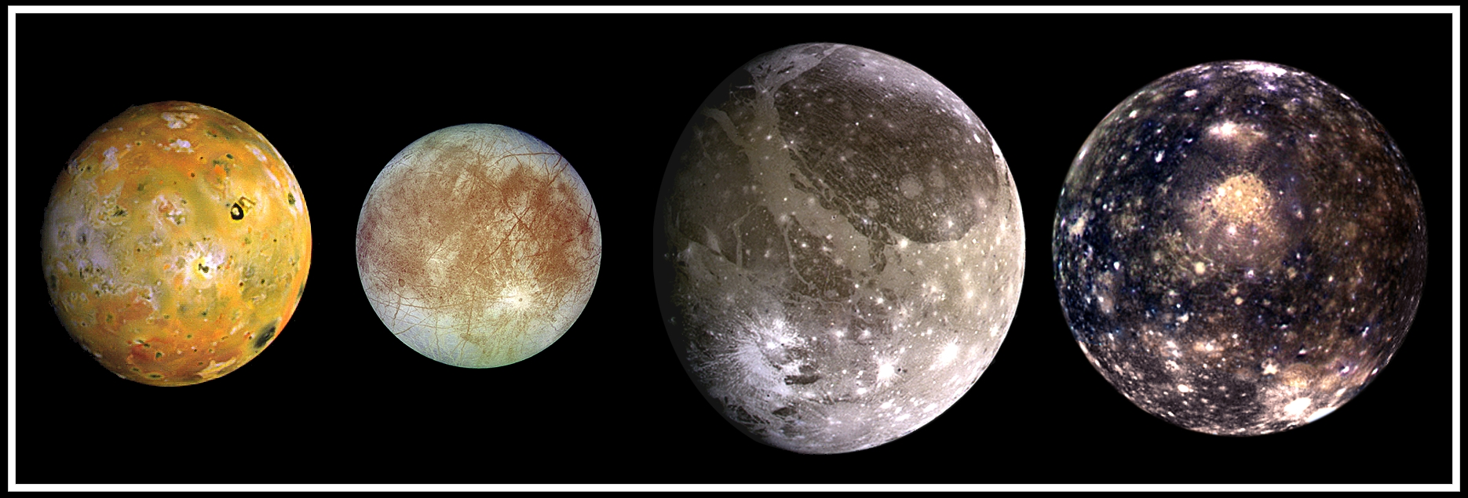
All of them together (sibling portrait)
Images scaled to give correct relative sizes

Slide 66
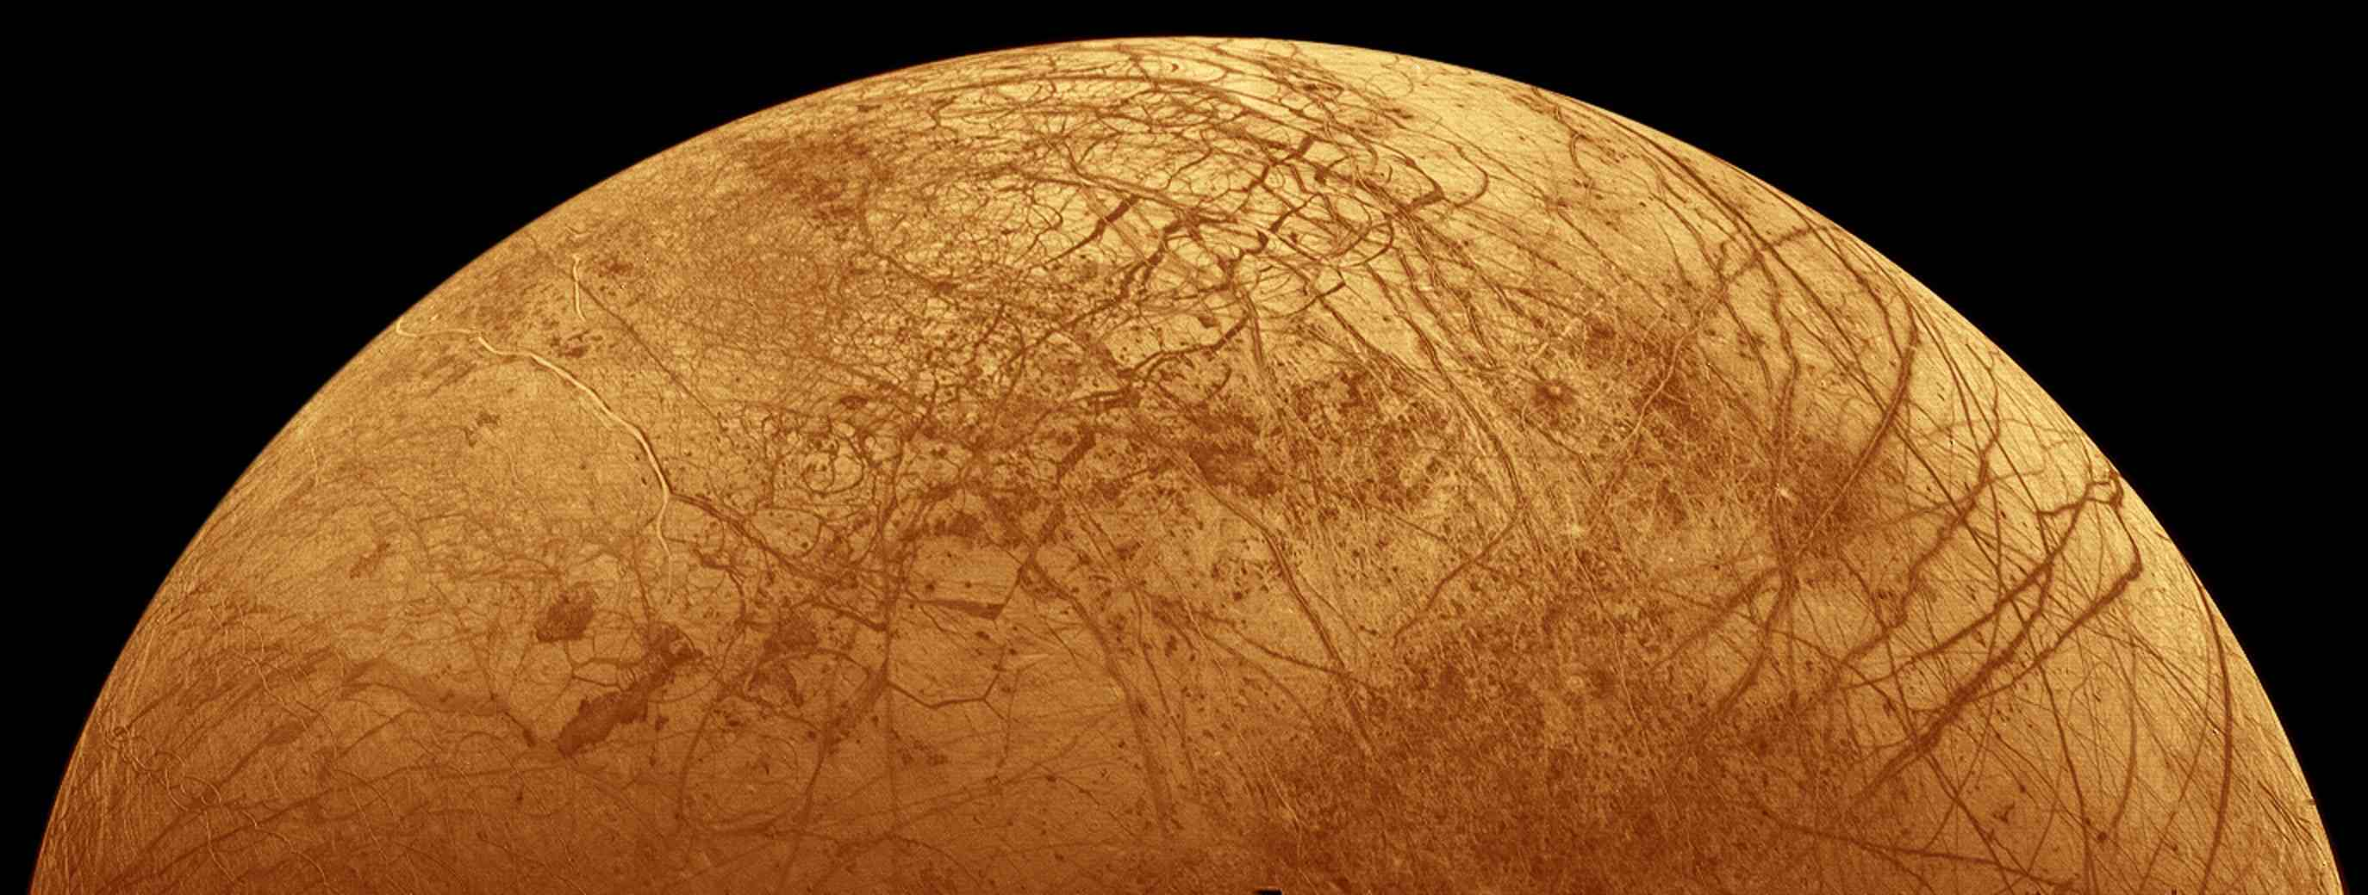
Exploring Europa
What is under its ice-covered plains?

Slide 67
Europa is slightly smaller and less massive than our Moon. It is of interest because the entire moon is encased in ice. There are cracks and other features that hint at liquid water at some point below the surface,

Slide 68
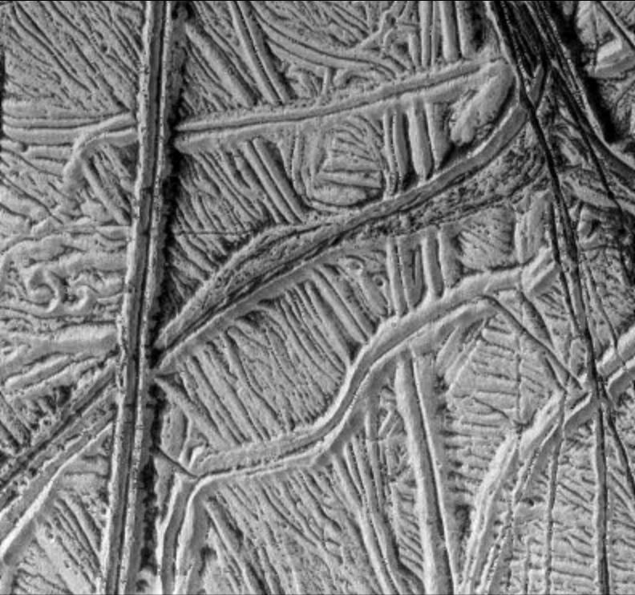
Views of the cracks from Galileo
Picture about 100 miles on a side

Slide 69
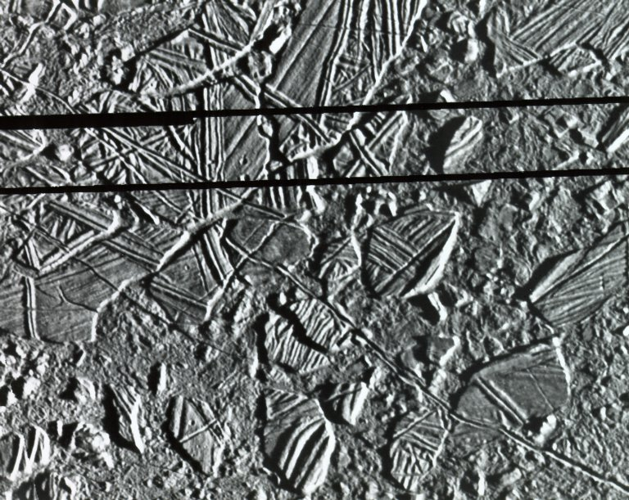
A related phenomenon. The ice rafts of Europa
Similar features seen in arctic ocean and are due to flows of ocean underneath

Slide 70
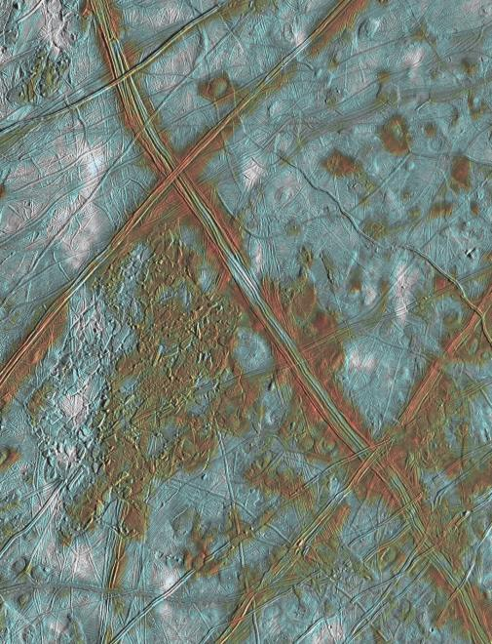
Evidence for flows from beneath the surface of Europa

Slide 71
There is evidence (circumstantial) for liquid water under the surface, but how far down is it? What is below the water?
Spacecraft missions to Europa over the next few decades might tell us

Slide 72
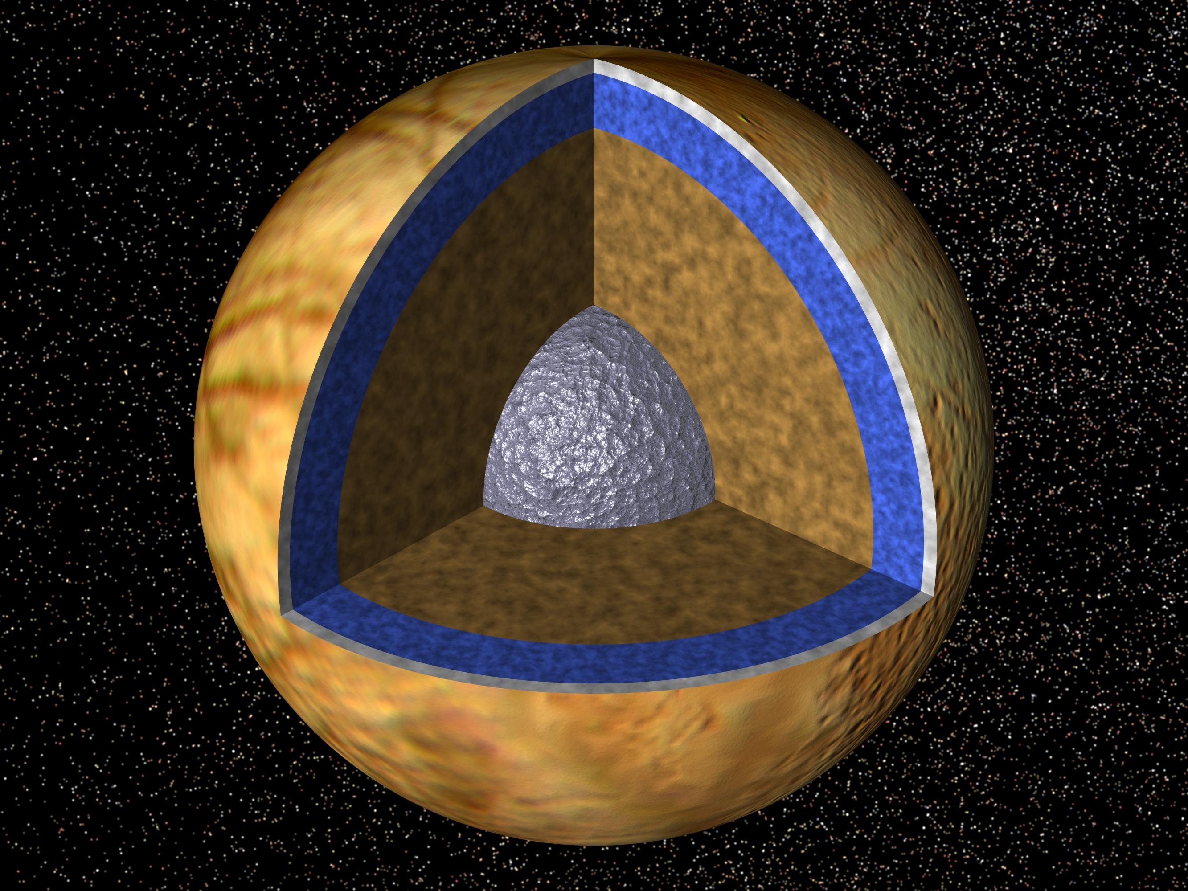
Speculations on interior structure of Europa

Slide 73
A summary of what we know about Europa
Slightly smaller in mass and diameter than the Moon
Surface covered with water ice casing
Evidence for surface “activity” from cracks and grooves, and ice rafts
Small numbers of craters implies surface has reformed in last 100 million years
Estimates that liquid layer, “sealed ocean” is between 10 - 50 kilometers below the surface, with possible rocky sea floor

Slide 74
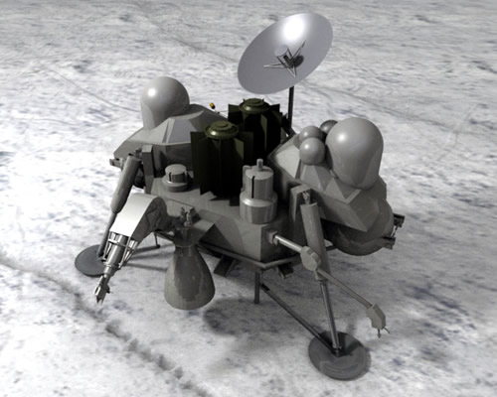
A future Europa Lander could tell us much about the possible subsurface ocean of Europa

Slide 75
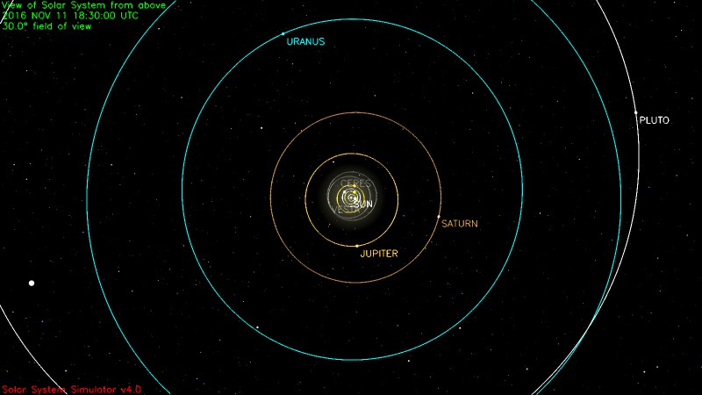
Further out…to the edge of the Solar System

Slide 76
Uranus and Neptune… where are they? Let’s look at a Table!
Planet | a (AU) | P(yr) | ecc | Incl (degrees)
Uranus | 19.20 | 83.7 | 0.046 | 0.8
Neptune | 30.5 | 163.7 | 0.011 | 1.8
Current locations: Uranus: Pisces; Neptune: Aquarius.
What do they look like?

Slide 77
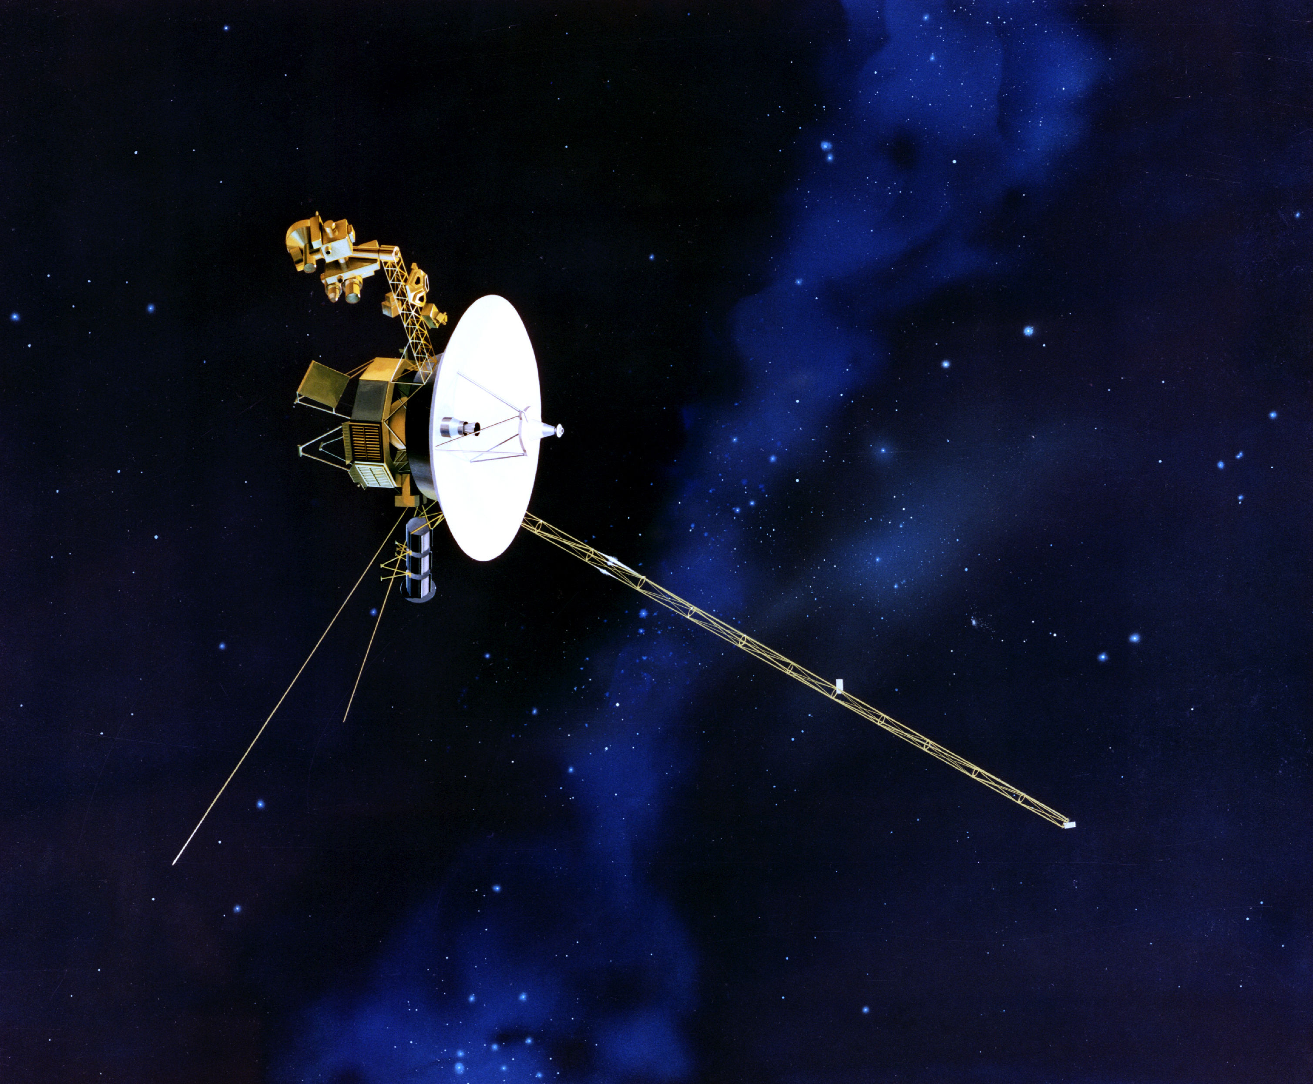
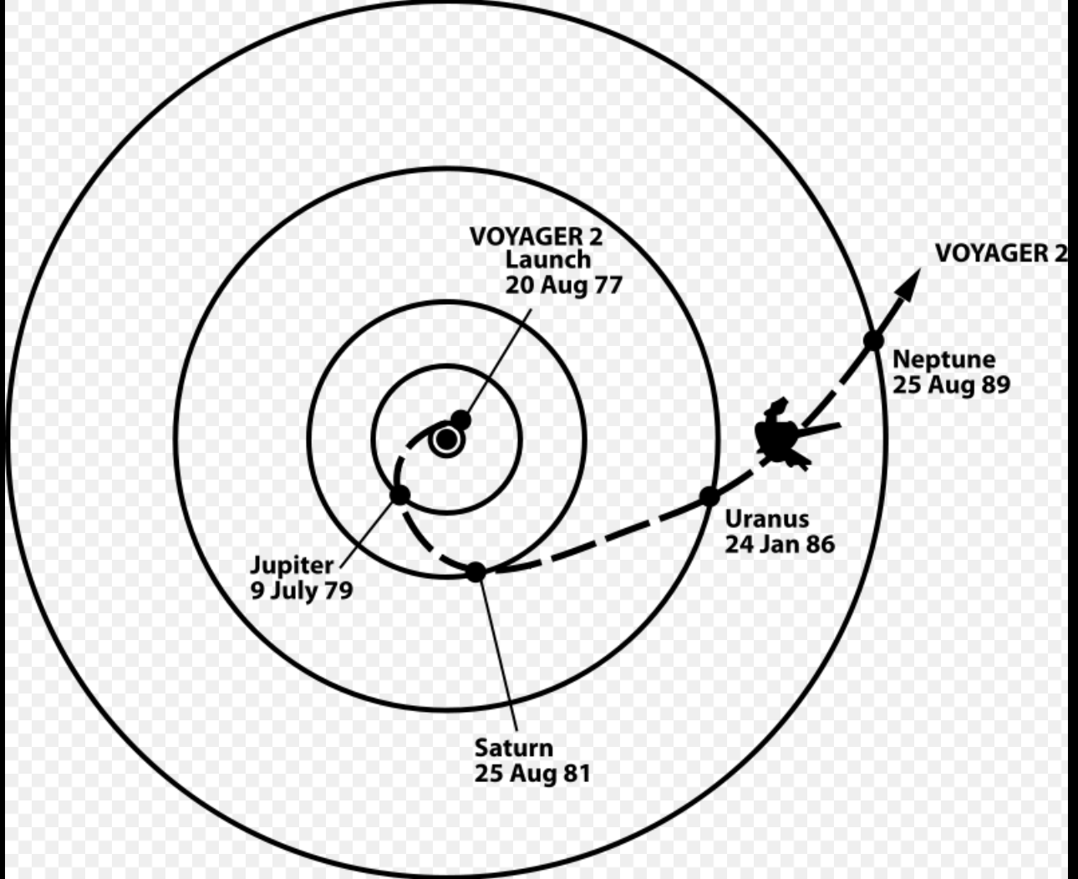
Our best views (and scientific information) come from visits (flybys) of the Voyager 2 spacecraft

Slide 78
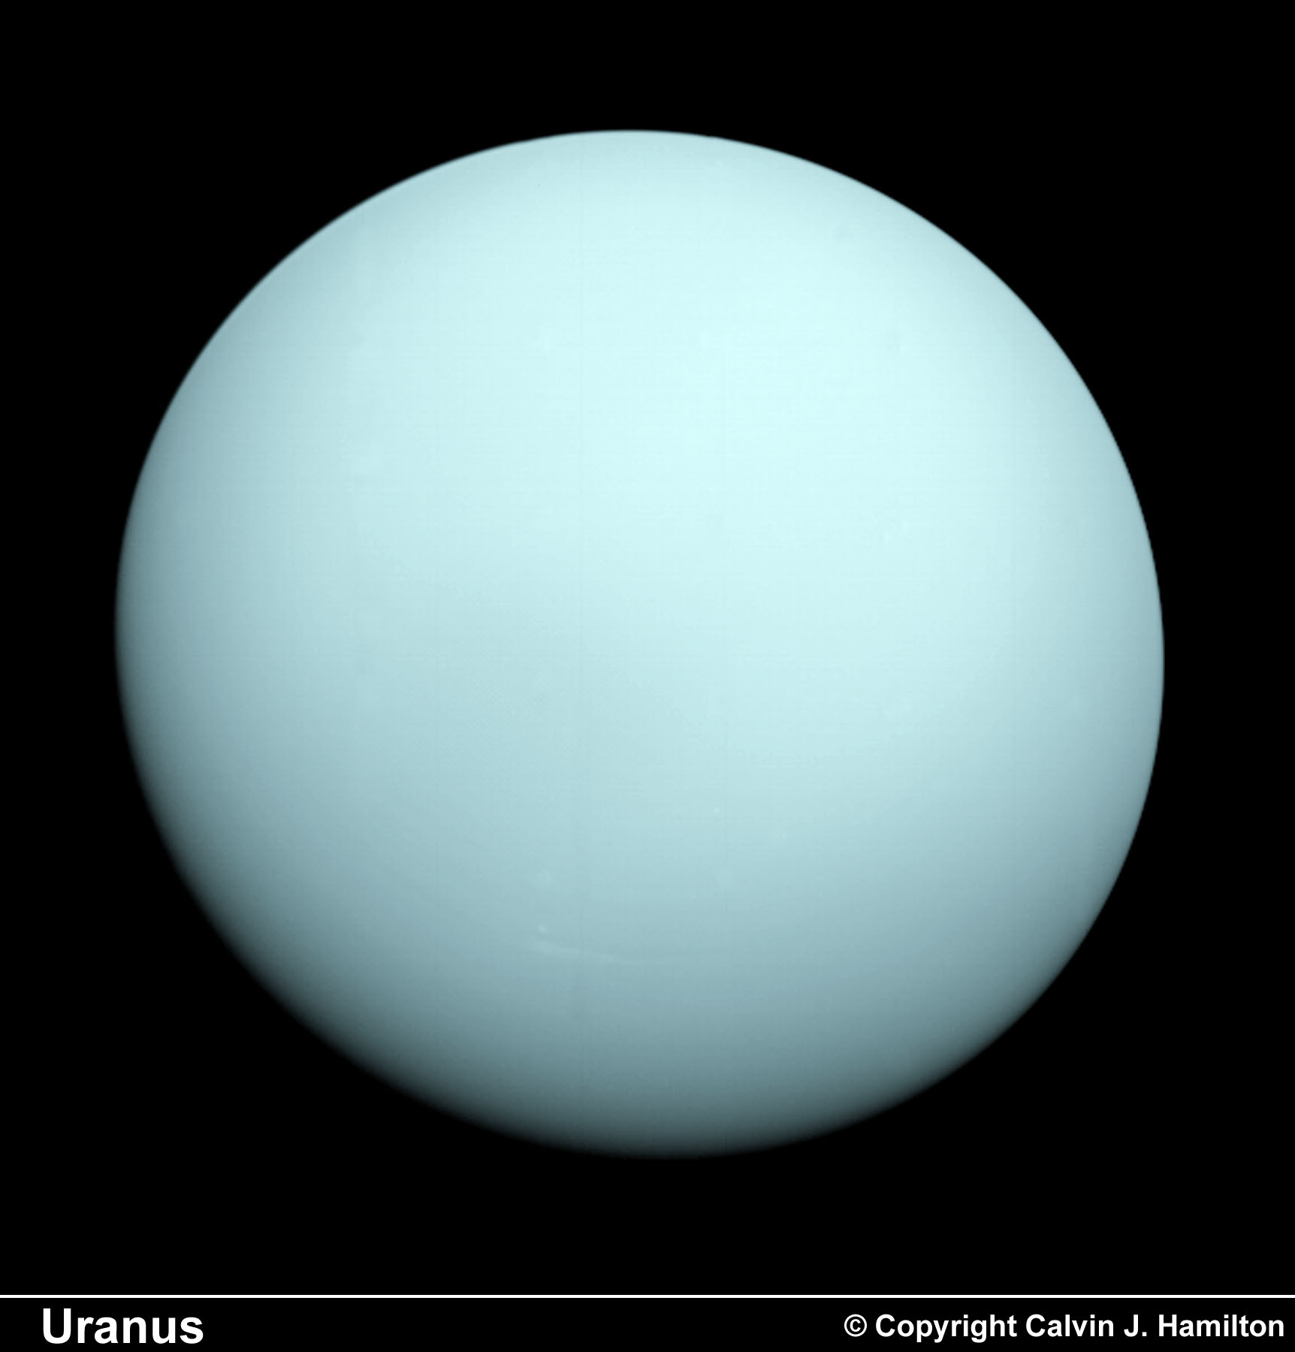
Uranus as seen by Voyager 2

Slide 79
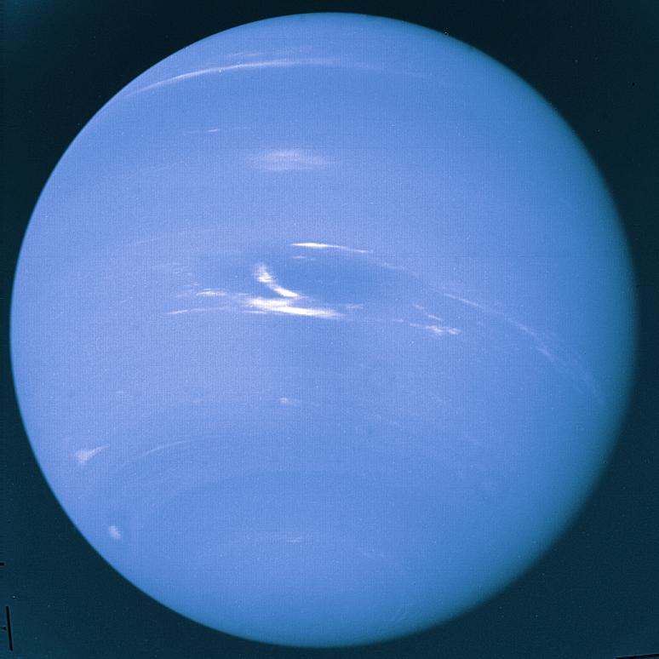
Neptune as seen by Voyager 2
They look like “blue Jupiters”

Slide 80
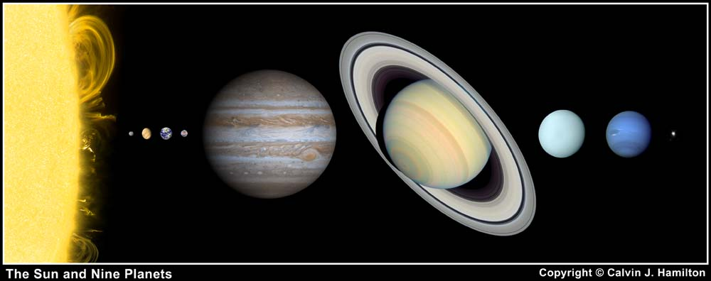
How do they match up to Jupiter and Saturn?
Smaller than Jupiter and Saturn; much bigger than the Earth

Slide 81
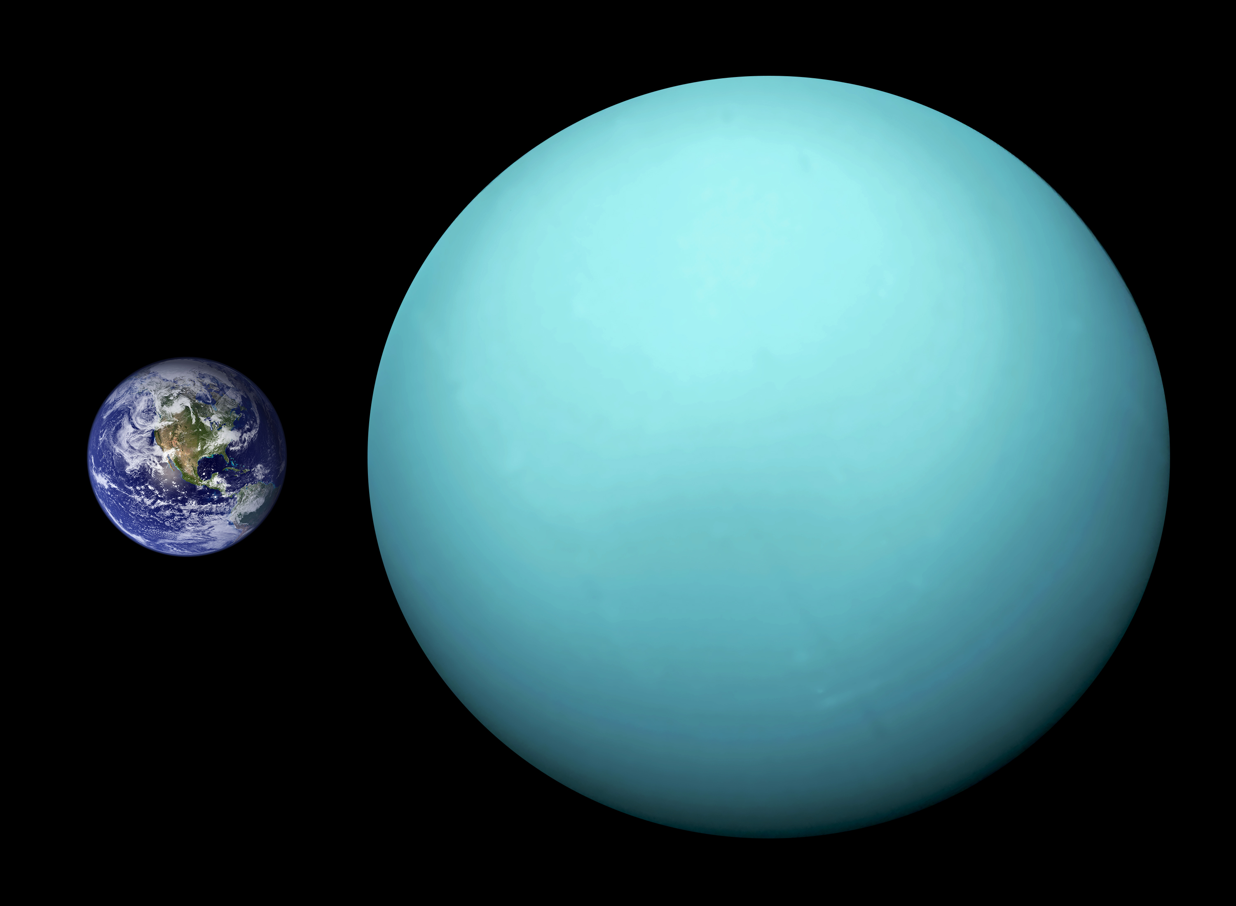
Uranus (and Neptune) substantially larger than Earth

Slide 82
Uranus and Neptune (just the facts, Ma’am)
planet | D (rel to Earth) | M (rel to Earth)
Uranus | 4.01 | 14.5
Neptune | 3.88 | 17.1
Uranus and Neptune are relevant in the exoplanet context

Slide 83
How do we summarize all of this?
The small rock planets are in close to the Sun
The big, gaseous planets are way out, far from the Sun
Mars may have had habitable conditions on its surface billions of years ago
Moons of the outer planets (Europa, Titan) may be promising locations for life

