Slide 1
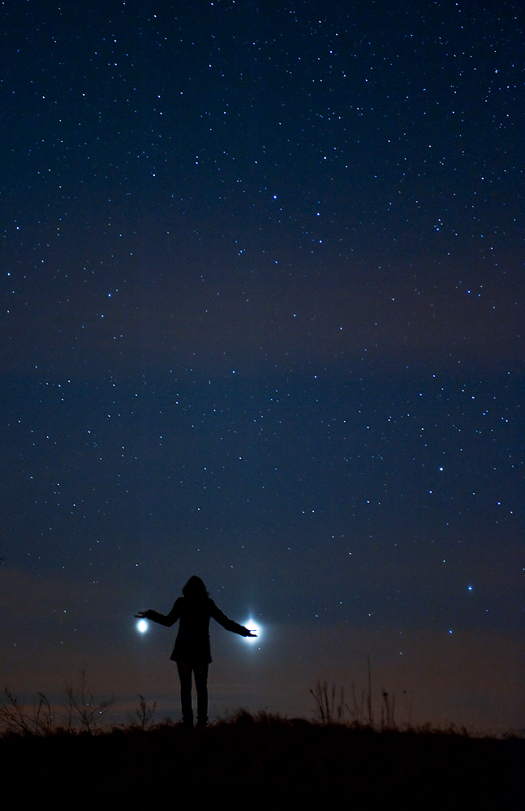
What about the more distant planets in the Solar System?
Other Worlds in Space, Class 2

Slide 2
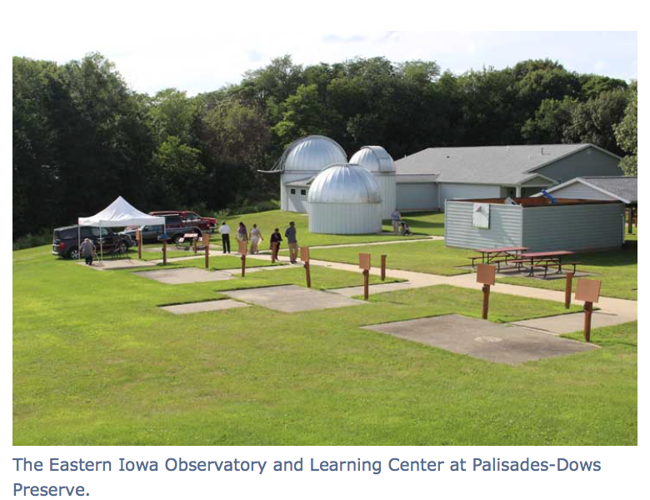
Field Trip for Other Worlds …
Location: EIOLC (near Mt. Vernon)
Prime Date: Wednesday, April 11
Backup Date (in case of clouds): Thursday, April 12
Time: 7:45 PM for about 2 hours
See some of the things we talk about (e.g. Venus)

Slide 3
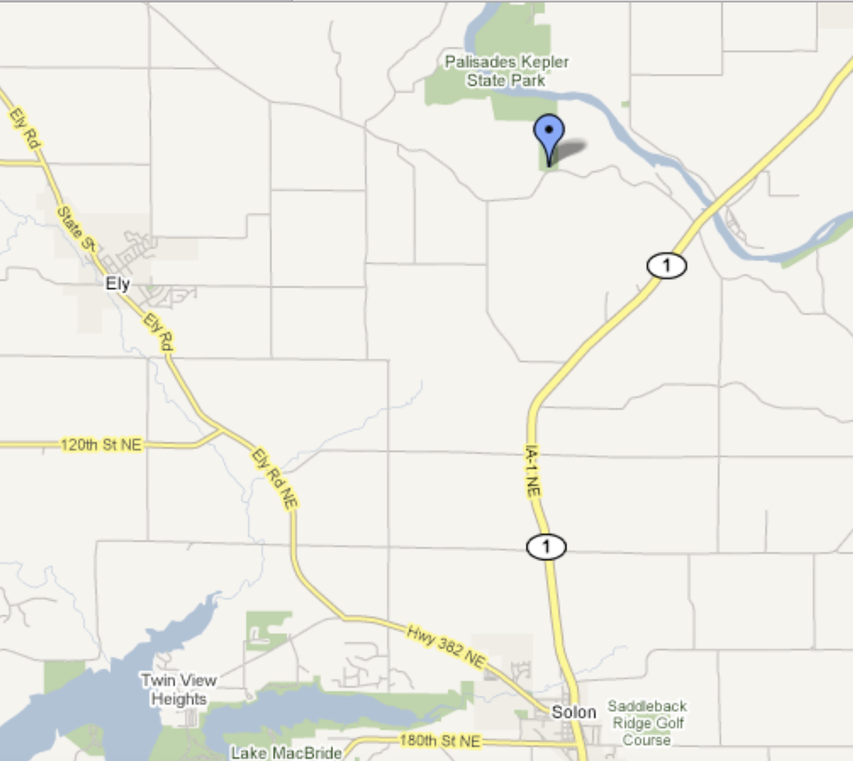
Field Trip (continued)
Carpooling good
Think about it now
Will ask for a show of hands next time to judge participation
Further details next week

Slide 4
Questions from last time?

Slide 5
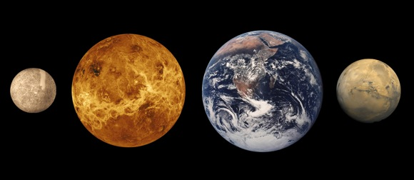
Summary of last time; the terrestrial planets
Earthlike (sort of) planets in the inner solar system
Venus is Earthlike in size and mass, totally different in temperature
Mars less Earthlike in size and mass, but may have had similar surface conditions billions of years ago
Earth unique among this set of planets

Slide 6
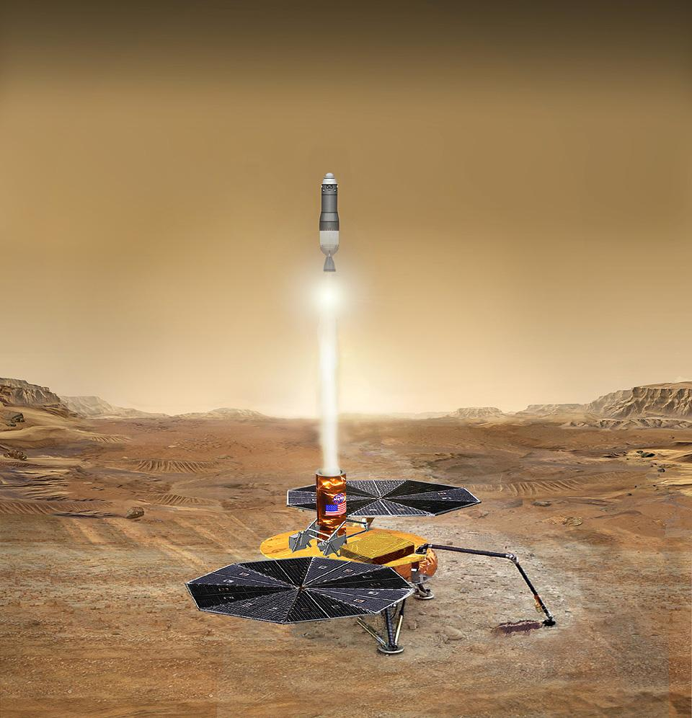
We are almost guaranteed to learn more about Mars in the next decade or two
rom
Earth) in 2014.

Slide 7
What about the more distant planets in the Solar System?
What can they tell us about how planets formed, the nature of other solar systems?

Slide 8
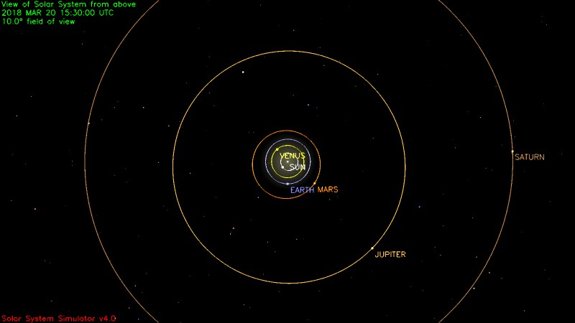
Exploring further out in the Solar System
Jupiter, Saturn, and friends

Slide 9
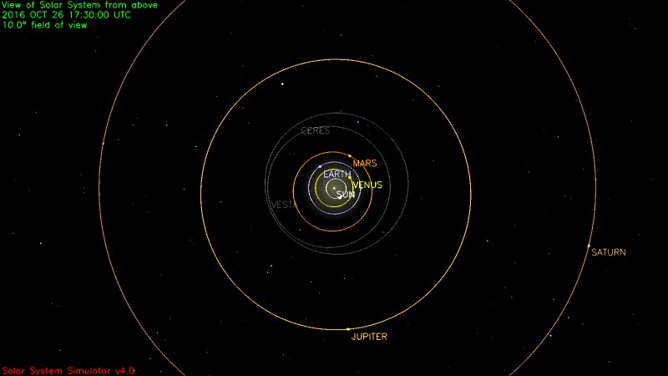
Jupiter and Saturn: orbital characteristics
Planet | a (AU) | P (yrs) | ecc | Incl (deg)
Jupiter | 5.20 | 11.9 | 0.049 | 1.3
Saturn | 9.58 | 29.4 | 0.057 | 2.5
What do they look like? Let’s start with Jupiter

Slide 10
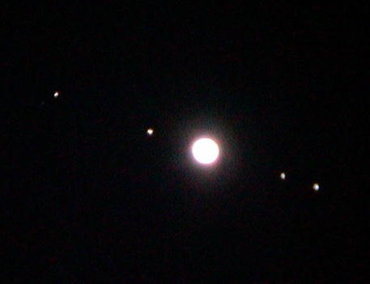
Jupiter…largest planet in the solar system

Slide 11
Basic properties of Jupiter and Saturn
Jupiter: 11.2 X diameter of Earth and 318 X mass
Saturn: 9.5 X diameter of Earth and 95 X the mass
Jupiter and Saturn: the “giant planets”
Jupiter and Saturn are “all atmosphere”, and mainly hydrogen and helium

Slide 12
Jupiter and the Earth

Slide 13
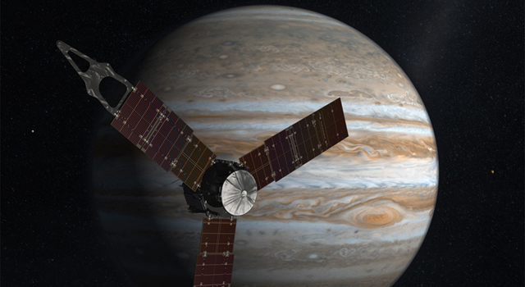
The future exploration of Jupiter… Juno (arrived last summer)
Launch: August 5, 2011… Arrival at Jupiter: July 4, 2016

Slide 14
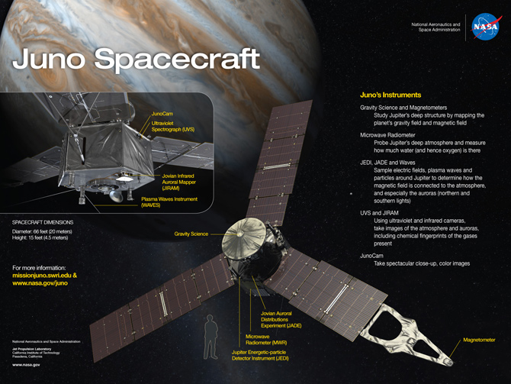

Slide 15
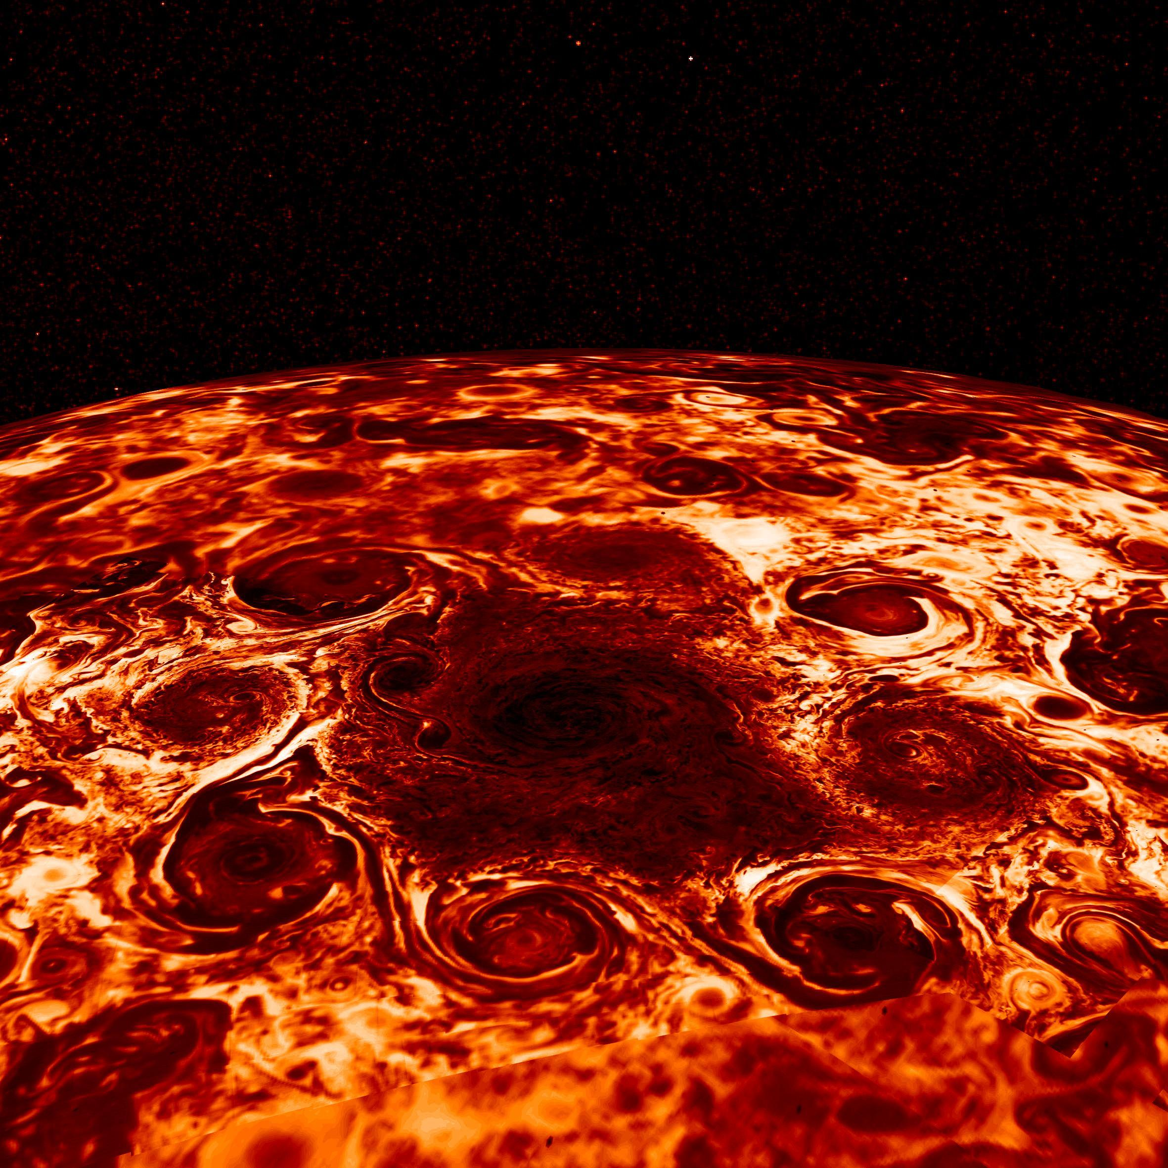
The Juno spacecraft is giving us new insights into Jupiter
There is really no surface on Jupiter; the gas density and pressure get larger and larger, matter weirder and weirder

Slide 16
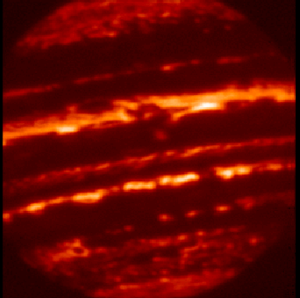
Are Jupiter and Saturn planets or stars?
Jupiter as seen at infrared wavelengths
Jupiter emits 70% more radiation to space than it receives from the Sun. It has an “engine” inside

Slide 17
The Moons of Jupiter…a new wrinkle for the outer planets

Slide 18
Jupiter has many moons
12 when I started studying astronomy
A standard textbook lists 38
Most important are the 4 Galilean satellites, Io, Europa, Ganymede, Callisto

Slide 19
From Earth, it is difficult to learn too much about the Galilean satellites
At opposition of Jupiter, the angular diameter of Ganymede is 1.7 arcseconds
Pre space-age telescope observations revealed a little bit about size, reflectivity (albedo), and surface features

Slide 20
Basic data on the Galilean satellites
moon | a (km) | P (days) | D (km)
Io | 422,000 | 1.769 | 3630
Europa | 671,000 | 3.551 | 3130
Ganymede | 1,071,000 | 7.155 | 5280
Callisto | 1,884,000 | 16.689 | 4840
MOON | 384,000 | 27.32 | 3476
The largest Moon, Ganymede, has a diameter about 50 percent larger than our Moon

Slide 21
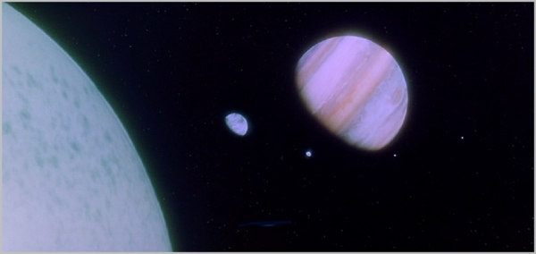
What are the moons of Jupiter like? Would do they look like “up close”?
The 1968 movie “2001 A Space Odyssey” has them similar and looking like our Moon

Slide 22
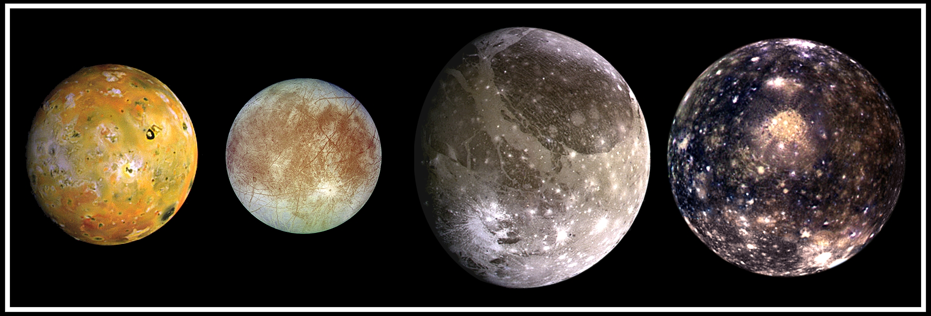
All of them together (sibling portrait)
Images scaled to give correct relative sizes

Slide 23
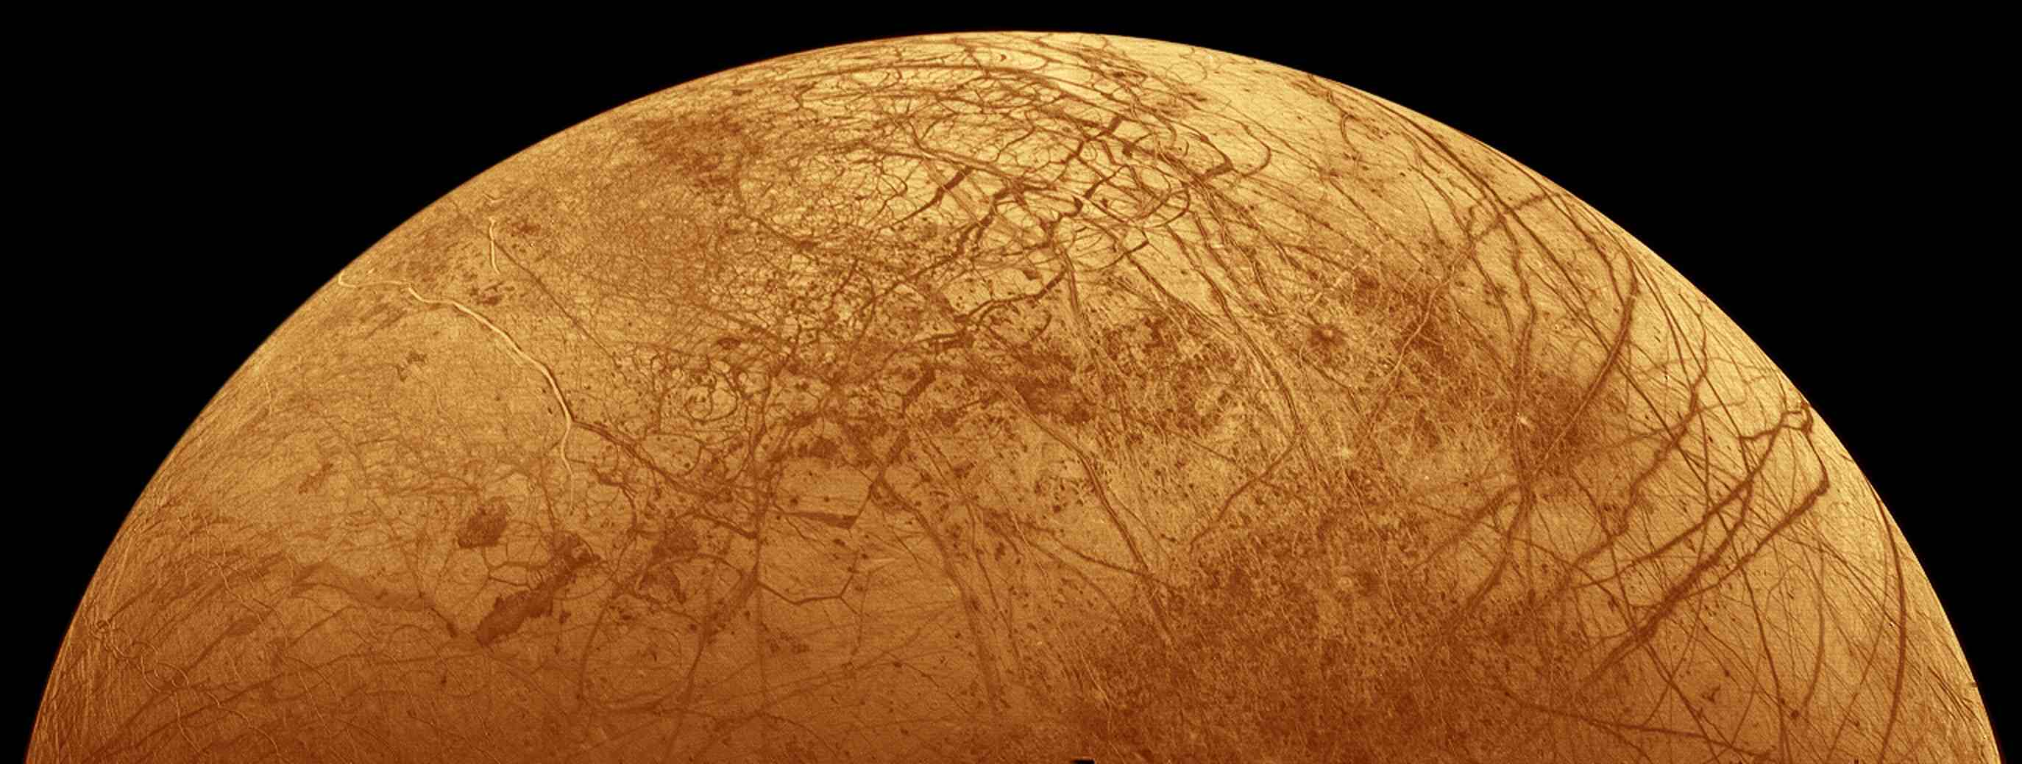
Exploring Europa
What is under its ice-covered plains?

Slide 24
Europa is slightly smaller and less massive than our Moon. It is of interest because the entire moon is encased in ice. There are cracks and other features that hint at liquid water at some point below the surface,

Slide 25
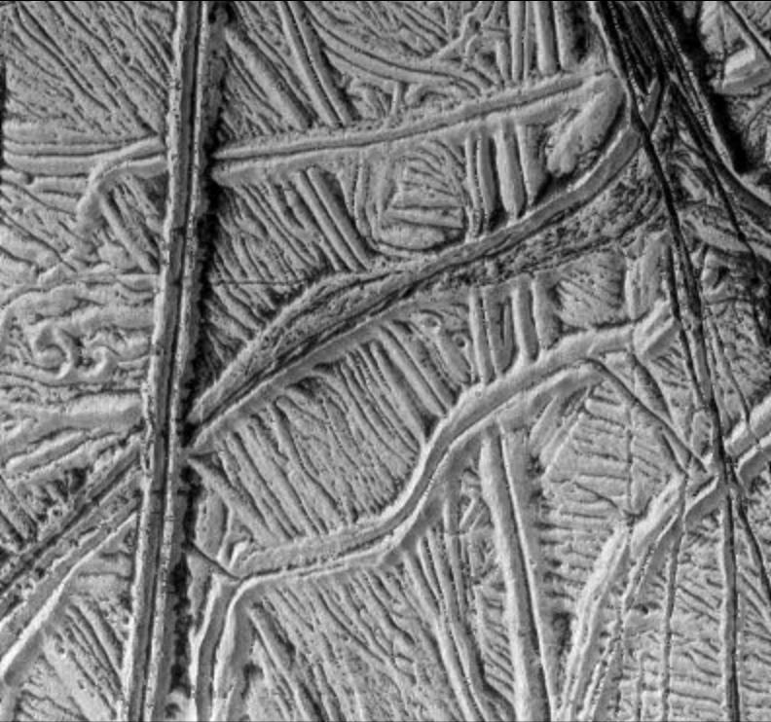
Views of the cracks from Galileo
Picture about 100 miles on a side

Slide 26
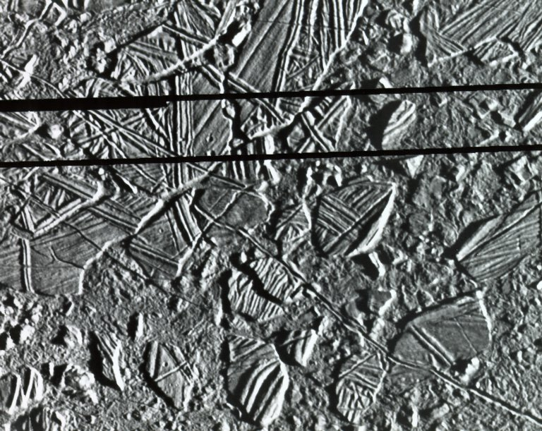
A related phenomenon. The ice rafts of Europa
Similar features seen in arctic ocean and are due to flows of ocean underneath

Slide 27
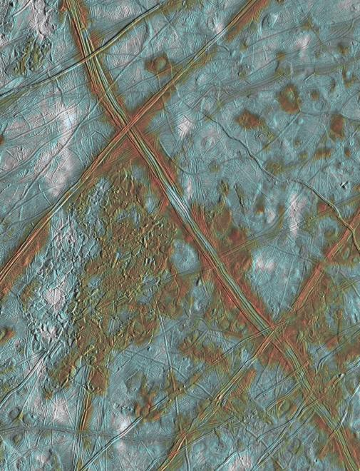
Evidence for flows from beneath the surface of Europa

Slide 28
There is evidence (circumstantial) for liquid water under the surface, but how far down is it? What is below the water?
Spacecraft missions to Europa over the next few decades might tell us

Slide 29
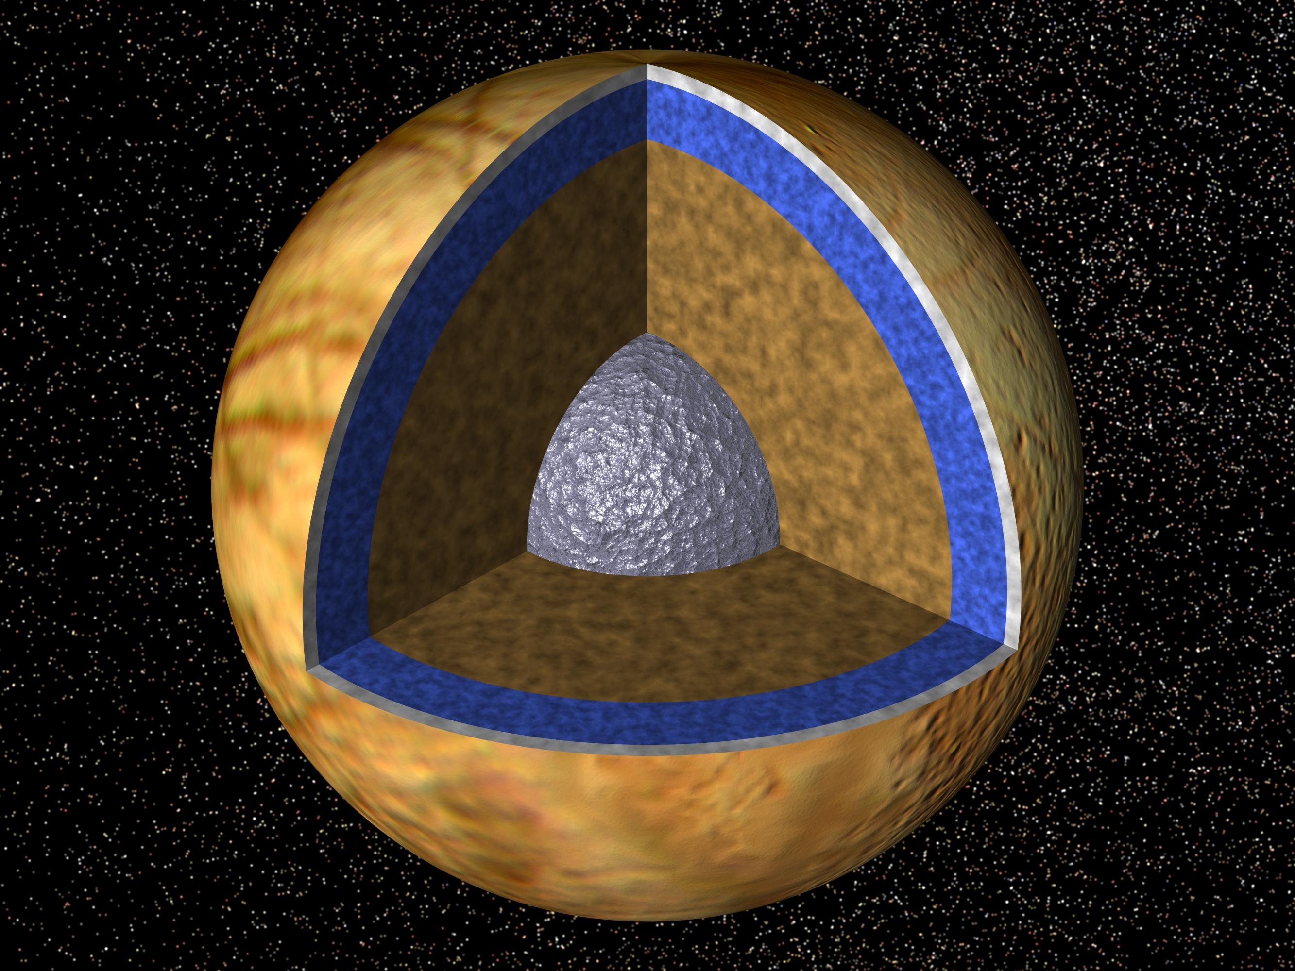
Speculations on interior structure of Europa

Slide 30
A summary of what we know about Europa
Slightly smaller in mass and diameter than the Moon
Surface covered with water ice casing
Evidence for surface “activity” from cracks and grooves, and ice rafts
Small numbers of craters implies surface has reformed in last 100 million years
Estimates that liquid layer, “sealed ocean” is between 10 - 50 kilometers below the surface, with possible rocky sea floor

Slide 31
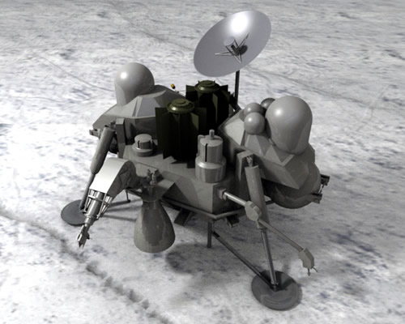
A future Europa Lander could tell us much about the possible subsurface ocean of Europa
Europa Clipper launch 2022, arrival 2024

Slide 32
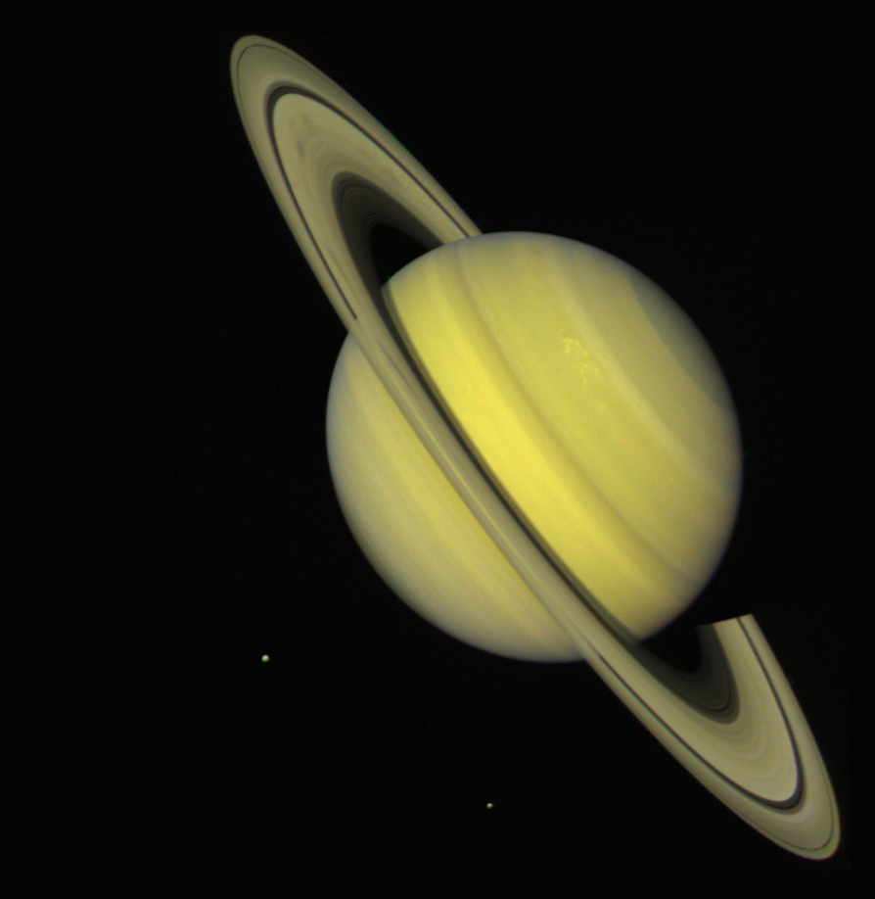
What about Saturn and its moons?
Most distant known planet in solar system before invention of telescope

Slide 33
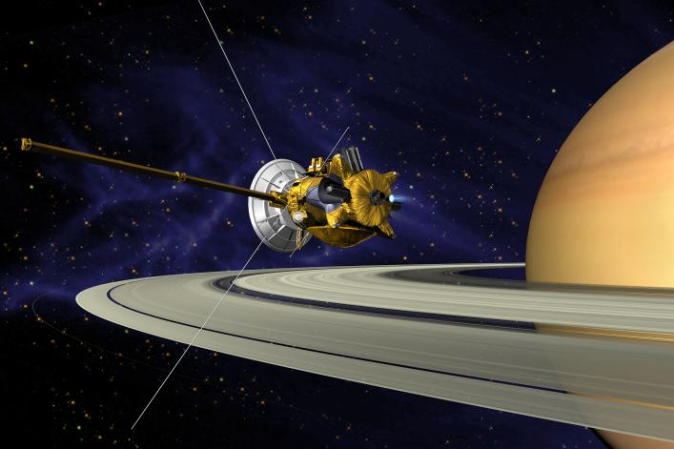
Exploration of the moons of Saturn

Slide 34
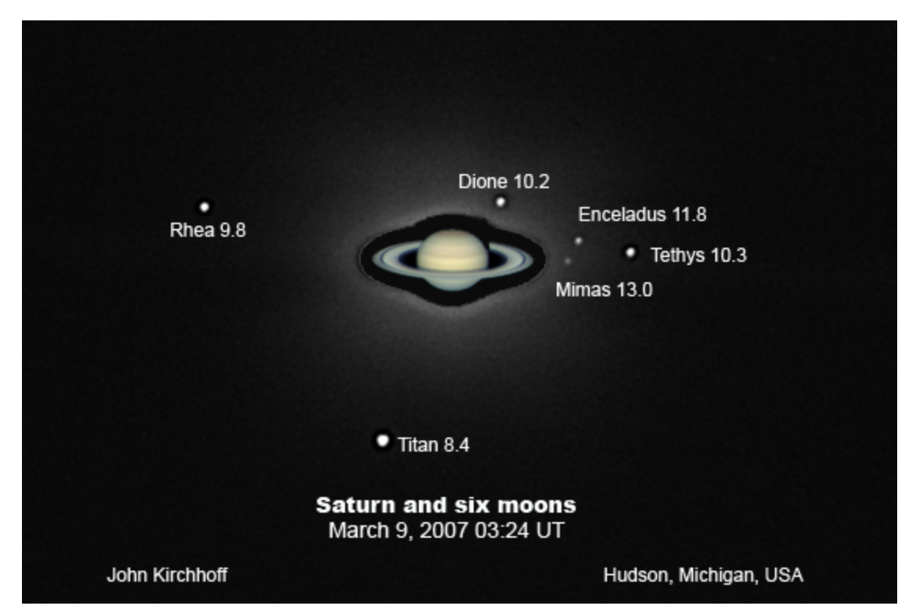
Saturn’s moons
The view through an amateur telescope

Slide 35
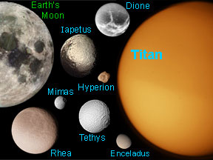
A “family portrait” of the larger moons of Saturn
One large one (Titan) in a class by itself

Slide 36
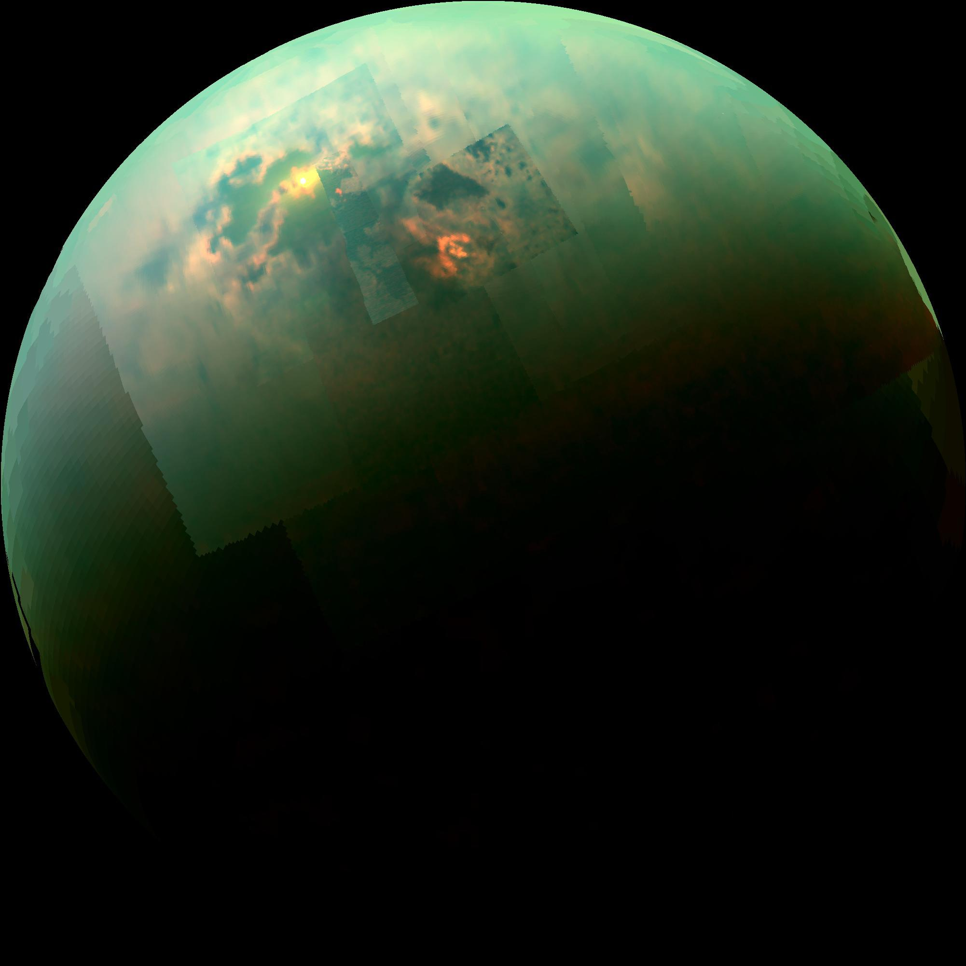
We have learned much about Titan in the last decade

Slide 37
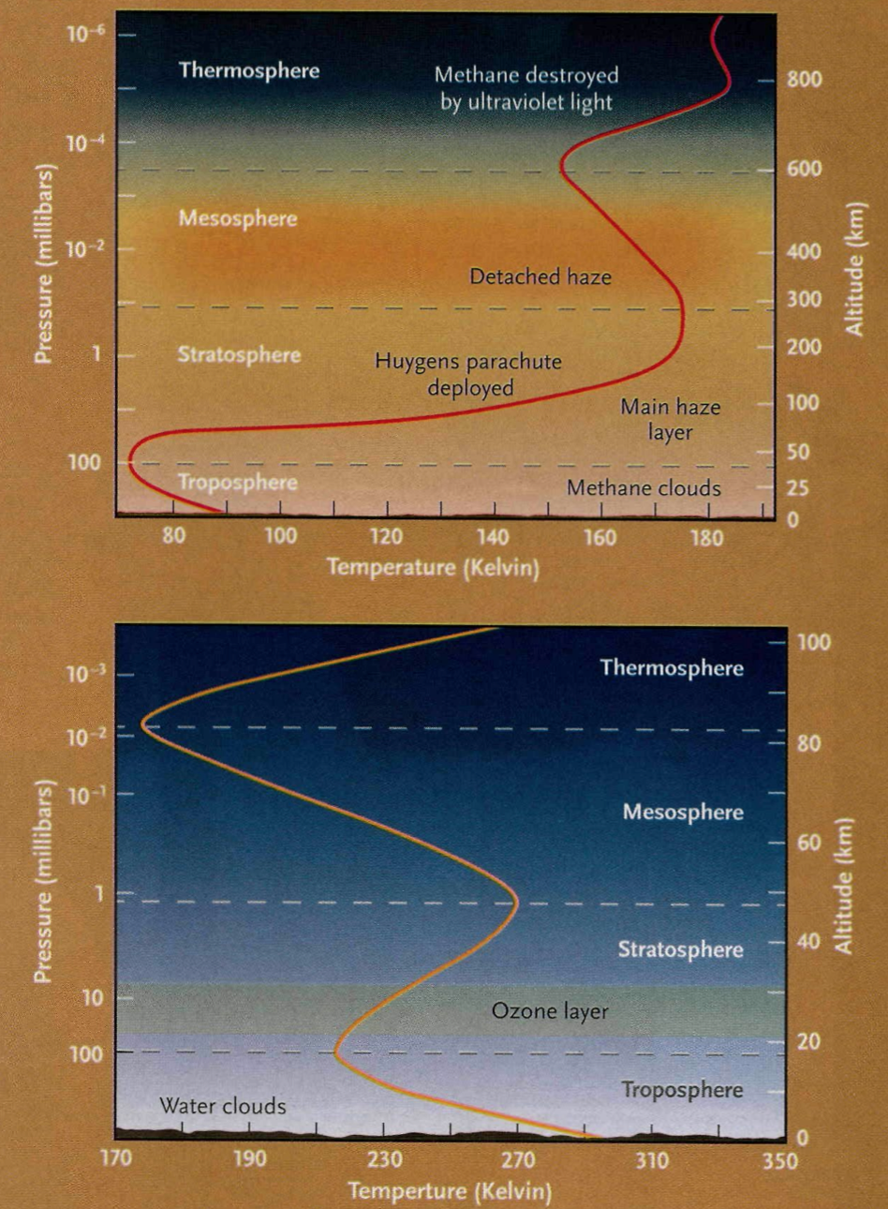
What we knew before the arrival of Cassini, July 2004
A lot. Titan has a thick atmosphere, unique among moons

Slide 38
A closer look
Primary atmospheric constituent is molecular nitrogen N2 (like Earth). Methane CH4 at about same proportion as water in Earth’s atmosphere. Ethane C2H6 also present

Slide 39
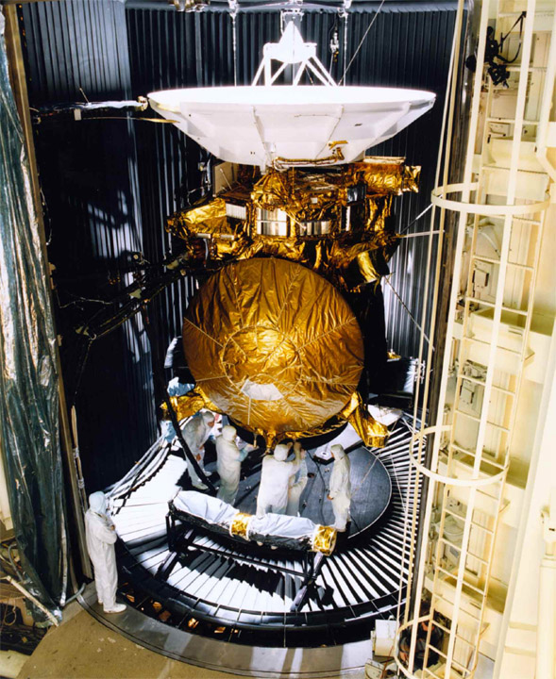
The Cassini and Huygens spacecraft
The Huygens
lander

Slide 40
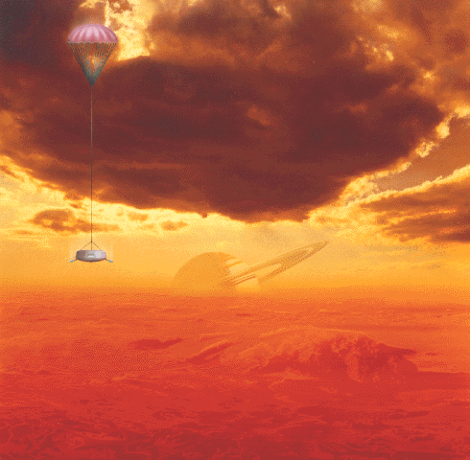
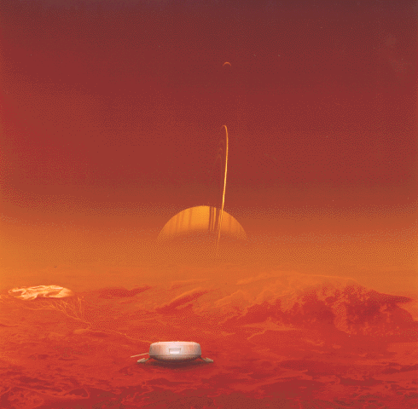
Concept of the Huygens lander…an artist’s conception

Slide 41
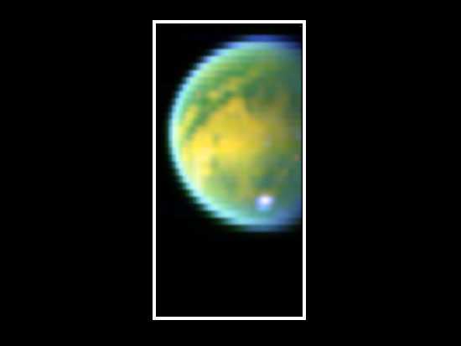
Pictures of Titan from the approaching Cassini spacecraft
Image at infrared wavelengths

Slide 42
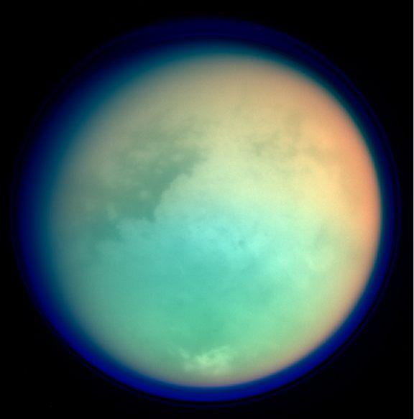
A new view of Titan (from close up)

Slide 43
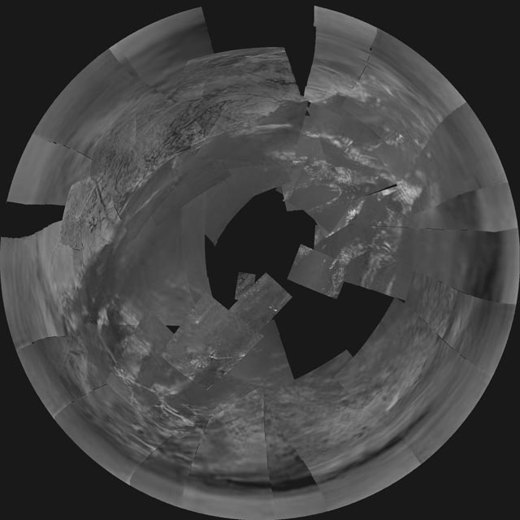
The view from Huygens on the way down

Slide 44
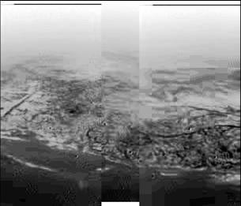
Closer to the surface

Slide 45
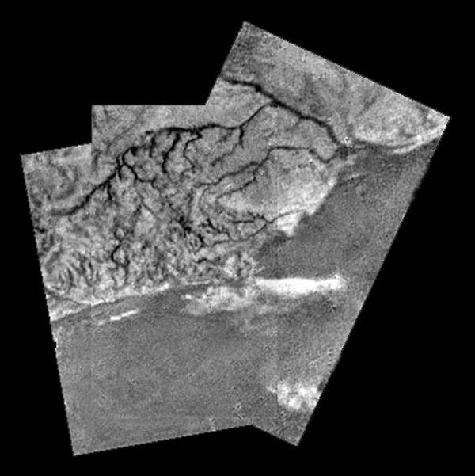
Titan has flow channels, too

Slide 46
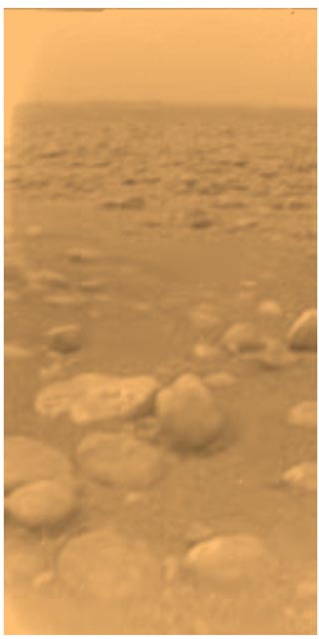
On the surface
“rocks” are blocks of ice
The most remote human “base” in the universe: nearly a billion miles from the Sun

Slide 47
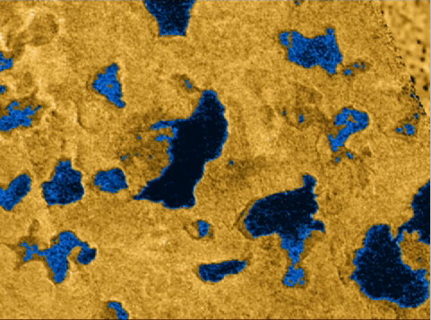
Cassini radar shows lakes of methane

Slide 48
Other observations from Cassini show different manifestation of methane lakes: sunlight glints from the lake surfaces

Slide 49
Reasons for the interest and importance of Titan: it has a dense atmosphere and a “hydrological cycle” based on another compound. Despite its alien nature, in some ways it is the most Earth-like object in the solar system

Slide 50
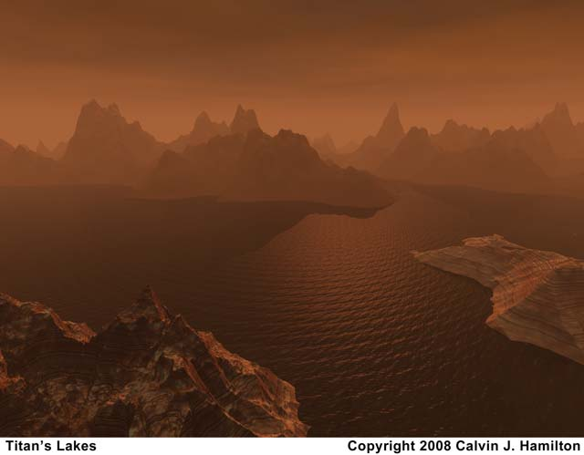
The surface of Titan: an artist’s view

Slide 51
Another moon of Saturn: Enceladus
Diameter=500 km
Mass = 0.0012 that of Earth’s Moon
Orbital period=1.37 days
Semimajor axis of orbit=238,000 km
Semimajor axis of orbit = 4.0 X radius of Saturn

Slide 52
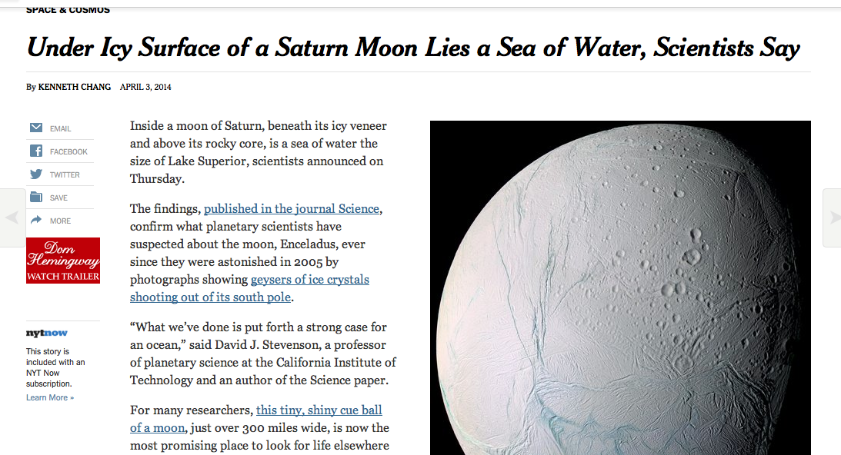
Solar system astronomy in the news

Slide 53
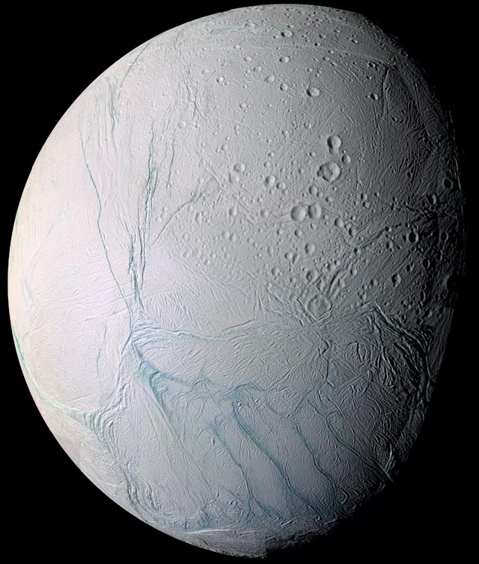
Cassini gives a closeup view of Enceladus

Slide 54
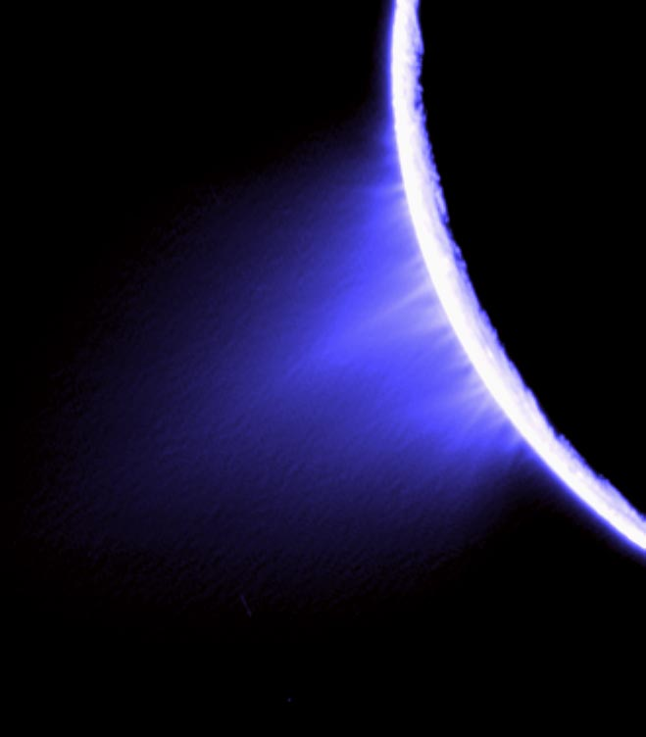
Why Enceladus is of interest
Water geysers coming from the “tiger stripes”
Now, recent report that there is a subsurface ocean on this small object

Slide 55
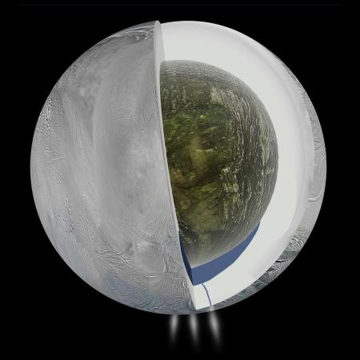
Recent measurements of gravitational field of Enceladus suggest a subsurface ocean at south pole

Slide 56
Summary: several moons of the outer planets, in addition to being amazing natural spectacles, may be abodes for primitive forms of life, or at least give us some insight into the astro-biochemical processes which gave rise (or didn’t) to life. Future spacecraft will have much to explore. Stay tuned.

Slide 57
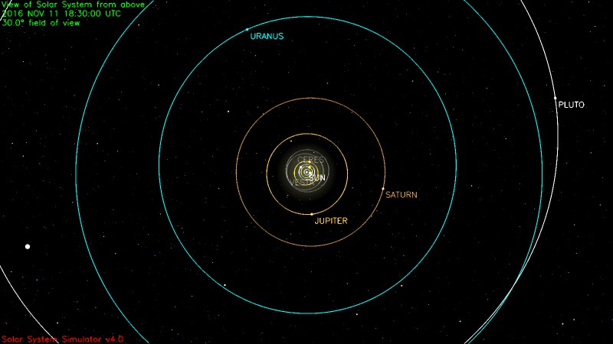
Further out…to the edge of the Solar System

Slide 58
Uranus and Neptune… where are they? Let’s look at a Table!
Planet | a (AU) | P(yr) | ecc | Incl (degrees)
Uranus | 19.20 | 83.7 | 0.046 | 0.8
Neptune | 30.5 | 163.7 | 0.011 | 1.8
Current locations: Uranus: Pisces; Neptune: Aquarius.
What do they look like?

Slide 59
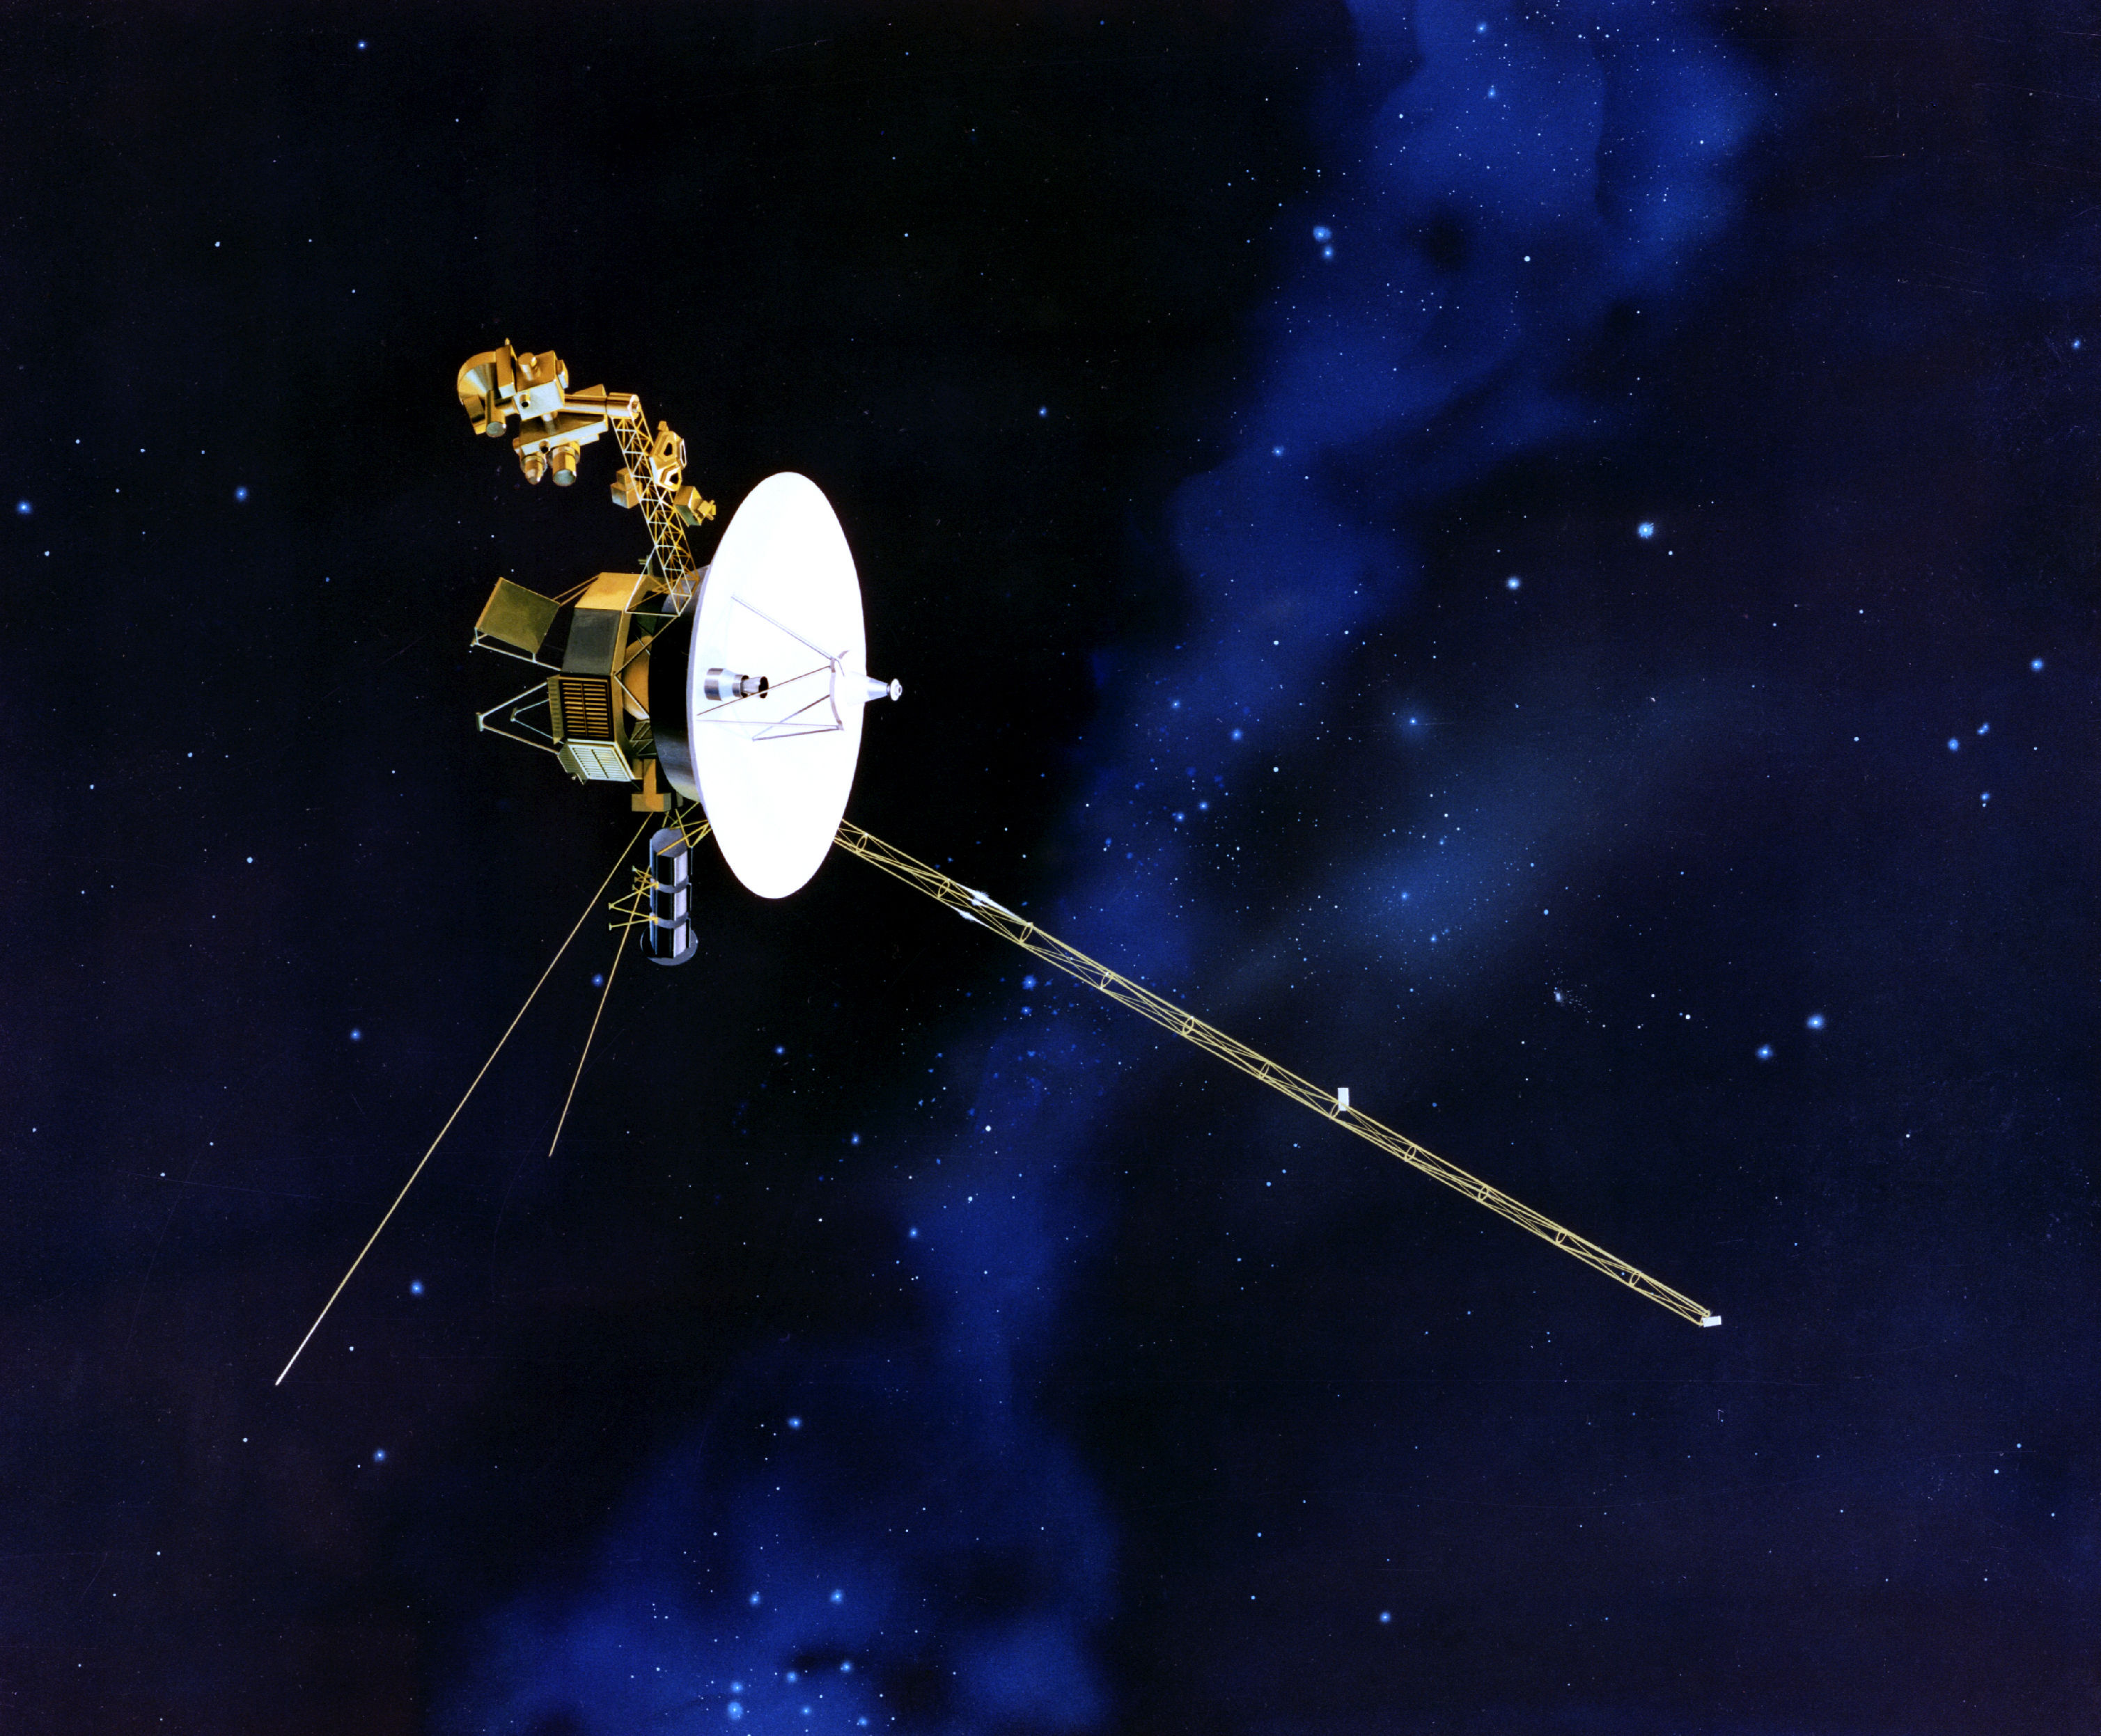
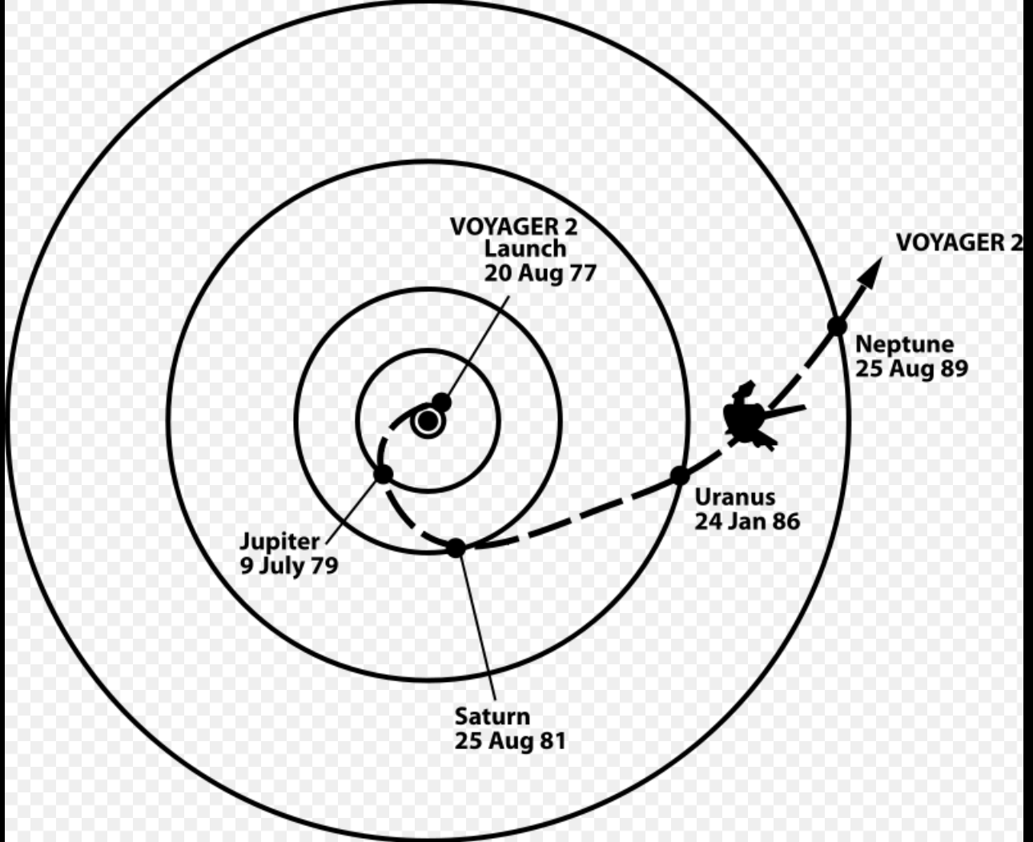
Our best views (and scientific information) come from visits (flybys) of the Voyager 2 spacecraft

Slide 60
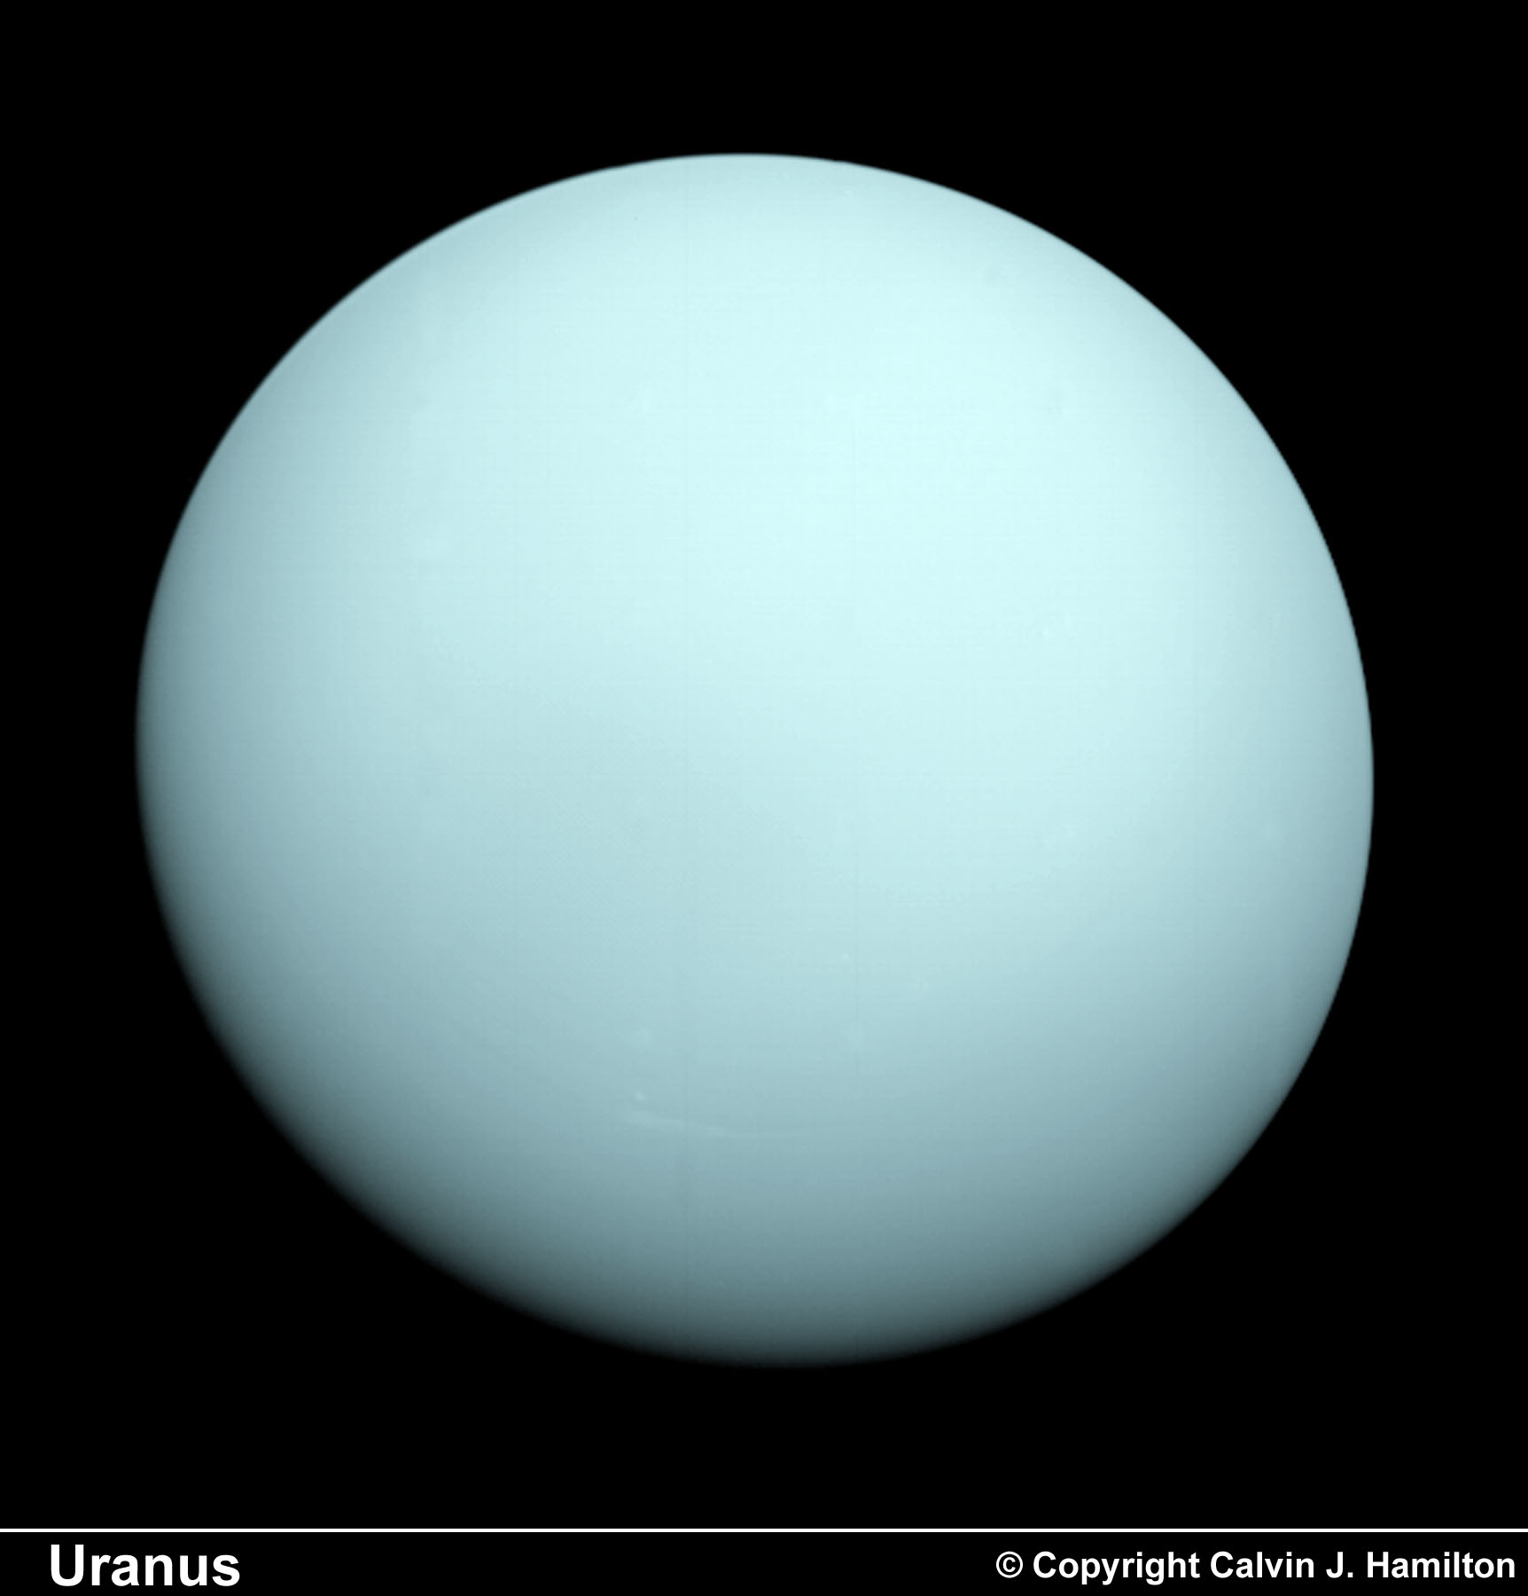
Uranus as seen by Voyager 2

Slide 61
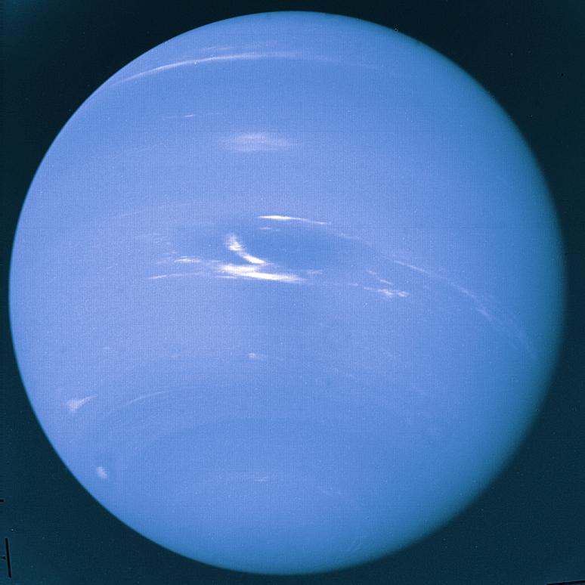
Neptune as seen by Voyager 2
They look like “blue Jupiters”

Slide 62
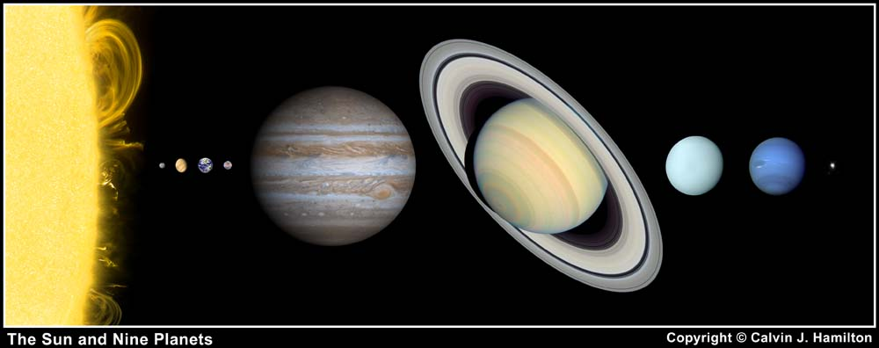
How do they match up to Jupiter and Saturn?
Smaller than Jupiter and Saturn; much bigger than the Earth

Slide 63
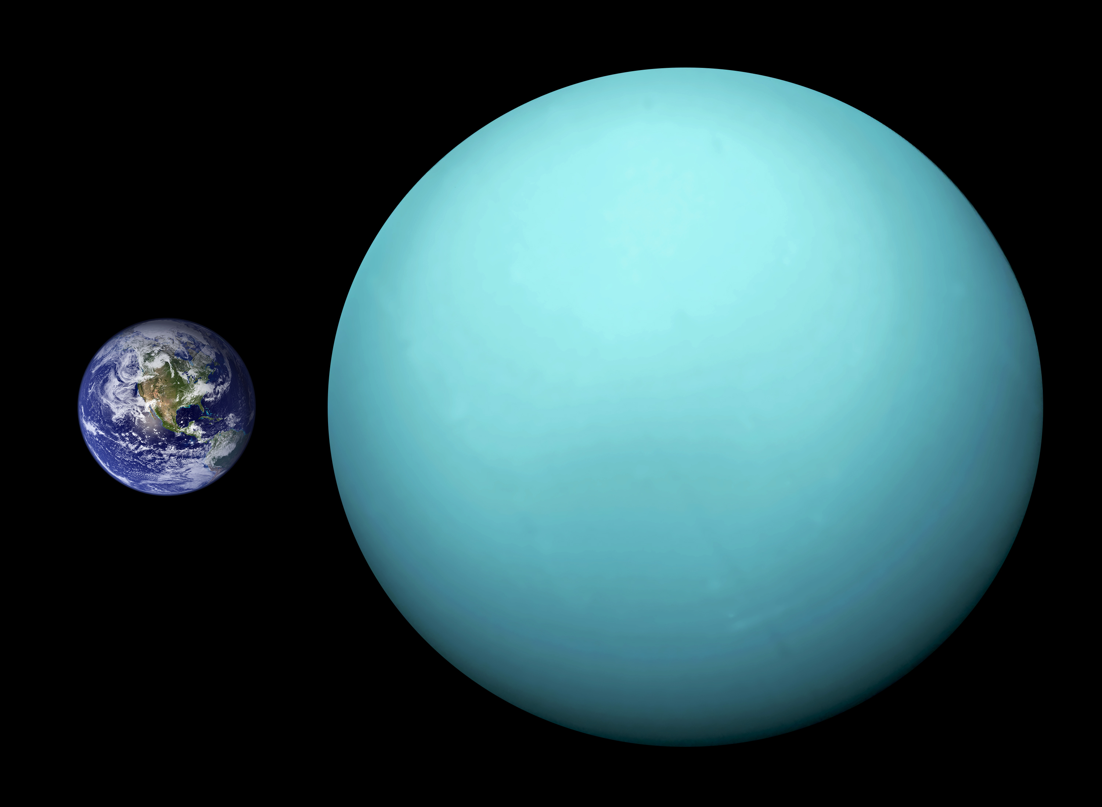
Uranus (and Neptune) substantially larger than Earth

Slide 64
Uranus and Neptune (just the facts, Ma’am)
planet | D (rel to Earth) | M (rel to Earth)
Uranus | 4.01 | 14.5
Neptune | 3.88 | 17.1
Uranus and Neptune are relevant in the exoplanet context

Slide 65
How do we summarize all of this?
The small rock planets are in close to the Sun
The big, gaseous planets are way out, far from the Sun
Mars may have had habitable conditions on its surface billions of years ago
Moons of the outer planets (Europa, Titan) may be promising locations for life

Slide 66
Would solar systems around other stars be similar?

