Slide 1
Planets Around Other Stars: How we find them; what we’ve found

Slide 2
Questions from last time?

Slide 3
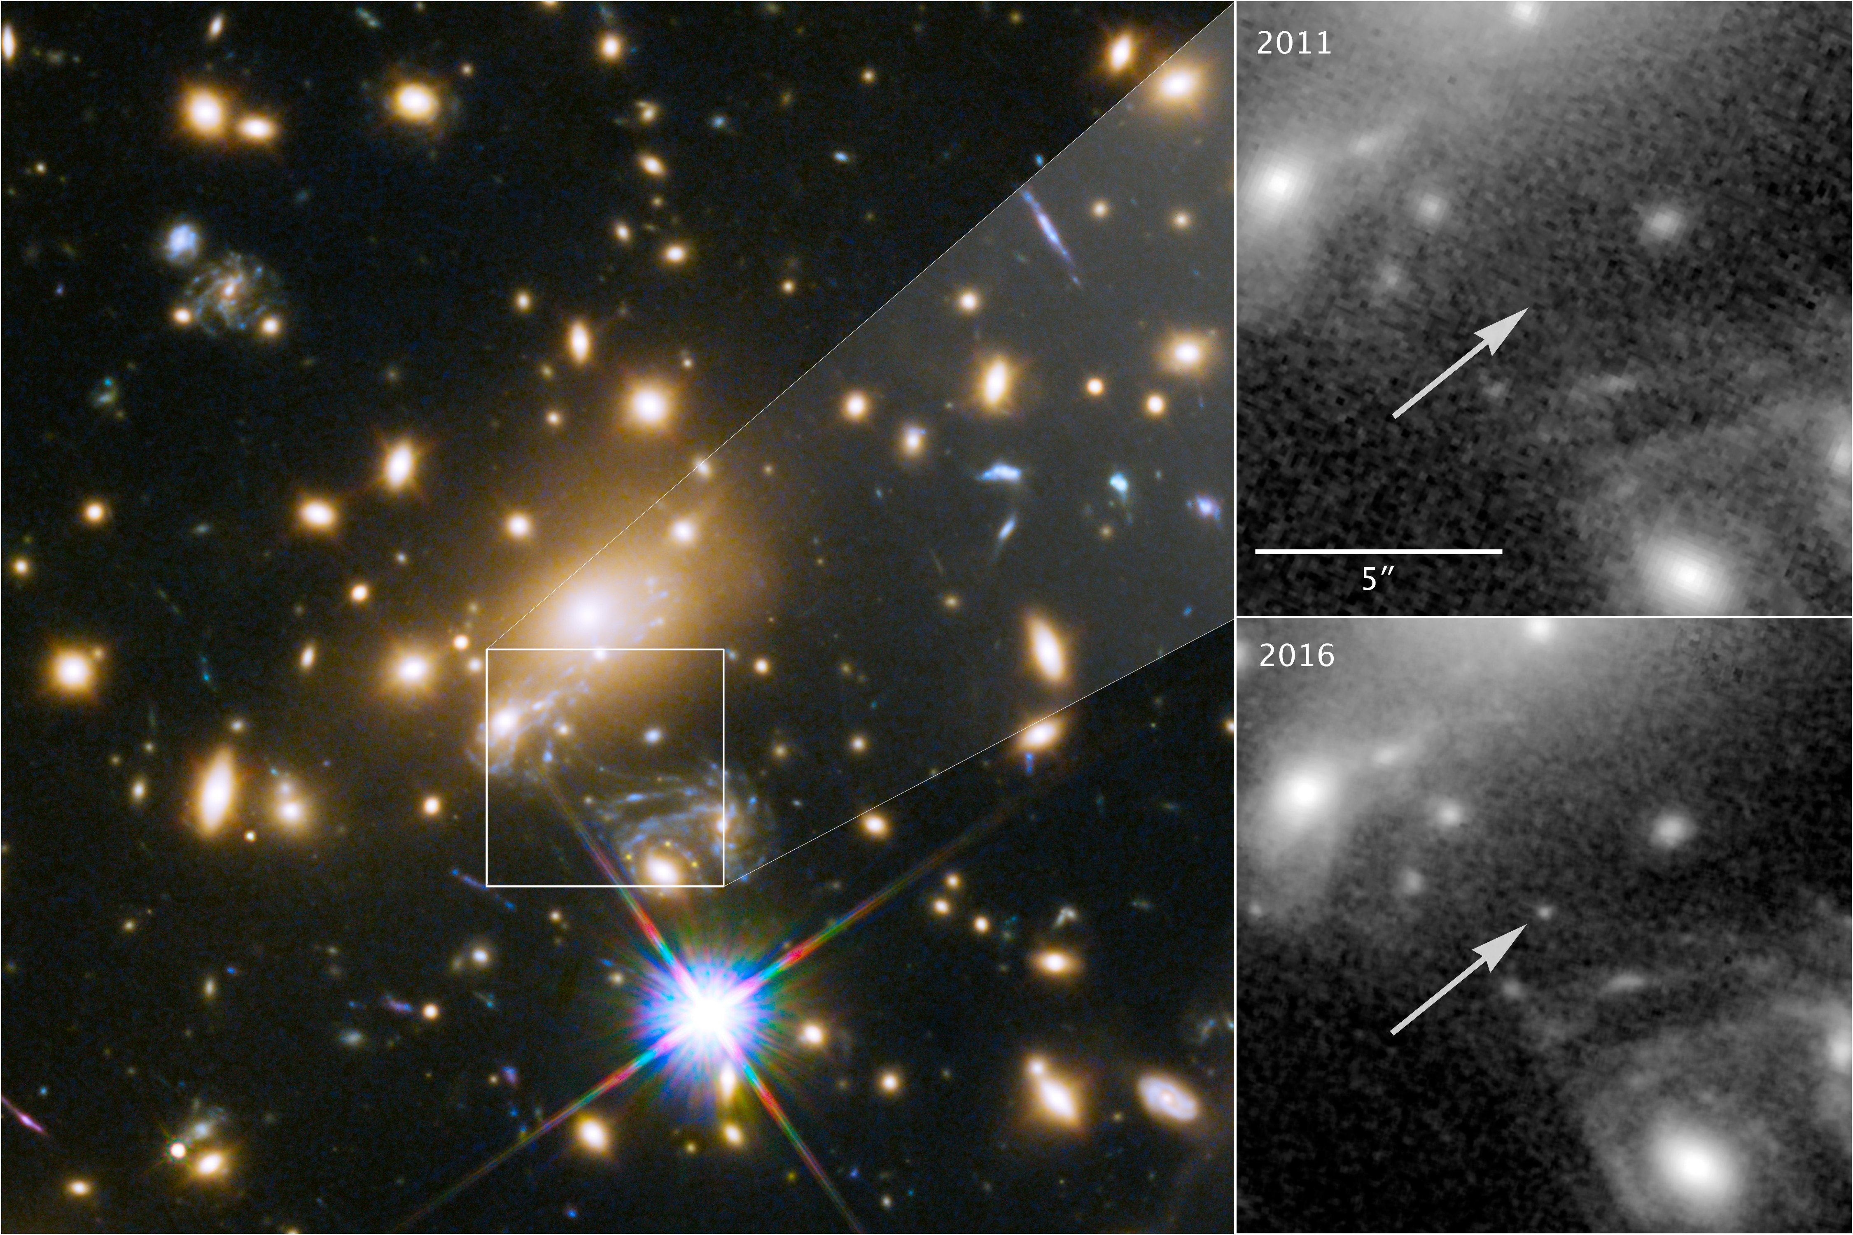
Question from Week 3 about “most distant star in the universe”
Interpreted as result of 2 episodes of gravitational lensing; total magnification by a factor of 2000. Star existed when the universe was only 30% of its current age

Slide 4
Planets Around Other Stars: How we find them; what we’ve found

Slide 5
Stars with planets are out there

Slide 6
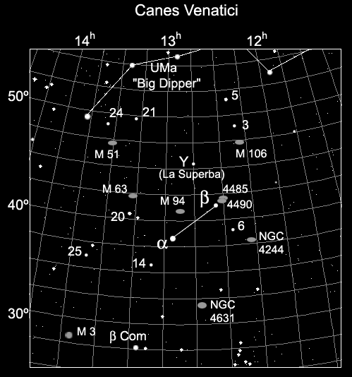
It seems almost impossible to detect a solar system-like planet in orbit around a nearby, solar-type star
Beta Canum Venaticorum

Slide 7
An Earthlike planet around Beta CVn would be a billion times fainter than the star
the angular separation (dark sky) between star and planet would be angle subtended by a dime at 10 miles!

Slide 8
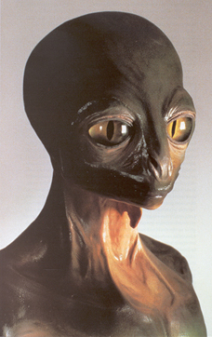
Give Up!

Slide 9
And yet we have found them. How?
22 techniques

Slide 10
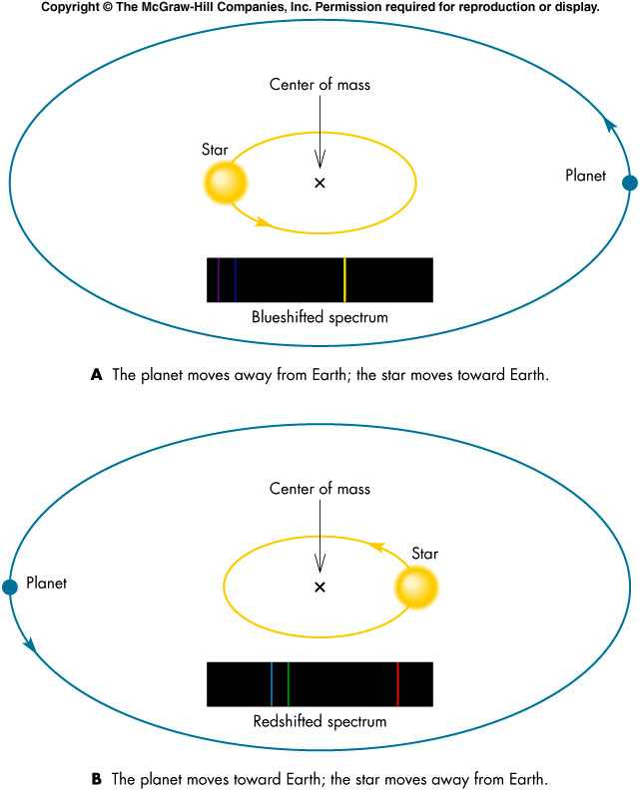
Technique 1: Radial velocity measurements
demo

Slide 11
How big would this be for the Sun moving around the Earth-Sun center of mass?
0.1 meters/sec = 0.22 mph !

Slide 12
Give Up!

Slide 13
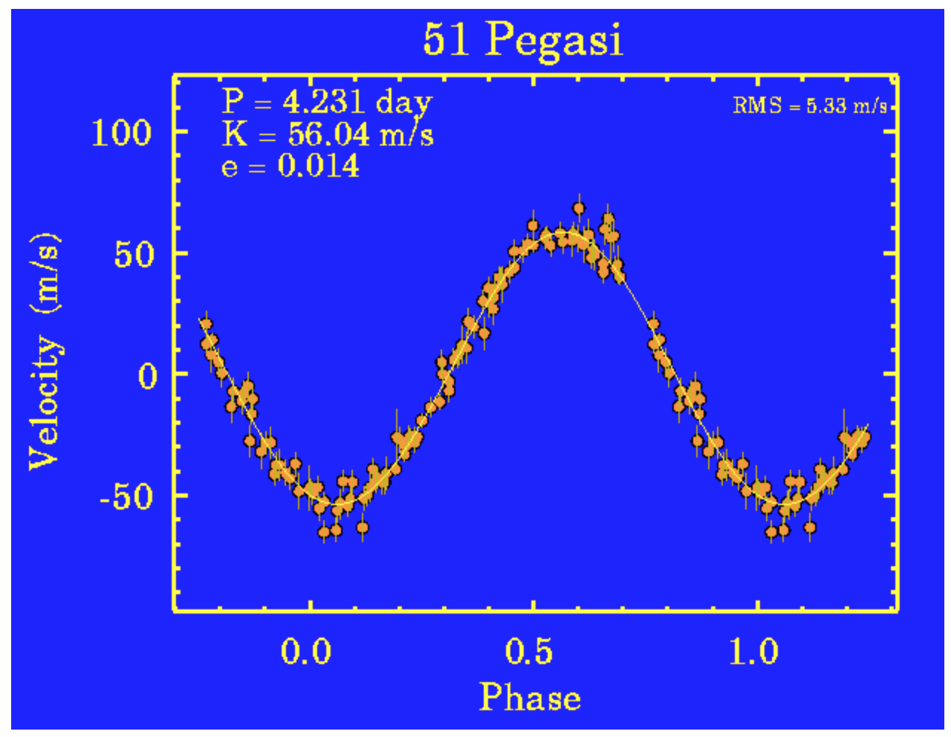
“You can always look…” Carl Heiles, University of California
Doppler shift larger, period shorter than we expected

Slide 14
The surprise came because to produce radial velocity variations as large as observed (and with such a short period), a planet would have to be as large as Jupiter, but much, much closer to the star than Mercury is to the Sun
HOT JUPITERS!
Planets in other solar systems could be (and are) different from those in our solar system

Slide 15
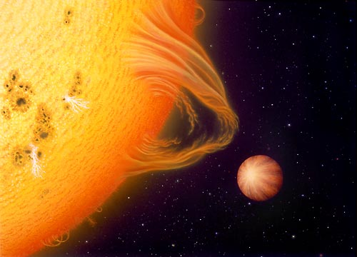
The existence of planets with the mass of Jupiter, so close to the star challenged (nice way of saying it’s wrong!) the picture of solar system formation we thought was well-established

Slide 16
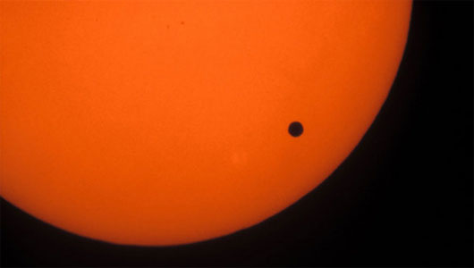
Technique 2: planetary transits
Transit of Venus: June, 2012

Slide 17
Technique 2: planetary transits
A very distant observer would see a tiny drop in the brightness of the Sun, even though the Sun appeared as a point of light

Slide 18
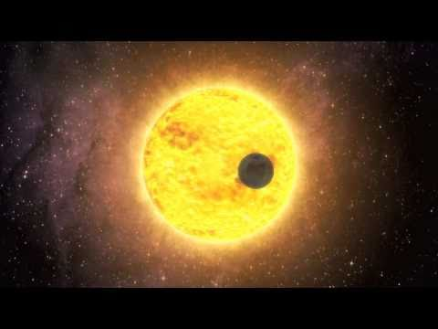
Planetary Transits
If you know the property of the star, transit observations give the size of the planet and its orbital period
The drop in light is really tiny, so you need a very precise measurement of the stellar brightness. That can only be done in space
The Earth transiting in front of the Sun would cause a drop of 1 part in 10,000!

Slide 19
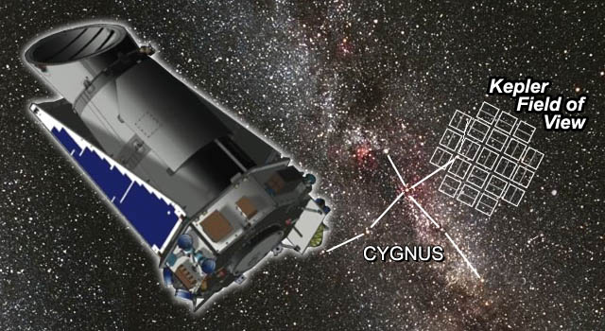
The Kepler spacecraft
Kepler continually watched 145,000 stars in its field of view
Launch: March 2009

Slide 20
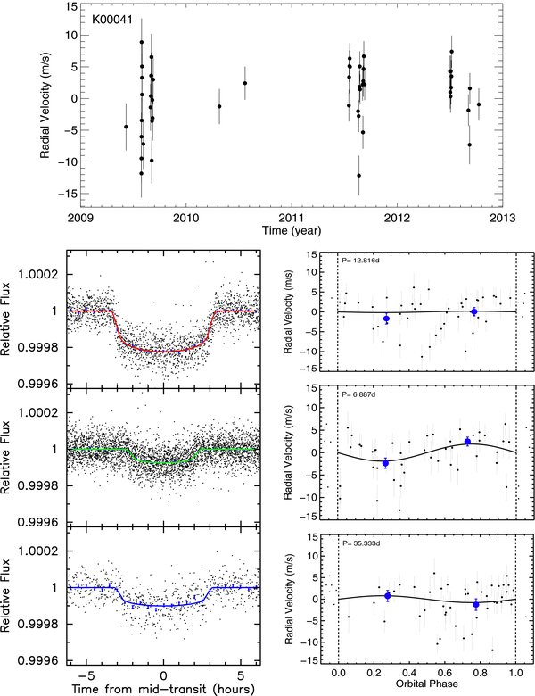
It sees the tiny dips in light associated with planets around other stars!

Slide 21
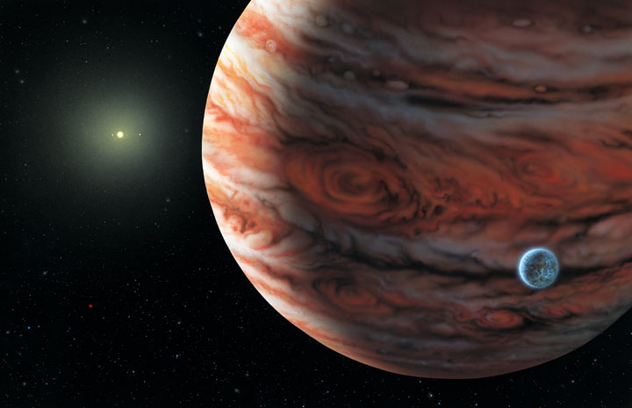
Current status of search for exoplanets
2337 candidate planets (sometimes more than one per star)
2950 confirmed planets
5287 total number of planets
30 confirmed in habitable zone
A planet of 55 Cancri
(1 of 5 confirmed)

Slide 22
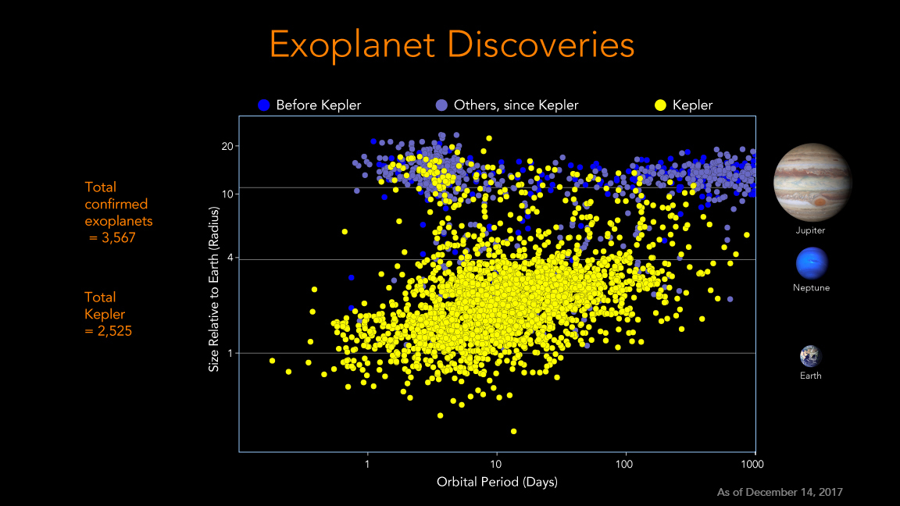
Current status of exoplanets
Each dot is a planet!

Slide 24
What are the exoplanets like? We don’t know. Nearly all the information we have is diameters and masses, sometimes not even both

Slide 25
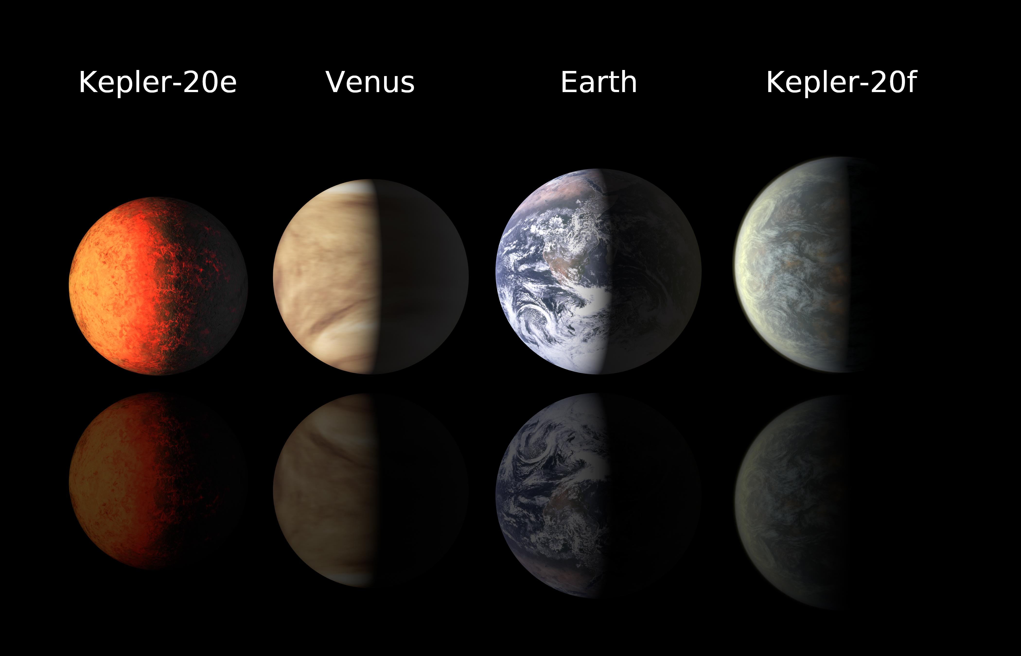
What are the Kepler planets like? Speculations on some particularly interesting examples

Slide 26
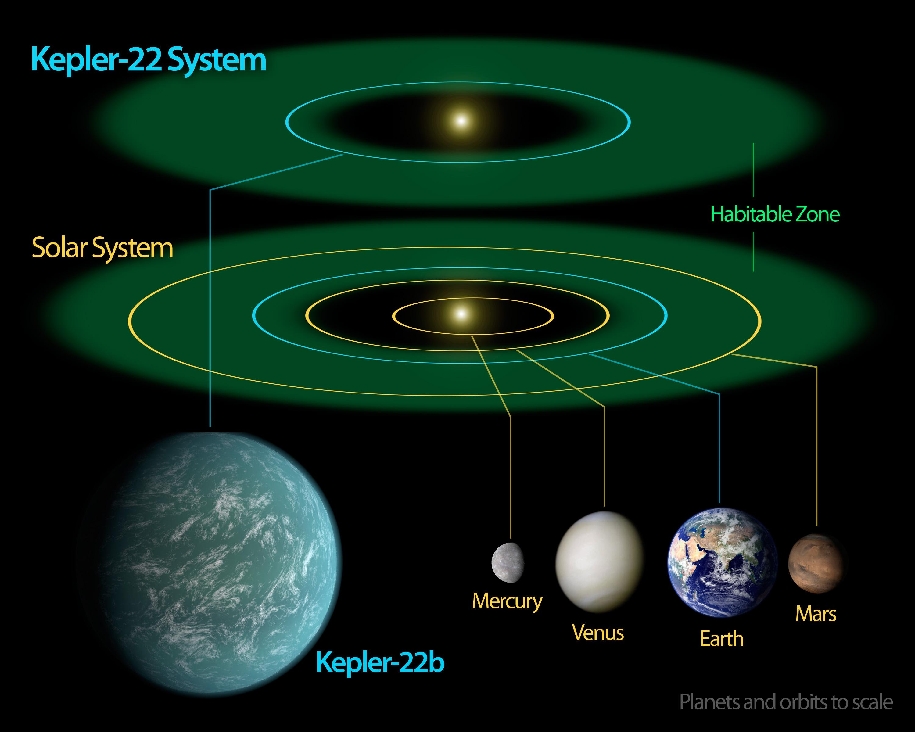
There is particular interest in Earth-sized planets in the habitable zone of the central star

Slide 27
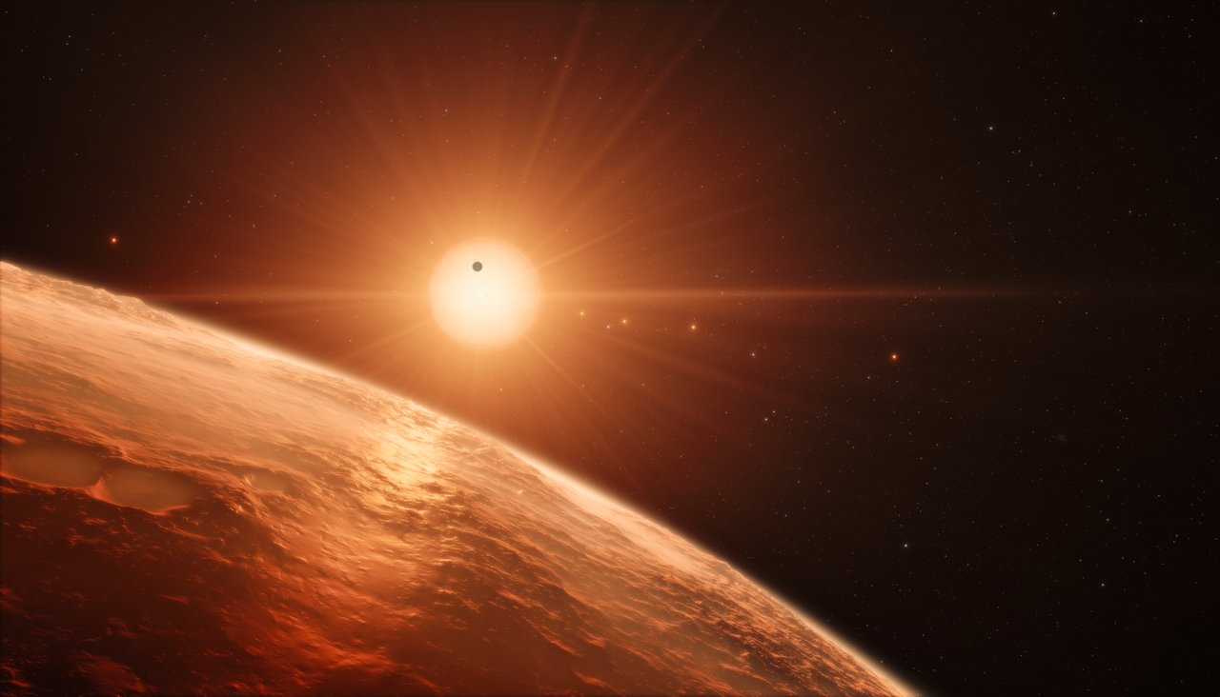
A brief diversion: astronomy in the news; Earthlike planets in habitable zone of another star

Slide 28
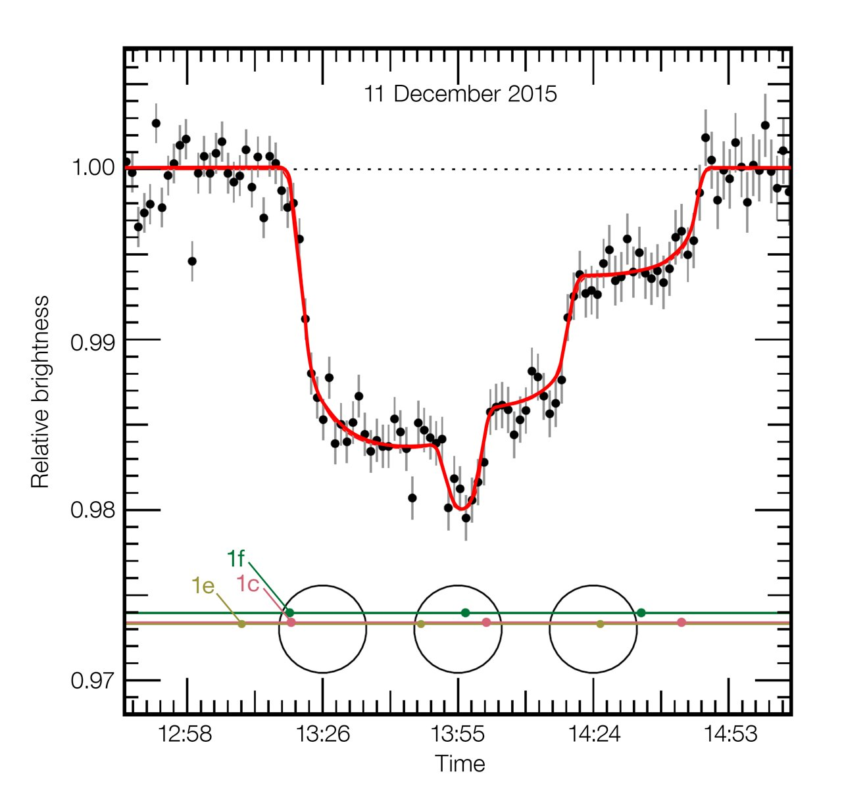
how are planets detected around other stars? In most cases via transit technique; little eclipses when planet moves across face of the star

Slide 29
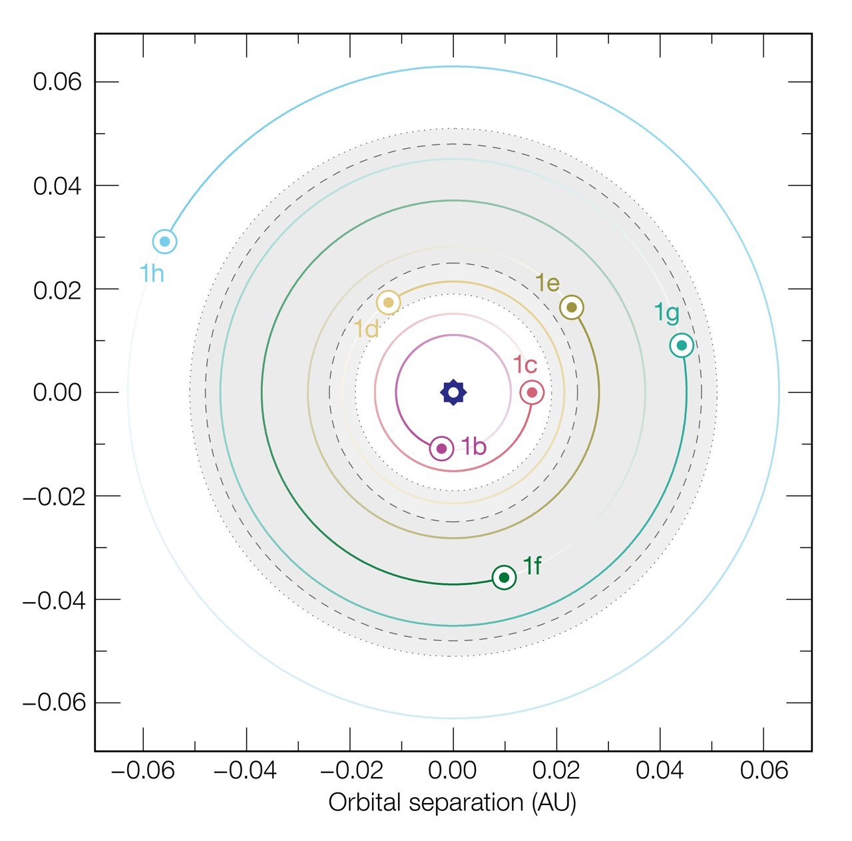
Orbits of planets in “Trappist-1” system
“habitable zone” for this star system

Slide 30
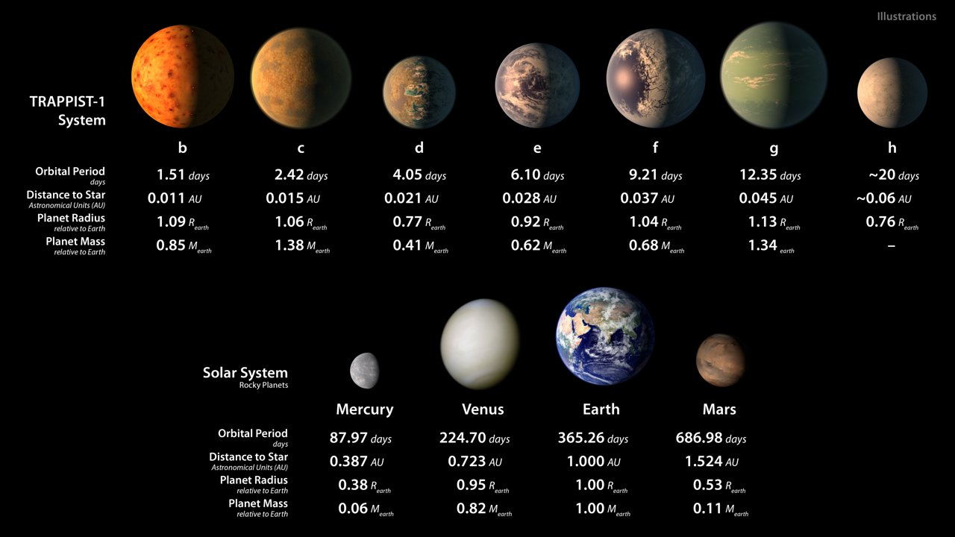
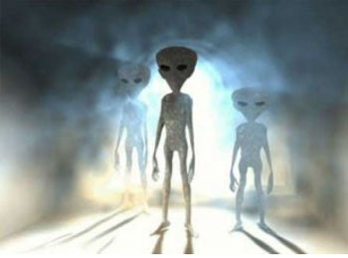
Why the big deal and the press conference?
Planets have roughly the size and mass of the Earth (similar to terrestrial planets in solar system)
The orbits of 4 of them are in the habitable zone, where liquid water is possible
Combination of two attributes is unusual in study of exoplanets

Slide 32
So, why isn’t there even more excitement?
the host star is an M8 Main Sequence Star
So what? It had to be some kind of star, didn’t it?

Slide 33
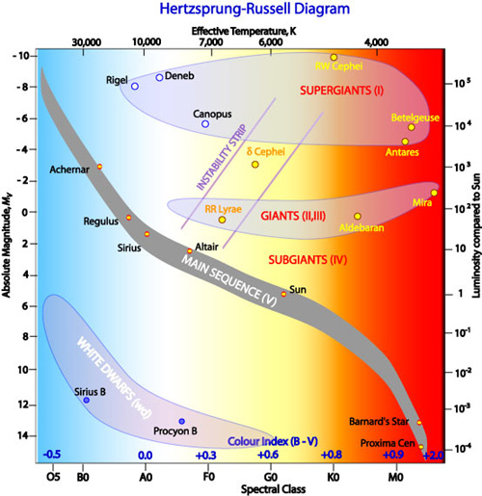
Let’s remind ourselves of what an M8 main sequence star is

Slide 34
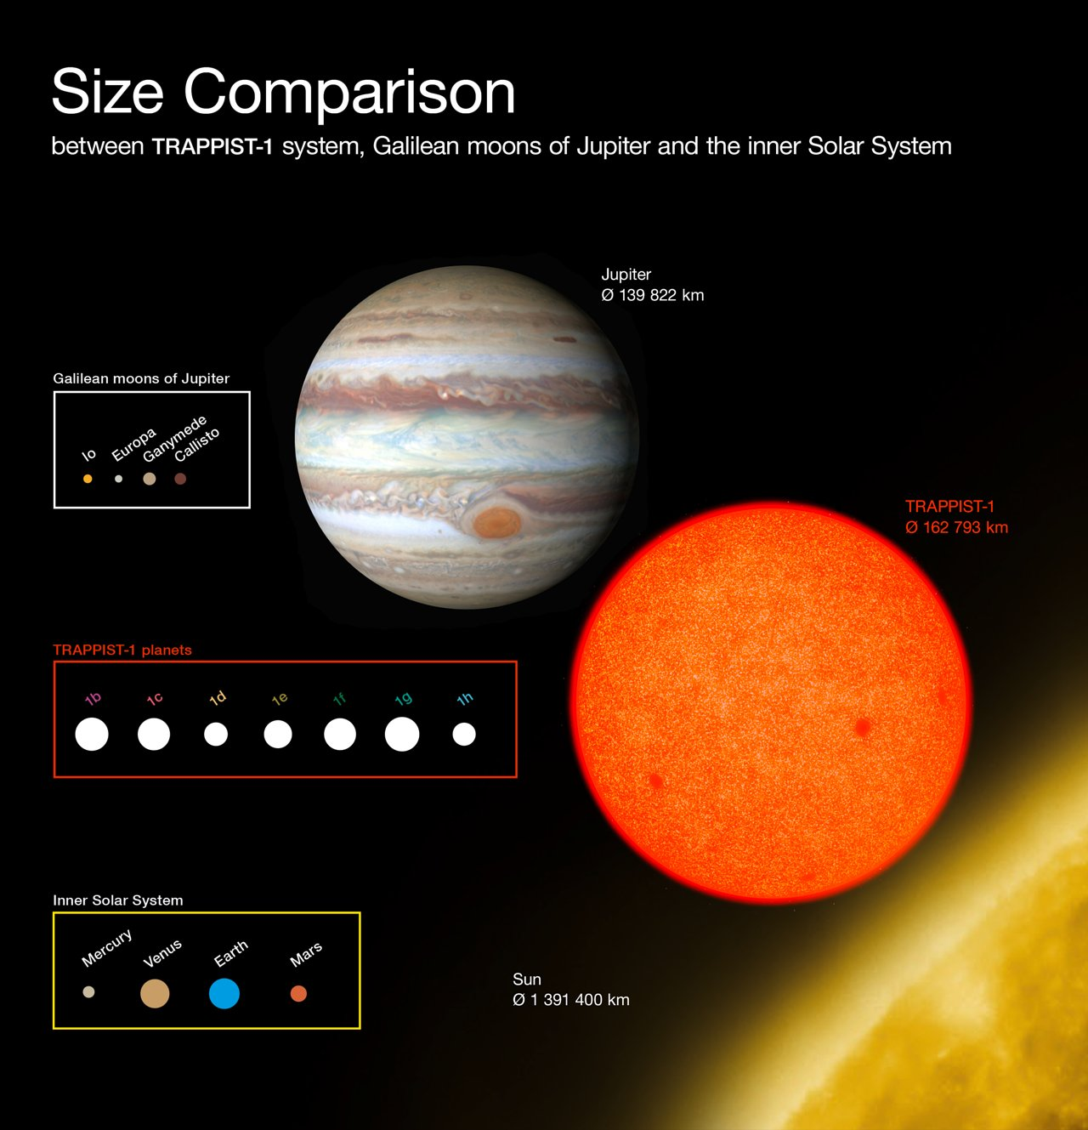
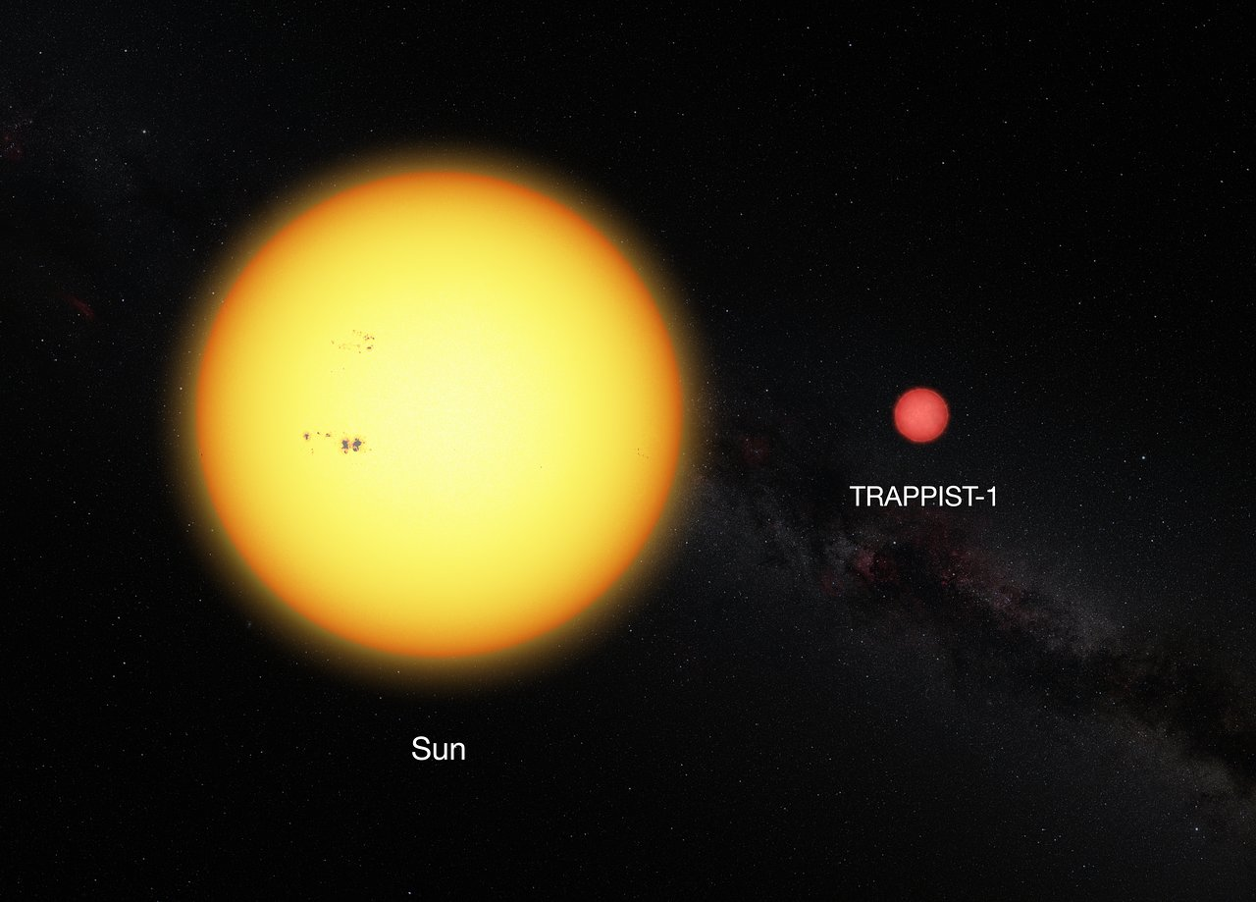
What stars are like on the lower end of the Main Sequence

Slide 35
An M8 Main Sequence star is the “end of the line”; extremely non-luminous and with (relatively) low surface temperatures. To be warm enough to allow liquid water, the planets have to be extremely close to the star
Final word: this system isn’t that similar to the solar system

Slide 36
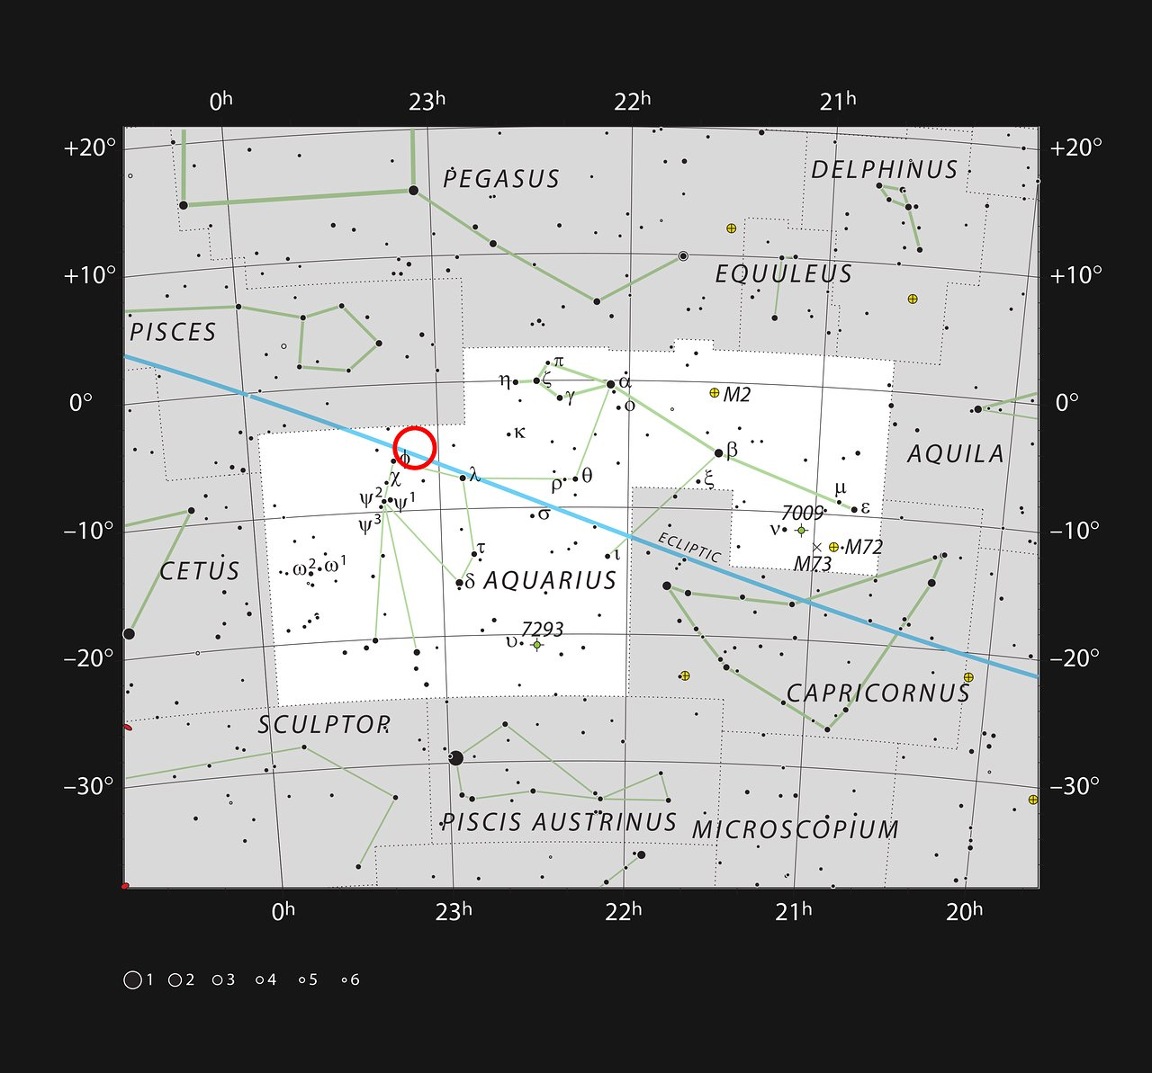
Want to know where it is? You’ll have to wait a few months to see it in the pre-dawn sky

Slide 37
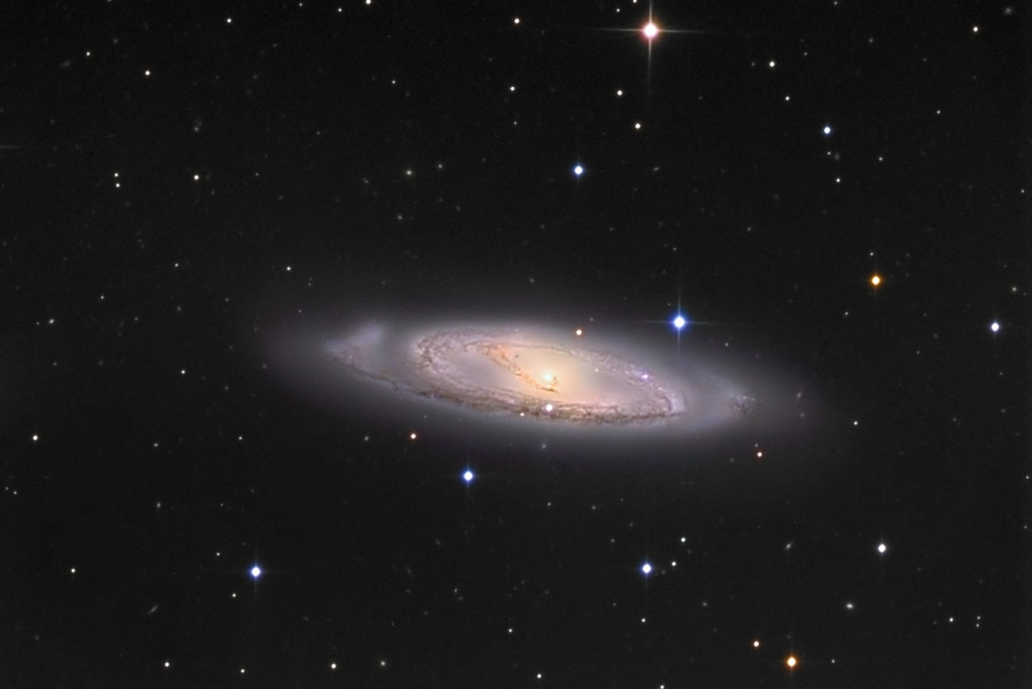
The 5000 planets we have found so far are all in our neighborhood in the Milky Way
We know of millions of galaxies in the universe
Messier 65 in Leo

Slide 38
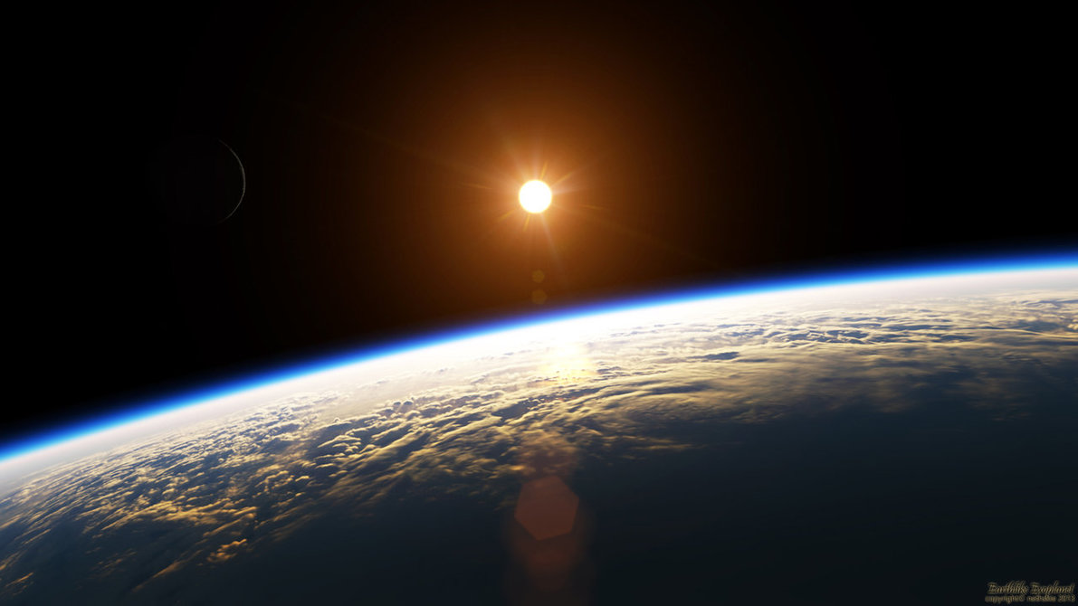
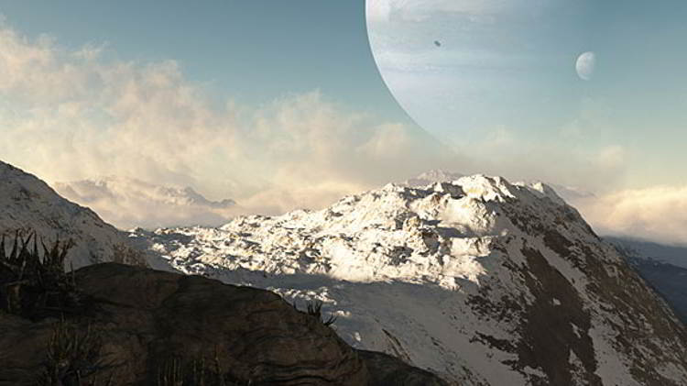
The future: within the next few years, it is virtually inevitable that Earthlike planets in ~1 a.u. orbits will emerge from the Kepler data and new spacecraft missions
Subsequent spacecraft (e.g. TESS, April 16 2018 launch!) and ground-based observations will find many more and tell us more about these planets

Slide 39
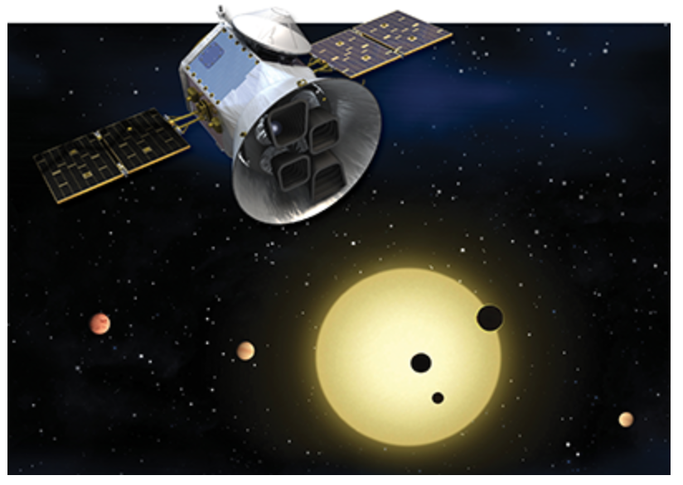
An exciting time to be thinking about exoplanets: launch of TESS on Monday, April 16
NASA has the countdown clock running!
TESS: Transiting Exoplanet Survey Satellite… “will discover thousands of exoplanets in orbit around the brightest stars in the sky”

Slide 40
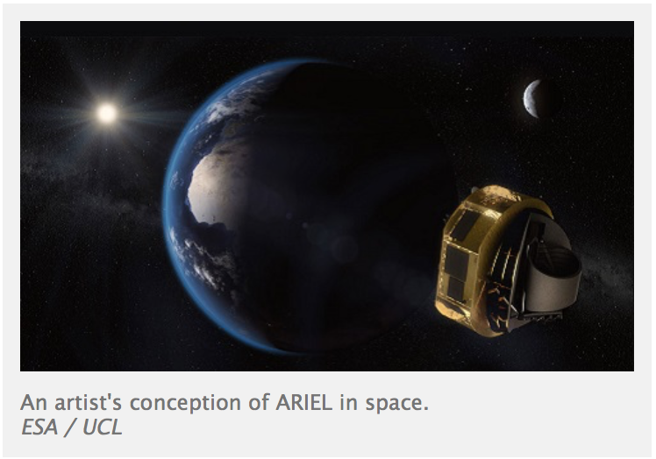
On the longer exoplanet timeframe…Ariel (ESA mission just selected)
Launch in 2028; evidence of atmospheres on 1000 planets

Slide 41
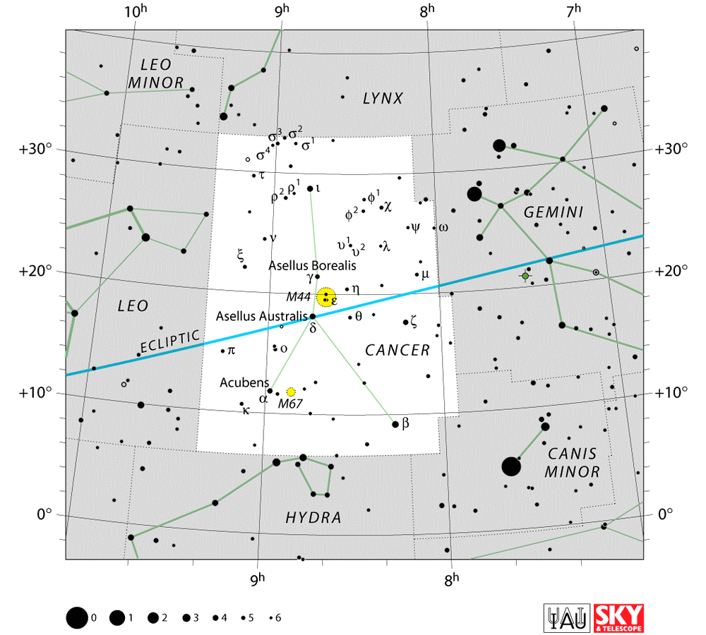
A great exoplanet star for these evenings: 55 Cancri has 5 planets!
55 Cancri:
Star type: G8V (very similar to Sun; probably older)
Distance: 40.2 light years

