Slide 1
“Flipping” method of teaching physics and other technical subjects
John GoREE
The university of iowa
1
Notes:
I’m John Goree, and this is the first of seven short videos, based on a colloquium talk – the Flipping method of teaching physics and other technical subjects.
The intended viewer for these videos is an instructor in physics, chemistry, astronomy, engineering, or a similar technical topic.

Slide 2
Polls:
Notes:
If you’ve taught such a course, ask yourself:

Slide 3
Polls:
Do you sometimes teach by
writing on board?
projector to show slides (powerpoint, etc.)?
Notes:
Do you sometimes teach by writing on a chalkboard or whiteboard?
Or sometimes by showing slides, such as Powerpoint or PDF slides?
If you answered yes, this talk is for you!

Slide 4
Polls:
Do you sometimes teach by
writing on board?
projector to show slides (powerpoint, etc.)
Do you sometimes feel there’s too much material to cover to allow:
enough examples
enough review
a lot of discussion
Notes:
Ask yourself also – do you sometimes feel you just don’t have enough time, because there’s too much material to cover.
So you sometimes don’t have time to do enough examples?
Or enough review?
Or enough time to do a lot of discussion?
If you answered yes, well, once again, this talk is for you. Our goal here is to solve these problems, using a method called “flipping.”

Slide 5
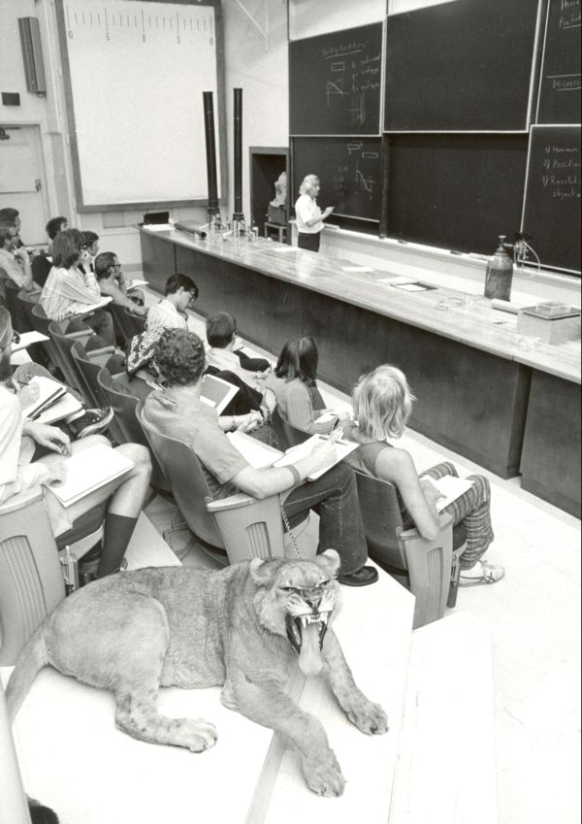
Traditional lecture
Prof. Ricardo Gomez, Caltech, 1975
Notes:
To understand flipping, we’ll start by comparing to a traditional lecture. This was the classroom where I took Freshman physics at Caltech, and this was my professor, Ricardo Gomez. He wrote his notes on the board. Students copied them onto their notebooks. That was a traditional lecture 40 years ago. It probably looked the same way 40 years earlier, in 1935. And it still looks the same way 40 years later, in 2015. In fact, there’s only one obvious difference in this photo, compared to a traditional lecture today. And that is, of course, nobody in 1975 was looking at their phones!
Oh, you might be thinking there is another difference. The cat. That’s Duchess. She was a 200 pound mountain lion. She belonged to the student in the second row, and she came to class with him that day. You can see that she wasn’t concentrating on the lecture. And that’s actually a problem for a lot of students as well – a problem that flipping helps you to overcome.

Slide 6
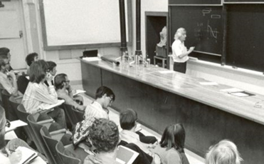
Flipping – what is it?
traditional
Before class
During class
After class
Notes:
In the paradigm of traditional lectures, a student is supposed to prepare for class, perhaps by reading an assignment. Then attend lecture, which is mostly a passive experience for the student. After class, there’s homework, which is often the central learning experience.

Slide 7
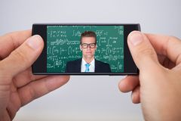
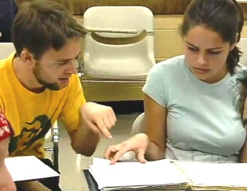
Flipping – what is it?
flipped
Before class
During class
After class
Notes:
In the flipped classroom, it’s different. The student watches the lecture first, before coming to class. She can actually watch it on a phone, thanks to the video-making software that I’ll show you. Now there’s lots of time available during class for something else, something that engages the student. After the class, there’s still the same homework. That’s how the flipped classroom works for me, in a technical subject such as physics.

Slide 8
Flipping – what is it?
Before class
During class
After class
Notes:
To compare the two paradigms,
the hour-long traditional lecture is replaced by two or three short videos that the student watches before class. With the software I’ll show you, the video looks good even on the small display of a phone.
Activities that might have been done before class are now replaced by activities in the class.

Slide 9
Two questions instructors ask about flipping:
What is it?
short videos replace lectures
class time used instead for discussion, examples, demonstrations
Doesn’t it take a lot of time?
for easy migration, use what’s familiar:
your old slides or handwritten notes
the same classroom
hosting on Blackboard (or similar)
it’s ok to start with partial flipping
Notes:
When I tell my colleagues about flipping, and they’ve never heard of it, they always ask two questions: what is it? And doesn’t it take a lot of time?
This series of seven short videos is intended to answer these questions, and more.
In short, to answer the question, what is it? For me, flipping is the use of short videos to replace lectures. The videos themselves are good, but they’re not what’s most important – what’s best that they free up lots of time, to use in class, for discussion examples, and demos.
Instructors also ask how much time it takes, because they’re busy. They’ve already got lecture notes, and they just want to keep using them. So I tell them that the time burden can be minimized, when migrating to flipping, by using what’s familiar. Your old slides or handwritten notes. The same classroom. All you have to do is host some files, which you can do on a platform like Blackboard, or ICON at the Univ. of Iowa.
I also emphasize that it’s okay to just flip part of a lecture. In fact, that’s probably best for the beginner.

Slide 10
There are many ways to do flipping
I will describe only one approach:
Not a radical change in teaching
so it’s sure to work
Not an intense time-pressured experience for students
so they’re happy
Notes:
There are many ways to do flipping. I’ll just describe one way, that I use.
It’s not a radical change in teaching, compared to traditional lectures. So if your traditional lectures work, this is sure to work. It will just work better.
It’s also not an intense time-pressured experience for students. And this helps keep them happy. That’s my approach.

Slide 11
There are many ways to do flipping
I will describe only one approach:
Not a radical change in teaching
so it’s sure to work
Not an intense time-pressured experience for students
so they’re happy
The videos themselves help,
but the main impact is from
increased discussion & examples
Notes:
How to make and use the videos will occupy much of this lecture. But the videos themselves are not the most important part of flipping, in my opinion. The main impact is from the way you use the classtime, for example increased discussion and examples.
In the 2nd video I will show you three kinds of flip videos.

Slide 12
“Flipping” method of teaching physics and other technical subjects
John GoREE
The university of iowa
2
Notes:
I’m John Goree, and this is the second of seven short videos, based on a colloquium talk – the Flipping method of teaching physics and other technical subjects.

Slide 13
Example flip videos
Notes:
Let’s watch three example videos.

Slide 14
Approach #1: flip video using pdf handwritten notes
Notes:
In the first example, I use handwritten lecture notes. In previous years I copied them onto a chalkboard, in a traditional lecture. Now I’ll take exactly the same handwritten notes, and just scan them to make a PDF file, which I’ll read while sitting in front of my desktop computer. Let’s watch.
You can see all the elements of a flip video. The screen is mostly filled with my notes. In the lower corner there’s a talking head. You see my face, so you connect with me. And you hear my voice. Even with my poor handwriting, you can watch this video on the small display of a smartphone, and it works okay.

Slide 15
Approach #2: flip video using powerpoint
Notes:
My second example is from a different class, when I used Powerpoint Slides. I like to joke that the most important difference between Powerpoint and PDF is that Powerpoint is high class. You can see that because with Powerpoint you have to shave!
Let’s watch a little of this video, which came from a general education class on physics:

Slide 16
Approach #3: Whiteboard screencast (requires tablet device)
credit: khanacademy.org
Notes:
A third way of presenting is screencasting. This mimics the use of a chalkboard. To do this, you use a tablet and a stylus. Like this.
This method is used with great success by the Khan Academy. Sal Khan just captures the screen of his computer monitor, while drawing using his tablet and talking. This is his video, not mine. Let’s watch a little:

Slide 17
Compare to a video capture of a classroom lecture
Prof. Walter Lewin, MIT OpenCourseWare
Notes:
Until you’ve seen a video like the ones I just showed you, you might have thought I would be talking about something else. A camera in the back of a lecture hall, pointed at you during a live class. Here’s an example.
What do you think? You probably couldn’t read anything in the first part of the video. Only in the second video, when the camera operator zoomed in, could you read the board. And the lecturer did not look at you, he did not connect with you. You can now make much better videos while sitting at your desktop. You use a camera like this. And a microphone like this. And software like Camtasia. I’ll tell you more in the next few videos.

Slide 18
“Flipping” method of teaching physics and other technical subjects
John GoREE
The university of iowa
3
Notes:
I’m John Goree, and this is the third of seven short videos, based on a colloquium talk – the Flipping method of teaching physics and other technical subjects.

Slide 19
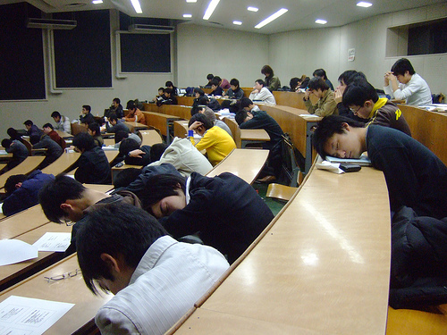
Problems that flipping solves
Notes:
A flipped classroom improves student learning. It does this by solving two problems.
The first problem that flipping solves is time. By shifting lecture content to the videos, you free up time. Lots of time. Time that you can use for more examples and discussion, for example.
The second problem that flipping solves is that a traditional lecture is long. I have trouble focusing my attention during an hour-long talk, and so do students. It’s easier to concentrate for six minutes, and that’s how long I make my lectures in a flip video.

Slide 20
What to do during class?
With flipping, you have more time. What to do with it?
Notes:
Suppose you’ve started flipping your class. You now have lots more time. What do you do with it?

Slide 21
What to do during class?
With flipping, you have more time. What to do with it?
Examples & discussion:
Problem solving
Demonstrations or simulations
Peer instruction
Notes:
In the physical sciences and engineering, it’s great to have more example problems in class. Discussion, demonstrations and simulations are possibilities, and so is Peer instruction. Peer instruction works great with flipping, because peer instruction takes time, and flipping creates that time.

Slide 22
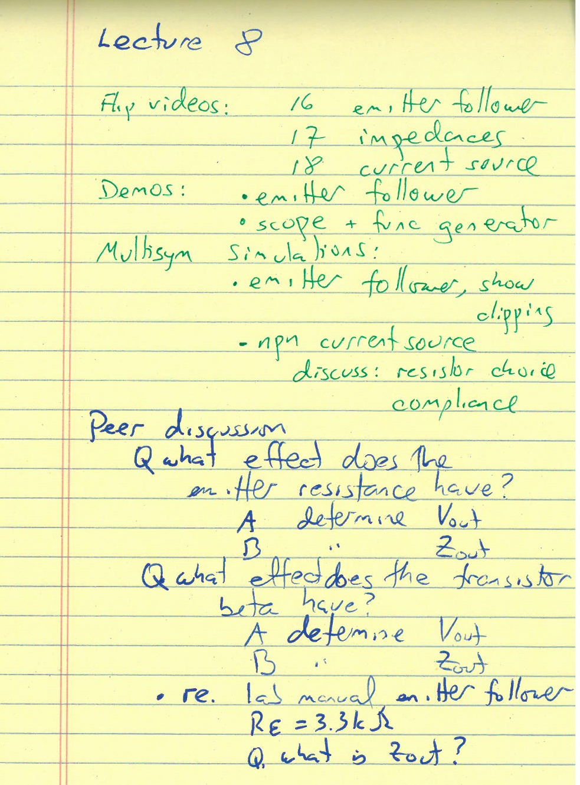
An activity agenda,
instead of lecture notes
Agenda that I followed
in a class
(first page)
Notes:
When I walk into a flipped classroom, I don’t bring my lecture notes. I bring an agenda. It’s just a list of activities. Here’s an example, where I listed some

Slide 23
An activity agenda,
instead of lecture notes
Agenda that I followed
in a class
(first page)
Notes:
demonstrations

Slide 24
An activity agenda,
instead of lecture notes
Agenda that I followed
in a class
(first page)
Notes:
simulations

Slide 25
An activity agenda,
instead of lecture notes
Agenda that I followed
in a class
(first page)
Notes:
And discussion topics that I intended to carry out that day. My discussion topics consisted of questions, for the students to answer. That’s my way of flipping the classroom. It’s a lot like a traditional lecture, because students sit in the same traditional classroom, and activities are led by the instructor during the entire class period. But it’s not the only way.

Slide 26
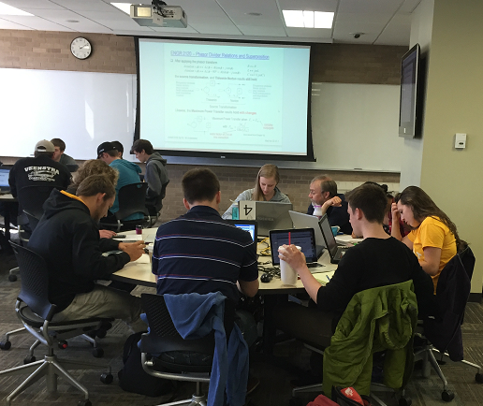
Another approach:
in-class homework
best in a room with large tables
Mark Andersland
Engineering
Univ. of Iowa
Notes:
Another approach is used by my colleague at the Univ. of Iowa. Mark Andersland. After a five-minute mini lecture, the remainder of the class period is used for students to work on homework. They have a list of problems to solve before the end of the period. Students can collaborate, and they can ask for help. They use their laptops, so they need a classroom with big tables, not a lecture hall. As I said, this is an approach that’s different from mine. In the next two videos I will provide some tips for the way that I do the flipped classroom.

Slide 27
“Flipping” method of teaching physics and other technical subjects
John GoREE
The university of iowa
4
Notes:
I’m John Goree from the University of Iowa, and this is the 4th of 7 short videos for a lecture on the Flipping method of teaching physics and other technical subjects.

Slide 28
Outline
Flipping - what is it?
Problems flipping solves
Good practices
How to do it:
Hosting, equipment and software
Notes:
In this 4th video I present some good practices for the flipped classroom. These include some tips on making the videos and what to do in class.

Slide 29
Good Practices
Video length (minutes):
4-6 general education
5-7 intermediate course
> 10 never
Notes:
Keep it short!
That’s the most important message, for recording flip videos.
For a general education class, my videos are only 4 to 6 minutes.
For an intermediate level class they are a bit longer, at 5 to 7 minutes.
Sometimes shorter, sometimes longer.
But never more than 10 minutes!

Slide 30
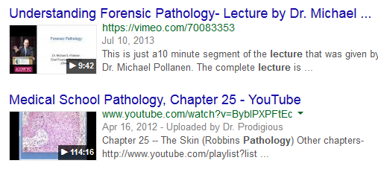
Not a whole lecture, like this:
Which is more tempting to watch?
Notes:
What you definitely don’t want to do is record an hour-long lecture as a single video. You can find many examples on YouTube, like this physics lecture that lasts 49 minutes. Students don’t want to watch that.
And for good reason.
Many of them are just as unexcited about your lecture as you would be, for watching a lecture on pathology.
So which of these two videos would you be more tempted to watch? The one that lasts 9 minutes, or 114 minutes?

Slide 31
Good Practices
Quizzes, to coerce students to view videos.
Notes:
One question that instructors ask me is this:
“How do you make the students watch them?”
My answer is that I give them quizzes.

Slide 32
Good Practices
Quizzes, to coerce students to view videos.
Ways to quiz:
In class:
Clickers
Paper
Notes:
There are several ways to implement the quiz. Two that I’ve used in class are clicker quizzes and paper quizzes. I’ll show you examples shortly.

Slide 33
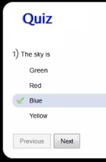
Good Practices
Quizzes, to coerce students to view videos.
Ways to quiz:
In class:
Clickers
Paper
As part of the video:
Flash or HTML5
Notes:
Another way is to build the quiz into the video itself. If you create your video using Camtasia software, if you wish you can put the video in a wrapper with a Flash or HTML5 file, that includes a quiz that you make. You can then set it up to report grades directly into your web-based grade book, such as Blackboard or ICON. I think this would work well, but I’m not advocating it because it’s more work for the instructor – my approach is to keep it simple, and to make it easy for the instructor. I’d like to see lots of instructors adopt flipping, and for that purpose it’s best for me to advocate the simplest methods, which would be quizzes that are implemented using clickers or paper. Let’s look at some examples.

Slide 34
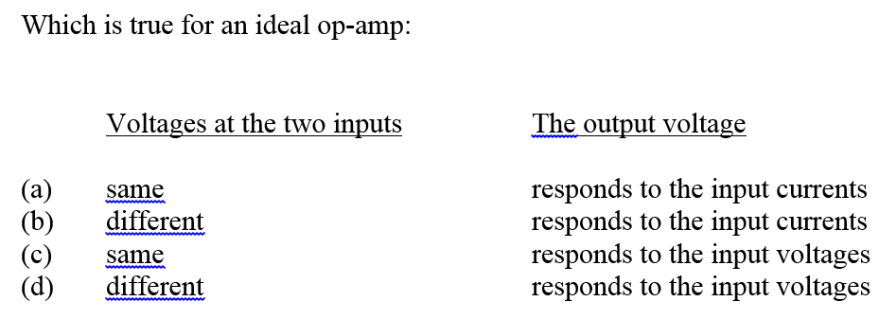
Good Practices
Example paper quiz question
for Electronics (an intermediate course for physics majors)
Notes:
In a small enrollment class, like my Electronics course for junior physics majors, I just distribute a paper quiz with a single multiple-choice question. One minute is enough time for a student to read and answer this question. It’s a question that’s obvious enough, so that most students will get it right, if they just watch the video once, or even better twice.

Slide 35
Good Practices
Next 5 slides:
clicker quiz slides (Basic Physics -- a general education class)
Notes:
For a large enrollment course, like my Basic Physics general education class at the University of Iowa, I use clickers for the quizzes, to motivate viewing the flip videos. In the next 5 slides I show you how I do this.

Slide 36
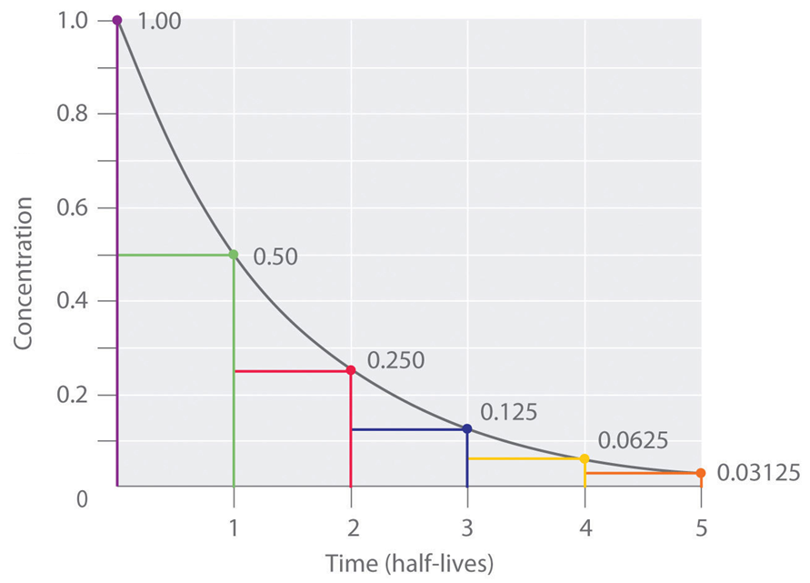
Nuclear decay
Half-life
Notes:
At this point in the lecture, I’ve already defined the concept of “half life”, and here I show a graph that illustrates it. I talk about it for a while.

Slide 37
Clicker Poll
Clicker poll: you ARE allowed to discuss this with neighbor
Clicker poll
next slide
Notes:
Then I have a clicker activity that I call a “poll”. Students are invited to discuss this question with their neighbor. It’s an easy peer-instruction activity.

Slide 38
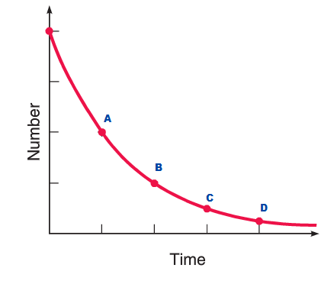
The number of nuclei in a sample are plotted vs time. At which data point is the time equal to the half-life?
a
B
C
d
Notes:
After students read the question shown in purple, 67% got the correct answer, A. I would then explain why answer B isn’t correct, and we move on.

Slide 39
.
Clicker quiz (flip video)
Clicker quiz: you ARE NOT allowed to discuss this with neighbor
Notes:
At this point, students have already fished their clickers from the backpacks. They already verified that they work. I’ve verified that my clicker receiver is working. We’re ready for the quiz, which is based on the flip video. Unlike the previous peer-instruction question, for this quiz I ask the students to not communicate with their neighbor.

Slide 40
Which is correct regarding radiation PET imaging in medicine?
 | Kinds of radiation detected | How it is produced
A | Alpha and gamma ray
B | Alpha and gamma ray
C | Alpha ray only
D | Alpha ray only
E | Beta and alpha rays
F | Beta and alpha rays
G | Gamma ray only
H | Gamma ray only
A
B
C
D
E
F
G
H
Notes:
And the students read a question about medical imaging. Nearly two thirds got the correct answer, H. They knew that in PET imaging, you detect only gamma rays, and they are produced by annihilation of an electron and proton.
This general education class is taken by students majoring in business, nursing, and lots of other non-science fields. And you can see that they learned something special, something that a lot of physicists might not know. This was a success, in the learning outcome. How did they learn it?

Slide 41
Before that quiz, students viewed a video with this:
Notes:
They viewed this flip video before coming to class. Let’s watch a bit of it.
This topic is something I never taught previously, in this course. When I adopted partial flipping, I chose to devote some of the flip videos to what you might call “enrichment” topics. This is one of them. I find that many of these general education students really appreciate a topic on medicine. It puts physics into practice, in a way they appreciate. I couldn’t do this topic earlier, because I didn’t have the time in my lecture. Flipping is all about creating time, and now I can do it. In the next video we’ll finish my practices with videos.

Slide 42
“Flipping” method of teaching physics and other technical subjects
John GoREE
The university of iowa
5
Notes:
I’m John Goree, and this is the fifth of seven short videos, based on a colloquium talk – the Flipping method of teaching physics and other technical subjects.

Slide 43
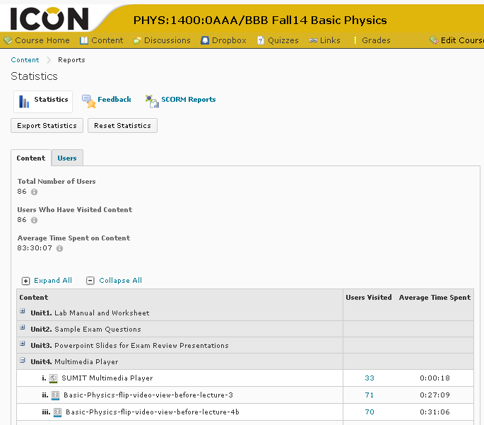
Verify students are viewing videos
Good Practices
Notes:
So now you’ve prepared short videos, and some quizzes to motivate the students. You ask, besides the quiz scores, is there a way to know if the students are watching the lectures? Yes there is – if you host your video files on a web-based teaching platform such as Blackboard or ICON. Here I can see that 71 students watched the flip video before lecture number #3. If I clicked on that blue #71, I could actually see a list of the names of students who downloaded the video.

Slide 44
Good Practices
Guiding the eye amongst the clutter
Example:
with PDF of handwritten notes
Notes:
When I started making my flip videos, a challenge I encountered immediately was how to direct the viewer’s attention. I’m confined to that little box in the corner, so I can just reach my hand out to point at something, the way I would in a live lecture. But the page has a lot of stuff, and the student doesn’t know where to look. So what do you do? Well, when I use a PDF file, with my handwritten notes, I add what are called “callouts”, which are arrows or boxes to direct your attention. Let’s watch an example from my electronics class.

Slide 45
Good Practices
Guiding the eye amongst the clutter
Example:
with powerpoint
Notes:
If you teach using Powerpoint, everything is easier, when you prepare a flip video using Camtasia software. It’s not hard with a PDF file, but it’s ridiculously easy with Powerpoint. That’s because you can use animation in your Powerpoint file to control the viewer’s attention. And you can use your mouse pointer. Let’s watch an example from my general education class.
This was another example of an enrichment topic. I did it near the end of the one-semester course, which I was only partially flipping. Videos earlier in the course served different purposes, such as demonstrating how to solve a two-step problem, one that wasn’t just a one-step plug-and-chug problem. That works, too!

Slide 46
Good Practices
Showing something from a previous page
Notes:
There’s another challenge that’s familiar to anyone who lectures with slides. When you change the slide, it’s gone. The student can’t look at the previous ones. And neither can you. I have a solution for this.

Slide 47
Good Practices
Showing something from a previous page
This space
is available!
Notes:
I use any space I can find on the page, and paste something from a previous slide. Like this space circled in orange. Let’s watch.
What I did was a screenshot to capture an image from earlier in the video. I cropped it using Microsoft Paint, and I placed it in my free space, near the top.

Slide 48
Good Practices
Movie players
Tell students: if the video looks bad
try a different browser
download video & try a different player.
Notes:
Here’s a final pointer, for the videos. To view the video, students will usually just use a browser. That’s all the software they need.
If the video looks bad, the problem is the browser. For example, the video player most of my students use on an iPad or iPhone works poorly with Safari, but great with Chrome. So I tell them to try another browser if the video looks bad. Alternatively, they can download the video and view it with a different player. In the next video we’ll look at teaching outcomes.

Slide 49
“Flipping” method of teaching physics and other technical subjects
John GoREE
The university of iowa
6
Notes:
I’m John Goree, and this is the sixth of seven short videos, based on a colloquium talk – the Flipping method of teaching physics and other technical subjects.

Slide 50
Outcomes
Notes:
When I flip a classroom, I’m seeking an improved teaching outcome, while minimizing the amount of extra time that I spend. And it works great!

Slide 51
Outcomes
Student learning:
improved
Student satisfaction:
improved, or not, depending on:
- what you do in the class
- how much more time you demand
Notes:
The most important outcome is that student learning is improved. My students learn more, and I’m sure that yours will too.
I also want my students to be happy. That can happen, but as you might expect, it depends on exactly what you do. Student satisfaction depends on what you do in class, to use all the time you created by flipping. It also depends on how much time you demand. More on that in a moment.

Slide 52
Student Satisfaction
Basic Physics – partially flipped
Notes:
Let’s look at my outcomes. I’ve used flipping in two classes. First, my general education class, Basic Physics. It was my first, so I only partially flipped this class.

Slide 53
Student Satisfaction
Basic Physics – partially flipped
“Love the flip video.”
“Flip videos are interesting.”
“I liked the flip video because it helped me to connect what we learned in class to real-life applications.”
“The flip vids prepare me for class.”
Four students liked videos
Notes:
At the end of class, students wrote their evaluations of my teaching, and six chose to comment on flipping. Four of them like it.

Slide 54
Student Satisfaction
Basic Physics – partially flipped
“Love the flip video.”
“Flip videos are interesting.”
“I liked the flip video because it helped me to connect what we learned in class to real-life applications.”
“The flip vids prepare me for class.”
“Flip videos could be improved a little bit to make them more beneficial when it comes to class material.”
“The flip videos weren’t very helpful.”
Four students liked videos
Two didn’t
Notes:
And two didn’t.
But their criticisms are not scathing. And I can learn from them. Most importantly, there was no rebellion against flipping, and in fact more students like it, and even praised it.

Slide 55
Student Satisfaction
Electronics – fully flipped
Poll, at midterm, which do students prefer (N = 9):
8 continue with flip videos
0 switch to traditional lectures
no preference
Comment re. increased discussion & examples during class:
“extremely beneficial”
Notes:
The second class I’ve flipped is a small enrollment class for majors, Electronics. I fully flipped this class. I didn’t give traditional lectures. Halfway through, I polled my students, to ask whether they wanted me to continue with flip videos, or switch to traditional lectures. In this small class, almost every student asked me to continue flipping. That’s a nice indication of student satisfaction.

Slide 56
Student Learning
Electronics
Midterm exam statistics
Average score increased p = 0.02
76% fully flipped 2015 (N = 9)
56% traditional 2014 (N = 21)
Notes:
But what about learning? In my fully flipped class, electronics, I gave the same midterm exam as the previous year, when I wrote on the chalkboard in a traditional lecture. The score went up. A lot, from 56% to 76%.
Now these statistics are for small numbers, with N = 9. But the t-statistics take that into account, and with a p-value of only 0.02, I am pretty confident in saying that my students performed better on my exam.

Slide 57
Student Satisfaction
Not every instructor achieves improved satisfaction:
Notes:
I think that improved learning is almost certain, when you flip a class. That’s because a traditional lecture is too long, and students get tired after ten minutes. You don’t have to do a great job of making your videos to improve learning.
But what about student satisfaction? My students like the flipping. But I’ve heard of other cases where they didn’t.

Slide 58
Student Satisfaction
Not every instructor achieves improved satisfaction:
Missildine et al., Journal of Nursing Education (2013)
Experiment, comparing:
flipping, classtime used for
- case studies
- simulations of clinical practice
vs traditional lecture.
Results: with flipping,
Exam scores were higher (p = 0.003)
Students were less satisfied (p < 0.001)
(They perceived they
had to do more work.)
Notes:
There’s one paper I found in the literature. A nursing class was taught with a traditional lecture one year, then flipping the next. The classtime was used for things that make good sense for nursing: case studies and simulations for clinical practice. The outcome was very conclusive: the students did better on exams. But they were less satisfied. The paper didn’t elaborate much on why they were less satisfied, but it did mention that students reported that they perceived they had to do more work.

Slide 59
End

Slide 60
“Flipping” method of teaching physics and other technical subjects
John GoREE
The university of iowa
7
Notes:
I’m John Goree, and this is the last of seven short videos, based on a colloquium talk – the Flipping method of teaching physics and other technical subjects.

Slide 61
Outline
Flipping - what is it?
Problems flipping solves
Good practices
How to do it:
Hosting, equipment and software
Notes:
In this video I tell you about the technical details of flipping. How to host the videos. How to record them. The equipment you need, and the software.

Slide 62
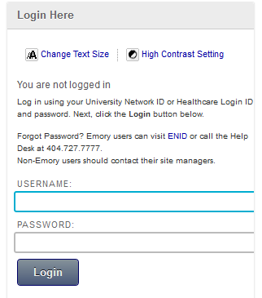
Hosting
Blackboard, ICON, or similar
Password protected
Track student viewing
Notes:
As an instructor, you’ll need to deliver the content to the students. The content consists of movie files that the students will watch using the internet. So you’ll need a hosting service.
At the University of Iowa I use ICON, which is an in-house version of Blackboard. That’s a teaching platform that allows you to post grades and such things. It also allows you to post computer files for students to download. And that’s what I do.
It’s password protected. Which makes it different from YouTube. You could use YouTube, but I like to include lots of copyrighted material in my videos, because it’s easy, and it improves the videos. So I can’t post them in the public domain. That’s one reason to use a password protected site, such as Blackboard.

Slide 63
Equipment
Notes:
You already have the most important piece of equipment that’s required. That’s a desktop computer, or a laptop.

Slide 64
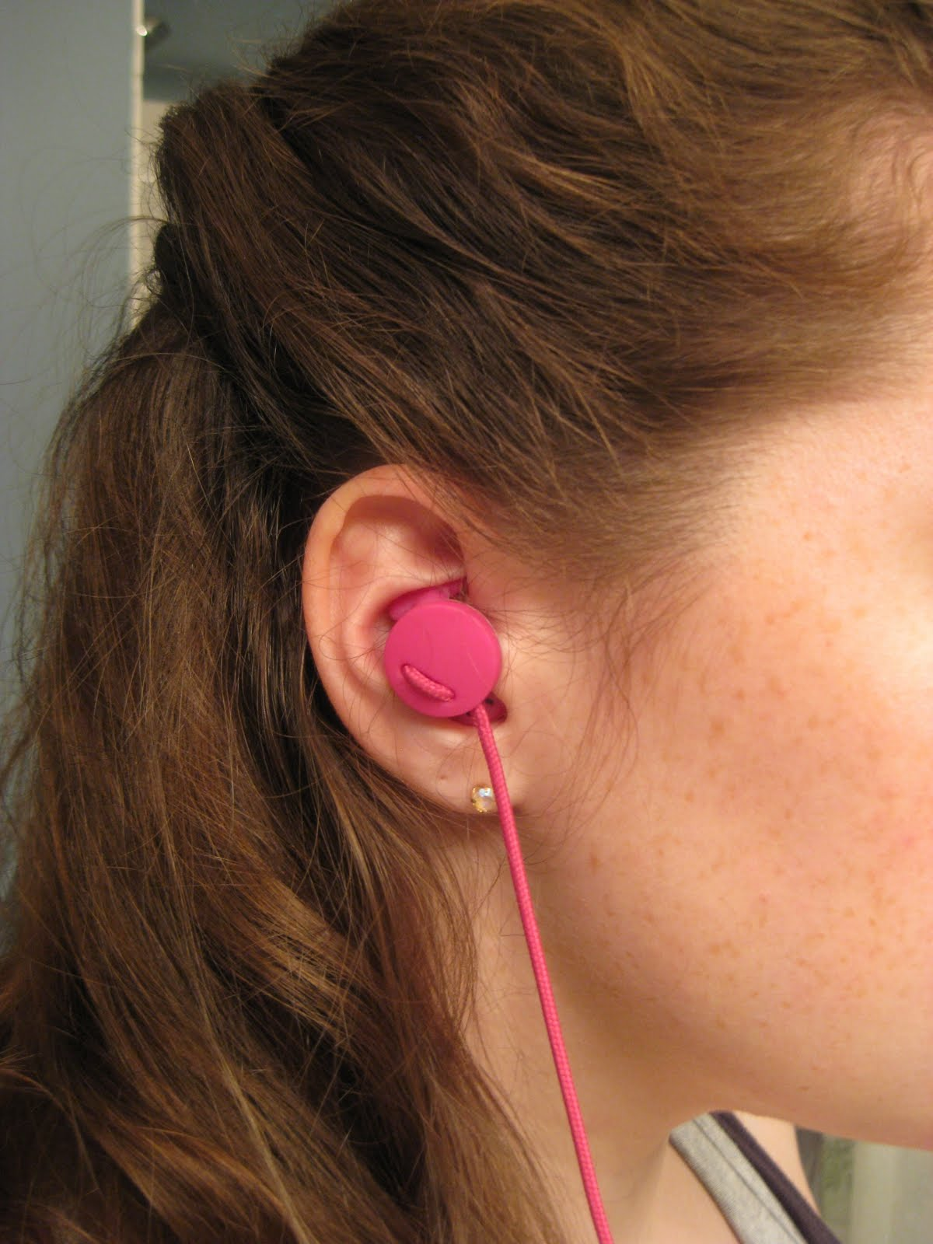
Equipment
Camera
Microphone
Mic quality is crucial
This is where you are
Notes:
Besides that, you’ll need a camera and a microphone. The quality of the camera doesn’t’ matter much, but the mic is crucial. You’ll be right here, in the student’s ear, and you’ll be there a long time. You want to sound good.
If your computer has a built-in mic, it isn’t good enough. And it’s located too far from your mouth.

Slide 65
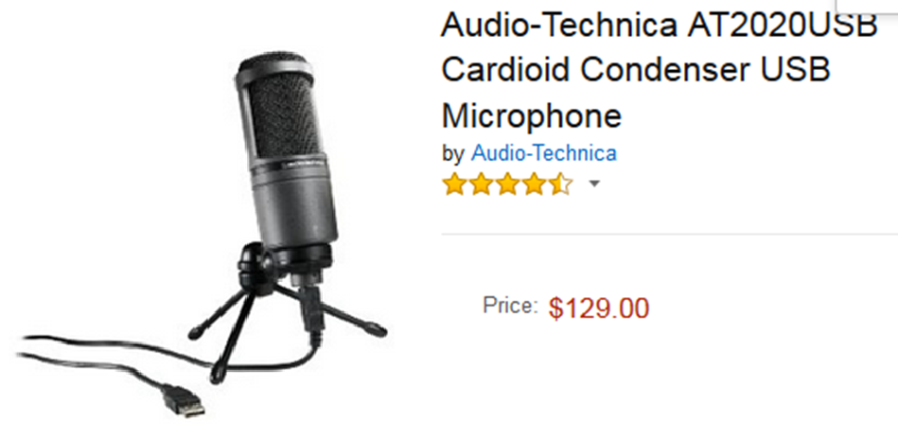
Equipment
USB microphone (built-in mic is not recommended)
Notes:
You need an external microphone. The makers of Camtasia software strongly recommend a USB mic. And they list examples that they’ve tested. I chose the most expensive one, shown here.
This is what it looks like.
You can use a cheaper one, but don’t use a built-in mic on your computer.

Slide 66
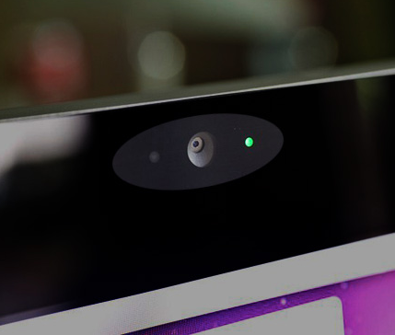
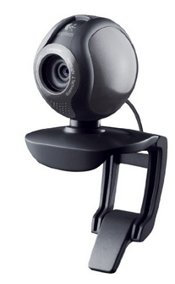
Equipment
Camera atop computer monitor:
built-in (FREE)
USB (typically $60)
Notes:
The camera is less important, because your talking head is just a little postage stamp in the corner of the screen. A built-in mic on a laptop is fine. My desktop computer doesn’t have one, so I bought this one, for $60. It clips on the top of my monitor.
Like this.

Slide 67
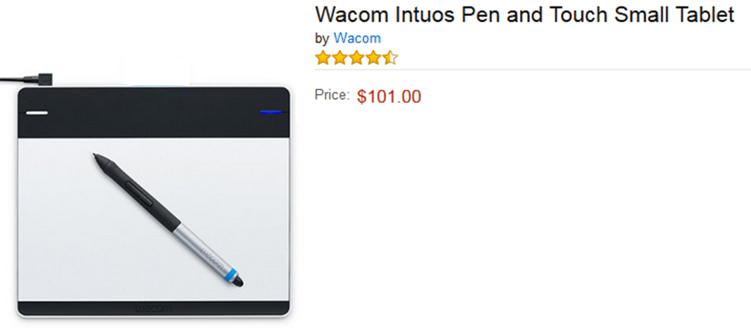
Equipment
Tablet device - only if you want to “whiteboard”
Notes:
The final item, you probably won’t need. Unless you want to do the whiteboard screencasting, like the Khan Academy. To do that, you need a tablet. Here’s the kind that Sal Khan uses to record instructional videos for the Khan Academy website.

Slide 68
Software
Lecture capture:
$180
FREE UI license
Notes:
Most importantly, you’ll need software. This is what makes flipping work so well. You sit at your desktop and record a video while looking at your computer monitor. It’s easy, because the software is very refined.
I use Camtasia, which is the standard. It has lots of features, especially for the Windows version. The Mac version is cheaper, and has fewer features, but it’s plenty good enough.
I haven’t tried it, but you can also use a competing product, Panopto. My university has a site license for it, but I bought Camtasia anyway.

Slide 69
Software
Lecture capture:
$180
FREE UI license
Screen shots & cropping
Microsoft Paint FREE
Notes:
Occasionally you’ll want to paste an image of something from a webpage. To do that, just do a screen shot, then crop the image using something like Microsoft Paint. You can then include the image as part of your video.

Slide 70
Software
Lecture capture:
$180
FREE UI license
Screen shots & cropping
Microsoft Paint FREE
Drawing (for whiteboarding with tablet):
SmoothDraw FREE
Notes:
The final bit of software is something you’ll need only if you want to do the whiteboard screencasting with a tablet. You’ll need a good drawing application. The Khan Academy makes videos using Camtasia software capturing the screen of a computer monitor, while running SmoothDraw. They use the tablet to draw, the drawing appears on the computer monitor in the SmoothDraw window, and a live video capture of this is recorded in Camtasia. That’s if you want to do whiteboarding, but most lecturers probably won’t.

Slide 71
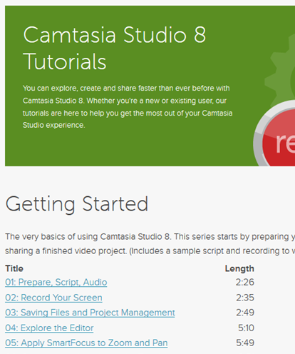
How to learn Camtasia
Notes:
The bad news is that you have to learn a new software application.
The good news is that they make it very easy for you. Camtasia is intended for making training videos. So not surprisingly, its maker offers excellent training videos. That’s how I learned, I just watched these videos once or twice.
And you’ll note that the videos are short! Only 2 to 5 minutes.

Slide 72
How to learn Camtasia
Demonstration
Notes:
In my live colloquium talk, at this point I give a demonstration of Camtasia. I ask a volunteer to read their notes or slides on my laptop, while I capture the display and record their voice using Camtasia. We do this for half a minute, and then produce the video. The audience sees how easy it really is. Unfortunately in this video version of the colloquium I can’t easily include that experience.

Slide 73
Summary
Outcome
Improves student learning & satisfaction
What is Flipping?
Short videos viewed before class.
Discussion or other activity during class.
How much time does it take?
For easy migration, use what’s familiar:
your old handwritten notes or slides
the same classroom
hosting with Blackboard, ICON, or similar
Notes:
To conclude the talk, I want to stress that flipping is great. It improves student learning. You don’t even have to be good at it to improve the learning outcome. That’s because a traditional lecture is too long, while the videos are short and can be watched while the student is fresh. Flipping can also improve student satisfaction. That was my experience.
Once again, when I tell a fellow instructor about flipping, and they’ve never heard about it, their first two questions are usually ‘what is it’ and ‘how much time does it take’? Well, it does take a bit of time, but you can minimize the extra time. I recommend migrating from a traditional lecture by using what’s already familiar to you: use the same old handwritten lecture notes, or the same old powerpoint slides. They’ll be fine. Use the same classroom. And just host your videos on something like Blackboard, which your university is probably already providing you.

Slide 74
End

