Slide 1
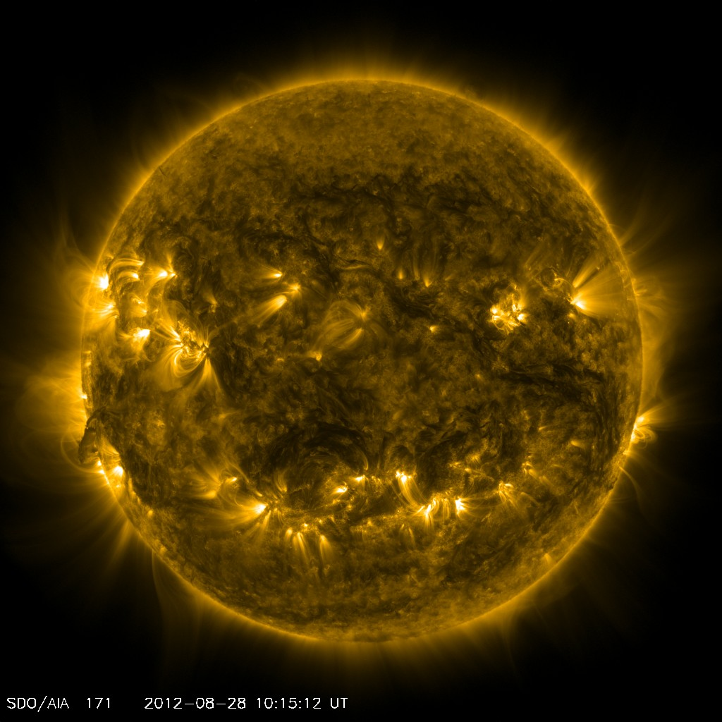
Plasmas in Space: From the Surface of the Sun to the Orbit of the Earth
Steven R. Spangler, University of Iowa
Division of Plasma Physics, American Physical Society

Slide 2
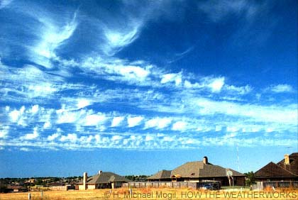
To gain a perspective on gaseous media in space, first consider a more familiar gaseous medium….the Earth’s atmosphere
Physical conditions: T=290K,
Ionization state: neutral (molecular collisions not energetic enough to ionize)

Slide 3
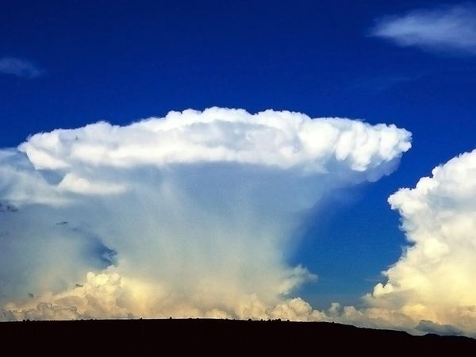
Forces that act on gas in neutral atmosphere
Gravity
Pressure gradients
Coriolis forces
These forces lead to interesting fluid motions on scales from continental (frontal systems) to pocket-sized. These includes waves and turbulence, convective motions, etc.

Slide 4
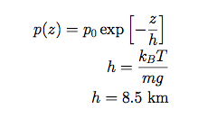
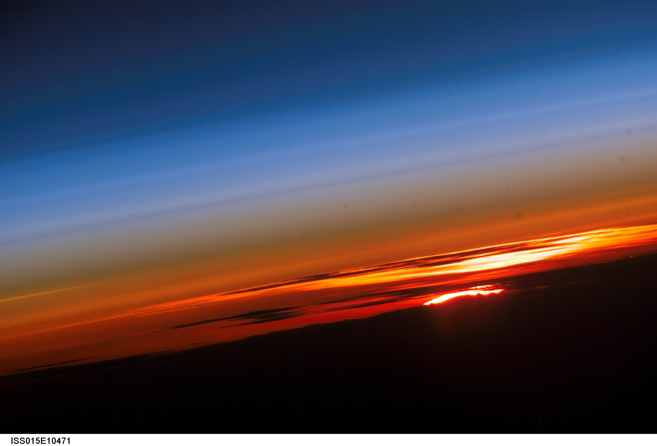
How high does the atmosphere extend?
Hydrostatic equilibrium

Slide 5
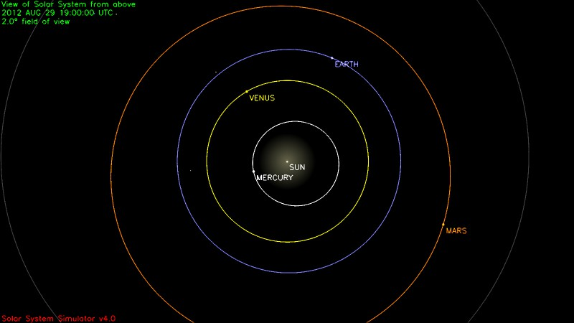
Now let’s look at the interplanetary perspective
1 astronomical unit

Slide 6
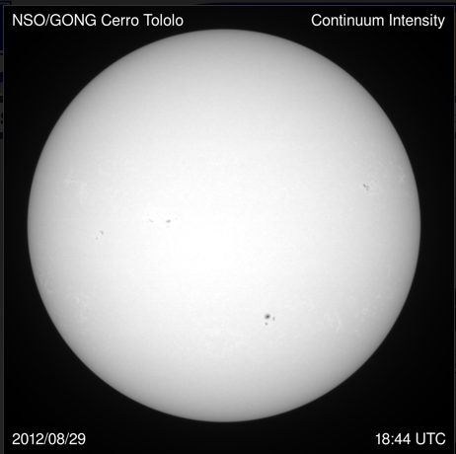
The Sun
mass
radius
density

Slide 7
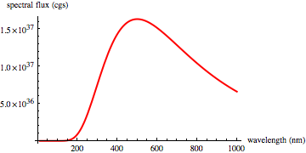
What are the conditions in the solar atmosphere? Compare solar spectrum with Planck function

Slide 8
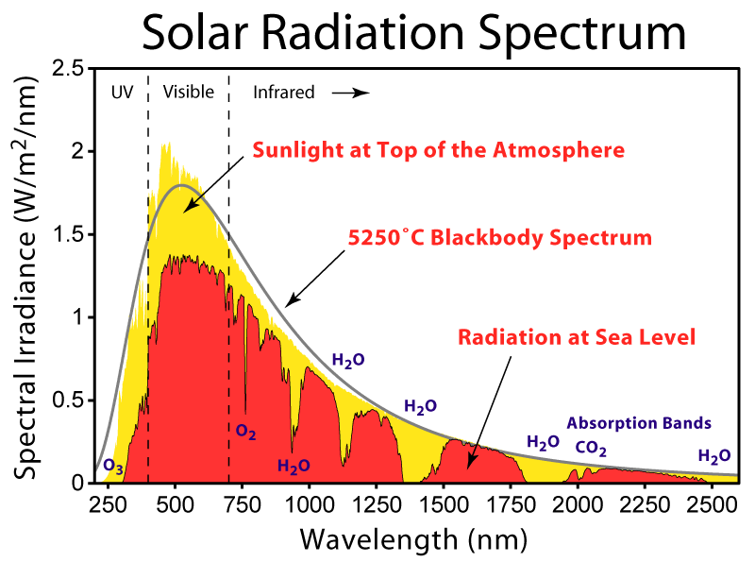
What are the conditions in the solar atmosphere?

Slide 9
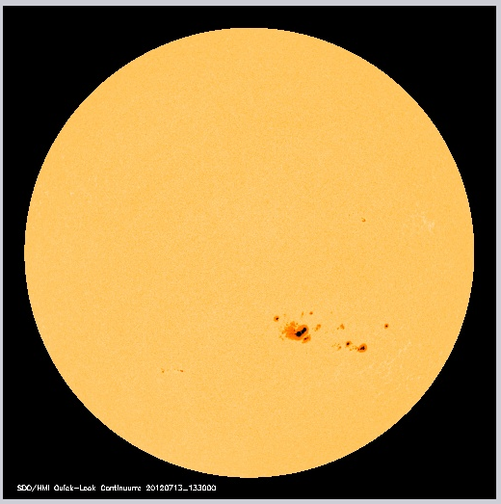
Physical conditions in the solar atmosphere: the remarkable achievements of spectroscopy
pressure
number density
temperature
Atmospheric scale height
174 km
Temperature still too low to ionize hydrogen

Slide 10
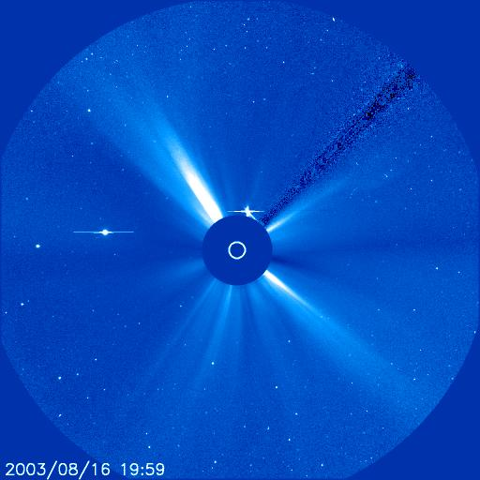
The fascinating nature of the solar corona
Extends much higher than 174 km

Slide 11
A clue to the nature of the corona: the red and green emission lines

Slide 12
A clue to the nature of the corona: the red and green emission lines
Formation temperatures of FeX and FeXIV T~ 800,000K
The corona is heated, and at these temperatures, becomes ionized

Slide 13
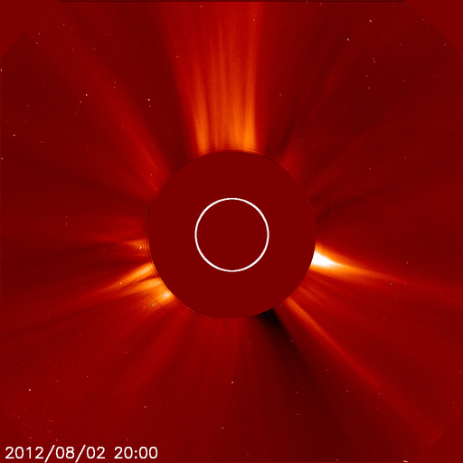
The outer atmosphere of the Sun (the corona) is heated to temperatures of 1-2 million K, and is nearly fully ionized (a plasma)

Slide 14
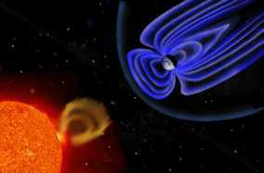
A gas heated to high temperatures and at high altitude should begin to flow outwards…the solar wind

Slide 15
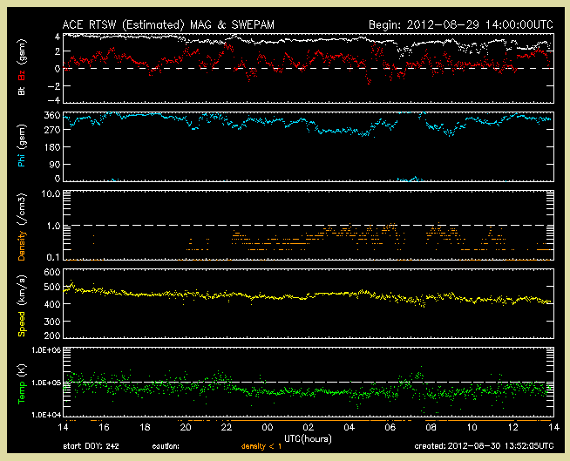
Spacecraft in interplanetary space (e.g. ACE) can directly measure the solar wind

Slide 16
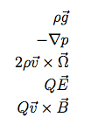
Plasmas are interesting media

Slide 17
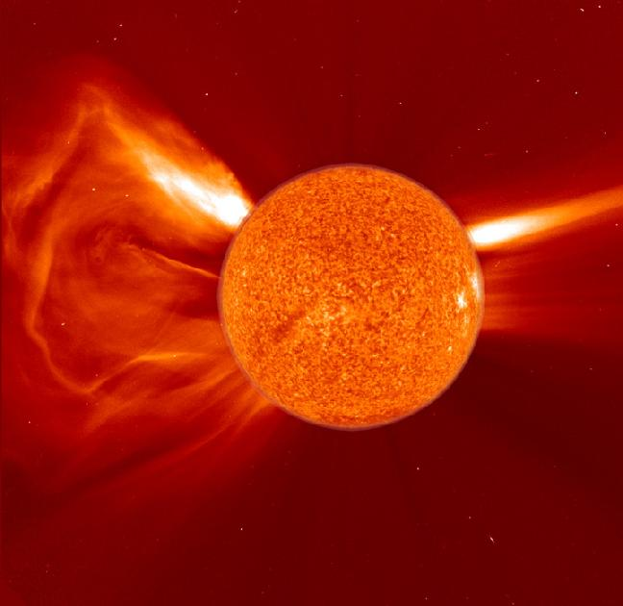
Some basic properties of plasmas
Plasma frequency
Cyclotron frequency
DeBye length

Slide 18
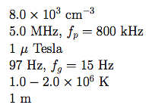
What are the plasma properties of the solar corona at r = 10 solar radii?
Electron density
Plasma frequency
Magnetic field strength
Proton gyrofrequency
Temperature
DeBye length

Slide 19
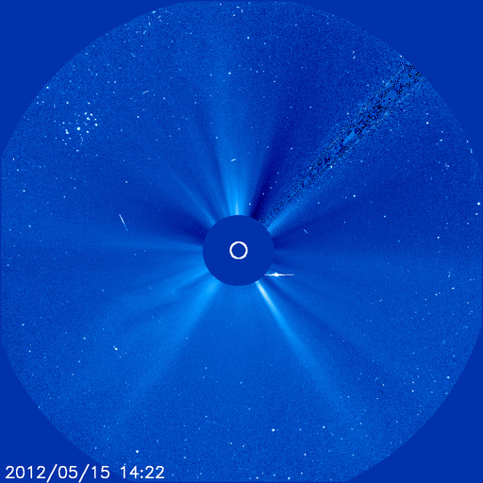
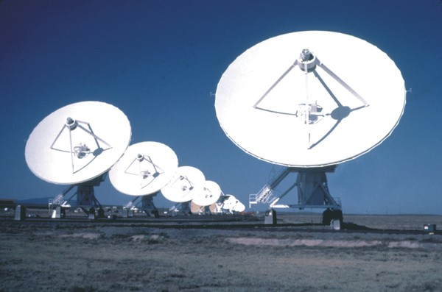
Faraday Rotation as a Probe of the Coronal Magnetic Field

Slide 20
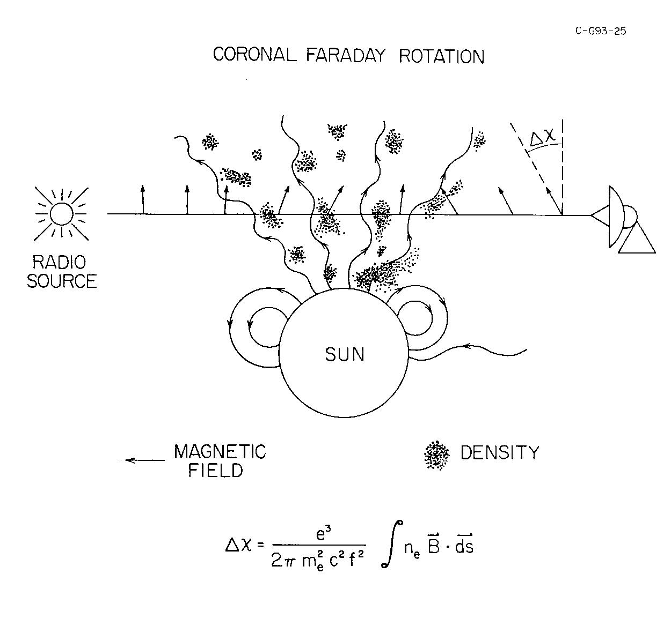
Faraday Rotation in the corona
Rotation measure

Slide 21
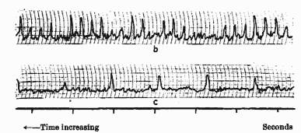
Trans-coronal sources for Faraday rotation measurements
Spacecraft transmitters (M. Bird, E. Jensen)
Pulsars (provide both RM and DM)
Extragalactic radio sources (numerous, provide “constellations” and possibility of multiple lines of sight)

Slide 22
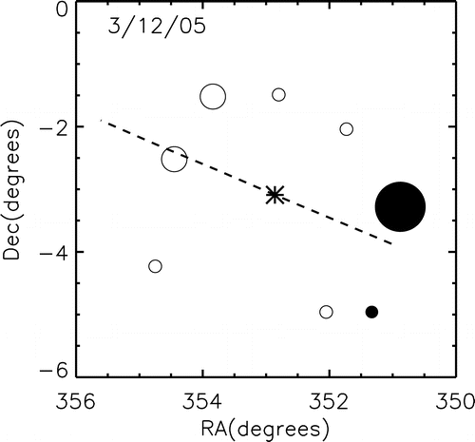
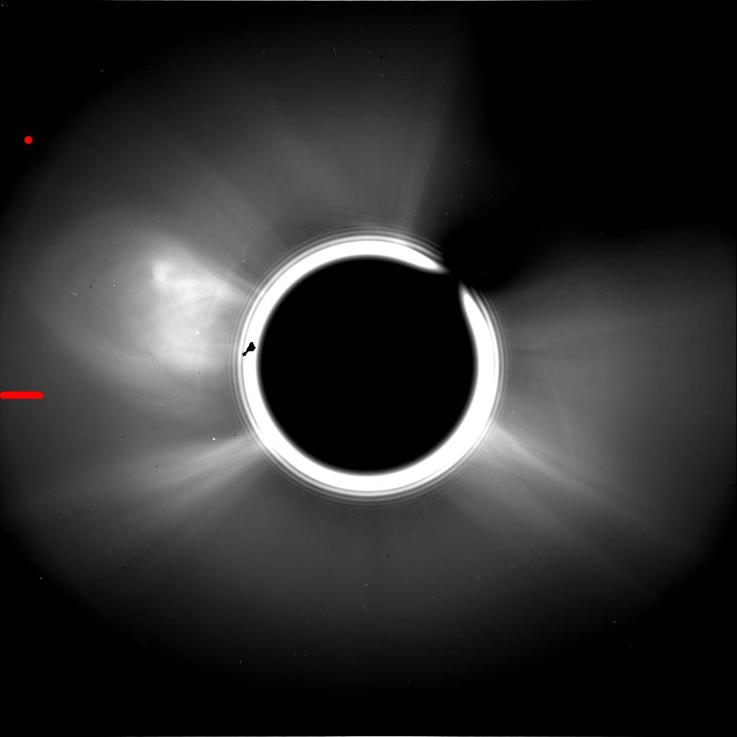
Constellation of radio galaxies around the Sun
Constellation of radio sources
LASCO coronagraph image during observing session
Ingleby et al, ApJ 668, 520, 2007

Slide 23
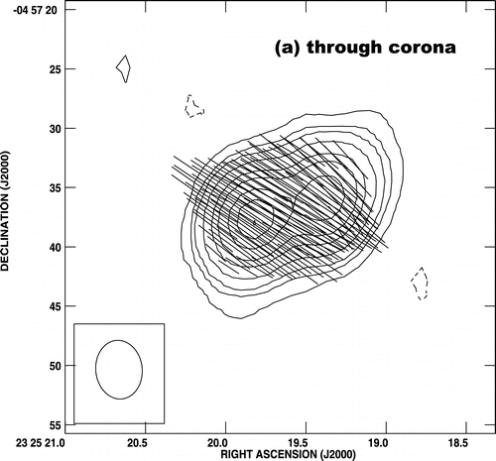
From The Astrophysical Journal 668(1):520–532.
© 2007 by The American Astronomical Society.
For permission to reuse, contact journalpermissions@press.uchicago.edu.
Fig. 3.— Illustration of data used to obtain the coronal Faraday rotation for one of the lines of sight, that to 2325−049 on March 12. In all three panels, the orientation and length of the plotted lines correspond to the polarization position angle and the polarized intensity, respectively, at that position in the source. The contours are of total intensity (Stokes parameter I). (a) The 1465 MHz polarization position angle map on March 12, when the line of sight passed through the corona. (b) Similar map of the source on May 29, when the corona was far from the source. (c) Position angle difference between the two maps, Δχ, which is the Faraday rotation due to the corona. For both components of the source, the Faraday rotation is 14°, corresponding to an RM of 6 rad m−2. The resolution of all three maps is about 5$\arcsec$ (angular diameter FWHM of the restoring beam).

Slide 24
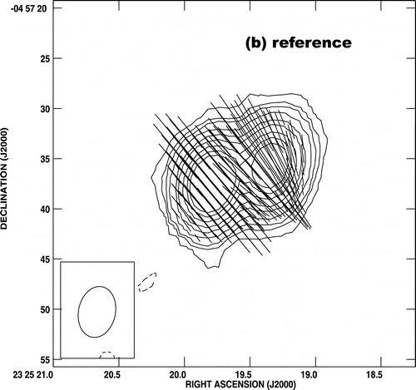
From The Astrophysical Journal 668(1):520–532.
© 2007 by The American Astronomical Society.
For permission to reuse, contact journalpermissions@press.uchicago.edu.
Fig. 3.— Illustration of data used to obtain the coronal Faraday rotation for one of the lines of sight, that to 2325−049 on March 12. In all three panels, the orientation and length of the plotted lines correspond to the polarization position angle and the polarized intensity, respectively, at that position in the source. The contours are of total intensity (Stokes parameter I). (a) The 1465 MHz polarization position angle map on March 12, when the line of sight passed through the corona. (b) Similar map of the source on May 29, when the corona was far from the source. (c) Position angle difference between the two maps, Δχ, which is the Faraday rotation due to the corona. For both components of the source, the Faraday rotation is 14°, corresponding to an RM of 6 rad m−2. The resolution of all three maps is about 5$\arcsec$ (angular diameter FWHM of the restoring beam).

Slide 25
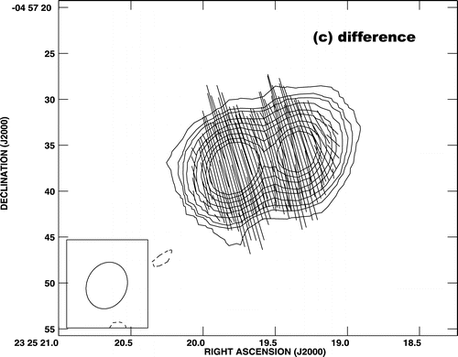
From The Astrophysical Journal 668(1):520–532.
© 2007 by The American Astronomical Society.
For permission to reuse, contact journalpermissions@press.uchicago.edu.
Fig. 3.— Illustration of data used to obtain the coronal Faraday rotation for one of the lines of sight, that to 2325−049 on March 12. In all three panels, the orientation and length of the plotted lines correspond to the polarization position angle and the polarized intensity, respectively, at that position in the source. The contours are of total intensity (Stokes parameter I). (a) The 1465 MHz polarization position angle map on March 12, when the line of sight passed through the corona. (b) Similar map of the source on May 29, when the corona was far from the source. (c) Position angle difference between the two maps, Δχ, which is the Faraday rotation due to the corona. For both components of the source, the Faraday rotation is 14°, corresponding to an RM of 6 rad m−2. The resolution of all three maps is about 5$\arcsec$ (angular diameter FWHM of the restoring beam).

Slide 26
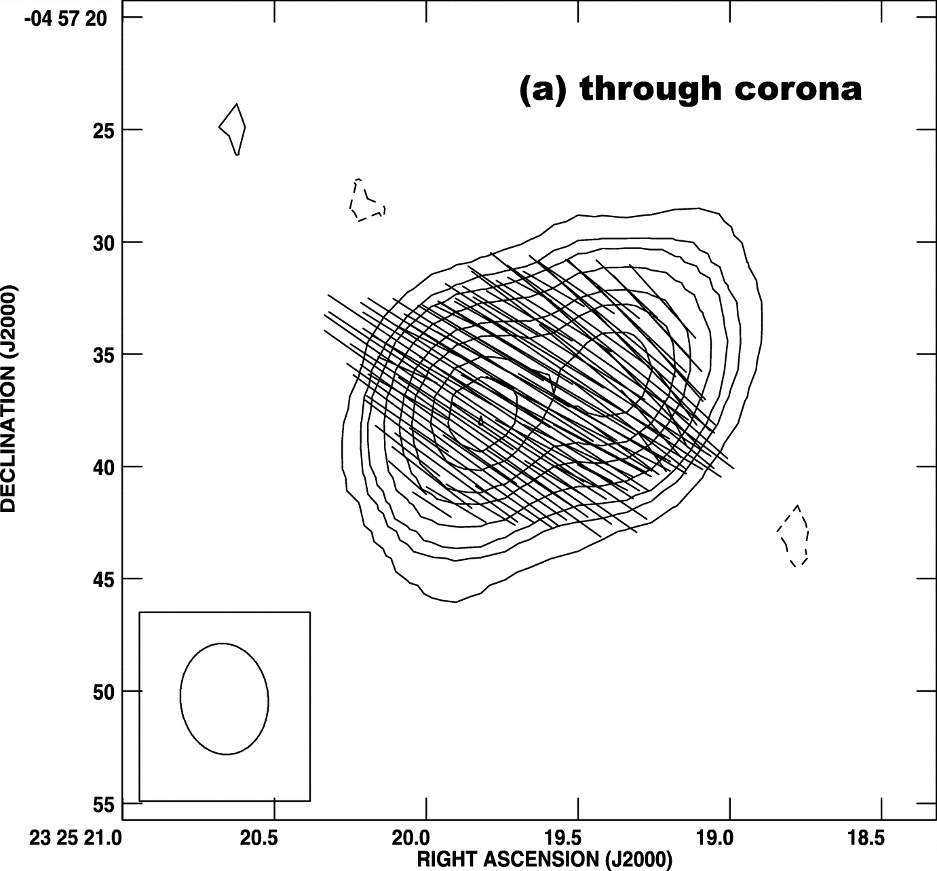
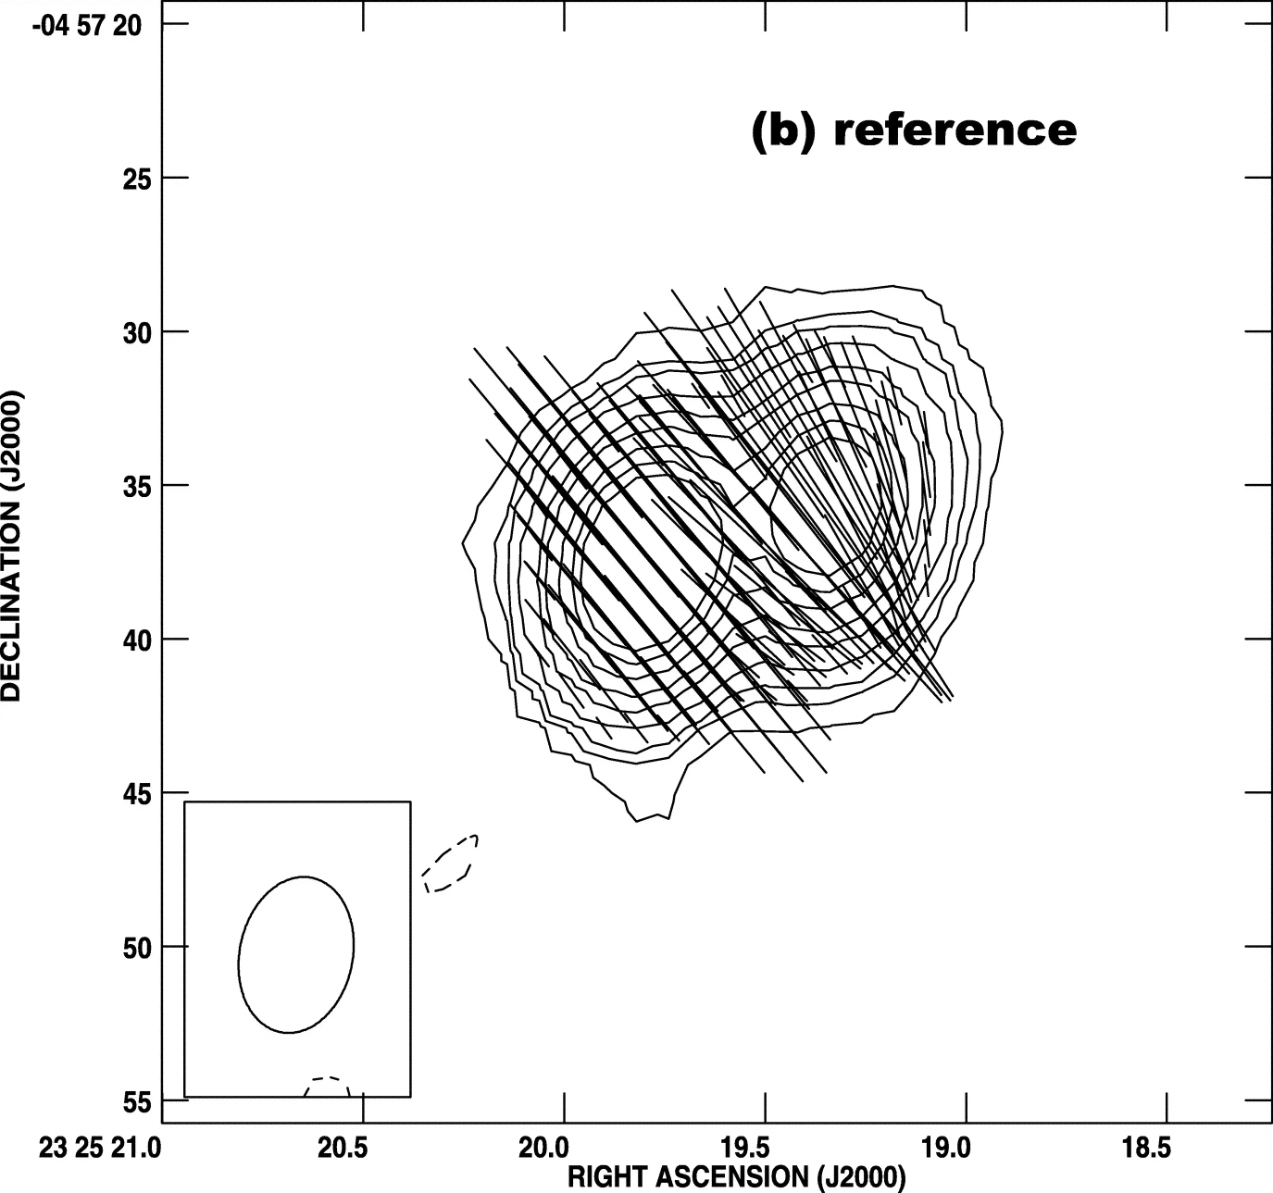
An illustration of Faraday rotation
Position angle rotation (1465 MHz) = 14 degrees
Coronal RM = 6 rad/sq-m
Ingleby, Spangler, Whiting 2007, ApJ 668, 520

Slide 27
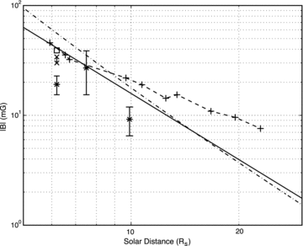
What are the results for the coronal field?
Monthly Notices of the Royal Astronomical Society Volume 422, Issue 2, pages 1160-1165, 14 MAR 2012 DOI: 10.1111/j.1365-2966.2012.20688.x http://onlinelibrary.wiley.com/doi/10.1111/j.1365-2966.2012.20688.x/full#f5
You et al 2012
Notes:
Magnetic field observations near the Sun. The measurements in Table 3 are plotted as asterisk (*) symbols with error bars. The extrapolated Helios measurements are a solid line (Burlaga 2001), an average of the Patzold et al. (1987) observations [|B|= 1000(6R⁻³+ 1.18R⁻²) mG] is a dot–dashed line and the observations of Gopalswamy & Yashiro (2011) are plus (+) symbols connected by a dashed line. The observation of Spangler (2005) is an open box and the range given by Ingleby et al. (2007) is a pair of connected cross (×) symbols.
© This slide is made available for non-commercial use only. Please note that permission may be required for re-use of images in which the copyright is owned by a third party.

Slide 28
Topics of Interest
Large scale coronal magnetic field
MHD turbulence in the corona
Probing electrical currents
Faraday rotation as a probe of CMEs
Future extensions of the technique (closer to and further from the Sun)

Slide 29
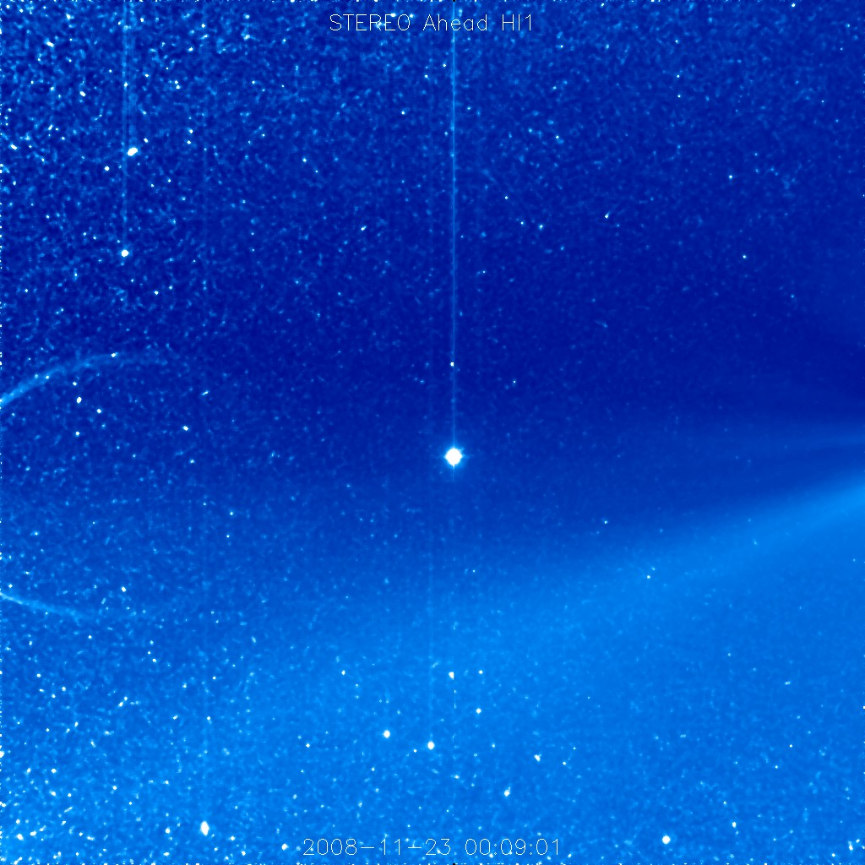
Main topics in heliospheric plasma physics
Nature of plasma turbulence
Heating of the solar corona and solar wind
Acceleration of charged particles to relativistic energies
Energy conversion through magnetic reconnection
The basic physics of “Space Weather”

Slide 30
There are many exciting things to study in astrophysical plasma physics and plasma physics in general. Come join us!

